Slide 1
Beneficial Utility
PX026
William Fisher
February 2023

Slide 2
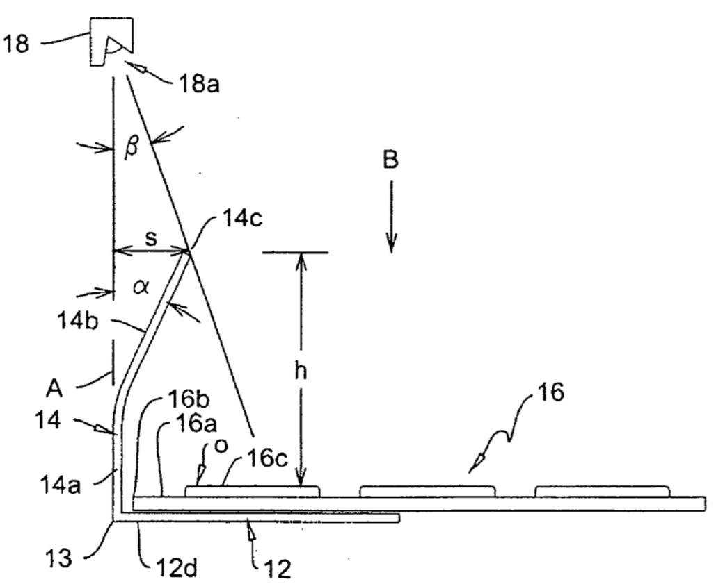
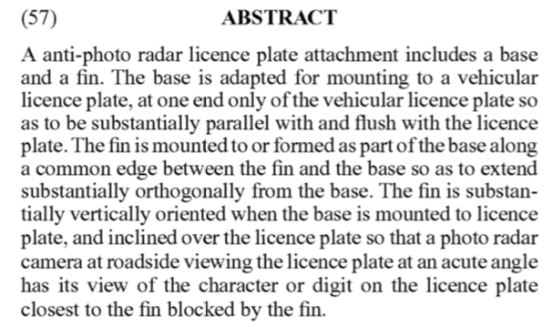

Slide 3
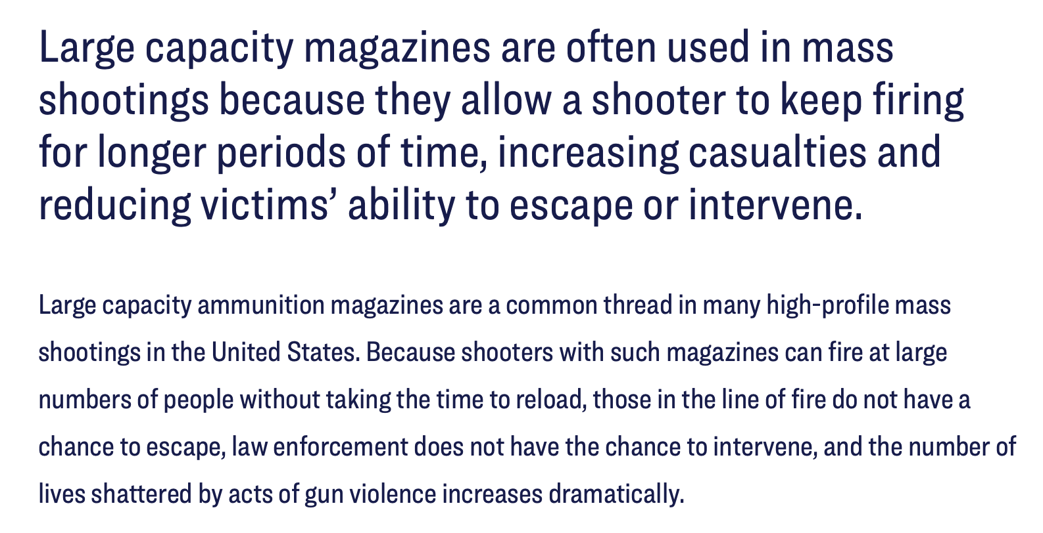
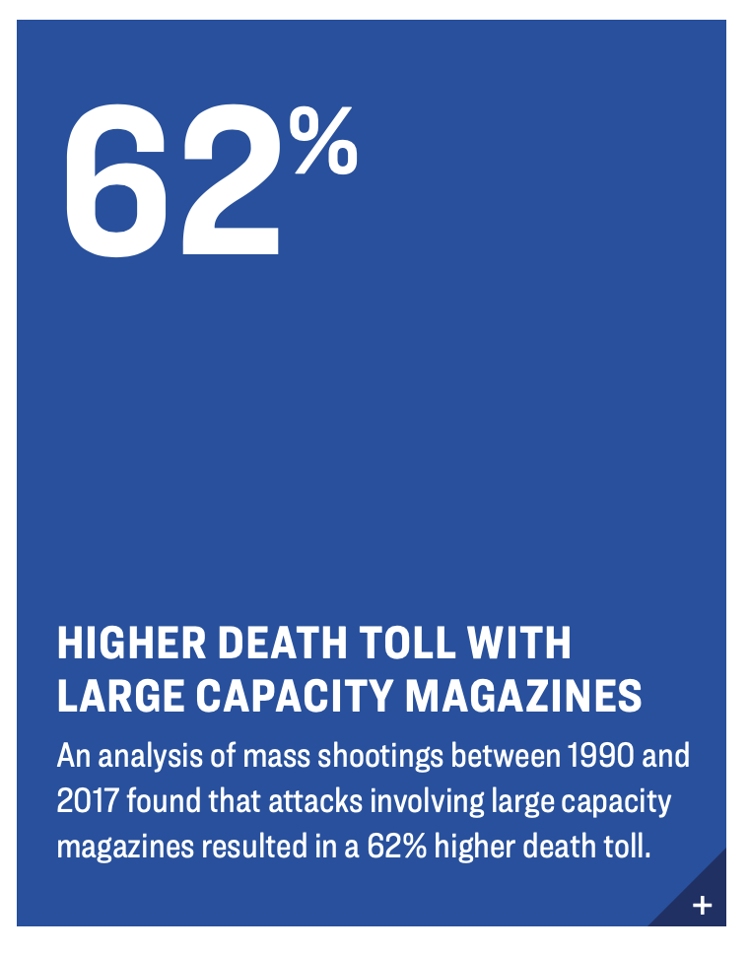
Source: https://giffords.org/lawcenter/gun-laws/policy-areas/hardware-ammunition/large-capacity-magazines/

Slide 4
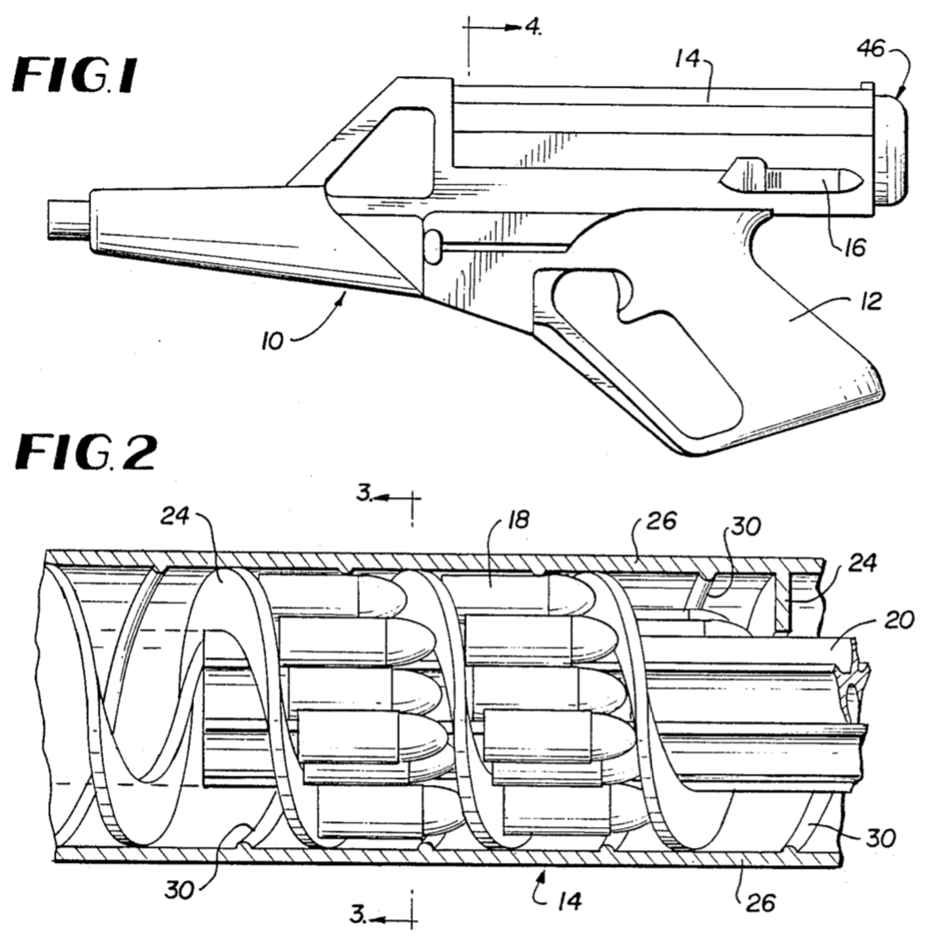
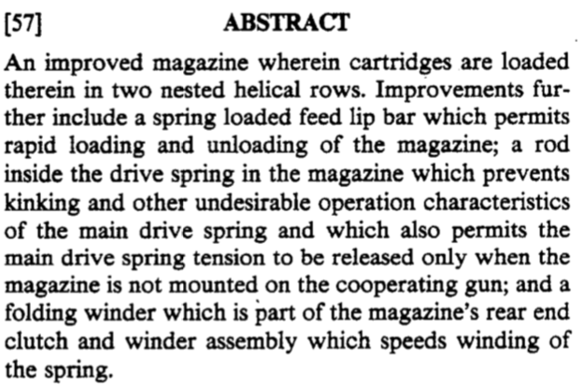

Slide 5
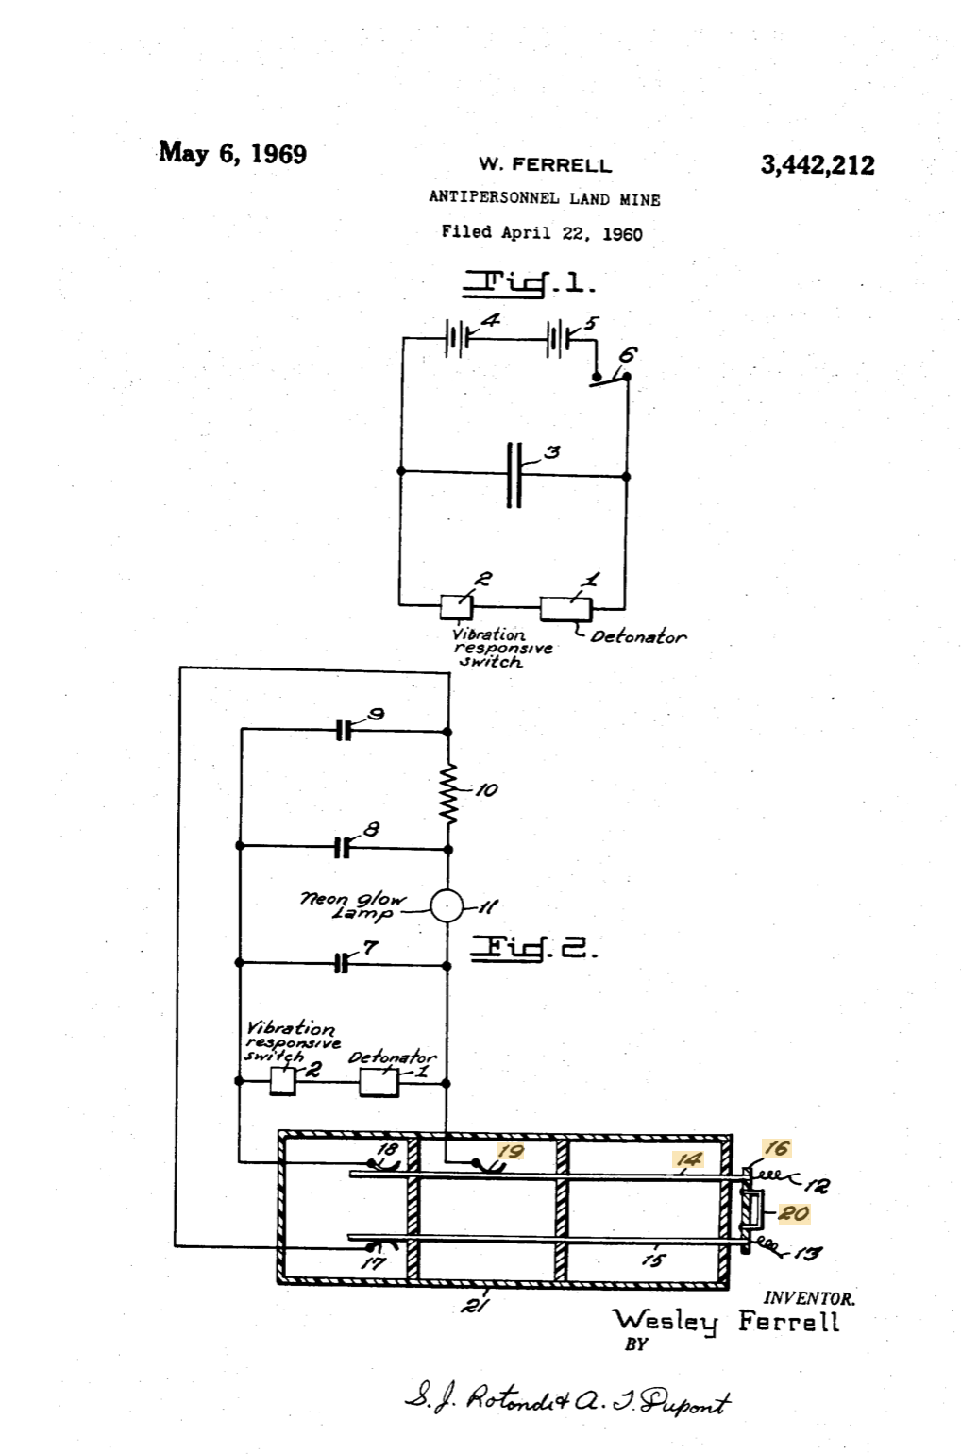
A problem in the laying of land mines is to provide a mine which is entirely safe to handle when it is being laid and will remain safe for a long enough period for the laying personnel to get clear of the area. In conventional type mines the person who lays the mine removes a safety device such as a pin, wire or the like and the mine is then armed and ready for detonation. It can thus be seen that if the mine is to be sensitive for the purpose intended it is also dangerous to the laying personnel after having been armed.
The mine of the present invention overcomes the above noted deficiencies of conventional land mines. The mine of this invention is provided with an electrical arming means which has a time delay in the circuit. When personnel lay the mines they initiate the arming process. A charge is then built up on a condenser and until this charge reaches the amount necessary to operate the detonator the mine is safe. By properly selecting the components of the arming circuit this delay can be made to be several minutes, thus giving the laying personnel ample time to retreat from the area. The detonator is operated by suitable means such as a vibration responsive switch and it can be seen that this means can be made as sensitive as desired Without endangering the laying personnel.
An object of this invention is to provide a land mine which is safe to lay and very sensitive after having been laid.

Slide 6
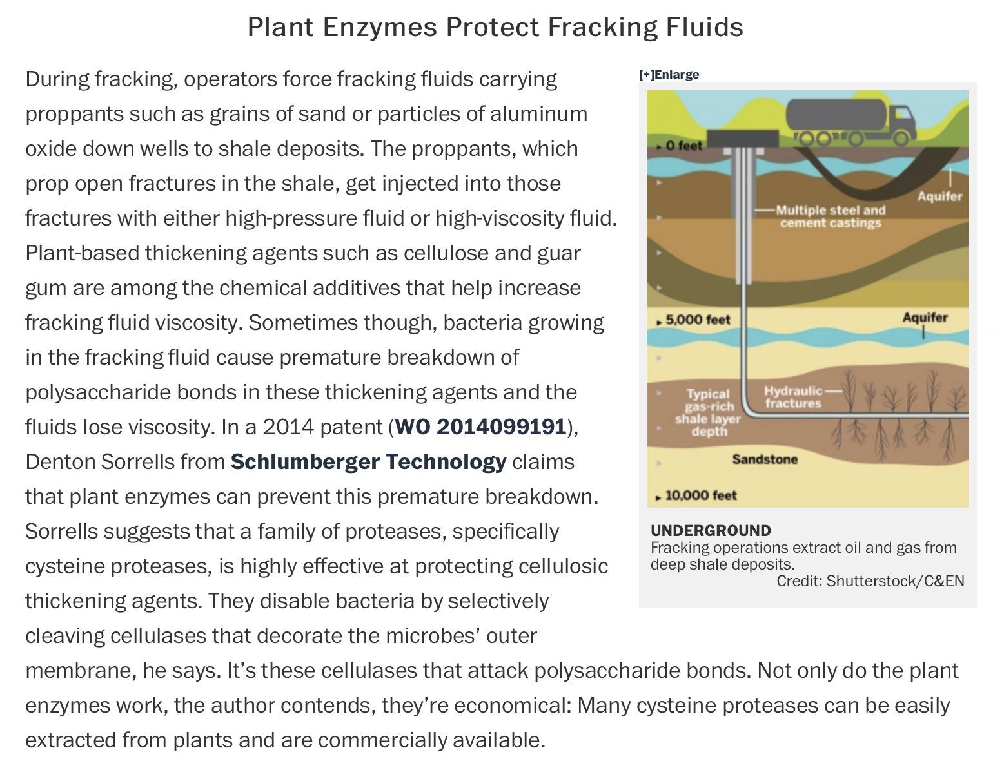
Source: https://cen.acs.org/articles/93/i4/Patent-Picks-Fracking-Technology.html

Slide 7
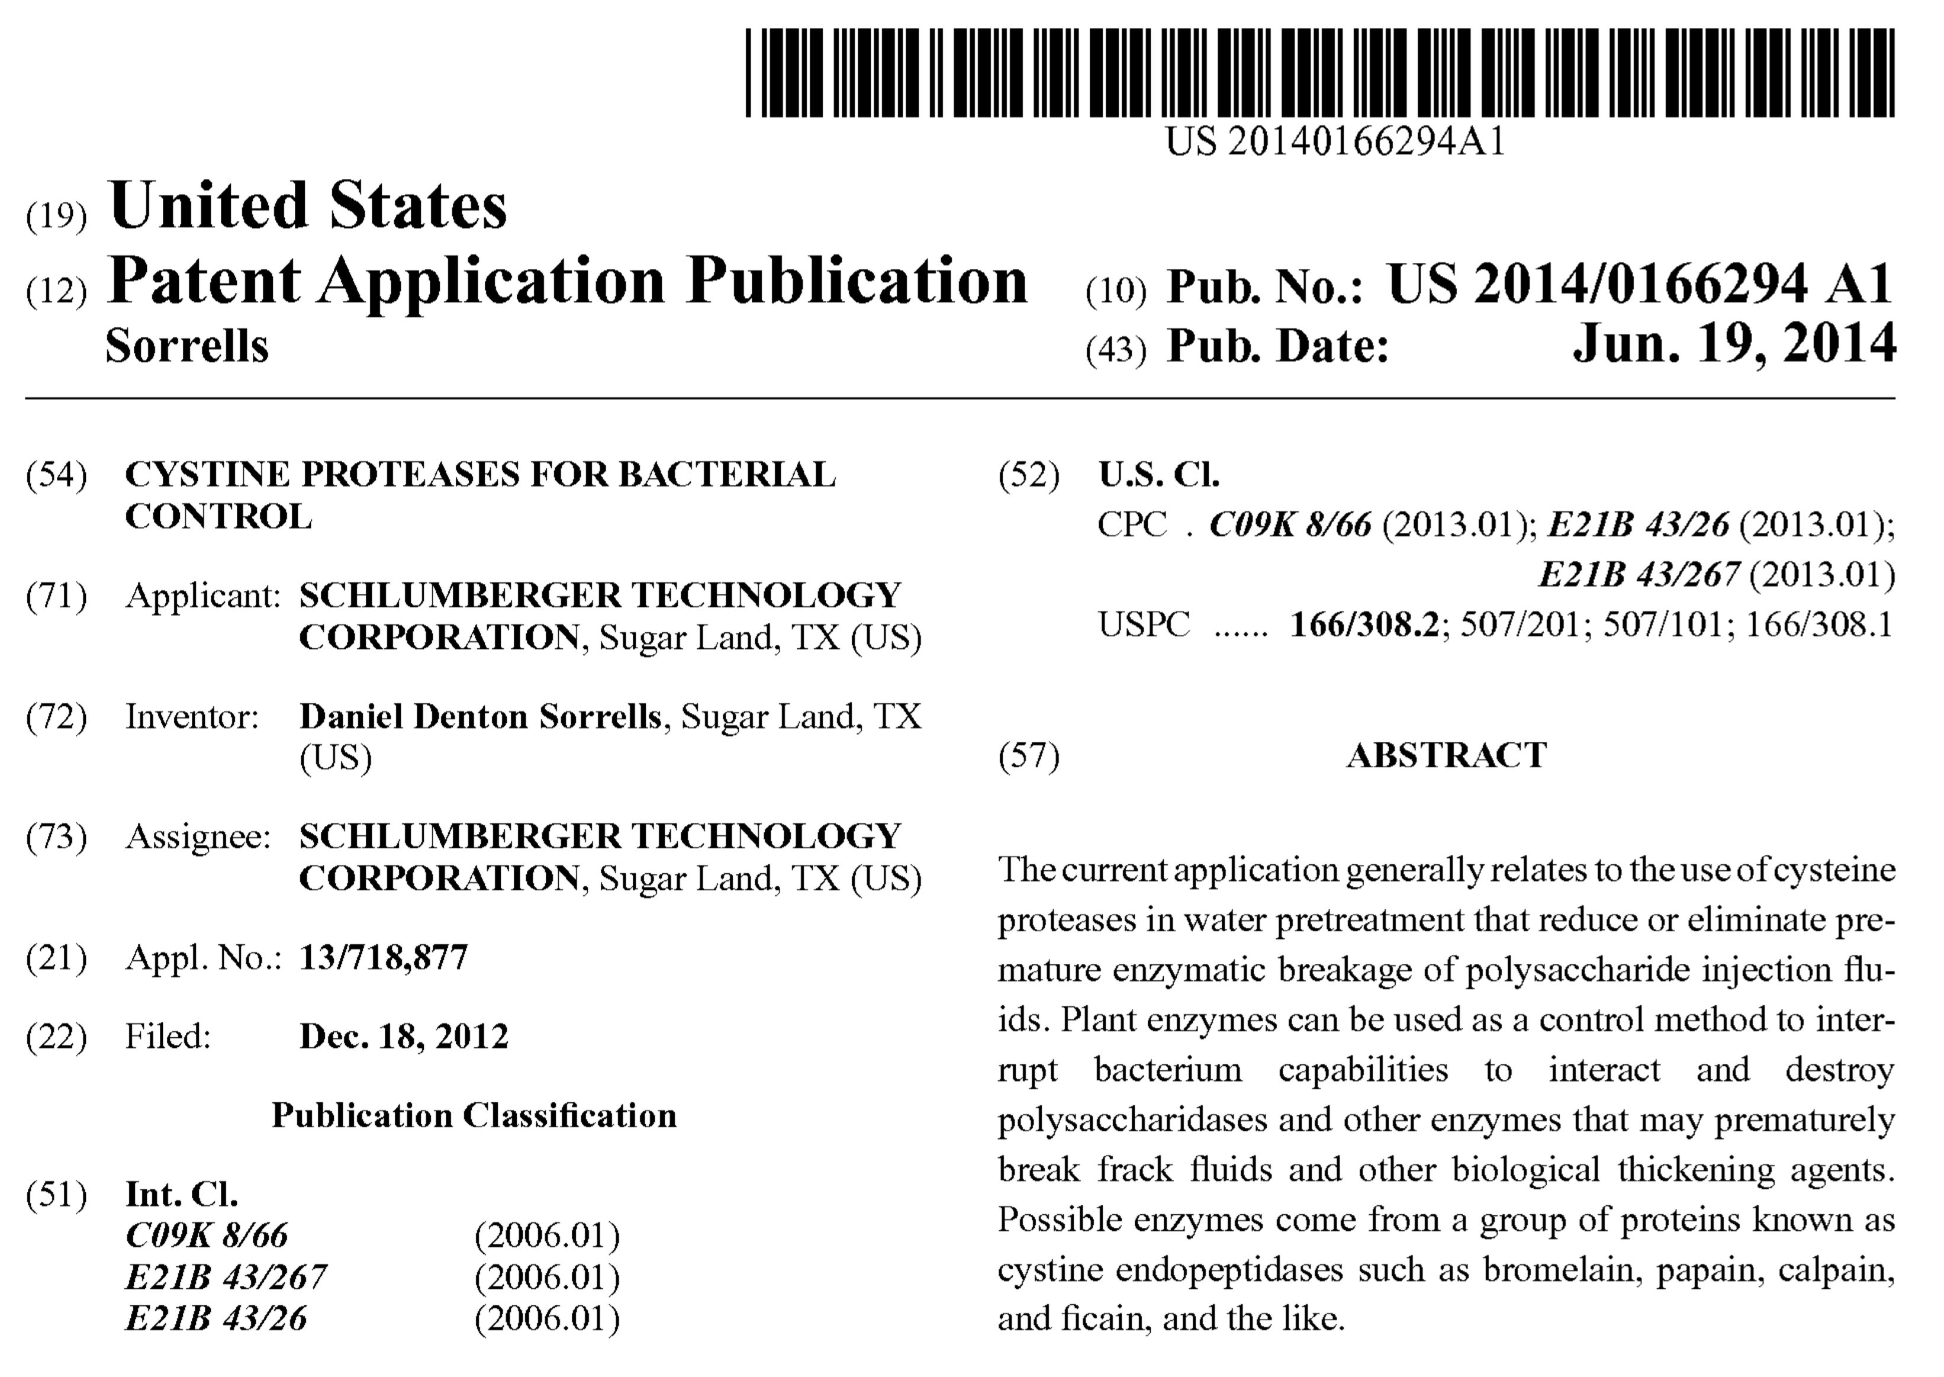

Slide 8
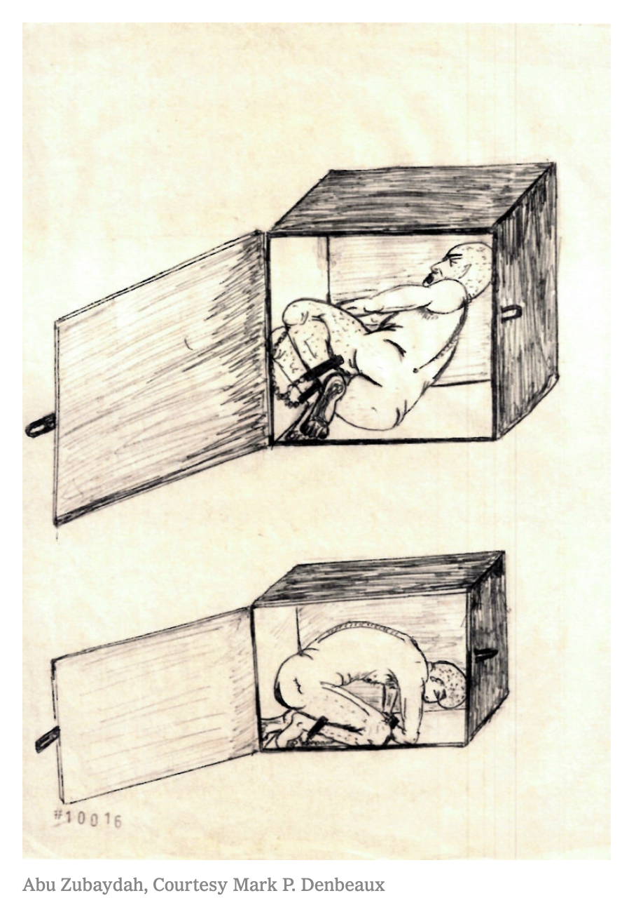
Method of Enhanced Interrogation
Confinement of a prisoner in a box with dimensions:
Width: 53cm
Depth: 76cm
Height: 76cm
Sources: Carol Rosenberg, “What the C.I.A.’s Torture Program Looked Like to the Tortured,” New York Times, December 4, 2019; “CIA Tactics: What is ‘Enhanced Interrogation,’” BBC, December 10, 2014

Slide 9
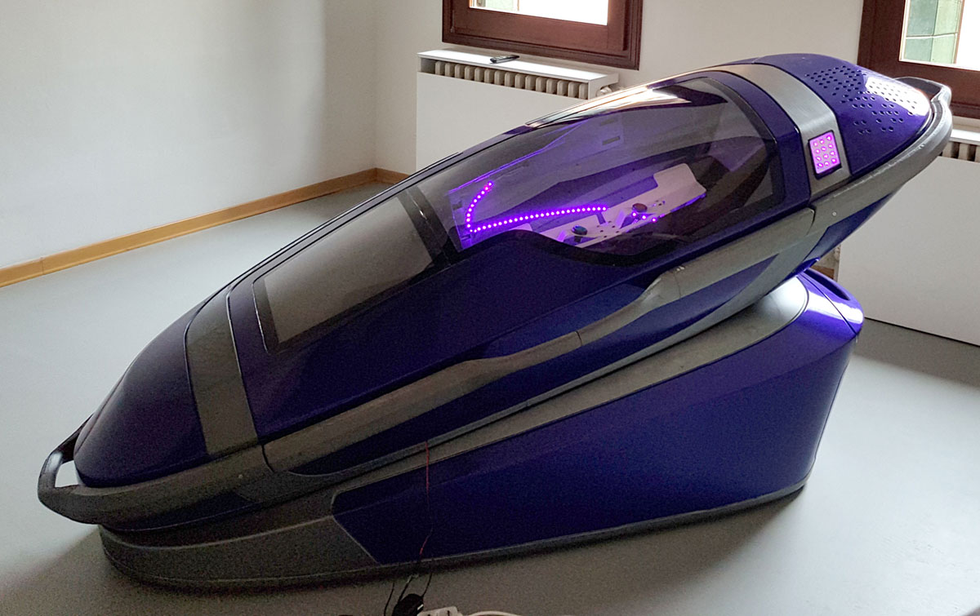
“A controversial suicide pod that enables its occupant to kill themselves at the press of a button went on display at an Amsterdam funeral show on Saturday.
Called the ‘Sarco,’ short for sarcophagus, the 3D-printed machine invented by Australian euthanasia activist Philip Nitschke and Dutch designer Alexander Bannink comes with a detachable coffin, mounted on a stand that contains a nitrogen canister.
‘The person who wants to die presses the button and the capsule is filled with nitrogen. He or she will feel a bit dizzy but will then rapidly lose consciousness and die,’ said Nitschke. The Sarco was a device ‘to provide people with a death when they wish to die,’ Nitschke said.”
Source: The Guardian, April 14, 2018

Slide 10
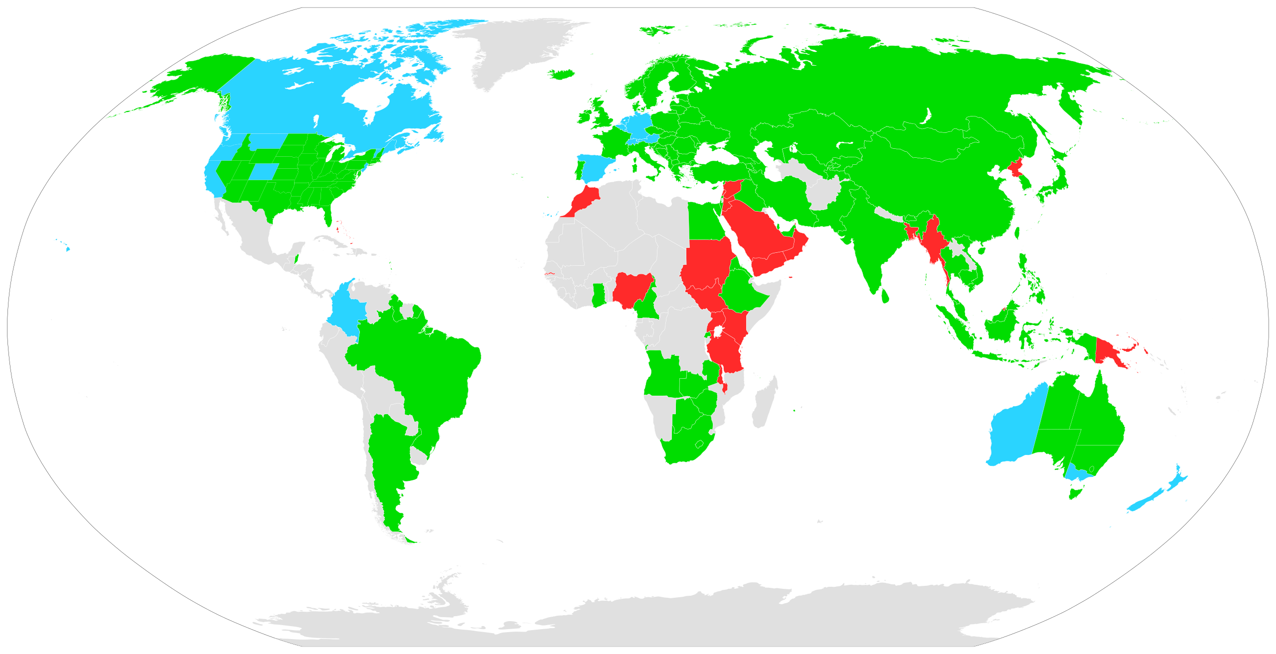
February
2024
Source: Wikipedia

Slide 11
Source: Turecki et al., “Suicide and Suicide Risk,” Nature (2019)

Slide 12
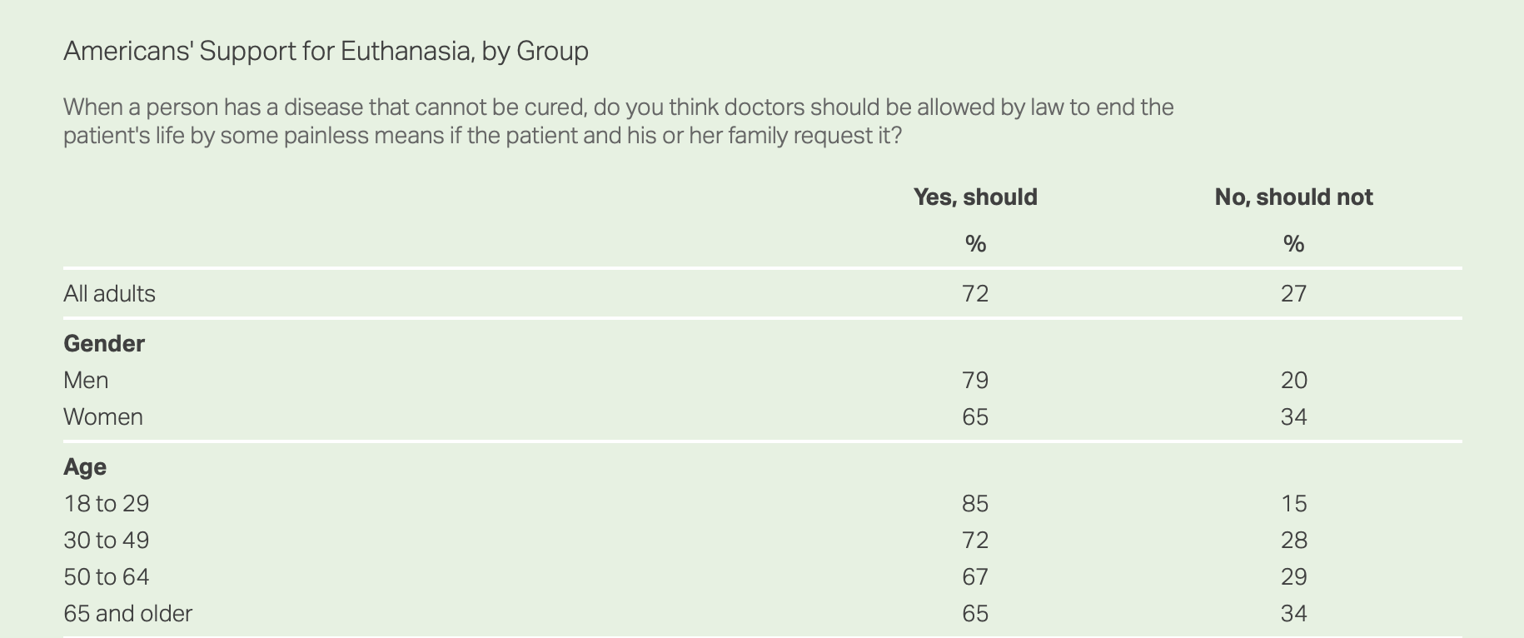
Source: Brenan, “Americans’ Strong Support for Euthanasia Persists,” Gallup (2018)

Slide 13
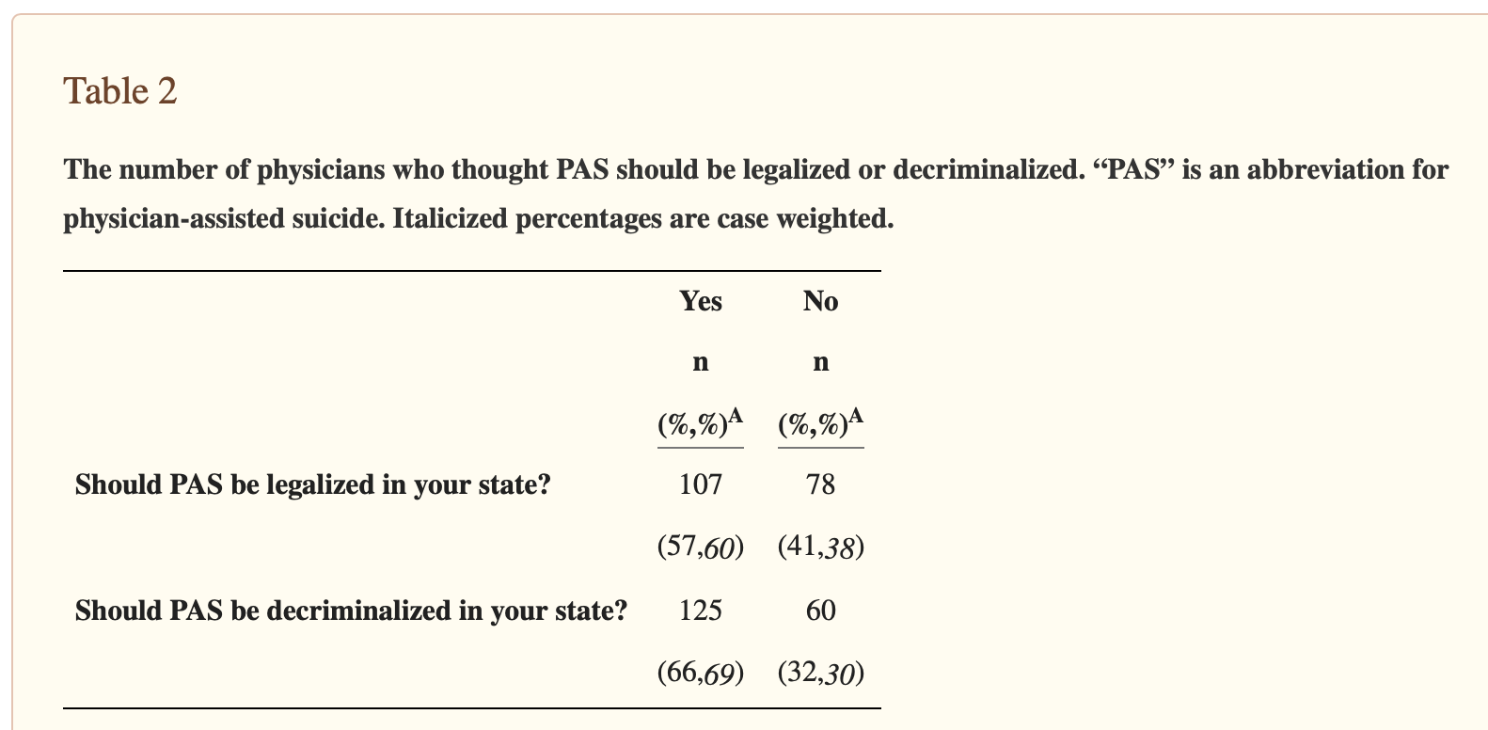
Source: Helzer et al., “A Report of Physicians’ Beliefs about Physician-Assisted Suicide: A National Study,” Yale J Biol Med (2019)

Slide 14
Which, if any, of these inventions should be deemed to satisfy the beneficial utility requirement and thus be patentable?
Anti-photo radar license plate attachment
Large capacity ammunition magazine
Improved anti-personnel landmine
Technique for increasing efficiency of Hydraulic Fracking
Method of Enhanced Interrogation
Sarco

