Slide 1
Salty Frog
PX009
William Fisher
February 2023

Slide 2
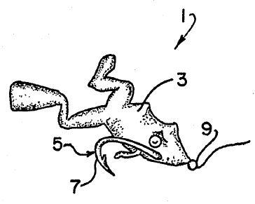
Obvious?
Prior Art
Fishermen have long used frozen salted minnows to catch trout.
"Spice Up Your Lures" (1972) stated that fish "taste" the lure before biting.
The Modern Book of the Black Bass (1972) described the use of salted pork rind as bait.
US Patent No. 3,079,722 described a fishing fly formed from squirrel hair with yeast and salt baked in, and explained that salt is an attractant to fish.
US Patent No. 2,979,778 described a plastic lure containing an organic fish attractant, preferably rhodinyl acetate; this reference warned against the use of insoluble additives in plastic lures.
A patent to Orn suggested as lure additives fish attractants having "the flavor or odor of natural bait."
Patent Claim
“I claim: 1. In a fishing lure comprising a body part and at least one hook part connected thereto, the improvement wherein said body part is formed of a plastisol of a resin dispersed in an organic solvent, said plastisol being impregnated with sufficient salt to impart a salty taste to said body part.”

Slide 3
For the curious: Adding salt to lures (Jan. 7, 2021)
https://www.youtube.com/watch?v=XFgjr0fnYQ4

