Slide 1
SRAM
PX021
William Fisher February 2023

Slide 2
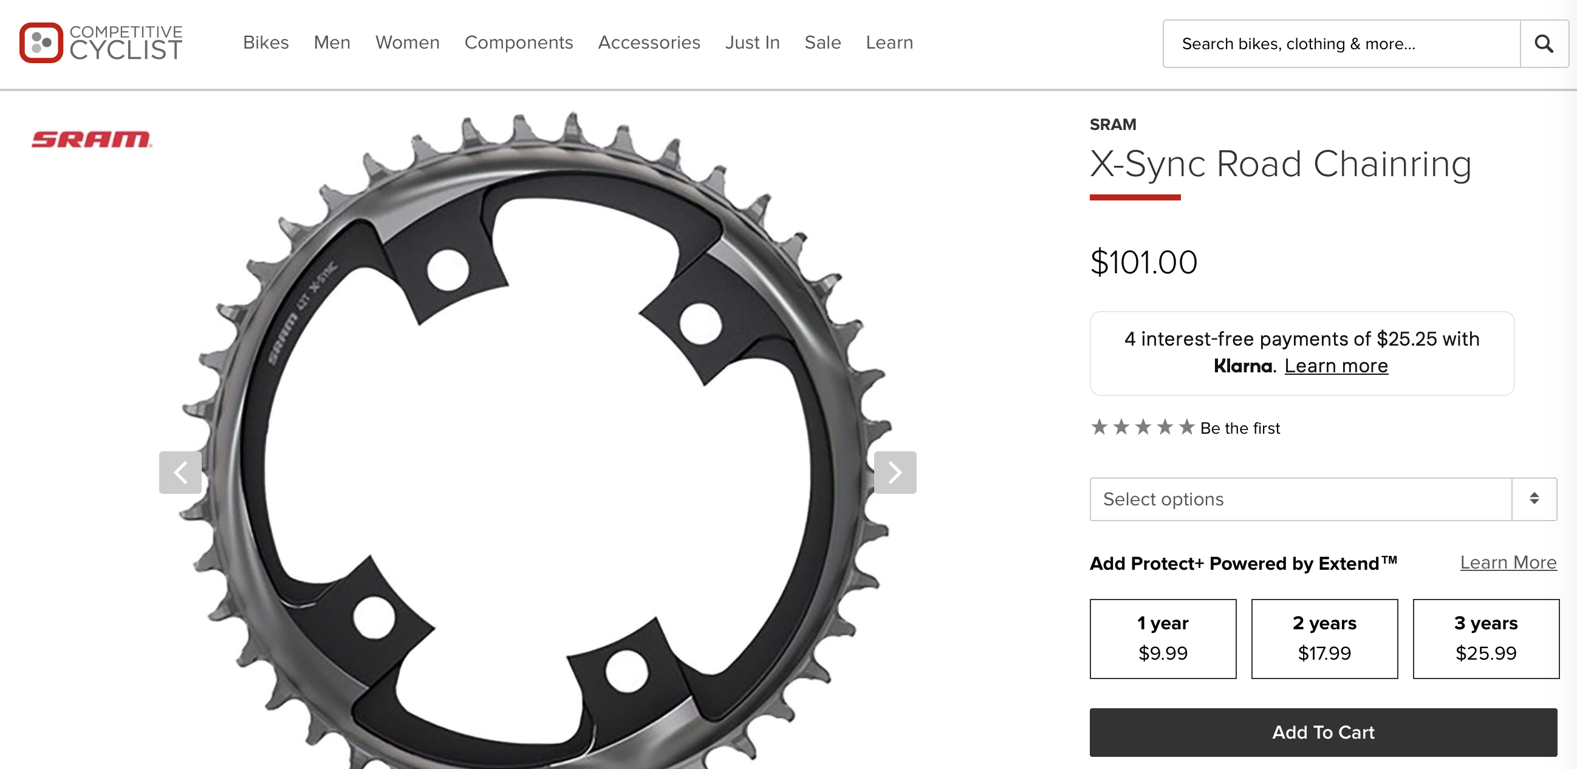

Slide 3
US Patent 9,182,027
Claimed features:
Alternating narrow and wide teeth
Teeth offset to one side

Slide 4
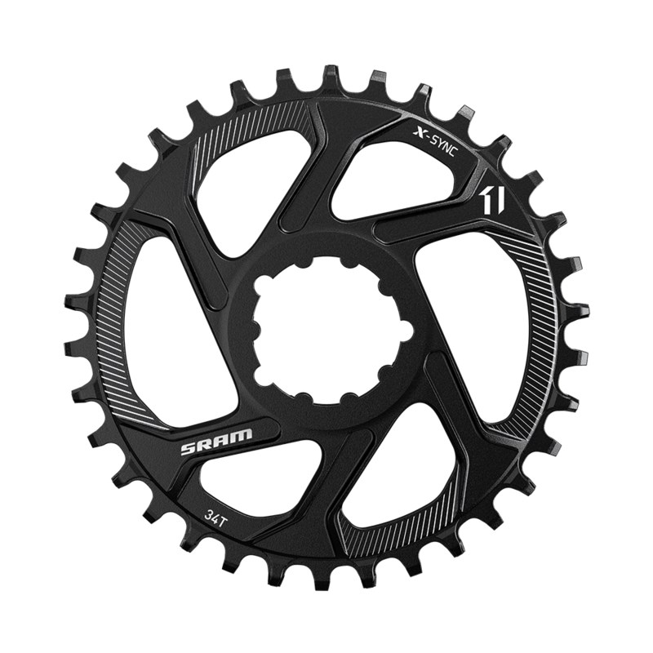
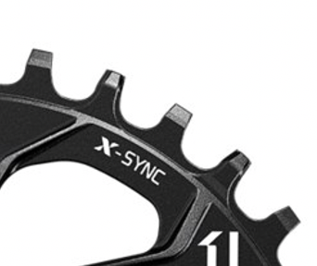

Slide 5
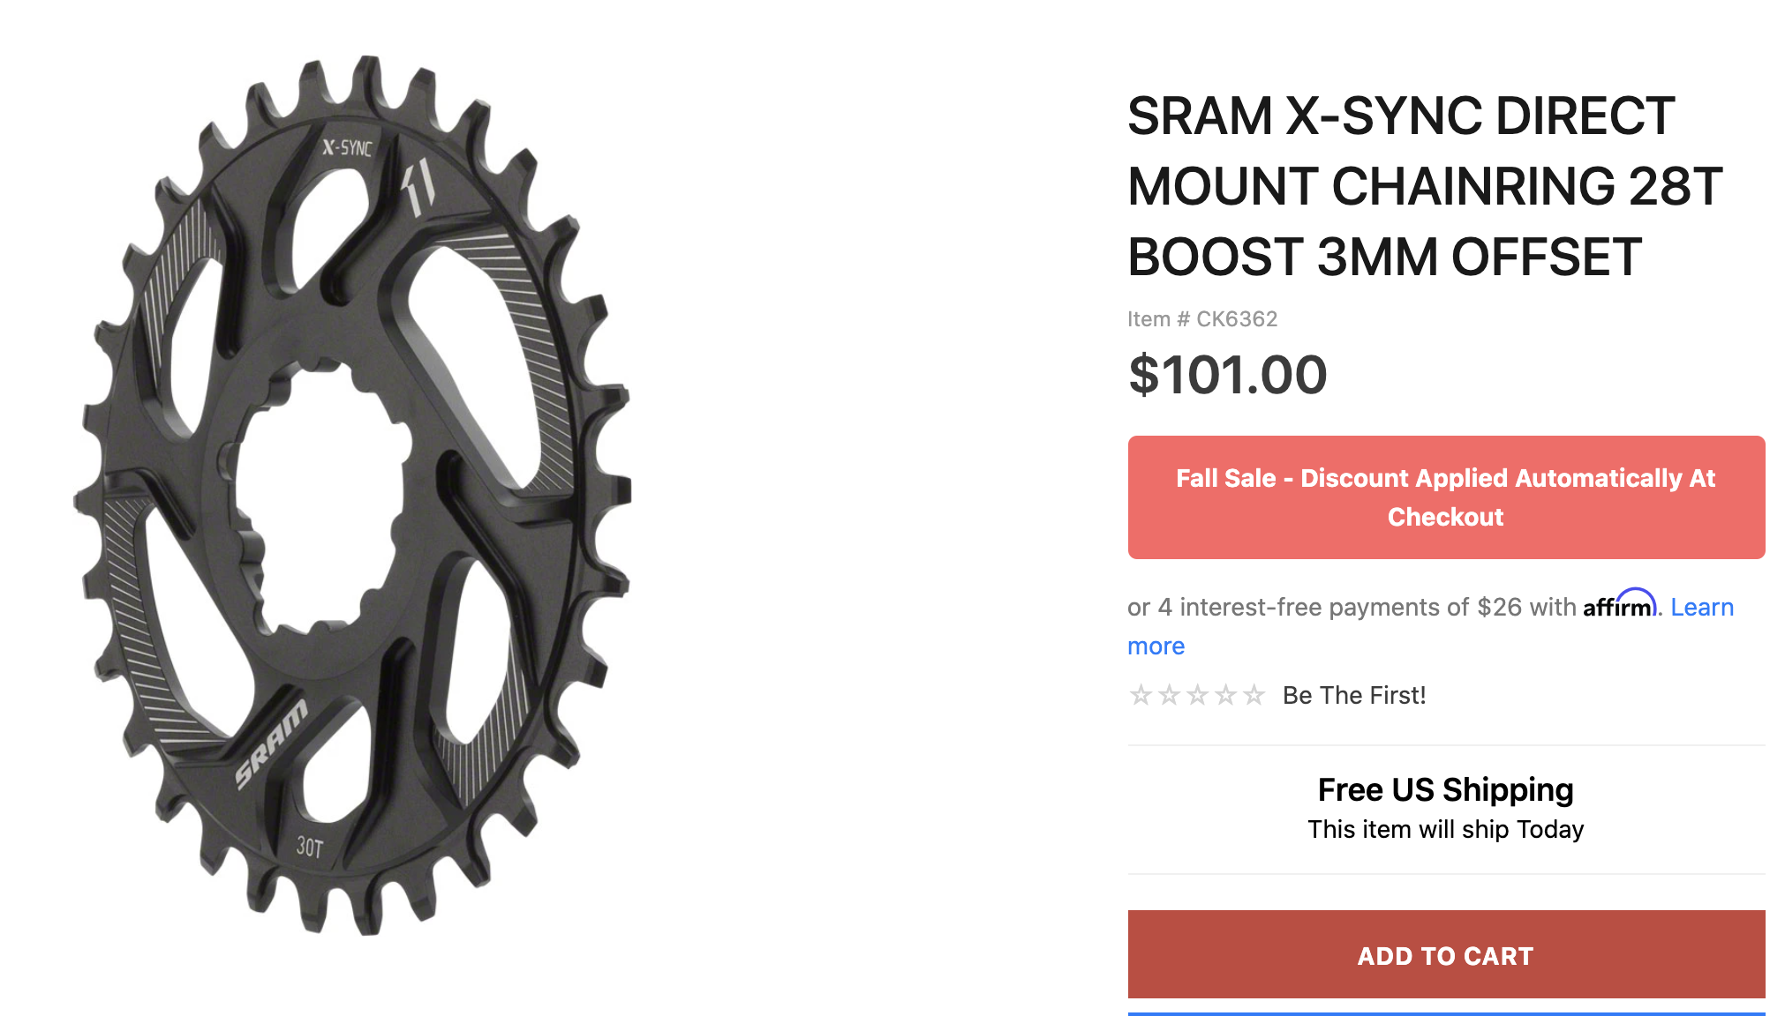

Slide 6
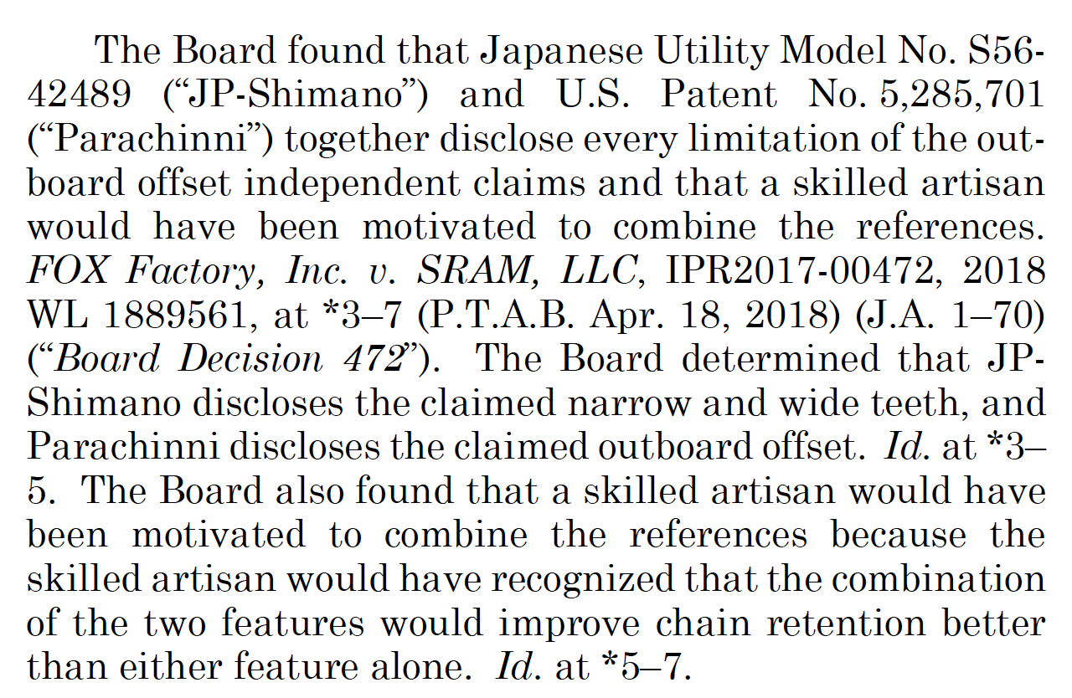
US Patent 9,182,027
Claimed features:
Alternating narrow and wide teeth
Teeth offset to one side

Slide 7
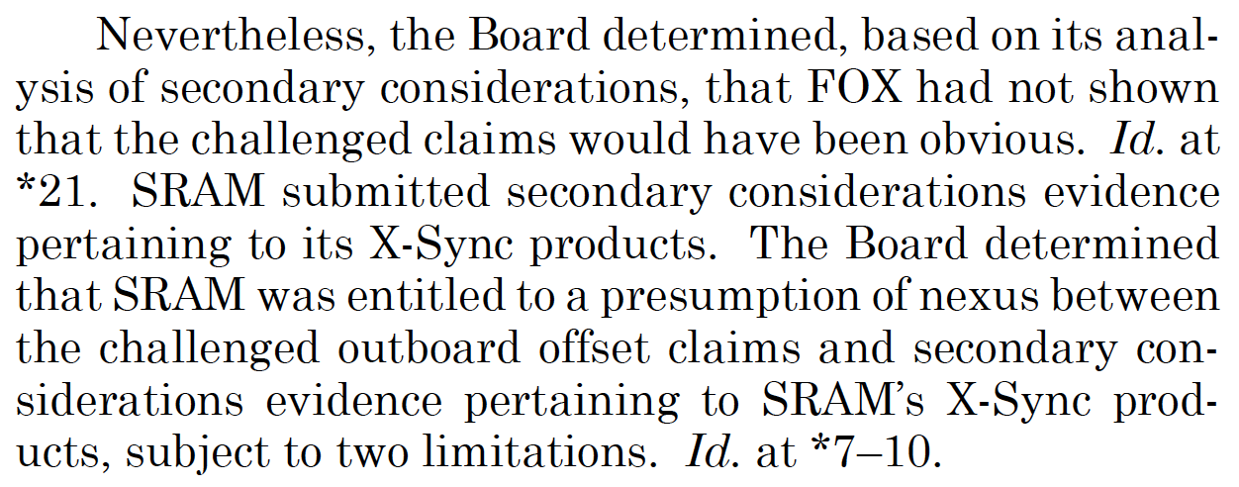
US Patent 9,182,027
Claimed features:
Alternating narrow and wide teeth
Teeth offset to one side

Slide 8
C. Procedural Postures in which Nonobviousness challenges are presented -- Post AIA (2012 to present)
SCOTUS
π
π
Δ
Challenger
Δ
CAFC
π
Δ
inter-
partes
review
π
Δ
District Court
infringement
litigation
ITC
exclusion
litigation
PTAB
allow
Patent
reject
allow
Examiner
PTO
amended
application
reject
application
Inventor

Slide 9
Relevance of Commercial Success?

Slide 10
US Patent 9,182,027
Claimed features:
Alternating narrow and wide teeth
Teeth offset to one side
Additional unclaimed features of the product:
“forwardly protruding tooth tips”
“hook features on the teeth”
“mud-clearing recesses”

Slide 11
Nexus – necessary for use of secondary nonobviousness factors
SRAM is in this zone
“coextensivenss”
Nexus not presumed but may be proved
Nexus presumed
0%
100%
”Correspondence” between product and patent claim

Slide 12
Application of the “Co-extensiveness” Requirement
“Put differently, the degree of correspondence between a product and a patent claim falls along a spectrum. At one end of the spectrum lies perfect or near perfect correspondence. At the other end lies no or very little correspondence, such as where “the patented invention is only a component of a commercially successful machine or process.” Although we do not require the patentee to prove perfect correspondence to meet the coextensiveness requirement, what we do require is that the patentee demonstrate that the product is essentially the claimed invention. While coextensiveness is an issue of fact that should ordinarily be decided by the fact finder in the first instance, no reasonable fact finder could conclude, under the proper standard, that the X-Sync chainrings are coextensive with the patent claims….
“Because the Board erroneously presumed nexus between the evidence of secondary considerations and the independent claims, we vacate the Board’s obviousness determination and remand for further proceedings. On remand, SRAM will have the opportunity to prove nexus between the challenged independent claims and the evidence of secondary considerations. More specifically, SRAM will bear the burden of proving that the evidence of secondary considerations is attributable to the claimed combination of wide and narrow teeth with inboard or outboard offset teeth, as opposed to, for example, prior art features in isolation or unclaimed features.”

