Slide 1
Patent Damages: Proposals for Reform Case Study 106
Patent^{x}
William Fisher
March 2024
Licensed under terms available at https://ipxcourses.org

Slide 2
Calabresi & Melamed,
“Property Rules, Liability Rules, and Inalienability” (1972)

Slide 3
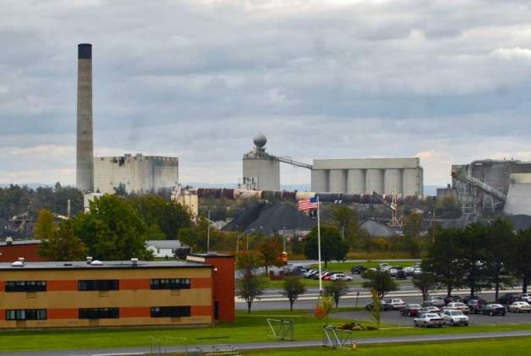
“The Lafarge cement plant in Ravena, shown here across Route 9W from the Ravena-Coeymans-Selkirk High School.”
Source: https://www.timesunion.com/default/photo/The-Lafarge-cement-plant-in-Ravena-shown-here-457115.php (courtesy of John Barna)

Slide 4
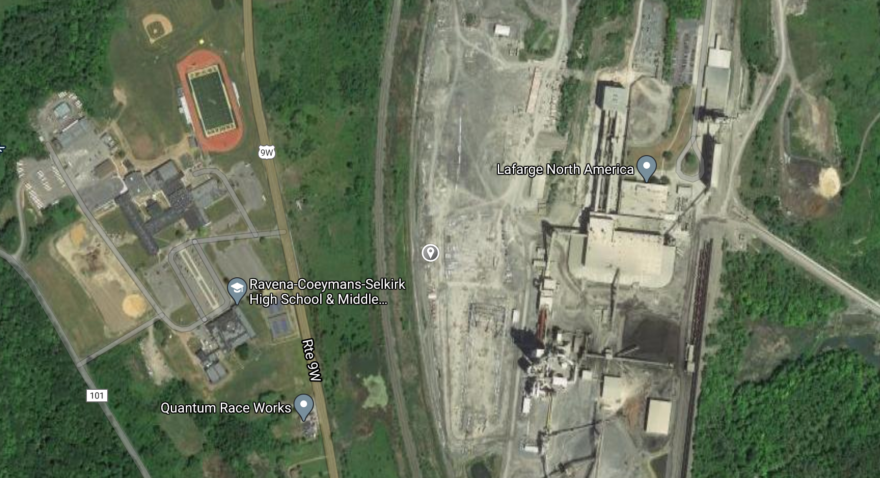
Courtesy of John Barna

Slide 5
Calabresi & Melamed,
“Property Rules, Liability Rules, and Inalienability” (1972)

Slide 6
Spur Industries

Slide 7
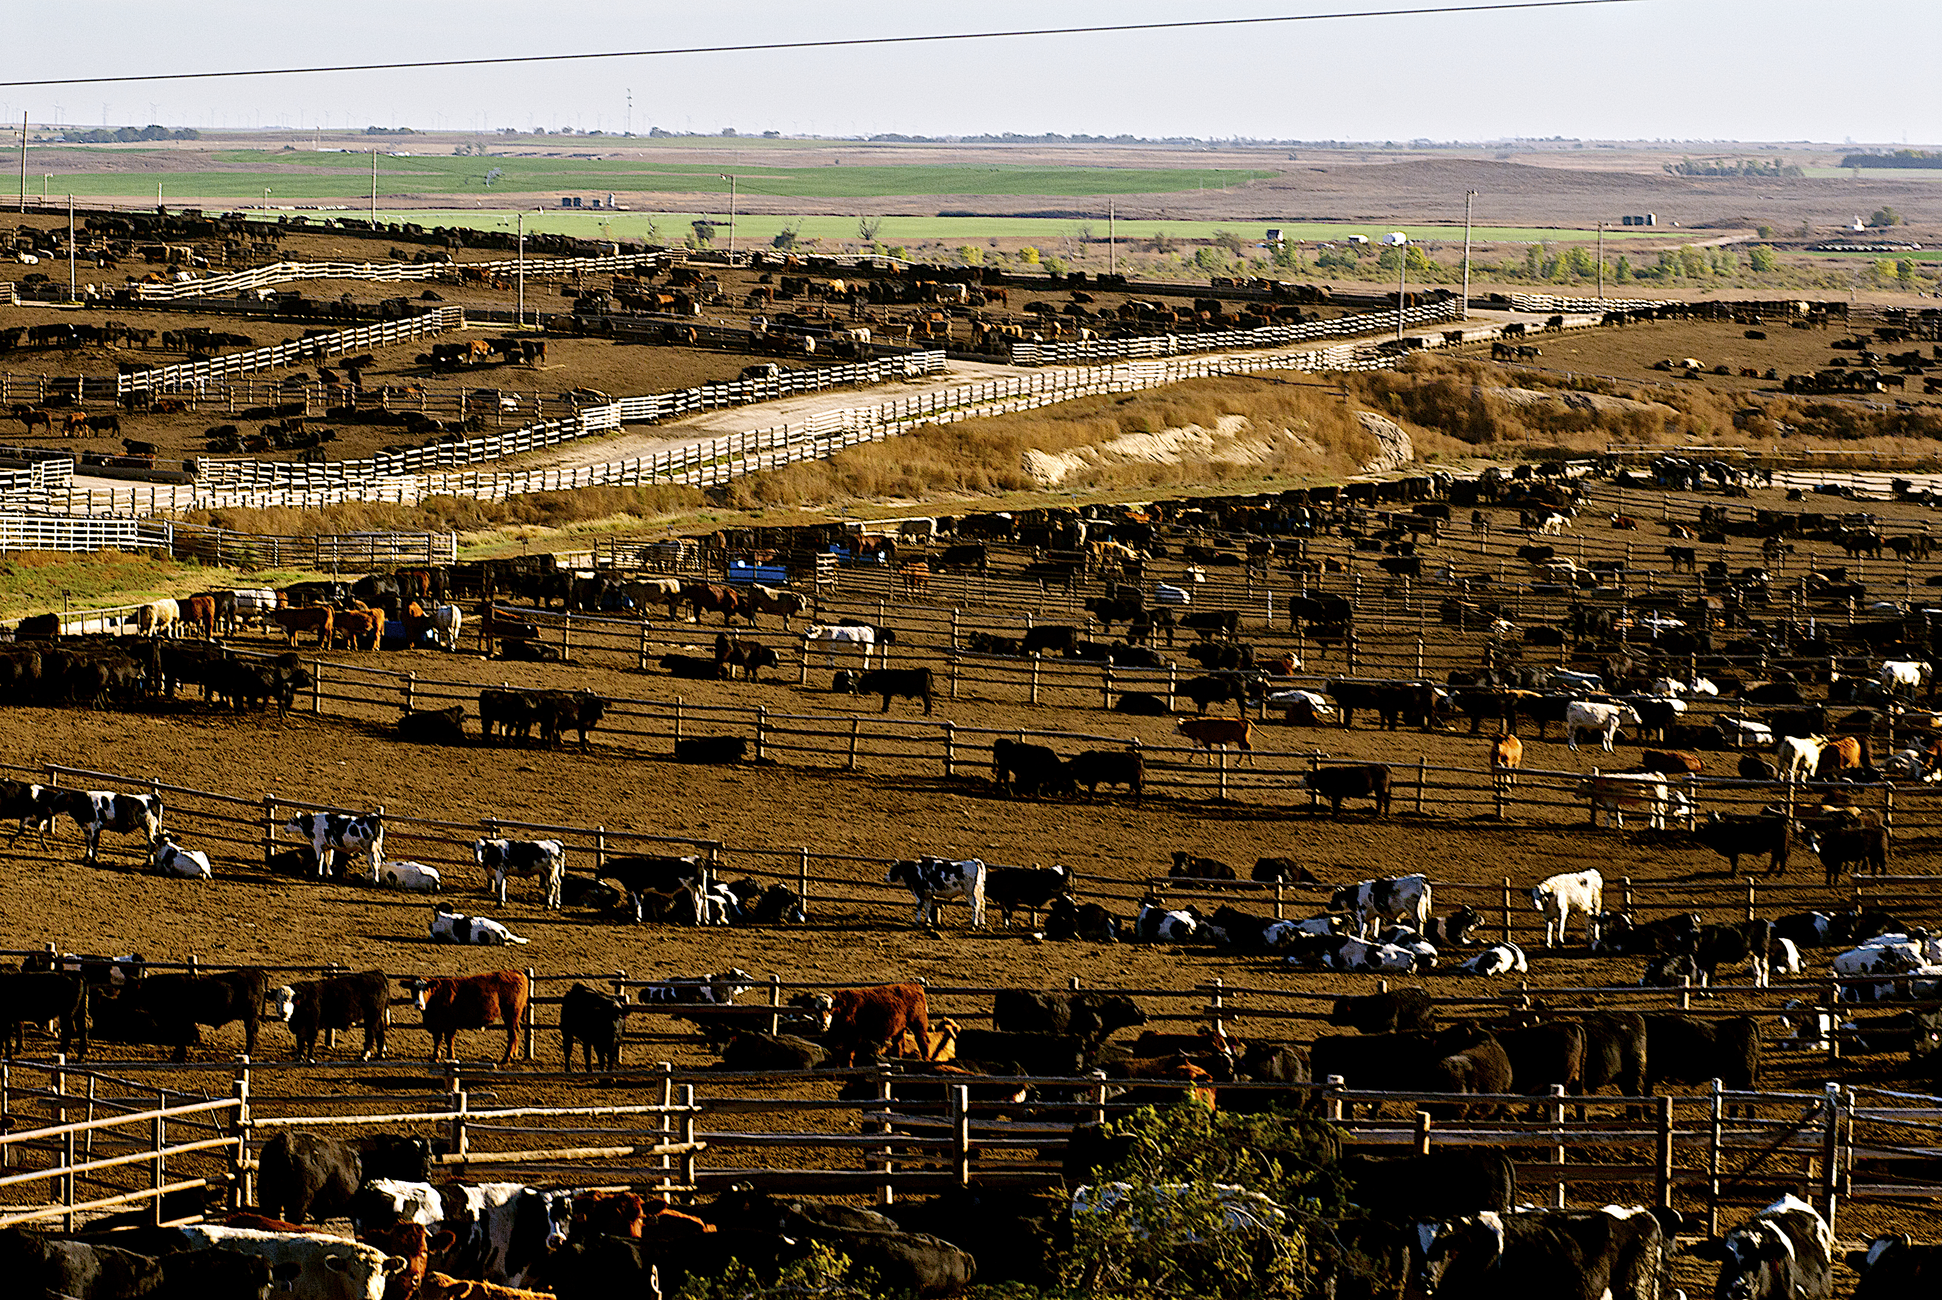
Typical
feedlot
Source: https://i2.wp.com/southeastagnet.com/wp-content/uploads/2019/09/cattle-feedlot.editorial.shutterstock_741033517.jpg?ssl=1

Slide 8
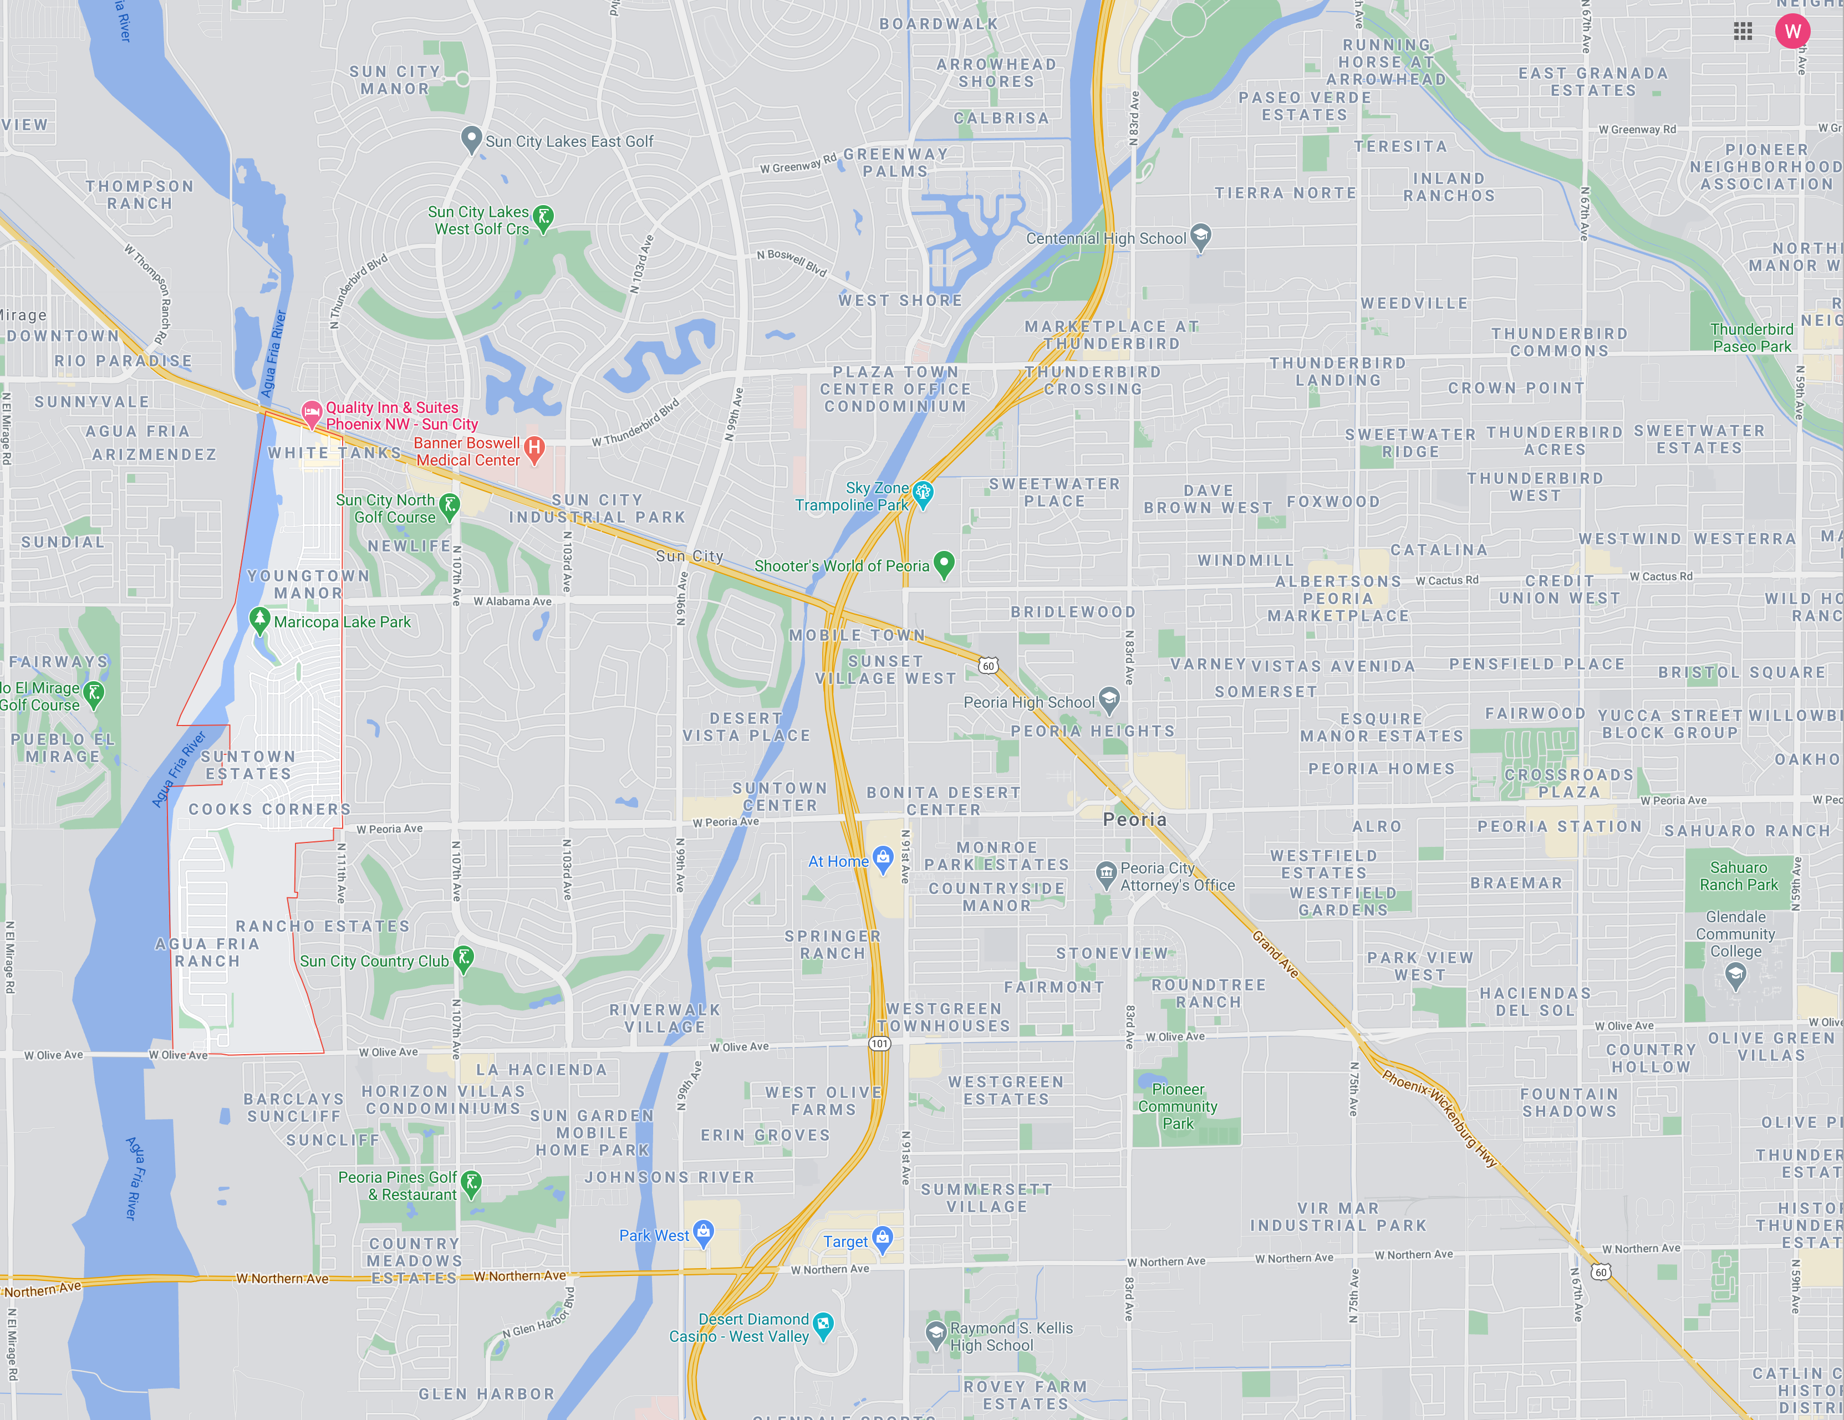
Spur Industries: Condition of the Land today
Residential in 1962
Residential in 1965
Tract originally occupied by Spur

Slide 9
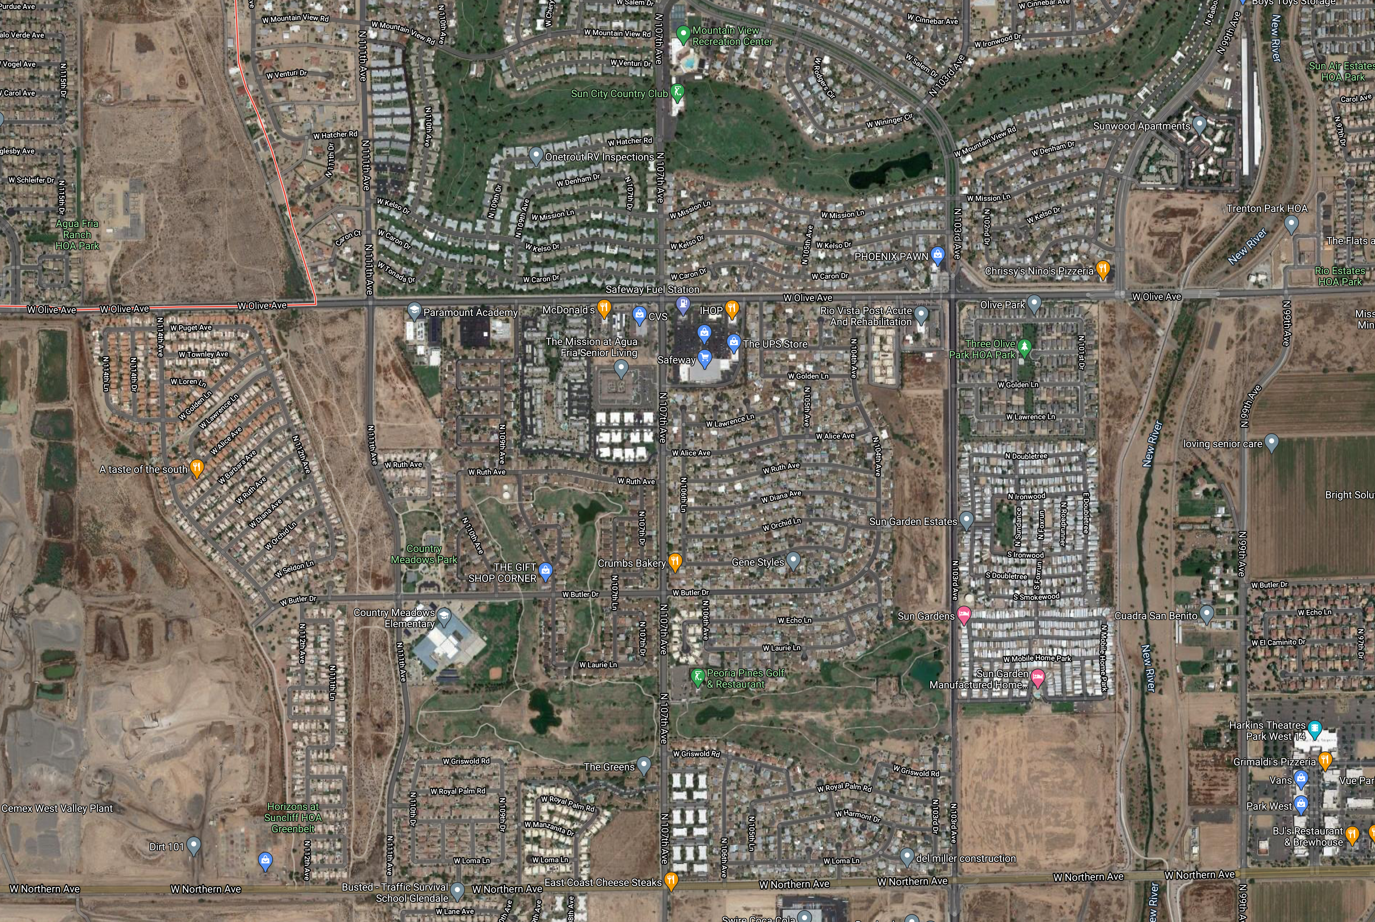
Spur Industries: Condition of the Land today
Tract originally occupied by Spur

Slide 10
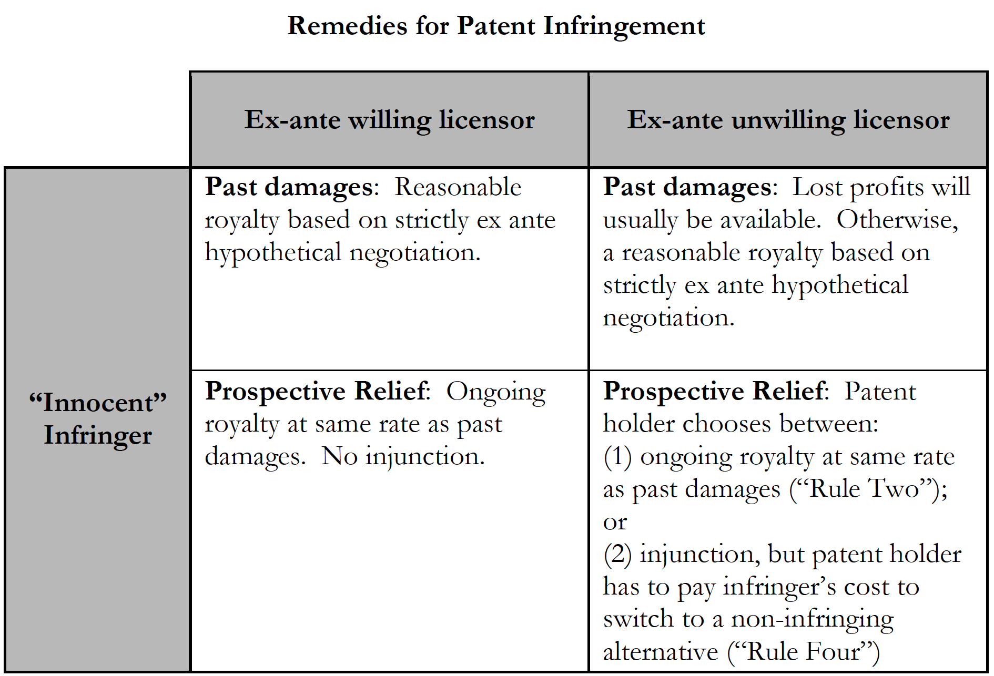
Lee & Melamed,
“Breaking the Vicious Cycle of Patent Damages” (2016)

Slide 11
Lost profits
Alternative measures
of damages
Reasonable royalty
Patentee’s profits
Infringer’s profits
§286
2024
Patent
2008
2009
2010
2011
2012
2013
2014
2015
2016
2017
2018
2019
2020
2021
2022
2023
Lawsuit filed
Patentee prevails

Slide 12
Reasonable royalty
Patentee’s profits
Infringer’s profits
§286
2024
Patent
2008
2009
2010
2011
2012
2013
2014
2015
2016
2017
2018
2019
2020
2021
2022
2023
Lawsuit filed
Patentee prevails

Slide 13
Reasonable royalty
Patentee’s profits
Infringer’s profits
§286
2024
Patent
2008
2009
2010
2011
2012
2013
2014
2015
2016
2017
2018
2019
2020
2021
2022
2023
Lawsuit filed
Patentee prevails

Slide 14
Lee & Melamed,
“Breaking the Vicious Cycle of Patent Damages” (2016)

Slide 15
Reasonable royalty
Patentee’s profits
Infringer’s profits
§286
2024
Patent
2008
2009
2010
2011
2012
2013
2014
2015
2016
2017
2018
2019
2020
2021
2022
2023
Lawsuit filed
Patentee prevails

Slide 16
Reasonable royalty
Patentee’s profits
Infringer’s profits
§286
2024
Patent
2008
2009
2010
2011
2012
2013
2014
2015
2016
2017
2018
2019
2020
2021
2022
2023
Lawsuit filed
Patentee prevails

Slide 17
Ongoing royalty
Reasonable royalty
Patentee’s profits
Infringer’s profits
§286
2024
Patent
2008
2009
2010
2011
2012
2013
2014
2015
2016
2017
2018
2019
2020
2021
2022
2023
Lawsuit filed
Patentee prevails

Slide 18
Ongoing royalty
Reasonable royalty
Patentee’s profits
Infringer’s profits
§286
2024
Patent
2008
2009
2010
2011
2012
2013
2014
2015
2016
2017
2018
2019
2020
2021
2022
2023
Lawsuit filed
Patentee prevails

Slide 19
Lee & Melamed,
“Breaking the Vicious Cycle of Patent Damages” (2016)

Slide 20
Lost profits
Reasonable royalty
Patentee’s profits
Infringer’s profits
§286
2024
Patent
2008
2009
2010
2011
2012
2013
2014
2015
2016
2017
2018
2019
2020
2021
2022
2023
Lawsuit filed
Patentee prevails

Slide 21
Lee & Melamed,
“Breaking the Vicious Cycle of Patent Damages” (2016)

Slide 22
Lost profits
Reasonable royalty
Patentee’s profits
Infringer’s profits
§286
2024
Patent
2008
2009
2010
2011
2012
2013
2014
2015
2016
2017
2018
2019
2020
2021
2022
2023
Lawsuit filed
Patentee prevails

Slide 23
Option 1
Ongoing royalty
Reasonable royalty
Patentee’s profits
Infringer’s profits
§286
2024
Patent
2008
2009
2010
2011
2012
2013
2014
2015
2016
2017
2018
2019
2020
2021
2022
2023
Lawsuit filed
Patentee prevails

Slide 24
Option 2: To secure this outcome, patentee must pay the cost to the defendant of switching to non-infringing alternative technology
Lost profits
Alternative measures
of damages
Reasonable royalty
Patentee’s profits
Infringer’s profits
§286
Injunction
2024
Patent
2008
2009
2010
2011
2012
2013
2014
2015
2016
2017
2018
2019
2020
2021
2022
2023
Lawsuit filed
Patentee prevails

Slide 25
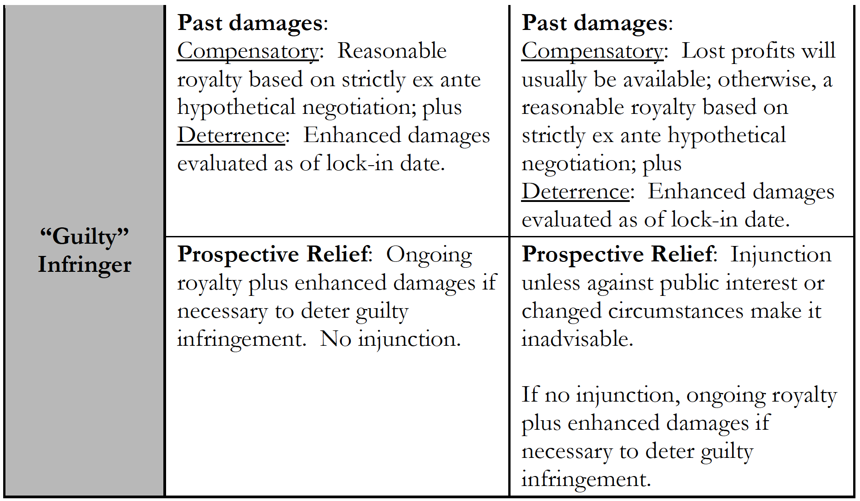
Lee & Melamed,
“Breaking the Vicious Cycle of Patent Damages” (2016)

Slide 26
Reasonable royalty
Patentee’s profits
§286
2024
Patent
2008
2009
2010
2011
2012
2013
2014
2015
2016
2017
2018
2019
2020
2021
2022
2023
Lawsuit filed
Patentee prevails

Slide 27
Enhanced damages for
“egregious” conduct
Reasonable royalty
Patentee’s profits
Infringer’s profits
§286
2024
Patent
2008
2009
2010
2011
2012
2013
2014
2015
2016
2017
2018
2019
2020
2021
2022
2023
Lawsuit filed
Patentee prevails

Slide 28
Lee & Melamed,
“Breaking the Vicious Cycle of Patent Damages” (2016)

Slide 29
Ongoing royalty
Reasonable royalty
Patentee’s profits
§286
2024
Patent
2008
2009
2010
2011
2012
2013
2014
2015
2016
2017
2018
2019
2020
2021
2022
2023
Lawsuit filed
Patentee prevails

Slide 30
Enhanced damages for
“egregious” conduct
Ongoing royalty
Reasonable royalty
Patentee’s profits
Infringer’s profits
§286
2024
Patent
2008
2009
2010
2011
2012
2013
2014
2015
2016
2017
2018
2019
2020
2021
2022
2023
Lawsuit filed
Patentee prevails

Slide 31
Lee & Melamed,
“Breaking the Vicious Cycle of Patent Damages” (2016)

Slide 32
Lost profits
Reasonable royalty
Patentee’s profits
Infringer’s profits
§286
2024
Patent
2008
2009
2010
2011
2012
2013
2014
2015
2016
2017
2018
2019
2020
2021
2022
2023
Lawsuit filed
Patentee prevails

Slide 33
Lost profits
Reasonable royalty
Patentee’s profits
Infringer’s profits
§286
2024
Patent
2008
2009
2010
2011
2012
2013
2014
2015
2016
2017
2018
2019
2020
2021
2022
2023
Lawsuit filed
Patentee prevails

Slide 34
Lee & Melamed,
“Breaking the Vicious Cycle of Patent Damages” (2016)

Slide 35
Lost profits
Alternative measures
of damages
Reasonable royalty
Patentee’s profits
Infringer’s profits
§286
Injunction
2024
Patent
2008
2009
2010
2011
2012
2013
2014
2015
2016
2017
2018
2019
2020
2021
2022
2023
Lawsuit filed
Patentee prevails

Slide 36
Enhanced damages for
“egregious” conduct
Ongoing royalty
Reasonable royalty
Patentee’s profits
Infringer’s profits
§286
2024
Patent
2008
2009
2010
2011
2012
2013
2014
2015
2016
2017
2018
2019
2020
2021
2022
2023
Lawsuit filed
Patentee prevails

Slide 37
Lee & Melamed,
“Breaking the Vicious Cycle of Patent Damages” (2016)

Slide 38
Lee & Melamed,
“Breaking the Vicious Cycle of Patent Damages” (2016)

