Slide 1
Novelty Problems
Case Study 093
William Fisher
February 2024
Licensed under terms available at https://ipxcourses.org

Slide 2
Problem 1
On April 21, 2016, Celie demonstrated the operation of an embodiment of her invention at a trade show that was open to the public.
On April 23, 2017, Celie filed a US patent application for the invention
Source: Golden et al., Principles of Patent Law (7th ed. 2018)

Slide 3
Problem 2
On April 21, 2016, Celie demonstrated the operation of an embodiment of her invention at a trade show that was open to the public.
On April 18, 2017, Celie filed a US patent application for the invention
Source: Golden et al., Principles of Patent Law (7th ed. 2018)

Slide 4
Problem 3
On April 15, 2013, Frank publicly uses an embodiment of an invention at a trade conference in Canada. No resident of the US attends or learns about the conference. C never files a patent application anywhere
On May 15, 2013, Gail, who has invented the same invention independently, prior to Frank, files a US patent application on it.
Source: Golden et al., Principles of Patent Law (7th ed. 2018)

Slide 5
Problem 11
January 1, 2018: Dan invents an improved mousetrap
July 1, 2018: Dan files for a US patent
March 1, 2018: Ellen invents an identical mousetrap
May 1, 2018: Ellen files for a US patent
Will Ellen’s application be granted?

Slide 6
Problem 12
January 1, 2018: Dan invents an improved mousetrap
July 1, 2018: Dan files for a US patent
Will Dan’s application be granted?
March 1, 2018: Ellen invents an identical mousetrap
May 1, 2018: Ellen files for a US patent

Slide 7
Problem 13
January 1, 2018: Dan invents an improved mousetrap
July 1, 2018: Dan files for a US patent
March 1, 2018: Ellen obtains the blueprint for Dan’s mousetrap
May 1, 2018: Ellen files for a US patent
Will Ellen’s application be granted?

Slide 8
Problem 14
January 1, 2018: Dan invents an improved mousetrap
July 1, 2018: Dan files for a US patent
Will Dan’s application be granted?
March 1, 2018: Ellen obtains the blueprint for Dan’s mousetrap
May 1, 2018: Ellen files for a US patent

Slide 9
Problem 21
October 1, 2020: Ann has an idea for a new wireless microphone
November 1, 2020: Ann completes a working prototype
January 1, 2021: Ann submits an article to Pedagogy Magazine, in which she describes the microphone
February 1, 2021: the editor of Pedagogy submits the article to three outside readers.
March 1, 2021: the outside readers submit comments to Pedagogy, suggesting revisions.
April 1, 2021: Ann submits a revised draft
May 1, 2021: Pedagogy prints the issue containing the article.
May 7, 2021: copies of the issue are delivered to subscribers.
August 1, 2021: Ann files a US patent application
January 15, 2021: Bill has an idea for a similar microphone
February 15, 2021: Bill completes a prototype and uses it to teach an online class
May 9, 2016: Bill reads Ann’s article
May 10, 2016: Bill files a US patent application on the microphone

Slide 10
Problem 22
October 1, 2020: Ann has an idea for a new wireless microphone
November 1, 2020: Ann completes a working prototype
January 1, 2021: Ann submits an article to Pedagogy Magazine, in which she describes the microphone
February 1, 2021: the editor of Pedagogy submits the article to three outside readers.
March 1, 2021: the outside readers submit comments to Pedagogy, suggesting revisions.
April 1, 2021: Ann submits a revised draft
May 1, 2021: Pedagogy prints the issue containing the article.
May 7, 2021: copies of the issue are delivered to subscribers.
August 1, 2021: Ann files a US patent application
January 15, 2021: Bill independently has an idea for a similar microphone
February 15, 2021: Bill completes a prototype and uses it to teach an online class
May 9, 2021: Bill reads Ann’s article
May 10, 2021: Bill files a US patent application on the microphone

Slide 11
Problem 23
October 1, 2020: Ann has an idea for a new wireless microphone
November 1, 2020: Ann completes a working prototype
January 1, 2021: Ann submits an article to Pedagogy Magazine, in which she describes the microphone
February 1, 2021: the editor of Pedagogy submits the article to three outside readers.
March 1, 2021: the outside readers submit comments to Pedagogy, suggesting revisions.
April 1, 2021: Ann submits a revised draft
May 1, 2021: Pedagogy prints the issue containing the article.
May 7, 2021: copies of the issue are delivered to subscribers.
August 1, 2021: Ann files a US patent application
January 15, 2021: Bill independently has an idea for a similar microphone
February 15, 2021: Bill completes a prototype and uses it to teach an online class
May 9, 2021: Bill reads Ann’s article
May 10, 2021: Bill files a US patent application on the microphone

Slide 12
Problem 24
October 1, 2020: Ann has an idea for a new wireless microphone
November 1, 2020: Ann completes a working prototype; publishes a blog describing it
January 1, 2021: Ann submits an article to Pedagogy Magazine, in which she describes the microphone
February 1, 2021: the editor of Pedagogy submits the article to three outside readers.
March 1, 2021: the outside readers submit comments to Pedagogy, suggesting revisions.
April 1, 2021: Ann submits a revised draft
May 1, 2021: Pedagogy prints the issue containing the article.
May 7, 2021: copies of the issue are delivered to subscribers.
August 1, 2021: Ann files a US patent application
January 15, 2021: Bill independently has an idea for a similar microphone
February 15, 2021: Bill completes a prototype and uses it to teach an online class
May 9, 2021: Bill reads Ann’s article
May 10, 2021: Bill files a US patent application on the microphone

Slide 13
Problem 25
October 1, 2020: Ann has an idea for a new wireless microphone
November 1, 2020: Ann completes a working prototype; files EPO patent application
January 1, 2021: Ann submits an article to Pedagogy Magazine, in which she describes the microphone
February 1, 2021: the editor of Pedagogy submits the article to three outside readers.
March 1, 2021: the outside readers submit comments to Pedagogy, suggesting revisions.
April 1, 2021: Ann submits a revised draft
May 1, 2021: Pedagogy prints the issue containing the article.
May 7, 2021: copies of the issue are delivered to subscribers.
August 1, 2021: Ann files a US patent application
January 15, 2021: Bill independently has an idea for a similar microphone
February 15, 2021: Bill completes a prototype and uses it to teach an online class
May 9, 2021: Bill reads Ann’s article
May 10, 2021: Bill files a US patent application on the microphone

Slide 14
Problem 26
October 1, 2010: Ann has an idea for a new wireless microphone
November 1, 2010: Ann completes a working prototype
January 1, 2011: Ann submits an article to Pedagogy Magazine, in which she describes the microphone
February 1, 2011: the editor of Pedagogy submits the article to three outside readers.
March 1, 2011: the outside readers submit comments to Pedagogy, suggesting revisions.
April 1, 2011: Ann submits a revised draft
May 1, 2011: Pedagogy prints the issue containing the article.
May 7, 2011: copies of the issue are delivered to subscribers.
August 1, 2021: Ann files a US patent application
January 15, 2021: Bill has an idea for a similar microphone
February 15, 2021: Bill completes a prototype and uses it to teach an online class
May 9, 2011: Bill reads Ann’s article
May 10, 2011: Bill files a US patent application on the microphone

Slide 15
Problem 27
October 1, 2010: Ann has an idea for a new wireless microphone
November 1, 2010: Ann completes a working prototype
January 1, 2011: Ann submits an article to Pedagogy Magazine, in which she describes the microphone
February 1, 2011: the editor of Pedagogy submits the article to three outside readers.
March 1, 2011: the outside readers submit comments to Pedagogy, suggesting revisions.
April 1, 2011: Ann submits a revised draft
May 1, 2011: Pedagogy prints the issue containing the article.
May 7, 2011: copies of the issue are delivered to subscribers.
August 1, 2021: Ann files a US patent application
January 15, 2011: Bill has an idea for a similar microphone
February 15, 2011: Bill completes a prototype and uses it to teach an online class
May 9, 2011: Bill reads Ann’s article
May 10, 2011: Bill files a US patent application on the microphone

Slide 16
Problem 28
October 1, 2010: Ann has an idea for a new wireless microphone
November 1, 2010: Ann completes a working prototype
January 1, 2011: Ann submits an article to Pedagogy Magazine, in which she describes the microphone
February 1, 2011: the editor of Pedagogy submits the article to three outside readers.
March 1, 2011: the outside readers submit comments to Pedagogy, suggesting revisions.
April 1, 2011: Ann submits a revised draft
May 1, 2011: Pedagogy prints the issue containing the article.
May 7, 2011: copies of the issue are delivered to subscribers.
August 1, 2011: Ann files a US patent application
January 15, 2011: Bill has an idea for a similar microphone
February 15, 2011: Bill completes a prototype and uses it to teach an online class
May 9, 2011: Bill reads Ann’s article
May 10, 2011: Bill files a US patent application on the microphone

Slide 17
Problem 29
October 1, 2010: Ann has an idea for a new wireless microphone
November 1, 2010: Ann completes a working prototype; publishes a blog describing it
January 1, 2011: Ann submits an article to Pedagogy Magazine, in which she describes the microphone
February 1, 2011: the editor of Pedagogy submits the article to three outside readers.
March 1, 2011: the outside readers submit comments to Pedagogy, suggesting revisions.
April 1, 2011: Ann submits a revised draft
May 1, 2011: Pedagogy prints the issue containing the article.
May 7, 2011: copies of the issue are delivered to subscribers.
August 1, 2011: Ann files a US patent application
January 15, 2011: Bill has an idea for a similar microphone
February 15, 2011: Bill completes a prototype and uses it to teach an online class
May 9, 2011: Bill reads Ann’s article
May 10, 2011: Bill files a US patent application on the microphone

Slide 18
Problem 30
October 1, 2010: Ann has an idea for a new wireless microphone
November 1, 2010: Ann completes a working prototype; files an EPO patent application
January 1, 2011: Ann submits an article to Pedagogy Magazine, in which she describes the microphone
February 1, 2011: the editor of Pedagogy submits the article to three outside readers.
March 1, 2011: the outside readers submit comments to Pedagogy, suggesting revisions.
April 1, 2011: Ann submits a revised draft
May 1, 2011: Pedagogy prints the issue containing the article.
May 7, 2011: copies of the issue are delivered to subscribers.
August 1, 2011: Ann files a US patent application
January 15, 2011: Bill has an idea for a similar microphone
February 15, 2011: Bill completes a prototype and uses it to teach an online class
May 9, 2011: Bill reads Ann’s article
May 10, 2011: Bill files a US patent application on the microphone

Slide 19
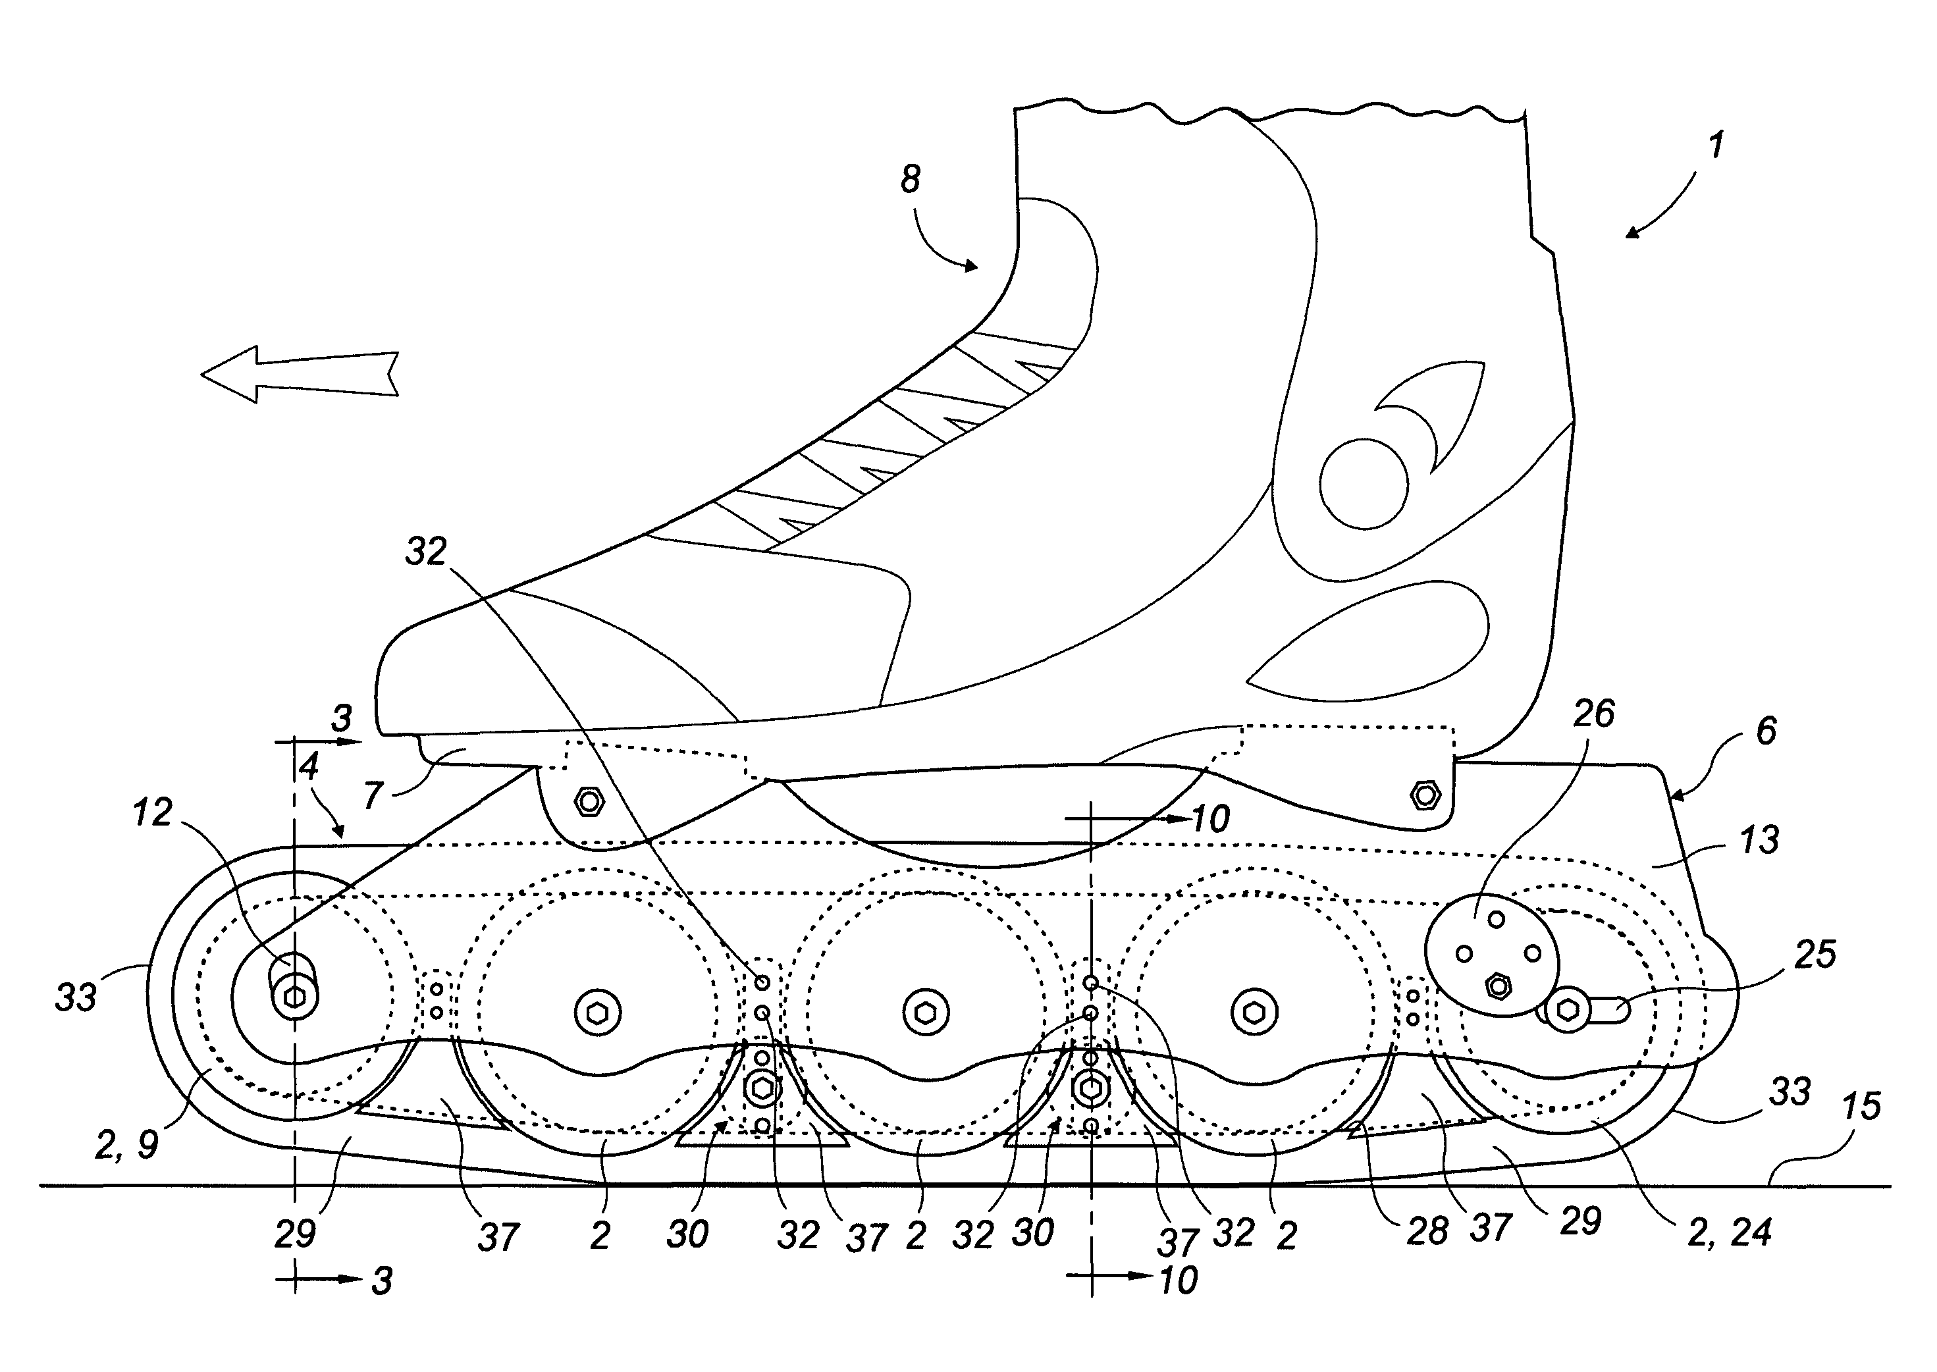
Problem #31:
Mila invents a novel roller skate in January 2012 and files a U.S. patent application in July 2013. Hayk independently invents the same roller skate in April 2013 and files a U.S. patent application in May 2013. Both patent applications are published in due course, 18 months after filing. Who gets a patent?
Mila
Hayk
Both
Neither
Source: Masur & Ouellette, Patent Law (3d ed. 2023)
Notes:
M&O: B. Hayk
Both patent applications are filed post-AIA, so Mila’s earlier invention is irrelevant. There is no relevant prior art before Hayk’s application, so it will be granted. Mila’s application will be rejected because Hayk’s application is prior art under § 102(a)(2).
TF: New Rules
Who invented first is irrelevant.
As to Hayk, no prior art (before critical date of May 2013)
As to Mila, Hayk’s application is prior art, even though secret at the time Mila applies.
So Hayk wins; Mila loses

Slide 20
Problem #32:
Same facts, but Hayk decides to abandon his patent application in May 2014 because he does not think there is a large market for the roller skate. Who gets a patent?
Mila
Hayk
Both
Neither
Source: Masur & Ouellette, Patent Law (3d ed. 2023)
Notes:
Answer: A. Mila
Hayk’s application is abandoned before it is published, so it is as if it never happened.
TF: New Rules
Who invented first is irrelevant.
As to Mila, Hayk’s application is not prior art, because never published.
Hayk is not seeking a patent.
So Mila wins

Slide 21
Problem #33:
Same facts, but Hayk now abandons his patent application in May 2015. Who gets a patent?
Mila
Hayk
Both
Neither
Source: Masur & Ouellette, Patent Law (3d ed. 2023)
Notes:
Answer: D
Hayk’s patent application will not be granted because it was abandoned, and Mila’s will not be granted because Hayk’s application is abandoned after publication.
[Instructors might also remind students that “Both” is NEVER the right answer when the two patent applications are for the same invention.]

Slide 22
Problem 34
1. On January 1, 2015, A writes a blog post describing and enabling a new invention. Four days later, completely independently, B writes a blog post describing the same invention. B files for a patent on October 15, 2015, and A files for a patent on November 1, 2015. Who can obtain a patent?
Source: Masur & Ouellette, Patent Law (3d ed. 2023)
Notes:
M&O: A is entitled to the patent because its blog post eliminates B’s blog post and B’s filing as prior art.
TF: First view the problem on the assumption of B seeking a patent. From B’s Standpoint, A’s blog post is a reference (printed publication) whose effective date precedes B’s critical date, and no exception is applicable. So B cannot get a patent. [B’s own blog post is also a reference, but falls into an exception: “Disclosure (within a year prior to the effective date of the claim) by the inventor or someone who derived the information from the inventor.”
Next view the problem from the standpoint of A. B’s blog post is a potentially fatal reference, but it falls into an exception: “A reference by a third party (within a year prior to the effective date of the claim) that is preceded by public disclosure of the invention by the inventor or someone who derived the information from the inventor.” So A can get a patent.

Slide 23
Problem 35
2. On January 1, 2015, A writes a blog post describing and enabling a new invention. Four days later, completely independently, B writes a blog post describing the same invention. B files for a patent on February 10, 2016, and A files for a patent on February 1, 2016. Who can obtain a patent?
Source: Masur & Ouellette, Patent Law (3d ed. 2023)
Notes:
M&O: Neither can obtain a patent. A can’t because its 1-year grace period has expired. B can’t for that reason and because A disclosed first.
TF: First view the problem on the assumption of B seeking a patent. From B’s Standpoint, A’s blog post is a reference (printed publication) whose effective date precedes B’s critical date, and no exception is applicable. So B cannot get a patent. B’s own blog post is also a reference and falls out of the grace period.
Next view the problem from the standpoint of A. B’s blog post is a fatal reference, and falls outside of the 1-year exception: “A reference by a third party (within a year prior to the effective date of the claim) that is preceded by public disclosure of the invention by the inventor or someone who derived the information from the inventor.” So A cannot get a patent.

Slide 24
Problem 36
A invents a widget on Jan. 1, 2015. On June 1, 2015, A reaches an agreement to sell the widget to B. This agreement is never made public. C invents the same widget on July 1, 2015 and files for a patent on October 1, 2015. A files for a patent on October 2, 2015. Who can obtain a patent?
Notes:
M&O: The answer to this question depends on whether A’s sales agreement bars C, and whether it counts as a public disclosure. We think the best way to read the law is that A’s sales agreement does not bar C and that it does not create a grace period for A relative to C’s patent filing. C can receive the patent.
TF: New Rules
Can A get a patent? No, because of C’s prior patent application. A’s secret agreement to sell is also a reference, but falls within the grace period.
Can C get a patent? It depends on whether A’s secret agreement constitutes being on sale, with respect to C. M&O think no (if so, need to add another exception: secrecy of third-party sale.). No case law.

Slide 25
Problem 37
A invents a widget on Jan. 1, 2015. On April 1, 2015, A gives an oral presentation about the widget to an audience of 50 widget purchasers. The next day, one of them writes an enabling blog post about the widget. Without reading the blog post, B files for a patent on the widget on April 3, 2015. A files for a patent on April 5, 2015. Who can obtain a patent?
Source: Masur & Ouellette, Patent Law (3d ed. 2023)
Notes:
M&O: A’s oral presentation might make the invention “otherwise available to the public,” but even if it does not, the blog post constitutes a printed publication and is attributed to A (“made . . . by another who obtained the subject matter disclosed directly . . . from the inventor”), so it will bar B and eliminate B’s filing as prior art against A. A can receive the patent.
TF: With respect to B, the blog post is a fatal printed publication, if enabling.
With respect to A, the blog post is not fatal because it was derived from A.
B’s patent application would be fatal, but it falls into the exception: “A reference by a third party (within a year prior to the effective date of the claim) that is preceded by public disclosure of the invention by the inventor or someone who derived the information from the inventor.”
So A gets the patent, even if the blog post is enabling.

