Slide 1
Nirsevimab Negotiation Exercise
PX074
William Fisher
March 2024

Slide 2
Introduction
“Monoclonal antibodies are one of the most powerful tools in modern medicine. More than 100 of them have been licensed over the past 30 years and they are transforming the way doctors treat, prevent and even cure serious non-communicable diseases, including many cancers and autoimmune disorders. These monoclonal antibody products are significantly more effective than previously available therapies and are often better tolerated and easier to deliver. There’s also a rapidly growing pipeline of monoclonal antibodies to treat and prevent many existing and emerging infectious and neglected diseases.
“Millions of people around the world stand to benefit both from existing monoclonal antibody-based products and those in development. Rates of non-communicable diseases are on the rise in many developing countries. In addition, there are numerous existing and emerging infectious disease threats, including COVID-19, Ebola and HIV, for which monoclonal antibodies are poised to play an important role in treatment and prevention. As the COVID-19 pandemic has shown, no country is immune to the threat posed by emerging infectious diseases. If monoclonal antibodies prove to be effective for COVID-19, ensuring prompt, equitable and affordable global access to these products, as well as others, will be imperative. …
“Today, the market for monoclonal antibodies is overwhelmingly in high-income countries. Few, if any, monoclonal antibodies are registered in low-income countries, and those that are registered in many middle-income countries are often unavailable in their public health systems, making them prohibitively expensive. This gap in access will only widen because monoclonal antibodies are an increasingly large proportion of pharmaceutical company pipelines.
“Identifying pathways to provide affordable, timely and sustainable access to monoclonal antibody-based products across the globe is therefore a global health priority.
“There is not a simple solution to this problem. Monoclonal antibodies are more complex and expensive to develop and produce than small molecule generic drugs. And the business and partnership models that have vastly expanded global access to some HIV drugs are not necessarily applicable or sufficient. Ensuring monoclonal antibodies are available and affordable globally will require new ways of thinking, new types of collaboration and new ways of doing business…. ”
Source: Wellcome/IAVI, “Expanding Access to Monoclonal Antibody-based Products”

Slide 3
Monoclonal Antibodies

Slide 4
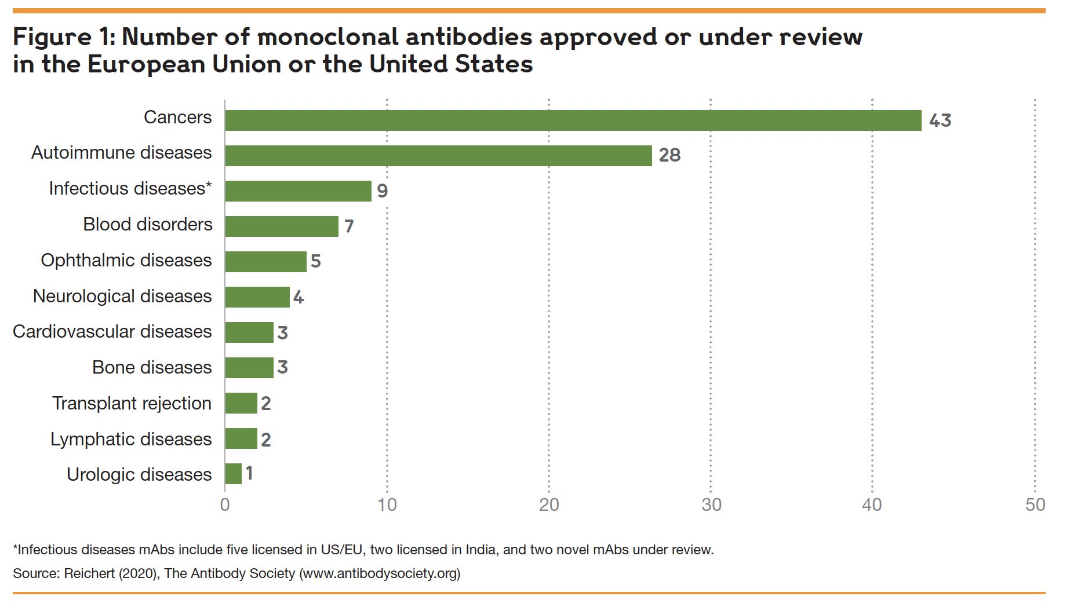
Source: Wellcome/IAVI, “Expanding Access to Monoclonal Antibody-based Products”

Slide 5
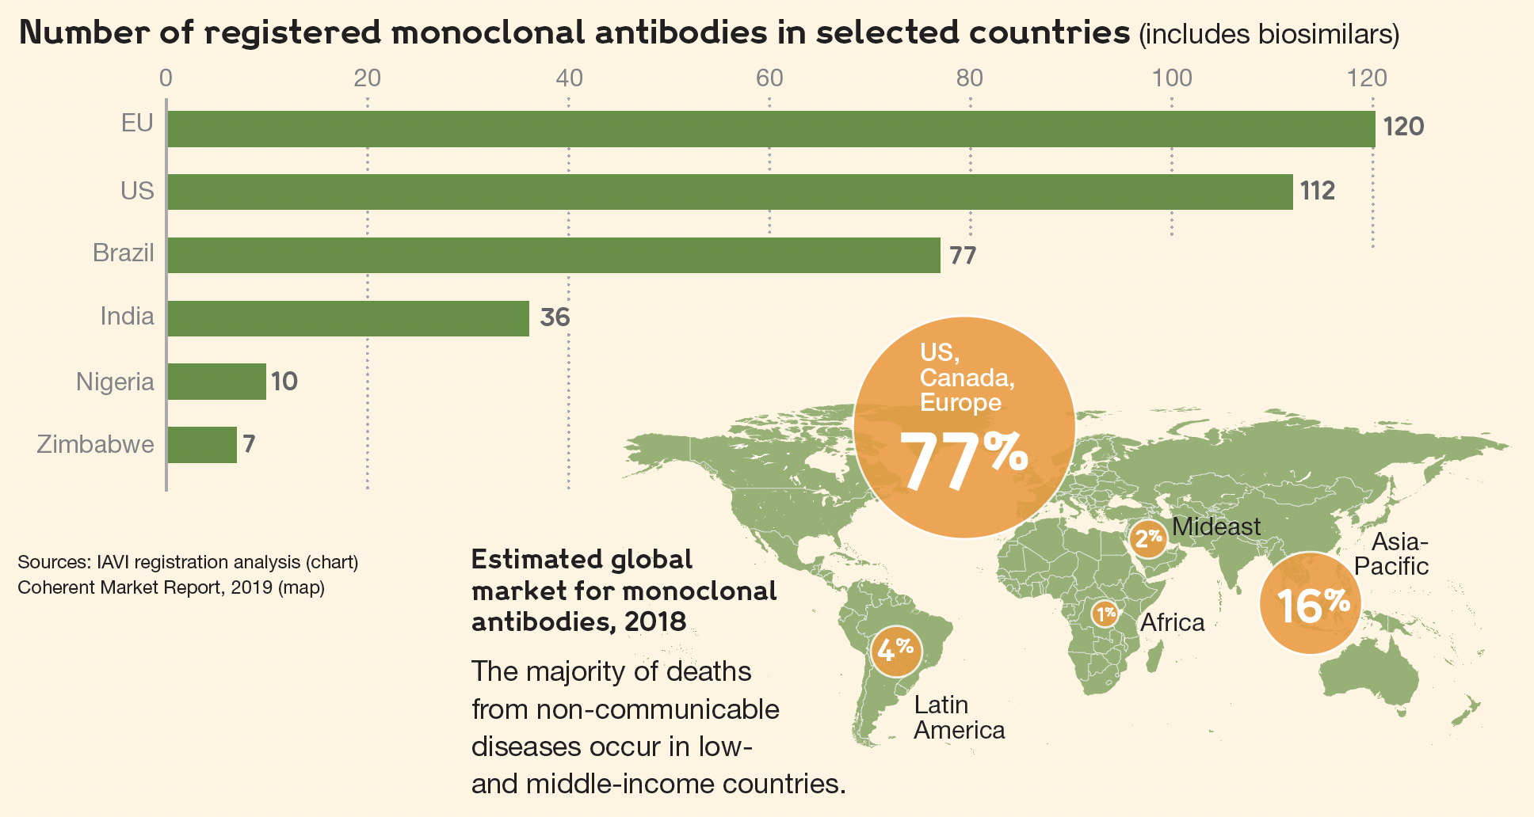
Source: Wellcome/IAVI, “Expanding Access to Monoclonal Antibody-based Products”

Slide 6
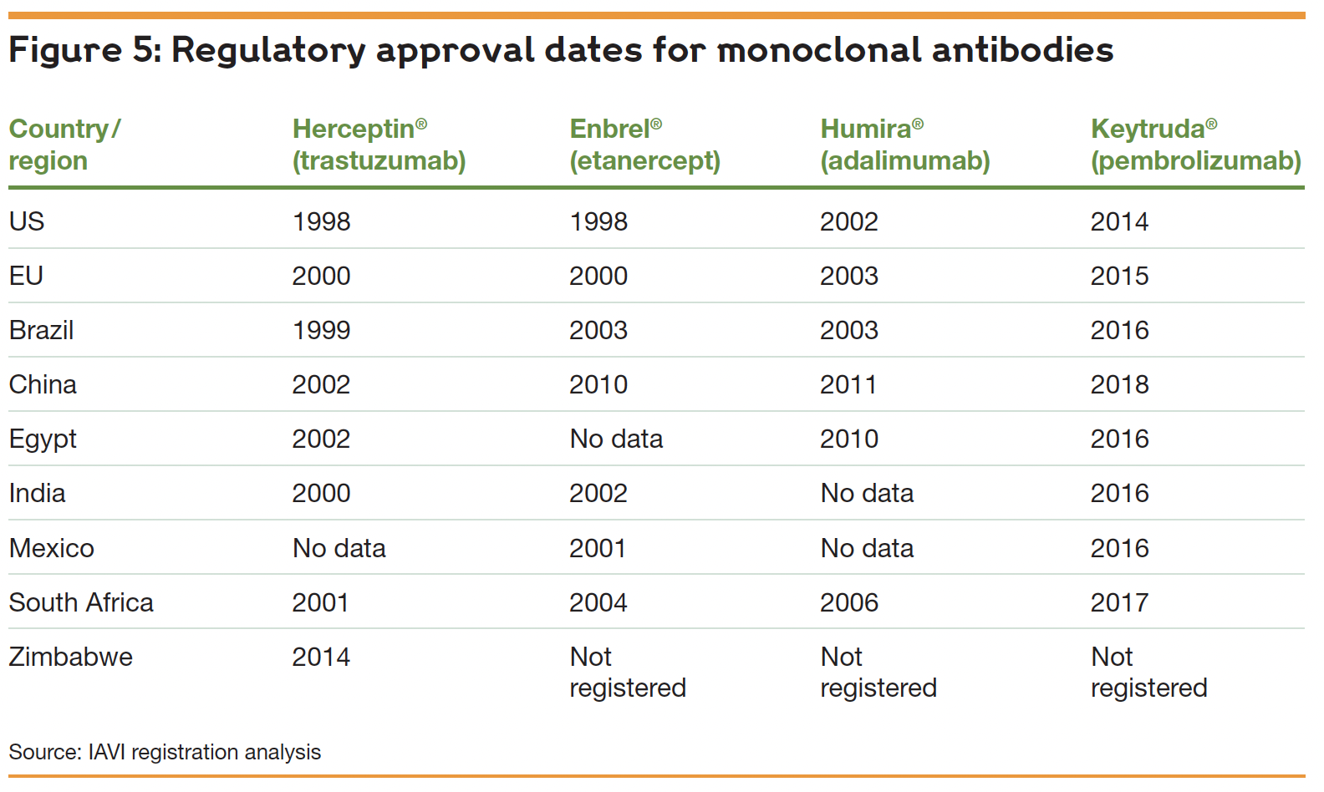
Source: Wellcome/IAVI, “Expanding Access to Monoclonal Antibody-based Products”

Slide 7
Commercial Production of Antibodies
“The traditional monoclonal antibody (mAb) production process usually starts with generation of mAb-producing cells (i.e. hybridomas) by fusing myeloma cells with desired antibody-producing splenocytes (e.g. B cells). These B cells are typically sourced from animals, usually mice. After cell fusion, large numbers of clones are screened and selected on the basis of antigen specificity and immunoglobulin class. Once candidate hybridoma cell lines are identified, each "hit” is confirmed, validated, and characterized using a variety of downstream functional assays. Upon completion, the clones are scaled up where additional downstream bioprocesses occur.”
Source: https://www.moleculardevices.com/applications/monoclonal-antibody-production

Slide 8
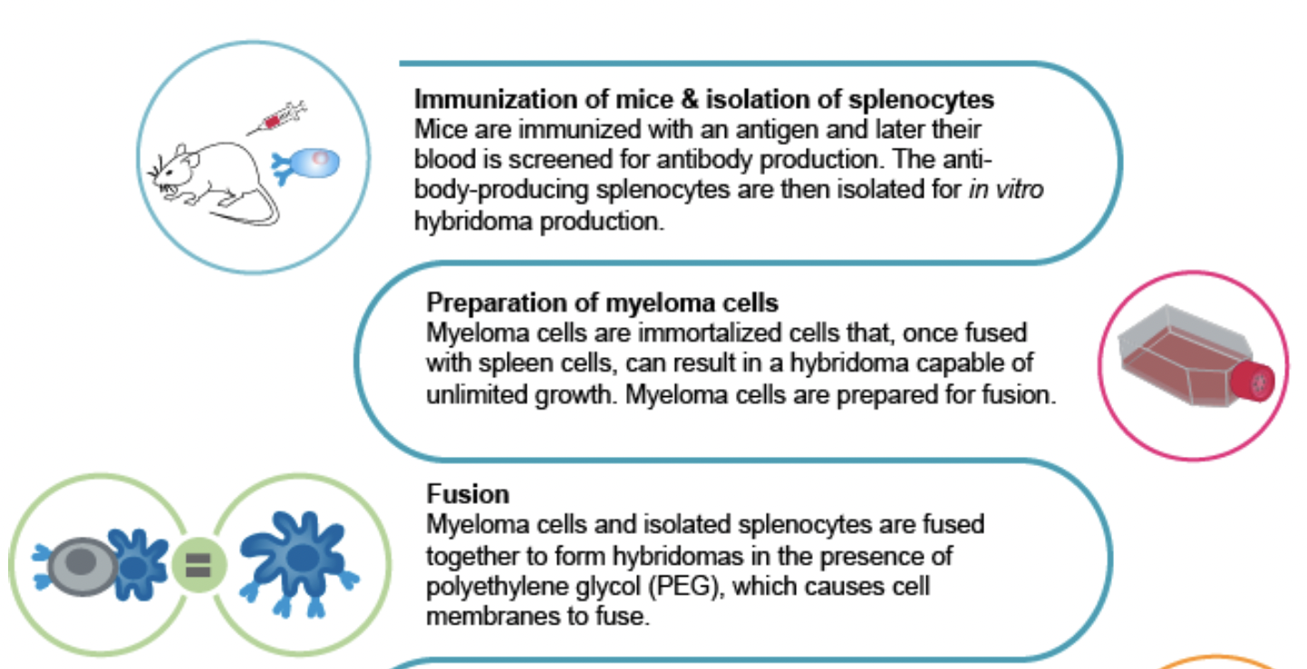
Commercial Production of Antibodies
Continued….

Slide 9
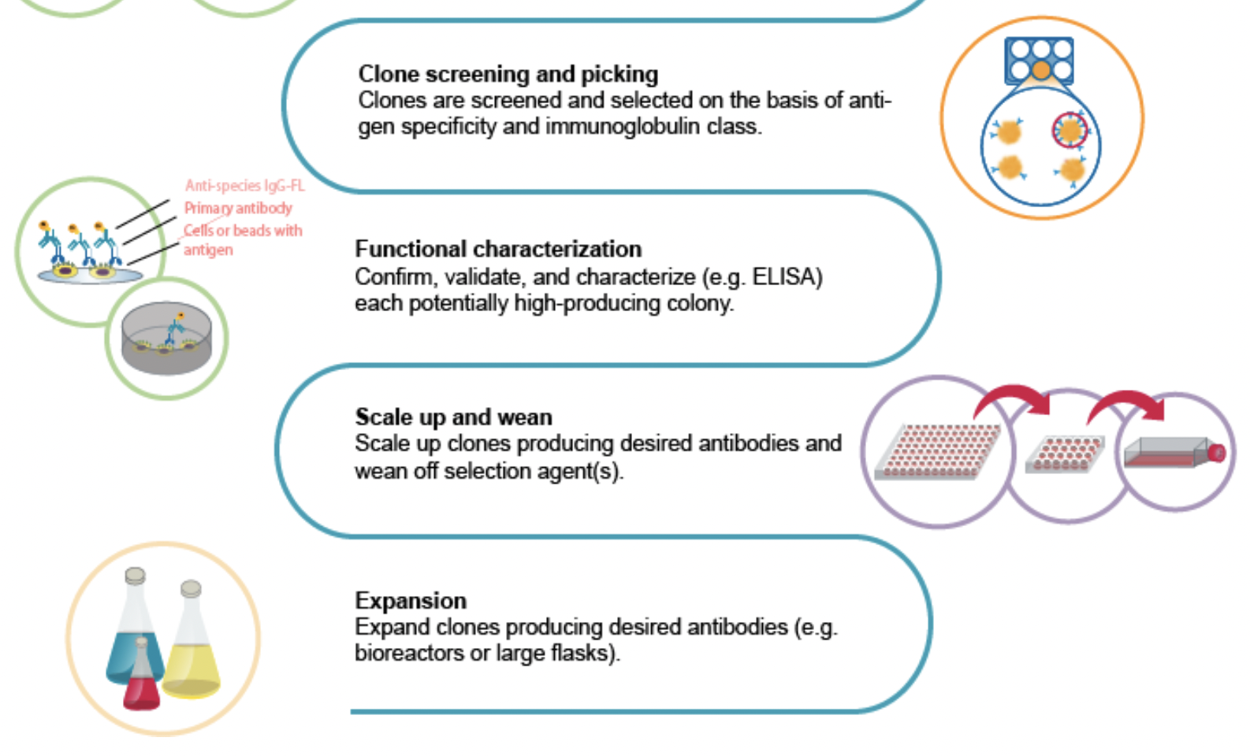

Slide 10
RSV

Slide 11
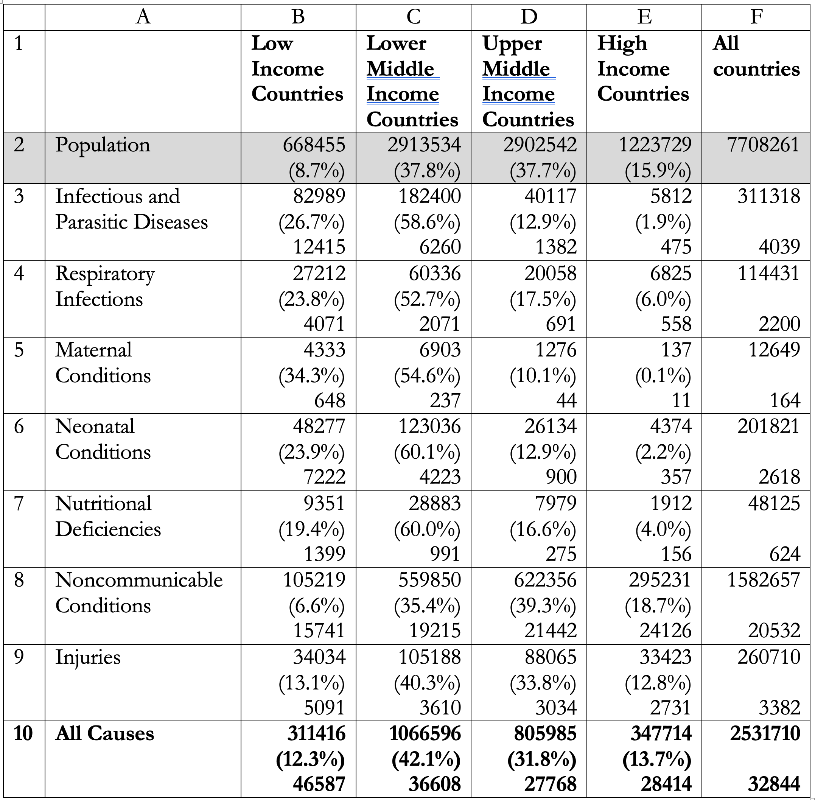
Mortality and Morbidity by Region and Cause (2019)
In each cell,
the first number represents the loss per year (in thousands of Disability Adjusted Life Years [DALYs]) attributable to the cause;
the second number is the proportion of the global burden associated with the cause borne by the region;
the third number is the number of DALYs lost per 100,000 people in the region

Slide 12
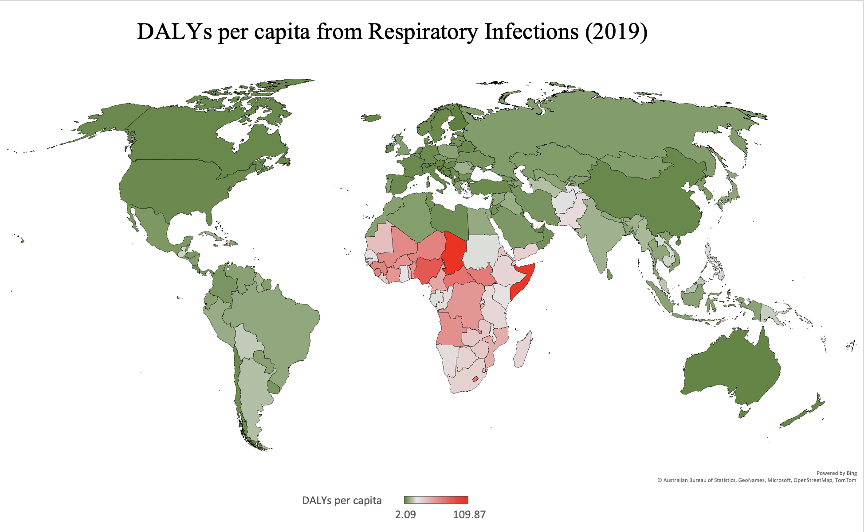

Slide 13
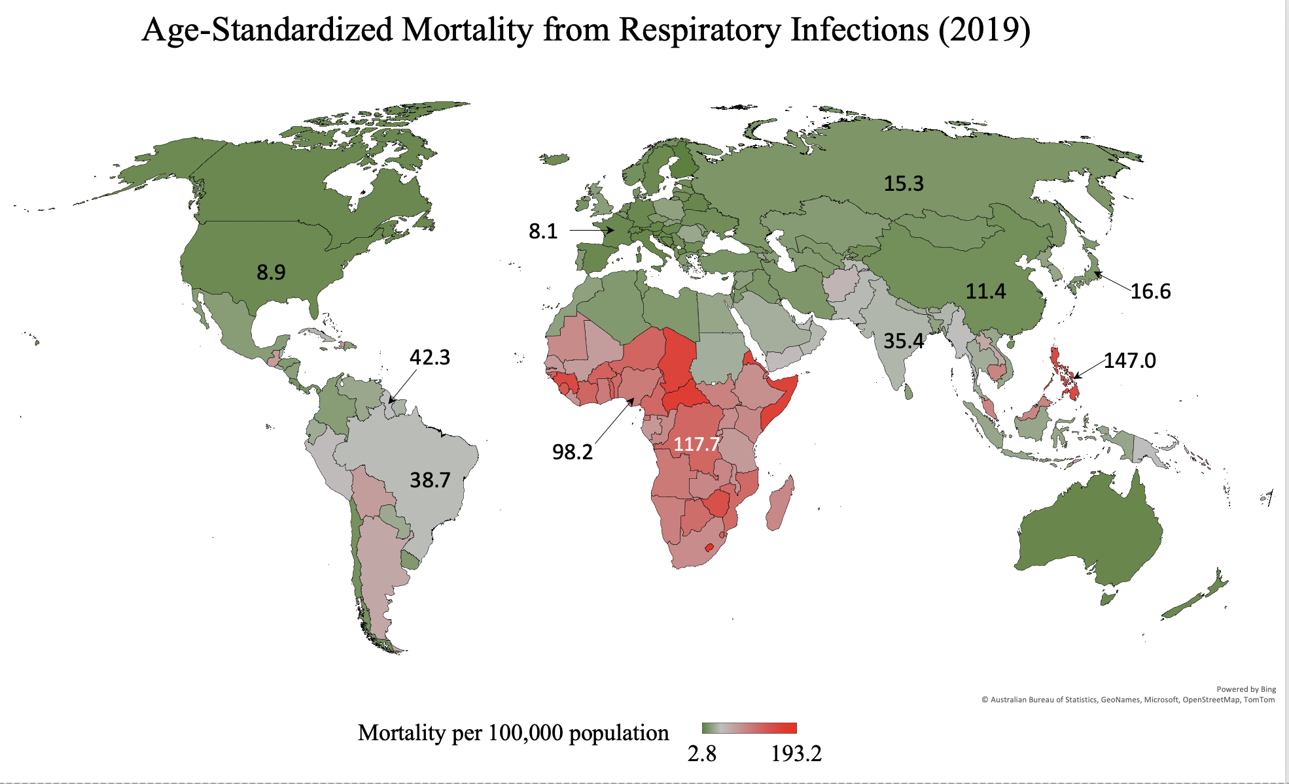

Slide 14
RSV
“Respiratory syncytial virus (RSV) is the leading cause of bronchiolitis and pneumonia in infants and represents around 60% of all lower respiratory tract infections in children younger than 5 years of age. RSV can also affect other vulnerable groups such as the elderly and immunocompromised patients. Globally, it is estimated that RSV causes about 34 million episodes of acute lower respiratory infections in children under the age of 5, representing approximately 3.4 million hospitalizations per year and about 66,000–199,000 deaths worldwide. In low middle–income countries, RSV represents the second cause of infant mortality, only after malaria….
“In the first year of life, approximately 70% of infants have been infected with RSV at least once, and seropositivity is approximately 100% by 2 years of age. High-risk groups for severe RSV infection are well defined, including children with prematurity, chronic lung disease and congenital heart disease (CHD). Vulnerable patients, such as children with Down syndrome and immunodeficiencies, are also at high risk. Nevertheless, previously healthy term infants under 3 months of age represent the largest group of hospitalized children with severe RSV infection.”
Source: Rodriguez-Fernandez et al., “Monoclonal Antibodies for Prevention of Respiratory Syncytial Virus Infection” (2019)

Slide 15
RSV
“The socioeconomic costs from paediatric RSV infection on family and workplace productivity are also high. Among working parents of infants < 1 year of age hospitalised for RSV studied in Canada, Finland, and the USA, mean absenteeism ranged from 49% to 73%, and mean overall work impairment ranged from 78% to 81% (Heikkinen et al 2017, Mitchell et al 2017, Pokrzywinski et al 2019).
“Controlling RSV disease in infants may have added benefits that may become apparent in the long term. Infant RSV LRTI has been associated with long-term respiratory morbidity (eg, wheezing, asthma, and impaired lung function in adult life). Long-term studies that have prospectively followed cohorts from infancy until childhood have suggested an association with increased incidence of subsequent wheezing episodes and/or development of asthma in subjects with a history of RSV bronchiolitis in infancy (Escobar et al 2013, Pérez-Yarza et al 2007, Romero et al 2010, Ruotsalainen et al 2010, Sigurs et al 2005). ”
Source: European Medicines Agency, “Nirsevimab Assessment Report,” September 15, 2022

Slide 16
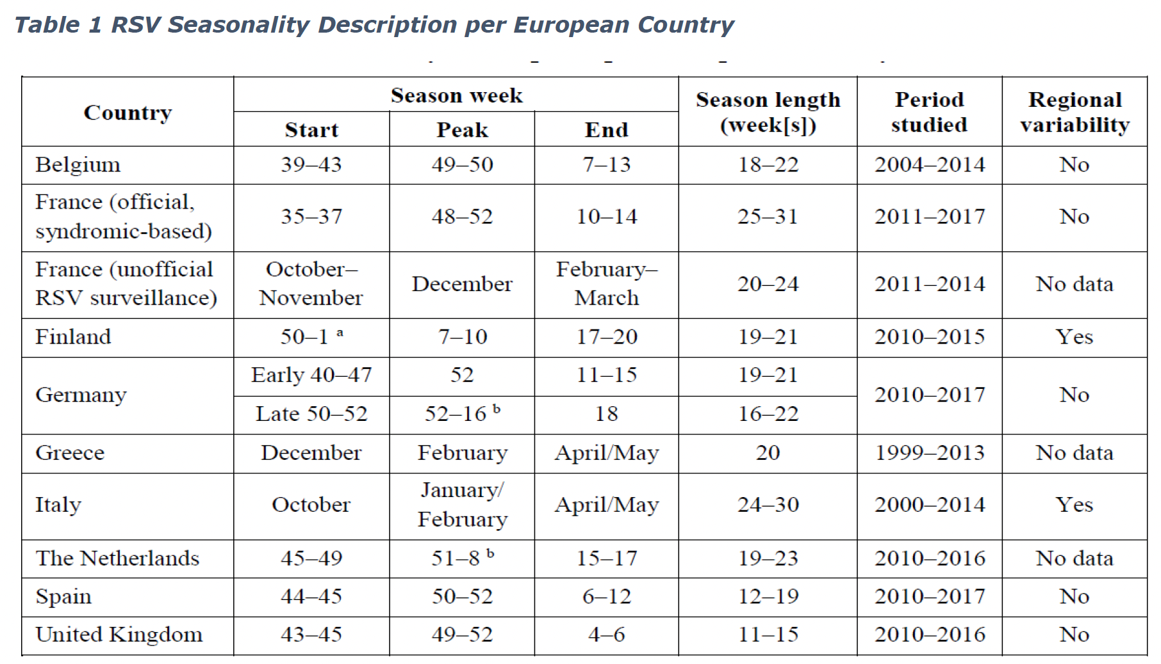
Source: European Medicines Agency, “Nirsevimab Assessment Report,” September 15, 2022

Slide 17
Nirsevimab

Slide 18
The Promise of Nirsevimab
“Respiratory syncytial virus (RSV) infection is a major cause of respiratory tract infections in infants and young children and remains the leading cause of hospitalization among those less than 1 year of age. On a global scale, it is estimated that 3.4 million infants develop severe RSV disease and that as many as 253,000 children under 5 years of age die from the infection every year. Decades of effort to develop a safe and effective active vaccine have been unsuccessful. Moreover, available treatment modalities are limited to supportive interventions, such as hydration, delivery of supplemental oxygen, and when necessary, invasive mechanical ventilation. Pharmacologic interventions aimed at preventing severe RSV infection using passive immunization have been more successful but, to date, are used only for disease prevention in very high-risk infants. Palivizumab, a humanized RSV monoclonal antibody has been the mainstay for infant RSV prevention among specific high-risk infants for more than two decades. While its efficacy is well established, its relatively short halflife requires that it be administered monthly during periods of exposure. New extended half-life monoclonal antibodies are now showing favourable results in clinical trials. One of these new investigational extended half-life monoclonal antibodies, nirsevimab, has already advanced to phase III clinical trials.”
Source: Domachowske, “Nirsevimab: An Extended Half-life Monoclonal Antibody for the Prevention of Infant Respiratory Syncytial Virus Infection” (2021)

Slide 19
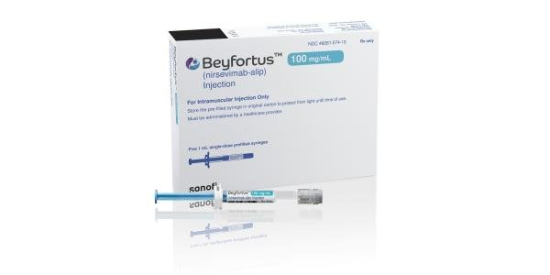
Nirsevimab
“Nirsevimab finished product is a sterile, preservative-free, liquid dosage form intended for intramuscular injection. It is supplied as a single-dose PFS without needle in two presentations: 50 mg in 0.5 mL or 100 mg in 1 mL of nirsevimab per PFS. The PFS is considered a medical device in accordance with the Medical Device Regulation (Regulation (EU) 2017/745) and a revised Notified Body Opinion (NBOp) on the device, confirming full compliance with the relevant general safety and performance requirements (GSPRs), has been provided. The CE marked needles are co-packaged or provided separately. ”
Source: European Medicines Agency, “Nirsevimab Assessment Report,” September 15, 2022

Slide 20
The Development of Nirsevimab
Question: When it came to finding a solution, what were the steps involved, and how difficult a challenge was it to address?
Response: “RSV prevention has been notoriously hard to achieve. Research began more than 60 years ago and until now options have been limited to infants identified to be at highest risk of developing severe illness from the virus. This has left a number of infants unprotected. Beyfortus’ [the trade name of Nirsevimab in the EU] approval as the first preventative option for a broad infant population is the culmination of an eight-year clinical trial program, including three pivotal studies. Following antibody development, we added our YTE technology to extend the half-life of Beyfortus so that it can help provide protection with a single dose for an entire RSV season,” said Tonya Villafana, vice president, global franchise head, infection, AstraZeneca.
Source: Jim Cornall, “In depth interview: AstraZeneca/Sanofi RSV drug Beyfortus,” Labiotech.eu, November 14, 2022

Slide 21
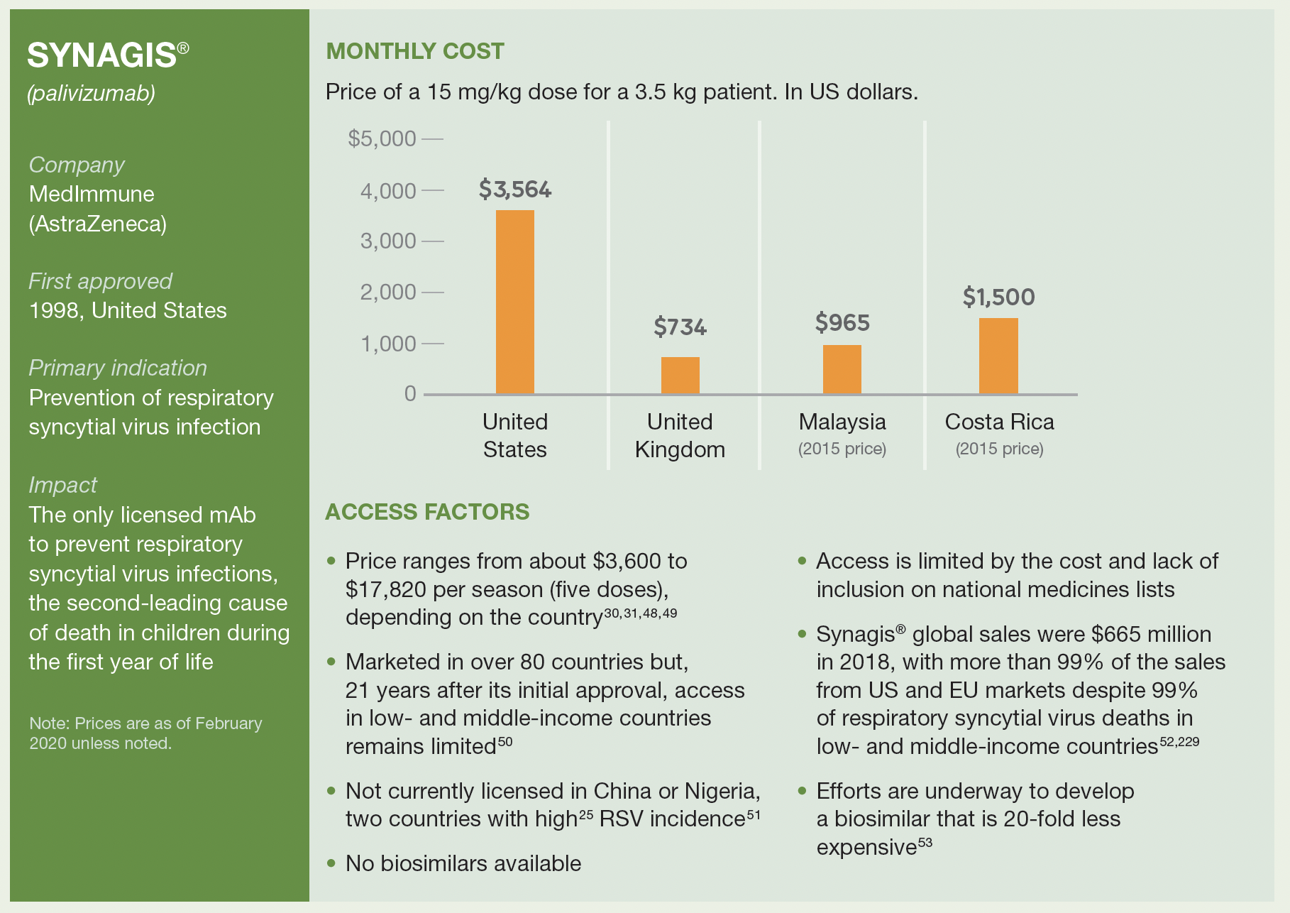
Current pricing of Palivizumab
Source: Wellcome/IAVI, “Expanding Access to Monoclonal Antibody-based Products”

Slide 22
Marketing Approvals
Most of the clinical trials for Nirsevimab are now complete
In October of 2022, Nirsevimab was approved for distribution in Europe (under the trade name of Beyfortus)
Further approvals were obtained in Great Britain in November 2022, and in Canada in April 2023
In July 2023, The U.S. Food and Drug Administration (FDA) approved AstraZeneca’s (in collaboration with Sanofi) Nirsevimab (under the trade name of Beyfortus)
January 2, 2024: Marketing approval in China

Slide 23
Distribution
2022 Interview:
Question: Following its approval in the United States, Europe, and other countries, how will it be rolled out (and when)? And will it reach those in most need?
Response: Sanofi and AstraZeneca said they are targeting the 2023/2024 season for a product launch and availability. As European national authorities determine their recommendations, we look forward to working with them to secure the right level of access and ensure the medical community is ready for the implementation of Beyfortus.
“We have seen the recent spikes in RSV cases around the world, including in the United States, which underscore the need for a preventative option against of RSV in infants. We are dedicated to working as quickly as we can to reduce the impact of severe RSV disease and continue to participate in discussions with healthcare authorities and are currently targeting launches in 2023,” the companies said.
Source: Jim Cornall, “In depth interview: AstraZeneca/Sanofi RSV drug Beyfortus,” Labiotech.eu, November 14, 2022

Slide 24
Distribution
2023:
A surge in RSV infections in the US in the fall of 2023 prompted the CDC to recommend reserving the scarce supply of Beyfortus for use on high-risk infants
In January 2024, an increase in the supply of Beyfortus in the US prompted the CDC revised its guidance:
  “On October 23, 2023, the Centers for Disease Control and Prevention (CDC) issued Health Alert Network (HAN) Health Advisory 499 to provide guidance for prioritization of nirsevimab given limited supply. Nirsevimab (Beyfortus, Sanofi and AstraZeneca) is a long-acting monoclonal antibody immunization recommended for preventing RSV-associated lower respiratory tract disease in young children. Given the recent increase in nirsevimab supply and the manufacturers’ plan to release an additional 230,000 doses in January, CDC advises healthcare providers to return to recommendations put forward by CDC and the Advisory Committee on Immunization Practices (ACIP) on use of nirsevimab in young children. Infants and children recommended to receive nirsevimab should be immunized as quickly as possible. Healthcare providers should not reserve nirsevimab doses for infants born later in the season when RSV circulation and risk for exposure to RSV may be lower. RSV activity remains elevated nationwide and is continuing to increase in many parts of the country, though decreased activity has been observed in the Southeast.” Source: https://emergency.cdc.gov/newsletters/coca/2024/010524a.html

Slide 25
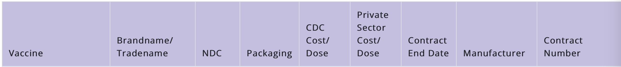
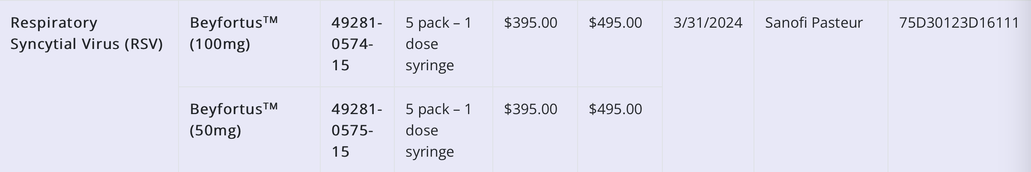
CDC Vaccine Price List
March 6, 2024

Slide 26
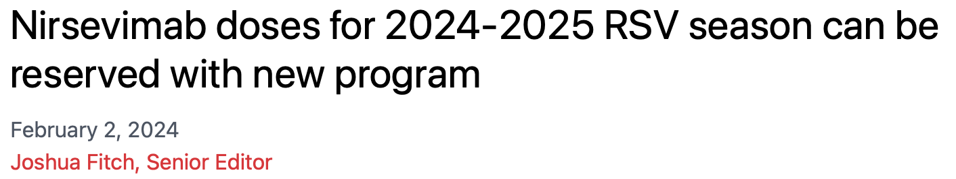
“Sanofi and its manufacturing partner AstraZeneca are exploring ways to make nirsevimab (Beyfortus) 50 mg and 100 mg doses for the prevention of respiratory syncytial virus (RSV) readily available for the 2024 to 2025 RSV season.
“In these efforts, the companies have created the Beyfortus Reservation Program, which, according to the manufacturers, "provides critical insight on customer demand and allows for prioritized fulfillment of requests placed through this program. It offers providers flexibility in scheduling shipments and the ability to cancel orders within terms."
“According to a press release, Sanofi stated, "Currently, insurance coverage is in place for nearly 100% of infant lives in the US. To help facilitate ongoing access to available doses for eligible babies, Sanofi continues to work closely with providers in the private market and the Vaccines for Children (VFC) program to best support the communities they serve. Nearly 40% of eligible babies could have the ability to be immunized against RSV with [nirsevimab] this RSV season.”
Source: https://www.contemporarypediatrics.com/view/nirsevimab-doses-for-2024-2025-rsv-season-can-be-reserved-with-new-program

Slide 27
Negotiation Exercise

Slide 28
The following parties will attempt to negotiate a voluntary license designed to increase the availability of Nirsevimab in South Africa and in other low and middle-income countries:
AstraZeneca, which holds the intellectual-property rights and proprietary know-how to Nirsevimab
Aspen Pharmacare, a manufacturer of pharmaceutical products based in South Africa, which is capable of producing Nirsevimab
The Government of South Africa, which includes:
  The South African Health Products Regulatory Authority (SAHPRA), whose approval is essential to the marketing of Nirsevimab; and
  The South African Department of Health, which purchases and distributes pharmaceutical products to the public-health sector, which serves approximately 85% of the population
The Gates Foundation, a potential source of supplemental funding

Slide 29
Procedure
Seminar participants will be divided randomly into four groups, each of which will represent one of the parties to the negotiation
AstraZeneca
  Hannah Bablak, Matthew, Jihoo, Rebekah, Brian
Aspen Pharmacare
  Grace, Zazie, Alice, Julian, Tyler
The Government of South Africa
  Hannah Chi, Namanjaya, Renae, Annie
The Gates Foundation
  Yanni, Tatiana, Hansel, Hoi Kiu

Slide 30
Procedure
6:15-6:30: Participants will read the materials individually
6:30-7:00: Each of the four groups will meet to discuss the interests and negotiating strategy of the party that the group represents – and to select a spokesperson
7:10-7:40: The four groups will then reconvene for a plenary negotiation, in which the four spokespersons (assisted by the other members of their respective groups) attempt to craft a mutually acceptable voluntary license for Nirsevimab, aimed at low and middle-income countries
7:40-8:00: The instructor and the participants will debrief the negotiation

Slide 31
Assumptions
For the purpose of this exercise, all participants should assume the following:
No other mAbs or vaccine targeting RSV will be available for distribution in LMICs for at least 10 years
The patents held by AstraZeneca on Nirsevimab will not expire for at least 10 years – and would survive challenges to their validity
The standard dose for Nirsevimab (which will last for one season) is 100 milligrams. (Unusually small infants receive half that dose.)
The Cost of Goods to produce Nirsevimab at large scale is approximately $100 per gram
  More specifically, $100/gram would be the cost of goods using a continuous manufacturing process (rather than a “batch” process) to produce roughly 150 kg (i.e., 1,500,000 doses) per year
  Thus, at that scale, the cost of producing each dose would be approximately $10
  Because of substantial fixed costs, the cost of goods would rise if the volume produced were smaller
The price of a dose of Nirsevimab is projected to be $300 in Europe and $500 in the United States, starting in 2023
  However, if AstraZeneca matches the price of Palivizumab, the price of Nirsevimab in the United States may be substantially higher

Slide 32
The issues that the negotiators should seek to address include:
The royalty rate
Whether the license is exclusive or nonexclusive
Provisions, if any, governing the pace of the regulatory approval process in South Africa
The territorial scope of the license (i.e., the countries or regions in which Aspen could sell the licensed product)
Mechanisms of controlling the price of the licensed products
Possible provisions for tiered pricing
Mechanisms for transferring technology from AstraZeneca to Aspen
Mechanisms for preventing the public disclosure of proprietary know-how
Whether the license is dependent upon either patent protection or data-exclusivity protection for Nirsevimab in any of the relevant jurisdictions
Legal rights to any improvements on the product (or the manufacturing process) made by Aspen
Terms of any Advanced Market Commitments by South Africa (or other countries)
Amount, terms, and conditions of Gates’ financial contributions
Milestones for Gates’ contributions
Grounds for termination of the license

Slide 33
Additional Information concerning the Parties to the Negotiation

Slide 34
AstraZeneca

Slide 35
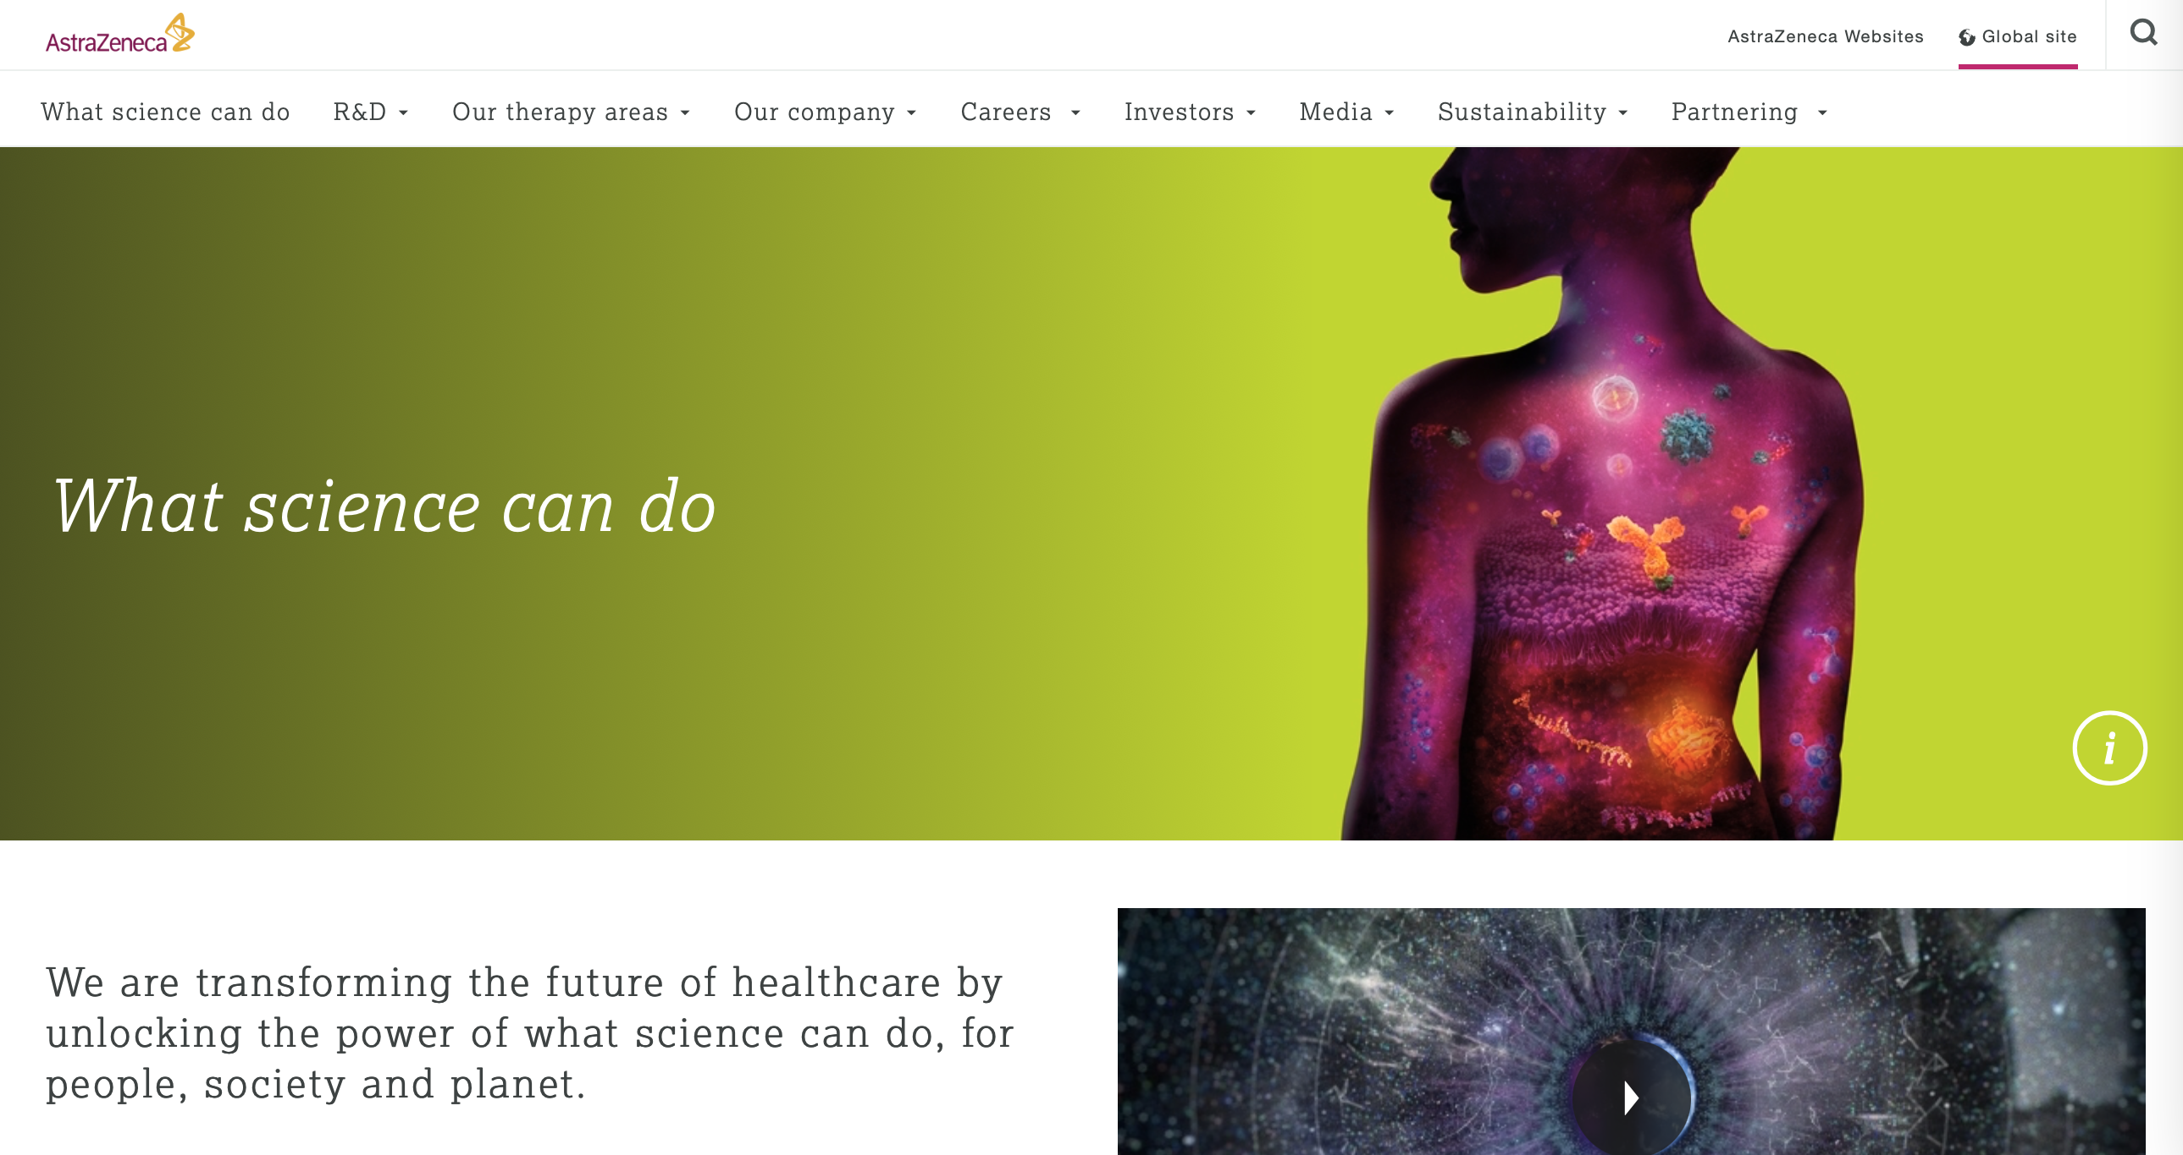

Slide 36
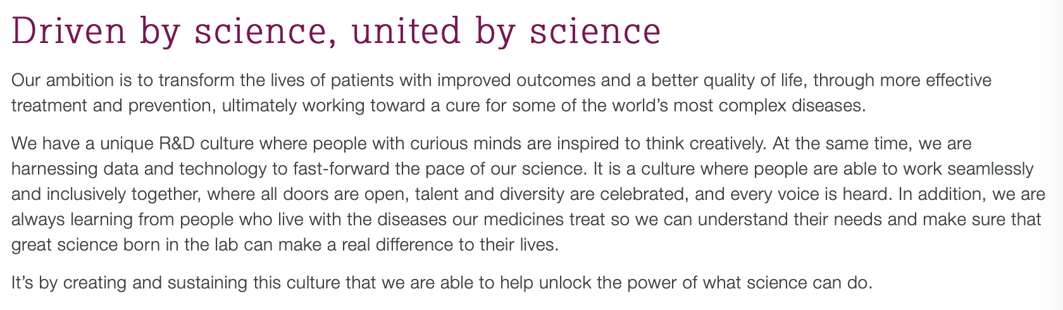

Slide 37
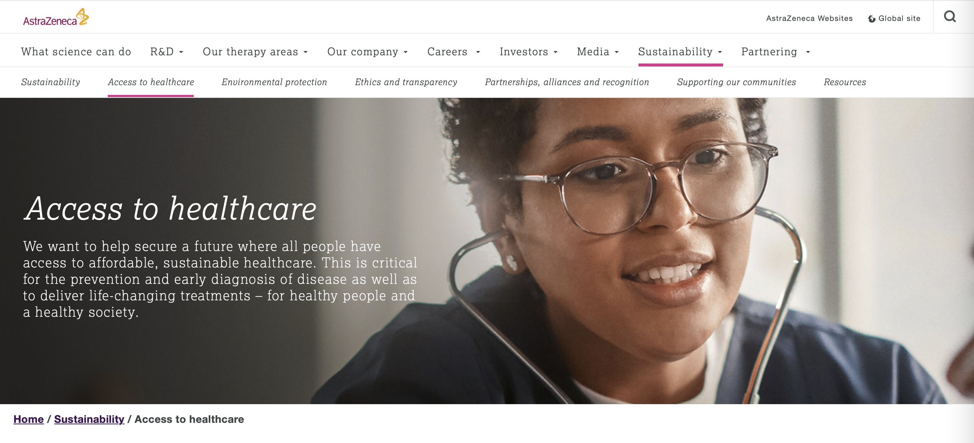
AstraZeneca’s “Affordability Statement” is available at:
https://www.astrazeneca.com/content/dam/az/PDF/Sustainability/Affordability_statement.pdf

Slide 38
Aspen

Slide 39
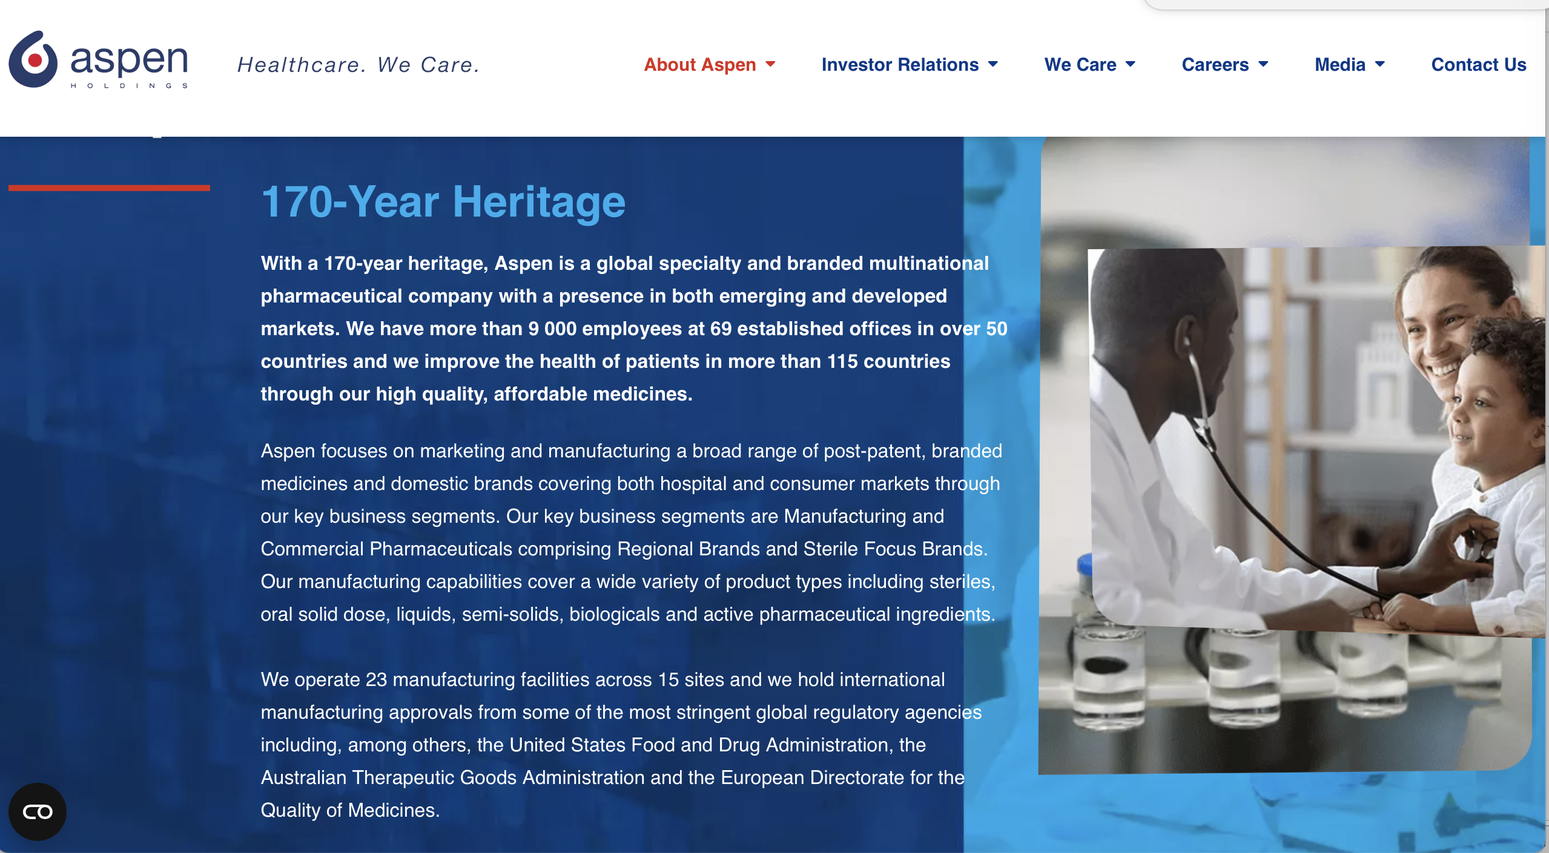

Slide 40
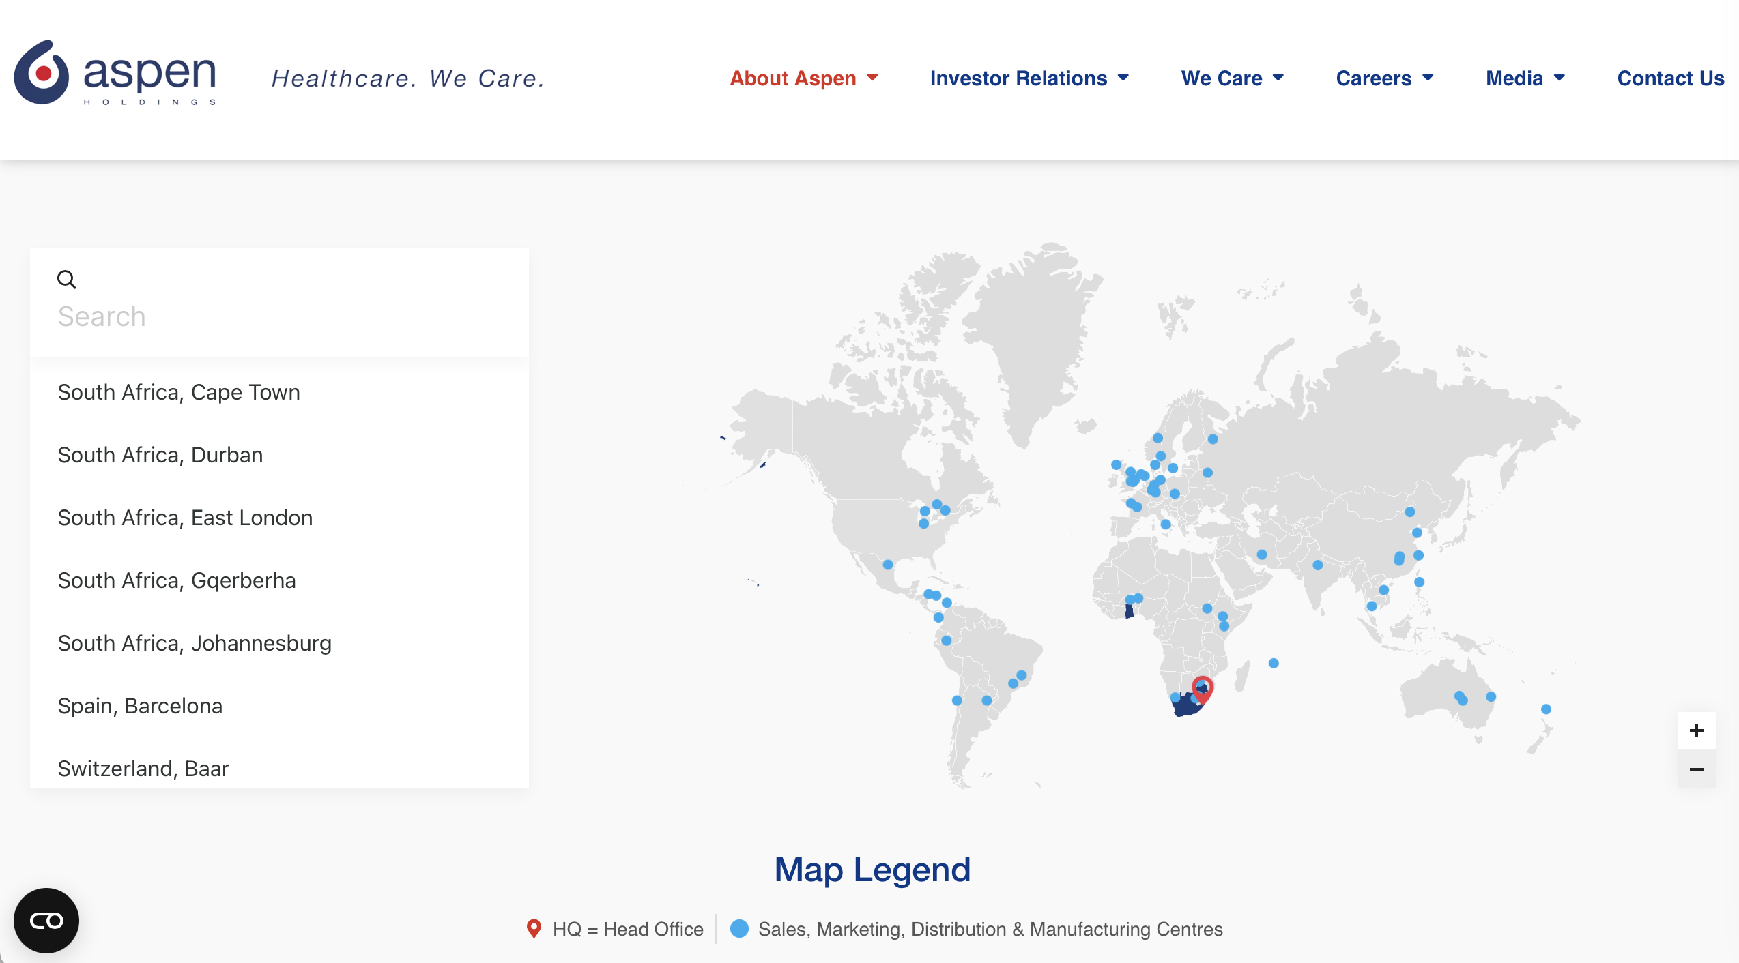

Slide 41
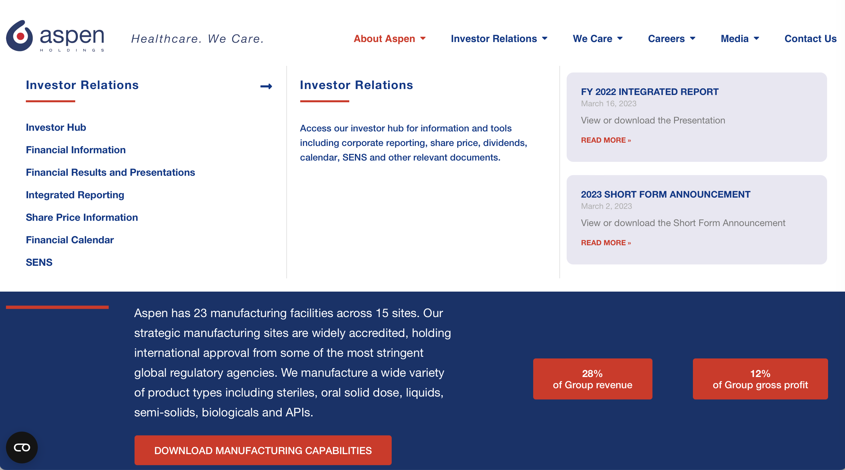

Slide 42
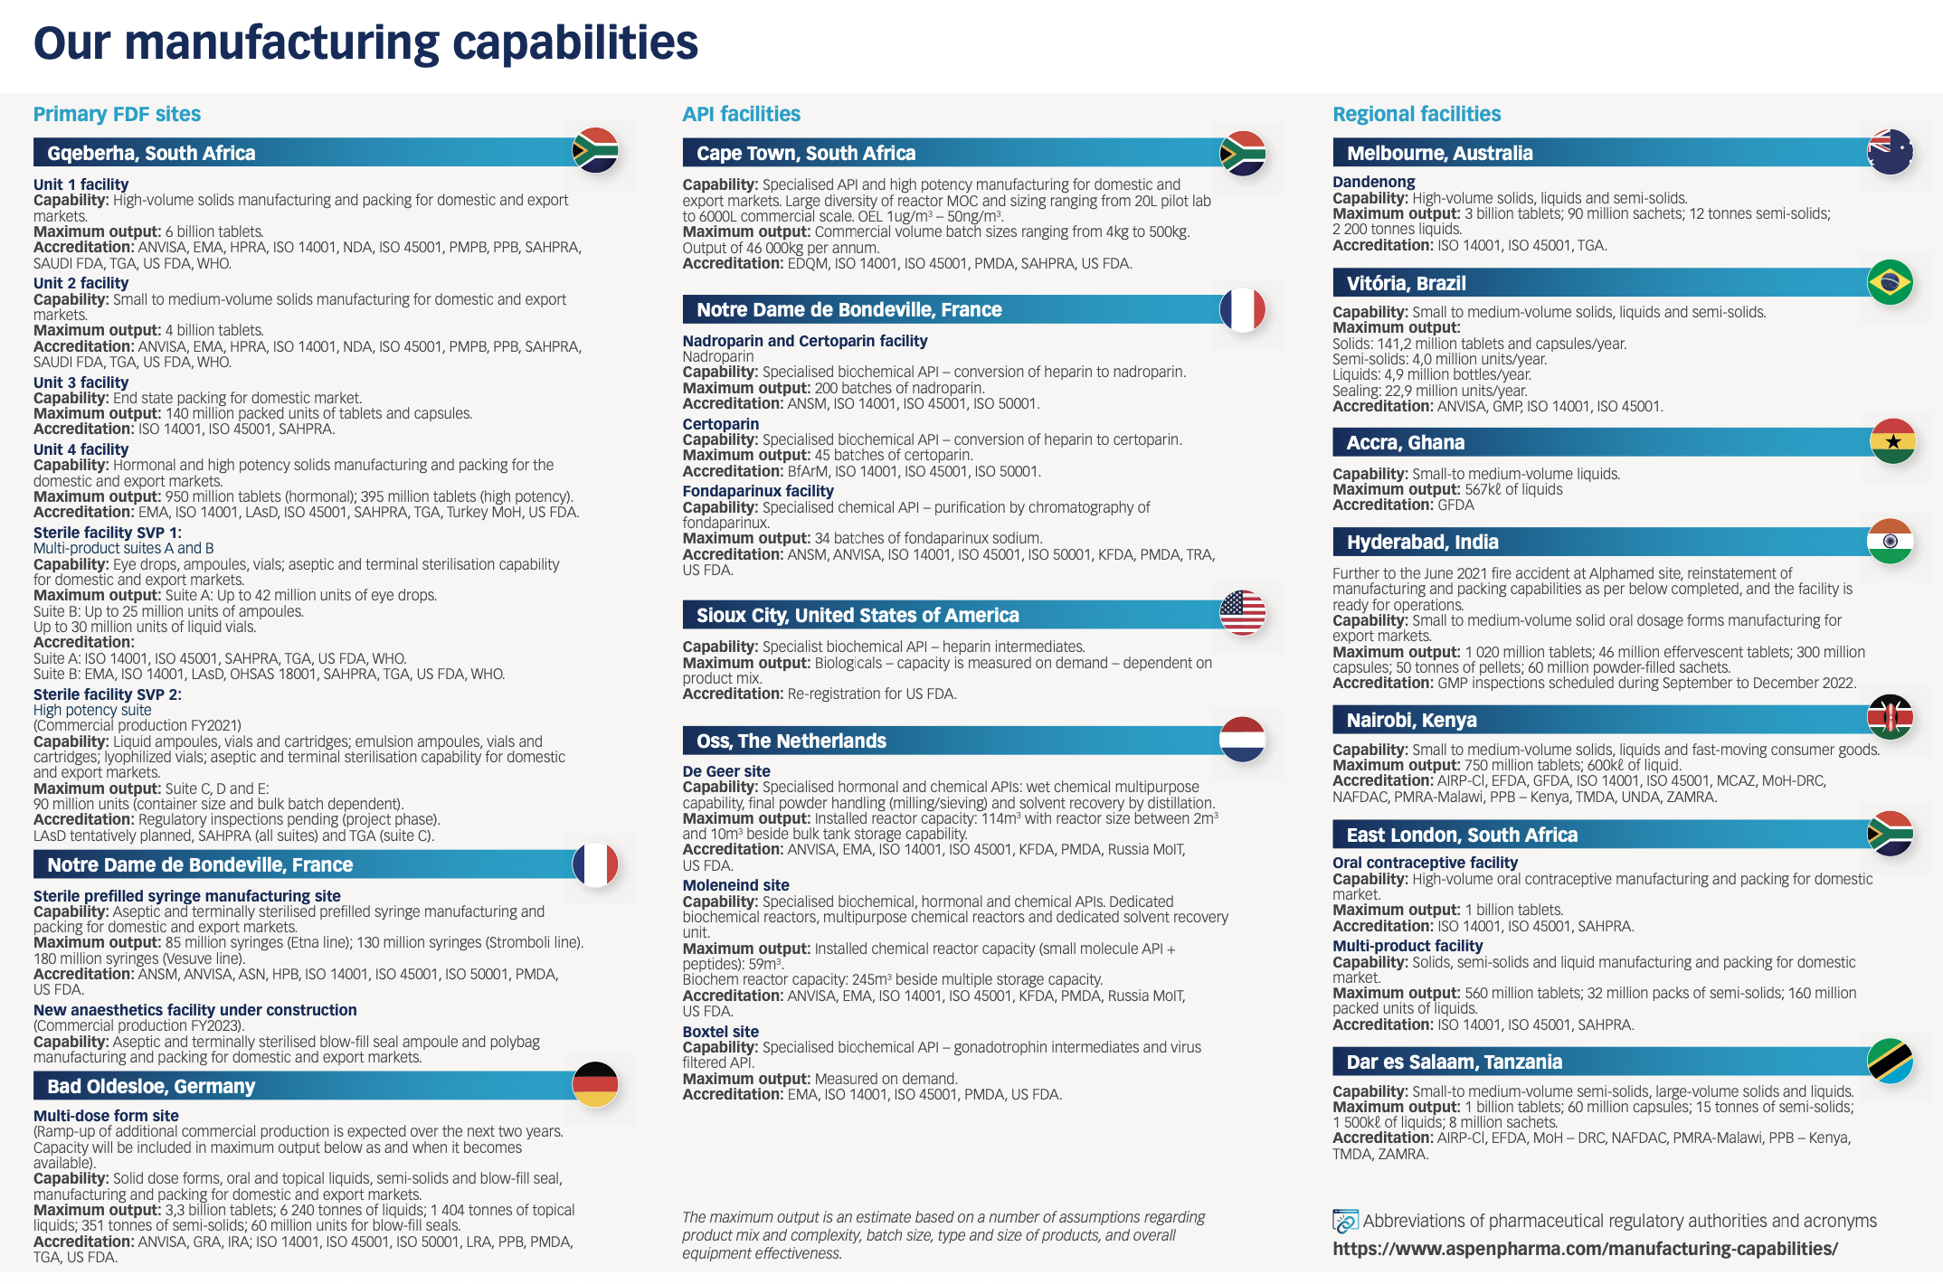

Slide 43
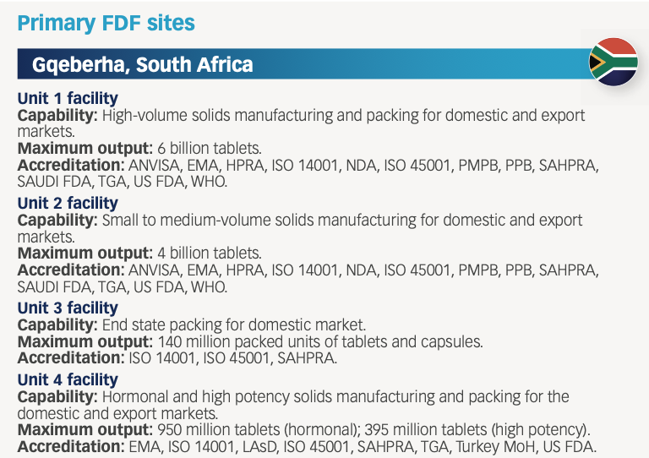
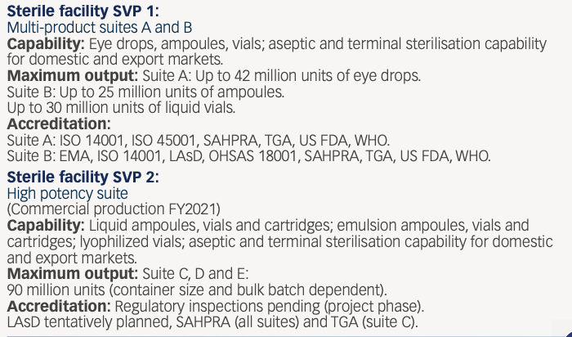

Slide 44
The Government of South Africa

Slide 45
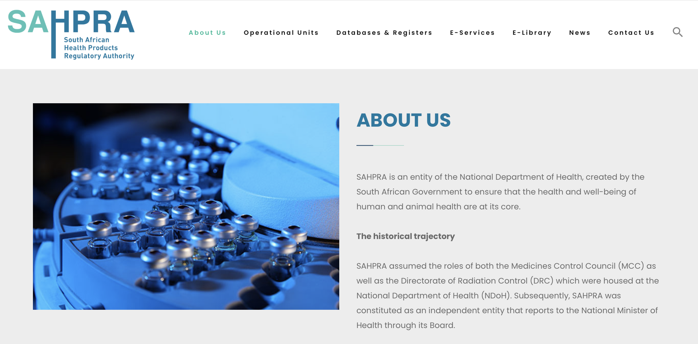

Slide 46
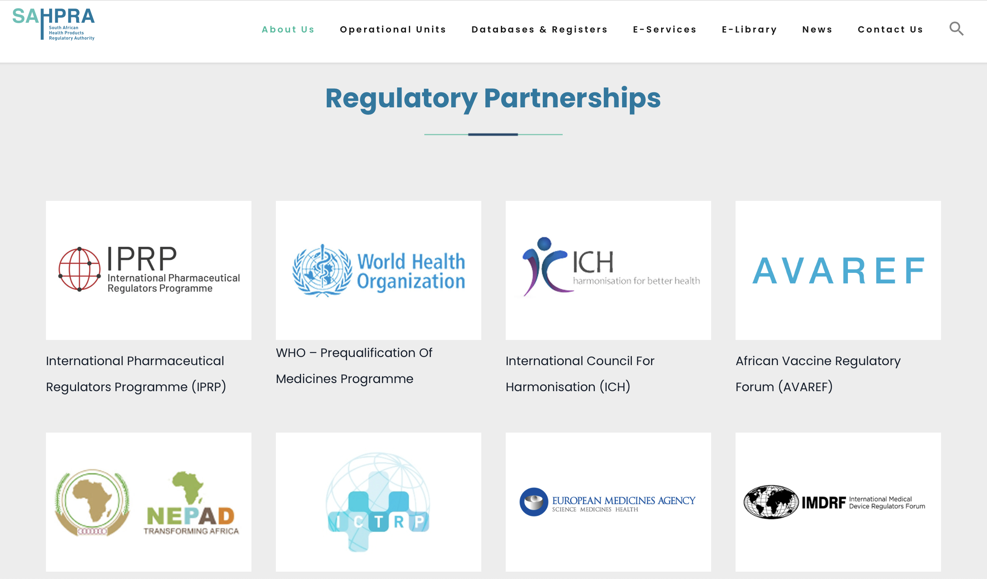

Slide 47
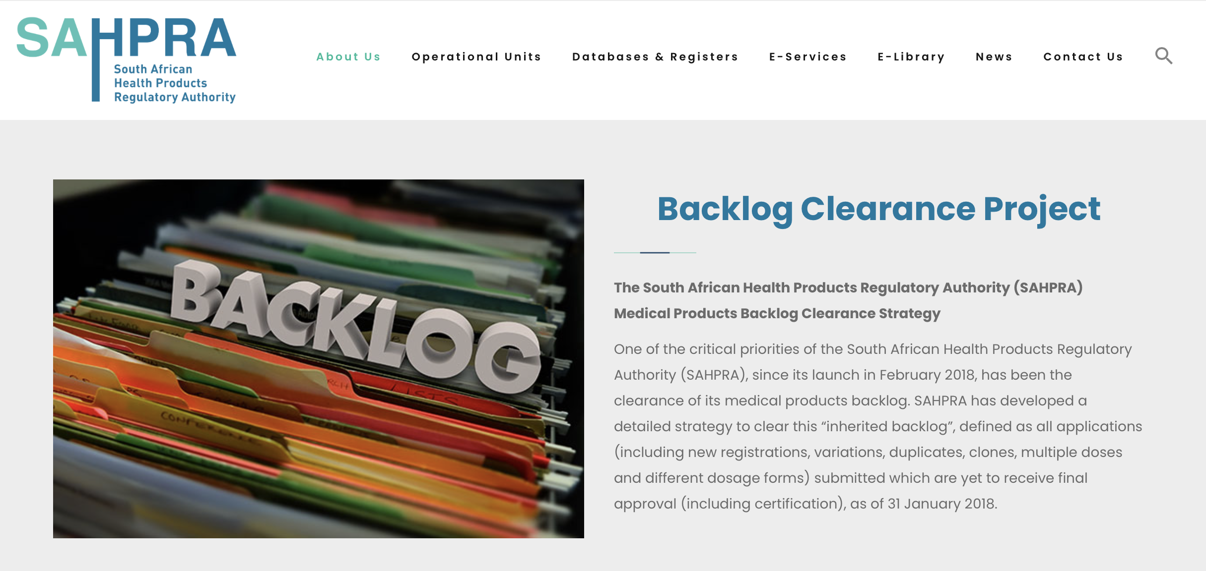

Slide 48
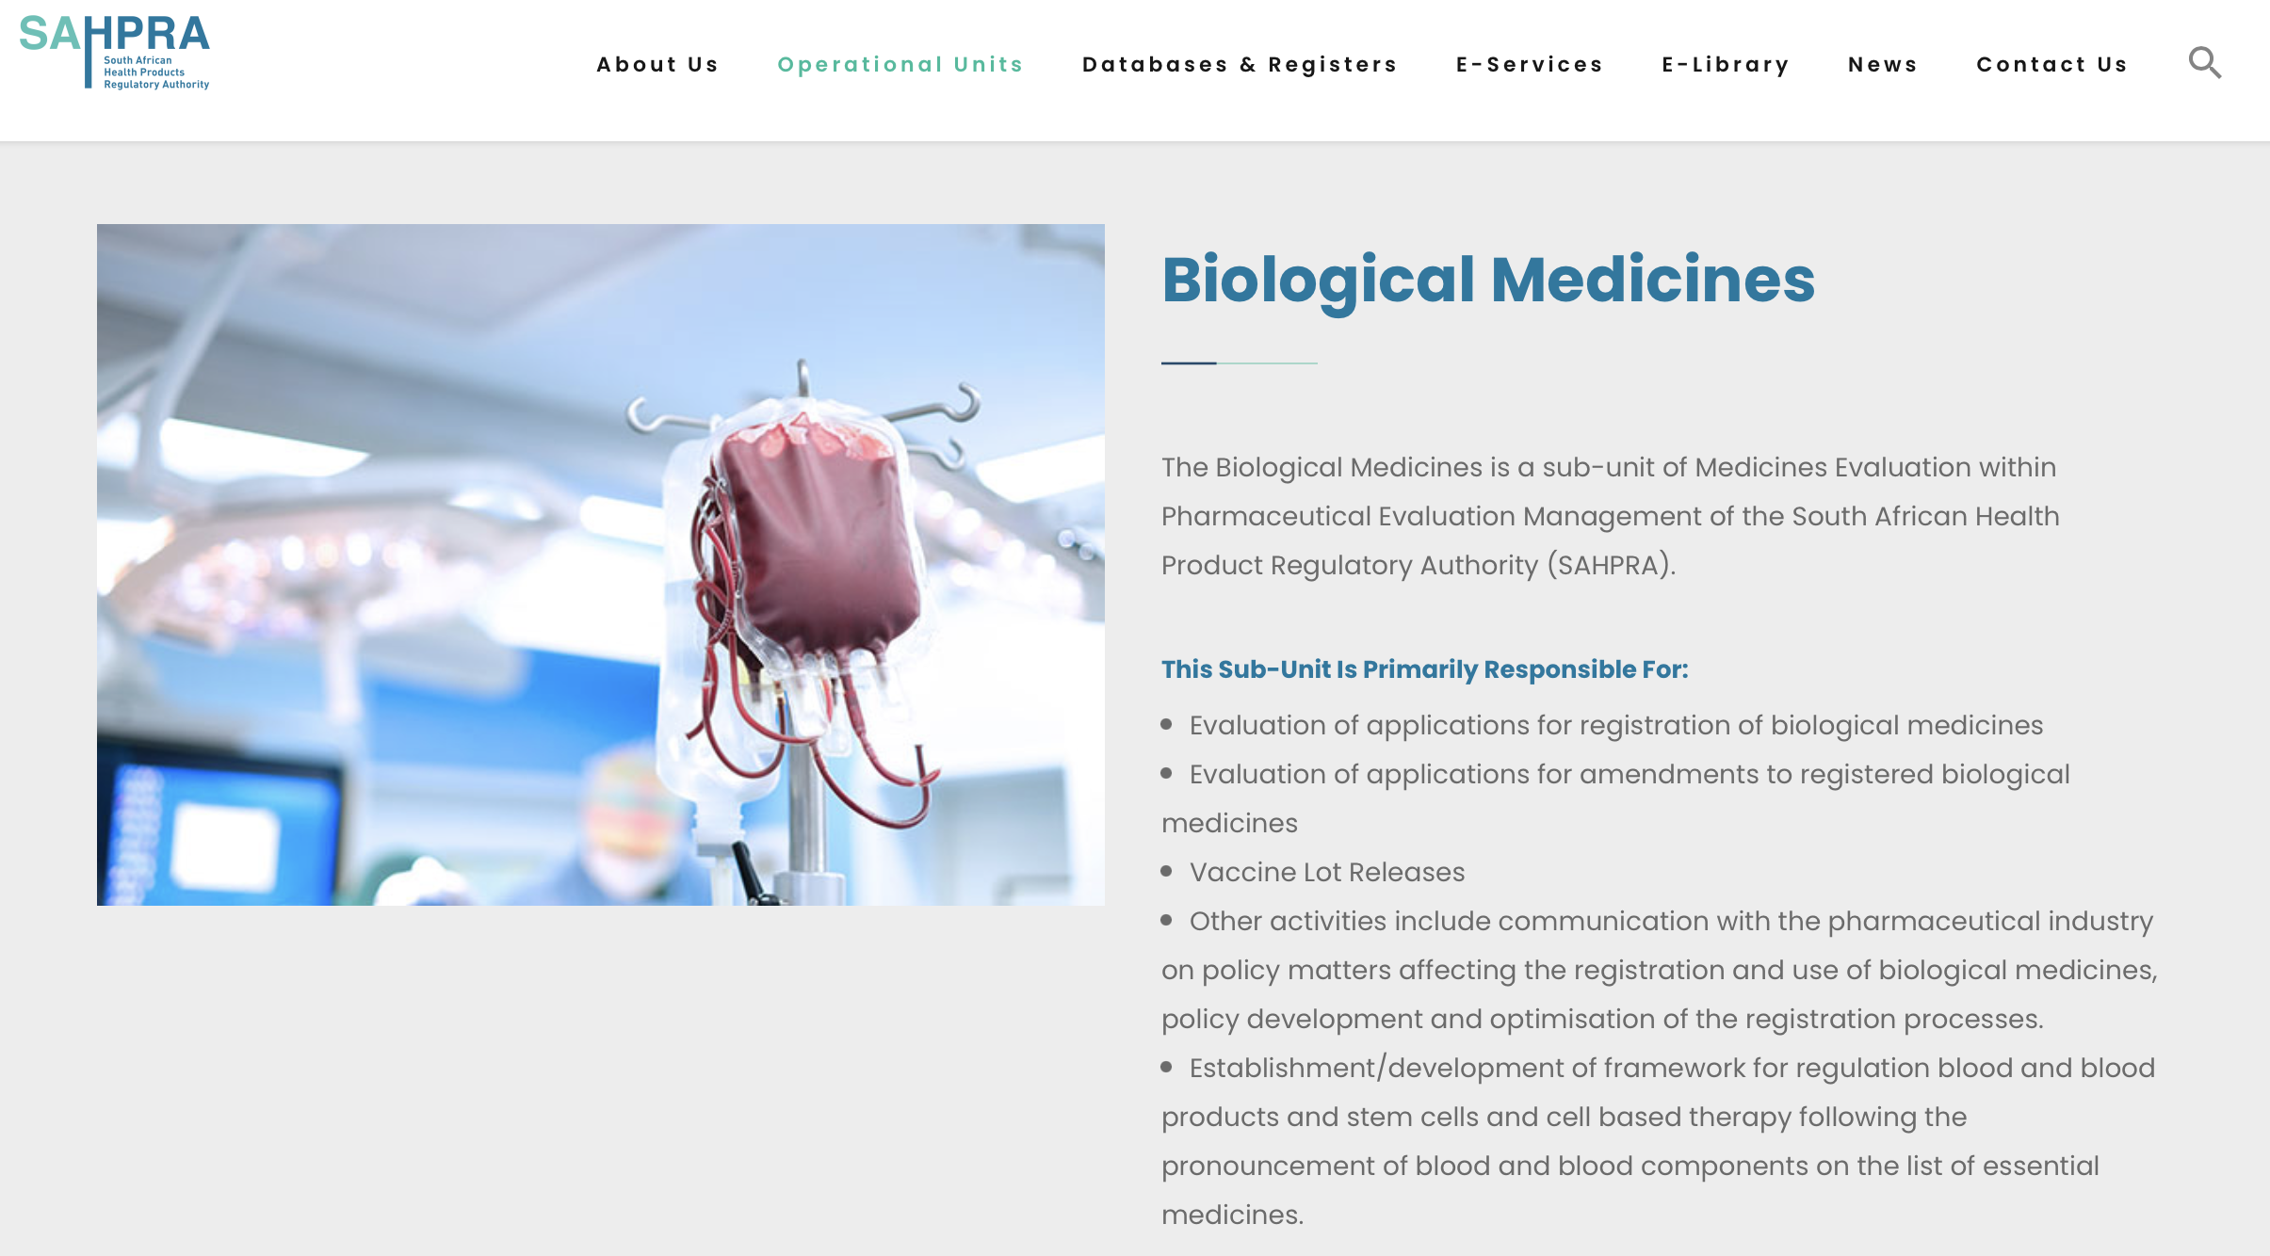

Slide 49
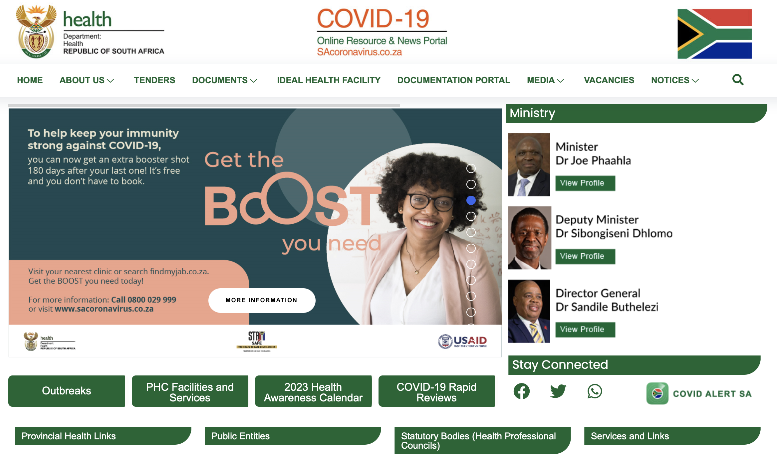

Slide 50
The Gates Foundation

Slide 51
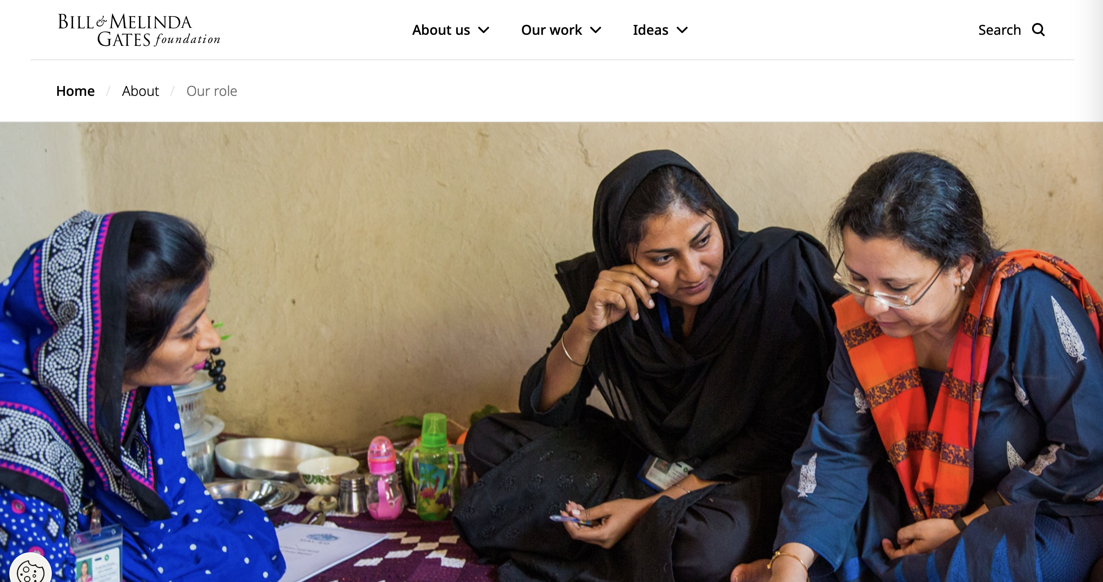

Slide 52
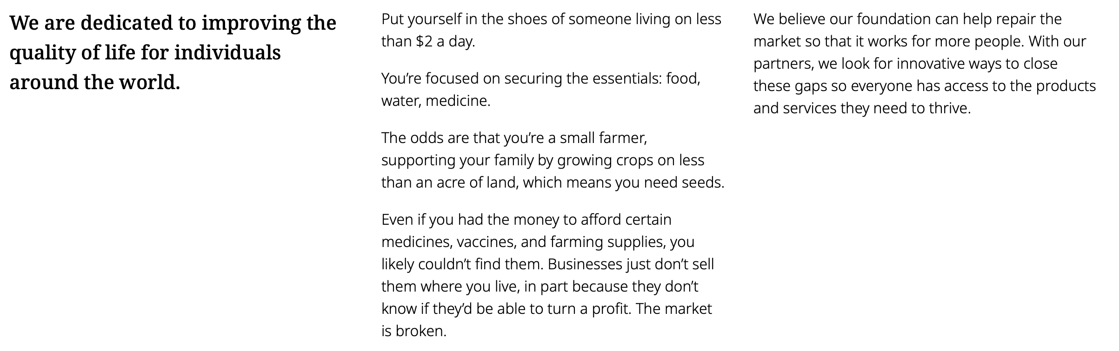

Slide 53
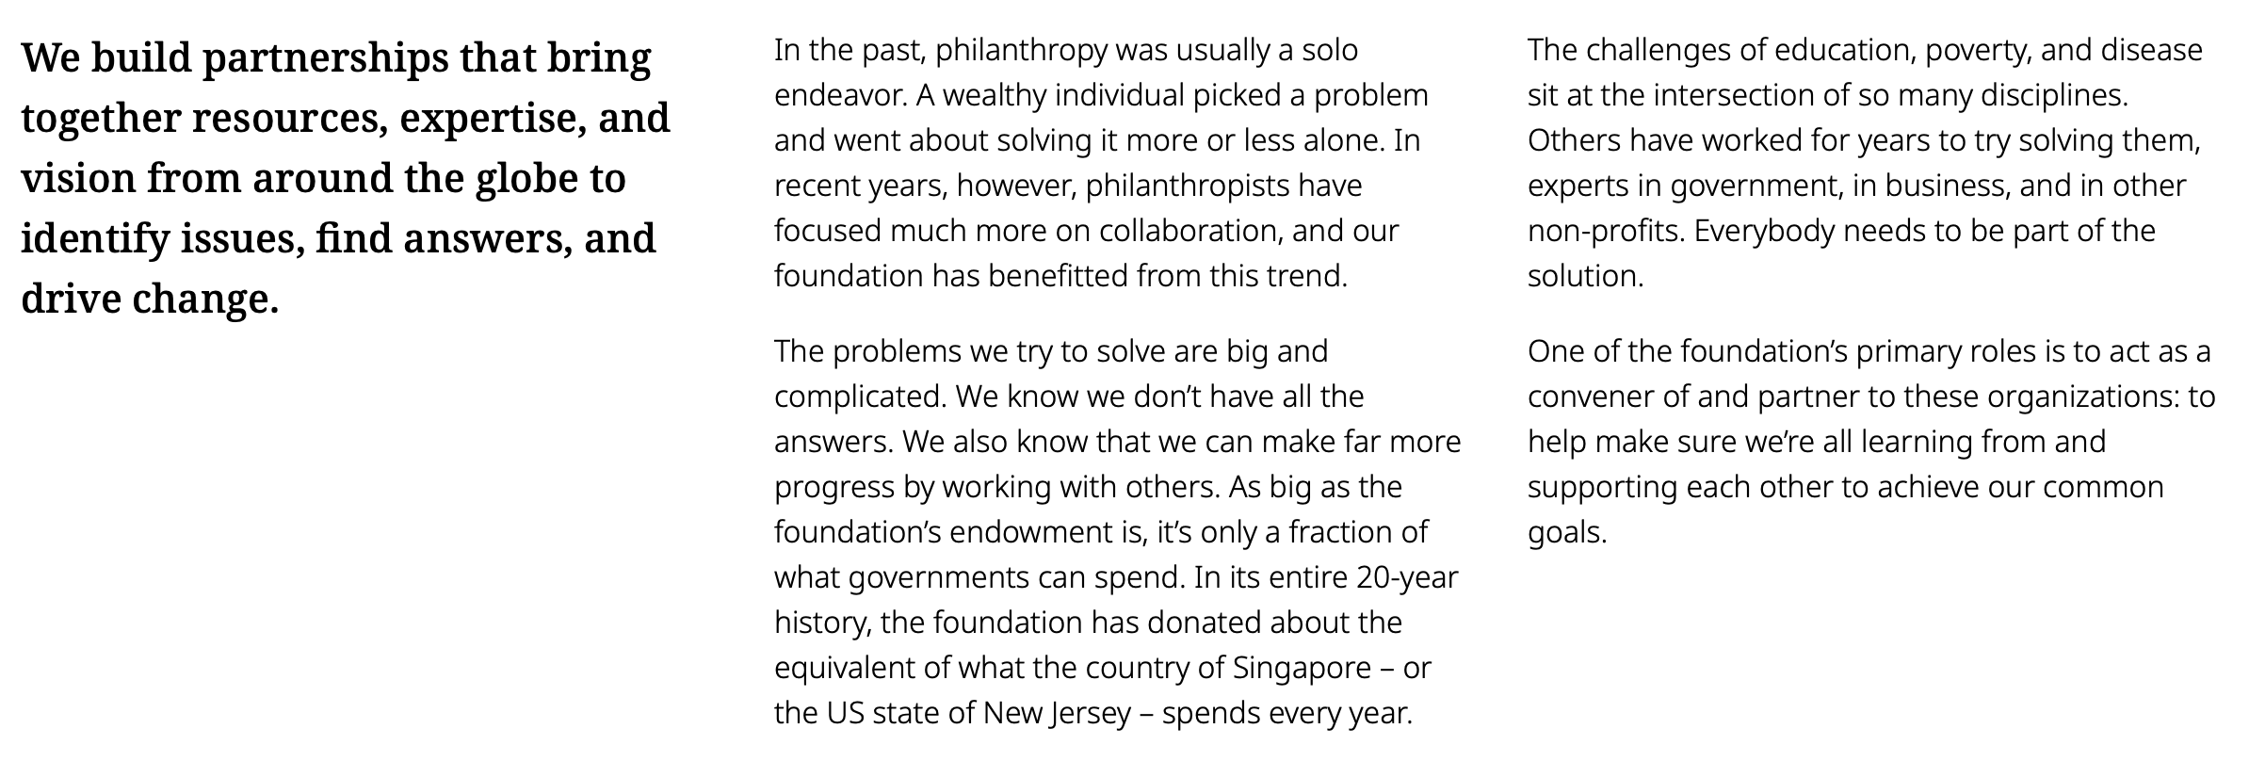

Slide 54
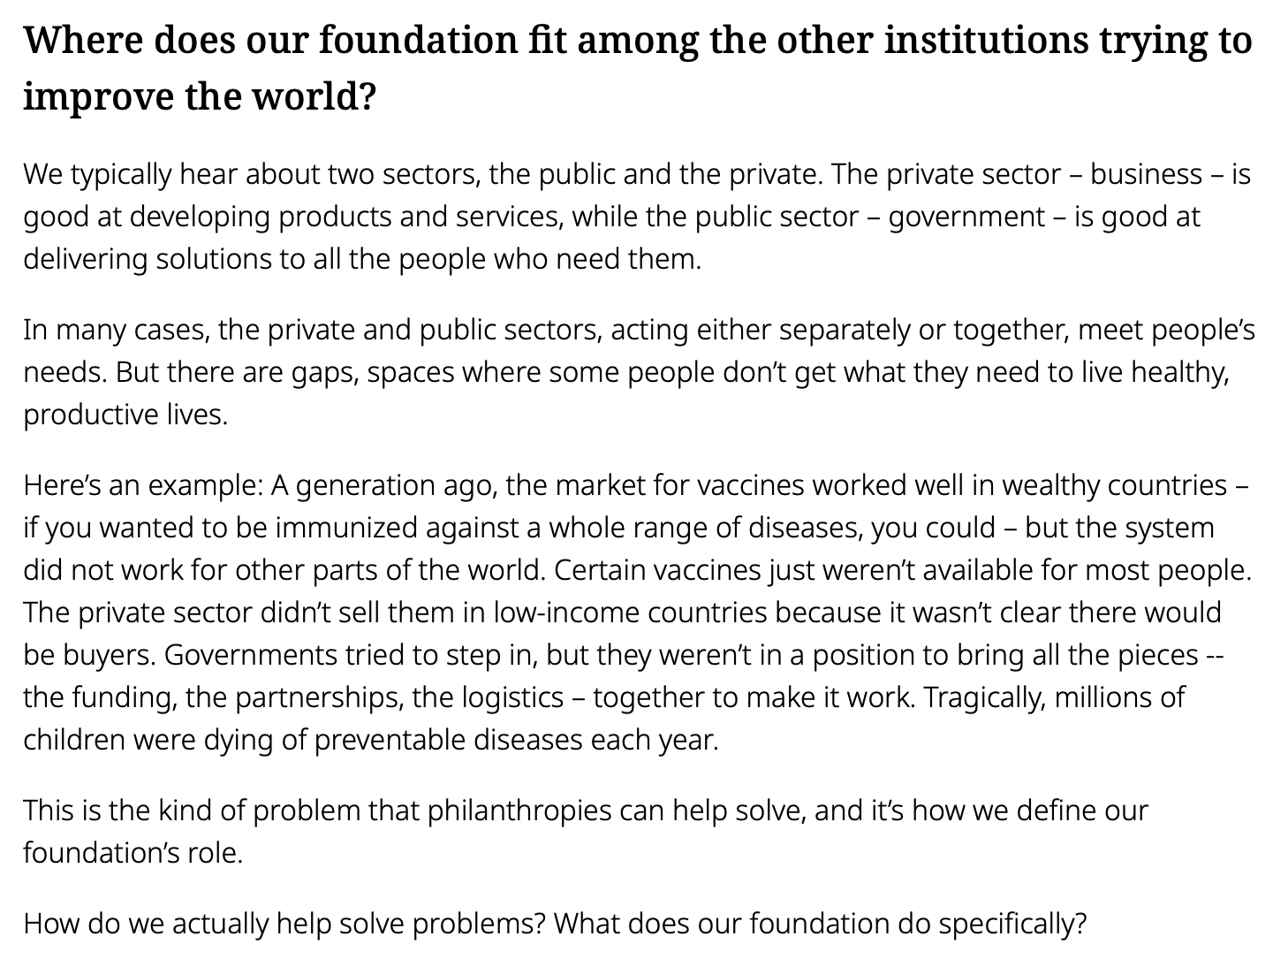

Slide 55
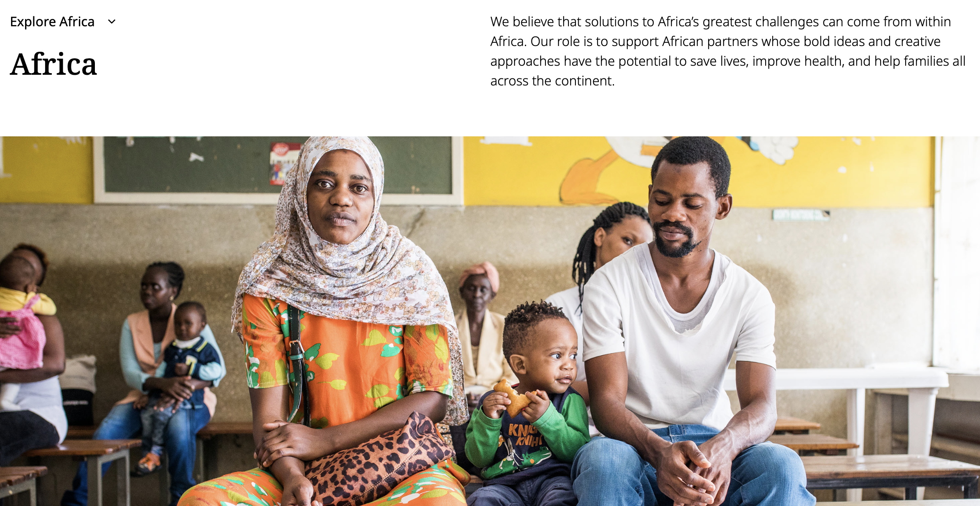

Slide 56
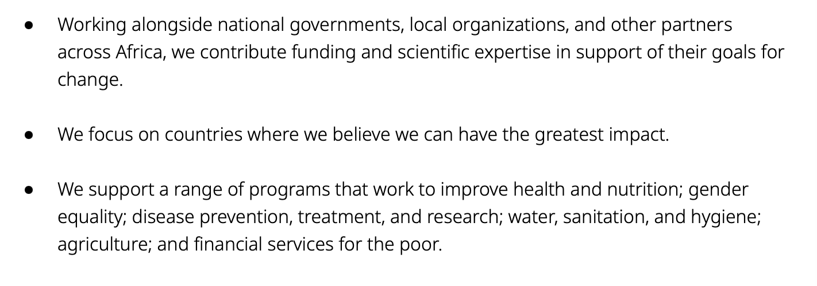

Slide 57
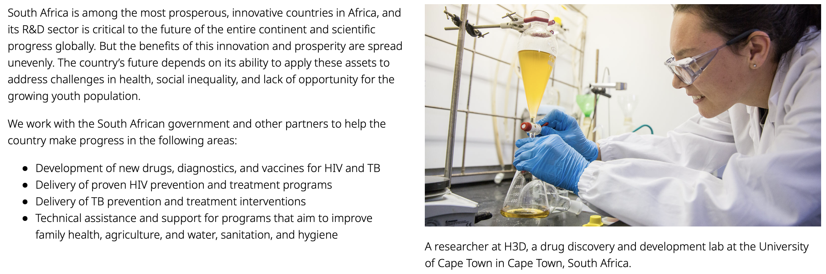

Slide 59
Appendix

Slide 60
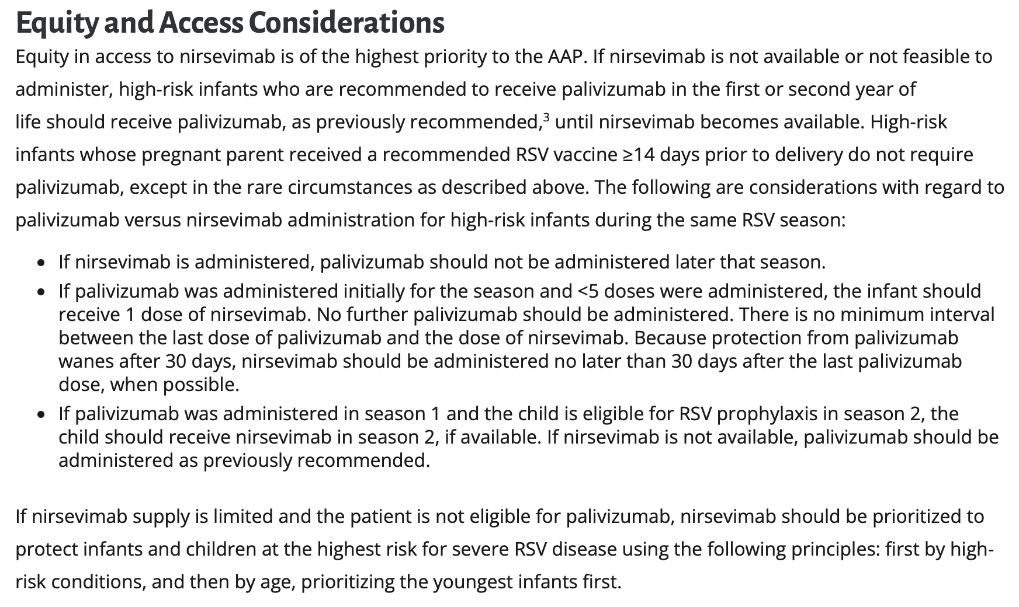
American Association of Pediatrics, February 21, 2024, https://publications.aap.org/redbook/resources/25379/AAP-Recommendations-for-the-Prevention-of-RSV?autologincheck=redirected

Slide 61
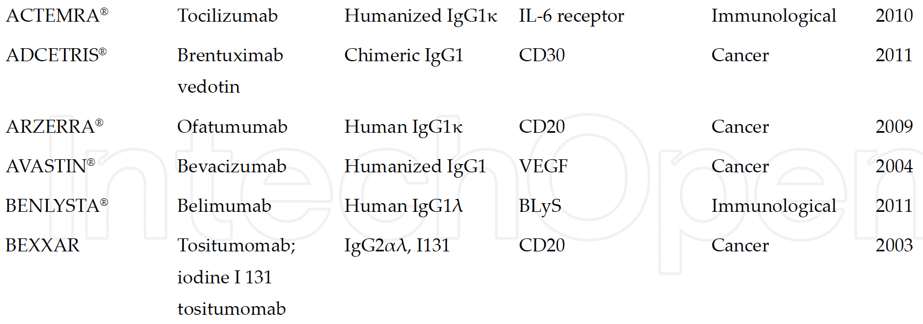
Source: Lucas Silva Carvalho, “Production Processes for Monoclonal Antibodies” (2017)

Slide 62
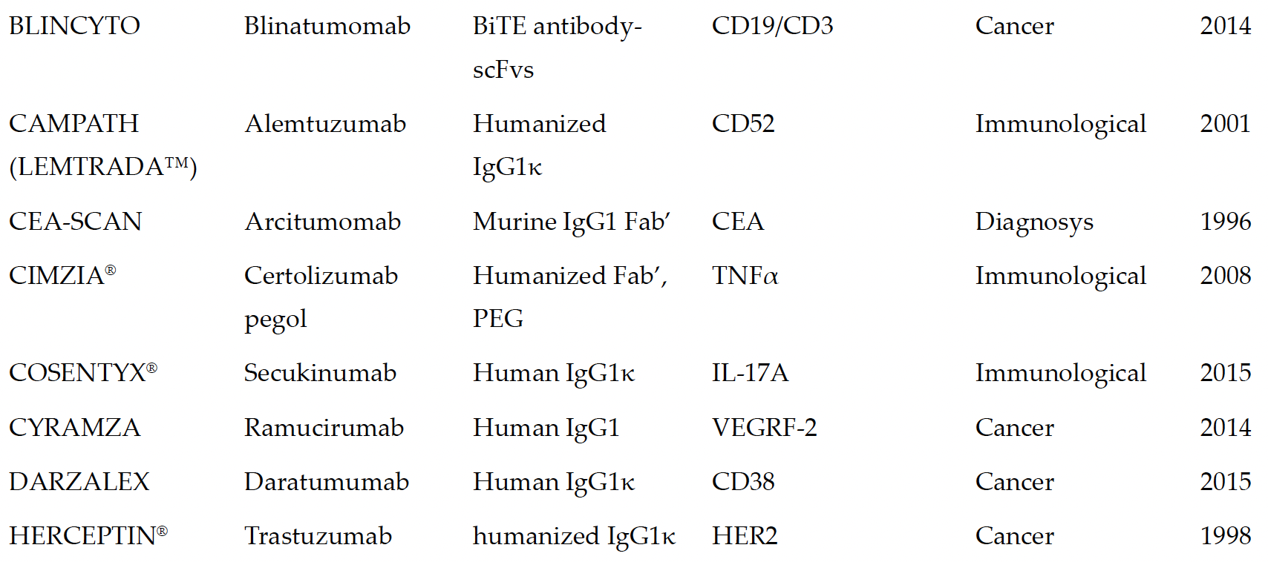

Slide 63
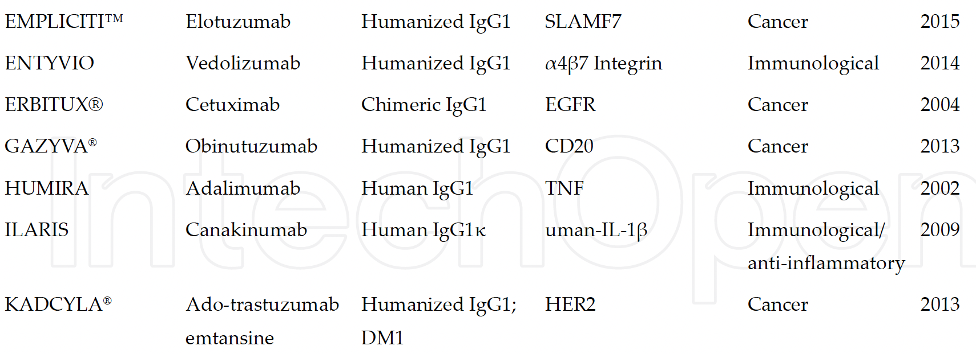

Slide 64
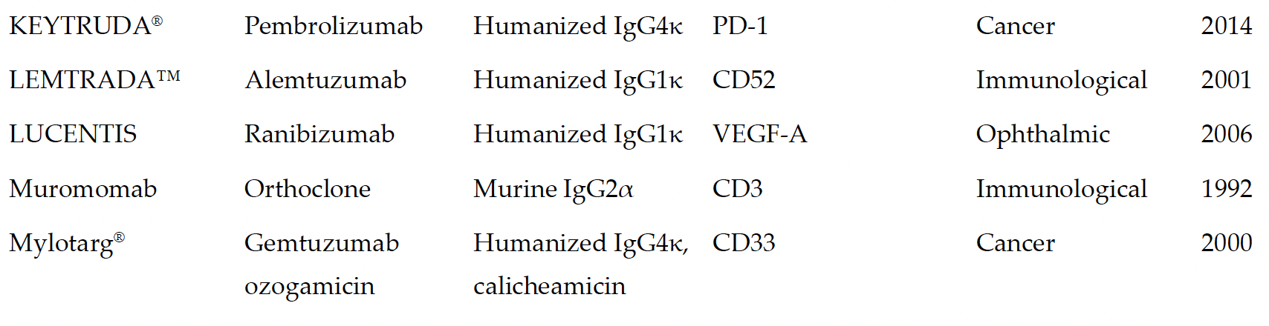

Slide 65
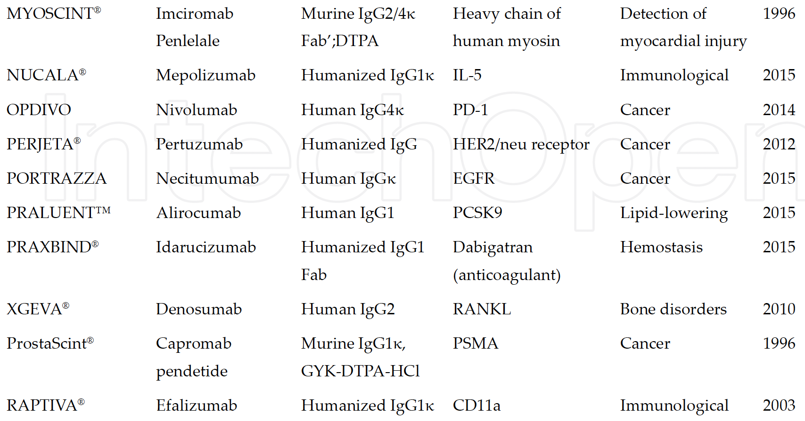

Slide 66
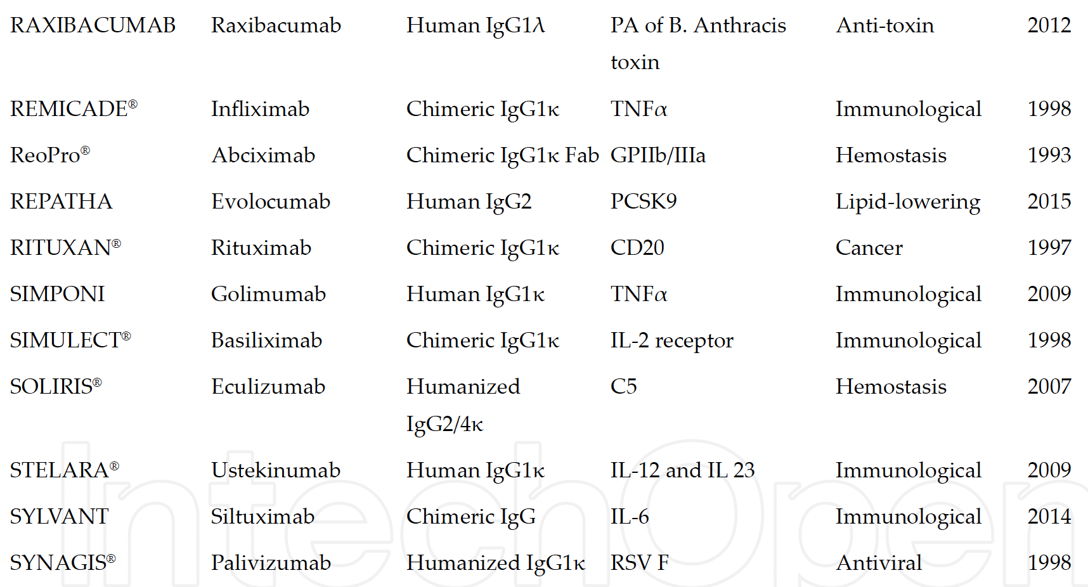

Slide 67
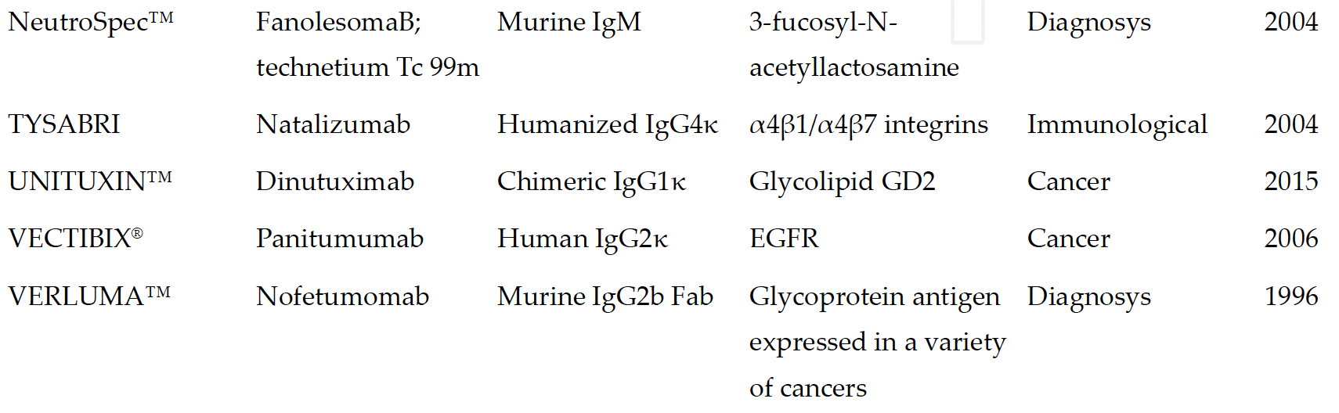

Slide 68
