Slide 1
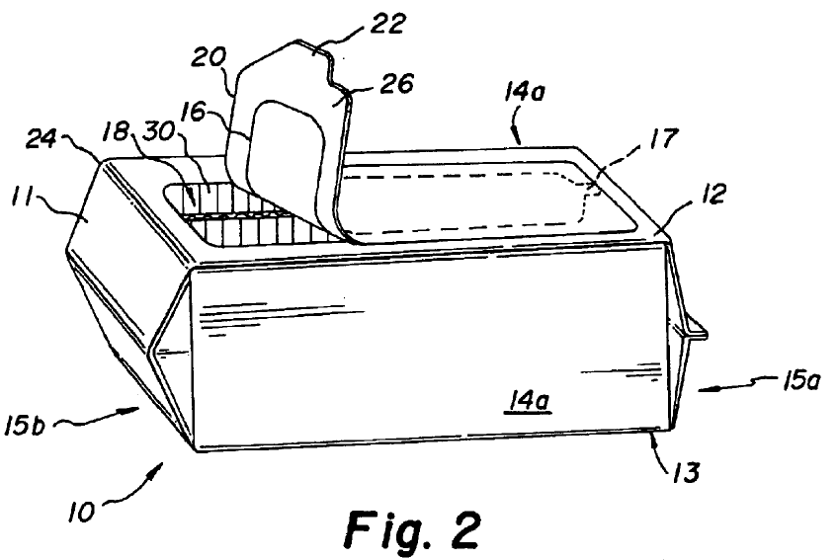
Accessibility
Prior Art
Packaging News (2001)
notorious
Machinery Update (2001)
Machinery Update (2002)
time
US Filing
April 16, 2003
Grant
July 19, 2005
secret
Technological Progress

Slide 2
Background: History of Cookie Packaging
1912
1912
1931
1963
1973
1993
1998

Slide 3
“Wet wipes” have long been sold in soft container with resealable tops

Slide 4
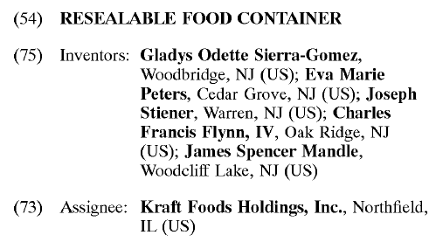
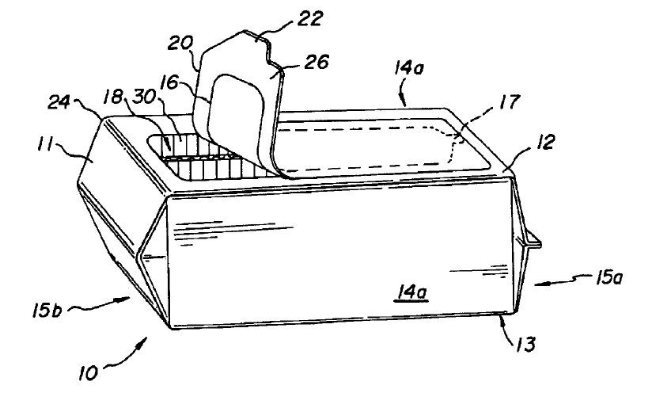
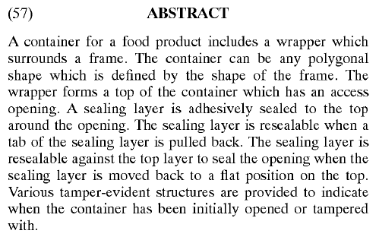

Slide 5
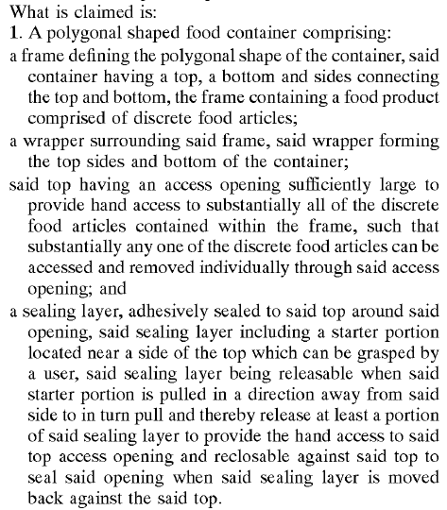

Slide 6
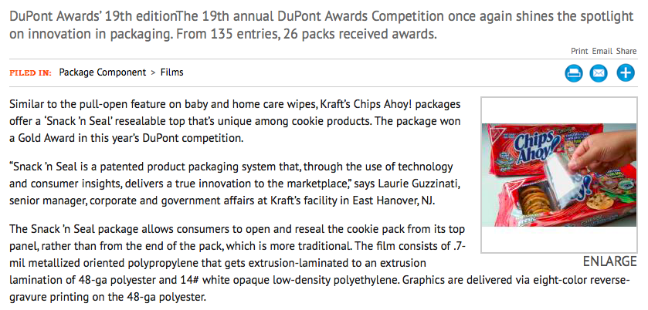
Source: Packworld, August 31, 2006, https://www.packworld.com/article/food/bakery/resealable-bag-brings-differentiation

Slide 7
Prior Art
2001 article in Packaging News that displayed and described Re-Seal It packaging made by a Swedish firm and marketed by Paramount Packaging.
two related articles in the Machinery Update publication describing and showing a Re-Seal It package marketed in Britain by Paramount Packaging as an agent for Re-Seal It Sweden.
Machinery Update, September/October 2001 at 46–47.
Machinery Update, March/April 2002 at 59–60: “The 2002 article describes the Re-Seal It system, which "allows flow-wraps of bacon, sliced cooked meat, cheese and similar food products that are consumed over a period of time to be opened, then reclosed to avoid drying out in the refrigerator.” The system can also "be used for trays of high value prepared food such as sushi or canapés."

Slide 8
