Slide 1
Responsibilities of Public-Health Actors
PX087
William Fisher
January 2024

Slide 2
Responsibilities?
Actors:
Global Health Organizations
National Governments
Pharmaceutical Firms
Individual Physicians
Community Health Workers
Pharmacists
Online advisors
Potential Objectives:
Maximize Global Average Healthy Life Expectancy
Maximize National Average Healthy Life Expectancy
Equalize Average Healthy Life Expectancy across countries
Equalize Average Healthy Life Expectancy within each country
Equalize Average Healthy Life Expectancy among races, ethnic groups, and social classes
Promote a sustainable human population
Corrective Justice
Maximize Financial Returns to shareholders
Promote the welfare of each patient
Abide by Hippocratic oath
Distributive Justice
Relative weight of each actor’s responsibilities?

Slide 3
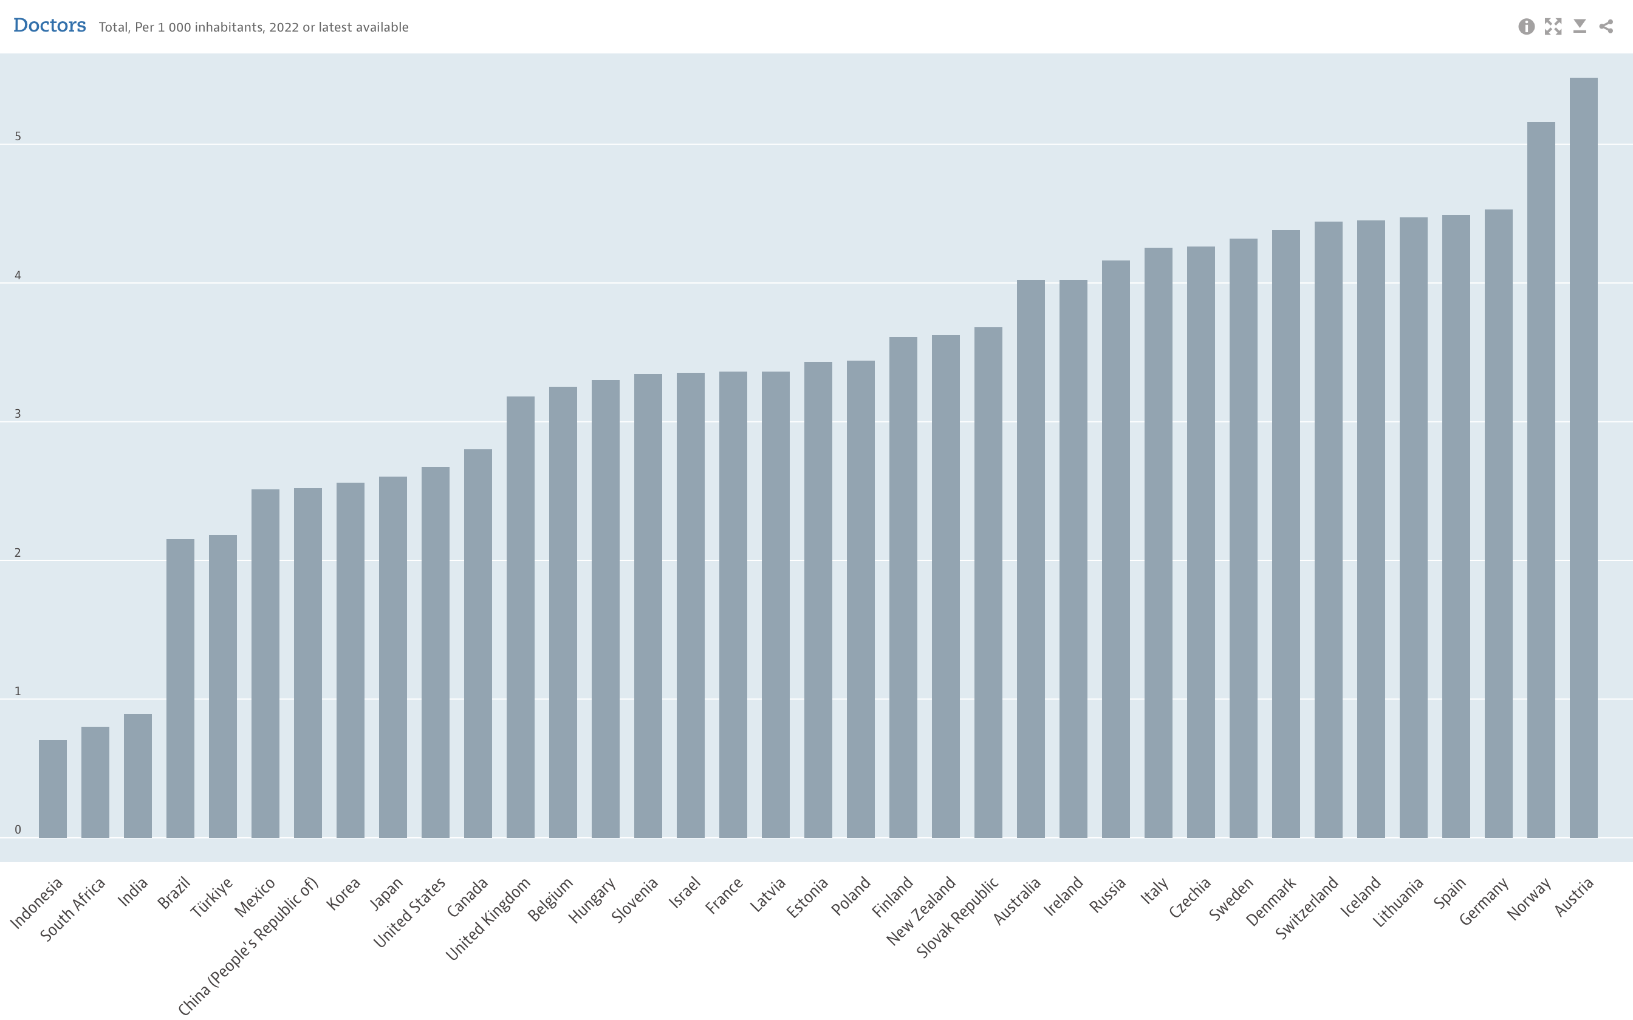
Doctors per 10,000 inhabitants
Source: OECD (2022 data or most recent)
50
40
30
20
10

Slide 4
4
Density of medical doctors in West Africa in 2020, by country
(per 10,000 inhabitants)
Note(s): Africa; April 4, 2020; 15 years and older
Further information regarding this statistic can be found on page 8.
Source(s): OECD; ID 1122671

Slide 5
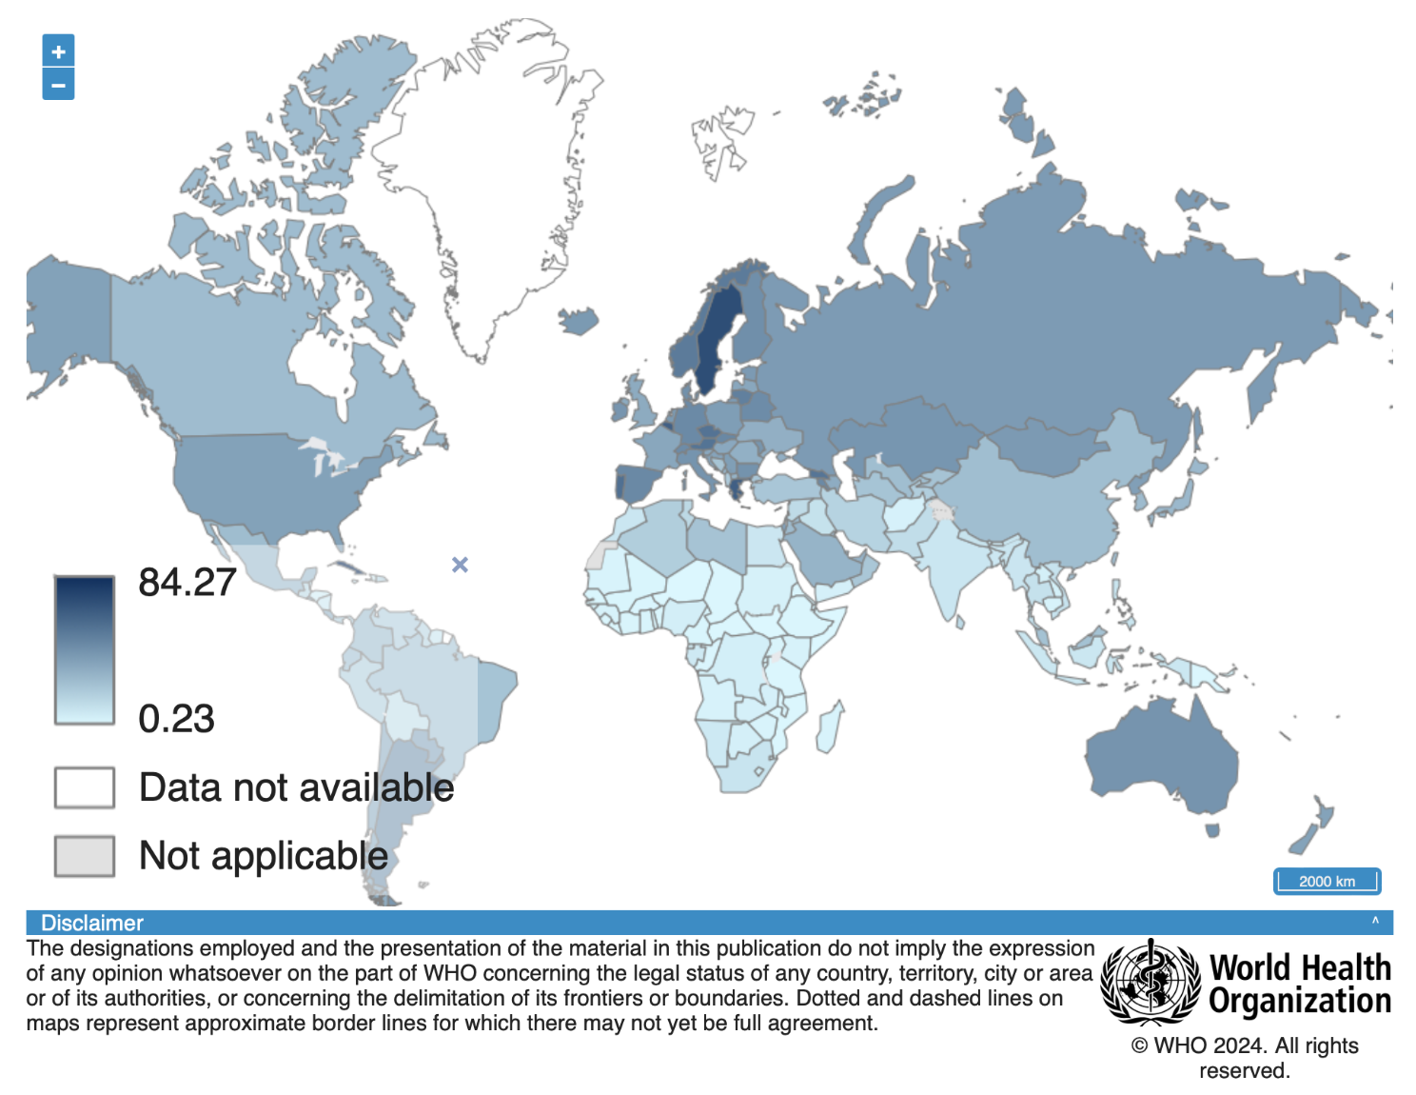
Doctors per 10,000
inhabitants

Slide 6
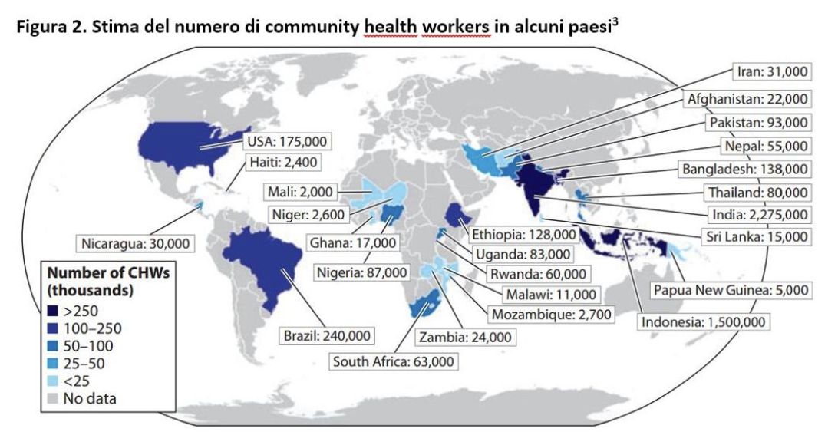
Source: https://www.saluteinternazionale.info/2019/03/community-health-workers/

Slide 7
Responsibilities?
Actors:
Global Health Organizations
National Governments
Pharmaceutical Firms
Individual Physicians
Community Health Workers
Pharmacists
Online advisors
“[T]he well-read LLM chatbots could take doctor-AI collaboration—and even diagnosis—to a new level. In a study posted on the preprint server medRxiv in February that has not yet been peer-reviewed, epidemiologist Andrew Beam of Harvard University and his colleagues wrote 48 prompts phrased as descriptions of patients’ symptoms. When they fed these to Open AI’s GPT-3—the version of the algorithm that powered ChatGPT at the time—the LLM’s top three potential diagnoses for each case included the correct one 88 percent of the time. Physicians, by comparison, could do this 96 percent of the time when given the same prompts, while people without medical training could do so 54 percent of the time.”
Sara Reardon, “AI Chatbots Can Diagnose Medical Conditions at Home. How Good Are They?,” Scientific American, March 31, 2023

Slide 8
Responsibilities?
Actors:
Global Health Organizations
National Governments
Pharmaceutical Firms
Individual Physicians
Community Health Workers
Pharmacists
Online advisors
“Google is taking a different approach with its LLM chatbot Med-PaLM, which pulls from a massive data set of real questions and answers from patients and providers, as well as medical licensing exams, stored in various databases. When researchers at Google tested Med-PaLM’s performance on different “axes,” including alignment with medical consensus, completeness and possibility of harm, in a preprint study, its answers aligned with medical and scientific consensus 92.6 percent of the time. Human clinicians scored 92.9 percent overall. Chatbot answers were more likely to have missing content than human answers were, but the answers were slightly less likely to harm users’ physical or mental health.”
Sara Reardon, “AI Chatbots Can Diagnose Medical Conditions at Home. How Good Are They?,” Scientific American, March 31, 2023

Slide 9
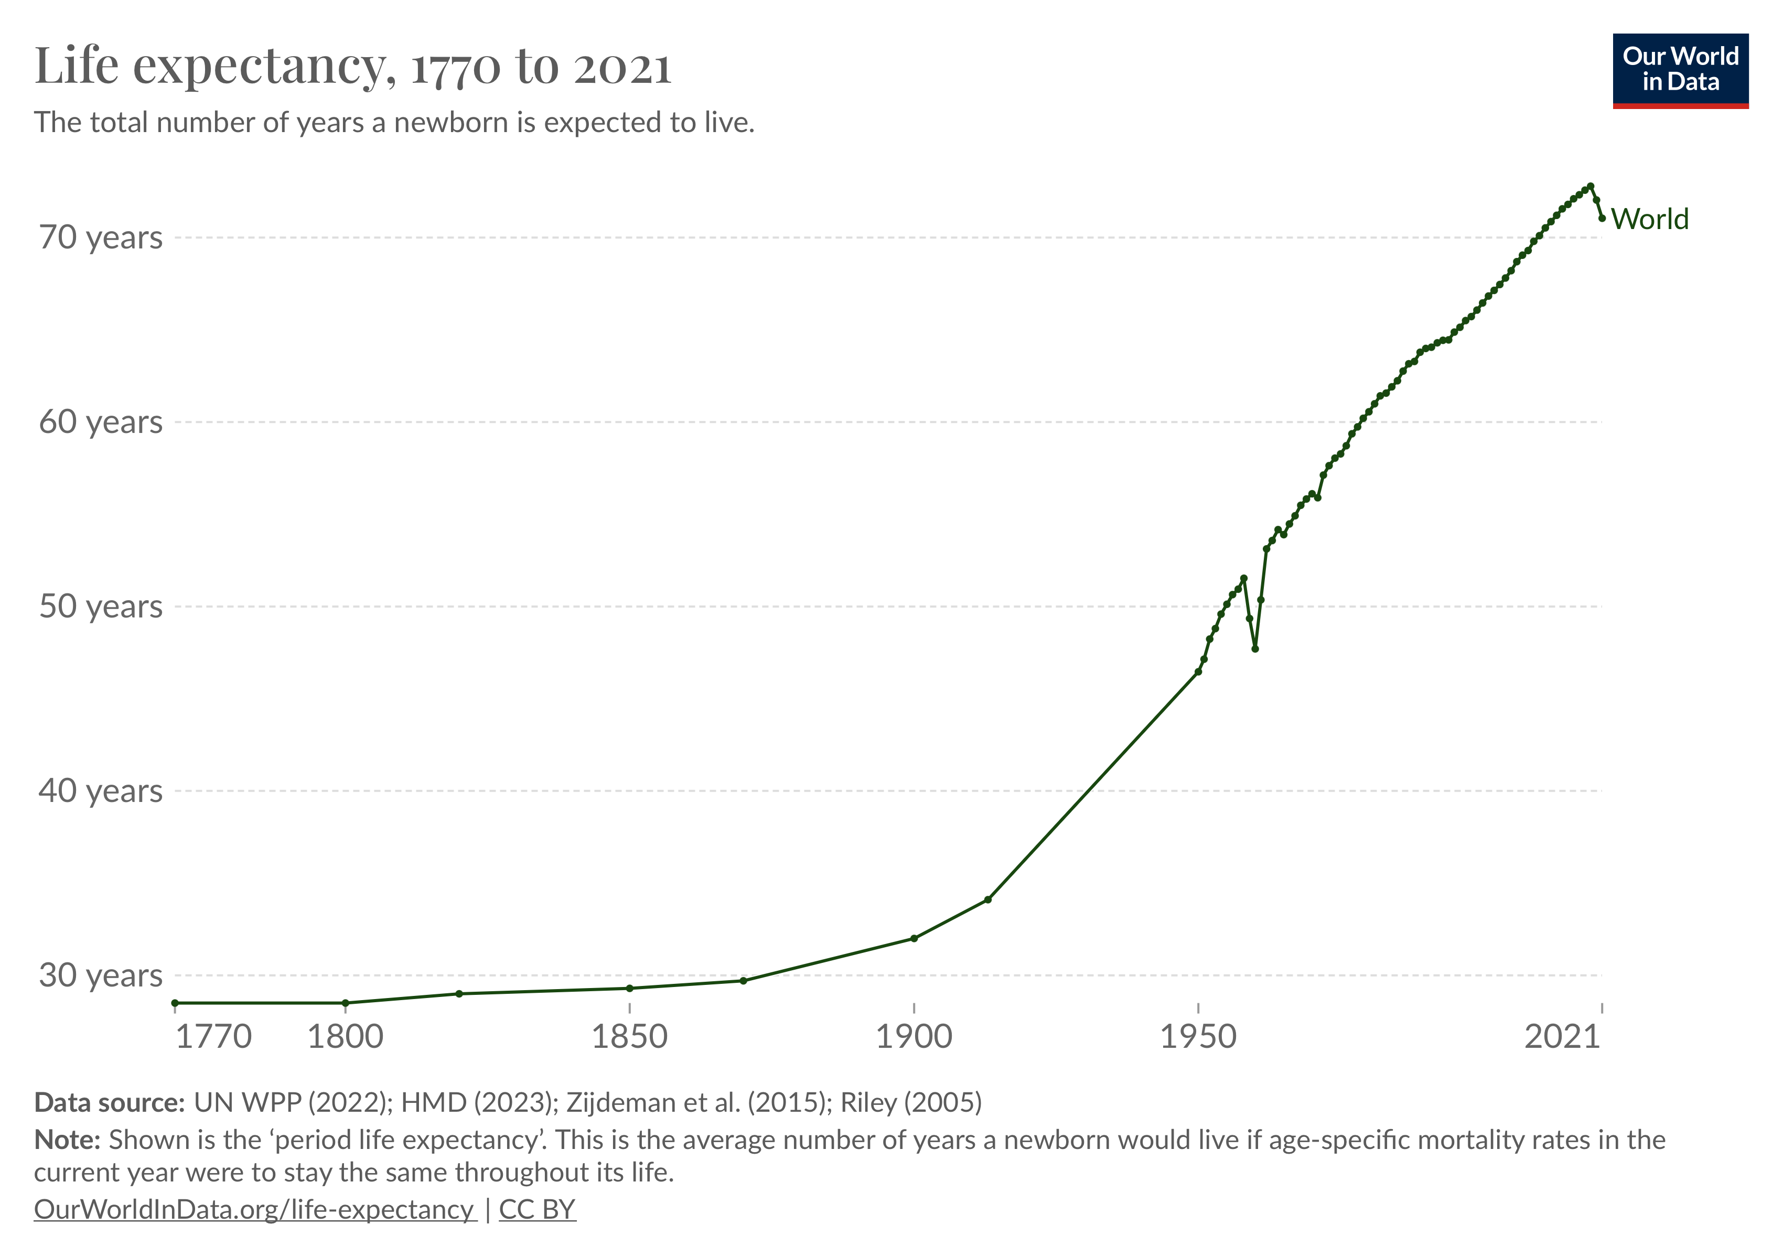

Slide 10
2
Global life expectancy at birth from 1950 to 2021,
with projections until 2100 (in years)
.
Source(s): UN DESA; ID 805060

Slide 11
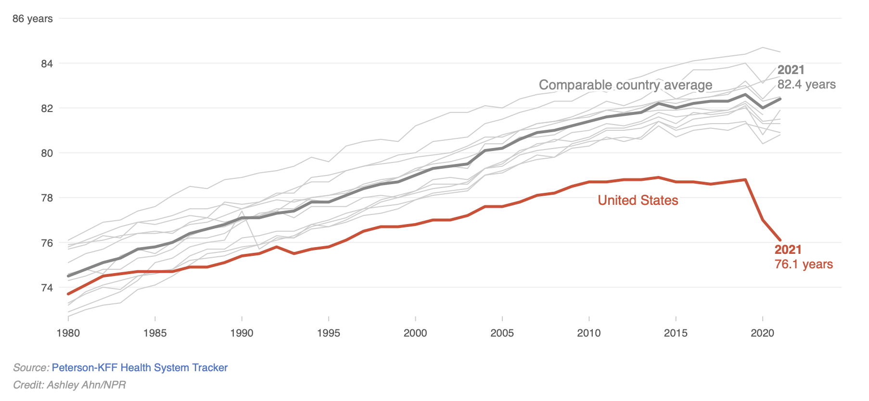
Source: “Life expectancy continues to decline in the U.S. as it rebounds in other countries,” NPR, March 25, 2023,
https://www.npr.org/sections/health-shots/2023/03/25/1164819944/live-free-and-die-the-sad-state-of-u-s-life-expectancy

Slide 12
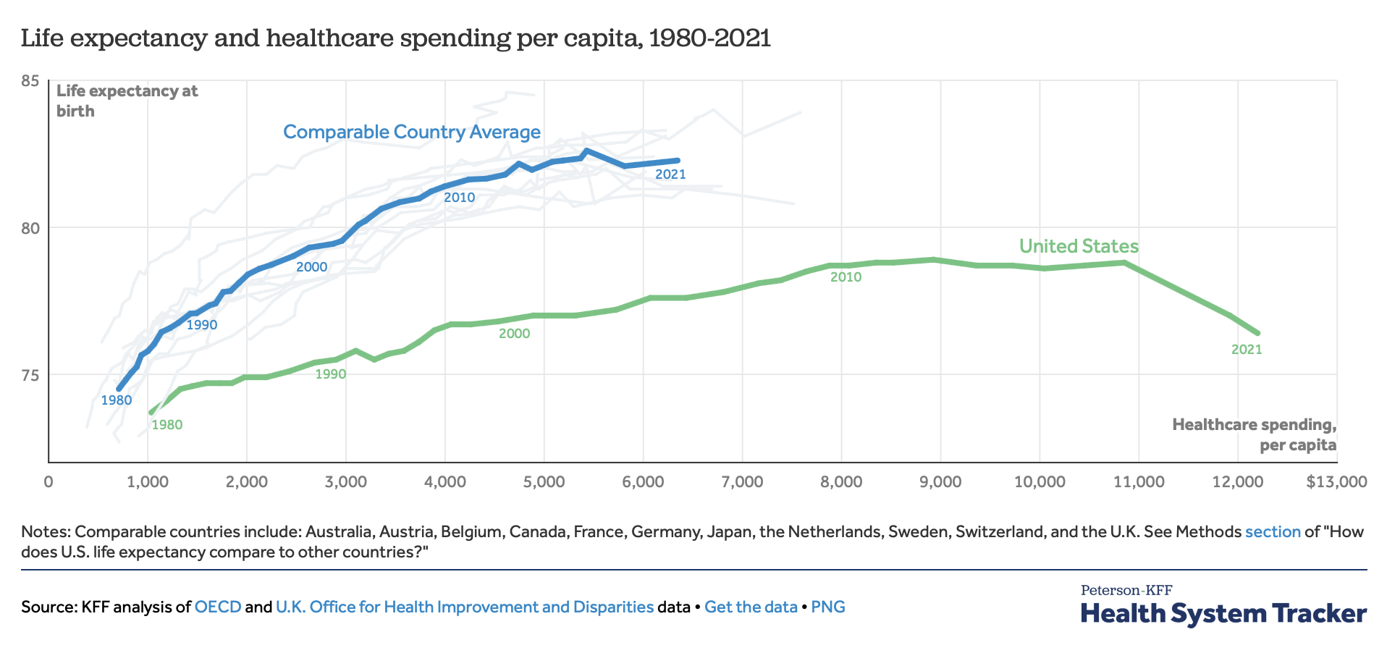
Source: https://www.healthsystemtracker.org/chart-collection/u-s-life-expectancy-compare-countries/#Life%20expectancy%20at%20birth%20by%20sex,%20in%20years,%202021

Slide 13
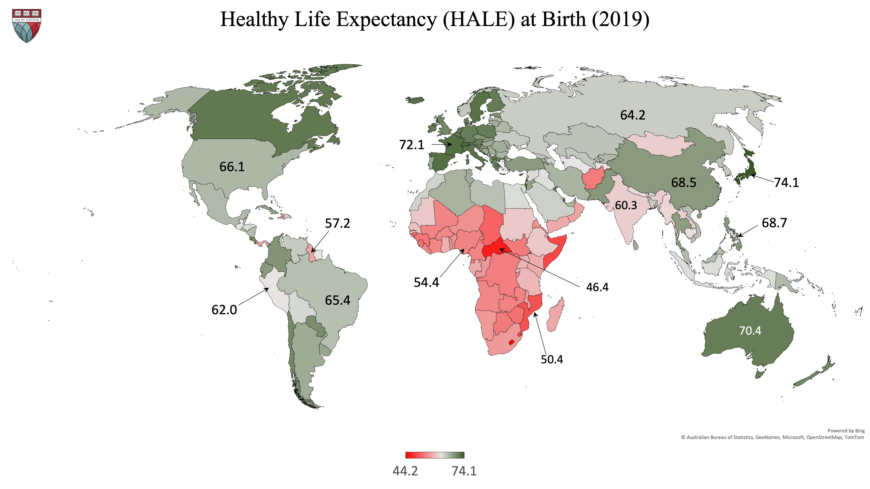

Slide 14
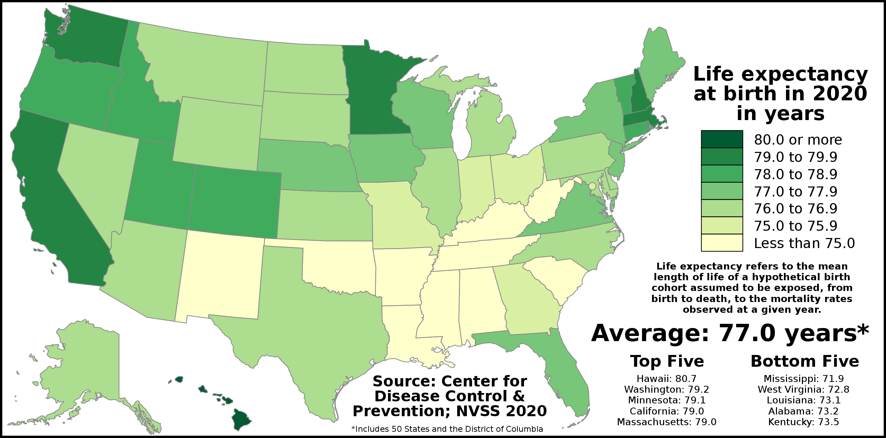

Slide 15
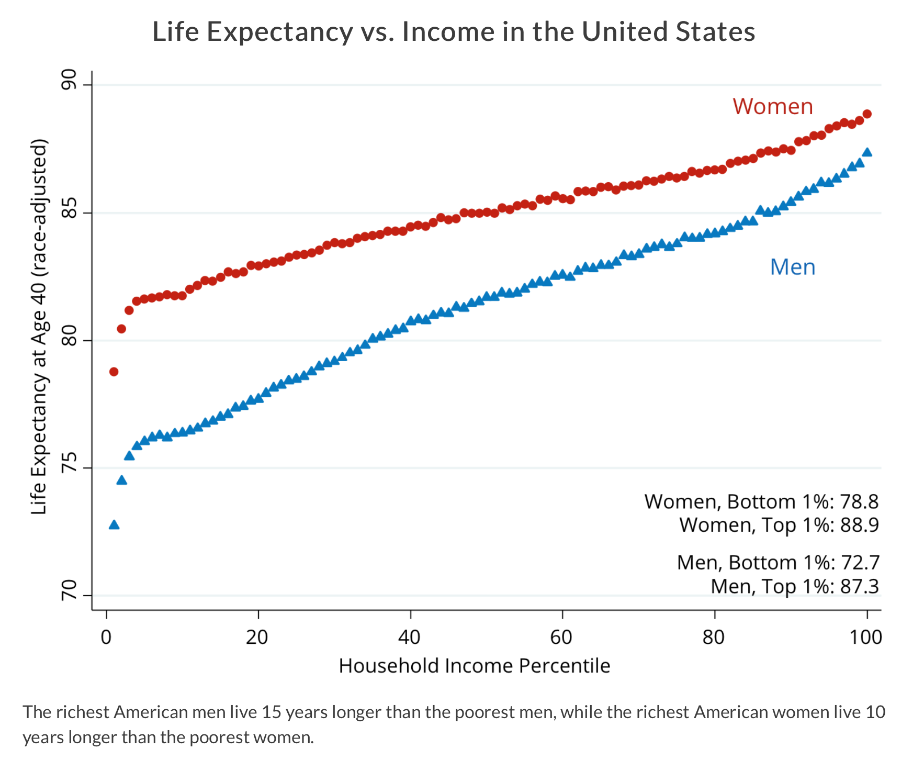
Source: http://www.equality-of-opportunity.org/health/

Slide 16
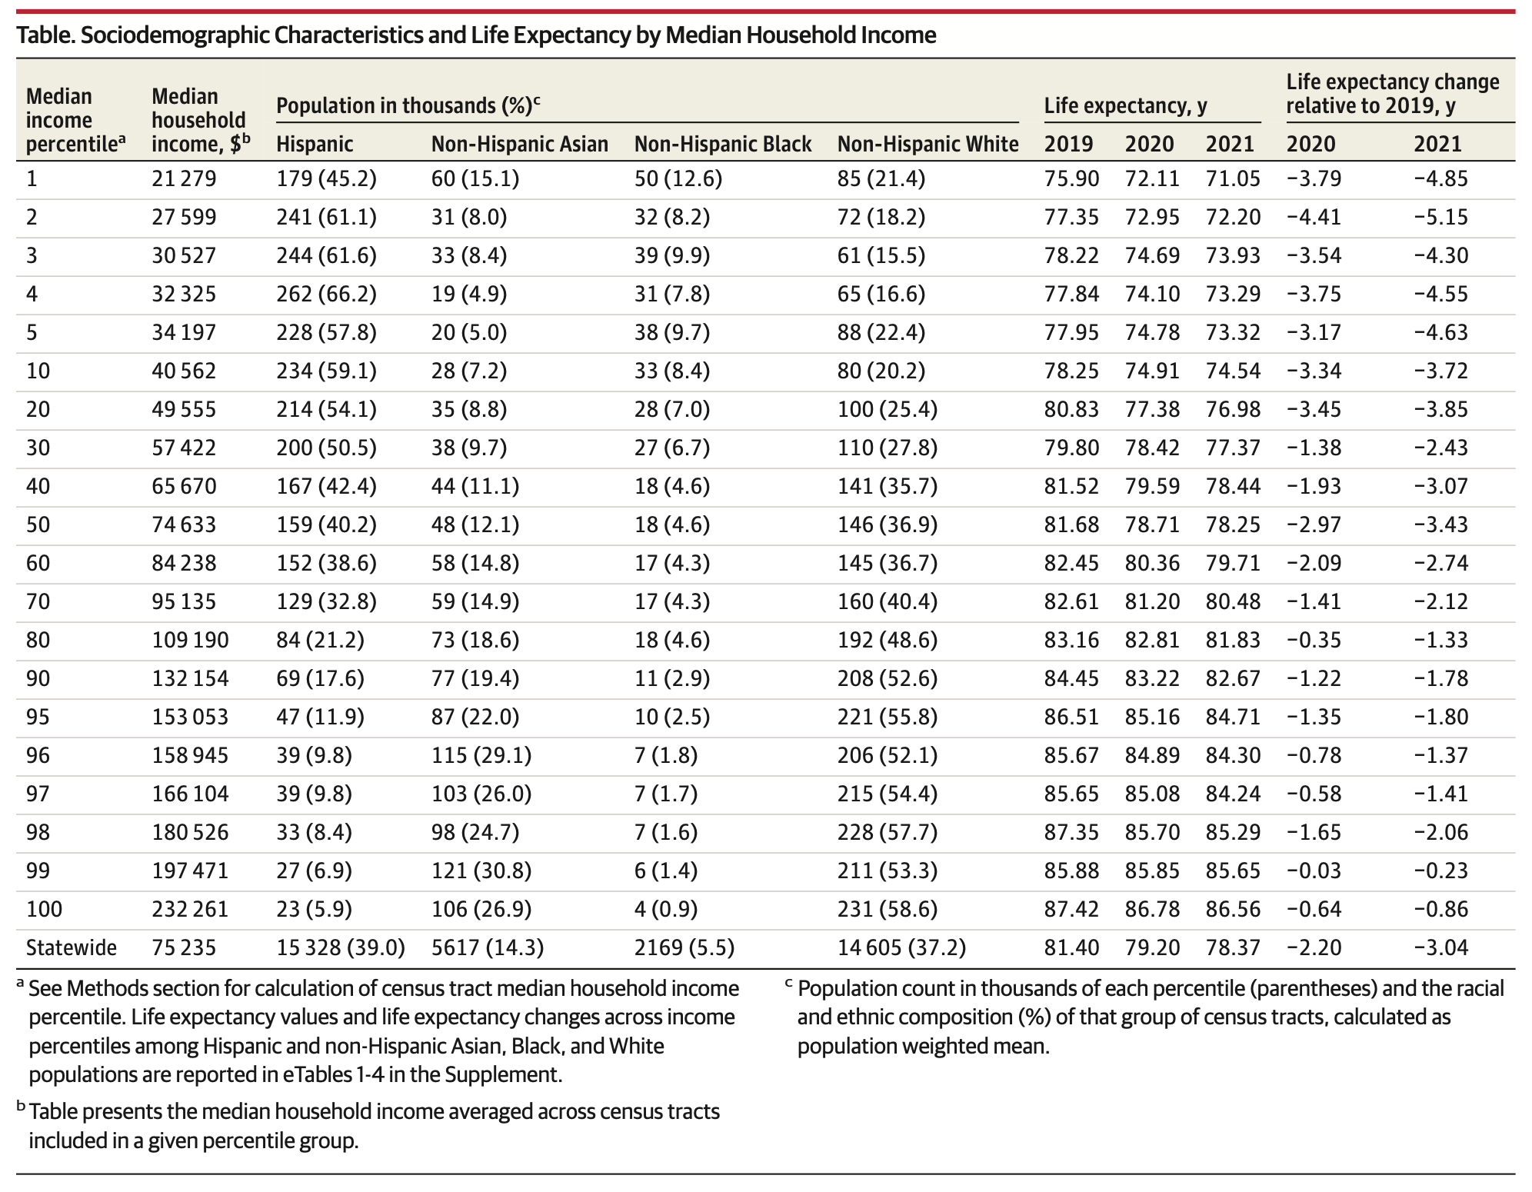
Source: Schwandt et al., “Changes in the Relationship Between Income and Life Expectancy Before and During the COVID-19 Pandemic, California, 2015-2021 (2022)

Slide 17
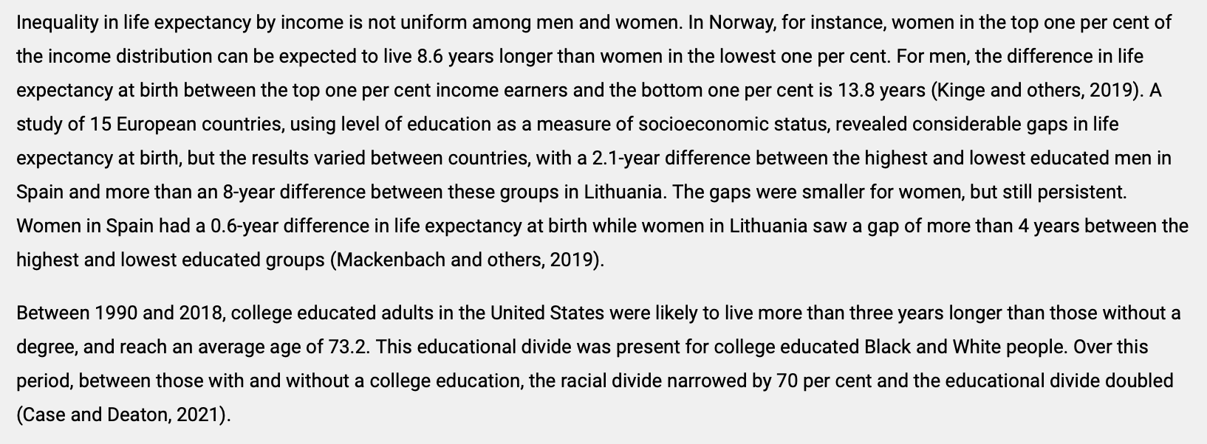
Intra-country Inequalities
Source: https://www.un.org/development/desa/dpad/publication/un-desa-policy-brief-no-145-on-the-importance-of-monitoring-inequality-in-life-expectancy/

Slide 18
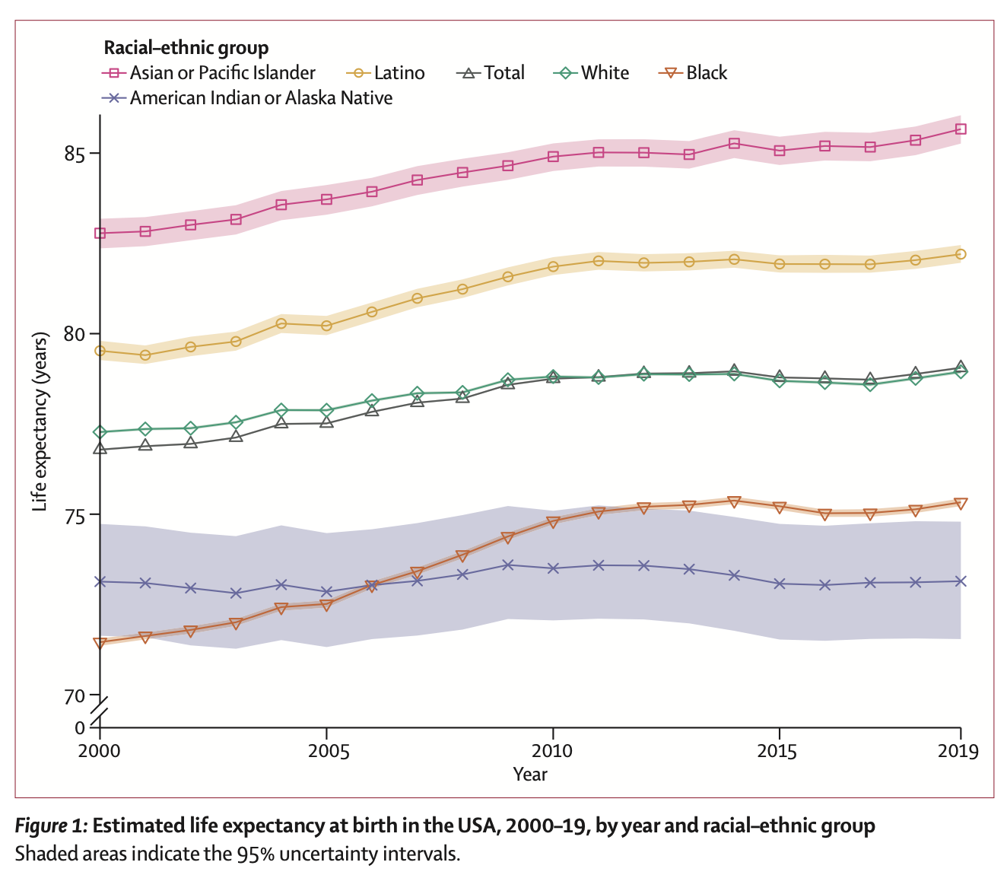
Source: Dwyer et al., “Life expectancy by county, race, and ethnicity
in the USA, 2000–19: a systematic analysis of health disparities” Lancet (2022)

Slide 19
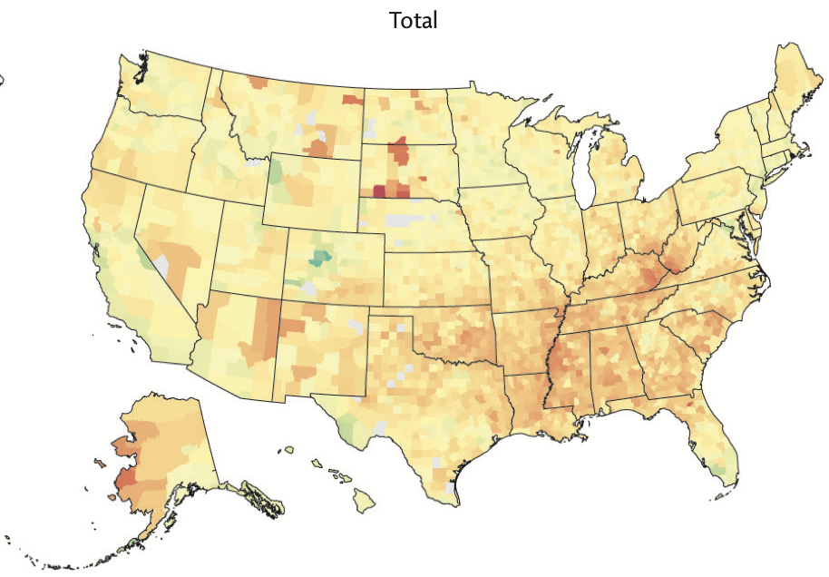
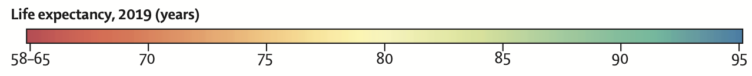
Source: Dwyer et al., “Life expectancy by county, race, and ethnicity
in the USA, 2000–19: a systematic analysis of health disparities” Lancet (2022)

Slide 20
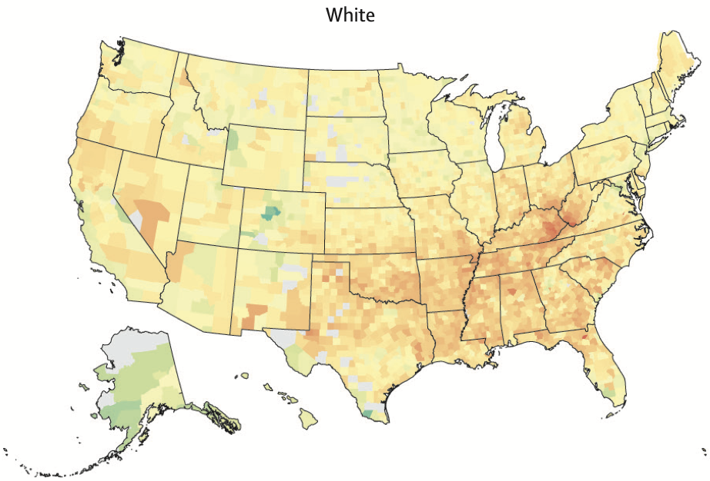
Source: Dwyer et al., “Life expectancy by county, race, and ethnicity
in the USA, 2000–19: a systematic analysis of health disparities” Lancet (2022)

Slide 21
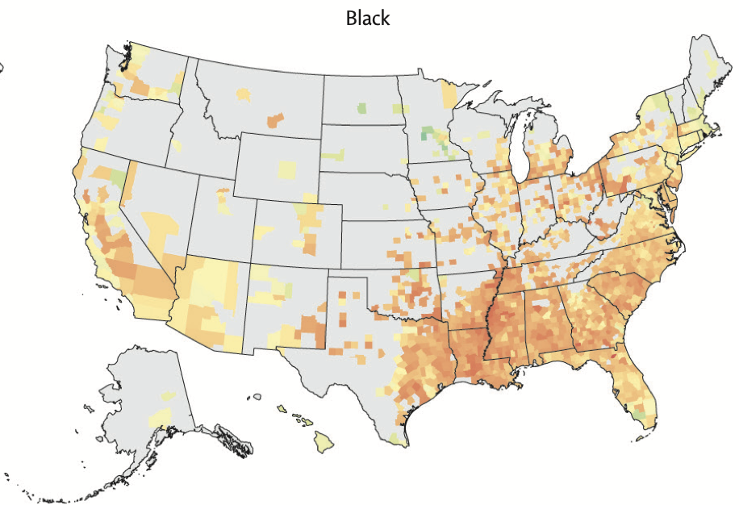
Source: Dwyer et al., “Life expectancy by county, race, and ethnicity
in the USA, 2000–19: a systematic analysis of health disparities” Lancet (2022)

Slide 22
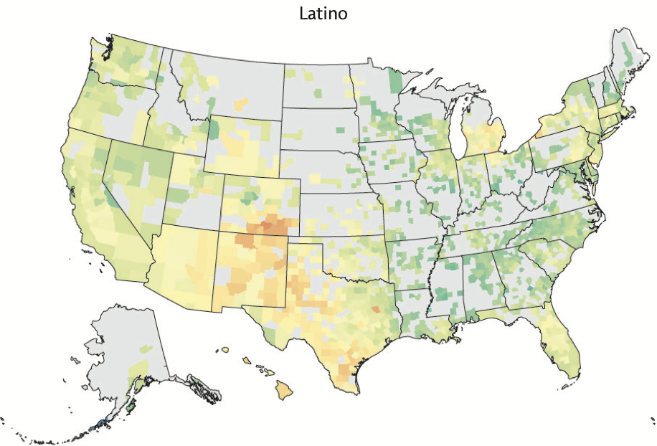
Source: Dwyer et al., “Life expectancy by county, race, and ethnicity
in the USA, 2000–19: a systematic analysis of health disparities” Lancet (2022)

Slide 23
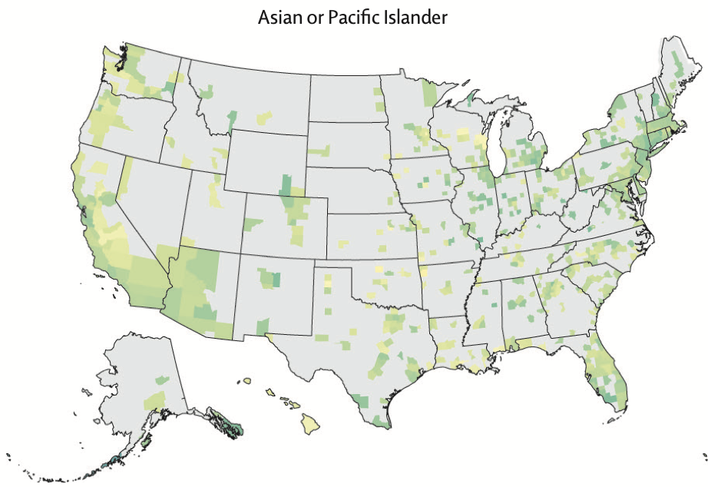
Source: Dwyer et al., “Life expectancy by county, race, and ethnicity
in the USA, 2000–19: a systematic analysis of health disparities” Lancet (2022)

Slide 24
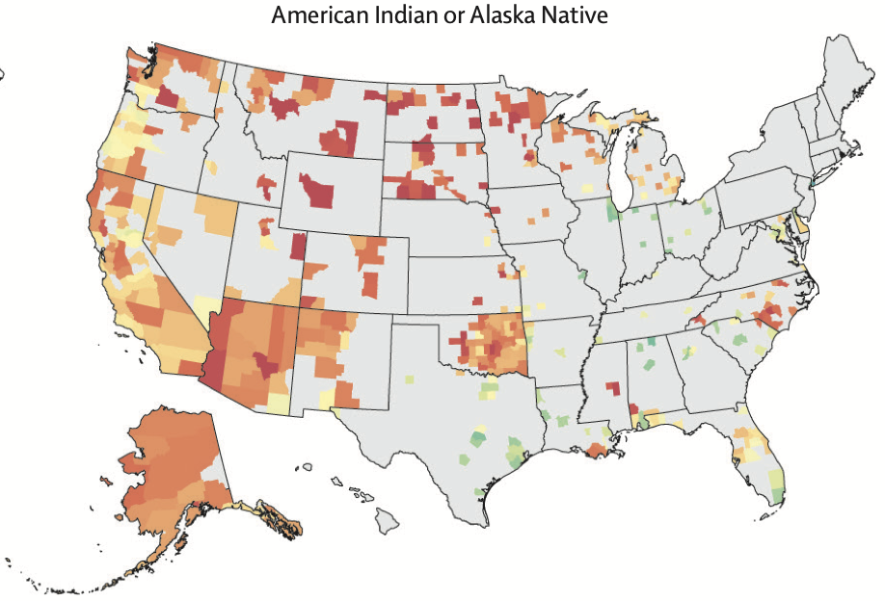
Source: Dwyer et al., “Life expectancy by county, race, and ethnicity
in the USA, 2000–19: a systematic analysis of health disparities” Lancet (2022)

Slide 25
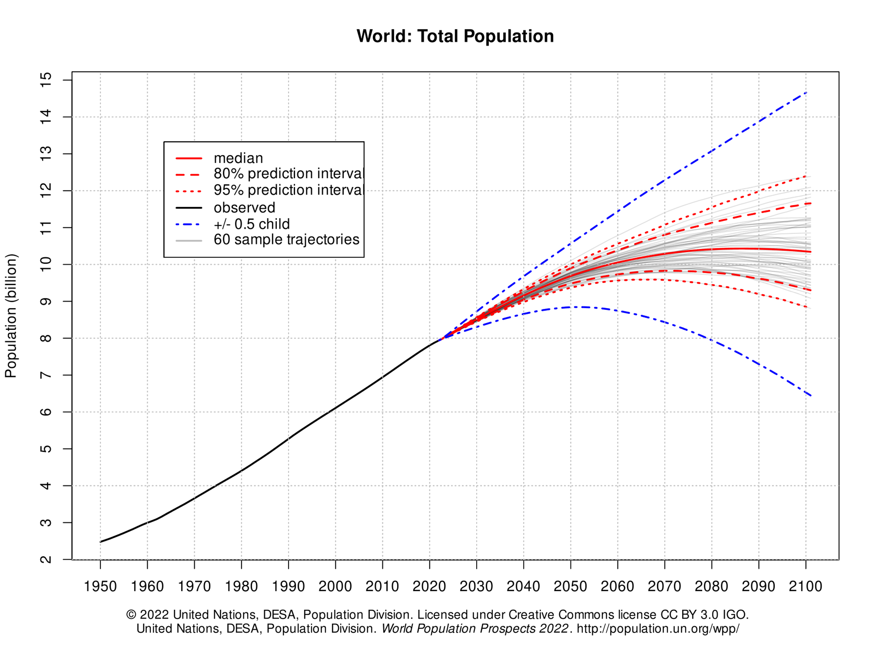
Median

Slide 26
Catastrophic increase (20% chance)

Slide 27
Best, reasonably probable, scenario
(20% chance)

Slide 28
Sustainable level?

Slide 29
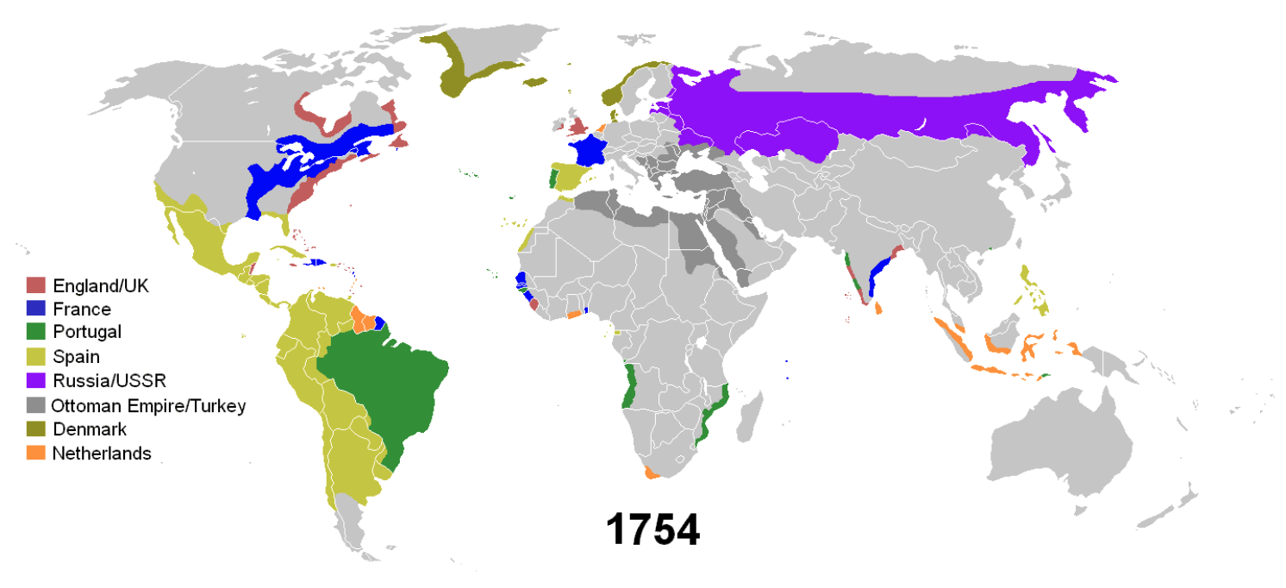
Corrective Justice?
Colonialism in 1754

Slide 30
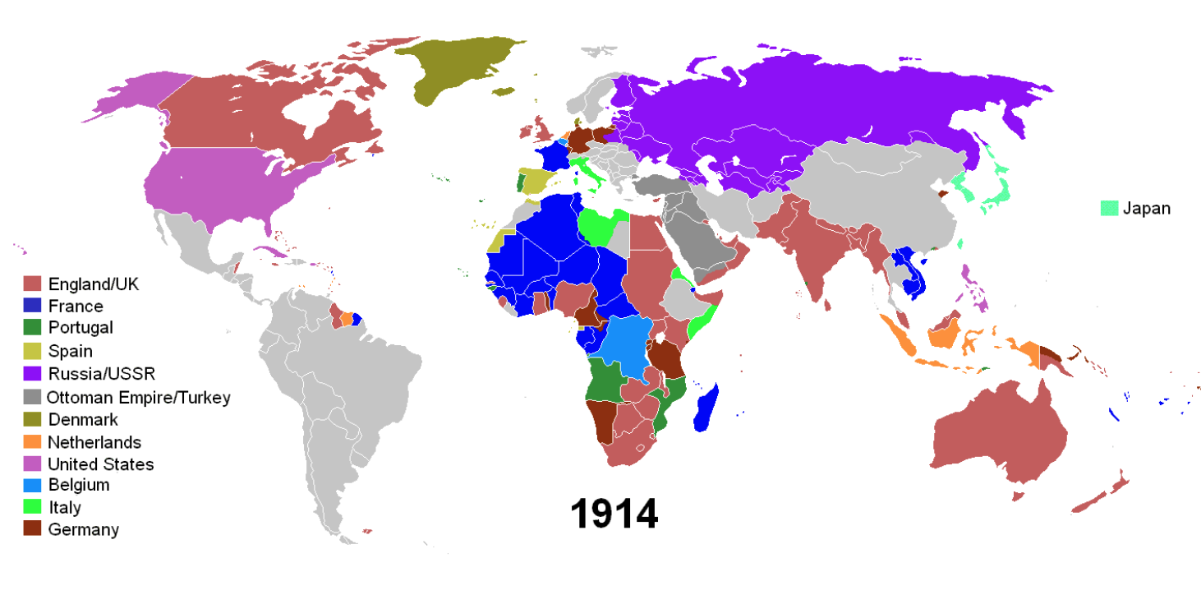
Corrective Justice?
Colonialism in 1914

Slide 31
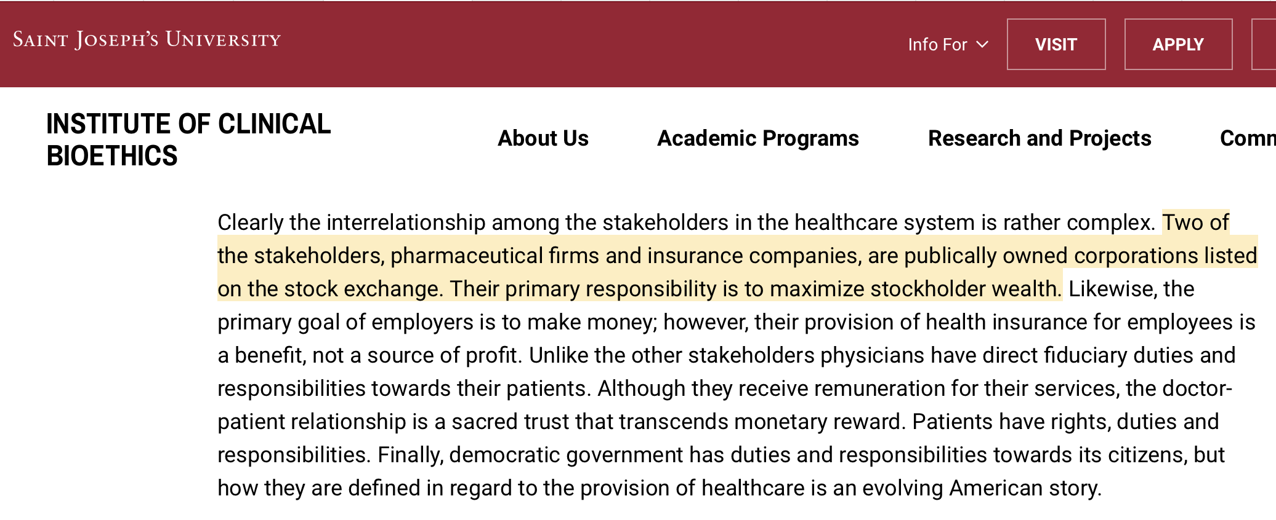

Slide 32
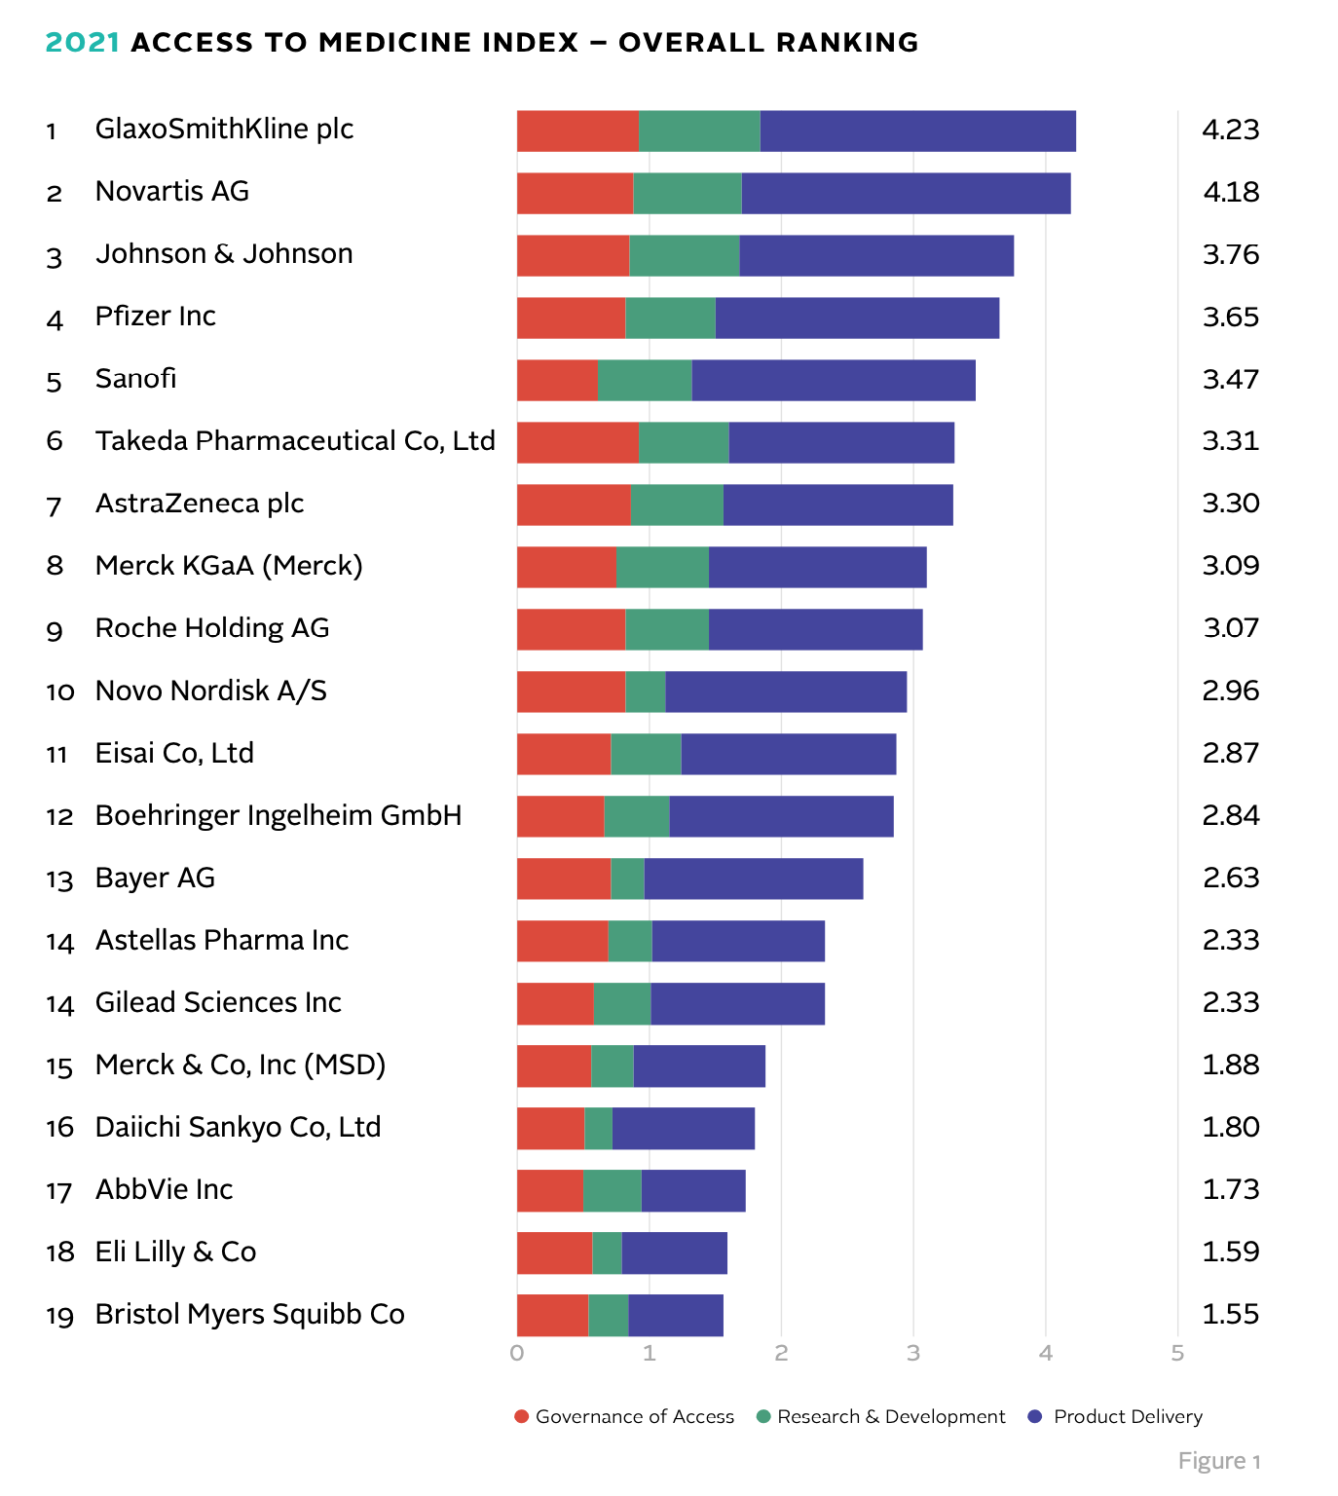
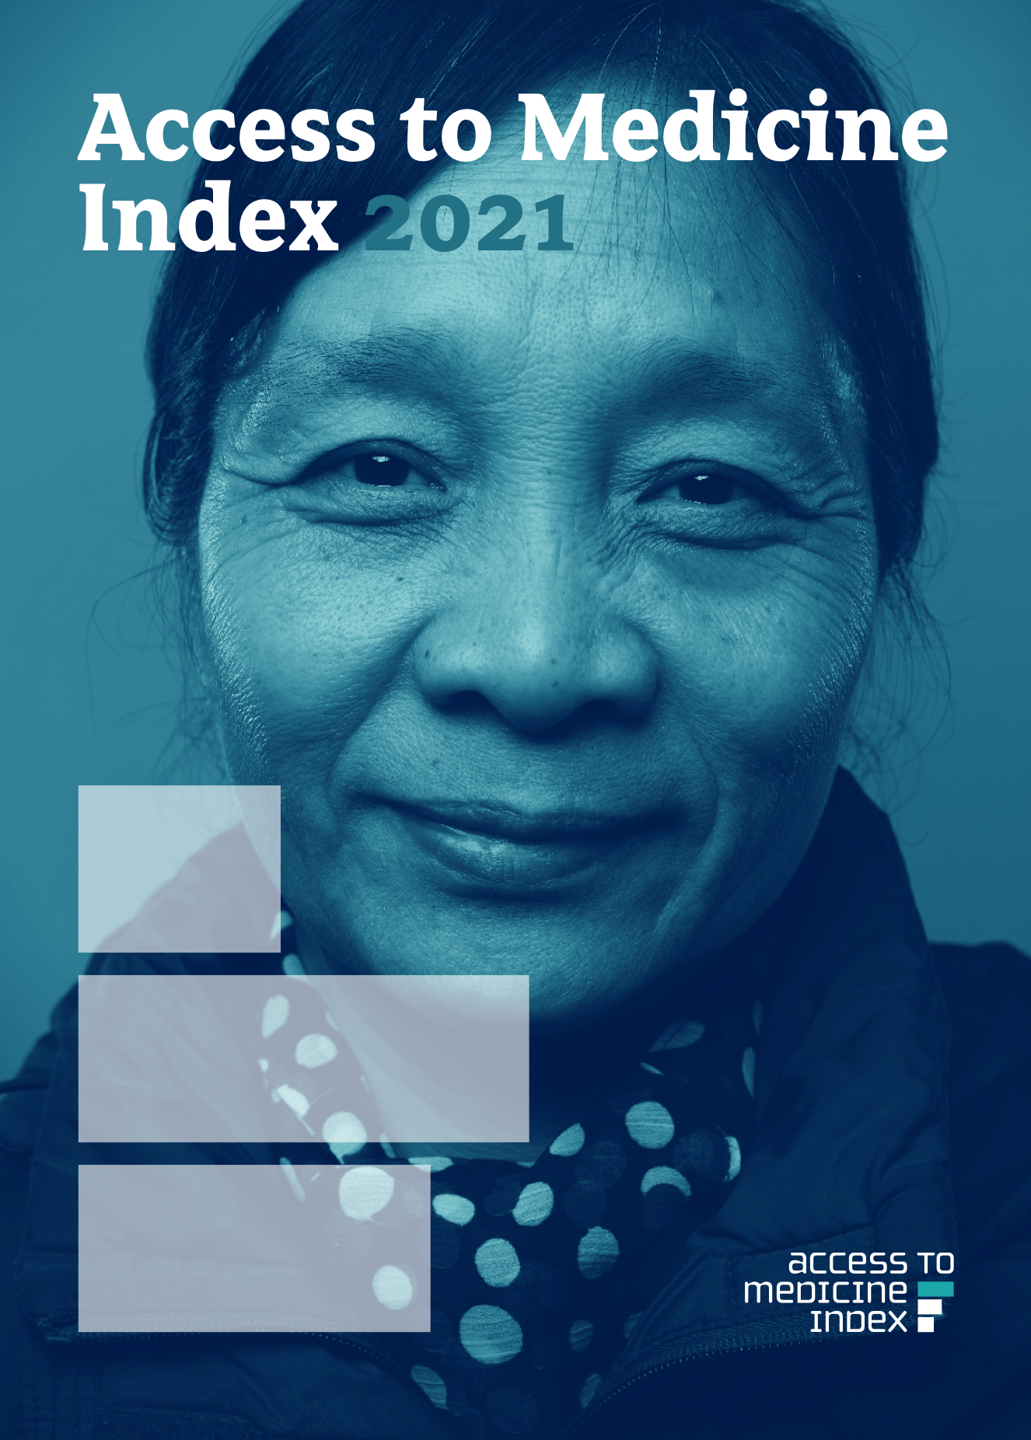

Slide 33
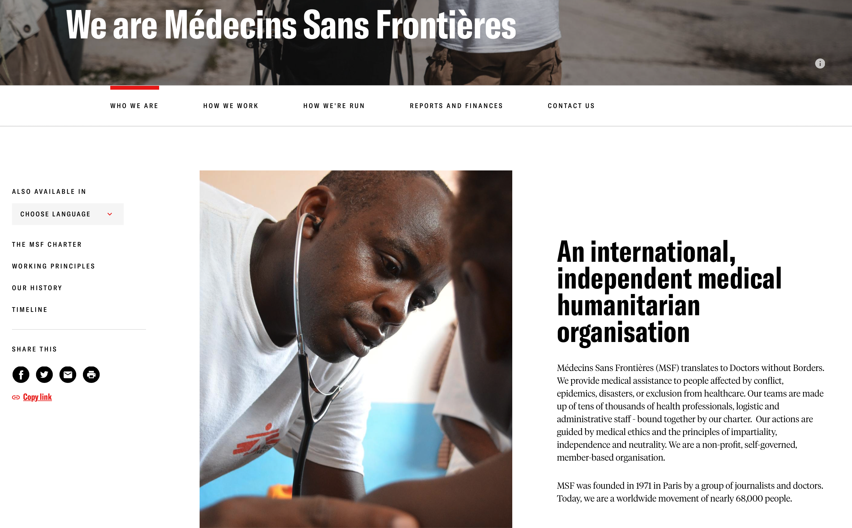
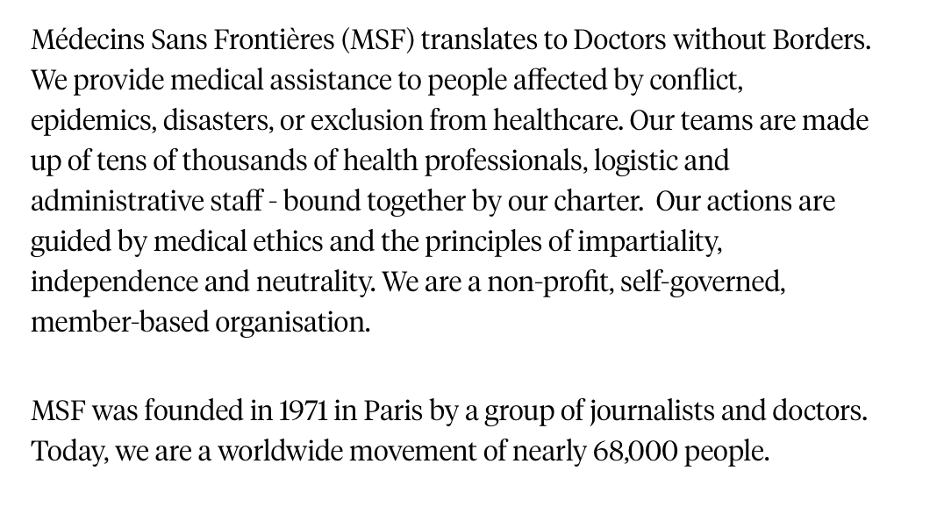

Slide 34
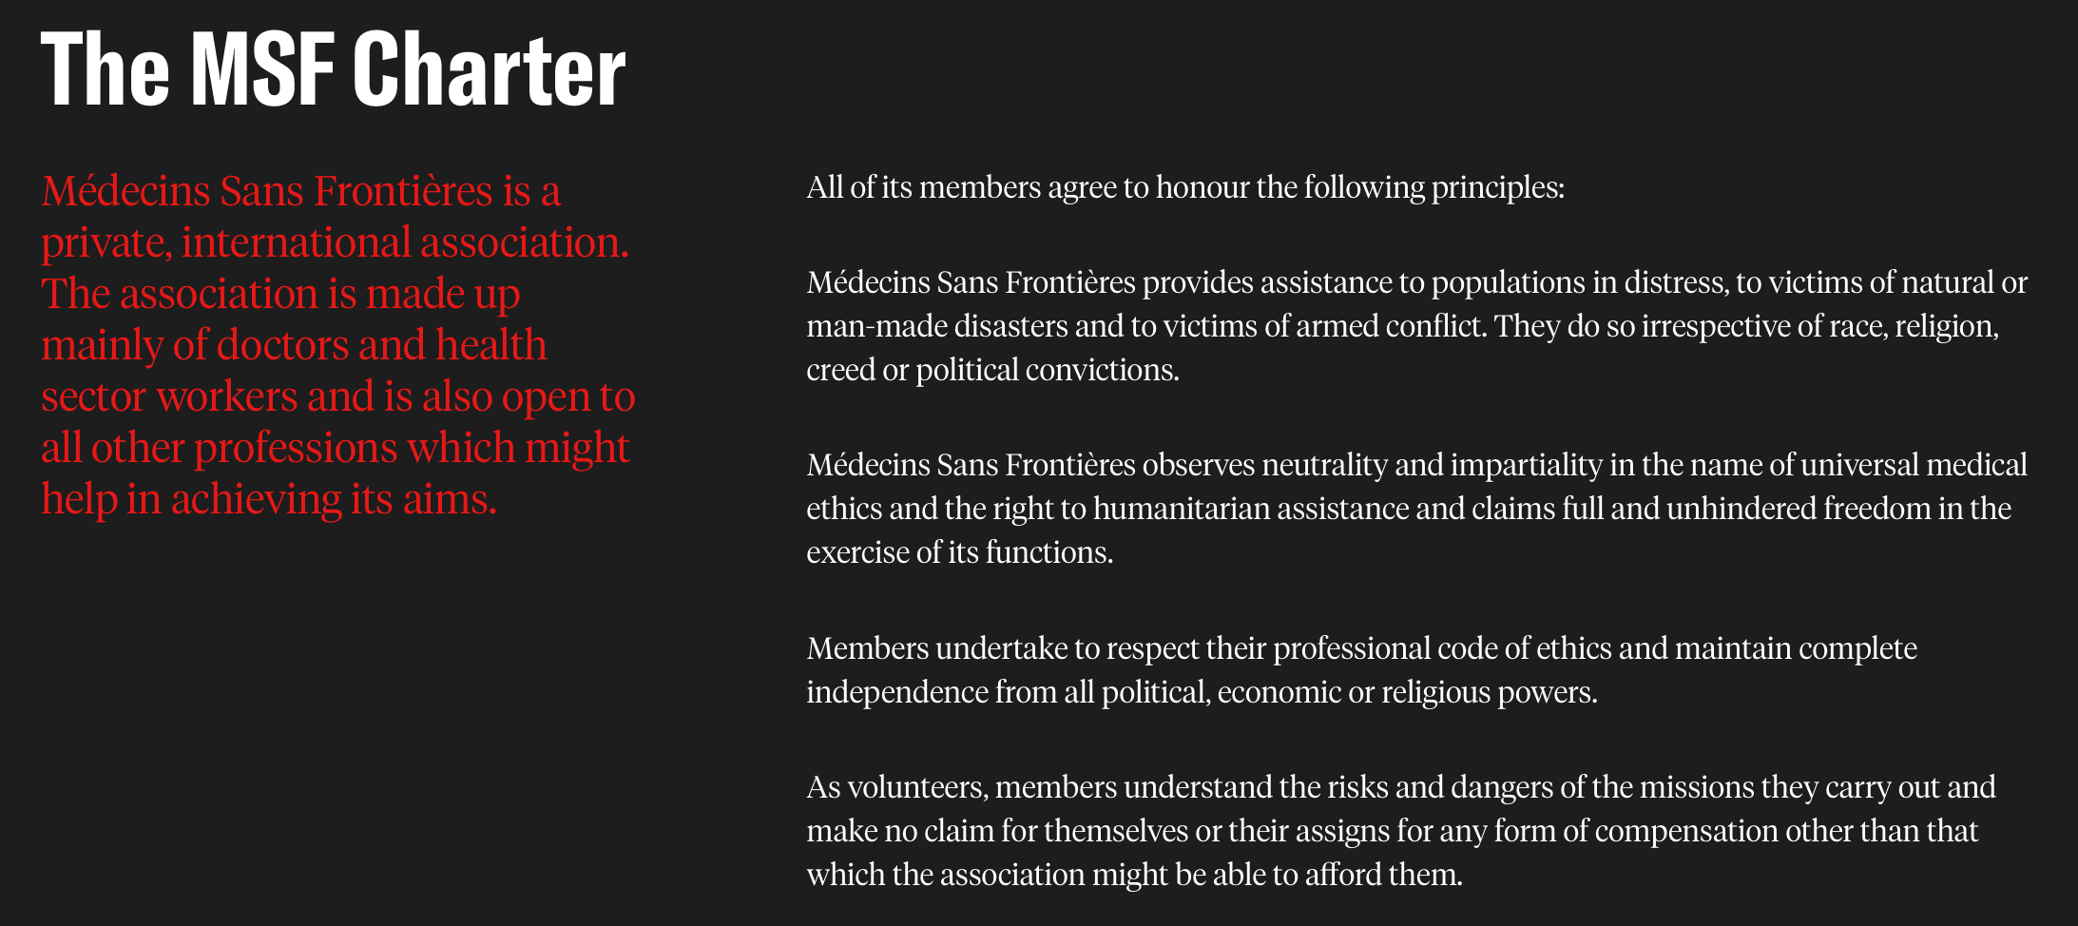

Slide 35
Hippocratic Oath (translation of original)
I swear by Apollo Healer, by Asclepius, by Hygieia, by Panacea, and by all the gods and goddesses, making them my witnesses, that I will carry out, according to my ability and judgment, this oath and this indenture.
To hold my teacher in this art equal to my own parents; to make him partner in my livelihood; when he is in need of money to share mine with him; to consider his family as my own brothers, and to teach them this art, if they want to learn it, without fee or indenture; to impart precept, oral instruction, and all other instruction to my own sons, the sons of my teacher, and to indentured pupils who have taken the Healer's oath, but to nobody else.
I will use those dietary regimens which will benefit my patients according to my greatest ability and judgment, and I will do no harm or injustice to them. Neither will I administer a poison to anybody when asked to do so, nor will I suggest such a course. Similarly I will not give to a woman a pessary to cause abortion. But I will keep pure and holy both my life and my art. I will not use the knife, not even, verily, on sufferers from stone, but I will give place to such as are craftsmen therein.
Into whatsoever houses I enter, I will enter to help the sick, and I will abstain from all intentional wrong-doing and harm, especially from abusing the bodies of man or woman, bond or free. And whatsoever I shall see or hear in the course of my profession, as well as outside my profession in my intercourse with men, if it be what should not be published abroad, I will never divulge, holding such things to be holy secrets.
Now if I carry out this oath, and break it not, may I gain for ever reputation among all men for my life and for my art; but if I break it and forswear myself, may the opposite befall me. – Translation by W.H.S. Jones.

Slide 36
Hippocratic Oath (Lasagna version, 1964)
I swear to fulfill, to the best of my ability and judgment, this covenant:
I will respect the hard-won scientific gains of those physicians in whose steps I walk, and gladly share such knowledge as is mine with those who are to follow.
I will apply, for the benefit of the sick, all measures [that] are required, avoiding those twin traps of overtreatment and therapeutic nihilism.
I will remember that there is art to medicine as well as science, and that warmth, sympathy, and understanding may outweigh the surgeon's knife or the chemist's drug.
I will not be ashamed to say, "I know not," nor will I fail to call in my colleagues when the skills of another are needed for a patient's recovery.
I will respect the privacy of my patients, for their problems are not disclosed to me that the world may know. Most especially must I tread with care in matters of life and death. If it is given me to save a life, all thanks. But it may also be within my power to take a life; this awesome responsibility must be faced with great humbleness and awareness of my own frailty. Above all, I must not play at God.
I will remember that I do not treat a fever chart, a cancerous growth, but a sick human being, whose illness may affect the person's family and economic stability. My responsibility includes these related problems, if I am to care adequately for the sick.
I will prevent disease whenever I can, for prevention is preferable to cure.
I will remember that I remain a member of society, with special obligations to all my fellow human beings, those sound of mind and body as well as the infirm.
If I do not violate this oath, may I enjoy life and art, respected while I live and remembered with affection thereafter. May I always act so as to preserve the finest traditions of my calling and may I long experience the joy of healing those who seek my help.

