Slide 1
Funding Adjustments
PX090
William Fisher
March 2024

Slide 2
Healthcare spending in general

Slide 3
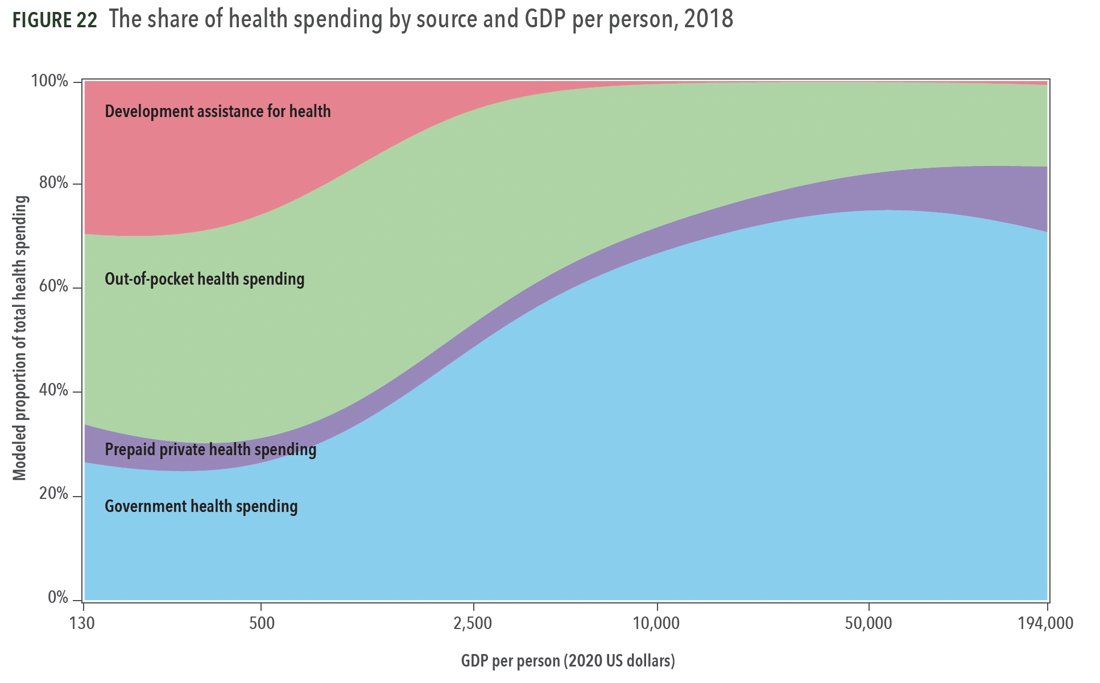
Source: Institute for Health Metrics and Evaluation, Financing Global Health 2020

Slide 4
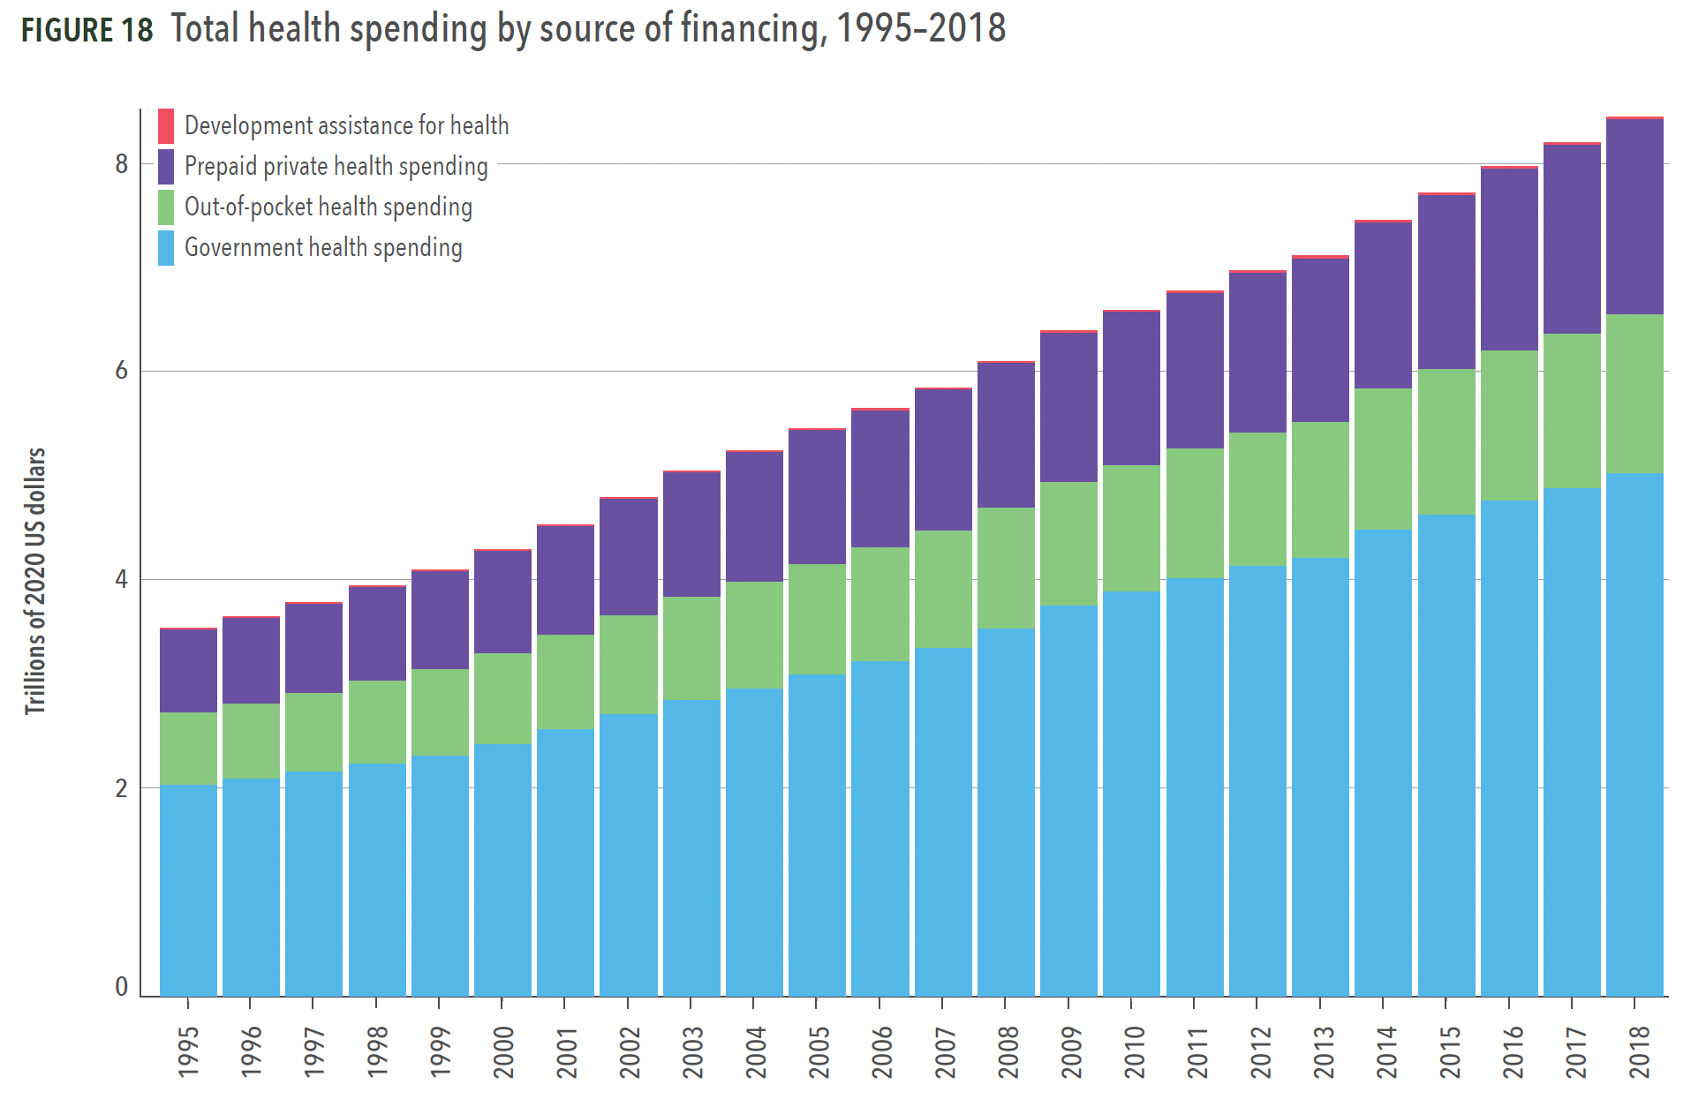
Source: Institute for Health Metrics and Evaluation, Financing Global Health 2020

Slide 5
Source: Institute for Health Metrics and Evaluation, Financing Global Health 2020

Slide 6
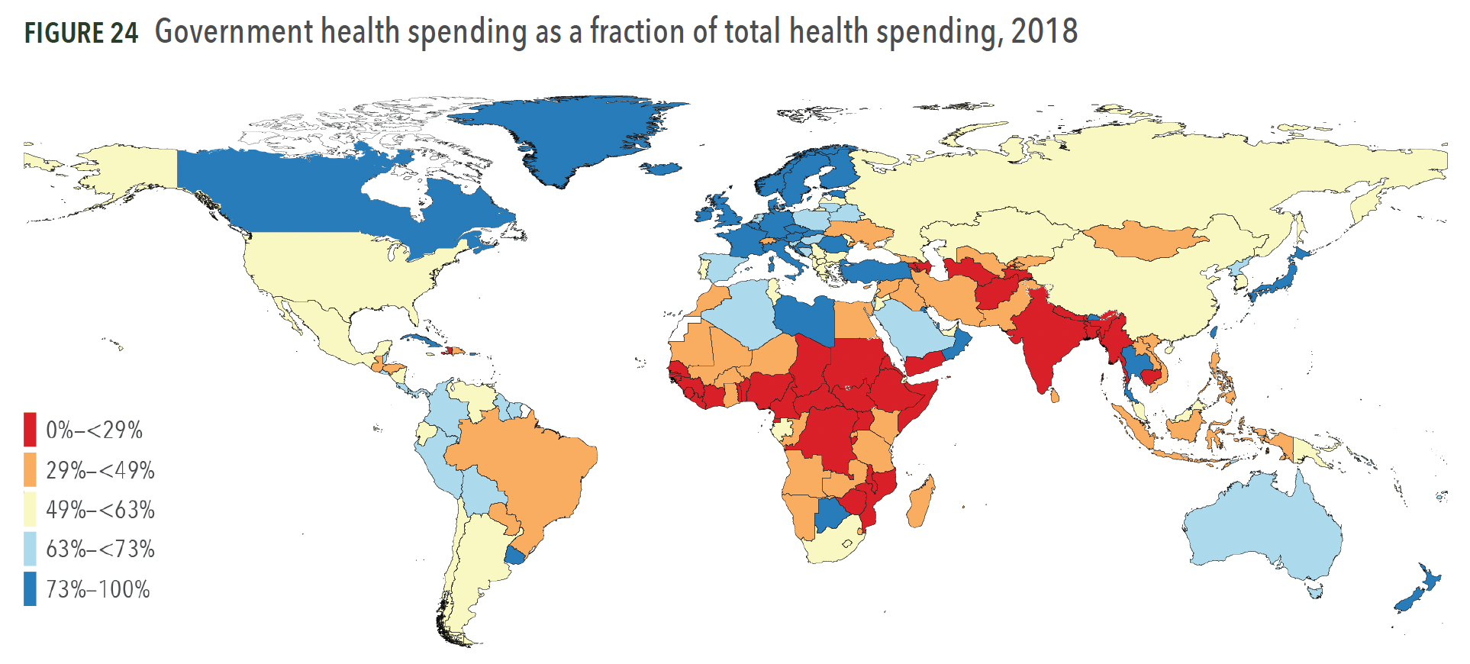
Source: Institute for Health Metrics and Evaluation, Financing Global Health 2020

Slide 7
“Development Assistance”

Slide 8
Source: Institute for Health Metrics and Evaluation, Financing Global Health 2020

Slide 9
Where does this come from?
Source: Institute for Health Metrics and Evaluation, Financing Global Health 2020

Slide 10
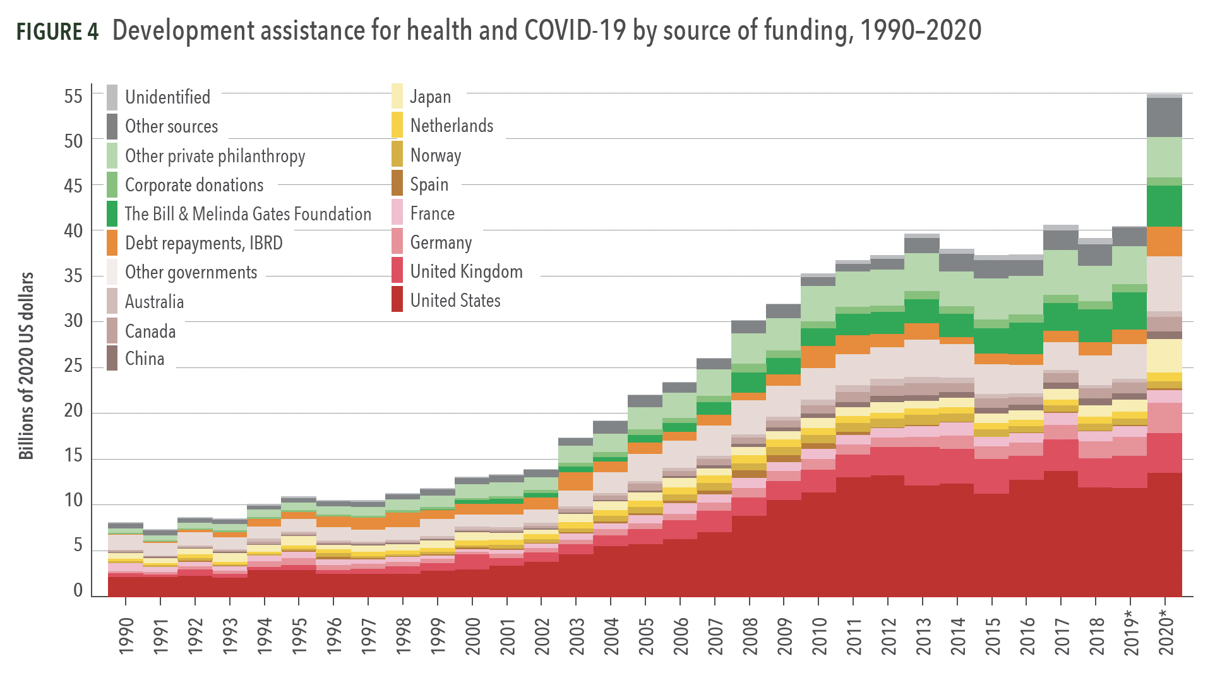
Source: Institute for Health Metrics and Evaluation, Financing Global Health 2020

Slide 11
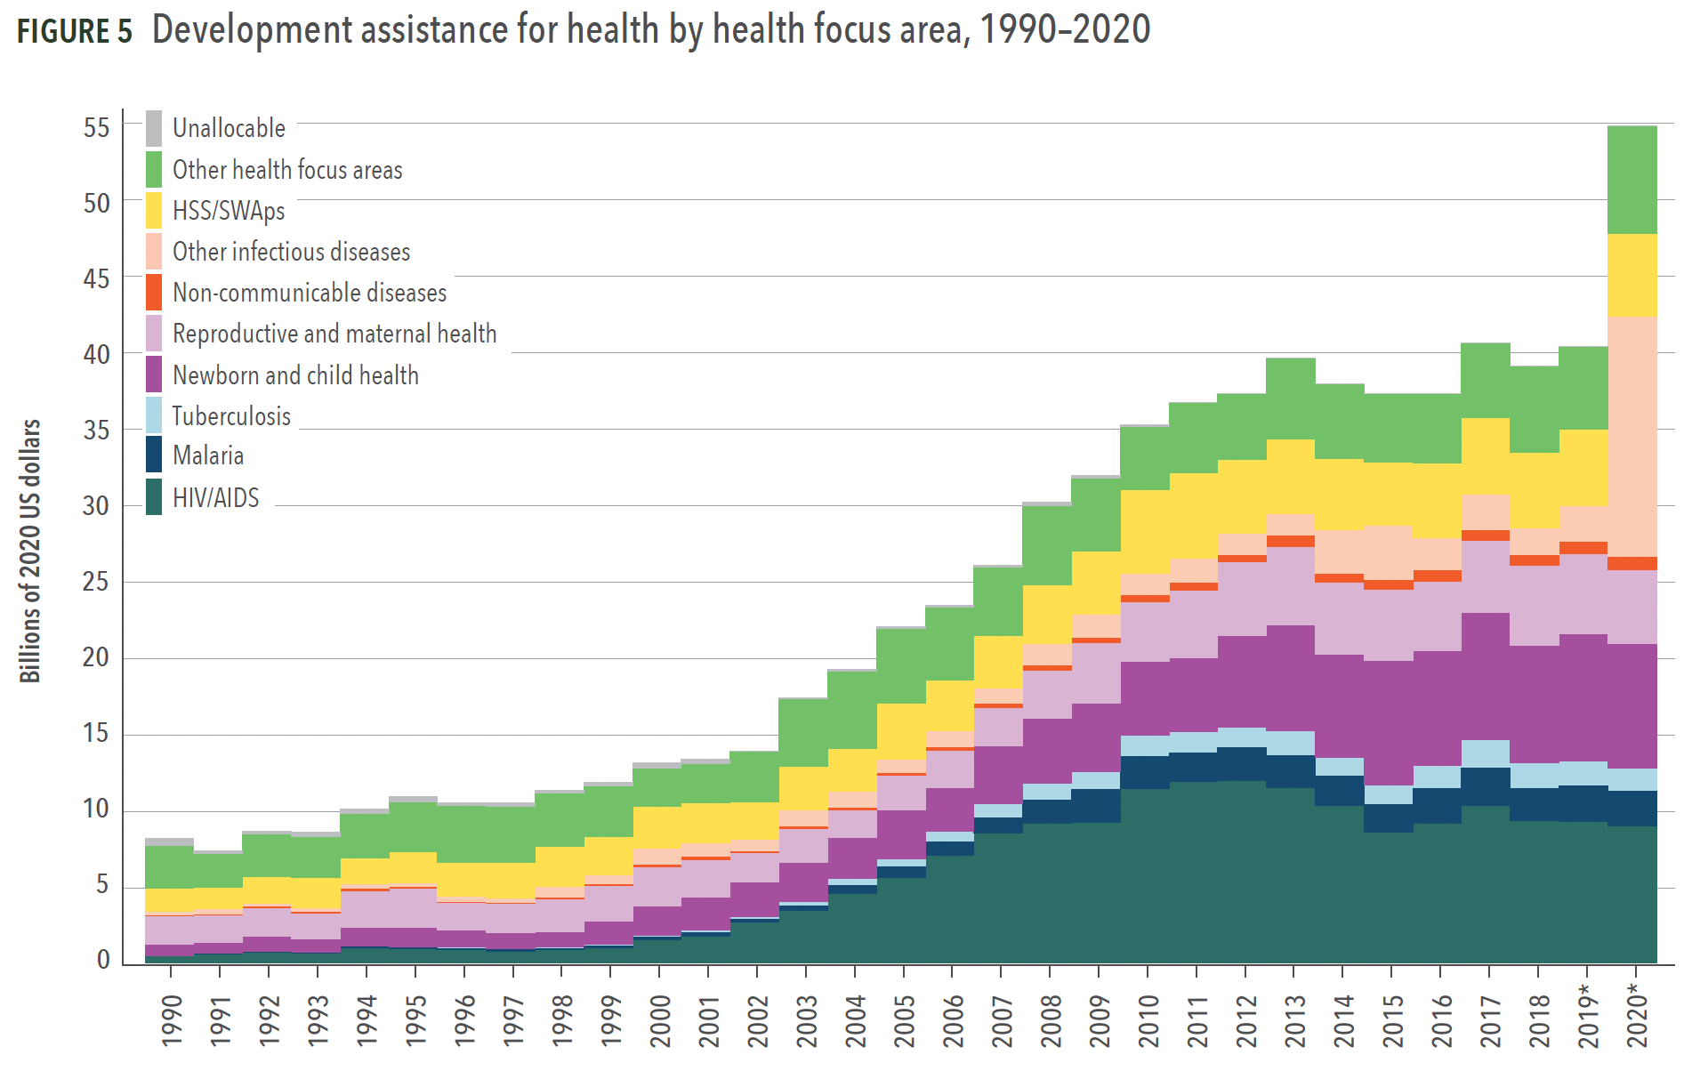
Source: Institute for Health Metrics and Evaluation, Financing Global Health 2020

Slide 12
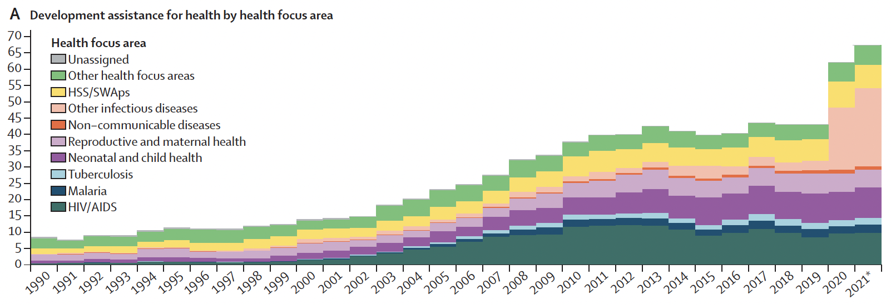
Source: Global investments in pandemic preparedness and COVID-19: development assistance and domestic spending on health between 1990 and 2026,” The Lancet 2023

Slide 13
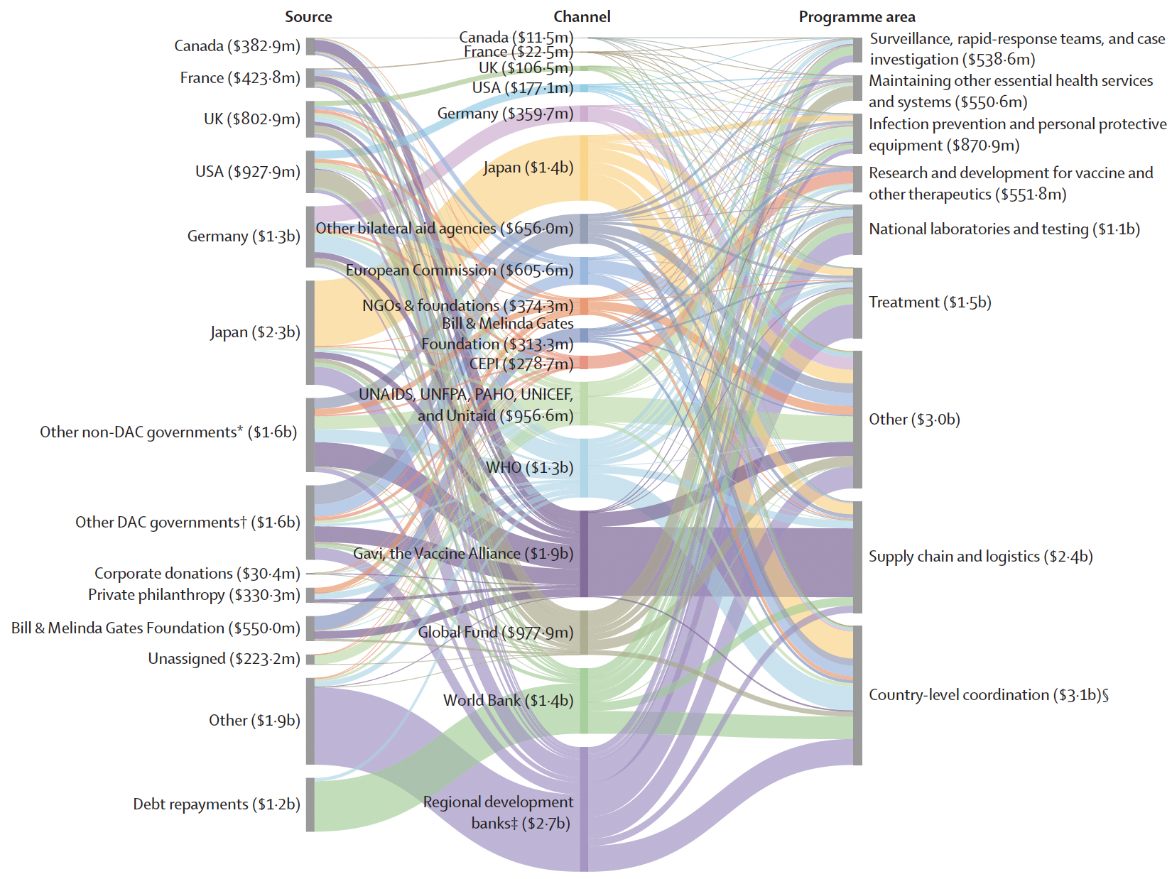
Source: ”Tracking development assistance for health and for COVID-19:
a review of development assistance, government, out-of-pocket, and
other private spending on health for 204 countries and territories, 1990–2050,” The Lancet (2021)
Flows of Assistance
For COVID-19
In 2020
(Total: $13 billion)

Slide 14
Neglected Diseases

Slide 15
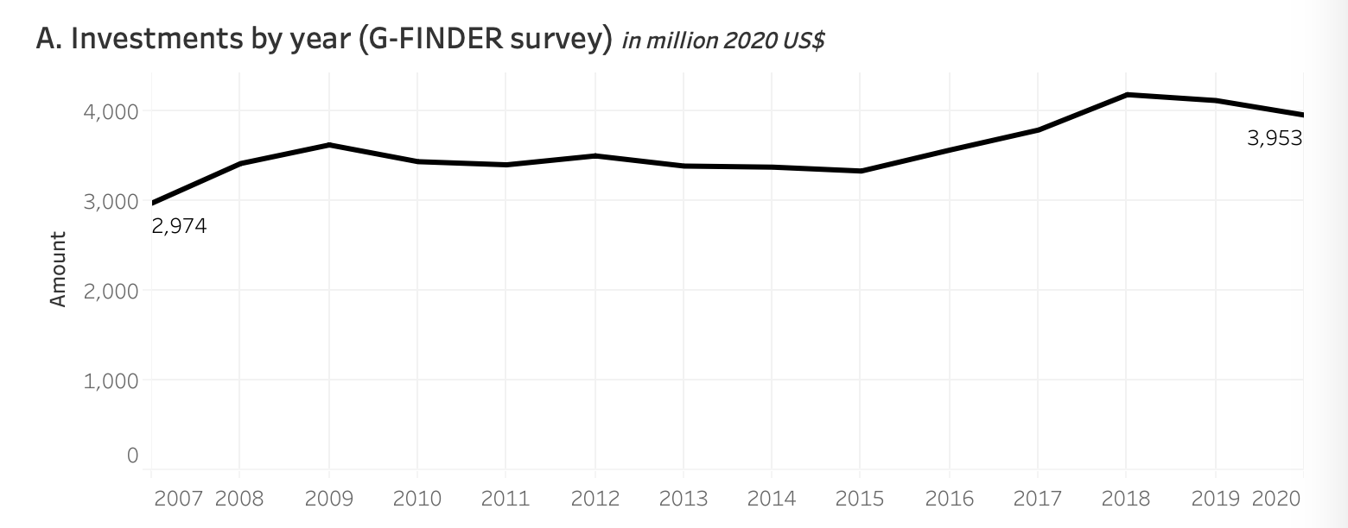
Investments by Governments and Philanthropies in R&D on Neglected Diseases
Source: https://www.who.int/observatories/global-observatory-on-health-research-and-development/monitoring/
distribution-of-r-d-funding-flows-for-neglected-diseases-by-country-funder-recipient-organization

Slide 16
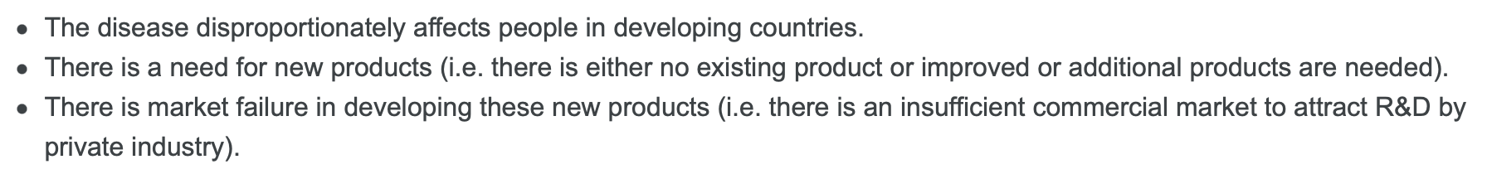
To qualify as “neglected,” a disease must meet three requirements

Slide 17
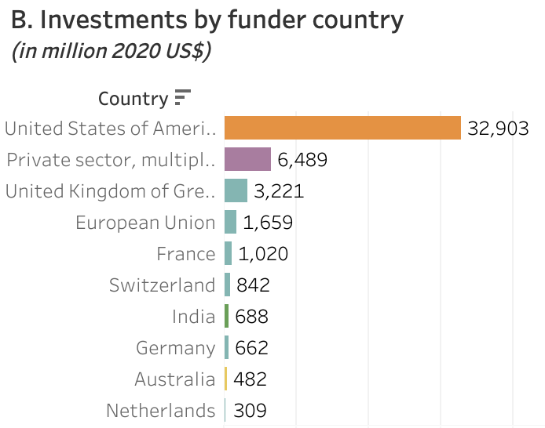
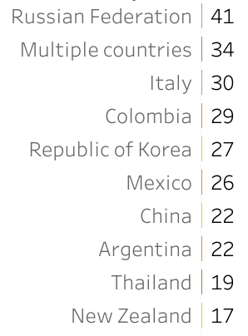
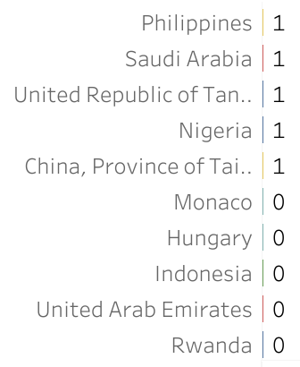
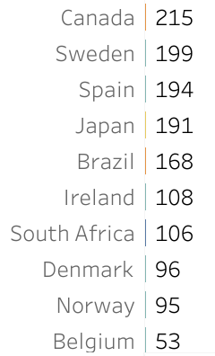
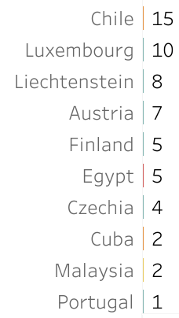
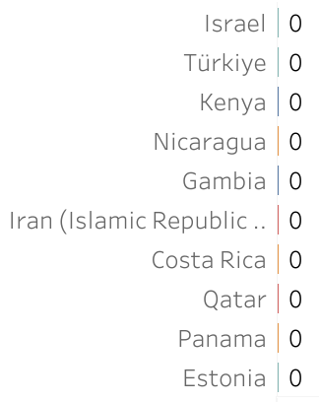
(Totals for 2007-2020)
Source: https://www.who.int/observatories/global-observatory-on-health-research-and-development/monitoring/
distribution-of-r-d-funding-flows-for-neglected-diseases-by-country-funder-recipient-organization

Slide 18
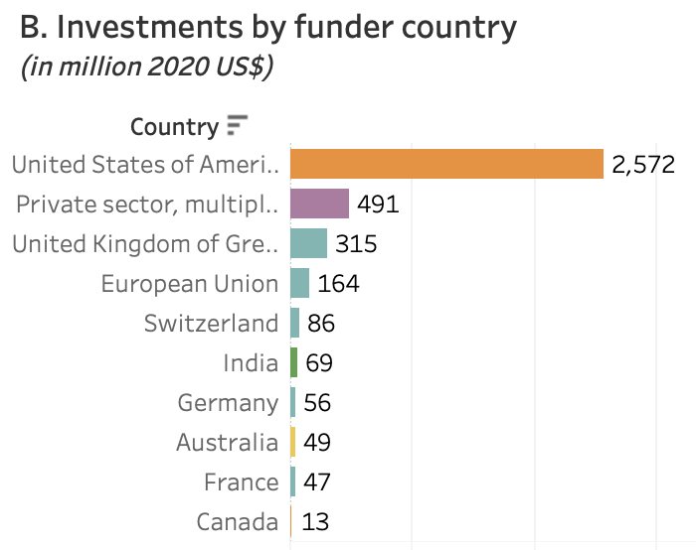
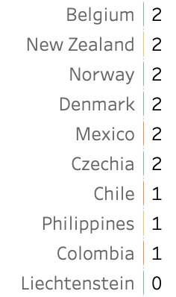
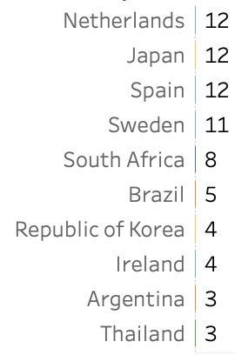
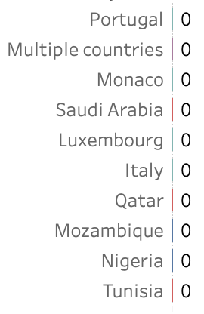
(in 2020)
Source: https://www.who.int/observatories/global-observatory-on-health-research-and-development/monitoring/
distribution-of-r-d-funding-flows-for-neglected-diseases-by-country-funder-recipient-organization

Slide 19
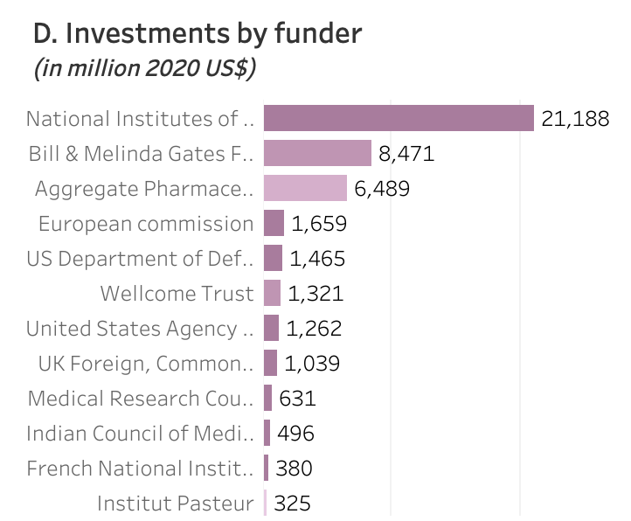
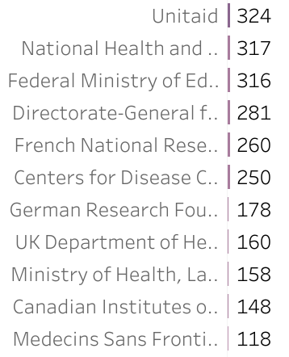
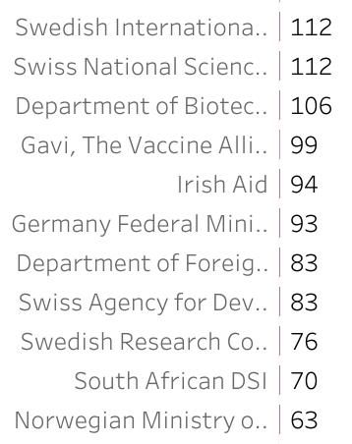
(Totals for 2007-2020)
Source: https://www.who.int/observatories/global-observatory-on-health-research-and-development/monitoring/
distribution-of-r-d-funding-flows-for-neglected-diseases-by-country-funder-recipient-organization

Slide 20
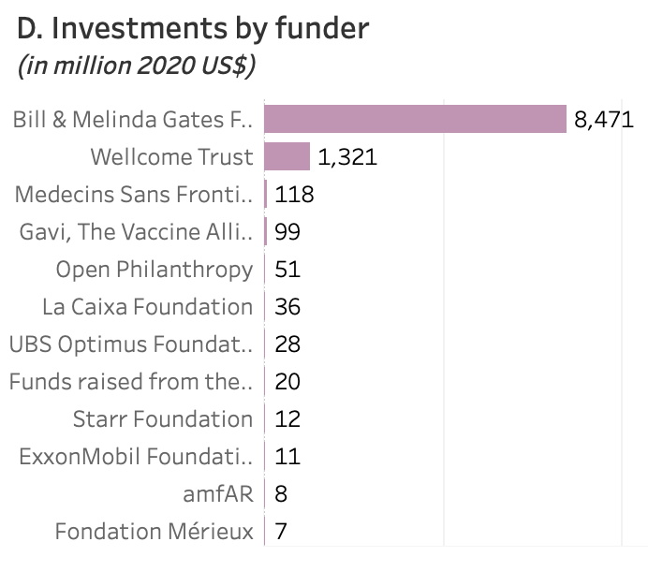
(Philanthropies alone)
Source: https://www.who.int/observatories/global-observatory-on-health-research-and-development/monitoring/
distribution-of-r-d-funding-flows-for-neglected-diseases-by-country-funder-recipient-organization
(Totals for 2007-2020)

Slide 21
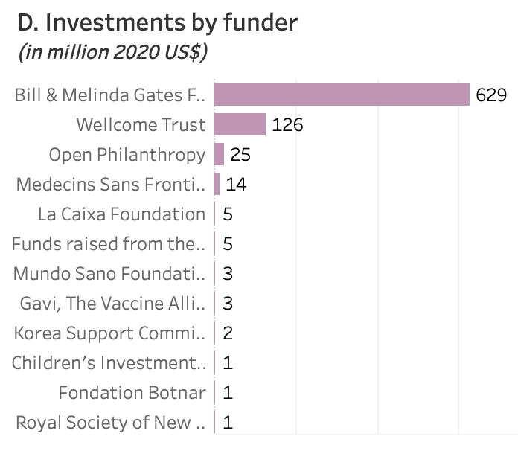
(Philanthropies alone)
Source: https://www.who.int/observatories/global-observatory-on-health-research-and-development/monitoring/
distribution-of-r-d-funding-flows-for-neglected-diseases-by-country-funder-recipient-organization
(in 2020)

Slide 22
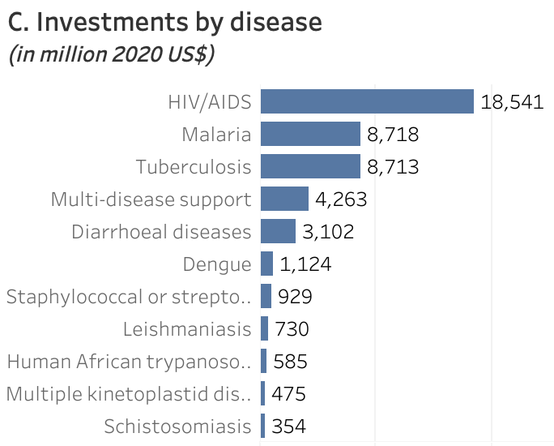
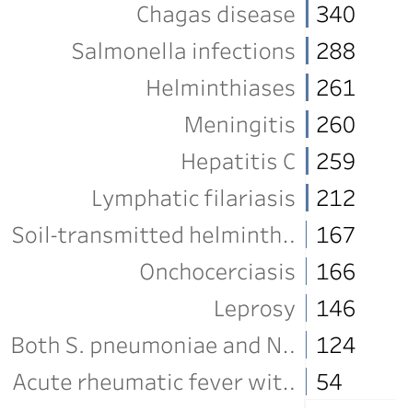
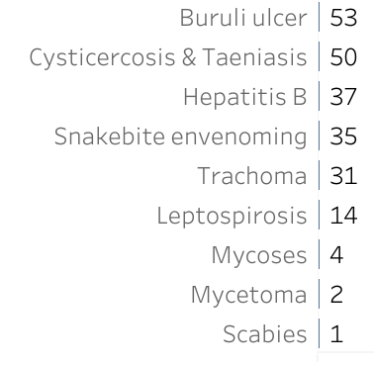
(Totals for 2007-2020)
Source: https://www.who.int/observatories/global-observatory-on-health-research-and-development/monitoring/
distribution-of-r-d-funding-flows-for-neglected-diseases-by-country-funder-recipient-organization

Slide 23
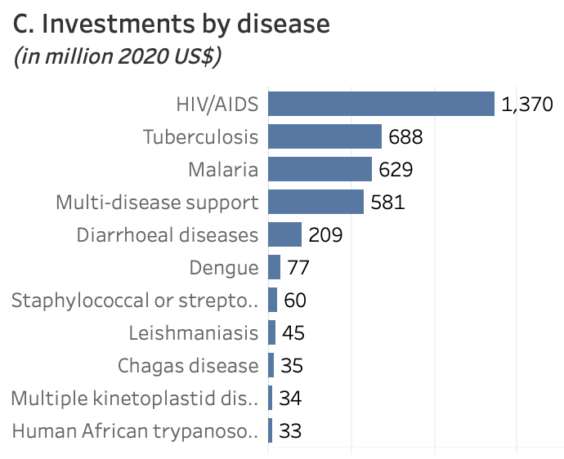
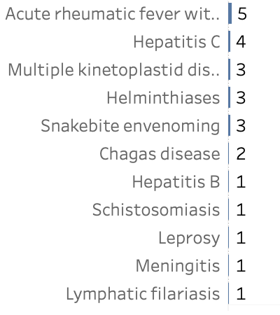
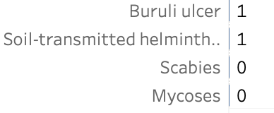
(in 2020)
Source: https://www.who.int/observatories/global-observatory-on-health-research-and-development/monitoring/
distribution-of-r-d-funding-flows-for-neglected-diseases-by-country-funder-recipient-organization

Slide 24
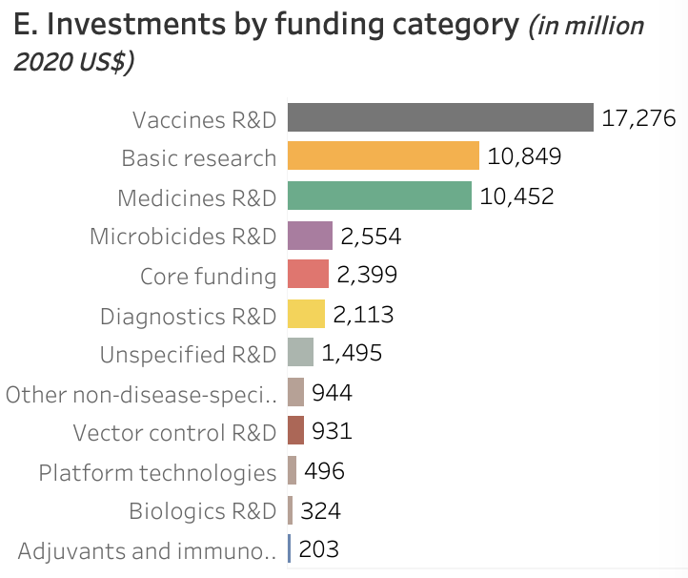
(Totals for 2007-2020)
Source: https://www.who.int/observatories/global-observatory-on-health-research-and-development/monitoring/
distribution-of-r-d-funding-flows-for-neglected-diseases-by-country-funder-recipient-organization

Slide 25
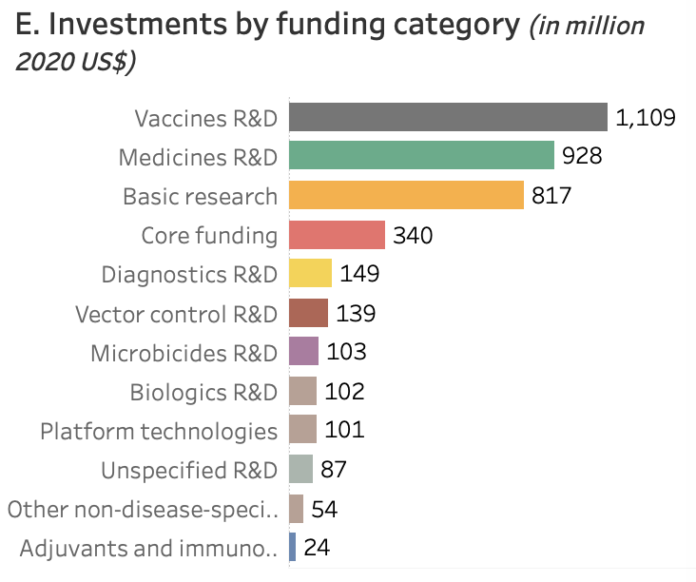
(in 2020)
Source: https://www.who.int/observatories/global-observatory-on-health-research-and-development/monitoring/
distribution-of-r-d-funding-flows-for-neglected-diseases-by-country-funder-recipient-organization

Slide 26
Potential Forms of Government Funding

Slide 27
Examples of Forms of Funding for Pharmaceutical R&D
In-house
Research
Grants
Prizes
Money
Money
Disbursement
of Money
Priority Review Vouchers
Tax Relief
Honors

Slide 28
Examples of Forms of Funding for Pharmaceutical R&D
In-house
Research
Grants
Prizes
Money
Money
Disbursement
of Money
Priority Review Vouchers
Tax Relief
Honors

Slide 29
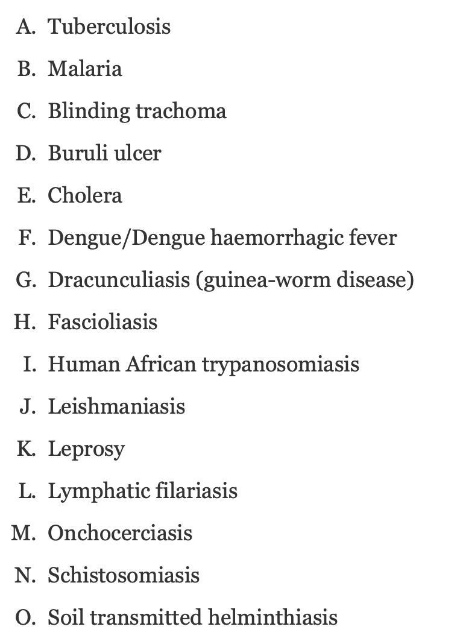
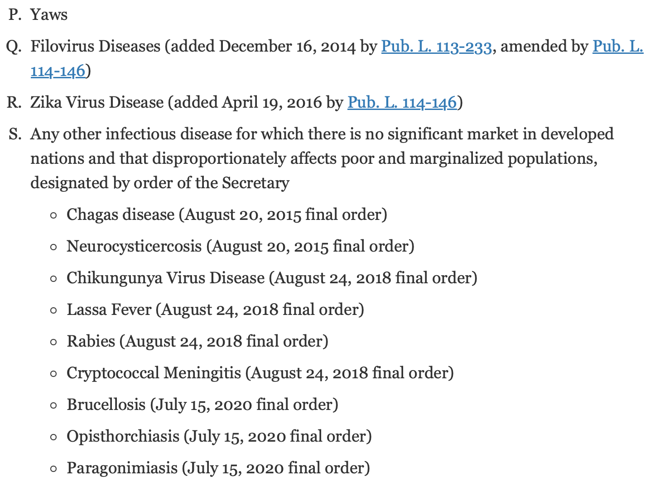
The current list of “Tropical Diseases”
Source: https://www.fda.gov/about-fda/center-drug-evaluation-and-research-cder/tropical-disease-priority-review-voucher-program

Slide 30
Comparing the Potential Forms

Slide 31
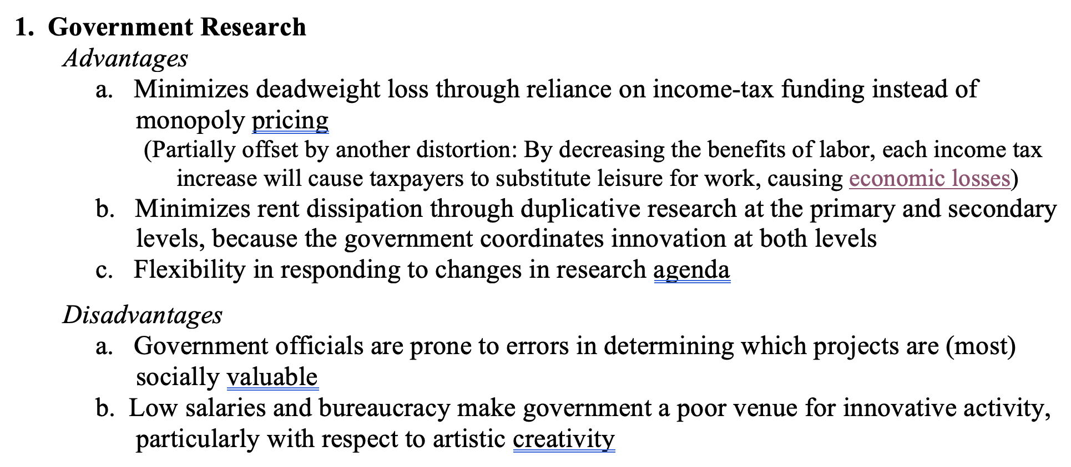
Comparing the Forms

Slide 32
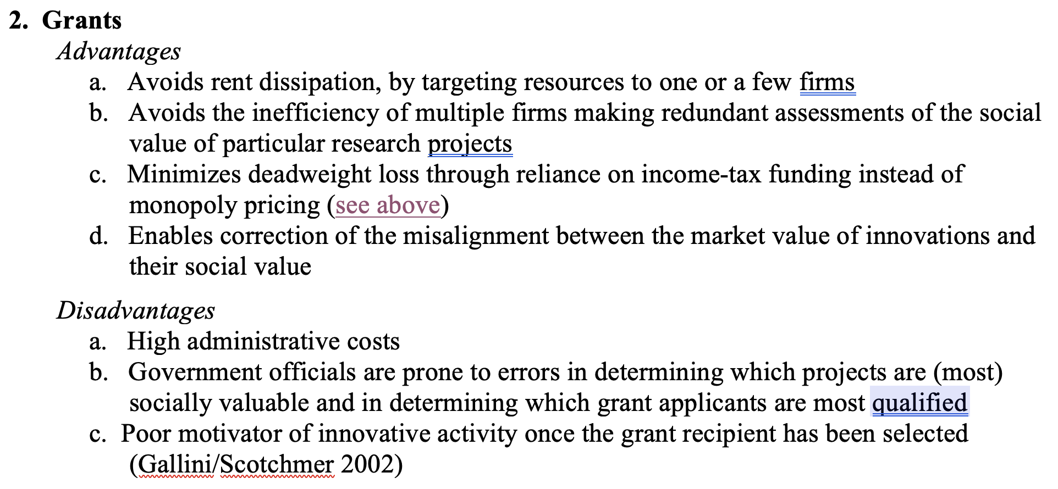
Comparing the Forms

Slide 33
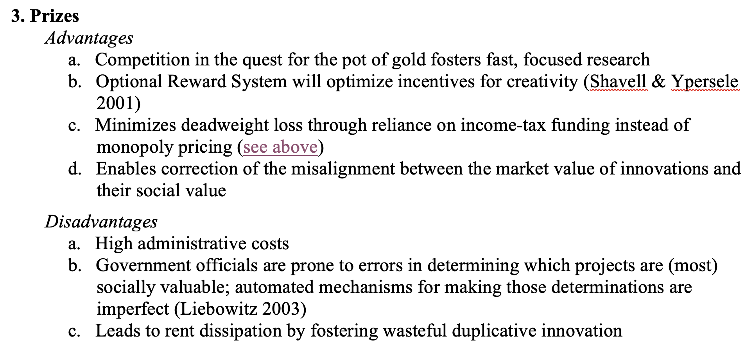
Comparing the Forms

Slide 34
Conditional Funding?

Slide 35
Innovator

Slide 36
Government
Funding (grants; prizes; tax relief)
Innovator

Slide 37
Government
Funding (grants; prizes; tax relief)
IP
Innovator

Slide 38
Government
Funding (grants; prizes; tax relief)
IP
Innovator
license
Licensee
(manufacturer)

Slide 39
Government
Funding (grants; prizes; tax relief)
IP
Innovator
license
License
fees
Licensee
(manufacturer)

Slide 40
Government
Funding (grants; prizes; tax relief)
IP
Innovator
license
License
fees
Licensee
(manufacturer)
products
Intermediaries
Consumers (Patients)

Slide 41
Government
Funding (grants; prizes; tax relief)
IP
Innovator
license
License
fees
Licensee
(manufacturer)
products
Intermediaries
$
Consumers (Patients)

Slide 42
Government
Funding (grants; prizes; tax relief)
IP
Innovator
license
License
fees
Licensee
(manufacturer)
products
Government
Intermediaries
$
Consumers (Patients)

Slide 43
Government
Funding (grants; prizes; tax relief)
IP
Innovator
license
License
fees
Licensee
(manufacturer)
products
Government
Intermediaries
$
Consumers (Patients)

Slide 44
Government
Funding (grants; prizes; tax relief)
IP
Innovator
license
License
fees
Licensee
(manufacturer)
products
Intermediaries
$
Consumers (Patients)

Slide 45
Government
Funding (grants; prizes; tax relief)
IP
Innovator
information
license
Follow-on innovator
License
fees
Licensee
(manufacturer)
products
Intermediaries
$
Consumers (Patients)

Slide 46
Government
Funding (grants; prizes; tax relief)
IP
Innovator
information
license
Follow-on innovator
License
fees
Licensee
(manufacturer)
products
products
Intermediaries
Intermediaries
$
$
Consumers (Patients)
Consumers (Patients)

Slide 47
Government
Funding (grants; prizes; tax relief)
IP
Innovator
information
license
Follow-on innovator
License
fees
Licensee
(manufacturer)
vaccines, therapies, diagnostics
products
Intermediaries
Intermediaries
$
$
Consumers (Patients)
Consumers (Patients)

Slide 48
Government
Funding (grants; prizes; tax relief)
IP
Innovator
information
license
Follow-on innovator
License
fees
Licensee
(manufacturer)
vaccines, therapies, diagnostics
products
Dysfunctions during
Health emergencies
Include:
Intermediaries
Intermediaries
$
$
Consumers (Patients)
Consumers (Patients)

Slide 49
Government
Funding (grants; prizes; tax relief)
IP
Innovator
information
license
Follow-on innovator
License
fees
Licensee
(manufacturer)
vaccines, therapies, diagnostics
products
Dysfunctions during
Health emergencies
Include:
Intermediaries
Intermediaries
$
$
Consumers (Patients)
Consumers (Patients)

Slide 50
Government
Funding (grants; prizes; tax relief)
IP
Innovator
information
license
Follow-on innovator
License
fees
Licensee
(manufacturer)
vaccines, therapies, diagnostics
products
Dysfunctions during
Health emergencies
Include:
Intermediaries
Intermediaries
$
$
Consumers (Patients)
Consumers (Patients)
geographic
restrictions

Slide 51
Government
Funding (grants; prizes; tax relief)
IP
Innovator
information
license
Follow-on innovator
License
fees
Licensee
(manufacturer)
vaccines, therapies, diagnostics
products
Dysfunctions during
Health emergencies
Include:
Intermediaries
Intermediaries
$
$
Consumers (Patients)
Consumers (Patients)
geographic
restrictions

Slide 52
Government
Funding (grants; prizes; tax relief)
IP
Innovator
information
license
Follow-on innovator
License
fees
Licensee
(manufacturer)
vaccines, therapies, diagnostics
products
Dysfunctions during
Health emergencies
Include:
misalignment between products and threats
Intermediaries
Intermediaries
$
$
Consumers (Patients)
Consumers (Patients)
geographic
restrictions

Slide 53
Government
Funding (grants; prizes; tax relief)
IP
Innovator
information
license
Follow-on innovator
License
fees
Licensee
(manufacturer)
vaccines, therapies, diagnostics
products
Intermediaries
Intermediaries
$
$
Consumers (Patients)
Consumers (Patients)

Slide 54
Issue #1: Should publicly funded
private Innovators be permitted
to acquire IP rights?
Government
Funding (grants; prizes; tax relief)
IP
Innovator
information
license
Follow-on innovator
License
fees
Licensee
(manufacturer)
vaccines, therapies, diagnostics
products
Intermediaries
Intermediaries
$
$
Consumers (Patients)
Consumers (Patients)

Slide 55
The Debate Over IP Rights on Publicly Funded Innovations
Justifications
Criticisms
Optimize commercialization of funded discoveries
Incentivize additional research by university scientists
Internalization theory (Hemel & Ouellette 2017)
Increase revenues of universities
Forces the public to “pay twice”
Strategic behavior by university TTOs undermines, not advances, goal of optimizing use of funded discoveries
Most of the licenses granted by universities to firms are non-exclusive
Little evidence of impact of university royalty sharing policies on inventive activity by faculty – or faculty mobility
Deflects academic science from proper job: basic science
At most, justifies patenting in other countries, not in US
Causes most universities to waste resources on TTOs

Slide 56
The Debate Over IP Rights on Publicly Funded Innovations
Justifications
Criticisms
Optimize commercialization of funded discoveries
Incentivize additional research by university scientists
Internalization theory (Hemel & Ouellette 2017)
Increase revenues of universities
Forces the public to “pay twice”
Strategic behavior by university TTOs undermines, not advances, goal of optimizing use of funded discoveries
Most of the licenses granted by universities to firms are non-exclusive
Little evidence of impact of university royalty sharing policies on inventive activity by faculty – or faculty mobility
Deflects academic science from proper job: basic science
At most, justifies patenting in other countries, not in US
Causes most universities to waste resources on TTOs

Slide 57
The Debate Over IP Rights on Publicly Funded Innovations
Justifications
Criticisms
Optimize commercialization of funded discoveries
Incentivize additional research by university scientists
Internalization theory (Hemel & Ouellette 2017)
Increase revenues of universities
Forces the public to “pay twice”
Strategic behavior by university TTOs undermines, not advances, goal of optimizing use of funded discoveries
Most of the licenses granted by universities to firms are non-exclusive
Little evidence of impact of university royalty sharing policies on inventive activity by faculty – or faculty mobility
Deflects academic science from proper job: basic science
At most, justifies patenting in other countries, not in US
Causes most universities to waste resources on TTOs

Slide 58
The Debate Over IP Rights on Publicly Funded Innovations
Justifications
Criticisms
Optimize commercialization of funded discoveries
Incentivize additional research by university scientists
Internalization theory (Hemel & Ouellette 2017)
Increase revenues of universities
Forces the public to “pay twice”
Strategic behavior by university TTOs undermines, not advances, goal of optimizing use of funded discoveries
Most of the licenses granted by universities to firms are non-exclusive
Little evidence of impact of university royalty sharing policies on inventive activity by faculty – or faculty mobility
Deflects academic science from proper job: basic science
At most, justifies patenting in other countries, not in US
Causes most universities to waste resources on TTOs

Slide 59
The Debate Over IP Rights on Publicly Funded Innovations
Justifications
Criticisms
Optimize commercialization of funded discoveries
Incentivize additional research by university scientists
Internalization theory (Hemel & Ouellette 2017)
Increase revenues of universities
Forces the public to “pay twice”
Strategic behavior by university TTOs undermines, not advances, goal of optimizing use of funded discoveries
Most of the licenses granted by universities to firms are non-exclusive
Little evidence of impact of university royalty sharing policies on inventive activity by faculty – or faculty mobility
Deflects academic science from proper job: basic science
At most, justifies patenting in other countries, not in US
Causes most universities to waste resources on TTOs

Slide 60
The Debate Over IP Rights on Publicly Funded Innovations
Justifications
Criticisms
Optimize commercialization of funded discoveries
Incentivize additional research by university scientists
Internalization theory (Hemel & Ouellette 2017)
Increase revenues of universities
Forces the public to “pay twice”
Strategic behavior by university TTOs undermines, not advances, goal of optimizing use of funded discoveries
Most of the licenses granted by universities to firms are non-exclusive
Little evidence of impact of university royalty sharing policies on inventive activity by faculty – or faculty mobility
Deflects academic science from proper job: basic science
At most, justifies patenting in other countries, not in US
Causes most universities to waste resources on TTOs

Slide 61
The Debate Over IP Rights on Publicly Funded Innovations
Justifications
Criticisms
Optimize commercialization of funded discoveries
Incentivize additional research by university scientists
Internalization theory (Hemel & Ouellette 2017)
Increase revenues of universities
Forces the public to “pay twice”
Strategic behavior by university TTOs undermines, not advances, goal of optimizing use of funded discoveries
Most of the licenses granted by universities to firms are non-exclusive
Little evidence of impact of university royalty sharing policies on inventive activity by faculty – or faculty mobility
Deflects academic science from proper job: basic science
At most, justifies patenting in other countries, not domestic patenting
Causes most universities to waste resources on TTOs

Slide 62
The Debate Over IP Rights on Publicly Funded Innovations
Justifications
Criticisms
Optimize commercialization of funded discoveries
Incentivize additional research by university scientists
Internalization theory (Hemel & Ouellette 2017)
Increase revenues of universities
Forces the public to “pay twice”
Strategic behavior by university TTOs undermines, not advances, goal of optimizing use of funded discoveries
Most of the licenses granted by universities to firms are non-exclusive
Little evidence of impact of university royalty sharing policies on inventive activity by faculty – or faculty mobility
Deflects academic science from proper job: basic science
At most, justifies patenting in other countries, not domestic patenting
Causes most universities to waste resources on TTOs

Slide 63
Issue #1: Should publicly funded
private Innovators be permitted
to acquire IP rights?
Government
Funding (grants; prizes; tax relief)
IP
Innovator
information
license
Follow-on innovator
License
fees
Licensee
(manufacturer)
vaccines, therapies, diagnostics
products
Intermediaries
Intermediaries
$
$
Consumers (Patients)
Consumers (Patients)

Slide 64
Issue #2: Should dysfunctions
associated with exercise of those
rights be curbed through
conditions on the funding?
Government
Funding (grants; prizes; tax relief)
IP
Innovator
information
license
Follow-on innovator
License
fees
Licensee
(manufacturer)
vaccines, therapies, diagnostics
products
Intermediaries
Intermediaries
$
$
Consumers (Patients)
Consumers (Patients)

Slide 65
Issue #2: Should dysfunctions
associated with exercise of those
rights be curbed through
conditions on the funding?
Government
Funding (grants; prizes; tax relief)
1. “shop right”
IP
Innovator
information
license
Follow-on innovator
License
fees
Licensee
(manufacturer)
vaccines, therapies, diagnostics
products
Intermediaries
Intermediaries
$
$
Consumers (Patients)
Consumers (Patients)

Slide 66
Issue #2: Should dysfunctions
associated with exercise of those
rights be curbed through
conditions on the funding?
Government
Funding (grants; prizes; tax relief)
1. “shop right”
IP
Innovator
information
license
Follow-on innovator
License
fees
Licensee
(manufacturer)
2. Duty to make products available at affordable prices --
a. within LMICs,
b. within the nation, or
c. globally
vaccines, therapies, diagnostics
products
Intermediaries
Intermediaries
$
$
Consumers (Patients)
Consumers (Patients)

Slide 67
Issue #2: Should dysfunctions
associated with exercise of those
rights be curbed through
conditions on the funding?
Government
Funding (grants; prizes; tax relief)
1. “shop right”
IP
Innovator
information
license
Follow-on innovator
License
fees
Licensee
(manufacturer)
2. Duty to make products available at affordable prices --
a. within LMICs,
b. within the nation, or
c. globally
vaccines, therapies, diagnostics
products
Intermediaries
Intermediaries
$
$
Consumers (Patients)
Consumers (Patients)

Slide 68
Issue #2: Should dysfunctions
associated with exercise of those
rights be curbed through
conditions on the funding?
Government
Funding (grants; prizes; tax relief)
1. “shop right”
IP
Innovator
3. “March-in Rights”
information
license
Follow-on innovator
License
fees
Licensee
(manufacturer)
2. Duty to make products available at affordable prices --
a. within LMICs,
b. within the nation, or
c. globally
vaccines, therapies, diagnostics
products
Intermediaries
Intermediaries
$
$
Consumers (Patients)
Consumers (Patients)

Slide 69
Issue #2: Should dysfunctions
associated with exercise of those
rights be curbed through
conditions on the funding?
Government
Funding (grants; prizes; tax relief)
1. “shop right”
IP
Innovator
3. “March-in Rights”
information
license
Follow-on innovator
license
License
fees
Licensee
(manufacturer)
Licensee
(manufacturer)
2. Duty to make products available at affordable prices --
a. within LMICs,
b. within the nation, or
c. globally
vaccines, therapies, diagnostics
products
Intermediaries
Intermediaries
$
$
Consumers (Patients)
Consumers (Patients)

Slide 70
Issue #2: Should dysfunctions
associated with exercise of those
rights be curbed through
conditions on the funding?
Government
Funding (grants; prizes; tax relief)
1. “shop right”
IP
Innovator
3. “March-in Rights”
information
license
Follow-on innovator
license
License
fees
Licensee
(manufacturer)
Licensee
(manufacturer)
2. Duty to make products available at affordable prices --
a. within LMICs,
b. within the nation, or
c. globally
vaccines, therapies, diagnostics
products
products
Intermediaries
Intermediaries
Intermediaries
$
$
$
Consumers (Patients)
Consumers (Patients)
Consumers (Patients)

Slide 71
Issue #2: Should dysfunctions
associated with exercise of those
rights be curbed through
conditions on the funding?
Government
Funding (grants; prizes; tax relief)
1. “shop right”
IP
Innovator
4. Duty to increase flow of information
--research data; failed projects;
--fruits of clinical trials;
3. “March-in Rights”
information
license
Follow-on innovator
license
License
fees
Licensee
(manufacturer)
Licensee
(manufacturer)
2. Duty to make products available at affordable prices --
a. within LMICs,
b. within the nation, or
c. globally
vaccines, therapies, diagnostics
products
products
Intermediaries
Intermediaries
Intermediaries
$
$
$
Consumers (Patients)
Consumers (Patients)
Consumers (Patients)

Slide 72
Issue #3: If so, how should such
conditions be implemented?
Government
Funding (grants; prizes; tax relief)
1. “shop right”
IP
Innovator
4. Duty to increase flow of information
--research data; failed projects;
--fruits of clinical trials;
3. “March-in Rights”
information
license
Follow-on innovator
license
License
fees
Licensee
(manufacturer)
Licensee
(manufacturer)
2. Duty to make products available at affordable prices --
a. within LMICs,
b. within the nation, or
c. globally
vaccines, therapies, diagnostics
products
products
Intermediaries
Intermediaries
Intermediaries
$
$
$
Consumers (Patients)
Consumers (Patients)
Consumers (Patients)

Slide 73
Implementation Options (Prospective)
Conditions mandatory in all grants (typically imposed through legislation or administrative rule-making)
Default conditions
Conditions inserted in individual grants

Slide 74
Implementation Options (Prospective)
Conditions mandatory in all grants (typically imposed through legislation or administrative rule-making)
Default conditions
Conditions inserted in individual grants

Slide 75
Issue #3: If so, how should such
conditions be implemented?
Government
Funding (grants; prizes; tax relief)
1. “shop right”
IP
Innovator
4. Duty to increase flow of information
--research data; failed projects;
--fruits of clinical trials;
3. “March-in Rights”
information
license
Follow-on innovator
license
License
fees
Licensee
(manufacturer)
Licensee
(manufacturer)
2. Duty to make products available at affordable prices --
a. within LMICs,
b. within the nation, or
c. globally
vaccines, therapies, diagnostics
products
products
Intermediaries
Intermediaries
Intermediaries
$
$
$
Consumers (Patients)
Consumers (Patients)
Consumers (Patients)

Slide 76
Issue #4: Are there other ways
of efficiently increasing the
social benefits of publicly funded
Innovation?
Government
Funding (grants; prizes; tax relief)
1. “shop right”
IP
Innovator
4. Duty to increase flow of information
--research data; failed projects;
--fruits of clinical trials;
3. “March-in Rights”
information
license
Follow-on innovator
license
License
fees
Licensee
(manufacturer)
Licensee
(manufacturer)
2. Duty to make products available at affordable prices --
a. within LMICs,
b. within the nation, or
c. globally
vaccines, therapies, diagnostics
products
products
Intermediaries
Intermediaries
Intermediaries
$
$
$
Consumers (Patients)
Consumers (Patients)
Consumers (Patients)

Slide 77
Summary
Should publicly funded private Innovators be permitted to acquire IP rights?
If so, should the dysfunctions associated with exercise of those rights be curbed through conditions on the funding?
If so, how should such conditions be implemented?
Are there other ways of efficiently increasing the social benefits of publicly funded innovation in the context of health emergencies?

Slide 80
Breakthrough Drugs
Drugs aimed at Neglected Infectious Diseases
Vaccines

Slide 81
Funding for Research on Neglected Diseases
Source: https://www.who.int/observatories/global-observatory-on-health-research-and-development/monitoring/
distribution-of-r-d-funding-flows-for-neglected-diseases-by-country-funder-recipient-organization
(in 2020)

Slide 82
(Totals for 2007-2020)
Source: https://www.who.int/observatories/global-observatory-on-health-research-and-development/monitoring/
distribution-of-r-d-funding-flows-for-neglected-diseases-by-country-funder-recipient-organization

Slide 83
(Totals for 2007-2020)
Source: https://www.who.int/observatories/global-observatory-on-health-research-and-development/monitoring/
distribution-of-r-d-funding-flows-for-neglected-diseases-by-country-funder-recipient-organization

Slide 84
(Totals for 2007-2020)
Source: https://www.who.int/observatories/global-observatory-on-health-research-and-development/monitoring/
distribution-of-r-d-funding-flows-for-neglected-diseases-by-country-funder-recipient-organization

Slide 85
(thousands) | Global Deaths | Global DALYs
HIV/AIDS | 675 | 40147
Tuberculosis* | 1208 | 66024
Malaria* | 411 | 33398
STDs (excluding HIV/AIDS)
Syphilis | 43 | 3814
Chlamydia | 1 | 324
Gonorrhoea | 2 | 231
Trichomoniasis | 0 | 282
Genital herpes | 0 | 250
Other STDs | 3 | 352
Diarrhoeal Diseases | 1519 | 79311
Childhood Diseases
Pertussis (“whooping cough”) | 111 | 9839
Diphtheria | 5 | 420
Measles | 165 | 14528
Tetanus | 47 | 3474
Meningitis | 233 | 16314
Encephalitis | 78 | 4174
Hepatitis
A | 40 | 2102
B | 36 | 1633
C | 22 | 655
E | 2 | 123
(thousands) | Global Deaths | Global DALYs
Parasitic and vector diseases (excluding Malaria)
Trypanosomiasis* | 2 | 102
Chagas* | 8 | 217
Schistosomiasis | 12 | 1628
Leishmaniasis* | 6 | 722
Lymphatic filariasis (elephantiasis) | 0 | 1616
Onchocerciasis (river blindness) | 0 | 1210
Cysticercosis | 7 | 988
Echinococcosis | 9 | 461
Dengue | 30 | 1952
Trachoma (infectious blindness) | 0 | 194
Yellow fever | 6 | 413
Rabies | 47 | 2634
Intestinal nematode infections
Ascariasis | 2 | 749
Trichuriasis | 0 | 232
Hookworm | 0 | 962
Food-bourne trematodes | 7 | 805
Leprosy | 13 | 36
Other infectious diseases | 370 | 19000
Totals | 5101 | 311318

Slide 86
(thousands) | Global Deaths | Global DALYs
HIV/AIDS | 675 | 40147
Tuberculosis* | 1208 | 66024
Malaria* | 411 | 33398
STDs (excluding HIV/AIDS)
Syphilis | 43 | 3814
Chlamydia | 1 | 324
Gonorrhoea | 2 | 231
Trichomoniasis | 0 | 282
Genital herpes | 0 | 250
Other STDs | 3 | 352
Diarrhoeal Diseases | 1519 | 79311
Childhood Diseases
Pertussis (“whooping cough”) | 111 | 9839
Diphtheria | 5 | 420
Measles | 165 | 14528
Tetanus | 47 | 3474
Meningitis | 233 | 16314
Encephalitis | 78 | 4174
Hepatitis
A | 40 | 2102
B | 36 | 1633
C | 22 | 655
E | 2 | 123
(thousands) | Global Deaths | Global DALYs
Parasitic and vector diseases (excluding Malaria)
Trypanosomiasis* | 2 | 102
Chagas* | 8 | 217
Schistosomiasis | 12 | 1628
Leishmaniasis* | 6 | 722
Lymphatic filariasis (elephantiasis) | 0 | 1616
Onchocerciasis (river blindness) | 0 | 1210
Cysticercosis | 7 | 988
Echinococcosis | 9 | 461
Dengue | 30 | 1952
Trachoma (infectious blindness) | 0 | 194
Yellow fever | 6 | 413
Rabies | 47 | 2634
Intestinal nematode infections
Ascariasis | 2 | 749
Trichuriasis | 0 | 232
Hookworm | 0 | 962
Food-bourne trematodes | 7 | 805
Leprosy | 13 | 36
Other infectious diseases | 370 | 19000
Totals | 5101 | 311318

Slide 87
(thousands) | Global Deaths | Global DALYs | Share of DALYs | Funding (millions)
HIV/AIDS | 675 | 40147 | 13% | $516
Tuberculosis* | 1208 | 66024 | 21% | $848
Malaria* | 411 | 33398 | 11% | $429
STDs (excluding HIV/AIDS)
Syphilis | 43 | 3814
Chlamydia | 1 | 324
Gonorrhoea | 2 | 231
Trichomoniasis | 0 | 282
Genital herpes | 0 | 250
Other STDs | 3 | 352
Diarrhoeal Diseases | 1519 | 79311
Childhood Diseases
Pertussis (“whooping cough”) | 111 | 9839
Diphtheria | 5 | 420
Measles | 165 | 14528
Tetanus | 47 | 3474
Meningitis | 233 | 16314
Encephalitis | 78 | 4174
Hepatitis
A | 40 | 2102
B | 36 | 1633
C | 22 | 655
E | 2 | 123
(thousands) | Global Deaths | Global DALYs | Share of DALYs | Funding (millions)
Parasitic and vector diseases (excluding Malaria)
Trypanosomiasis* | 2 | 102
Chagas* | 8 | 217
Schistosomiasis | 12 | 1628
Leishmaniasis* | 6 | 722
Lymphatic filariasis (elephantiasis) | 0 | 1616
Onchocerciasis (river blindness) | 0 | 1210
Cysticercosis | 7 | 988
Echinococcosis | 9 | 461
Dengue | 30 | 1952
Trachoma (infectious blindness) | 0 | 194
Yellow fever | 6 | 413
Rabies | 47 | 2634
Intestinal nematode infections
Ascariasis | 2 | 749
Trichuriasis | 0 | 232
Hookworm | 0 | 962
Food-bourne trematodes | 7 | 805
Leprosy | 13 | 36
Other infectious diseases | 370 | 19000
Totals | 5101 | 311318

Slide 88
(Totals for 2007-2020)
Source: https://www.who.int/observatories/global-observatory-on-health-research-and-development/monitoring/
distribution-of-r-d-funding-flows-for-neglected-diseases-by-country-funder-recipient-organization

Slide 89
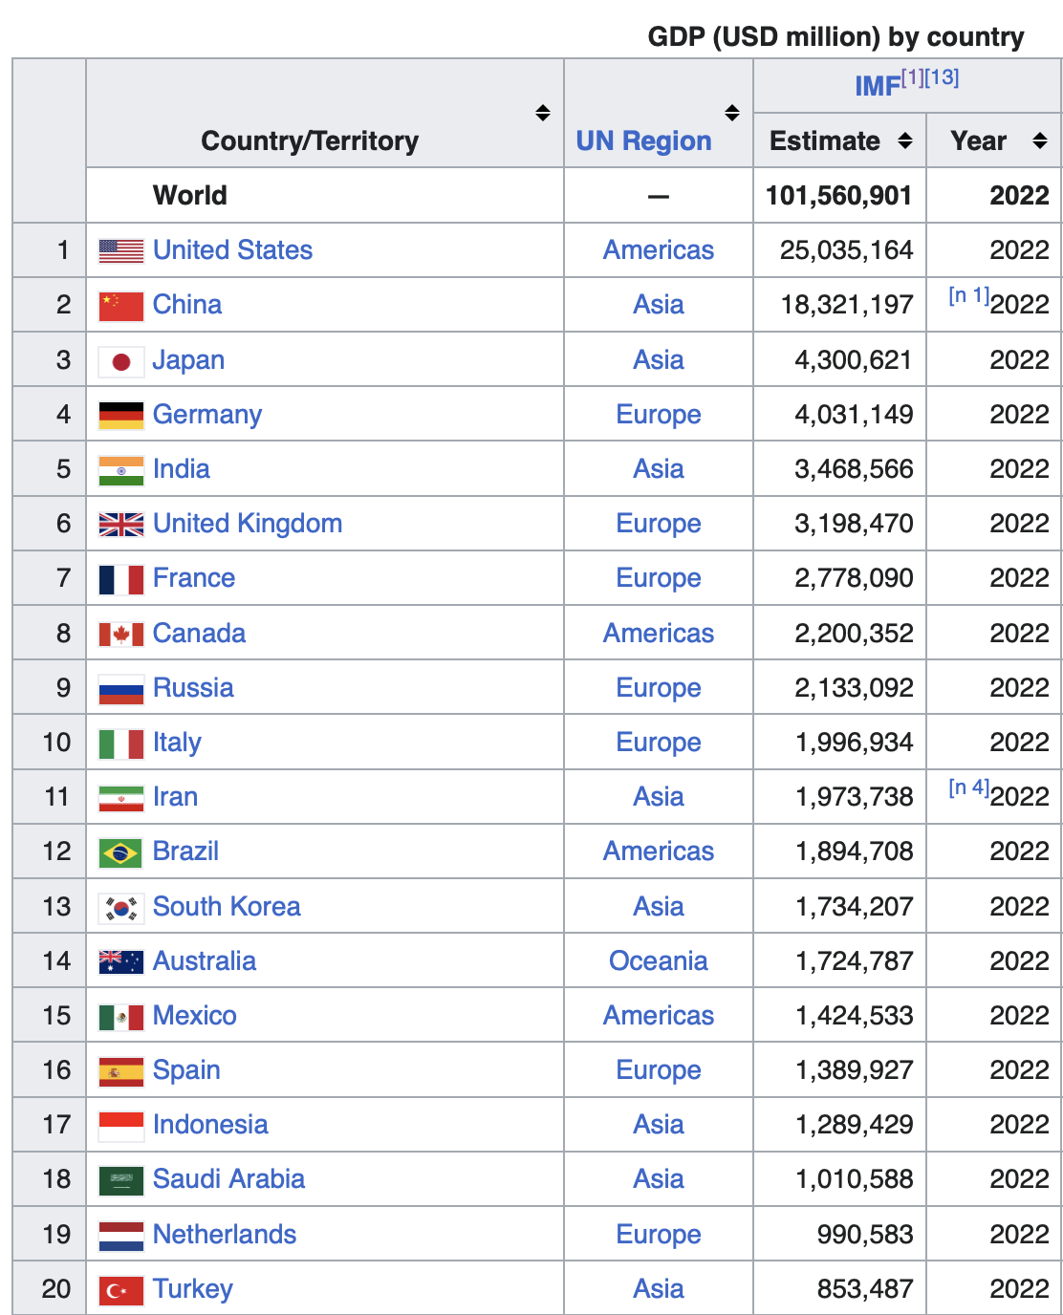
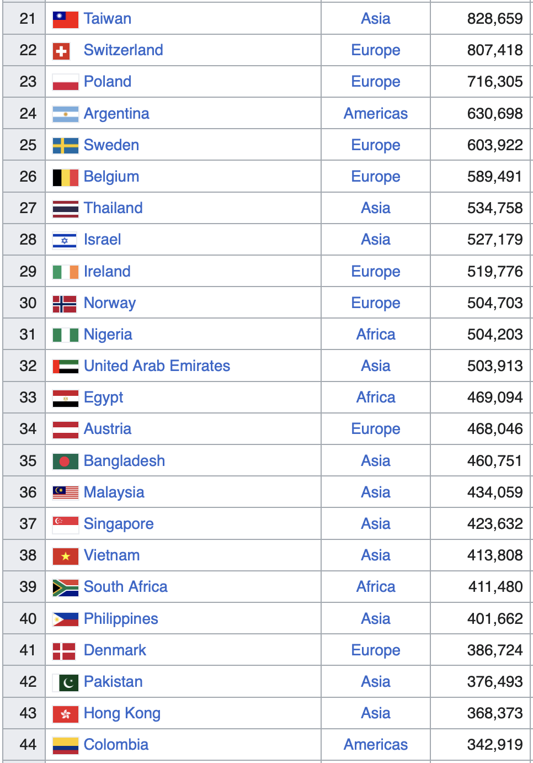

Slide 91
Funding for Research on Neglected Diseases
(Totals for 2007-2020)
Source: https://www.who.int/observatories/global-observatory-on-health-research-and-development/monitoring/
distribution-of-r-d-funding-flows-for-neglected-diseases-by-country-funder-recipient-organization

Slide 94
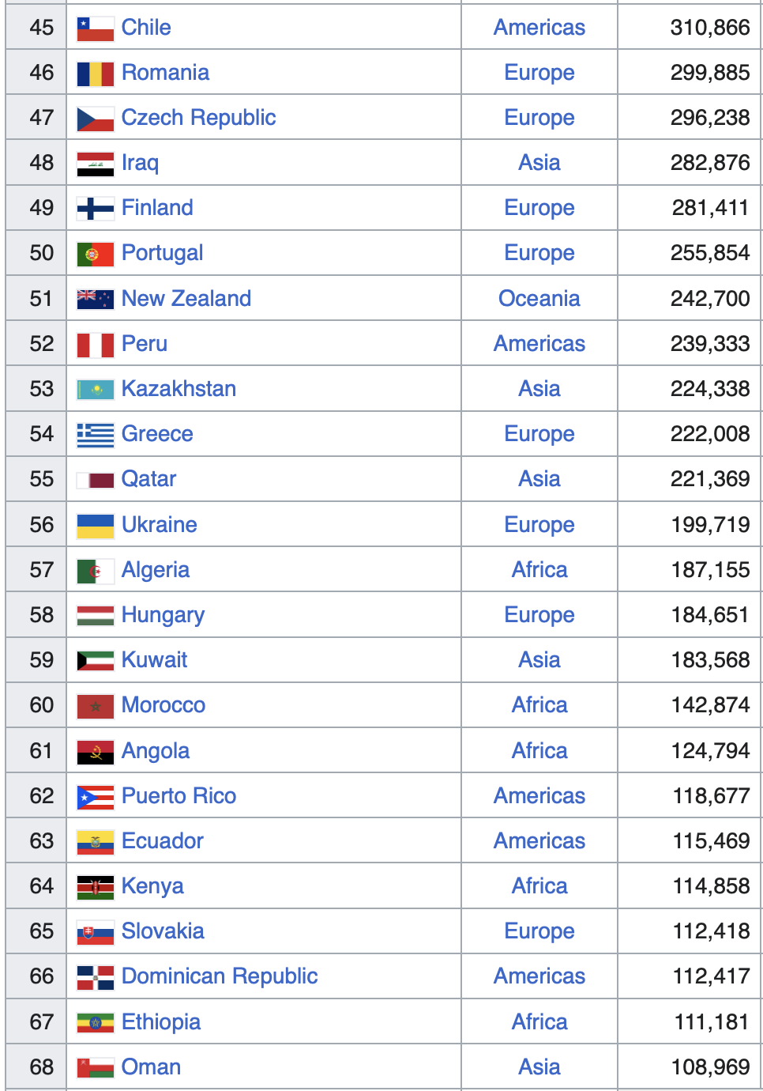
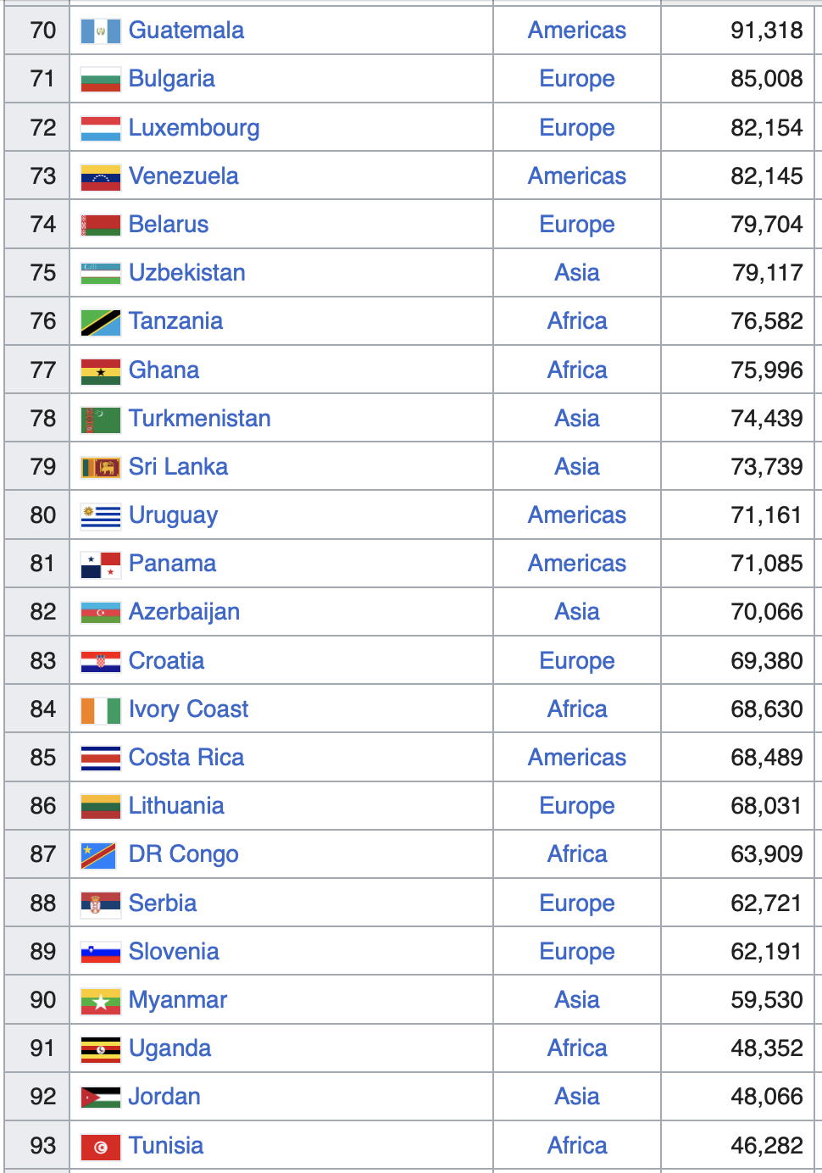

Slide 95
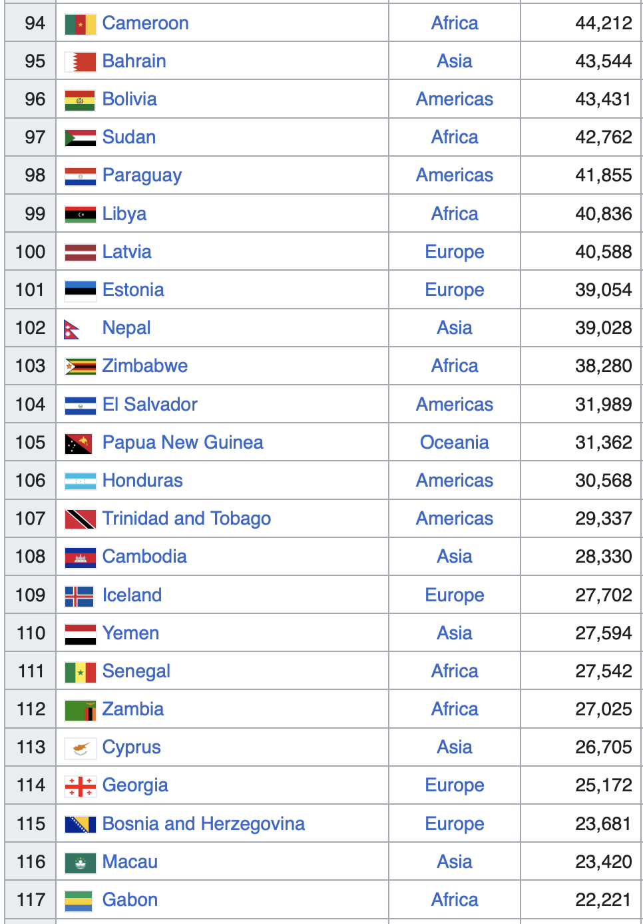
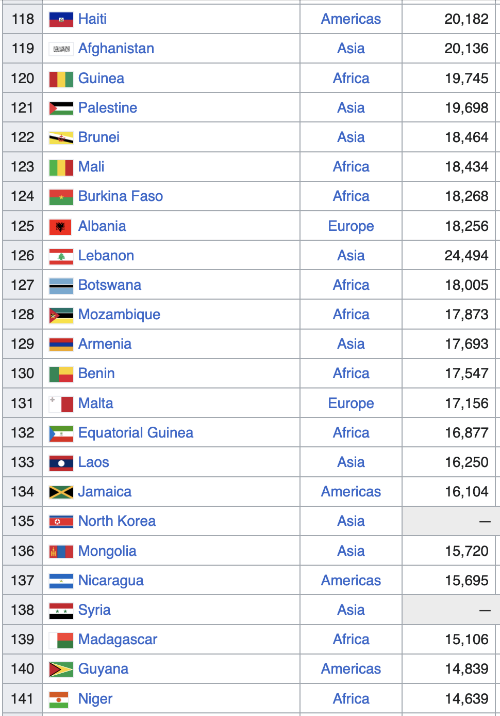

Slide 96
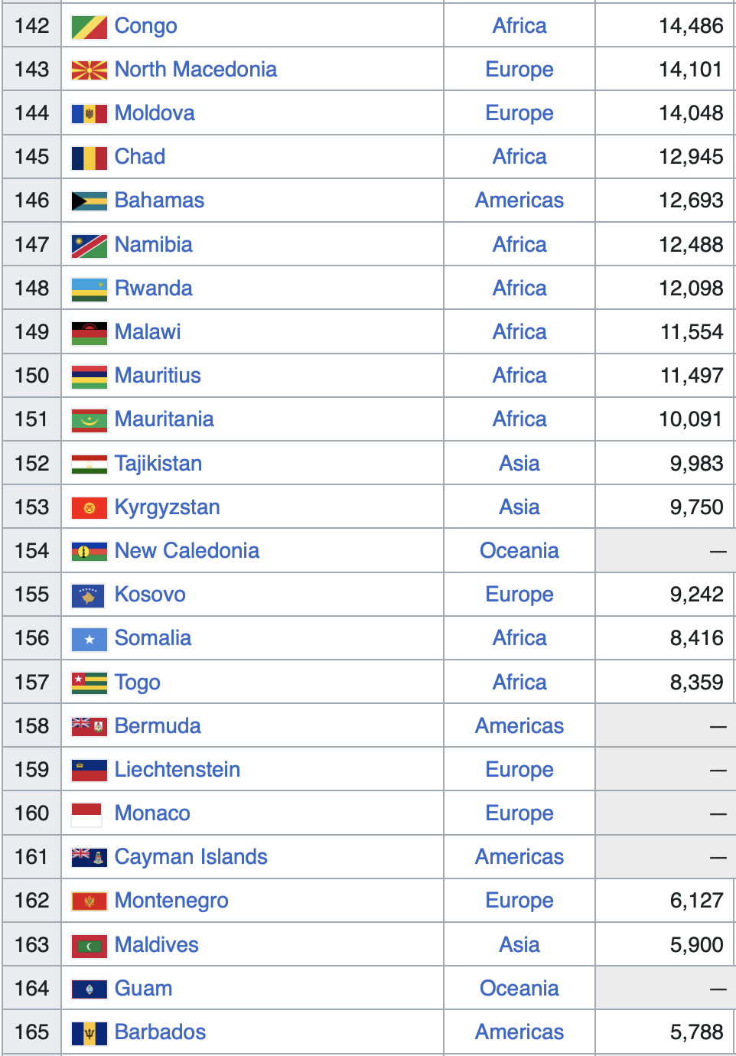
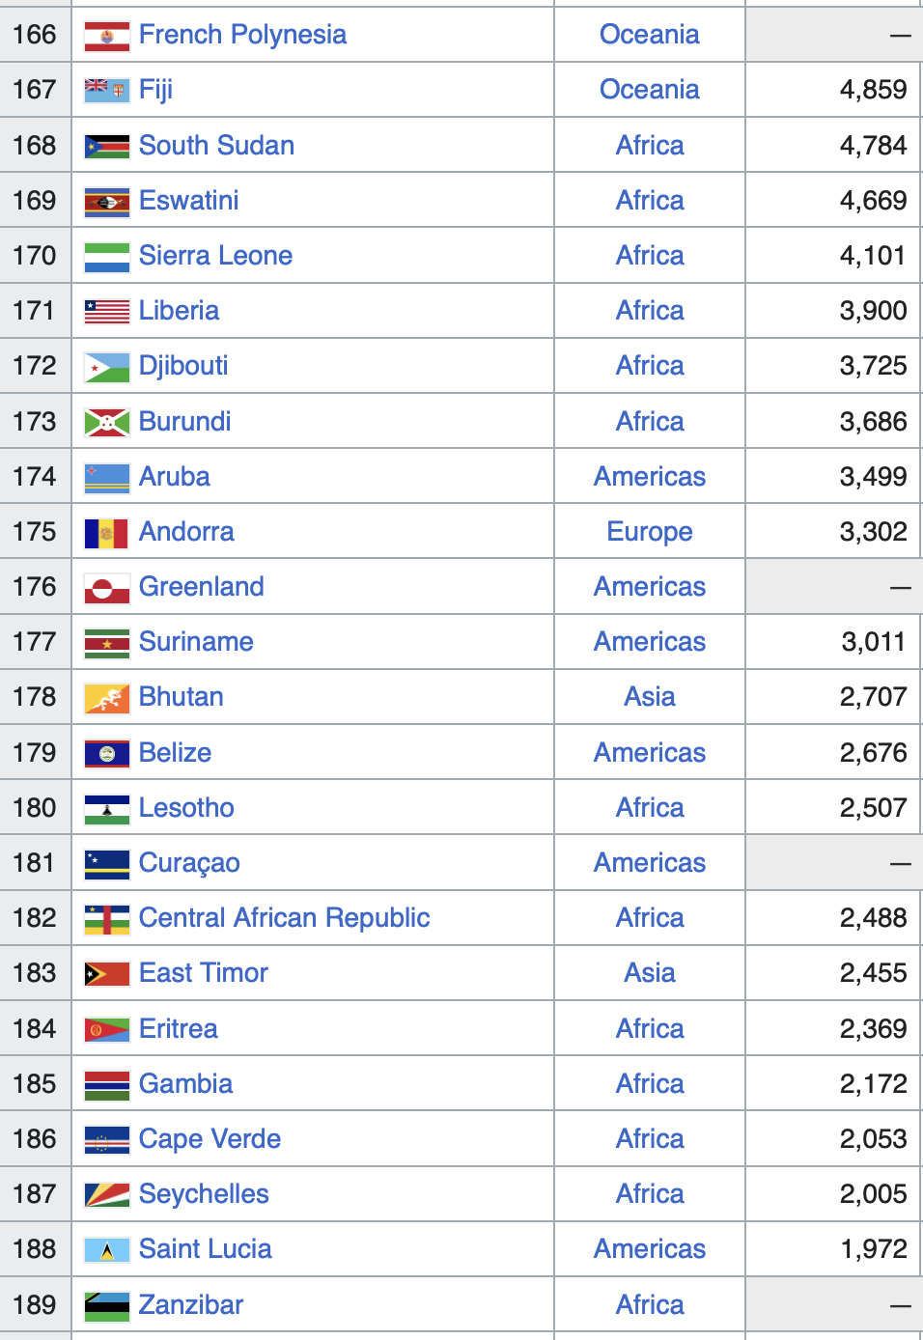

Slide 97
