Slide 1
Legal Treatment of the Fruits of Research Funded by Governments
PX090
William Fisher
January 2024

Slide 2
Background

Slide 3
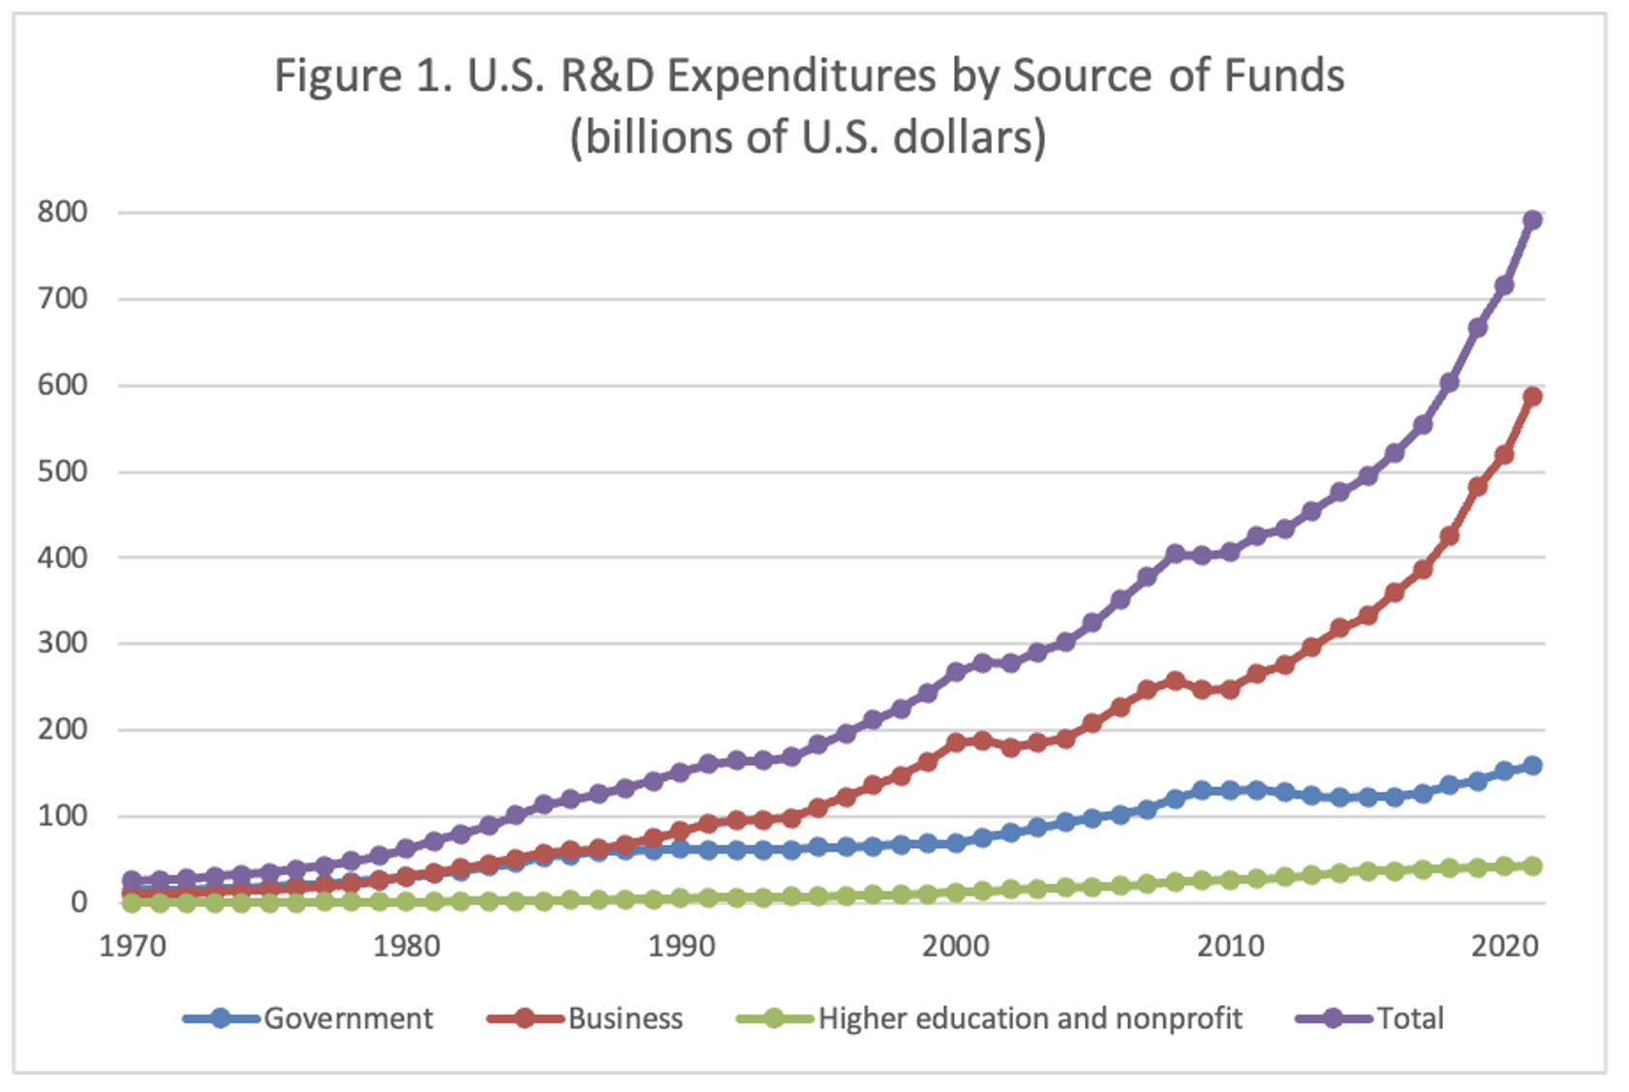
Source: Lisa Larrimore Ouellette, “IP and public research in health emergencies: U.S. law and best practices” (2024)

Slide 4
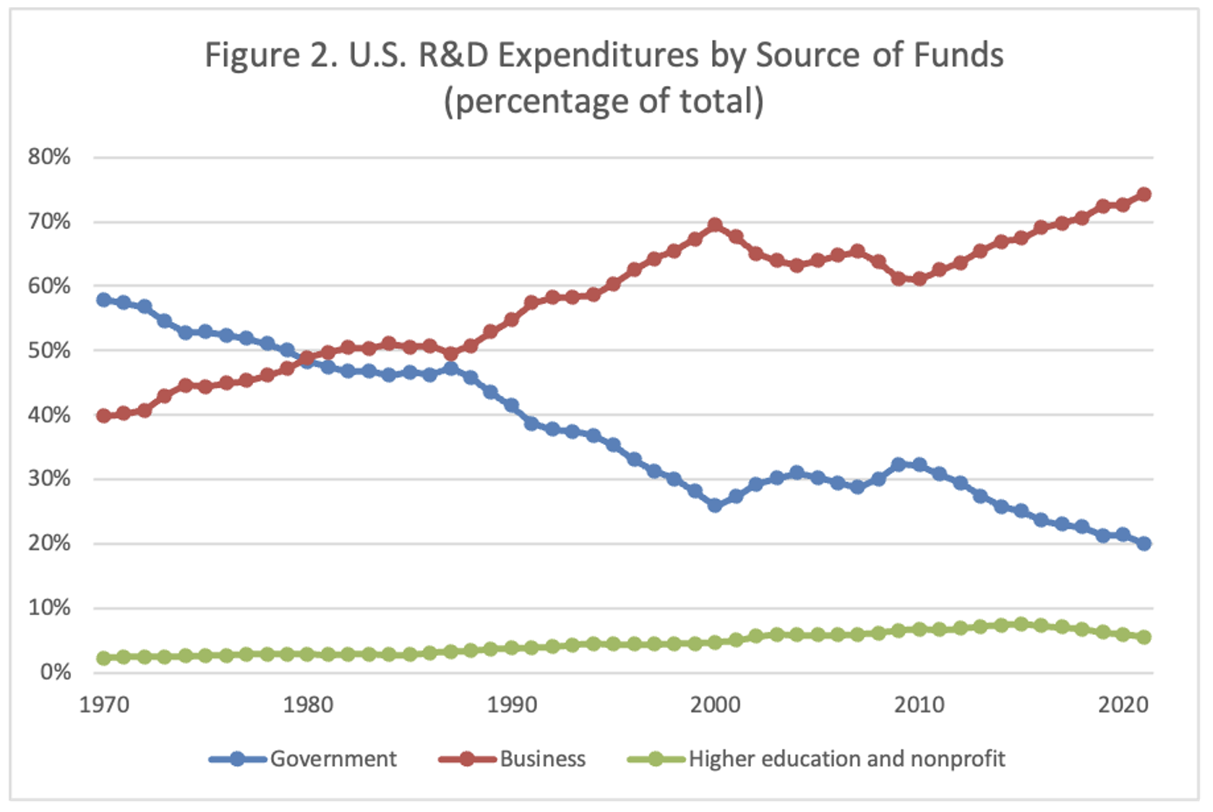
Source: Lisa Larrimore Ouellette, “IP and public research in health emergencies: U.S. law and best practices” (2024)

Slide 5
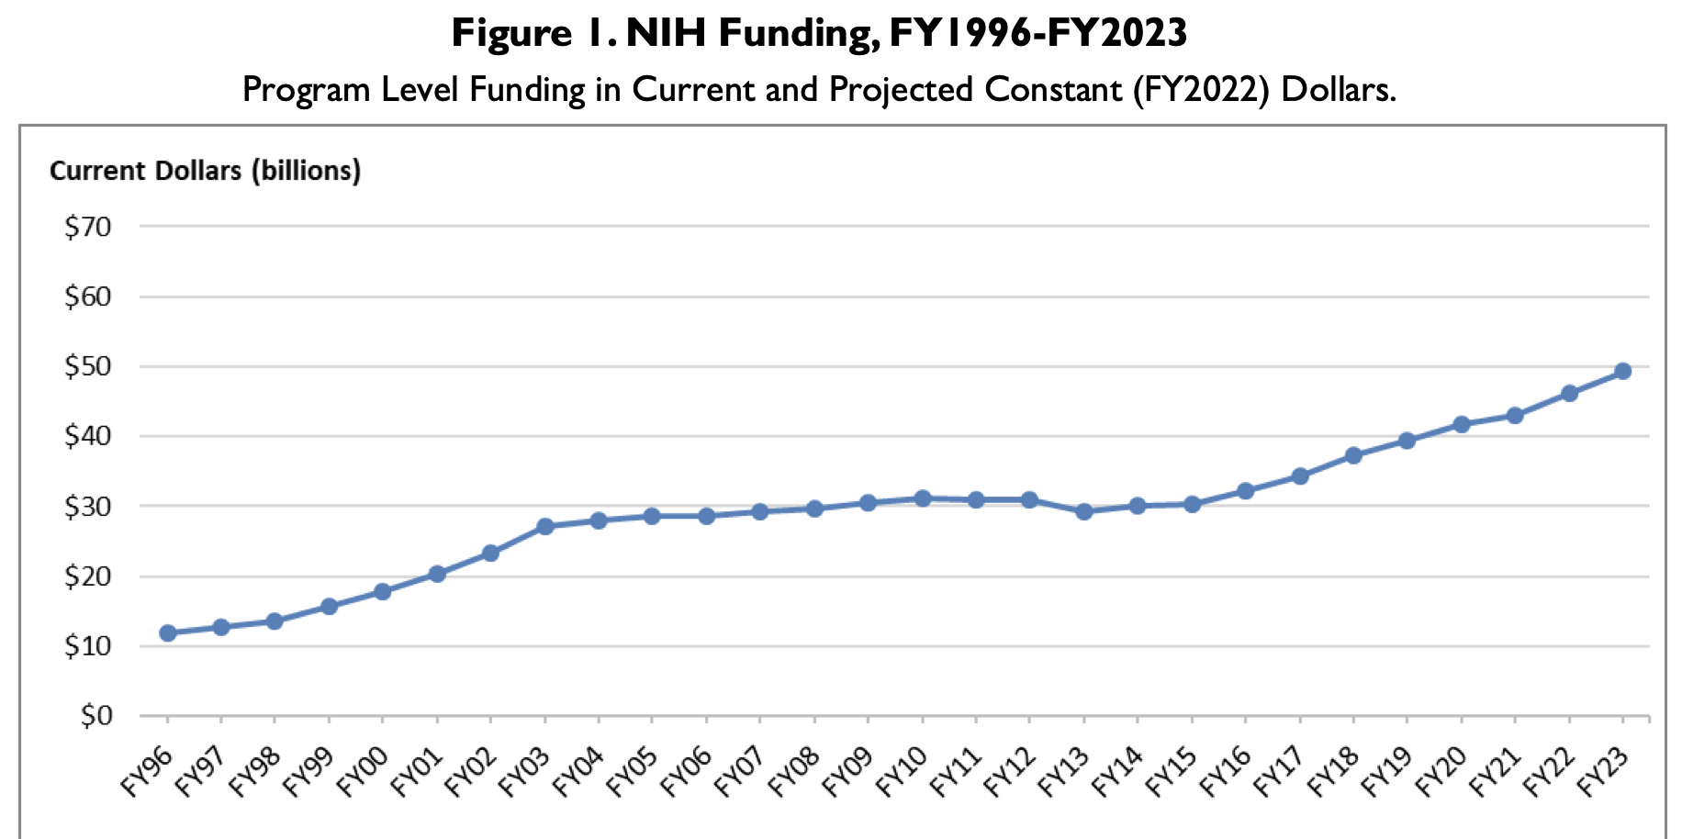
Source: https://crsreports.congress.gov/product/pdf/R/R43341/45

Slide 6
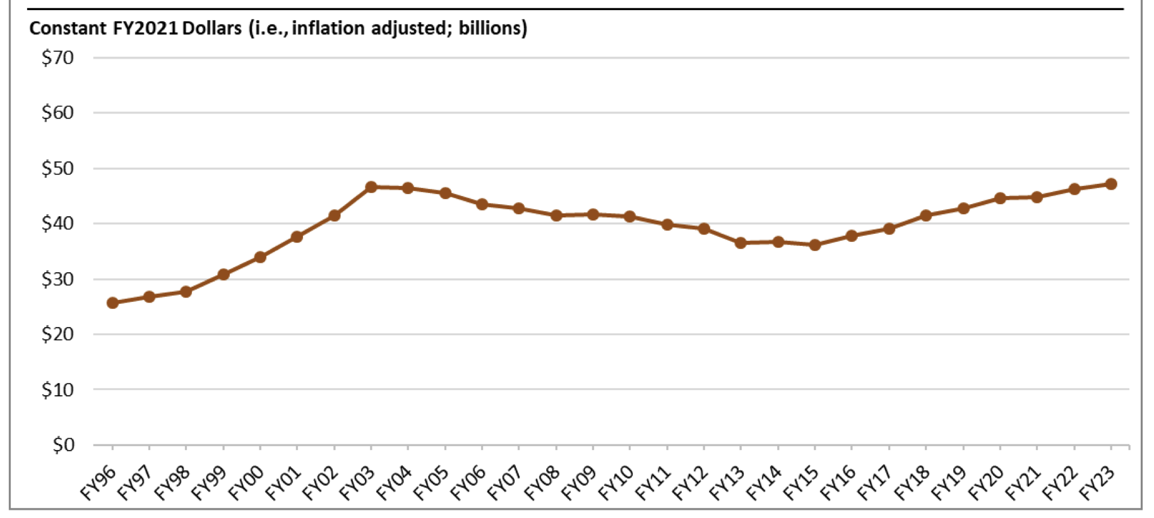
Source: https://crsreports.congress.gov/product/pdf/R/R43341/45

Slide 7
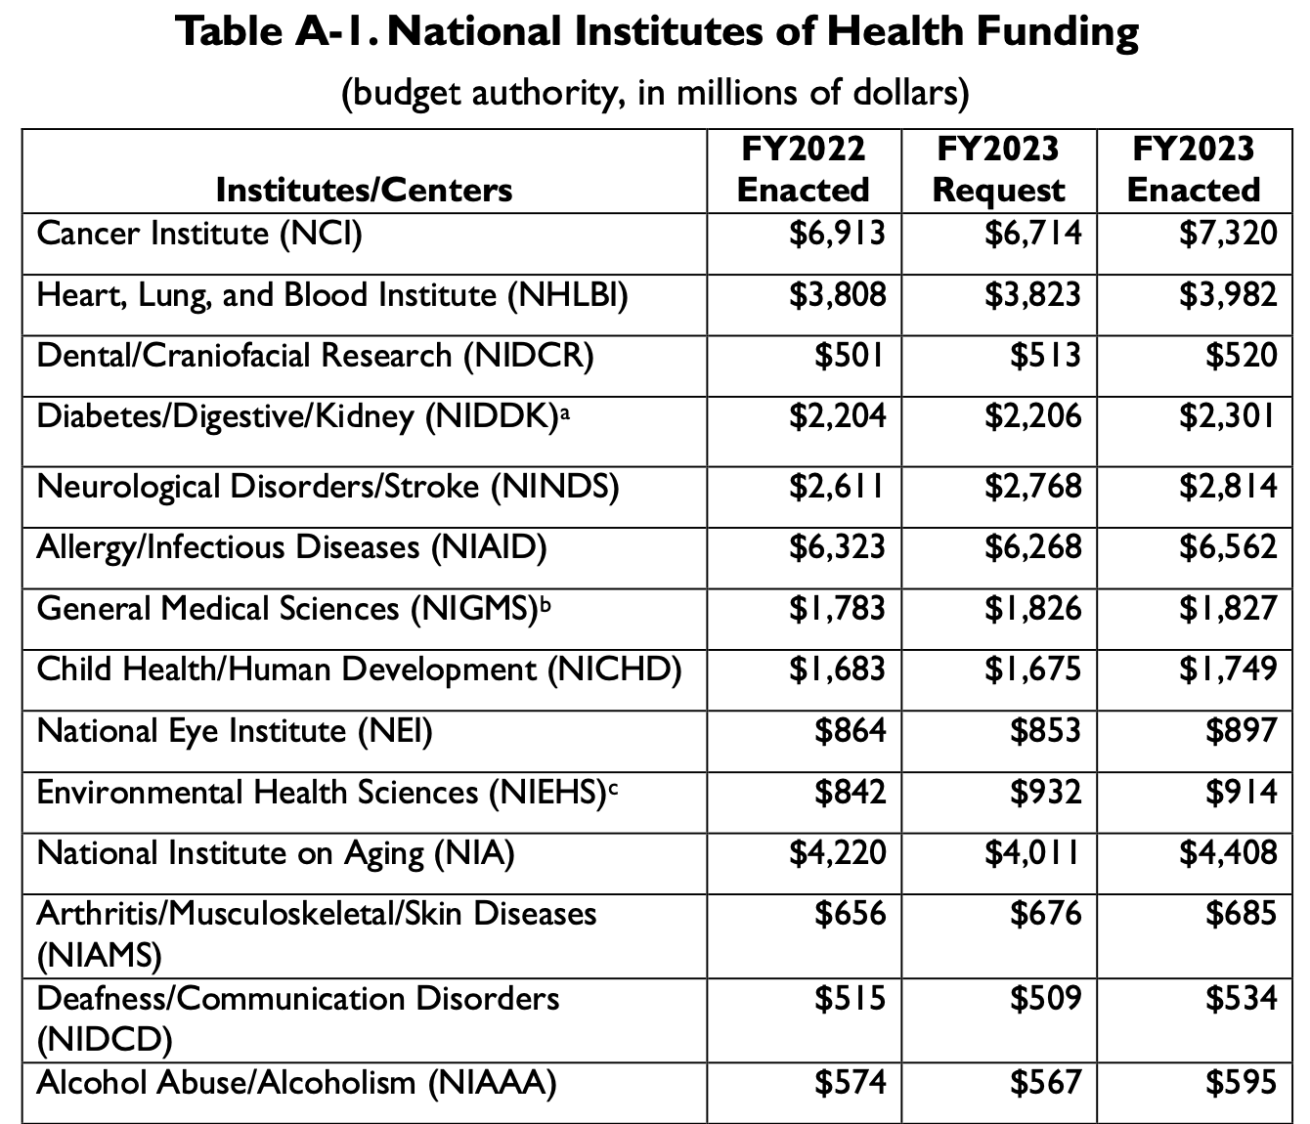

Slide 8
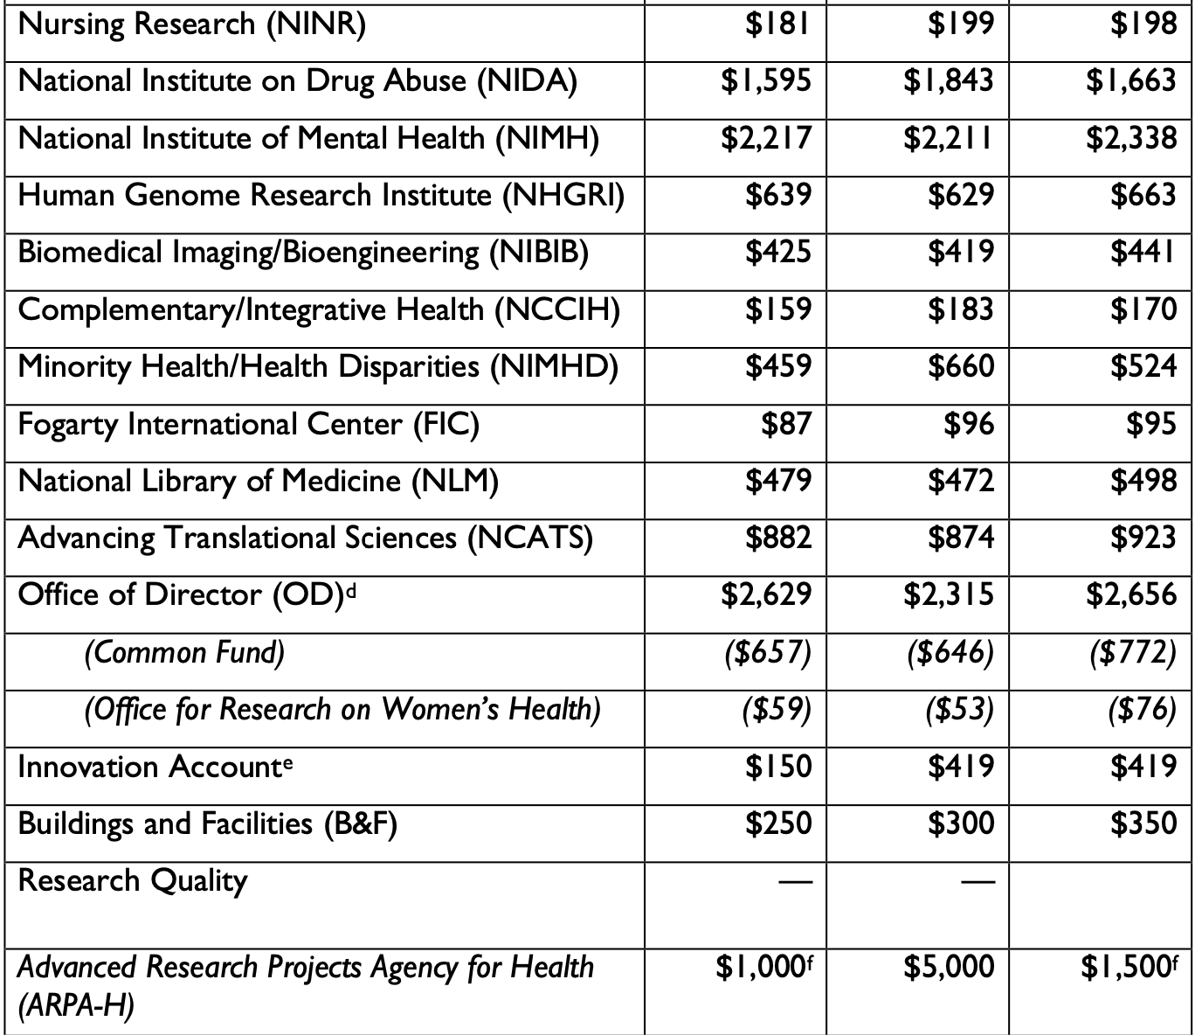

Slide 9
Issues
May a grantee obtain patents on inventions that grow out of a project funded by the government?
If so, does the government retain any rights concerning the manner in which the grantee uses the rights conferred by such patents?

Slide 10
In US, these issues are governed by Bayh-Dole Act
Recipients of federal funds may obtain patents on inventions supported by those funds
Federal Government retains the following rights:
“a nonexclusive, nontransferrable, irrevocable, paid-up license to practice . . . [the] subject invention.”
“March-in rights”: which permit the agency to grant a license to a responsible third party under certain circumstances, such as when the contractor fails to take “effective steps to achieve practical application” of the invention. §203.

Slide 11
Japan has an even more expansive version of Bayh-Dole
Applies to patents, utility models, design registrations, copyrights on software, semiconductor chip rights, plant variety rights
As in US, the government retains a shop right and march-in rights

Slide 12
Europe
Many countries have statutory provisions similar to Bayh-Dole, permitting grantees to patent fruits of funded research
Originally motivated by a desire to offset cuts in governmental funding for universities (provoked by financial doldrums in Europe during 1980s) and in some countries to curtail the traditional “professor’s privilege”
In none of those countries does the government retain march-in rights
In some of the countries, the governments have general power to use compulsory licenses to force grantees to exercise their rights in socially beneficial ways. However, those procedures are more cumbersome and expensive
Source: Prof. Sven Bostyn, Draft Research Paper (2024)

Slide 13
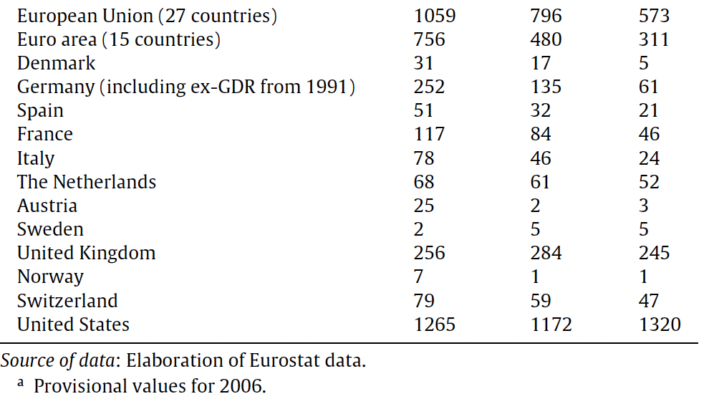
Patents Granted to Universities in European Countries
Source: Guena et al., “Changes to university IPR regulations
in Europe and the impact on academic patenting” (2011)
2004-2006. 2001-2003. 1998-2000

Slide 14
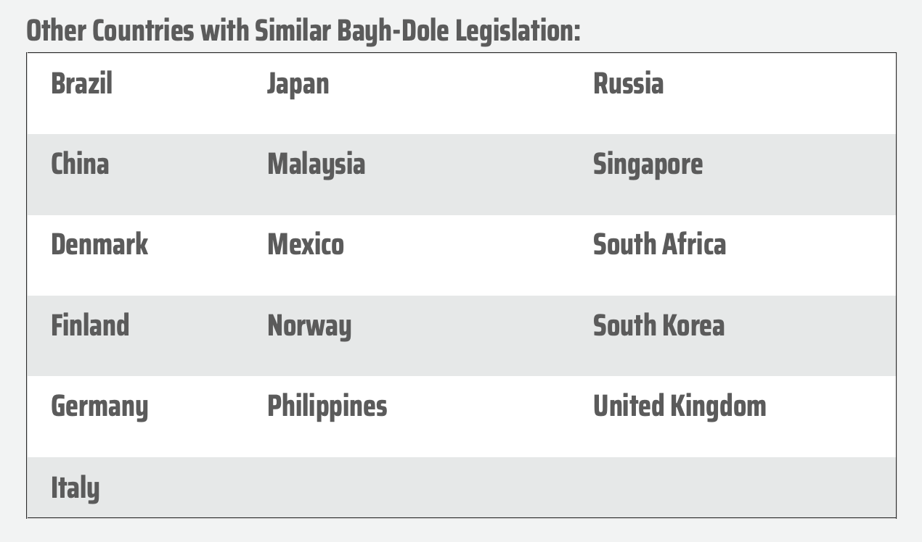
Source: https://autm.net/about-tech-transfer/advocacy/legislation/bayh-dole-act

Slide 15
Policy

Slide 16
The Debate Over Bayh-Dole
Justifications
Criticisms
Optimize use of funded discoveries (see, e.g., Breyer ¶56; Lander)
Incentivize additional research by university scientists
Internalization theory (Hemel & Ouellette 2017)
Increase revenues of universities
Forces the public to “pay twice” (e.g., Breyer ¶54)
Strategic behavior by university TTOs undermines, not advances, goal of optimizing use of funded discoveries
60% of the licenses granted by universities to firms are non-exclusive (Hemel)
Ouellette & Tutt (2020) find no correlation between university royalty sharing policies and inventive activity by faculty – or faculty mobility
Deflects academic science from proper job: basic science
At most, justifies patenting in other countries, not in US
Causes most universities to waste resources on TTOs

Slide 17
Harvard IP Policy
Supported Invention. Shall mean an Invention conceived or reduced to practice by a person covered by this policy (whether alone or together with others) if conceived or reduced to practice in whole or in part:
Under or subject to an agreement between Harvard and a third party; or
With use of direct or indirect financial support from Harvard, including support or funding from any outside source awarded to or administered by Harvard; or
With use (other than incidental use) of space, facilities, materials or other resources provided by or through the University.
Incidental Invention. Shall mean an Invention (other than a Supported Invention) that is conceived or reduced to practice by a person covered by this policy making an incidental use of space, facilities, materials or other resources related to the conception or reduction to practice of such Invention….
… Harvard shall have the right to own and each Inventor, at Harvard’s request, shall assign to Harvard all of his/her right, title and interest in a Supported Invention. Ownership of an Incidental Invention shall remain with its Inventor(s), subject to any rights that may be granted to Harvard as required by this policy.

Slide 18
Harvard IP Policy
Royalty Sharing: With respect to Net Royalties received on Creations reported to OTD on or after October 4, 2011:
Administrative fee – 15%
Of the remainder:
Creator personal share – 35%
Creator research share – 15%
Creator Department/Center share (except that if within FAS, or if no Department or Center, to be allocated by Dean of the Creator's School for research purposes) – 15%
Creator School share – 20%
President’s share – 15%

Slide 19
Hemel & Oulette 2017
“Bayh–Dole allows federal government grantees to obtain patents not only in the United States, but also in foreign jurisdictions. In this way, Bayh–Dole patents allow the United States to internalize some of the benefits that its own direct public spending on innovation brings to consumers overseas. Foreign consumers benefit from the inventions generated by federally funded research at US universities. And when foreign consumers pay supracompetitive prices on these patented inventions, much of this patent ‘shadow tax’ flows back to the United States. Some of this benefit goes to government labs and public universities; some goes to non-profit research universities and foundations that the federal government has chosen to support through tax exemptions; and some goes to US manufacturers like Myriad Genetics (and then to the US government through taxation of these profits).”
This effect, in turn, promotes Distributive Justice
Will tend to bring investment by US government in basic science closer to globally socially optimal level

Slide 20
Potential Conditions
A duty to make public any data generated by the funded project (e.g., the fruits of clinical trials; records of failed initiatives as well as successful ones);
Suspension by the grantee of intellectual-property rights sufficient to facilitate follow-on research by other firms or institutions;
Relinquishment by the grantee of all intellectual-property rights in discoveries attributable to the funding;
A “viral” relinquishment of intellectual-property rights, binding on downstream innovators as well as the grantee (analogous to the viral free-software and creative-commons licenses);
A commitment to make any products generated by the funding available at affordable prices in low and middle-income countries [LMICs];
A commitment to make any products generated by the funding available at affordable prices to poor residents of upper-income countries [differential pricing];
A commitment to make any products generated by the funding available at affordable prices to everyone;
A commitment to transfer proprietary technology generated by the funding to licensees in LMICs;
A commitment to transfer proprietary technology generated by the funding to the public at large;
A “clawback” provision, enabling the grantor to recover funds if the grantee fails to deploy products attributable to the funding.
Subsets of these options represent clusters of increasingly onerous (and socially beneficial) commitments (e.g., b-c-d; e-f-g). Others are independent of one another and thus could be combined.

