Slide 1
Fintech Scale
William Fisher
November 2023

Slide 2
Revenue of fintech industry worldwide from 2017 to 2027 (in billion U.S. dollars)
Revenue of fintech industry worldwide 2017-2027
5
Description: The global transaction value in the 'Neobanking' segment of the fintech market was forecast to continuously increase between 2023 and 2027 by in total 4.5 trillion U.S. dollars (+94.88 percent). After the tenth consecutive increasing year, the indicator is estimated to reach 9.2 trillion U.S. dollars and therefore a new peak in 2027. Notably, the transaction value of the 'Neobanking' segment of the fintech market was continuously increasing over the past years. Read more
Note(s): Worldwide; 2017 to 2027; data shown is using current exchange rates and reflects market impacts of the Russia-Ukraine war
Source(s): Statista Digital Market Insights

Slide 3
Total value of investments into fintech companies worldwide from 2010 to H1 2023 (in billion U.S. dollars)
10
Description: The total value of investments into fintech companies worldwide increased drastically between 2010 and 2019, when it reached 216.8 billion U.S. dollars. In 2020, however, fintech companies saw investments decrease notably, dropping below 140 billion U.S. dollars. Investment value increased again in 2021 up to more than 247 billion U.S. dollars. 2022, however, was another slow year for fintech, as the value of investments decreased notably, although remained well above the value [...] Read more
Note(s): Worldwide; 2010 to H1 2023
Source(s): KPMG; PitchBook

Slide 4
What Explains the Fluctuations?

Slide 5
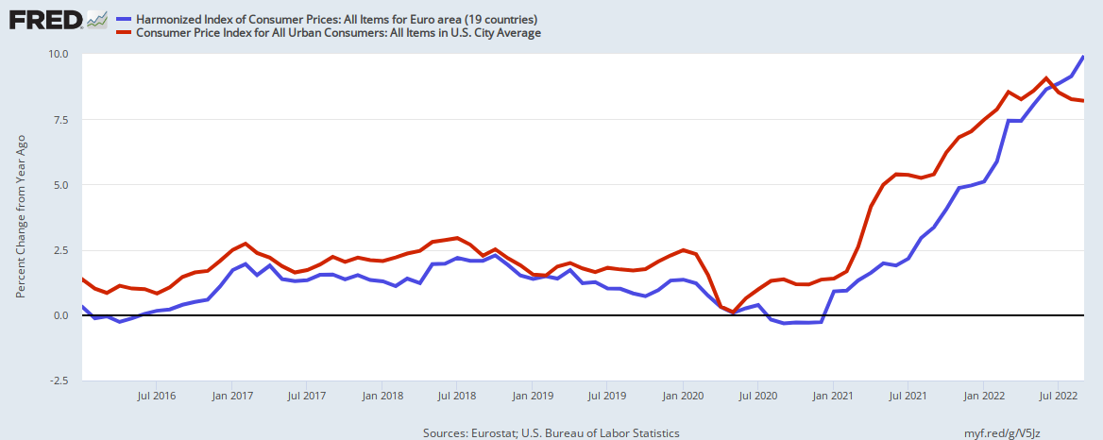
Inflation (in consumer prices) 2016-2022
US
Europe

Slide 6
Inflation rate and Federal Reserve interest rate monthly in the United States from January 2018 to September 2022
Note(s): United States; January 2018 to September 2022
Further information regarding this statistic can be found on page 8.
Source(s): Bureau of Labor Statistics; St. Louis Fed; ID 1312060

Slide 7
Value of investment in fintech globally from 1st quarter 2014 to 2nd quarter 2023 (in billion U.S. dollars)
Quarterly value of investment in fintech globally 2014-2023
11
Description: The quarterly worldwide value of investment in fintech peaked during the third quarter of 2019, with a deal value of almost 145 billion U.S. dollars. Other than the first quarter, 2022 brought a drastically slowing tendency, as the value of investments worldwide decreased notably between the first and the fourth quarter. The downward tendency continued in 2023, with quarterly investment value dropping even further. In the second quarter of 2023, fintech funding reached its lowest value in [...] Read more
Note(s): Worldwide; Q1 2014 to Q2 2023
Source(s): KPMG; PitchBook

Slide 8
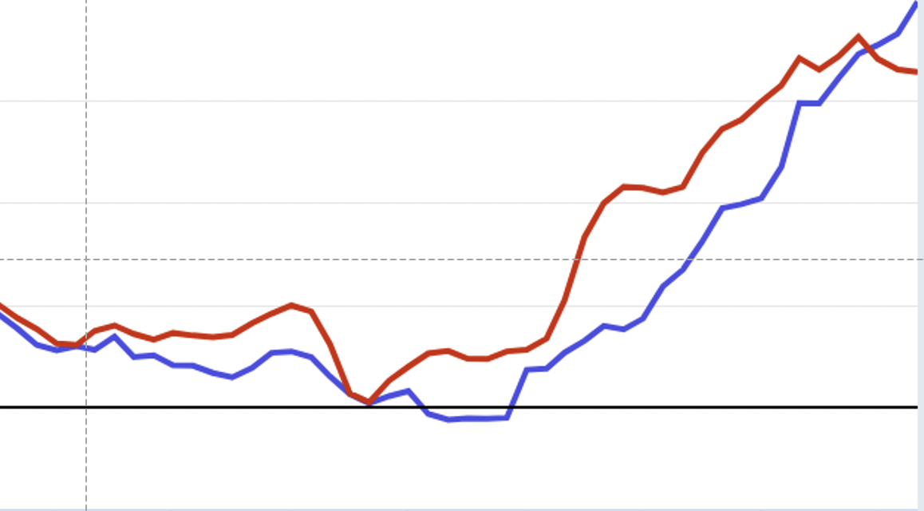
Value of investment in fintech globally from 1st quarter 2014 to 2nd quarter 2023 (in billion U.S. dollars)
Quarterly value of investment in fintech globally 2014-2023
11
Description: The quarterly worldwide value of investment in fintech peaked during the third quarter of 2019, with a deal value of almost 145 billion U.S. dollars. Other than the first quarter, 2022 brought a drastically slowing tendency, as the value of investments worldwide decreased notably between the first and the fourth quarter. The downward tendency continued in 2023, with quarterly investment value dropping even further. In the second quarter of 2023, fintech funding reached its lowest value in [...] Read more
Note(s): Worldwide; Q1 2014 to Q2 2023
Source(s): KPMG; PitchBook

Slide 9
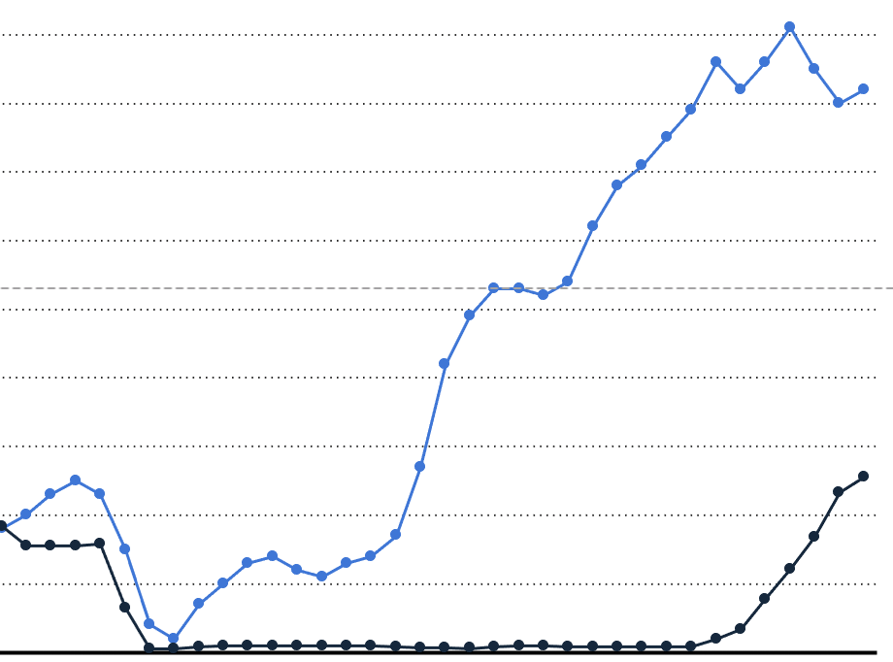
Value of investment in fintech globally from 1st quarter 2014 to 2nd quarter 2023 (in billion U.S. dollars)
Quarterly value of investment in fintech globally 2014-2023
11
Description: The quarterly worldwide value of investment in fintech peaked during the third quarter of 2019, with a deal value of almost 145 billion U.S. dollars. Other than the first quarter, 2022 brought a drastically slowing tendency, as the value of investments worldwide decreased notably between the first and the fourth quarter. The downward tendency continued in 2023, with quarterly investment value dropping even further. In the second quarter of 2023, fintech funding reached its lowest value in [...] Read more
Note(s): Worldwide; Q1 2014 to Q2 2023
Source(s): KPMG; PitchBook

Slide 10
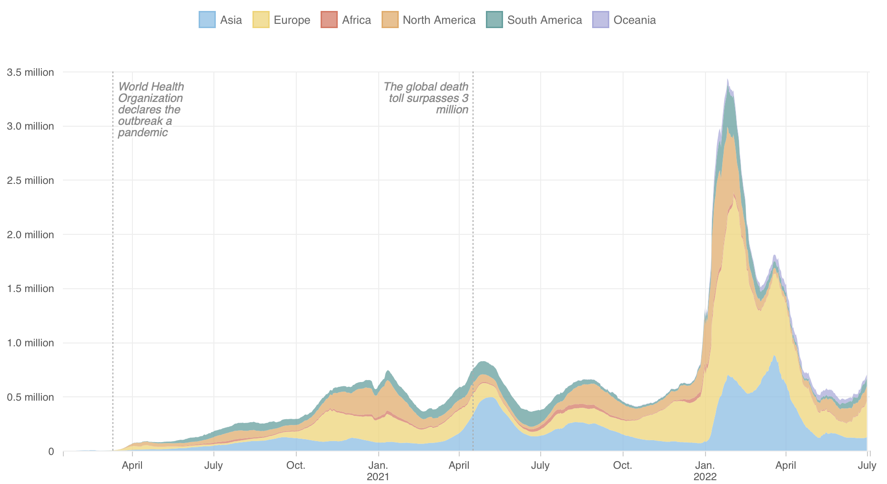
Covid-19:
New Daily Cases
Source: https://www.npr.org/sections/goatsandsoda/2020/03/30/822491838/coronavirus-world-map-tracking-the-spread-of-the-outbreak

Slide 11
Covid-19:
New Daily Cases
Source: https://www.npr.org/sections/goatsandsoda/2020/03/30/822491838/coronavirus-world-map-tracking-the-spread-of-the-outbreak

Slide 12
Covid-19:
New Daily Cases
Global deaths:
6.34 million
Source: https://www.npr.org/sections/goatsandsoda/2020/03/30/822491838/coronavirus-world-map-tracking-the-spread-of-the-outbreak

Slide 13
Value of investment in fintech globally from 1st quarter 2014 to 2nd quarter 2023 (in billion U.S. dollars)
Quarterly value of investment in fintech globally 2014-2023
11
Description: The quarterly worldwide value of investment in fintech peaked during the third quarter of 2019, with a deal value of almost 145 billion U.S. dollars. Other than the first quarter, 2022 brought a drastically slowing tendency, as the value of investments worldwide decreased notably between the first and the fourth quarter. The downward tendency continued in 2023, with quarterly investment value dropping even further. In the second quarter of 2023, fintech funding reached its lowest value in [...] Read more
Note(s): Worldwide; Q1 2014 to Q2 2023
Source(s): KPMG; PitchBook

Slide 14
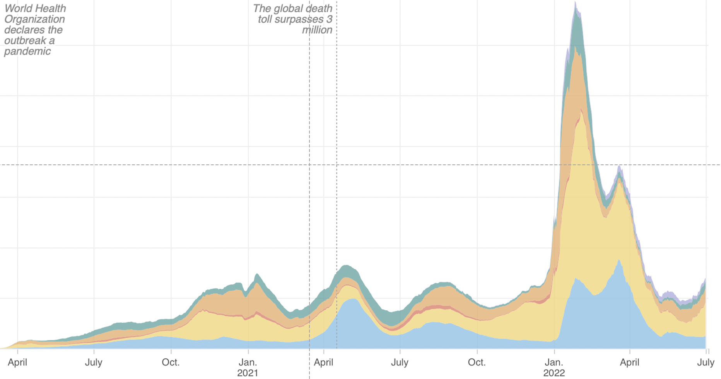
Value of investment in fintech globally from 1st quarter 2014 to 2nd quarter 2023 (in billion U.S. dollars)
Quarterly value of investment in fintech globally 2014-2023
11
Description: The quarterly worldwide value of investment in fintech peaked during the third quarter of 2019, with a deal value of almost 145 billion U.S. dollars. Other than the first quarter, 2022 brought a drastically slowing tendency, as the value of investments worldwide decreased notably between the first and the fourth quarter. The downward tendency continued in 2023, with quarterly investment value dropping even further. In the second quarter of 2023, fintech funding reached its lowest value in [...] Read more
Note(s): Worldwide; Q1 2014 to Q2 2023
Source(s): KPMG; PitchBook

Slide 15
Sources of Investment

Slide 16
Total value of investments into fintech companies worldwide from 2010 to H1 2023 (in billion U.S. dollars)
10
Description: The total value of investments into fintech companies worldwide increased drastically between 2010 and 2019, when it reached 216.8 billion U.S. dollars. In 2020, however, fintech companies saw investments decrease notably, dropping below 140 billion U.S. dollars. Investment value increased again in 2021 up to more than 247 billion U.S. dollars. 2022, however, was another slow year for fintech, as the value of investments decreased notably, although remained well above the value [...] Read more
Note(s): Worldwide; 2010 to H1 2023
Source(s): KPMG; PitchBook

Slide 17
Share of investment deals in the fintech sector from 2018 to 2022, by investment type
27
Description: Venture capital investments were by far the most dominant form of investment into the fintech sector worldwide between 2018 and 2022, although its share decreased slightly in 2021 and 2022. It was followed by angel investments, which became more popular in 2021 and 2022, with a share of 11 to 13 percent. Read more
Note(s): Worldwide; 2018 to 2022
Source(s): CB Insights

Slide 18
Value of venture capital-backed fintech funding worldwide from 2014 to 2022 (in billion U.S. dollars)
22
Description: The value of venture-capital-backed fintech funding increased considerably between 2014 and 2021, despite some fluctuations. In 2021, the value of venture-capital backed funding in the fintech sector was 121.5 billion U.S. dollars, which was a 261 percent increase compared to 2020. In 2022, however, global venture activity in fintech funding increased drastically, although it remained well above the funding measured in 2020. Read more
Note(s): Worldwide; 2014 to 2022
Source(s): KPMG; PitchBook

Slide 19
Number of venture capital-backed investment deals in fintech worldwide from 2017 to H1 2023
25
Description: In 2022, 6,128 venture capital-backed investment deals took place in the fintech sector worldwide. This was a notable decrease compared to 2021, when 6,623 deals were registered. Along with the number of deals, deal value also decreased significantly in 2022. The downward trend continued in the first half of 2023, when 1,818 fintech deals were registered, foreshadowing a challenging year for the fintech market. Read more
Note(s): Worldwide; 2017 to H1 2023
Source(s): KPMG; PitchBook

Slide 20
Number of venture capital-backed investment deals in fintech in 2022, by region
Number of VC-backed deals in fintech 2022, by region
26
Description: In 2022, the largest number of venture capital-baked fintech deals worldwide were secured in the Americas, with 2,409 deals. In Europe, Middle East, and Africa, 1,621 VC-backed fintech deals took place. In the Asia Pacific region, 1,093 deals were secured. Read more
Note(s): Worldwide; 2022
Source(s): KPMG; PitchBook

Slide 21
Scale by Sector

Slide 22
Consumer fintech adoption rates globally from 2015 to 2019, by category
Global consumer fintech adoption rates 2015-2019, by category
28
Description: Consumer adoption of fintech companies and products has grown rapidly worldwide between 2015 and 2019. As of 2019, 75 percent of consumers globally have adopted some form of money transfer and/or payment service. Insurance (insurtech) adoption has seen a significant growth from 8 percent in 2015 to almost 50 percent in 2019. Read more
Note(s): February 4 to March 11, 2019; 27,103 digitally active adults; 27 markets worldwide
Source(s): EY

Slide 23
Value of venture capital-backed funding in fintech worldwide in 2022, by sector (in billion U.S. dollars)
24
Description: In 2022, fintech businesses focusing on payment services were the most funded fintech companies worldwide. The funding raised through VC-backed investment deals in fintech companies operating in the payments segment amounted to approximately 20.8 billion U.S. dollars. It was followed by fintech businesses focusing on banking and digital lending. Read more
Note(s): Worldwide; 202
Source(s): CB Insights

Slide 24
2
Value of investment in fintech worldwide from 2014 to 2023 in selected segments (in billion U.S. dollars)
Note(s): Worldwide; 2014 to 2023; Figures include venture capital, private equity, and mergers and acquisitions deals.
Further information regarding this statistic can be found on page 8.
Source(s): KPMG; PitchBook; ID 1447294

Slide 25
2
Value of investment in fintech worldwide from 2014 to 2023 in selected segments (in billion U.S. dollars)
Note(s): Worldwide; 2014 to 2023; Figures include venture capital, private equity, and mergers and acquisitions deals.
Further information regarding this statistic can be found on page 8.
Source(s): KPMG; PitchBook; ID 1447294

Slide 26
2
Value of investment in fintech worldwide from 2014 to 2023 in selected segments (in billion U.S. dollars)
FTX Collapse,
November 2022
Note(s): Worldwide; 2014 to 2023; Figures include venture capital, private equity, and mergers and acquisitions deals.
Further information regarding this statistic can be found on page 8.
Source(s): KPMG; PitchBook; ID 1447294

