Slide 1
Fintech Patents
William Fisher
April 2024

Slide 2
USA

Slide 3
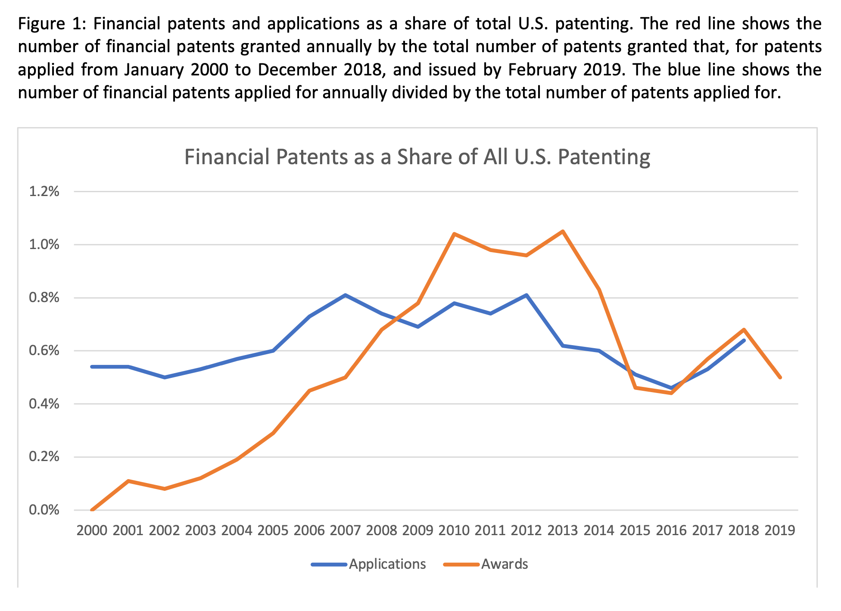
Source: Josh Lerner et al., “Financial Innovation in the 21st Century: Evidence from U.S. Patenting (2020),
https://scholar.harvard.edu/files/nickshort/files/financialinnovation21stcentury.20200730.pdf

Slide 4
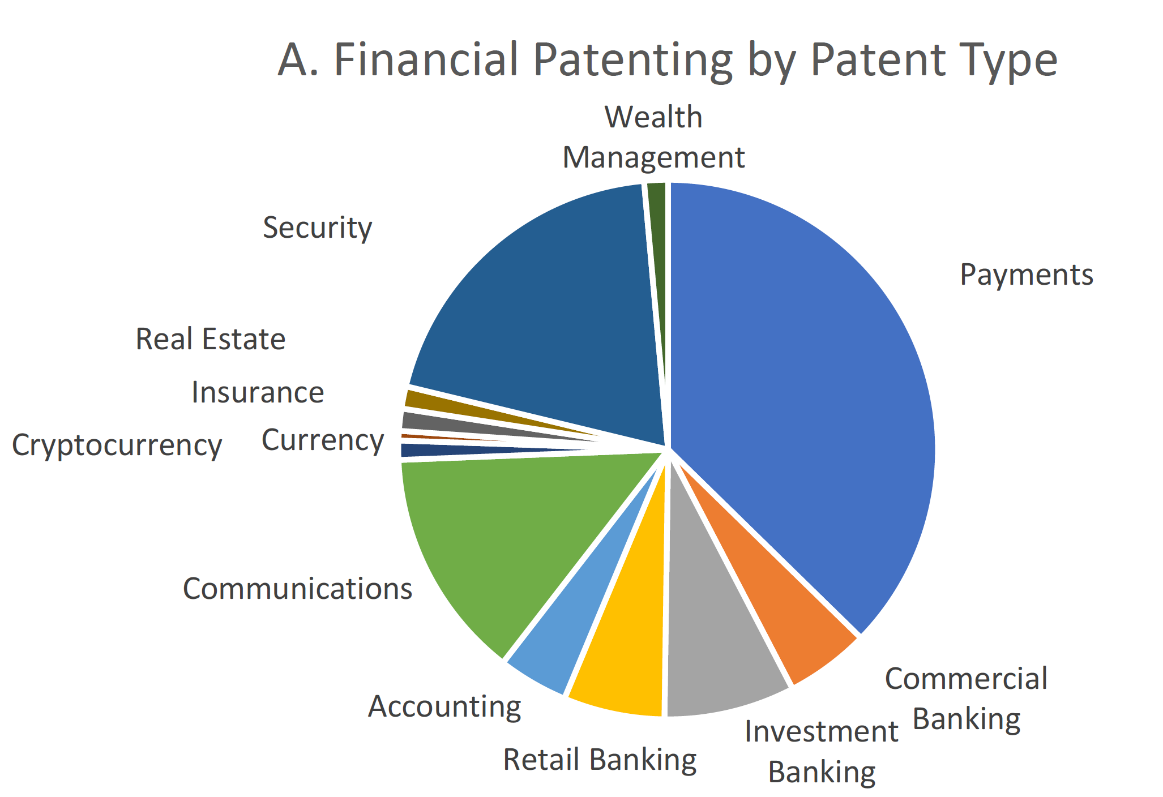
Source: Josh Lerner et al., “Financial Innovation in the 21st Century: Evidence from U.S. Patenting (2020),
https://scholar.harvard.edu/files/nickshort/files/financialinnovation21stcentury.20200730.pdf

Slide 5
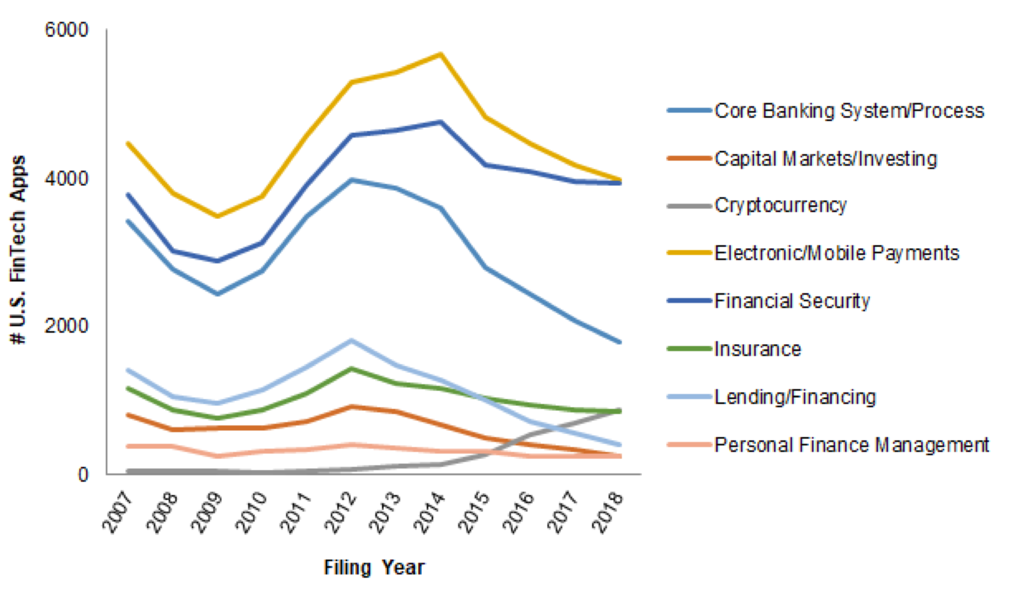
Applications for U.S. Patents
Source: https://www.kilpatricktownsend.com/-/media/Feature/Insights/Publication/
2019-Patent-Trends-Study_Fintech.ashx?la=en&hash=54EA939C23920A371931D4BD6BA07C3D4ED20787
Financial Crisis
IPRs commence
Alice

Slide 6
Applications for U.S. Patents
Source: https://www.kilpatricktownsend.com/-/media/Feature/Insights/Publication/
2019-Patent-Trends-Study_Fintech.ashx?la=en&hash=54EA939C23920A371931D4BD6BA07C3D4ED20787
Financial Crisis
IPRs commence
Alice

Slide 7
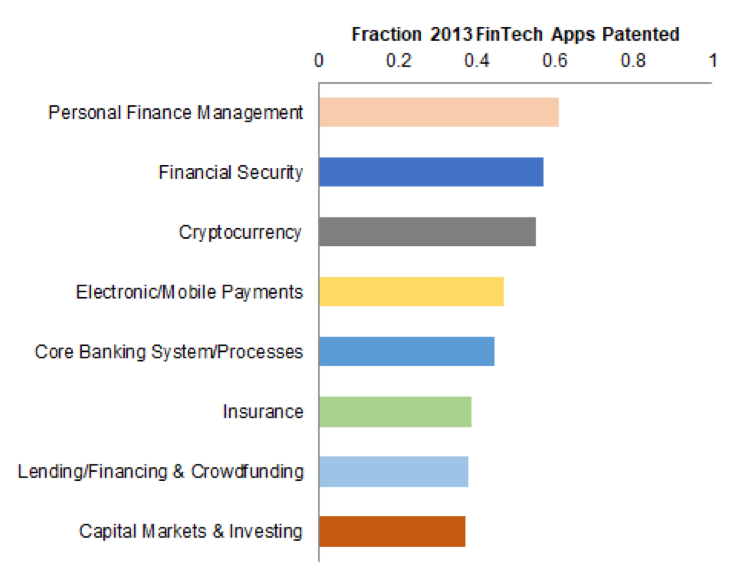
Grant Rate for U.S. Patents
Source: https://www.kilpatricktownsend.com/-/media/Feature/Insights/Publication/
2019-Patent-Trends-Study_Fintech.ashx?la=en&hash=54EA939C23920A371931D4BD6BA07C3D4ED20787

Slide 8
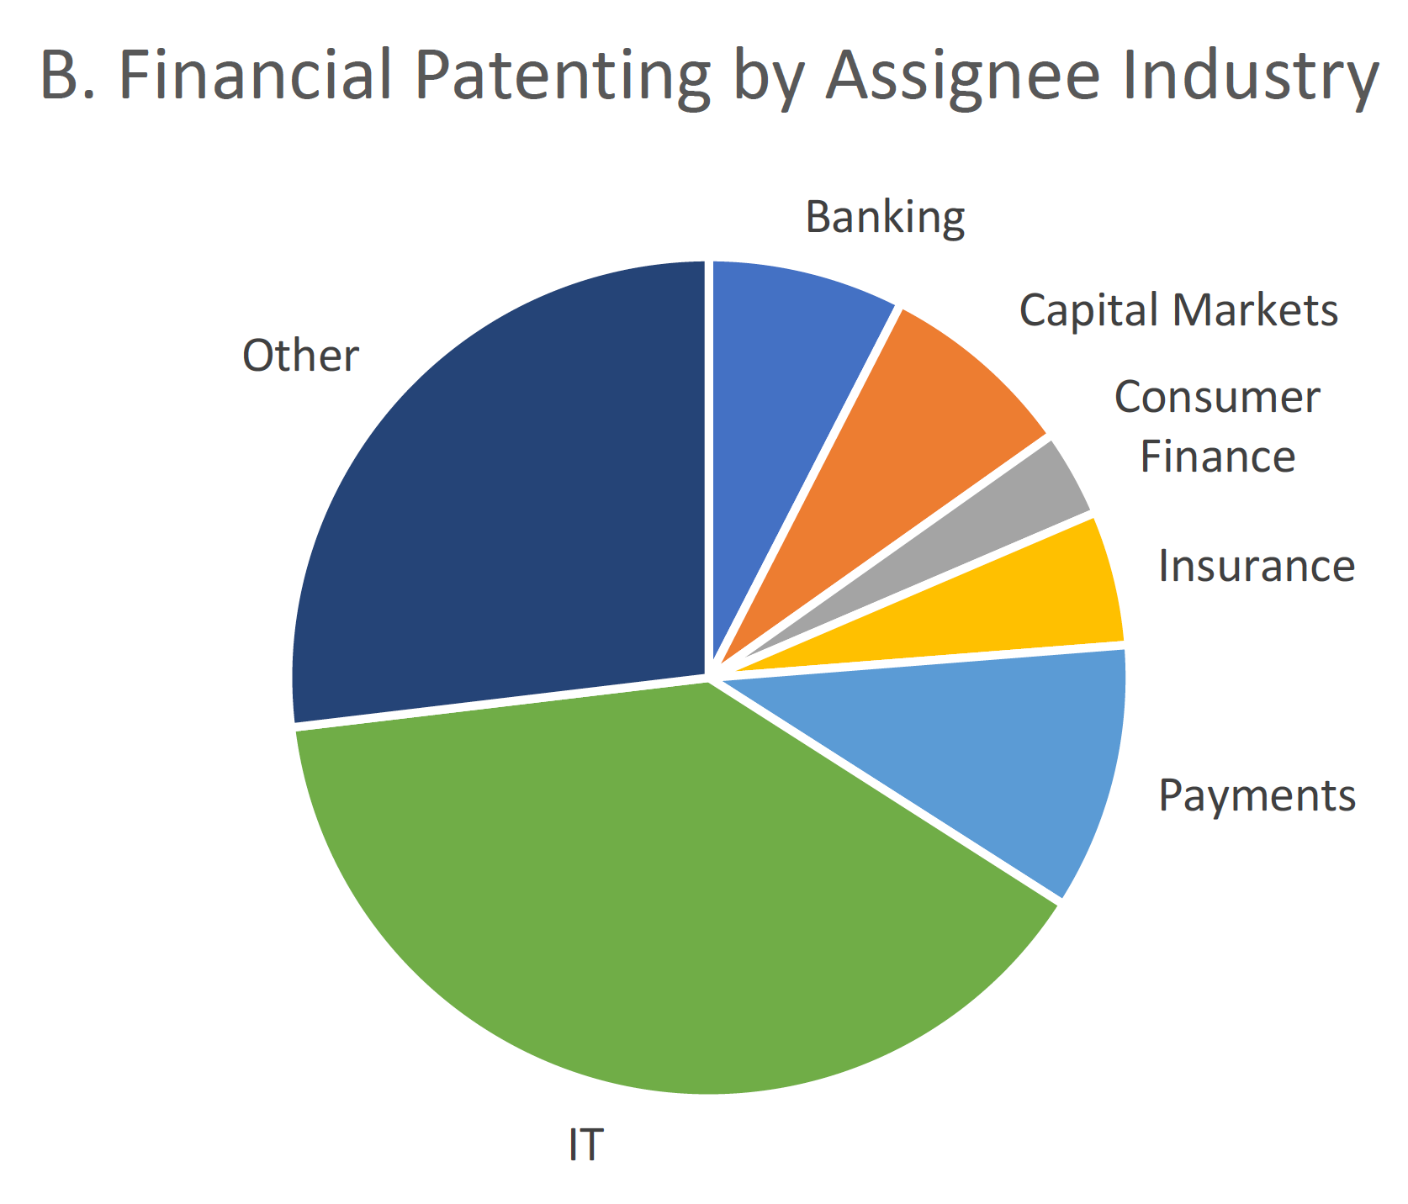
Source: Josh Lerner et al., “Financial Innovation in the 21st Century: Evidence from U.S. Patenting (2020),
https://scholar.harvard.edu/files/nickshort/files/financialinnovation21stcentury.20200730.pdf

Slide 9
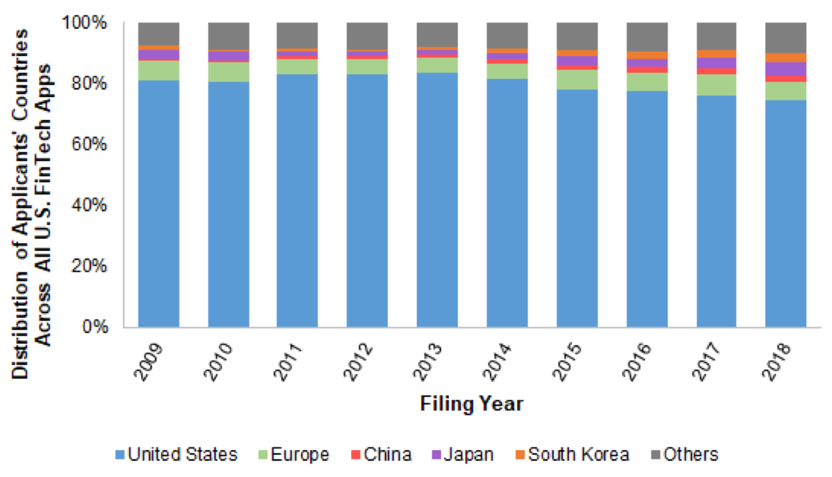
Applications for U.S. Patents
Source: https://www.kilpatricktownsend.com/-/media/Feature/Insights/Publication/
2019-Patent-Trends-Study_Fintech.ashx?la=en&hash=54EA939C23920A371931D4BD6BA07C3D4ED20787

Slide 10
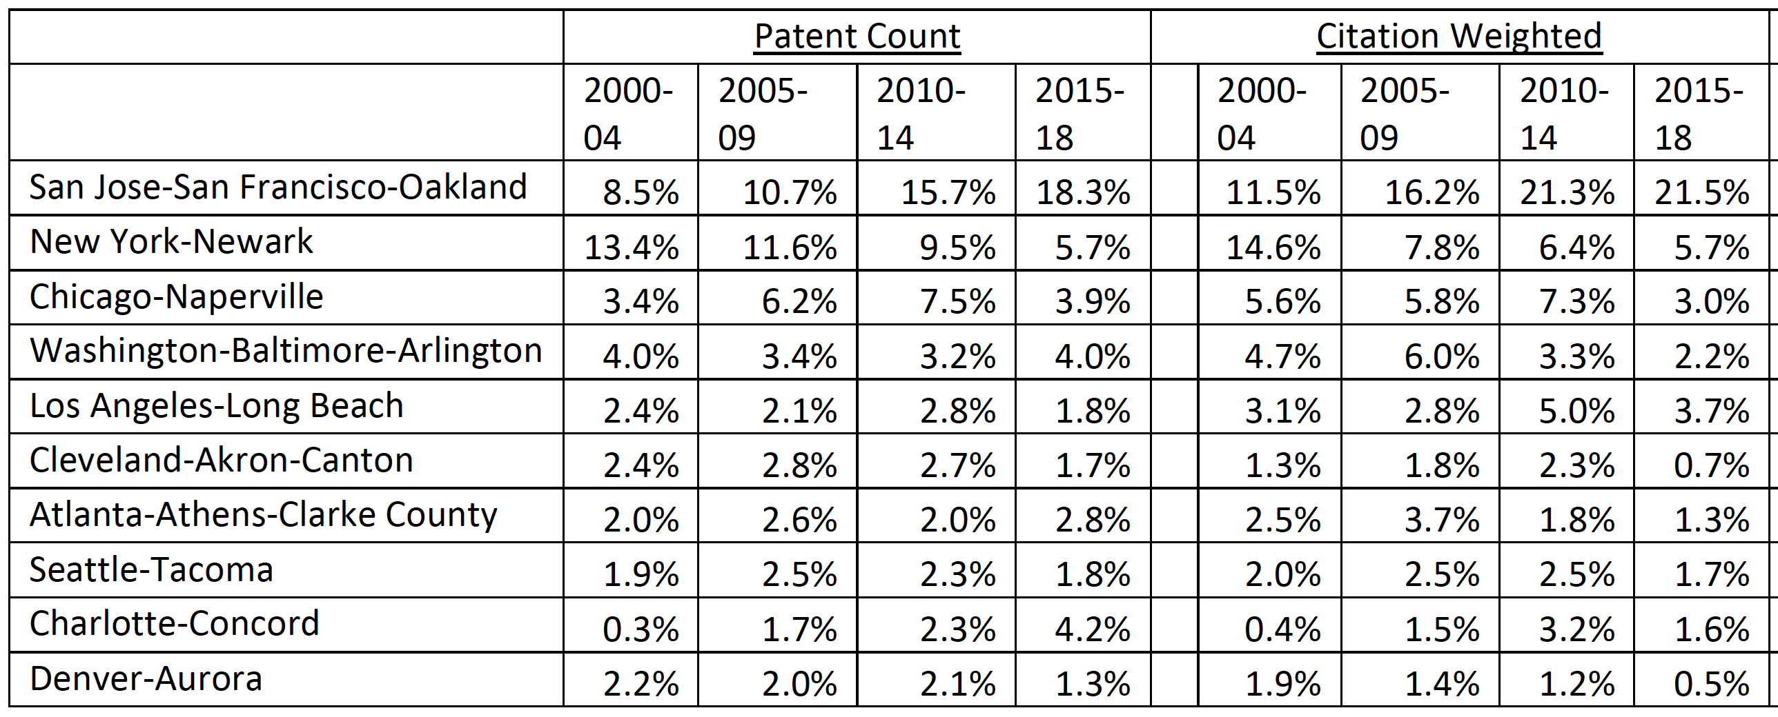
Source: Josh Lerner et al., “Financial Innovation in the 21st Century: Evidence from U.S. Patenting (2020),
https://scholar.harvard.edu/files/nickshort/files/financialinnovation21stcentury.20200730.pdf

Slide 11
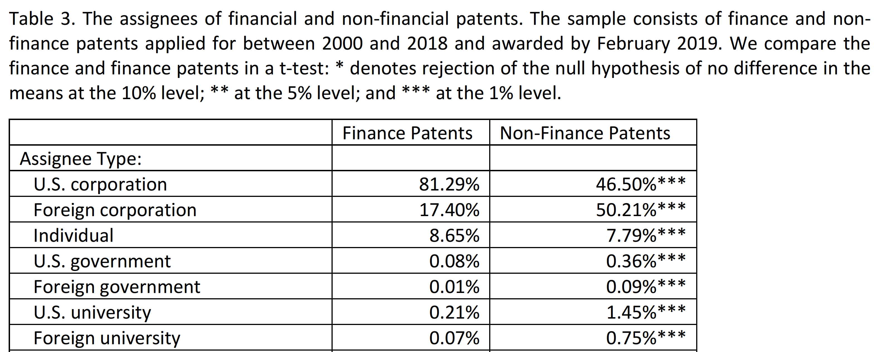
Source: Josh Lerner et al., “Financial Innovation in the 21st Century: Evidence from U.S. Patenting (2020),
https://scholar.harvard.edu/files/nickshort/files/financialinnovation21stcentury.20200730.pdf

Slide 12
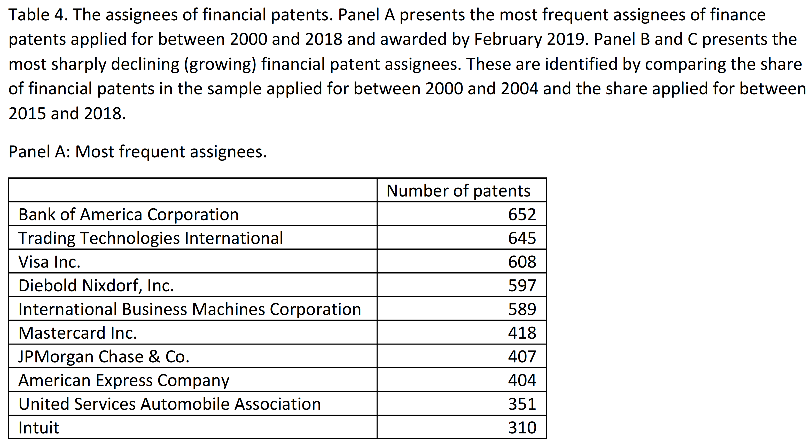
Source: Josh Lerner et al., “Financial Innovation in the 21st Century: Evidence from U.S. Patenting (2020),
https://scholar.harvard.edu/files/nickshort/files/financialinnovation21stcentury.20200730.pdf

Slide 13
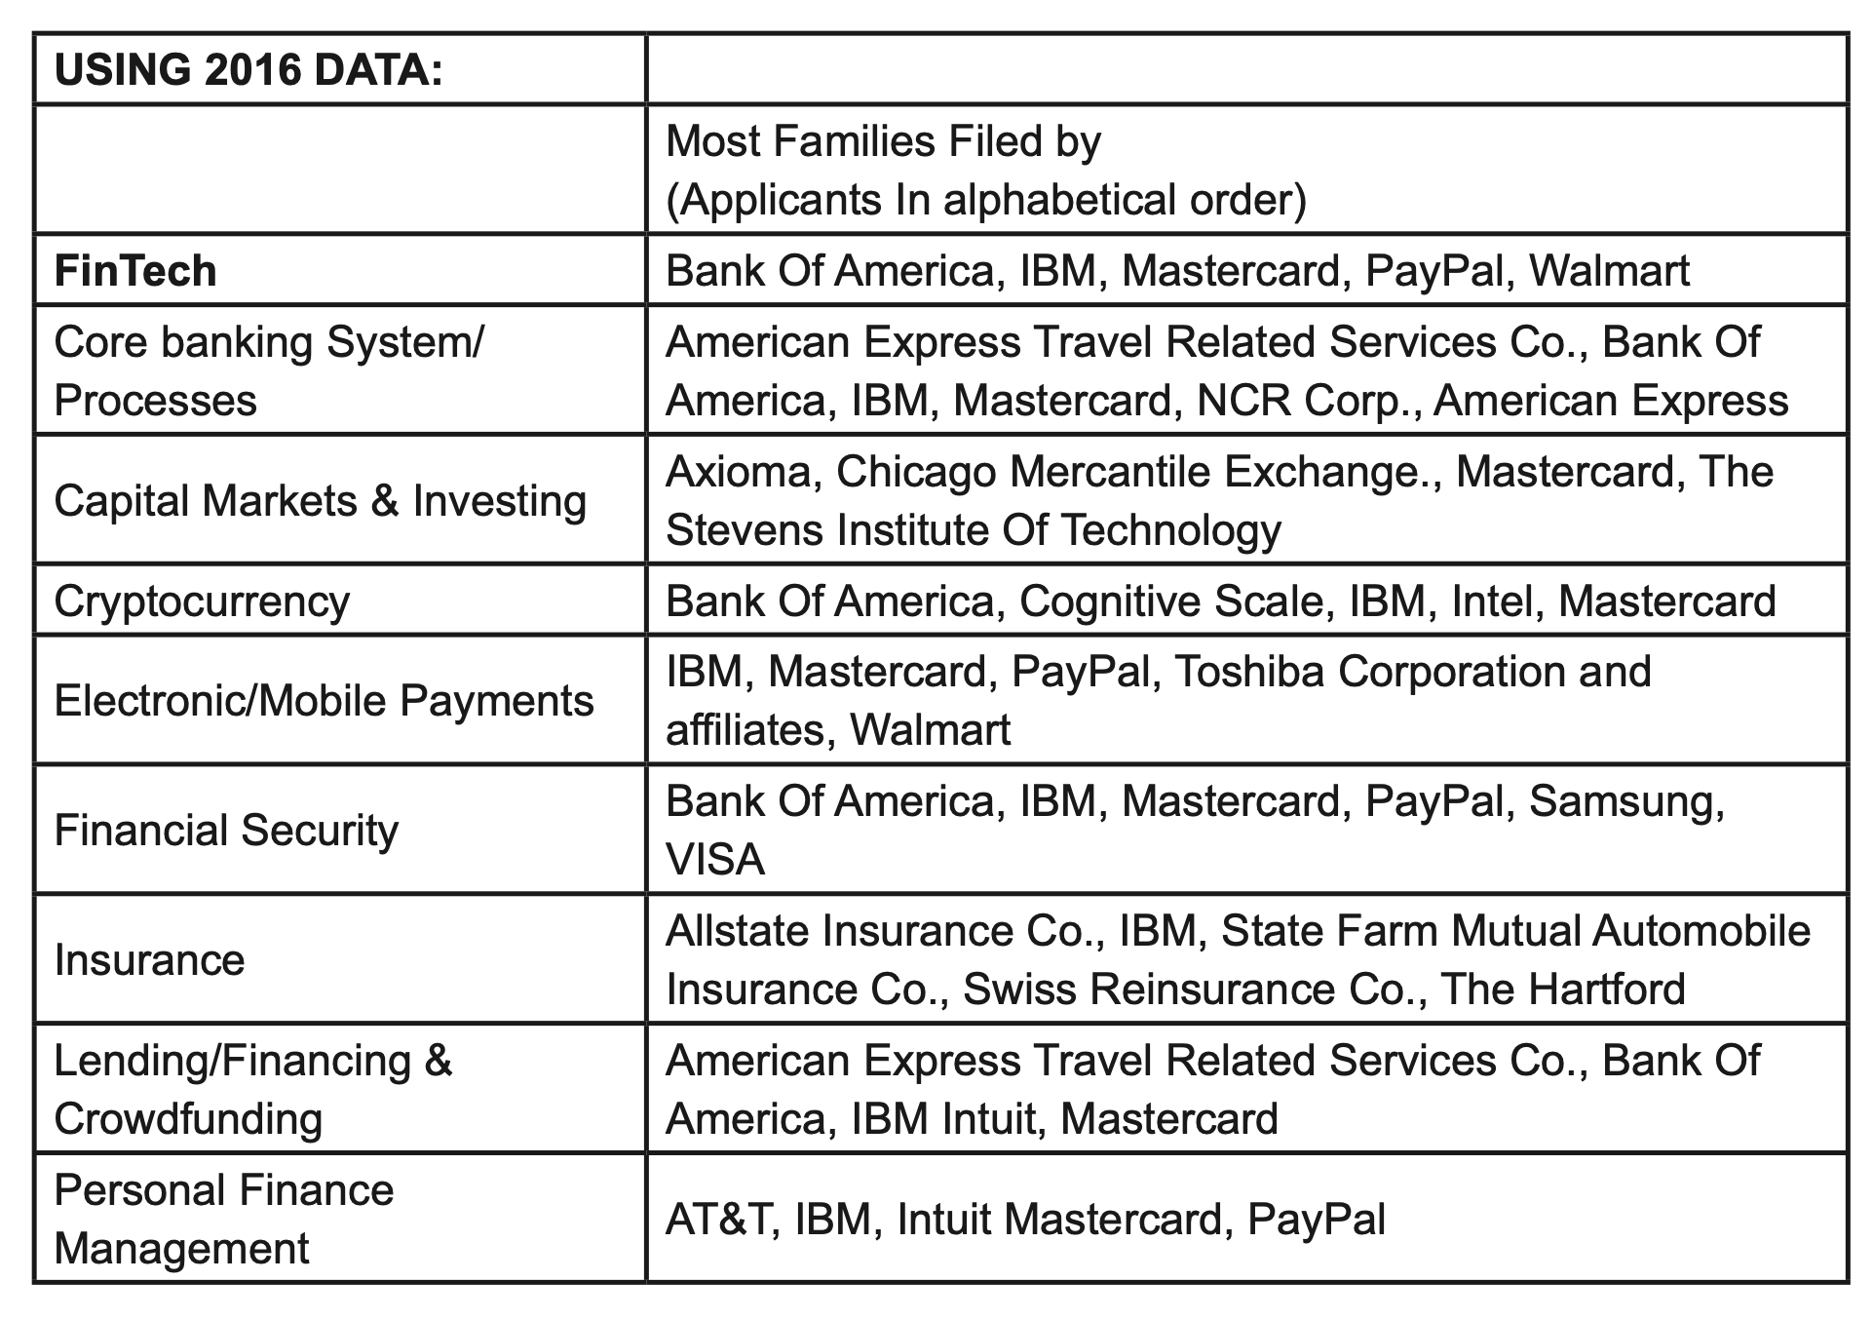
Applications for U.S. Patents
Source: https://www.kilpatricktownsend.com/-/media/Feature/Insights/Publication/
2019-Patent-Trends-Study_Fintech.ashx?la=en&hash=54EA939C23920A371931D4BD6BA07C3D4ED20787

Slide 14
China

Slide 15
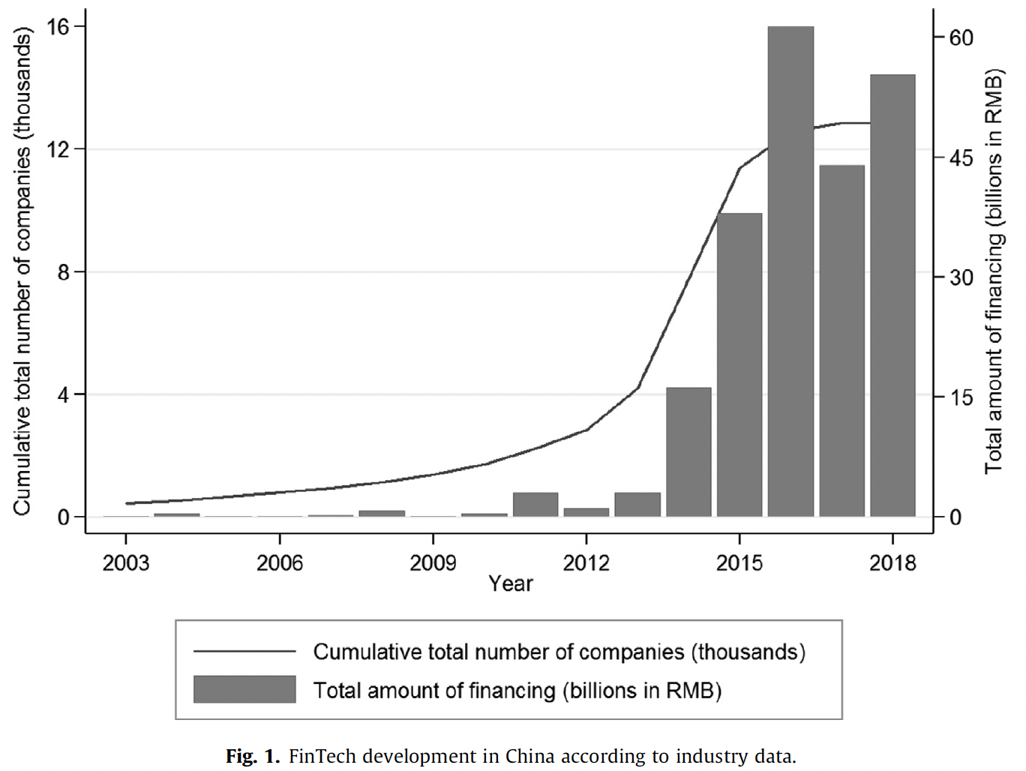
Source: Zhao et al., “Riding the FinTech innovation
wave: FinTech, patents and bank performance” (2022)

Slide 16
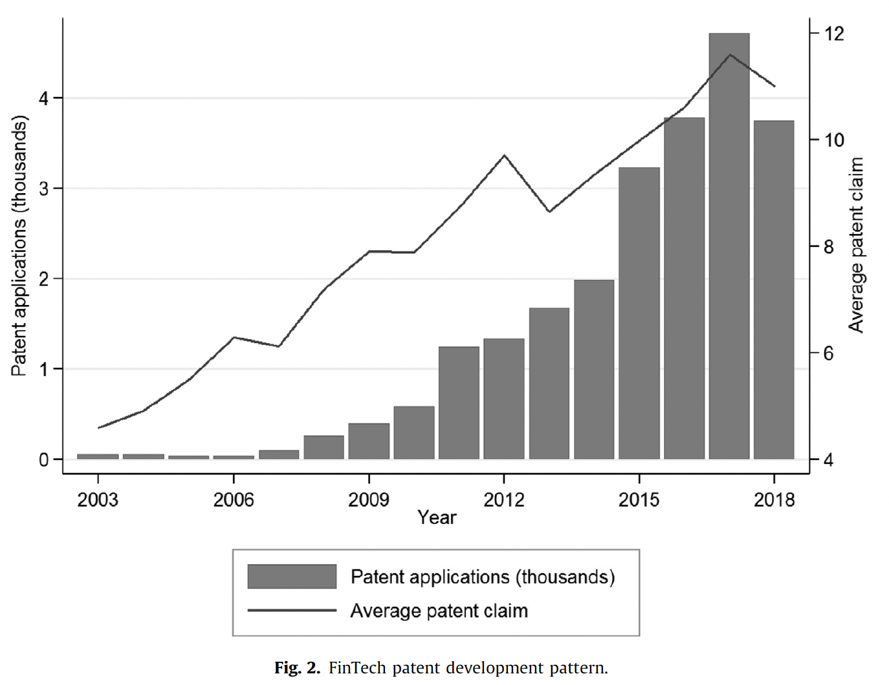
Source: Zhao et al., “Riding the FinTech innovation
wave: FinTech, patents and bank performance” (2022)

Slide 17
2
Number of patent applications of leading fintech enterprises in China in 2020, by company type
Note(s): China; 2020
Further information regarding this statistic can be found on page 8.
Source(s): KPMG; ID 1261420

Slide 18
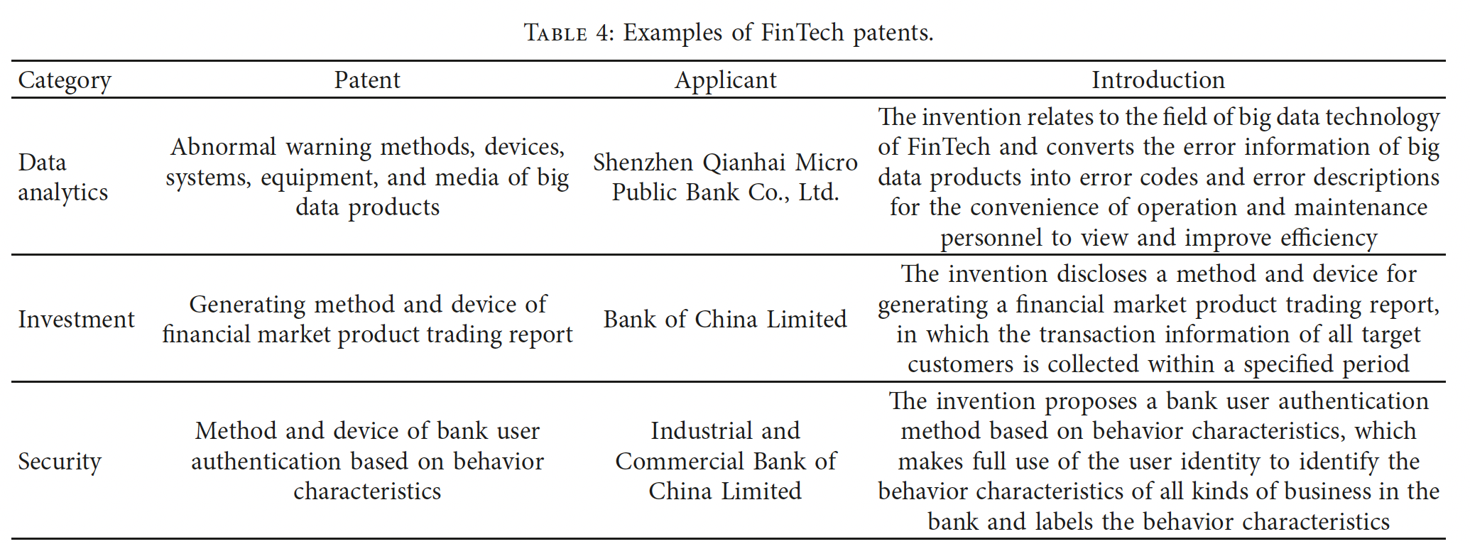
Examples of Fintech Patents in China
Source: Wang et al., “Classification of FinTech Patents by Machine Learning and Deep Learning Reveals
Trends of FinTech Development in China (2022)

Slide 19
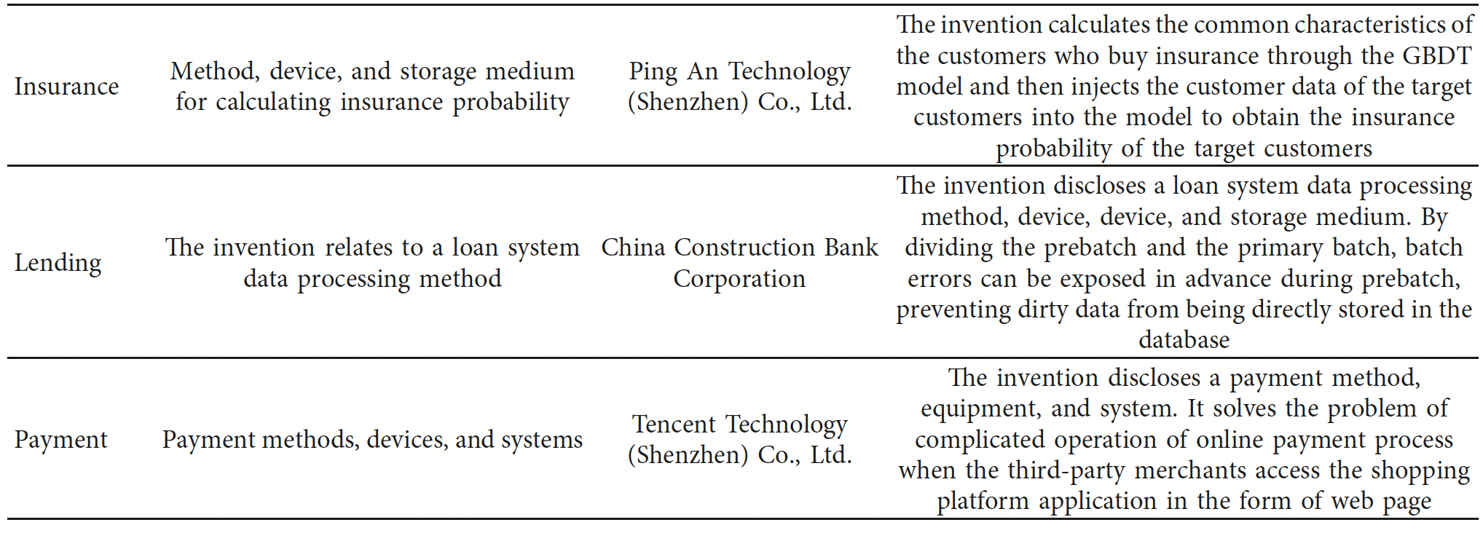
Examples of Fintech Patents in China
Source: Wang et al., “Classification of FinTech Patents by Machine Learning and Deep Learning Reveals
Trends of FinTech Development in China (2022)

Slide 20
Comparison

Slide 21
Applications for U.S. Patents
Source: https://www.kilpatricktownsend.com/-/media/Feature/Insights/Publication/
2019-Patent-Trends-Study_Fintech.ashx?la=en&hash=54EA939C23920A371931D4BD6BA07C3D4ED20787
Financial Crisis
IPRs commence
Alice

Slide 22
Source: Josh Lerner et al., “Financial Innovation in the 21st Century: Evidence from U.S. Patenting (2020),
https://scholar.harvard.edu/files/nickshort/files/financialinnovation21stcentury.20200730.pdf

Slide 23
2
Distribution of global blockchain patents in 2021, by country
Note(s): Worldwide; 2021
Further information regarding this statistic can be found on page 8.
Source(s): EE Times; Various sources (Zero One Think Tank); PatSnap; ID 1285542

Slide 24
Rough Comparison of Major Jurisdictions
 | China | USA | Europe
Adoption of Fintech Services | Highest | High | Low (except UK)
Investment in Fintech | Low | High | Medium
Availability of Patent Protection for Innovations in Fintech | Medium | Low | Low
Patenting Activity | High | Low | Low

Slide 25
Appendix

Slide 26
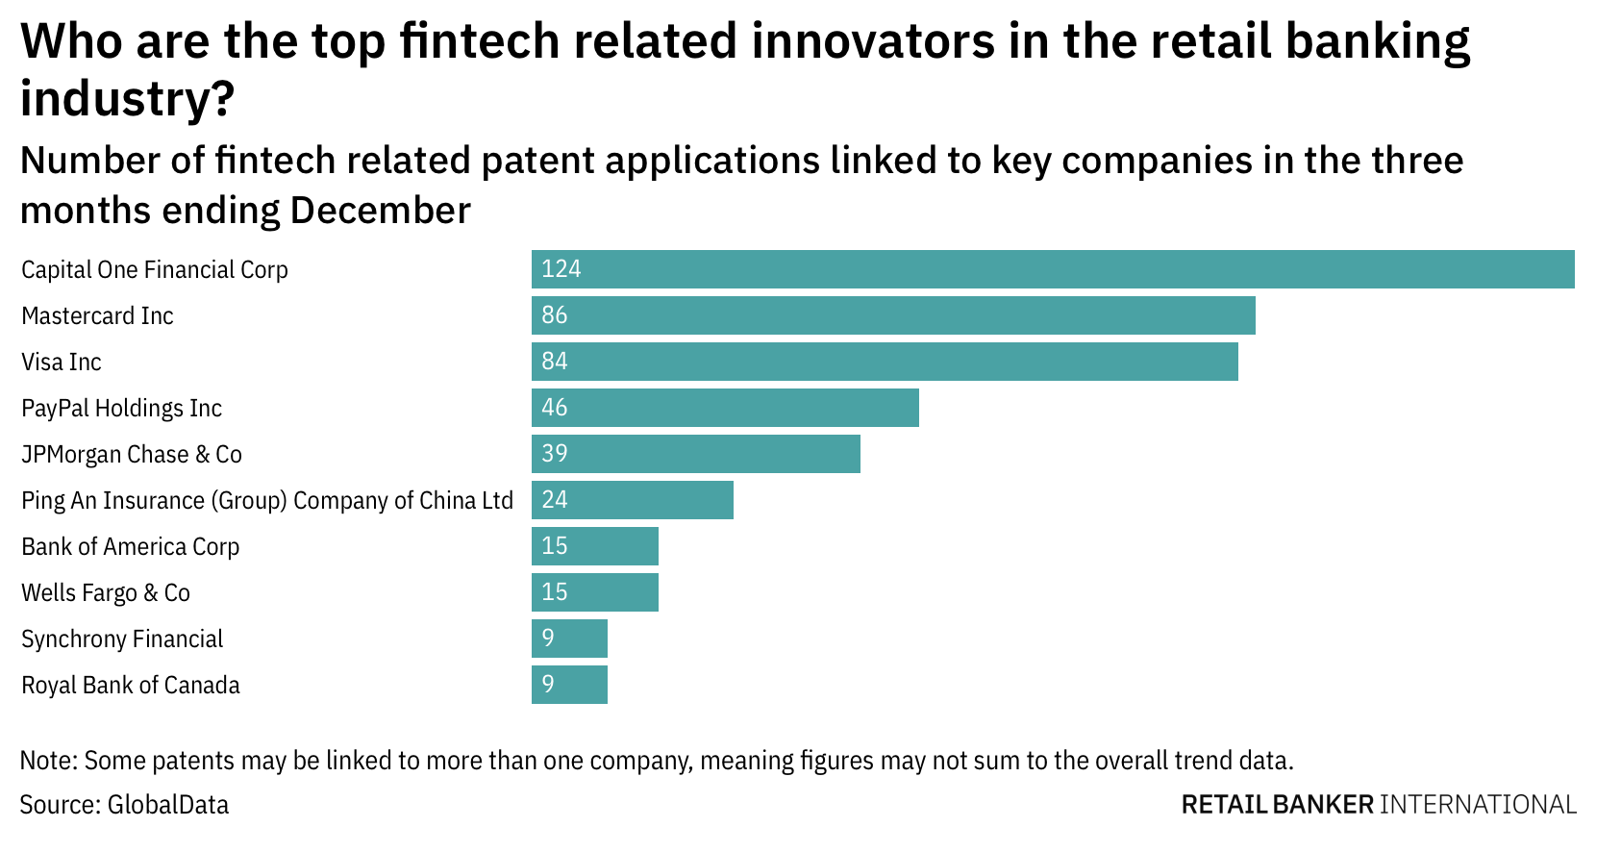
Source: Goodier, “Fintech innovation among retail banking industry companies has dropped off in the last year (2022)

Slide 27
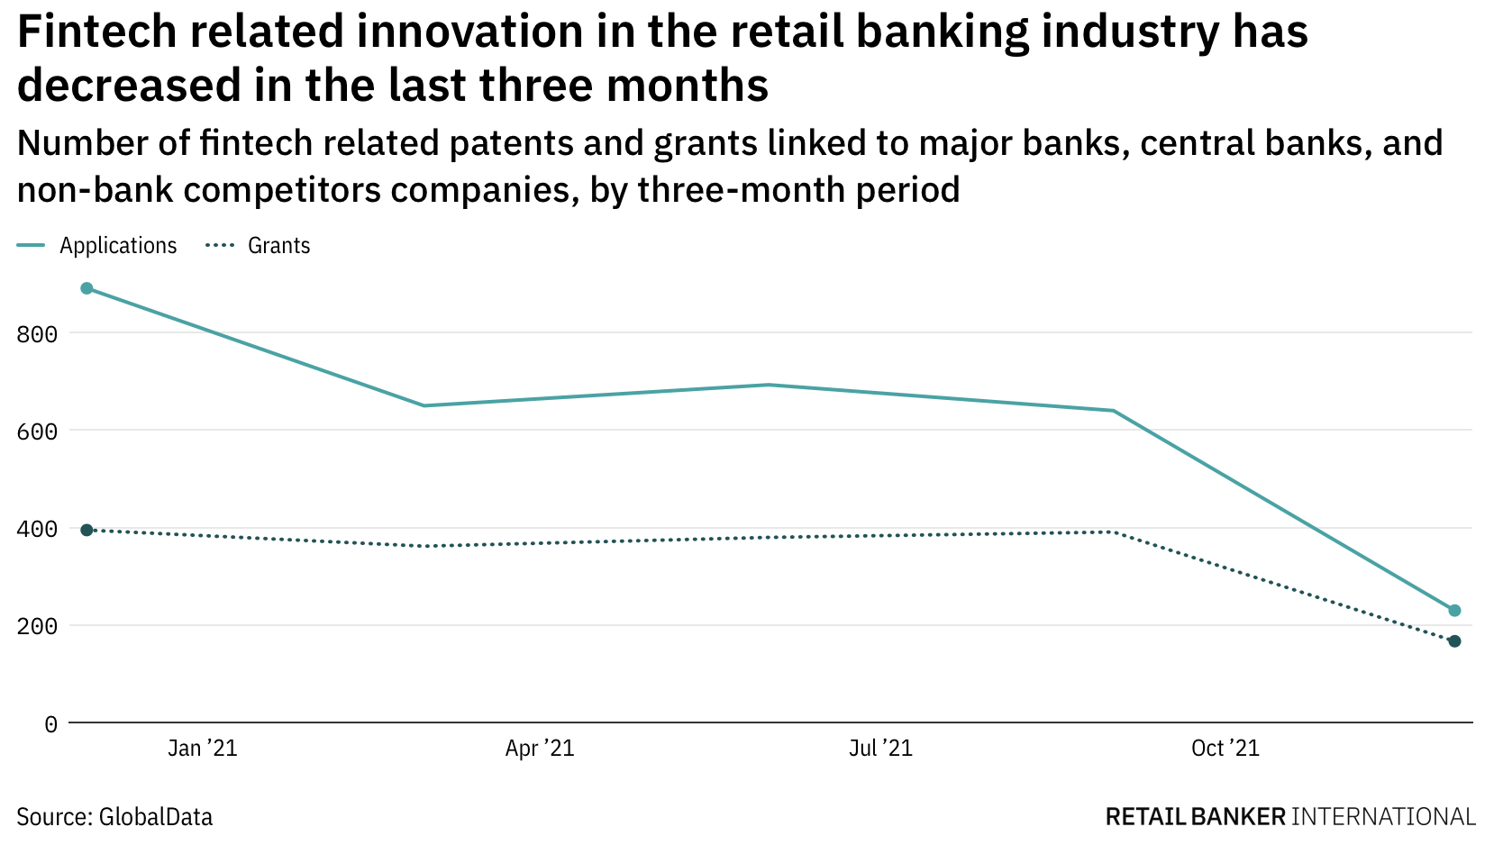
Source: Goodier, “Fintech innovation among retail banking industry companies has dropped off in the last year (2022)

