Slide 1
Employee Inventions
PX057
William Fisher
January 2024
revised by Koray Güven

Slide 2
Background

Slide 3
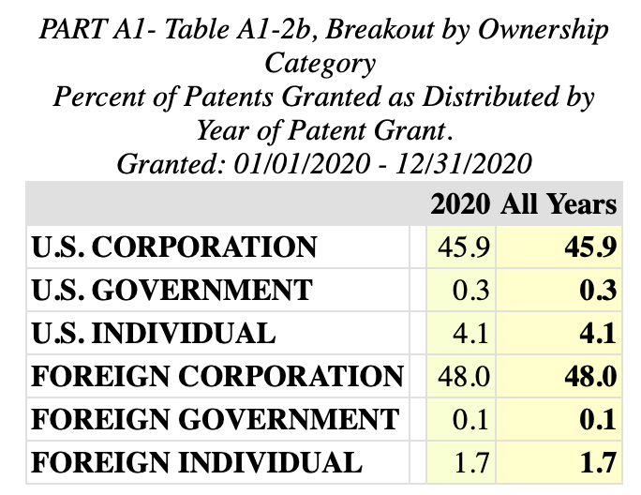
USPTO, “Top Organizations” Report
Source: https://www.uspto.gov/web/offices/ac/ido/oeip/taf/topo_20.htm

Slide 4
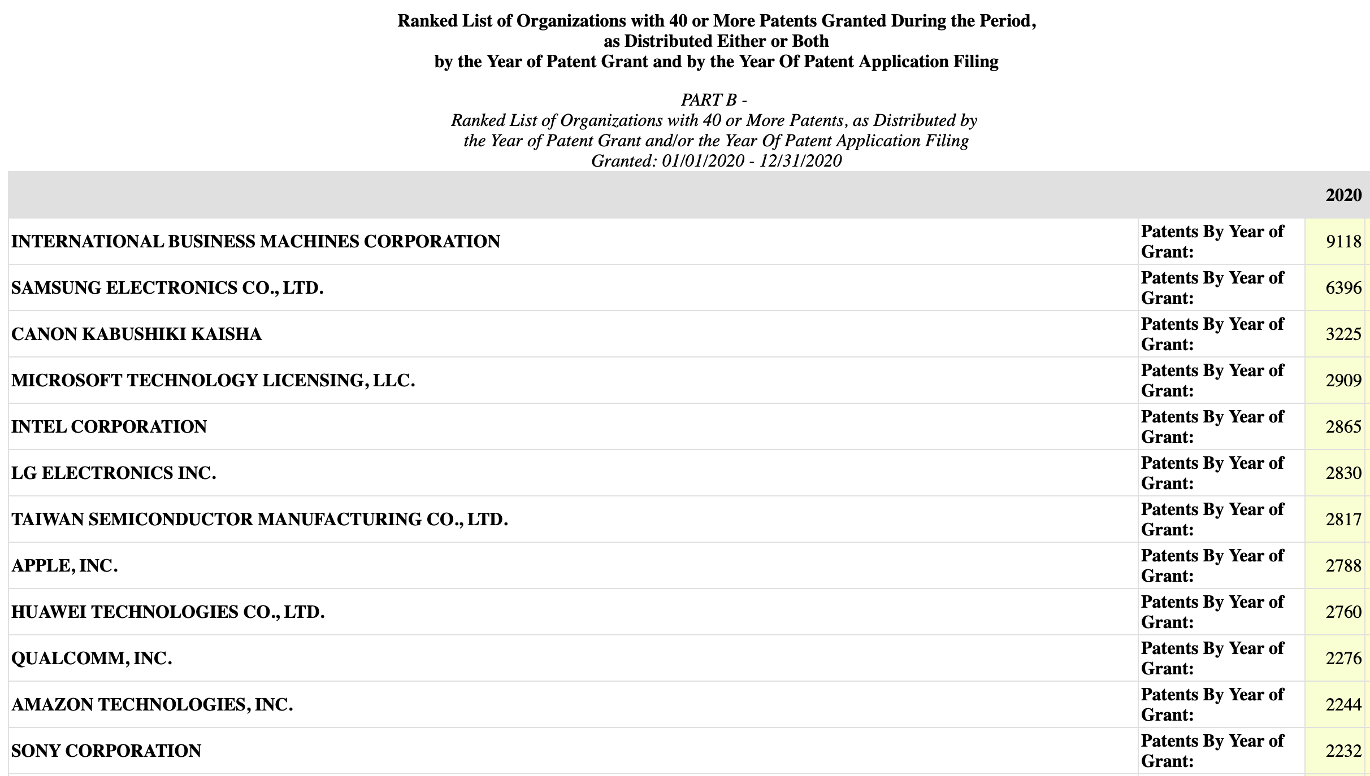

Slide 5
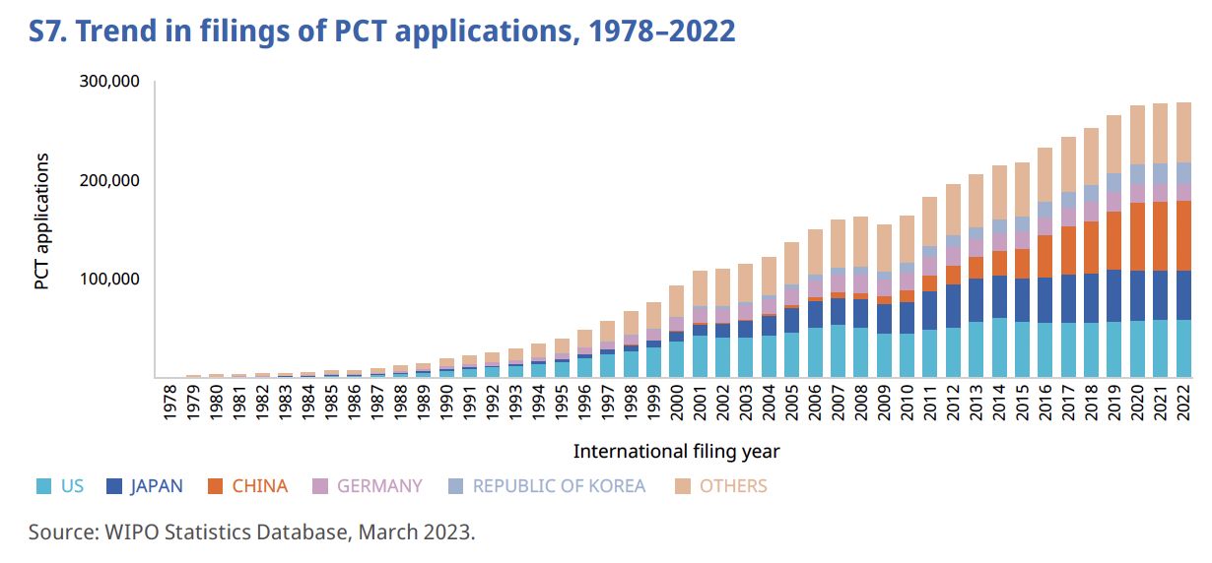
Source: WIPO, “PCT Yearly Report, 2023”

Slide 6
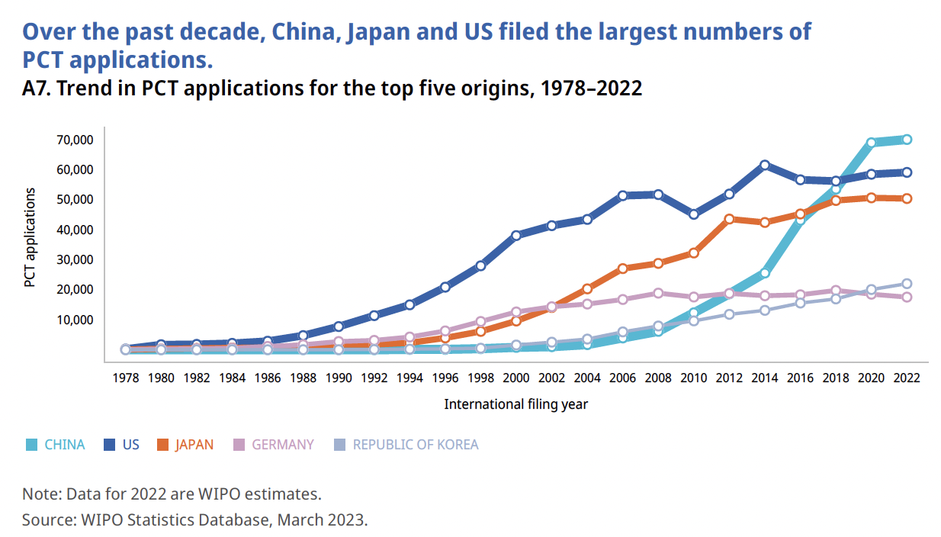
Source: WIPO, “PCT Yearly Report, 2023”

Slide 7
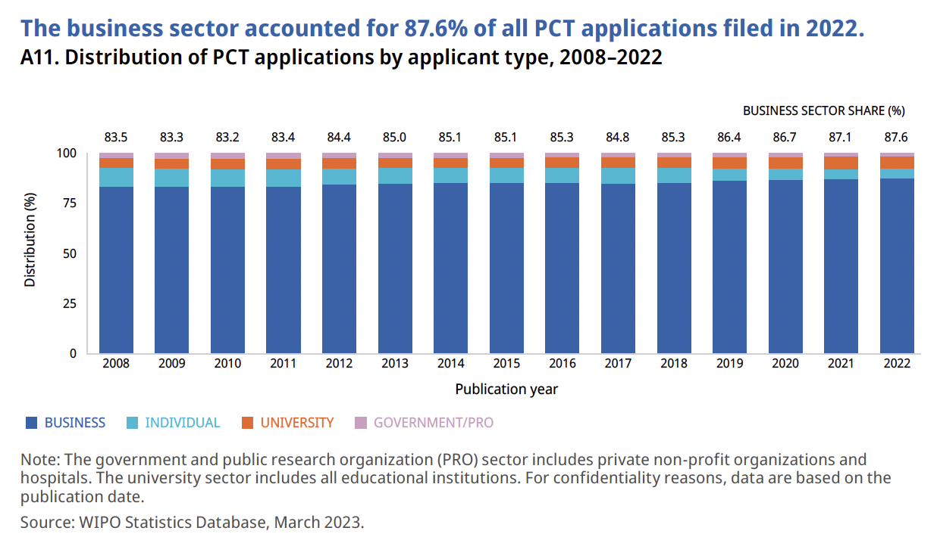
Source: WIPO, “PCT Yearly Report, 2023”

Slide 8
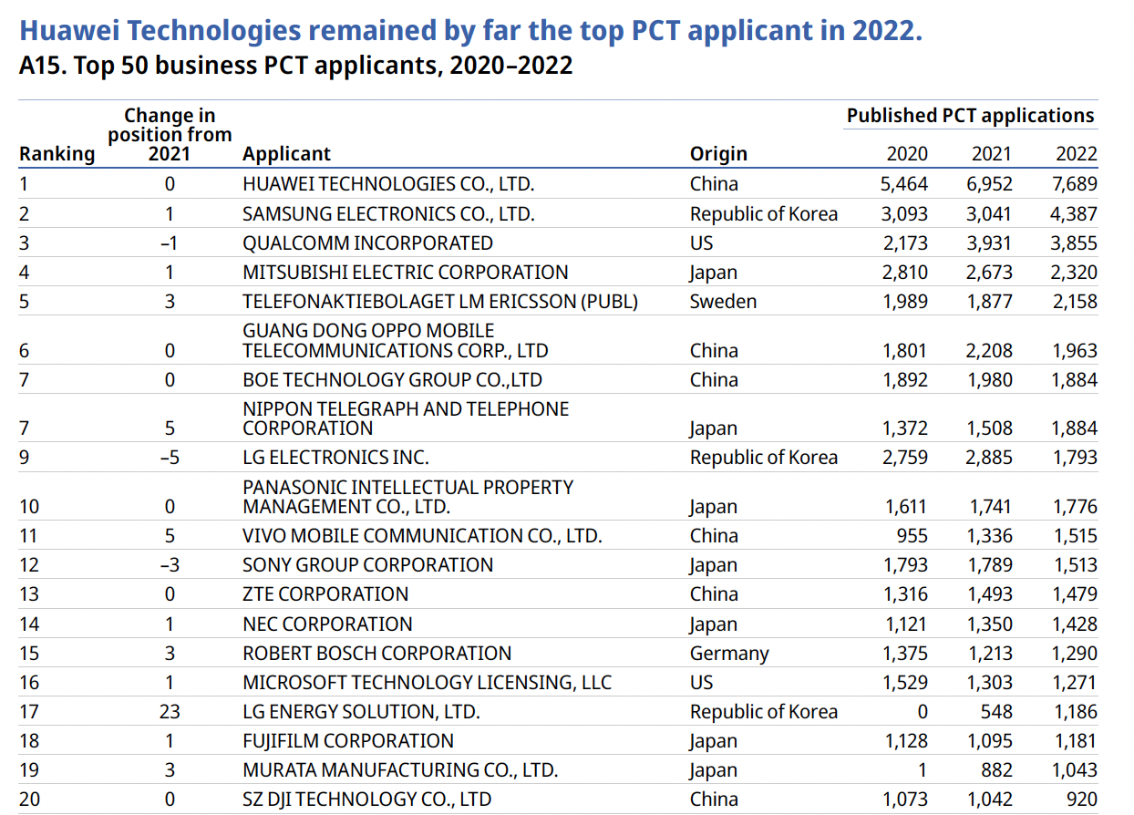

Slide 9
Case Study

Slide 10
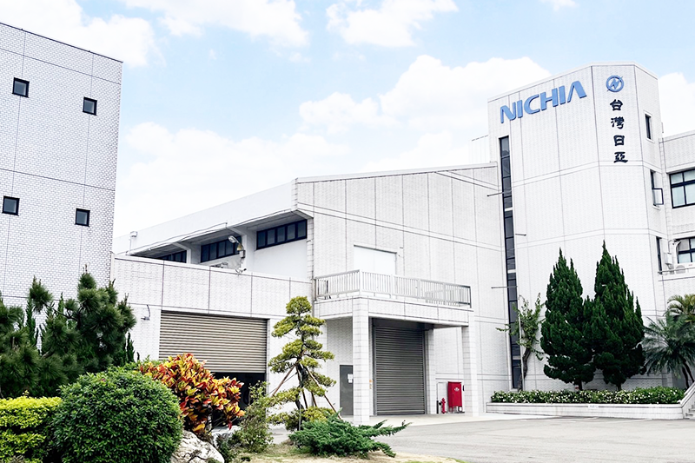
Shuji Nakamura
Source: https://www.pbs.org/wgbh/nova/article/how-blue-leds-work-and-why-they-deserve-the-physics-nobel/

Slide 11
1977: Nakamura graduates from the University of Tokushima; begins employment at Nichia Corp.
Until 1989, the president of Nichia supports Nakamura’s project, which sought to develop a blue diode; after 1989, the new president tells him to shut down the project, on the ground that it is unpromising and expensive
1993: Nakamura succeeds in developing the diode
1993-1999: Nichia obtains patents on the diode – later valued at aprx. 60B yen ($580M); Nichia promotes Nakamura and pays him bonuses – the amounts of which are disputed
1999: Nakamura quits – and joins the faculty of the University of Santa Barbara
2001: In Olympus v. Tanaka, the Tokyo High Court relies on Article 35 to require payment of “fair compensation” to an employee inventor
2001: Nakamura brings suit to recover a portion of the value of the Nichia patents
2003: Supreme Court of Japan affirms the ruling in Olympus
2004: The Tokyo High Court awards Nakamura 20B yen ($190M) (10x the amount he had sought); Nichia appeals
Other employee inventors in Japan file similar suits
2005: Nakamura and Nichia settle for 840M yen ($8.1M)
2005: Japanese legislature amends Article 35
2014: Nakamura shares Nobel Prize in Physics
2021: Nakamura shares Queen Elizabeth Prize in Engineering
2022: Nakamura co-founds Blue Laser Fusion; the company raises $25M in venture-capital funding

Slide 12
Comparative Law

Slide 13
In US, governed by state law
Presumption: Inventor owns the invention
Common-law rules favor employers
Pre-employment invention assignment agreements common and routinely enforced
“Hired to invent”
Shop right (if employee used employer’s time or other resources, employer gets a royalty-free, non-assignable, non-exclusive right to use)
Adjusted by state statutes
E.g., CA, NV
Contract
law
Equity

Slide 14
California Labor Code 2870
Any provision in an employment agreement which provides that an employee shall assign, or offer to assign, any of his or her rights in an invention to his or her employer shall not apply to an invention that the employee developed entirely on his or her own time without using the employer’s equipment, supplies, facilities, or trade secret information except for those inventions that either:
(1) Relate at the time of conception or reduction to practice of the invention to the employer’s business, or actual or demonstrably anticipated research or development of the employer; or
(2) Result from any work performed by the employee for the employer.

Slide 15
Nevada Revised Statutes 600.500: “Employer is sole owner of patentable invention or trade secret developed by employee.”
Except as otherwise provided by express written agreement, an employer is the sole owner of any patentable invention or trade secret developed by his or her employee during the course and scope of the employment that relates directly to work performed during the course and scope of the employment.

Slide 16
Japan
Employee is entitled to “reasonable remuneration” (Art 35, para 3)
Remuneration by an employer pursuant to an employment contract shall not be considered unreasonable if:
There was consultation between the employer and the employees to set standards for remuneration,
there was adequate disclosure of the standards for remuneration,
and the opinions of employees concerning the amount of remuneration are heard by the employer. (Art. 35, para 4)
In the absence of a valid contract of this sort, the amount of the compensation shall be determined by considering:
the amount of profit to be received by the employer from the invention,
the employer’s burden and contribution,
its treatment of the employee,
and any other circumstances relating to the invention. (para 5)

Slide 17
German Act on Employee Inventions (GAEI) (1957; reformed 2009)
Scope:
Applies whenever either:
The employee’s usual workplace is in Germany, or
The employment contracts specifies German law as the governing law

Slide 18
German Act on Employee Inventions (GAEI) (1957; reformed 2009)
Differentiation:
“Service Invention” = invention made during the term of employment which either:
Resulted from the employee’s tasks in employment, or
Is based upon the experience or activities of the employer
“Free invention” = any other invention made during the period of employment

Slide 19
German Act on Employee Inventions (GAEI) (1957; reformed 2009)
Rules governing service inventions
Employee must promptly notify employer in writing; employer must promptly confirm receipt
Employer can then “claim” the invention, either:
Expressly, or
Allowing 4 months to pass without expressly disclaiming
If employer uses the invention, must pay remuneration using VEAX formula

Slide 20
V = E * A * X
Typically calculated by multiplying additional revenue enabled by the invention x reasonable and customary license fee
Illustration:
An invention, by improving the efficiency of a manufacturing process, increases company’s revenues by 1,000,000 Euros per year
customary royalty for licensing a patent of this sort = 5%
Then E = 50,000 Euros
V = annual remuneration
E = invention value
A = employee’s “share factor”
a) role in identifying the problem solved by the invention
b) contribution to the solution of the problem
c) duties and position within the company
X = co-inventor share

Slide 21
V = E * A * X
Sum of:
1 to 6 “points,” depending on how extensive the employee’s role was in identifying the problem and taking the initiative in solving it
1 to 6 “points,” depending on whether the employee:
Used commonplace ideas to solves the problem or his own ingenuity
Used work or knowledge provided by the company
Used technical resources provided by the company
1 to 8 ”points,” depending on the employee’s position in the company
Unskilled workers and apprentices get the most; executives get the fewest
V = annual remuneration
E = invention value
A = employee’s “share factor”
a) role in identifying the problem solved by the invention
b) contribution to the solution of the problem
c) duties and position within the company
X = co-inventor share

Slide 22
V = E * A * X
Illustration:
Recently hired junior-level chemist [5 points], working alone, solves a problem identified by her supervisor in Biotech Inc. [1 point], using technology supplied by the company but also her own ingenuity and training [3 points]
Sum = 9
V = annual remuneration
E = invention value
A = employee’s “share factor”
a) role in identifying the problem solved by the invention
b) contribution to the solution of the problem
c) duties and position within the company
X = co-inventor share

Slide 23
V = E * A * X
V = annual remuneration
E = invention value
A = employee’s “share factor”
a) role in identifying the problem solved by the invention
b) contribution to the solution of the problem
c) duties and position within the company
X = co-inventor share
If the invention is created by a team, proportion contributed by each member

Slide 24
V = E * A * X
Illustration:
E = 50,000 Euros
A = 18%
X = 100%
V = 9000 Euros per year
V = annual remuneration
E = invention value
A = employee’s “share factor”
a) role in identifying the problem solved by the invention
b) contribution to the solution of the problem
c) duties and position within the company
X = co-inventor share

Slide 25
German Act on Employee Inventions (GAEI) (1957; reformed 2009)
Rules governing “free inventions”
Employee must promptly notify employer
If employer does not dispute classification as free invention within 3 months, employee is free to patent and exploit the invention
If the invention falls within the activities of the employer, employee must offer employer a nonexclusive right to use it on reasonable terms

Slide 26
German Act on Employee Inventions (GAEI) (1957; reformed 2009)
Permissible Contractual Modifications:
Contracts that purport to override these rules as to inventions that have not yet been made and reported are null and void
Contracts that override these rules with respect to inventions already made and reported are valid iff not “manifestly inequitable”
Lump-sum settlements are common; typically include a provision for reconsideration of the amount after defined periods

Slide 27
German Act on Employee Inventions (GAEI) (1957; reformed 2009)
Disputes:
German PTO offers free arbitration
Arbitration is mandatory prior to initiating a lawsuit

Slide 28
Rough Comparison
German
Regime
Japanese
Regime
US Regime
Favor
Employee
Favor
Employer

Slide 29
Discussion Questions
What did Nakamura deserve?
What Legal Regime governing Employee Inventions is Best?
US
Japan
Germany
Other ______

