Slide 1
Dana Farber
PX024
William Fisher
January 2024

Slide 2
The Invention
Method for removing a shield around cancer cells
“The discovery behind the present patents was the existence of an inhibitory receptor on T cells, PD-1, and that, when PD-1 binds to one of its ligands, either PD-L1 or PD-L2, the T cell is inhibited and does not attack the cell ex-pressing the ligand. Expression of the PD-1 ligands in healthy cells generally shields them from attack, but some tumor cells can also express the ligands, allowing them to circumvent an immune response. The patents in this case capitalize on the discovery of the PD-1 receptor-ligand interaction. Each claim recites uses of antibodies that target either the PD-1 receptor or its PD-L1 ligand, blocking the receptor-ligand interaction. By blocking the interaction, the use of the inventions in effect stimulates the immune response against tumor cells that would otherwise have been hidden by their expression of the PD-L1/L2 ligands.”

Slide 3
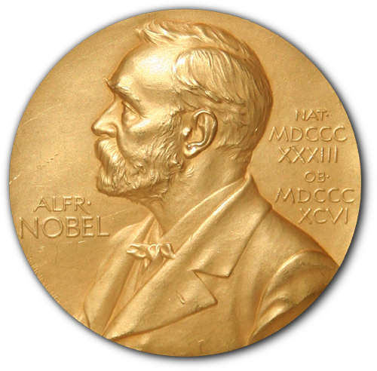
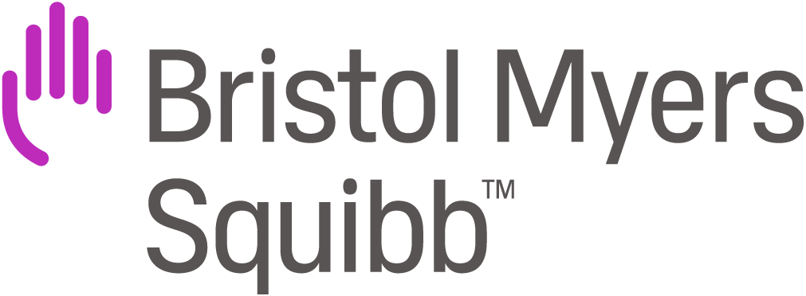
Early 1990s: Discover PD-1 receptor;
Immunity article (1999);
1999: in vitro experiments show inhibition of immune response;
2002: Honjo files Japanese patent application on use of antibodies to block interaction of PD-1 with PD-L1 and PD-L2 – establishes priority for six US applications
1998: Discover PD-L1 ligand (a sequence of amino acids);
1999: Discover PD-L2 ligand, conduct experiments on it;
2000: Dorfman finds PD-L1 ligand expression in human tumors;
2015: Dana-Farber initiates suit to add Freeman and Wood to US patents
Kyoto University
Dana Farber Cancer Inst.
assign
Ono Pharma. Co.
1998-1999: exchange of information, confidential drafts, and reagents;
Oct. 2000: joint article in J. Experimental Medicine;
2001: parties cease collaboration
Tasuku Honjo
Gordon Freeman
Nagashiro Minato
2015
David Dorfman
Julia Brown
Assign interest
in Honjo
US patents
Yoshiko Iwai
Clive Wood
license
1999: Provisional US patent application, disclosing modulation of immune response (assign to GI);
2001: GI refuses to add Honjo as inventor
Genetics Institute
assign
Pfizer
Purchase
(2009)
Wyeth
Purchase
(1996)

Slide 4

Commercialization
Starting in 2011, BMJ (licensee) develops Opdivo
– approved by FDA, December 22, 2014. R&D costs: $3B

Slide 5

Commercialization
Marck (not a licensee) develops Keytruda – approved by FDA September 4, 2014.

Slide 6
Litigation
Merck seeks to invalidate the European version of the Honjo patents
BMJ brings an infringement action in US against Merck
Merck seeks inter partes review of the US versions of the Honjo patents
2017: On the eve of trial, BMJ and Merck settle

Slide 7
BMS Press Release, January 1, 2017
Bristol-Myers Squibb Company (NYSE:BMY) and Ono Pharmaceutical Company, Ltd. today announced the companies have signed a global patent license agreement with Merck & Co., Inc. (NYSE: MRK) to settle all patent-infringement litigation related to Merck’s PD-1 antibody Keytruda (pembrolizumab). The agreement will result in the dismissal with prejudice of all patent litigation between the companies pertaining to Keytruda. Bristol-Myers Squibb and Ono, who discovered and developed the PD-1 antibody Opdivo (nivolumab), had asserted in litigation that Merck’s sale of Keytruda infringed the companies’ patents relating to the use of PD-1 antibodies to treat cancer in the U.S., Europe (United Kingdom, Netherlands, France, Germany, Ireland, Spain and Switzerland), Australia, and Japan.
As part of the agreement, Merck will make an initial payment of $625 million to Bristol-Myers Squibb and Ono. Merck is also obligated to pay ongoing royalties on global sales of Keytruda of 6.5% from January 1, 2017 through December 31, 2023, and 2.5% from January 1, 2024 through December 31, 2026. Under the agreement, the companies have also granted certain rights to each other under their respective patent portfolios pertaining to PD-1. The royalties will be shared between Bristol-Myers Squibb and Ono in a 75/25 percent allocation, respectively.

Slide 8
Joint Invention: 35 USC 116(b)
When an invention is made by two or more persons jointly, they shall apply for patent jointly and each make the required oath, except as otherwise pro-vided in this title. Inventors may apply for a patent jointly even though (1) they did not physically work together or at the same time, (2) each did not make the same type or amount of contribution, or (3) each did not make a contribution to the subject matter of every claim of the patent.

Slide 9
Current U.S. Doctrine concerning Joint Invention
“[A] valid patent requires correct inventorship.” In re VerHoef, 888 F.3d 1362, 1365 (Fed. Cir. 2018)
  AIA definition of “inventor”: “the individual or, if a joint invention, the individuals collectively who invented or discovered the subject matter of the invention”
  Both misjoinder (of non-inventors) and nonjoinder (of inventors) are potentially fatal
If the validity of a patent is successfully challenged on the basis of nonjoinder or misjoinder, the patentee may request – and a District Court may grant – correction of patent inventorship. 35 USC 256
Joint invention gives rise to joint ownership, absent valid assignment(s).

Slide 10
37 C.F.R. 3.1
IV. INDIVIDUAL AND JOINT OWNERSHIP
Individual ownership - An individual entity may own the entire right, title and interest of the patent property. This occurs where there is only one inventor, and the inventor has not assigned the patent property. Alternatively, it occurs where all parties having ownership interest (all inventors and assignees) assign the patent property to one party.
Joint ownership - Multiple parties may together own the entire right, title and interest of the patent property. This occurs when any of the following cases exist:
  (A) Multiple partial assignees of the patent property;
  (B) Multiple inventors who have not assigned their right, title and interest; or
  (C) A combination of partial assignee(s), and inventor(s) who have not assigned their right, title and interest.
Each individual inventor may only assign the interest he or she holds; thus, assignment by one joint inventor renders the assignee a partial assignee. A partial assignee likewise may only assign the interest it holds; thus, assignment by a partial assignee renders a subsequent assignee a partial assignee. All parties having any portion of the ownership in the patent property must act together as a composite entity in patent matters before the Office.

Slide 11
Joint Ownership
 | US (§262) | China | Japan | Korea
May an individual JO make/use/sell/import the invention? | Yes | Yes | Yes | Yes
May an individual JO transfer its interest to a 3rd party? | Yes | Yes | Yes | Yes
May an individual JO license the patent to a 3rd party? | Yes | Yes | No | No
Does each JO have a duty of accounting to others with respect to license fees? | No | Yes | n.a. | n.a.
Must all JOs join an infringement suit? | Yes | No | No | No

Slide 12
Dana Farber – CAFC, July 2020
“[A] joint invention is simply the product of a collaboration between two or more persons working together to solve the problem addressed.”
“To be a joint inventor, one must: (1) contribute in some significant manner to the conception or reduction to practice of the invention, (2) make a contribution to the claimed invention that is not insignificant in quality, when that contribution is measured against the dimension of the full invention, and (3) do more than merely explain to the real inventors well-known concepts and/or the current state of the art.”
“That Drs. Freeman and Wood were not present for or participants in all the experiments that led to the conception of the claimed inventions does not negate their overall contributions throughout their collaboration with Dr. Honjo.”
“Inventorship of a complex invention may depend on partial contributions to conception over time, and there is no principled reason to discount genuine contributions made by collaborators because portions of that work were published prior to conception for the benefit of the public.”
“Conception is the formation in the mind of the inventor, of a definite and permanent idea of the complete and operative invention, as it is hereafter to be applied in practice.” Hybritech, Inc. v. Monoclonal Antibodies, Inc. (CAFC 1986).
“Actual reduction to practice” = build a working prototype of a product or perform a process;
“Constructive reduction to practice” = file a patent application

Slide 13
Potential Interpretations of Joint Invention
(A) Each of the persons claiming to be a joint inventor must have contributed significantly to the overall research project out of which the invention grew, but not necessarily to the conception or reduction to practice of the invention embodied in the patent.
(B) Each of the persons claiming to be a joint inventor must have contributed significantly to the conception or reduction to practice of the invention embodied in the patent, but not necessarily to all of the variants of the invention embodied in the separate claims.
(C) Each of the persons claiming to be a joint inventor must have contributed significantly to all of the variants of the invention embodied in the separate claims.
(D) Each of the persons claiming to be a joint inventor must have contributed to the invention material that, standing alone, would be patentable.
(E) Each of the persons claiming to be a joint inventor must have contributed to the overall invention material that, standing alone, would be patentable – and all potential joint inventors must have intended to be joint inventors.
Dana Farber (CAFC 2020)?
Current U.S. rule
US: “All claims”
rule (pre-1984)
Cf. US rule governing copyrights

Slide 14
Aftermath

Slide 15
Dana Farber Press Release, May 25, 2021
We are very pleased that the U.S. Supreme Court has denied the petitioners’ request for further appellate review of the determination that Dana-Farber Cancer Institute scientist Gordon Freeman and a collaborator are joint inventors of the key patents covering PD-1/PD-L1 cancer immunotherapy. That determination is now final, and Dana-Farber is the co-owner of all eight patents issued to Ono Pharmaceutical Company and Dr. Tasuku Honjo claiming this technology.
From the day Dana-Farber filed suit in 2015, we never doubted that Dr. Freeman was wrongly omitted from the patents and should be fully recognized for his many contributions to the conception of these path-breaking new cancer treatments. Every court that has considered the inventorship of the claimed treatment methods, from the District Court to the U.S. Court of Appeals to the Supreme Court, has now agreed.
Dana-Farber is actively seeking to license the technology, which is embodied in several of the newest immunotherapy drugs, to additional companies developing PD-1 and PDL-1 cancer therapies, in furtherance of Dana-Farber’s mission to ensure that new therapies reach patients in need as quickly as possible.

Slide 16
Dana Farber Press Release, April 6, 2023
Dana-Farber Cancer Institute, Inc., Bristol Myers Squibb Co., and Ono Pharmaceutical Co., Ltd. have entered into a global agreement to settle all disputes relating to the Honjo-Freeman Patents. Under the agreement, Bristol Myers Squibb and Ono will make a lump-sum payment to Dana-Farber, with the possibility of additional payments in the future.
All other terms of the agreement are confidential. This resolution paves the way for our continued focus on pioneering discoveries that have enabled cancer immunotherapies and advances our shared goal to provide extraordinary care for our patients.

Slide 17
Policy Questions

Slide 18
(1) Which of the following possible rules governing joint inventorship is most consistent with the policies underlying the patent system?
(A) Each of the persons claiming to be a joint inventor must have contributed significantly to the overall research project out of which the invention grew, but not necessarily to the conception or reduction to practice of the invention embodied in the patent.
(B) Each of the persons claiming to be a joint inventor must have contributed significantly to the conception or reduction to practice of the invention embodied in the patent, but not necessarily to all of the variants of the invention embodied in the separate claims.
(C) Each of the persons claiming to be a joint inventor must have contributed significantly to all of the variants of the invention embodied in the separate claims.
(D) Each of the persons claiming to be a joint inventor must have contributed to the invention material that, standing alone, would be patentable.
(E) Each of the persons claiming to be a joint inventor must have contributed to the overall invention material that, standing alone, would be patentable – and all potential joint inventors must have intended to be joint inventors.

Slide 19
Which answers to the following questions concerning joint ownership are most consistent with the policies underlying the patent system?
Should an individual JO be able to make/use/sell/import the invention?
Should an individual JO be able to transfer its interest to a 3rd party?
Should an individual JO be able to license the patent to a 3rd party?
If the answer to #4 is yes, should each JO have a duty of accounting to others with respect to license fees?
Must all JOs join an infringement suit?

