Slide 1
Bounded Rationality and Patent Law Case Study 041
William Fisher
January 2024
Licensed under terms available at https://ipxcourses.org

Slide 2
The Incentive Theory of IP presumes that (a) potential innovators; (b) their employers; and (c) consumers will all respond rationally to financial signals. If they do not (in predictable ways), we may need to adjust legal doctrines to offset the resultant distortions
$
Consumer Surplus
Monopoly Profits
Demand
P
Profit-maximizing price
Deadweight Loss (foregone
consumer surplus)
Marginal Cost
Q
Marginal
Revenue
Quantity
Profit-maximizing output

Slide 3
Rationality
Conventional Conceptions of Rationality
Decisionmaking on the basis of expected utility
Concave utility functions
General phenomenon of risk aversion
Ubiquitous Forms of Bounded Rationality
Forms of Bounded Rationality specific to creators

Slide 4
Decision-making on the basis of expected utility
Rational choice = selecting path B over path A iff the sum of the expected utilities of the various possible outcomes of path B exceed those of path A
To illustrate:
path A leads to certain gain of 20 utiles (or units of pleasure)
path B leads to 25% chance of gaining 100 utiles and a 75% chance of gaining nothing
expected utility from pursuing path A is 20 utiles;
expected utility from pursuing path B is .25(100) + .75(0) = 25 utiles
Under these circumstances, a rational person will choose path B

Slide 5
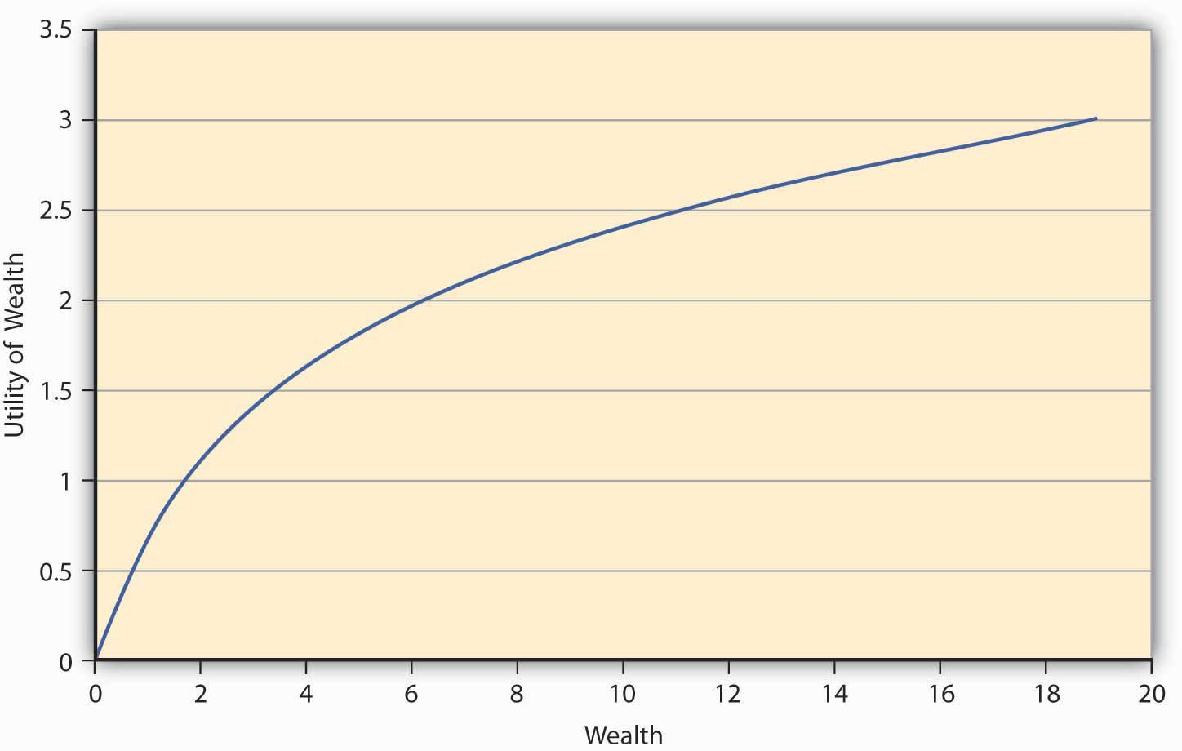
Standard Utility Curve
Source: Prakash, Enterprise and Individual Risk Management

Slide 6
Standard Utility Curve
Status quo
Person is offered a bet:
--odds: 50/50
--if she wins, gains $2K
--if she loses, forfeits $2K
She refuses the bet.
Expected utility of the gamble
Source: Prakash, Enterprise and Individual Risk Management

Slide 7
Rationality
Conventional Conceptions of Rationality
Ubiquitous Forms of Bounded Rationality
Prospect Theory
Endowment Effect
Presence Heuristic
Overoptimism
Lottery Effect
Forms of Bounded Rationality specific to creators

Slide 8
Prospect Theory
In general, people underweight prospects that are merely probable in comparison to prospects that are certain
Gains:
100% chance of winning $100 should be treated as equivalent of 10% chance of winning $1000
but people behave as if an opportunity offering a 10% change of winning $1000 were really a 5% chance of winning $1000
gives rise to risk aversion for gains – but for a reason different from that offered by classical theory
Losses:
100% chance of losing $100 should be treated as equivalent of 10% chance of losing $1000
but people behave as if a hazard posing a 10% chance of losing $1000 really posed only a 5% of losing $1000
gives rise to risk preference for losses
To illustrate:
I have a deck of 10 cards;
One of those cards will entitle you to $1000
If you pay me $75, I’ll allow you to draw one card from the deck
Conventional assumptions about rationality predict that you will accept the offer – but in practice they do not

Slide 9
Prospect Theory
In general, people underweight prospects that are merely probable in comparison to prospects that are certain
Gains:
100% chance of winning $100 should be treated as equivalent of 10% chance of winning $1000
but people behave as if an opportunity offering a 10% change of winning $1000 were really a 5% chance of winning $1000
gives rise to risk aversion for gains – but for a reason different from that offered by classical theory
Losses:
100% chance of losing $100 should be treated as equivalent of 10% chance of losing $1000
but people behave as if a hazard posing a 10% chance of losing $1000 really posed only a 5% of losing $1000
gives rise to risk preference for losses
To illustrate:
You approach a bar and ask for a beer;
The bartender offers you a choice:
Pay $1;
Roll a six-side die; if you get a “6,” you must pay $8. If you get any other number, the beer is free
Conventional assumptions about rationality predict that you will choose (a). But in practice, people choose (b).

Slide 10
Endowment Effect
The pain caused by a loss of X is typically greater than the pleasure reaped by a gain of X
Put differently, people place higher values on things to which they think they already have rights, than they do on identical things to which they think they don’t (yet) have rights.
The result: people will demand a higher price to induce them to surrender an object or an entitlement than they will offer to acquire that object or entitlement.
The reference point from which gains and losses are assessed is a psychological question, only indirectly a legal one

Slide 11
6
Value
4
2
Losses
Gains
-8
-6
-4
-2
2
4
6
8
-2
-4
-6
-8

Slide 12
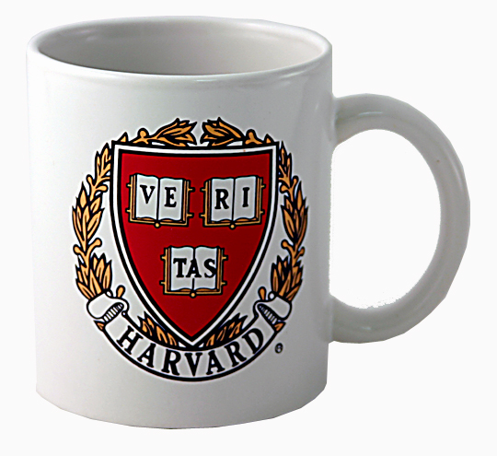
6
Value
$2
4
2
Losses
Gains
-8
-6
-4
-2
2
4
6
8
-2
-4
-6
-8

Slide 13
Manifestations
Springsteen tickets:
https://www.npr.org/2017/11/09/563133762/bruce-springsteen-on-broadway-comes-with-an-economics-lesson?utm_medium=RSS&utm_campaign=business
Bottles of wine in cellars of economists
Kahneman et al., “Anomalies: The Endowment Effect, Loss Aversion, and Status Quo Bias (1991), https://www.aeaweb.org/articles?id=10.1257/jep.5.1.193
Consumer demand for disaster insurance contracts
https://www.econstor.eu/bitstream/10419/57274/1/69009776X.pdf
Valuation of legal entitlements
e.g., solar easements;
rights to habitable apartments

Slide 14
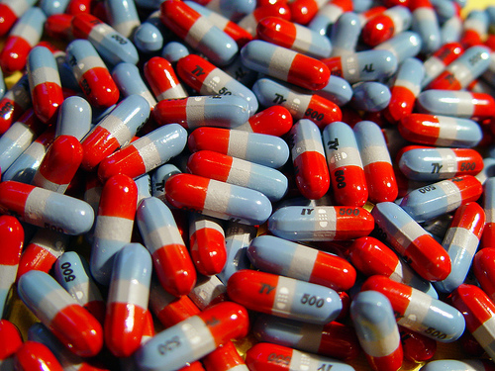
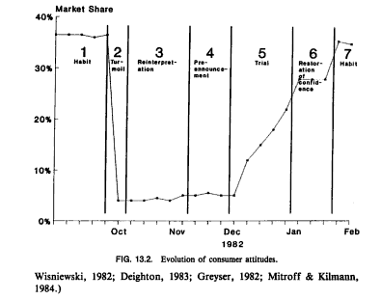

Slide 15
Levallow & Kahneman, “Delusions of Success: How Optimism Undermines Executives’ Decisions” (2003)
“Research into human cognition has traced this overoptimism to many sources. One of the most powerful is the tendency of individuals to exaggerate their own talents—to believe they are above average in their endowment of positive traits and abilities.
Consider a survey of 1 million students conducted by the College Board in the 1970s. When asked to rate themselves in comparison to their peers,
70% of the students said they were above average in leadership ability, while only 2% rated themselves below average.
For athletic prowess, 60% saw themselves above the median, 6% below.
When assessing their ability to get along with others, 60% of the students judged themselves to be in the top decile, and fully 25% considered themselves to be in the top 1%.”

Slide 16
Levallow & Kahneman, “Delusions of Success: How Optimism Undermines Executives’ Decisions” (2003)
“The inclination to exaggerate our talents is amplified by our tendency to misperceive the causes of certain events. The typical pattern of such attribution errors, as psychologists call them, is for people to take credit for positive outcomes and to attribute negative outcomes to external factors, no matter what their true cause.
One study of letters to shareholders in annual reports, for example, found that executives tend to attribute favorable outcomes to factors under their control, such as their corporate strategy or their R&D programs. Unfavorable outcomes, by contrast, were more likely to be attributed to uncontrollable external factors such as weather or inflation. Similar self-serving attributions have been found in other studies of annual reports and executive speeches.”

Slide 17
Manifestations
Backcountry skiing; avalanche risk
Investment decisions
Ability of lawyers to assess probability of victory
Gender bias

Slide 18
Carden, “Behavioral economics show that women tend to make better investments than men” (2013)
“Terry Odean, a University of California professor, has studied stock picking by gender for more than two decades. A seven-year study found single female investors outperformed single men by 2.3 percent, female investment groups outperformed male counterparts by 4.6 percent and women overall outperformed by 1.4 percent. Why? The short answer is overconfidence. Men trade more, and the more you trade, typically the more you lose — not to mention running up transaction costs….
Additionally, men hold onto their losers a lot longer than women. They’re sure the stock will come roaring back — even as it sinks. Academics call it confirmation bias; investment advisers call it boneheaded.”

Slide 19
Goodman-Delahunty et al., “Insightful or Wishful: Lawyers’ Ability to Predict Case Outcomes” (2010)
“The findings extend previous research on overconfidence in defense lawyers (Loftus & Wagenaar, 1988; Malsch, 1990), by establishing that similar biases arise in predictions by criminal prosecutors and by counsel for both plaintiffs and defendants in civil cases. Lawyers frequently made substantial judgmental errors, showing a proclivity to overoptimism. The most biased estimates were expressed with very high initial confidence: In these instances, lawyers were extremely overconfident. These findings are consistent with a large body of literature documenting overconfidence in a range of judgments (theoretical explanations of miscalibration of confidence are discussed in Gigerenzer, Hoffrage, & Kleinbolting, 1991; Kahneman, Slovic, & Tversky, 1982; Moore & Healy, 2008).”

Slide 20
Goodman-Delahunty et al., “Insightful or Wishful: Lawyers’ Ability to Predict Case Outcomes” (2010)
“With respect to the correlates of the overconfidence bias, certain results were somewhat counterintuitive, such as the finding that lawyers with more experience were not better calibrated than less experienced lawyers….
“With regard to gender, we replicated results obtained by Malsch (1990) that female lawyers were better calibrated than their male colleagues. Male practitioners were more overconfident than female practitioners. These findings are in line with gender differences observed in research on metacognition (Pallier, 2003).”

Slide 21
“Lottery Effect”
(Some) people overweight small probabilities of reaping very large gains
A partial exception to prospect theory
Manifestations
Playing lotteries (Scherer; Crouch)
People play lotteries, despite “house rake” of ~50%
A change in the amount of the payout will affect their willingness to participate much more than a change in probability of the payout
Amateur investors (Stout 1995)
Entrepreneurialism (Hopenhyn 2003; Astebro 2003)

Slide 22
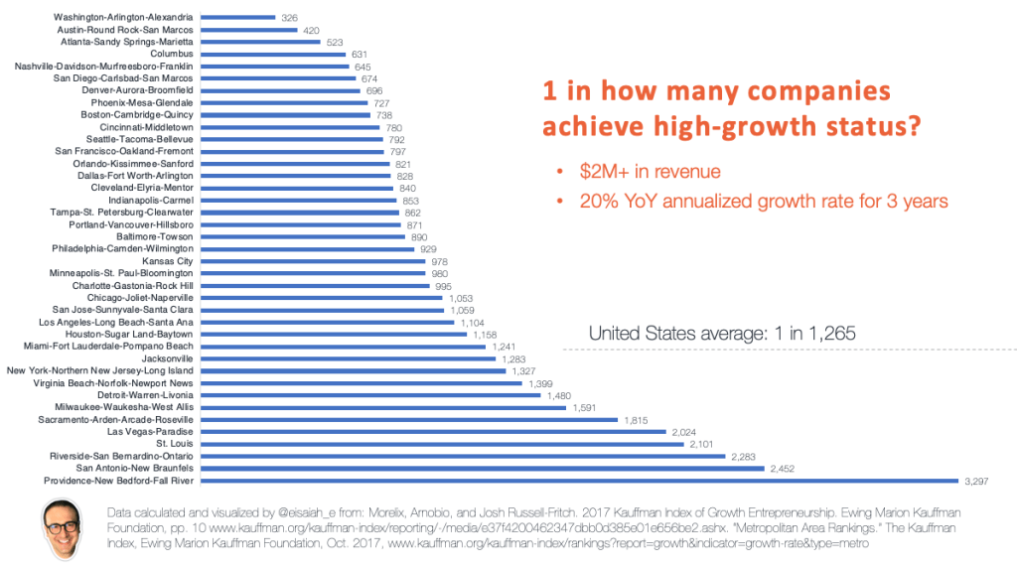
Probability that a Startup will become a “high-growth company”
Source: https://eisaiah.blog/2018/12/24/what-are-the-odds-of-startup-success-by-metro-area/

Slide 23
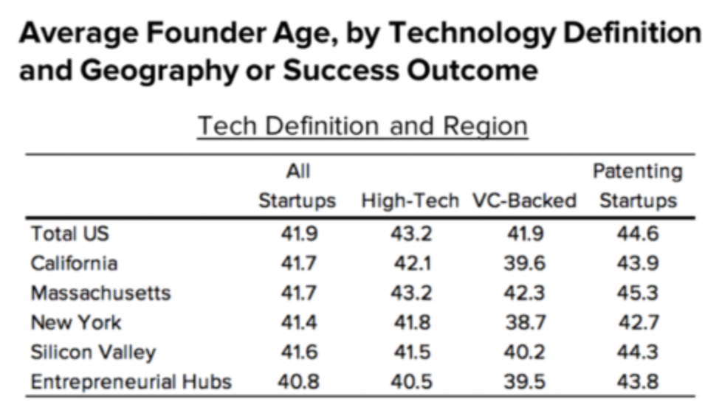
Source: https://startupsusa.org/the-myth-of-the-young-startup-founder/

Slide 24
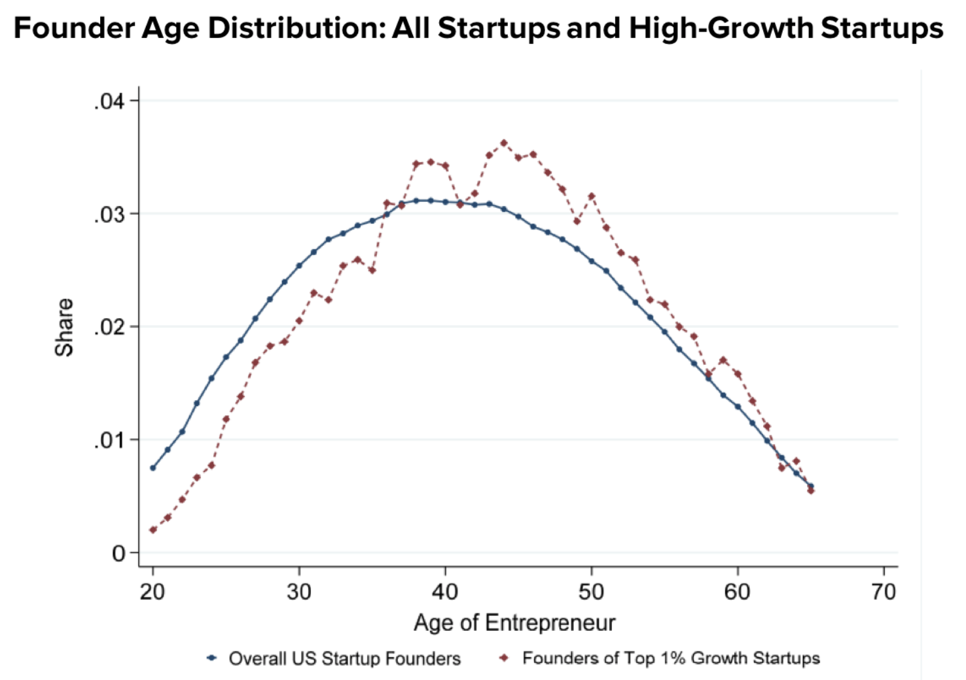
Source: https://startupsusa.org/the-myth-of-the-young-startup-founder/

Slide 25
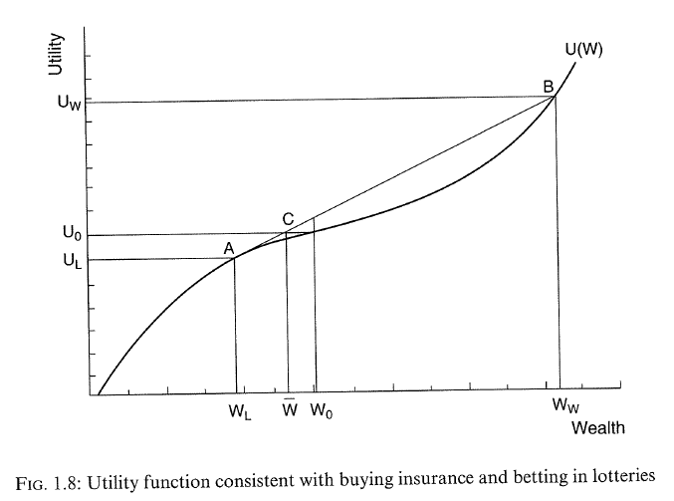
Scherer, “Innovation Lottery”

Slide 26
6
Value
4
2
Losses
Gains
-8
-6
-4
-2
2
4
6
8
-2
-4
-6
-8

Slide 27
Rationality
Conventional Conceptions of Rationality
Ubiquitous Forms of Bounded Rationality
Forms of Bounded Rationality specific to creators
Unusually strong version of “overoptimism”?
Are artists and inventors “skewness lovers”?

Slide 28
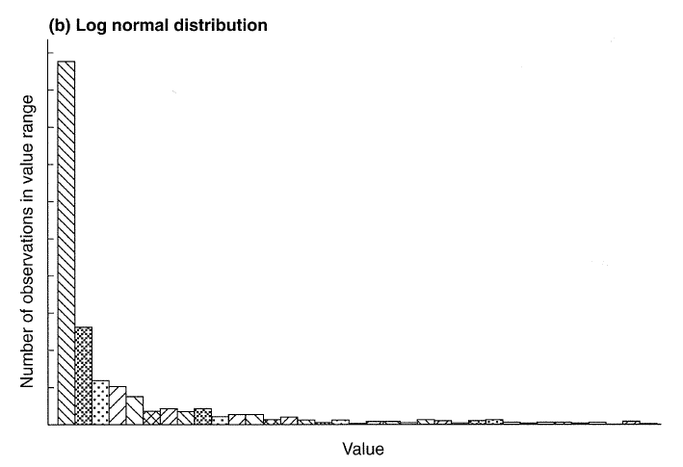
Scherer, “Innovation Lottery”
Scherer’s hypothesis:
socially beneficial because creators are attracted, rather than repelled by risk
Cf. rock climbing, https://docs.lib.purdue.edu/cgi/viewcontent.cgi?article=1044&context=jhpee; https://www.ncbi.nlm.nih.gov/pmc/articles/PMC6166576/

Slide 29
Implications for Patent Law

Slide 30
Implications of Bounded Rationality of Inventors
Hyper-optimism of inventors and entrepreneurs may be socially beneficial
argument against “debiasing” (Crouch)
If inventors are “skewness lovers” (not risk averse), ubiquitous pre-employment assignment agreements may be socially pernicious (Scherer)
Other things equal, we should adjust doctrines to increase payouts but reduce probability (Crouch)
e.g., increase the height of the inventive step
Enhancement of the entitlements associated with patents could have a greater socially-beneficial impact on incentives for innovation than extension of the patent term
Ethical?

Slide 31
Implications of Bounded Rationality of Consumers
Underestimation of likelihood of remote harms (rooted both in prospect theory and overoptimism bias) will cause consumers to undervalue products designed to prevent those harms and thus induce mismatch between pattern of innovation induced by the patent system and social welfare (Xue & Ouelette). Examples:
Vaccines
Innovations that retard climate change

