Slide 1
Archer
PX037
William Fisher
February 2024

Slide 2
The Technological Field

Slide 3
Introduction
https://www.youtube.com/watch?v=L5uToILRL5E&feature=emb_rel_end
3:51 to 5:29

Slide 4
Dimitris Manolakis, David Marden, and Gary A. Shaw, “Hyperspectral Image Processing for Automatic Target Detection Applications,” Lincoln Laboratory Journal 14 (2003): 79
“The basic idea for hyperspectral imaging stems from the fact that, for any given material, the amount of radiation that is reflected, absorbed, or emitted—i.e., the radiance—varies with wavelength. Hyperspectral imaging sensors measure the radiance of the materials within each pixel area at a very large number of contiguous spectral wavelength bands….
Hyperspectral imaging sensors are basically advanced digital color cameras with fine spectral resolution at given wavelengths of illumination. Instead of measuring three primary colors—red, green, and blue—these sensors measure the radiation reflected by each pixel at a large number of visible or invisible frequency (or wavelength) bands. Such an instrument is called an imaging spectrometer. Spectrometers are instruments that divide the impinging electromagnetic radiation into a number of finite bands and measure the energy in each band. (In this sense, the human eye can be considered a crude imaging spectrometer.)…
In practice, hyperspectral sensors represent a deliberate trade-off in which spatial resolution is degraded in favor of improved spectral resolution. By implication, hyperspectral imaging is therefore best matched to applications in which spectral information is more reliable or measurable than morphology or shape information…. A life jacket, which may be unresolved spatially, can still be detected and identified on the basis of its extreme color contrast with the ocean background.”

Slide 5
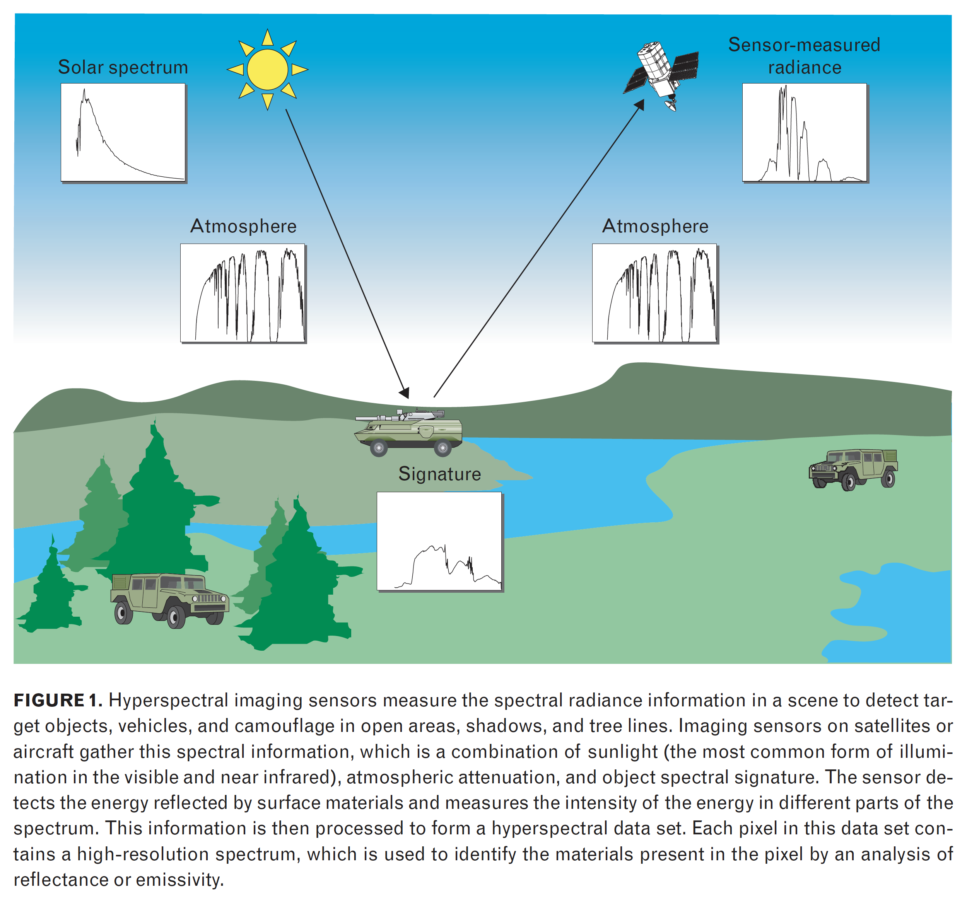

Slide 6
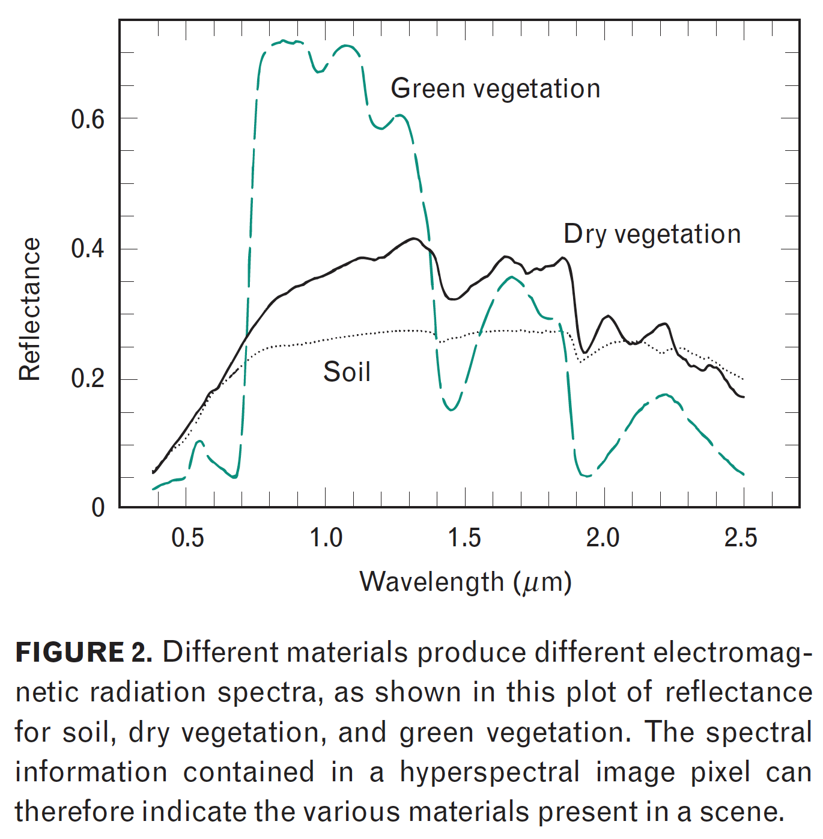

Slide 7
Demo: https://www.youtube.com/watch?v=nikg28XfCUE
(2019)

Slide 8
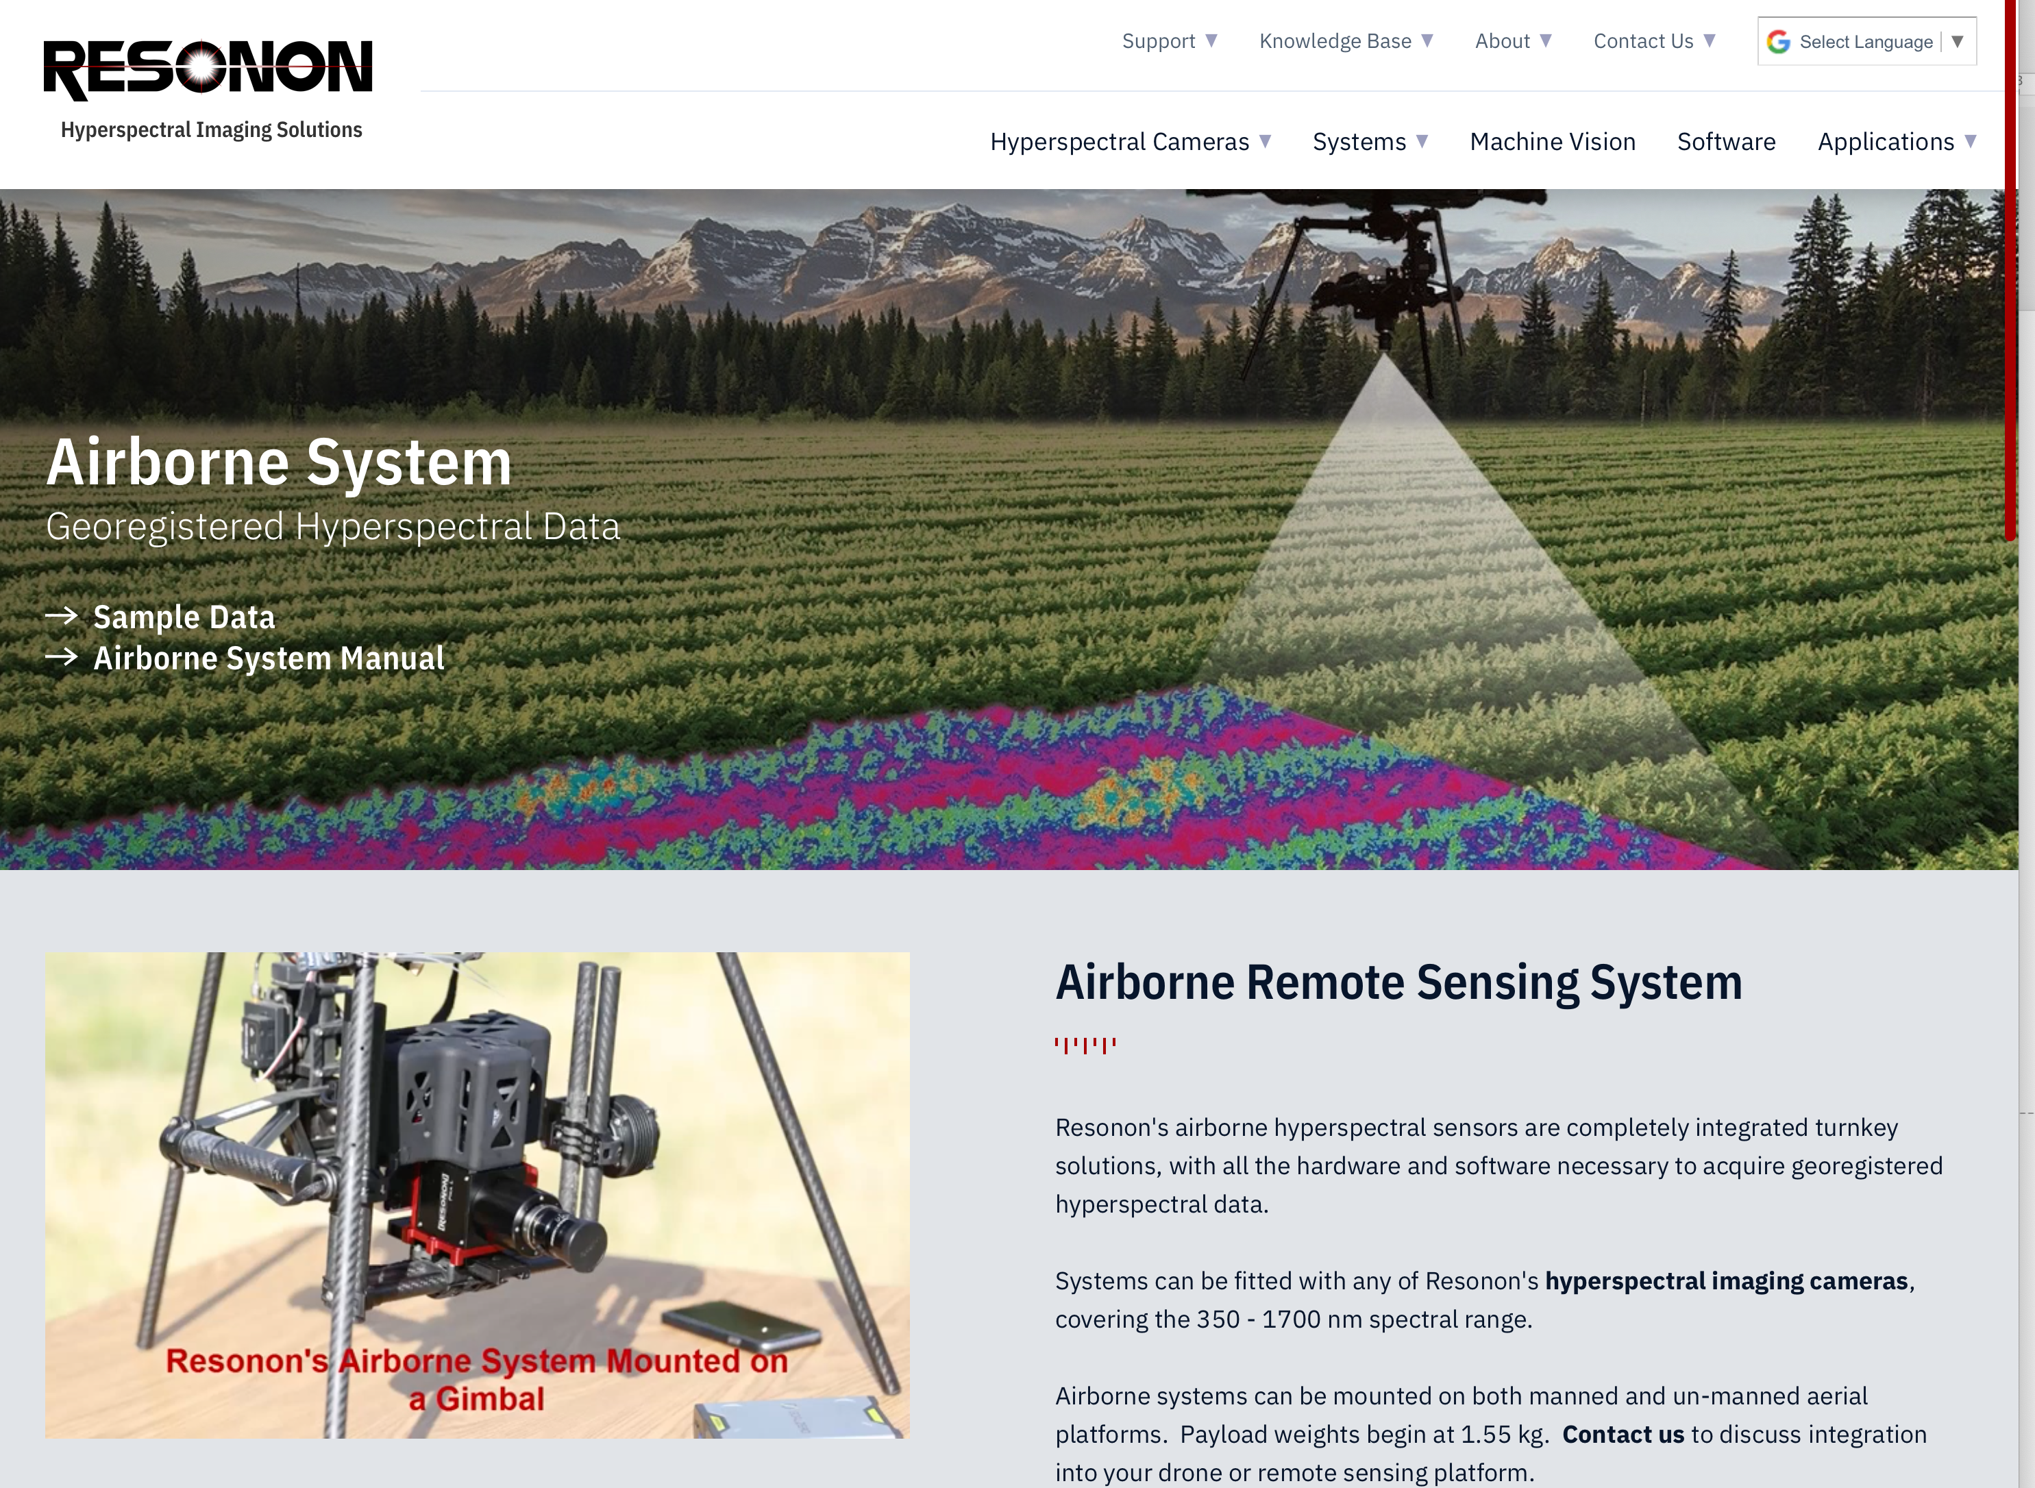
(2020)

Slide 9
Timeline of the Dispute

Slide 10
Timeline
2004
2005
2006
2007
2008
2009
2010
2011
2012
2013
2014
2015
2016

Slide 11
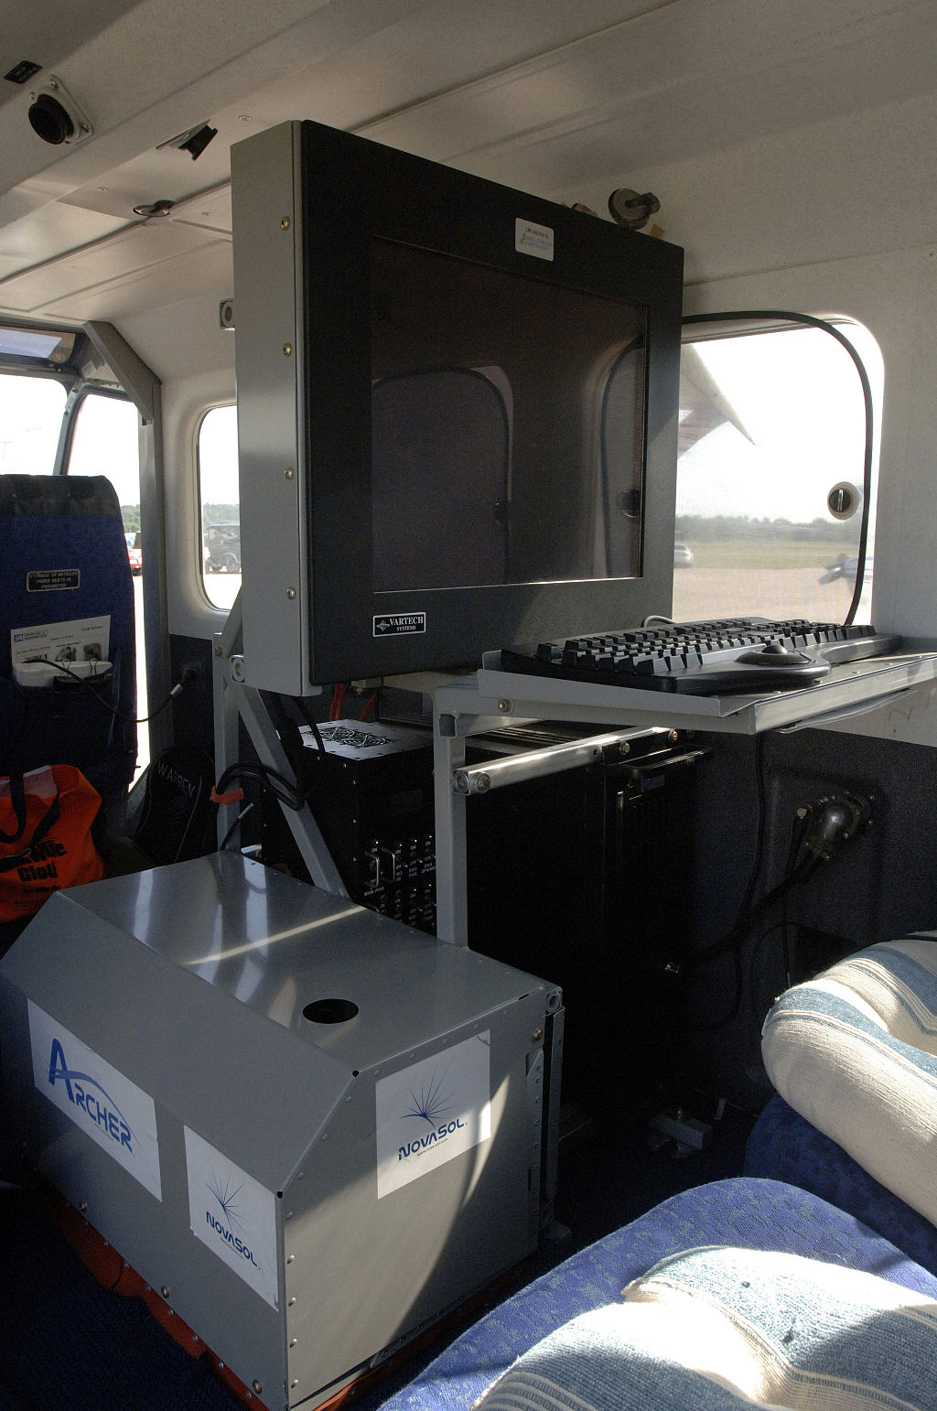
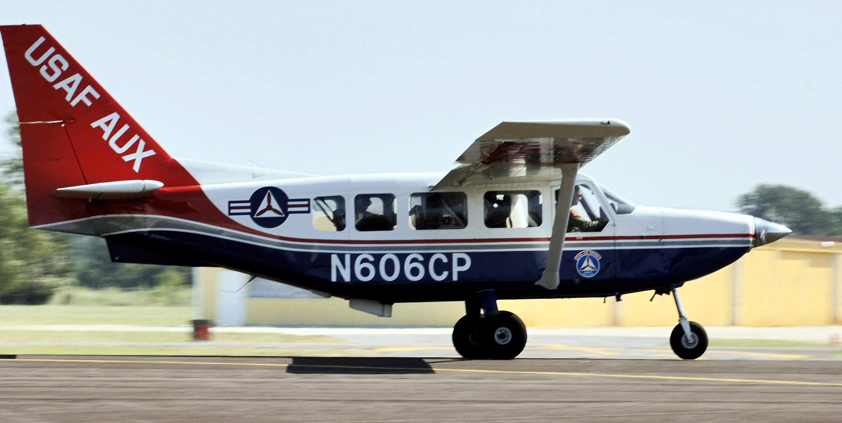
Timeline
2004
2005
2006
2007
2008
2009
2010
2011
2012
2013
2014
2015
2016

Slide 12
Timeline
2004
2005
2006
2007
2008
2009
2010
2011
2012
2013
2014
2015
2016
Archer
developed
deployed

Slide 13
Archer
ARCHER
Developed 2004
Deployed 2005

Slide 14
ARCHER
“Airborne Real-time Cueing Hyperspectral Enhanced Reconnaissance, also known by the acronym ARCHER, is an aerial imaging system that produces ground images far more detailed than plain sight or ordinary aerial photography can. It is the most sophisticated unclassified hyperspectral imaging system available, according to U.S. Government officials. ARCHER can automatically scan detailed imaging for a given signature of the object being sought (such as a missing aircraft), for abnormalities in the surrounding area, or for changes from previous recorded spectral signatures.
“It has direct applications for search and rescue, counterdrug, disaster relief and impact assessment, and homeland security, and has been deployed by the Civil Air Patrol (CAP) in the US on the Australian-built Gippsland GA8 Airvan fixed-wing aircraft.
Source: Wikipedia
“The major ARCHER subsystem components include:
advanced hyperspectral imaging (HSI) system with a resolution of one square meter per pixel.
panchromatic high-resolution imaging (HRI) camera with a resolution of 8 cm x 8 cm (3 in x 3 in) per pixel.
global positioning system (GPS) integrated with an inertial navigation system (INS)
“ARCHER has three methods for locating targets:
signature matching where reflected light is matched to spectral signatures
anomaly detection using a statistical model of the pixels in the image to determine the probability that a pixel does not match the profile, and
change detection which executes a pixel-by-pixel comparison of the current image against ground conditions that were obtained in a previous mission over the same area.

Slide 15
Timeline
2004
2005
2006
2007
2008
2009
2010
2011
2012
2013
2014
2015
2016
Archer
developed
deployed

Slide 16
Timeline
11/22/2008
Basener’s draft proposal
2004
2005
2006
2007
2008
2009
2010
2011
2012
2013
2014
2015
2016
Archer
developed
deployed

Slide 19
Timeline
11/22/2008
Basener’s draft proposal
2004
2005
2006
2007
2008
2009
2010
2011
2012
2013
2014
2015
2016
Archer
developed
deployed

Slide 20
Timeline
1/29/2010
Provisional
application
filed
11/22/2008
Basener’s draft proposal
2004
2005
2006
2007
2008
2009
2010
2011
2012
2013
2014
2015
2016
Archer
developed
deployed

Slide 21
Timeline
1/29/2010
Provisional
application
filed
11/22/2008
Basener’s draft proposal
1/28/2011
Application
filed
2004
2005
2006
2007
2008
2009
2010
2011
2012
2013
2014
2015
2016
Archer
developed
deployed

Slide 22
Claim 1 of the ‘489 Patent
A method for identification, sorting and ranking detections of one or more targets, the method comprising: determining with a target detection processing apparatus a target detection score for each pixel of a spectral image for one or more targets by obtaining with the target detection processing apparatus a signature for one or more of the targets for the image, and applying with the target detection processing apparatus the statistical target detection filter using the one or more obtained signatures to rank each of the pixels by its statistical score; identifying with the target detection processing apparatus a region around one or more of the pixels with the determined detection scores which are higher than a first score in said image; determining with the target detection processing apparatus an object-based spectral identification score for each of the identified regions in said image; and providing with the target detection processing apparatus the one or more identified regions with the determined object-based score for each region.

Slide 23
Claim 1 of the ‘489 Patent
A method for identification, sorting and ranking detections of one or more targets, the method comprising: determining with a target detection processing apparatus a target detection score for each pixel of a spectral image for one or more targets by [a] obtaining with the target detection processing apparatus a signature for one or more of the targets for the image, and [b] applying with the target detection processing apparatus the statistical target detection filter using the one or more obtained signatures to rank each of the pixels by its statistical score; [c] identifying with the target detection processing apparatus a region around one or more of the pixels with the determined detection scores which are higher than a first score in said image; [d] determining with the target detection processing apparatus an object-based spectral identification score for each of the identified regions in said image; and [e] providing with the target detection processing apparatus the one or more identified regions with the determined object-based score for each region.

Slide 24
Claim 1 of the ‘489 Patent
A method for identification, sorting and ranking detections of one or more targets, the method comprising: determining with a target detection processing apparatus a target detection score for each pixel of a spectral image for one or more targets by [a] obtaining with the target detection processing apparatus a signature for one or more of the targets for the image, and [b] applying with the target detection processing apparatus the statistical target detection filter using the one or more obtained signatures to rank each of the pixels by its statistical score; [c] identifying with the target detection processing apparatus a region around one or more of the pixels with the determined detection scores which are higher than a first score in said image; [d] determining with the target detection processing apparatus an object-based spectral identification score for each of the identified regions in said image; and [e] providing with the target detection processing apparatus the one or more identified regions with the determined object-based score for each region.
Claim Construction: “any metric that is computed from the pixels in an identified region using a process that provides better understanding of the material or object in the region."

Slide 25
Claims
4. A method for identification, sorting and ranking detections of one or more targets, the method comprising:
determining with a target detection processing apparatus a target detection score for each pixel in each of one or more images for each of one or more targets;
identifying with the target detection processing apparatus a region around one or more of the pixels with the determined detection scores which are higher than a first score in each of the one or more of images;
determining with the target detection processing apparatus an object-based score for each of the identified regions in each of the one or more images; and
providing with the target detection processing apparatus the one or more identified regions with the determined object-based score for each region, wherein the identifying further comprises:
masking out from each of the regions with the target detection processing apparatus the one or more of the pixels in each of the one or more images which have the highest determined statistical detection scores in each of the one or more images;
selecting with the target detection processing apparatus one or of the pixels which are end members for each of the regions; and
identifying with the target detection processing apparatus a convex hull of the selected end members as a boundary for the one or more regions for each of the one or more of images.
1. A method for identification, sorting and ranking detections of one or more targets, the method comprising:
determining with a target detection processing apparatus a target detection score for each pixel of a spectral image for one or more targets by
obtaining with the target detection processing apparatus a signature for one or more of the targets for the image, and applying with the target detection processing apparatus the statistical target detection filter using the one or more obtained signatures to rank each of the pixels by its statistical score;
identifying with the target detection processing apparatus a region around one or more of the pixels with the determined detection scores which are higher than a first score in said image;
determining with the target detection processing apparatus an object-based spectral identification score for each of the identified regions in said image; and
providing with the target detection processing apparatus the one or more identified regions with the determined object-based score for each region.

Slide 26
Claims
4. A method for identification, sorting and ranking detections of one or more targets, the method comprising:
determining with a target detection processing apparatus a target detection score for each pixel in each of one or more images for each of one or more targets;
identifying with the target detection processing apparatus a region around one or more of the pixels with the determined detection scores which are higher than a first score in each of the one or more of images;
determining with the target detection processing apparatus an object-based score for each of the identified regions in each of the one or more images; and
providing with the target detection processing apparatus the one or more identified regions with the determined object-based score for each region, wherein the identifying further comprises:
masking out from each of the regions with the target detection processing apparatus the one or more of the pixels in each of the one or more images which have the highest determined statistical detection scores in each of the one or more images;
selecting with the target detection processing apparatus one or of the pixels which are end members for each of the regions; and
identifying with the target detection processing apparatus a convex hull of the selected end members as a boundary for the one or more regions for each of the one or more of images.
1. A method for identification, sorting and ranking detections of one or more targets, the method comprising:
determining with a target detection processing apparatus a target detection score for each pixel of a spectral image for one or more targets by
obtaining with the target detection processing apparatus a signature for one or more of the targets for the image, and applying with the target detection processing apparatus the statistical target detection filter using the one or more obtained signatures to rank each of the pixels by its statistical score;
identifying with the target detection processing apparatus a region around one or more of the pixels with the determined detection scores which are higher than a first score in said image;
determining with the target detection processing apparatus an object-based spectral identification score for each of the identified regions in said image; and
providing with the target detection processing apparatus the one or more identified regions with the determined object-based score for each region.

Slide 27
Claims
5. A method for identification, sorting and ranking detections of one or more targets, the method comprising:
determining with a target detection processing apparatus a target detection score for each pixel in each of one or more images for each of one or more targets;
identifying with the target detection processing apparatus a region around one or more of the pixels with the determined detection scores which are higher than a first score in each of the one or more of images;
determining with the target detection processing apparatus an object-based score for each of the identified regions in each of the one or more images; and
providing with the target detection processing apparatus the one or more identified regions with the determined object-based score for each region, wherein the determining the object based score further comprises:
unmixing with the target detection processing apparatus the pixel with highest determined statistical detection score in each of the identified regions by finding one or more abundances to determine pixel spectra; and
comparing with the target detection processing apparatus target spectra for each of the one or more targets with the determined pixel spectra to determine the object based score for each of the identified regions.
1. A method for identification, sorting and ranking detections of one or more targets, the method comprising:
determining with a target detection processing apparatus a target detection score for each pixel of a spectral image for one or more targets by
obtaining with the target detection processing apparatus a signature for one or more of the targets for the image, and applying with the target detection processing apparatus the statistical target detection filter using the one or more obtained signatures to rank each of the pixels by its statistical score;
identifying with the target detection processing apparatus a region around one or more of the pixels with the determined detection scores which are higher than a first score in said image;
determining with the target detection processing apparatus an object-based spectral identification score for each of the identified regions in said image; and
providing with the target detection processing apparatus the one or more identified regions with the determined object-based score for each region.

Slide 28
Claims
5. A method for identification, sorting and ranking detections of one or more targets, the method comprising:
determining with a target detection processing apparatus a target detection score for each pixel in each of one or more images for each of one or more targets;
identifying with the target detection processing apparatus a region around one or more of the pixels with the determined detection scores which are higher than a first score in each of the one or more of images;
determining with the target detection processing apparatus an object-based score for each of the identified regions in each of the one or more images; and
providing with the target detection processing apparatus the one or more identified regions with the determined object-based score for each region, wherein the determining the object based score further comprises:
unmixing with the target detection processing apparatus the pixel with highest determined statistical detection score in each of the identified regions by finding one or more abundances to determine pixel spectra; and
comparing with the target detection processing apparatus target spectra for each of the one or more targets with the determined pixel spectra to determine the object based score for each of the identified regions.
1. A method for identification, sorting and ranking detections of one or more targets, the method comprising:
determining with a target detection processing apparatus a target detection score for each pixel of a spectral image for one or more targets by
obtaining with the target detection processing apparatus a signature for one or more of the targets for the image, and applying with the target detection processing apparatus the statistical target detection filter using the one or more obtained signatures to rank each of the pixels by its statistical score;
identifying with the target detection processing apparatus a region around one or more of the pixels with the determined detection scores which are higher than a first score in said image;
determining with the target detection processing apparatus an object-based spectral identification score for each of the identified regions in said image; and
providing with the target detection processing apparatus the one or more identified regions with the determined object-based score for each region.

Slide 29
Timeline
1/29/2010
Provisional
application
filed
11/22/2008
Basener’s draft proposal
1/28/2011
Application
filed
2004
2005
2006
2007
2008
2009
2010
2011
2012
2013
2014
2015
2016
Archer
developed
deployed

Slide 30
Timeline
1/29/2010
Provisional
application
filed
11/22/2008
Basener’s draft proposal
1/28/2011
Application
filed
11/25/2014
Patent granted
To RIT
2004
2005
2006
2007
2008
2009
2010
2011
2012
2013
2014
2015
2016
Archer
developed
deployed

Slide 31
Timeline
1/29/2010
Provisional
application
filed
11/25/2014
Exclusive license
RIT to GTA
11/22/2008
Basener’s draft proposal
1/28/2011
Application
filed
11/25/2014
Patent granted
To RIT
2004
2005
2006
2007
2008
2009
2010
2011
2012
2013
2014
2015
2016
Archer
developed
deployed

Slide 32
Timeline
1/29/2010
Provisional
application
filed
11/25/2014
Exclusive license
RIT to GTA
11/22/2008
Basener’s draft proposal
1/28/2011
Application
filed
11/25/2014
Patent granted
To RIT
2004
2005
2006
2007
2008
2009
2010
2011
2012
2013
2014
2015
2016
Archer
developed
deployed
Brief authorized use of the software by the United States

Slide 33
Rulings
April 8, 2021 (Griggsby):
GTA has not established date of conception on 11/22/2008
Provisional application is not enabling
Net effect: Critical date is 1/28/2011
Archer anticipates Claims 1, 4, and 5 through inherency
January 11, 2022 (Bruggink)
Reaffirm finding that Claim 1 and Claim 4 are anticipated by Archer
But overturn finding that Archer anticipates Claim 5 through inherency
February 3, 2023
Reject contention that the patent impermissibly mixes apparatus and process claims
Set issues of obviousness and indefiniteness for trial

Slide 34
Rulings
April 8, 2021 (Griggsby):
GTA has not established date of conception on 11/22/2008
Provisional application is not enabling
Net effect: Critical date is 1/28/2011
Archer anticipates Claims 1, 4, and 5 through inherency
January 11, 2022 (Bruggink)
Reaffirm finding that Claim 1 and Claim 4 are anticipated by Archer
But overturn finding that Archer anticipates Claim 5 through inherency
February 3, 2023
Reject contention that the patent impermissibly mixes apparatus and process claims
Set issues of obviousness and indefiniteness for trial

Slide 35
Rulings
April 8, 2021 (Griggsby):
GTA has not established date of conception on 11/22/2008
Provisional application is not enabling
Net effect: Critical date is 1/28/2011
Archer anticipates Claims 1, 4, and 5 through inherency
January 11, 2022 (Bruggink)
Reaffirm finding that Claim 1 and Claim 4 are anticipated by Archer
But overturn finding that Archer anticipates Claim 5 through inherency
February 3, 2023
Reject contention that the patent impermissibly mixes apparatus and process claims
Set issues of obviousness and indefiniteness for trial

Slide 36
Rulings
April 8, 2021 (Griggsby):
GTA has not established date of conception on 11/22/2008
Provisional application is not enabling
Net effect: Critical date is 1/28/2011
Archer anticipates Claims 1, 4, and 5 through inherency
January 11, 2022 (Bruggink)
Reaffirm finding that Claim 1 and Claim 4 are anticipated by Archer
But overturn finding that Archer anticipates Claim 5 through inherency
February 3, 2023
Reject contention that the patent impermissibly mixes apparatus and process claims
Set issues of obviousness and indefiniteness for trial

Slide 37
Rulings
April 8, 2021 (Griggsby):
GTA has not established date of conception on 11/22/2008
Provisional application is not enabling
Net effect: Critical date is 1/28/2011
Archer anticipates Claims 1, 4, and 5 through inherency
January 11, 2022 (Bruggink)
Reaffirm finding that Claim 1 and Claim 4 are anticipated by Archer
But overturn finding that Archer anticipates Claim 5 through inherency
February 3, 2023
Reject contention that the patent impermissibly mixes apparatus and process claims
Set issues of obviousness and indefiniteness for trial

