Slide 1
Artificial Intelligence
and the Interests of Humanity
William Fisher
April 2024

Slide 2
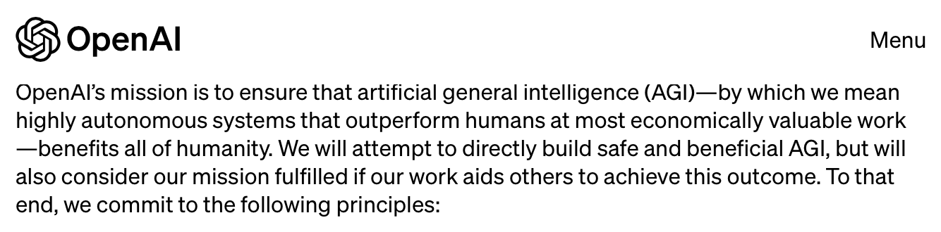

Slide 3
AI Summit, November 1-2, 2023
“The Bletchley Declaration”
Australia
Brazil
Canada
Chile
China
European Union
France
Germany
India
Indonesia
Ireland
Israel
Italy
Japan
Kenya
Korea
Netherlands
Nigeria
Philippines
Rwanda
Saudi Arabia
Singapore
Spain
Switzerland
Turkey
Ukraine
United Arab Emirates
United Kingdom
United States of America

Slide 4
AI Summit, November 1-2, 2023
“The Bletchley Declaration”
“[W]e affirm that, for the good of all, AI should be designed, developed, deployed, and used, in a manner that is safe, in such a way as to be human-centric, trustworthy and responsible. We welcome the international community’s efforts so far to cooperate on AI to promote inclusive economic growth, sustainable development and innovation, to protect human rights and fundamental freedoms, and to foster public trust and confidence in AI systems to fully realise their potential.”

Slide 5
Part I: What are the “interests of humanity”?

Slide 6
Conditions that Enable Human Flourishing
Life
Health
Autonomy
Engagement
Self-expression
Competence
Affiliation
Privacy

Slide 7
Conditions that Enable Human Flourishing
Life
Health
Autonomy
Engagement
Self-expression
Competence
Affiliation
Privacy

Slide 8
Conditions that Enable Human Flourishing
Life
Health
Autonomy
Engagement
Self-expression
Competence
Affiliation
Privacy
Mill;
Emerson;
Rawls;
Kateb;
Dworkin

Slide 9
Conditions that Enable Human Flourishing
Life
Health
Autonomy
Engagement
Self-expression
Competence
Affiliation
Privacy
“Meaningful work” (Marx);
Political democracy (Commonwealthmen; Tocqueville; Arendt; Sunstein)
Semiotic democracy (Frankfurt School; Fiske; Balkin; Lessig; Katyal)

Slide 10
Conditions that Enable Human Flourishing
Life
Health
Autonomy
Engagement
Self-expression
Competence
Affiliation
Privacy
Kant;
Hegel;
T.H. Green

Slide 11
Conditions that Enable Human Flourishing
Life
Health
Autonomy
Engagement
Self-expression
Competence
Affiliation
Privacy
Deci & Ryan;
Seligman;
Utman;
Schwartz

Slide 12
Conditions that Enable Human Flourishing
Life
Health
Autonomy
Engagement
Self-expression
Competence
Affiliation
Privacy
Nussbaum;
Helliwell & Putman

Slide 13
Conditions that Enable Human Flourishing
Life
Health
Autonomy
Engagement
Self-expression
Competence
Affiliation
Privacy

Slide 14
AI Summit, November 1-2, 2023
“The Bletchley Declaration”
“[W]e affirm that, for the good of all, AI should be designed, developed, deployed, and used, in a manner that is safe, in such a way as to be human-centric, trustworthy and responsible. We welcome the international community’s efforts so far to cooperate on AI to promote inclusive economic growth, sustainable development and innovation, to protect human rights and fundamental freedoms, and to foster public trust and confidence in AI systems to fully realise their potential.”

Slide 15
AI Summit, November 1-2, 2023
“The Bletchley Declaration”
“[W]e affirm that, for the good of all, AI should be designed, developed, deployed, and used, in a manner that is safe, in such a way as to be human-centric, trustworthy and responsible. We welcome the international community’s efforts so far to cooperate on AI to promote inclusive economic growth, sustainable development and innovation, to protect human rights and fundamental freedoms, and to foster public trust and confidence in AI systems to fully realise their potential.”
Implication: To the maximum extent practicable, all persons in the world should be provided affordances of these sorts. When fostering and managing AI, we should try to achieve a sustainable condition of equal access to the preconditions of a good life.

Slide 16
AI Summit, November 1-2, 2023
“The Bletchley Declaration”
“[W]e affirm that, for the good of all, AI should be designed, developed, deployed, and used, in a manner that is safe, in such a way as to be human-centric, trustworthy and responsible. We welcome the international community’s efforts so far to cooperate on AI to promote inclusive economic growth, sustainable development and innovation, to protect human rights and fundamental freedoms, and to foster public trust and confidence in AI systems to fully realise their potential.”
Implication: To the maximum extent practicable, all persons in the world should be provided affordances of these sorts. When fostering and managing AI, we should try to achieve a sustainable condition of equal access to the preconditions of a good life.

Slide 17
“Sustainability”
Original definition: “Humanity has the ability to make development sustainable to ensure that it meets the needs of the present without compromising the ability of future generations to meet their own needs.”
  United Nations, Report of the World Commission on Environment and Development: Our Common Future (1987), paragraph 27
In practice, this approach has assumed that the condition of all persons in the world can be brought up to the level enjoyed by the most prosperous – without curtailing the latter, slowing the pace of development, or limiting human population growth
  We have failed to achieve sustainability in this sense, not just because of lack of resolve, but because it is impossible
We should not abandon the goal of sustainability – but we need a more realistic conception

Slide 18
“Sustainability”
Original definition: “Humanity has the ability to make development sustainable to ensure that it meets the needs of the present without compromising the ability of future generations to meet their own needs.”
  United Nations, Report of the World Commission on Environment and Development: Our Common Future (1987), paragraph 27
In practice, this approach has assumed that the condition of all persons in the world can be brought up to the level enjoyed by the most prosperous – without curtailing the latter, slowing the pace of development, or limiting human population growth
  We have failed to achieve sustainability in this sense, not just because of lack of resolve, but because it is impossible
We should not abandon the goal of sustainability – but we need a more realistic conception

Slide 19
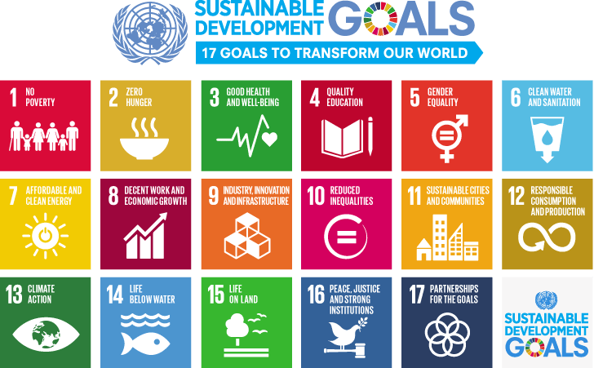

Slide 20
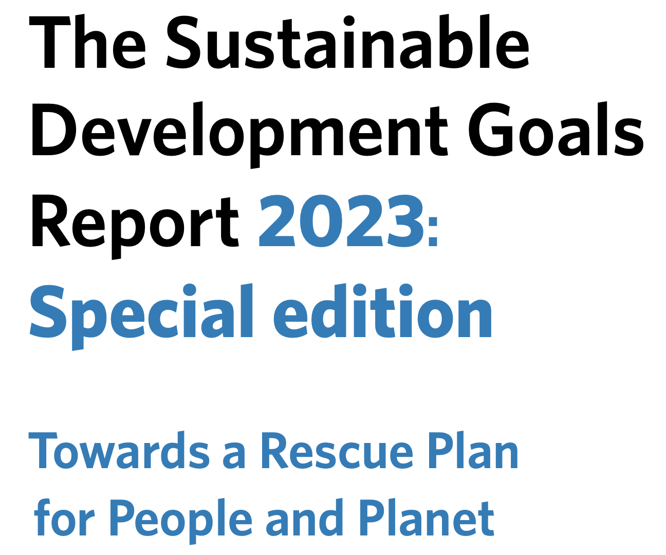
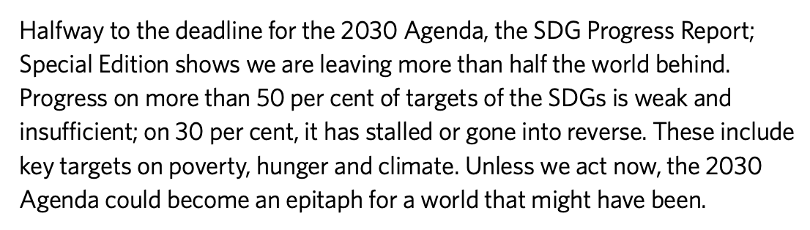

Slide 21
“Sustainability”
Original definition: “Humanity has the ability to make development sustainable to ensure that it meets the needs of the present without compromising the ability of future generations to meet their own needs.”
  United Nations, Report of the World Commission on Environment and Development: Our Common Future (1987), paragraph 27
In practice, this approach has assumed that the condition of all persons in the world can be brought up to the level enjoyed by the most prosperous – without curtailing the latter, slowing the pace of development, or limiting human population growth
  We have failed to achieve sustainability in this sense, not just because of lack of resolve, but because it is impossible
We should not abandon the goal of sustainability – but we need a more realistic conception

Slide 22
“Sustainability”
Original definition: “Humanity has the ability to make development sustainable to ensure that it meets the needs of the present without compromising the ability of future generations to meet their own needs.”
  United Nations, Report of the World Commission on Environment and Development: Our Common Future (1987), paragraph 27
In practice, this approach has assumed that the condition of all persons in the world can be brought up to the level enjoyed by the most prosperous – without curtailing the latter, slowing the pace of development, or limiting human population growth
  We have failed to achieve sustainability in this sense, not just because of lack of resolve, but because it is impossible
We should not abandon the goal of sustainability – but we need a more realistic conception

Slide 23
The dimensions of a feasible conception of sustainability should include:
Halting climate change
Balancing global consumption and renewal of fresh water
Achieving levels and types of food production compatible with sustainable equal access to health
Resolving the ongoing global disease crisis
Maintaining a total human population (and distribution thereof) that will
  Facilitate achievement of 1-4
  Enable all humans on the planet to enjoy flourishing lives

Slide 24
1. Climate

Slide 25
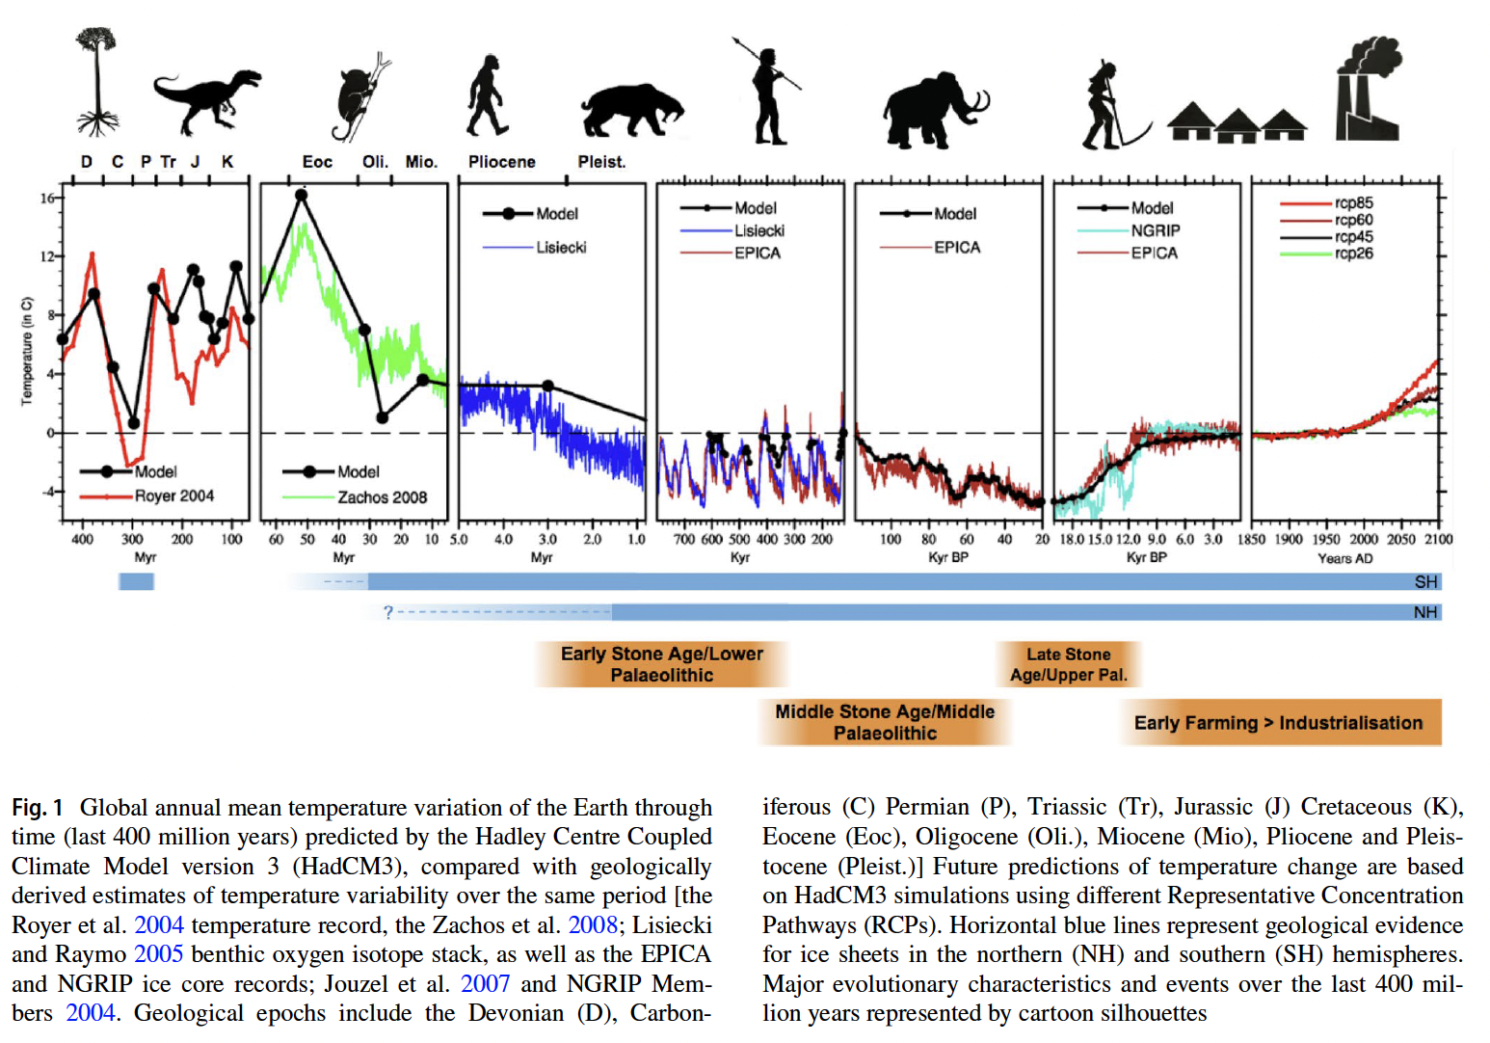
Source: Haywood et al., “What can Palaeoclimate
Modelling do for you?,” Earth Systems and Environment (2019)

Slide 26
Source: Haywood et al., “What can Palaeoclimate
Modelling do for you?,” Earth Systems and Environment (2019)

Slide 27
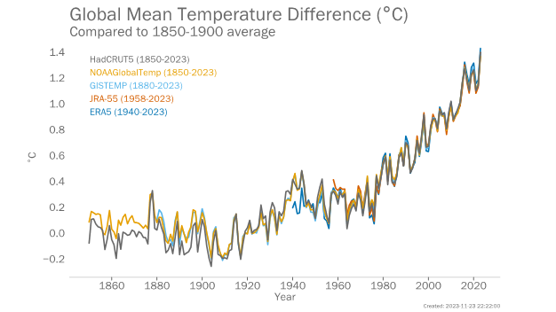
Source: World Meteorlogical Organization, “2023 Shatters Climate Records,”
November 30, 2023, https://wmo.int/news/media-centre/2023-shatters-climate-records-major-impacts

Slide 28
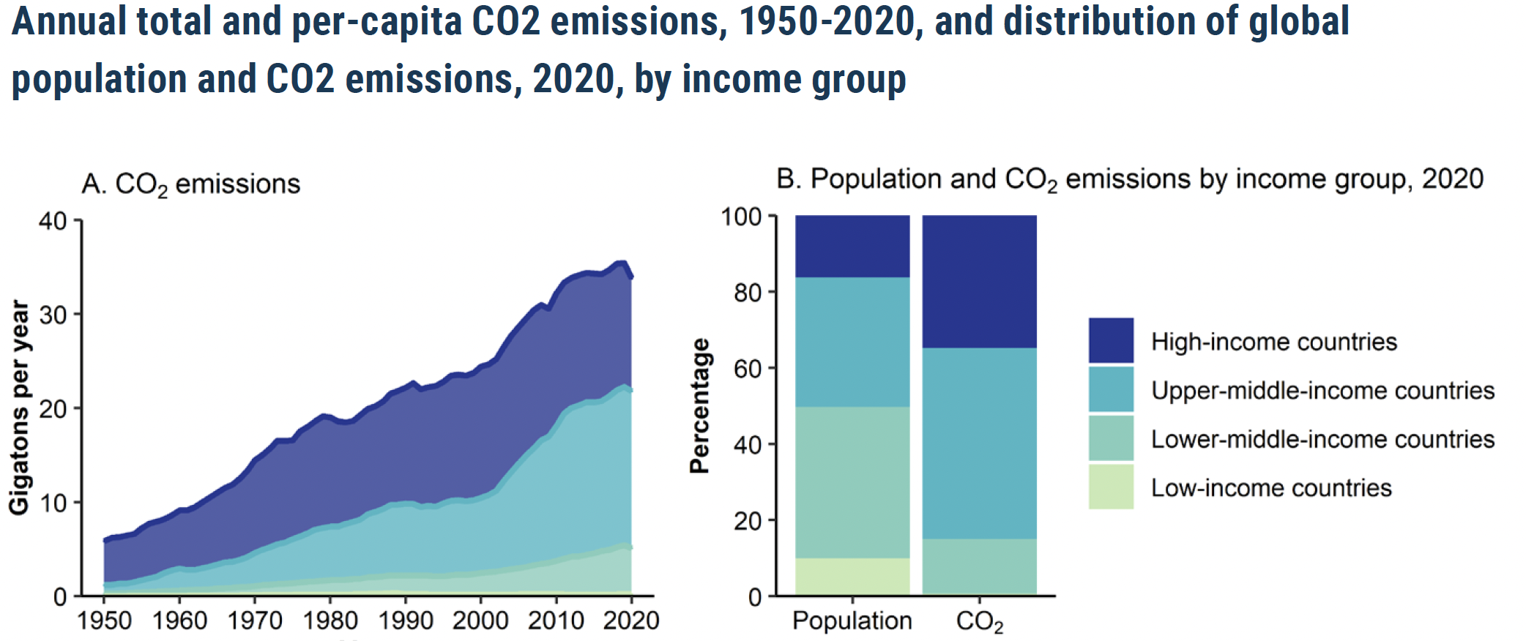
Source: https://www.un.org/development/desa/pd/sites/www.un.org.development.desa.pd/files/undesa_pd_2022_policy_brief_population_growth.pdf

Slide 29
Source: https://www.un.org/development/desa/pd/sites/www.un.org.development.desa.pd/files/undesa_pd_2022_policy_brief_population_growth.pdf

Slide 30
1. Water

Slide 31
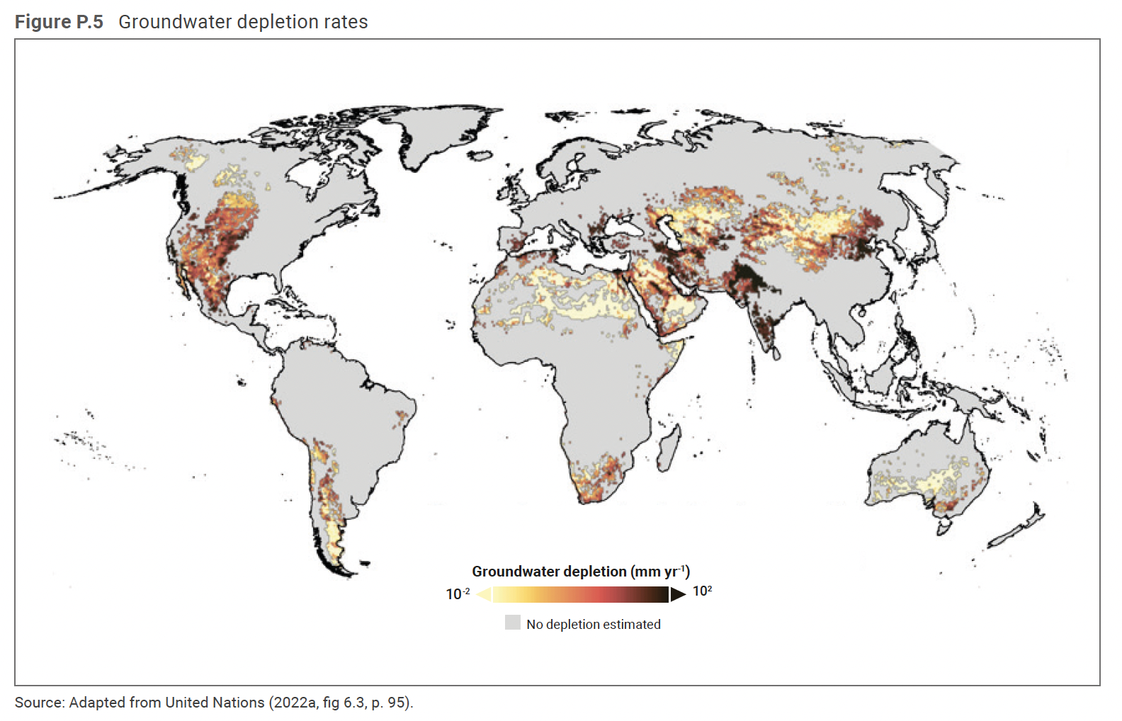

Slide 32
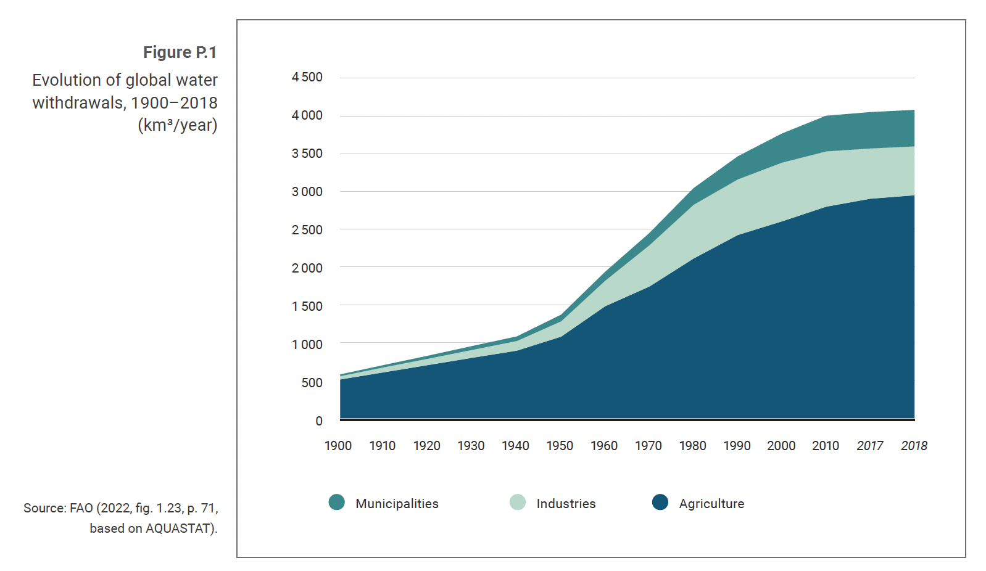

Slide 33
We need more water-efficient
forms of agriculture

Slide 34
4
Water withdrawals per capita worldwide as of 2020, by select country (in cubic meters per inhabitant)
Note(s): Worldwide; 2020*
Further information regarding this statistic can be found on page 8.
Source(s): OECD; ID 263156

Slide 35
4
Water withdrawals per capita worldwide as of 2020, by select country (in cubic meters per inhabitant)
Note(s): Worldwide; 2020*
Further information regarding this statistic can be found on page 8.
Source(s): OECD; ID 263156

Slide 36
3. Food

Slide 37
2
Global food consumption from 2015 to 2027, by food product group (in million metric tons)
Source(s): Statista Consumer Market Insights; Statista; ID 1298375

Slide 38
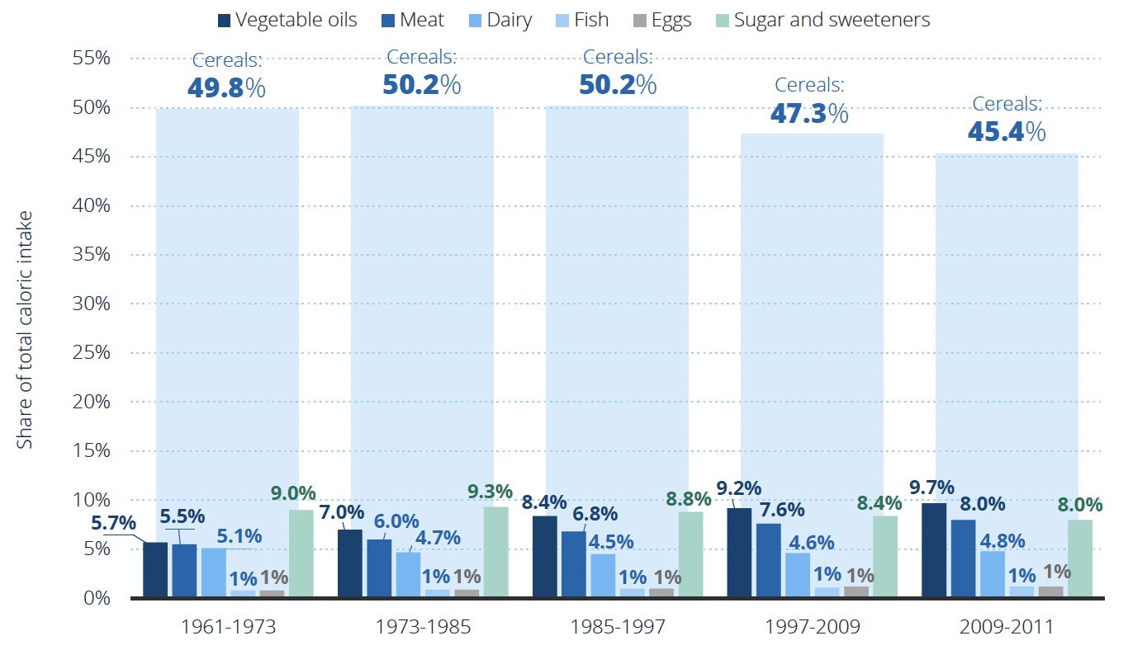
Share of per capita caloric intake worldwide

Slide 39
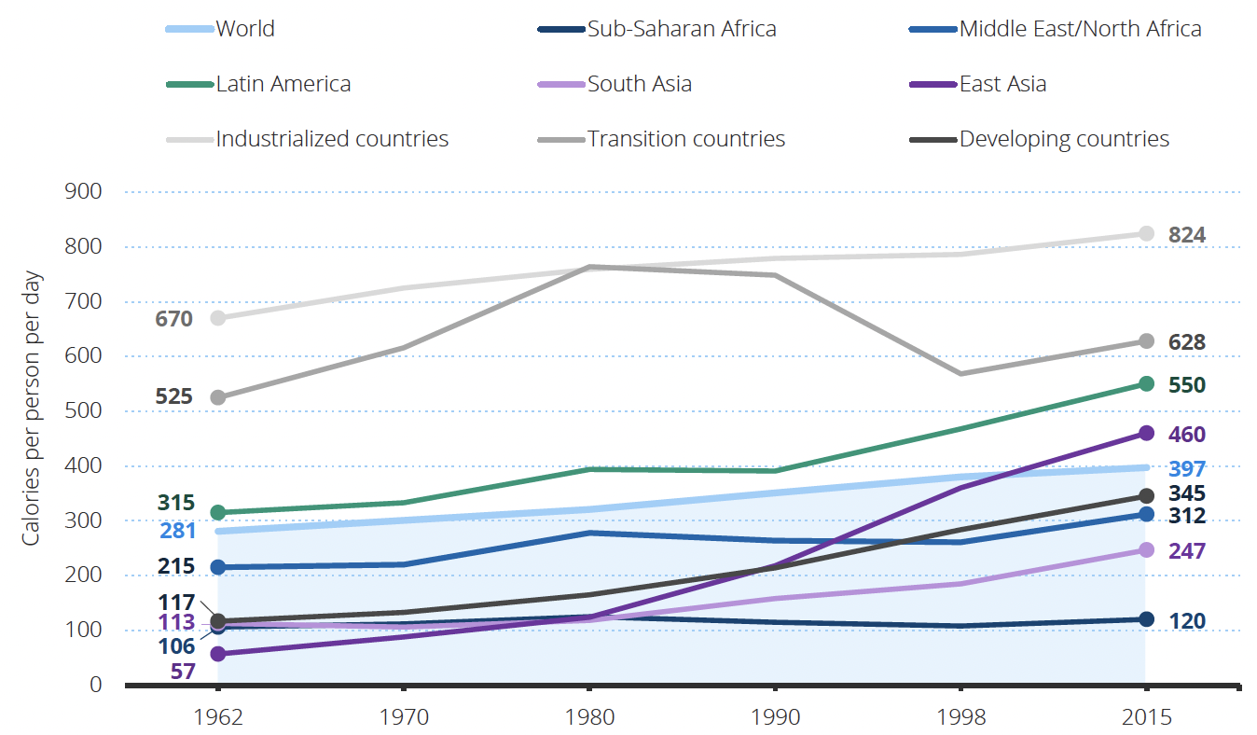
Calories Obtained from Livestock Products, by Region

Slide 40
4. Health

Slide 41
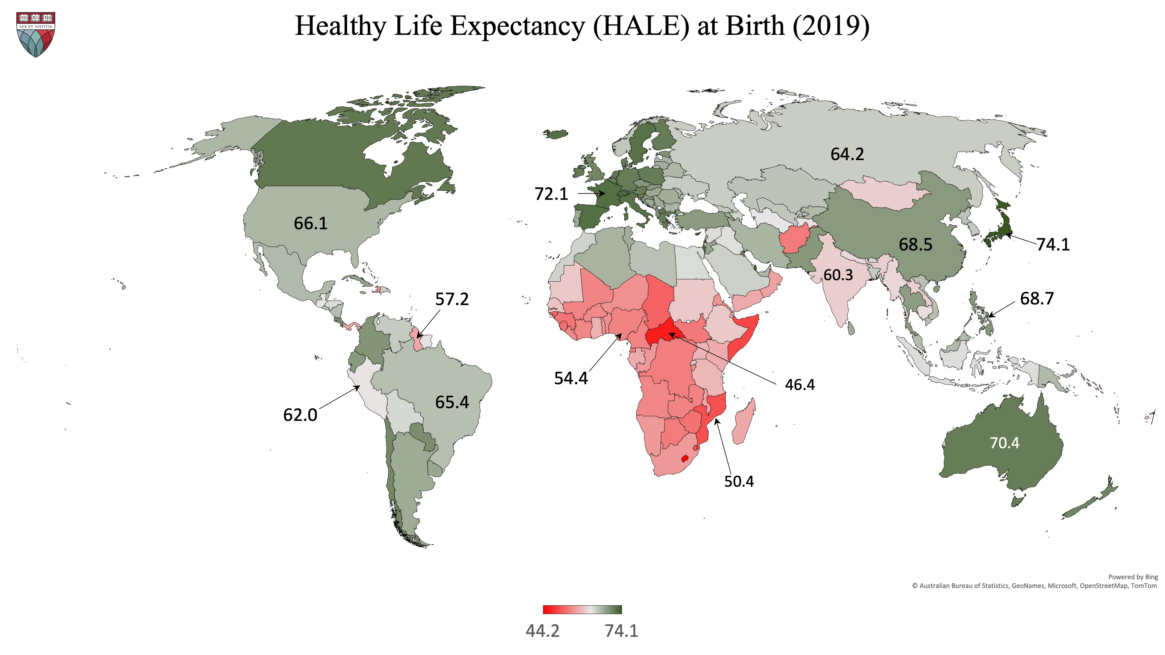

Slide 42
5. Population

Slide 43
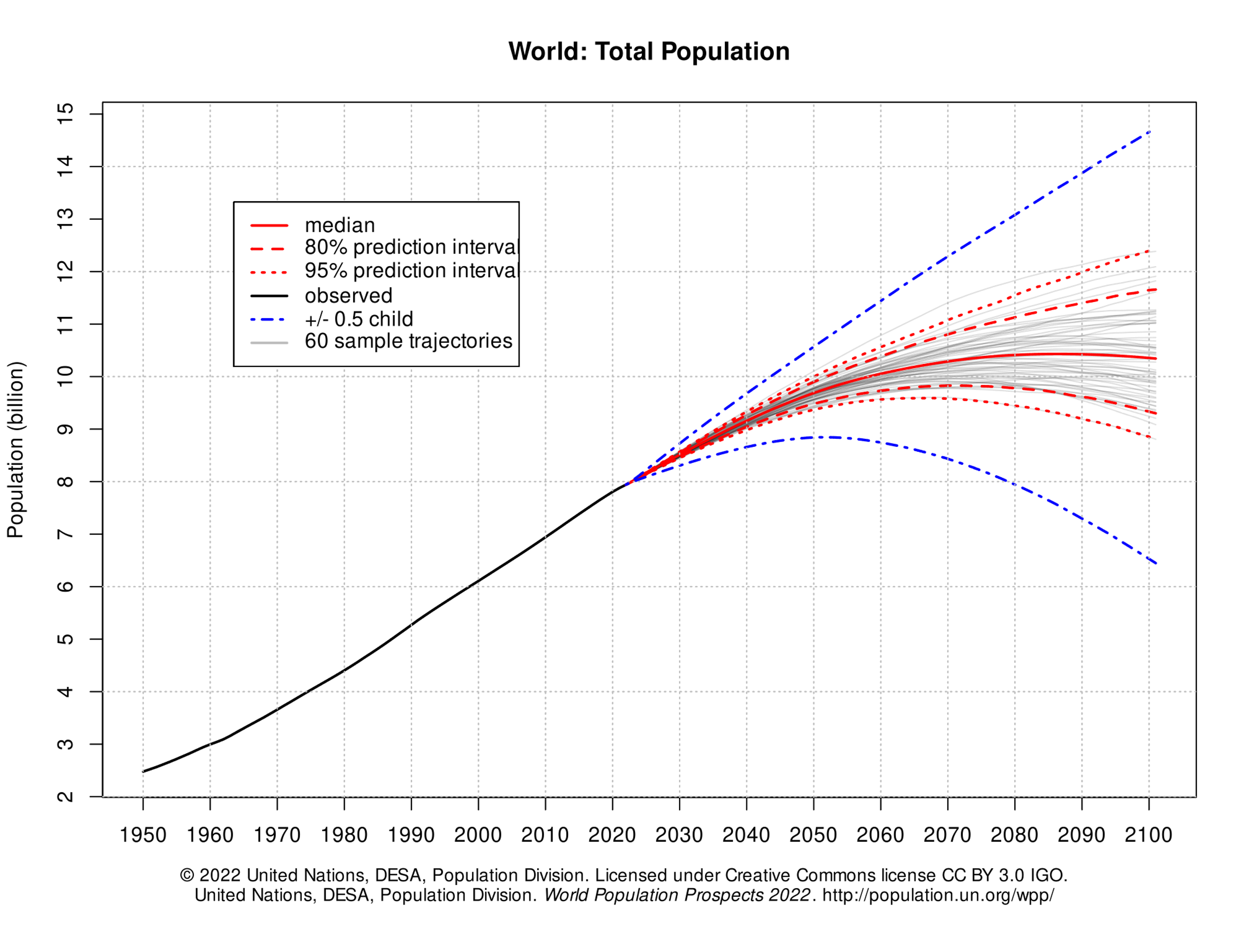
Median prediction – barely acceptable

Slide 44
Catastrophic increase (20% chance)

Slide 45
The trajectory we should prefer (20% chance)

Slide 46
The trajectory we should prefer
Sustainable level?

Slide 47
Part II: How might AI advance or threaten the “interests of humanity”?

Slide 48
Artificial Intelligence: Opportunities and Hazards
Existential threats:
  Extinction;
  Enslavement
Sustainability:
  AI could be highly beneficial in achieving most (not all) of the dimensions
Potential Impacts on democracy:
  Disinformation; propaganda
  Purification of information
Potential impact on meaningful work and self-expression:
  Alienation
  Enhanced Creativity
Equality:
  Linguistic specificity of large language models will continue to exacerbate national and regional inequality in access to information and assistance
Privacy
  Hazards both in the methods of gathering data and in the uses of the models
Relative magnitude will vary by field

Slide 49
Potential Contributions of AI to Sustainability

Slide 50
Ways in which AI can help with respect to Climate Change
Measuring rates of damage or improvement
Optimize transmissions of electricity through grids
Facilitate preventive maintenance, thus minimizing down time
Facilitate identification of more energy-efficient chemical processes
Manage grid-interactive buildings
Sources: https://news.un.org/en/story/2023/11/1143187; https://www.climatechange.ai/blog/2023-10-08-grants-zeonet;
https://www.sciencedirect.com/science/article/pii/S2666546822000489?via%3Dihub; https://www.climatechange.ai/blog/2022-10-03-grants-icenet;

Slide 51
Ways in which AI can help with respect to Water
Facilitate more efficient water resource management systems
Optimized groundwater management
Improve responses to emergencies
Sources: https://www.sciencedirect.com/science/article/abs/pii/S0195925520307939; https://www.bgr.bund.de/EN/Themen/Wasser/Aktuelles/2023-04_kimodis_en.html;
https://www.nature.com/articles/s44221-023-00069-6

Slide 52
Ways in which AI can help with respect to Food
Reduce Uses of Pesticides and Antibiotics
Improve Efficiency of the Food-Supply Chain
Reduce Food Waste
Sources: https://www.ncbi.nlm.nih.gov/pmc/articles/PMC10137586/pdf/foods-12-01654.pdf;
https://www.sciencedirect.com/science/article/pii/S1877050921018111 ;
https://www.forbes.com/sites/forbestechcouncil/2023/07/20/the-role-of-ai-in-creating-a-more-sustainable-food-system/?sh=3a15c5fd2841

Slide 53
Ways in which AI can help with respect to Health
More rapid and accurate determination of the causes of diseases
Enable affordable “personalized medicines”
Facilitate development of new pharmaceutical products [See Hutson 2023]

Slide 54
Ways in which AI might help with respect to Population Control
This is the zone where the existential threat of AI is perhaps most salient
  This does not mean that we should renounce pursuit of sustainability, but we must be extremely careful with respect to both who decides and how to proceed
Determination of acceptable methods of bringing the global population down to acceptable levels does not require AI
  The alternative approaches are reasonably clear
  Determination of which to adopt must be made on moral grounds, not technological grounds
In the future, maintenance of the global population at sustainable levels could be facilitated by – but not delegated to – AI

Slide 55
Potential Methods of Reducing Population Growth: an initial proposal
Obviously unacceptable
Starvation
Disease
War
Unacceptable
Laws limiting childbearing (e.g., China’s former policy)
Financial disincentives for childbearing
Acceptable
Enhanced educational opportunities for everyone
Enhanced employment opportunities for women
Improvements in social security
Eliminate counterfeit contraceptives from the global supply chain

Slide 56
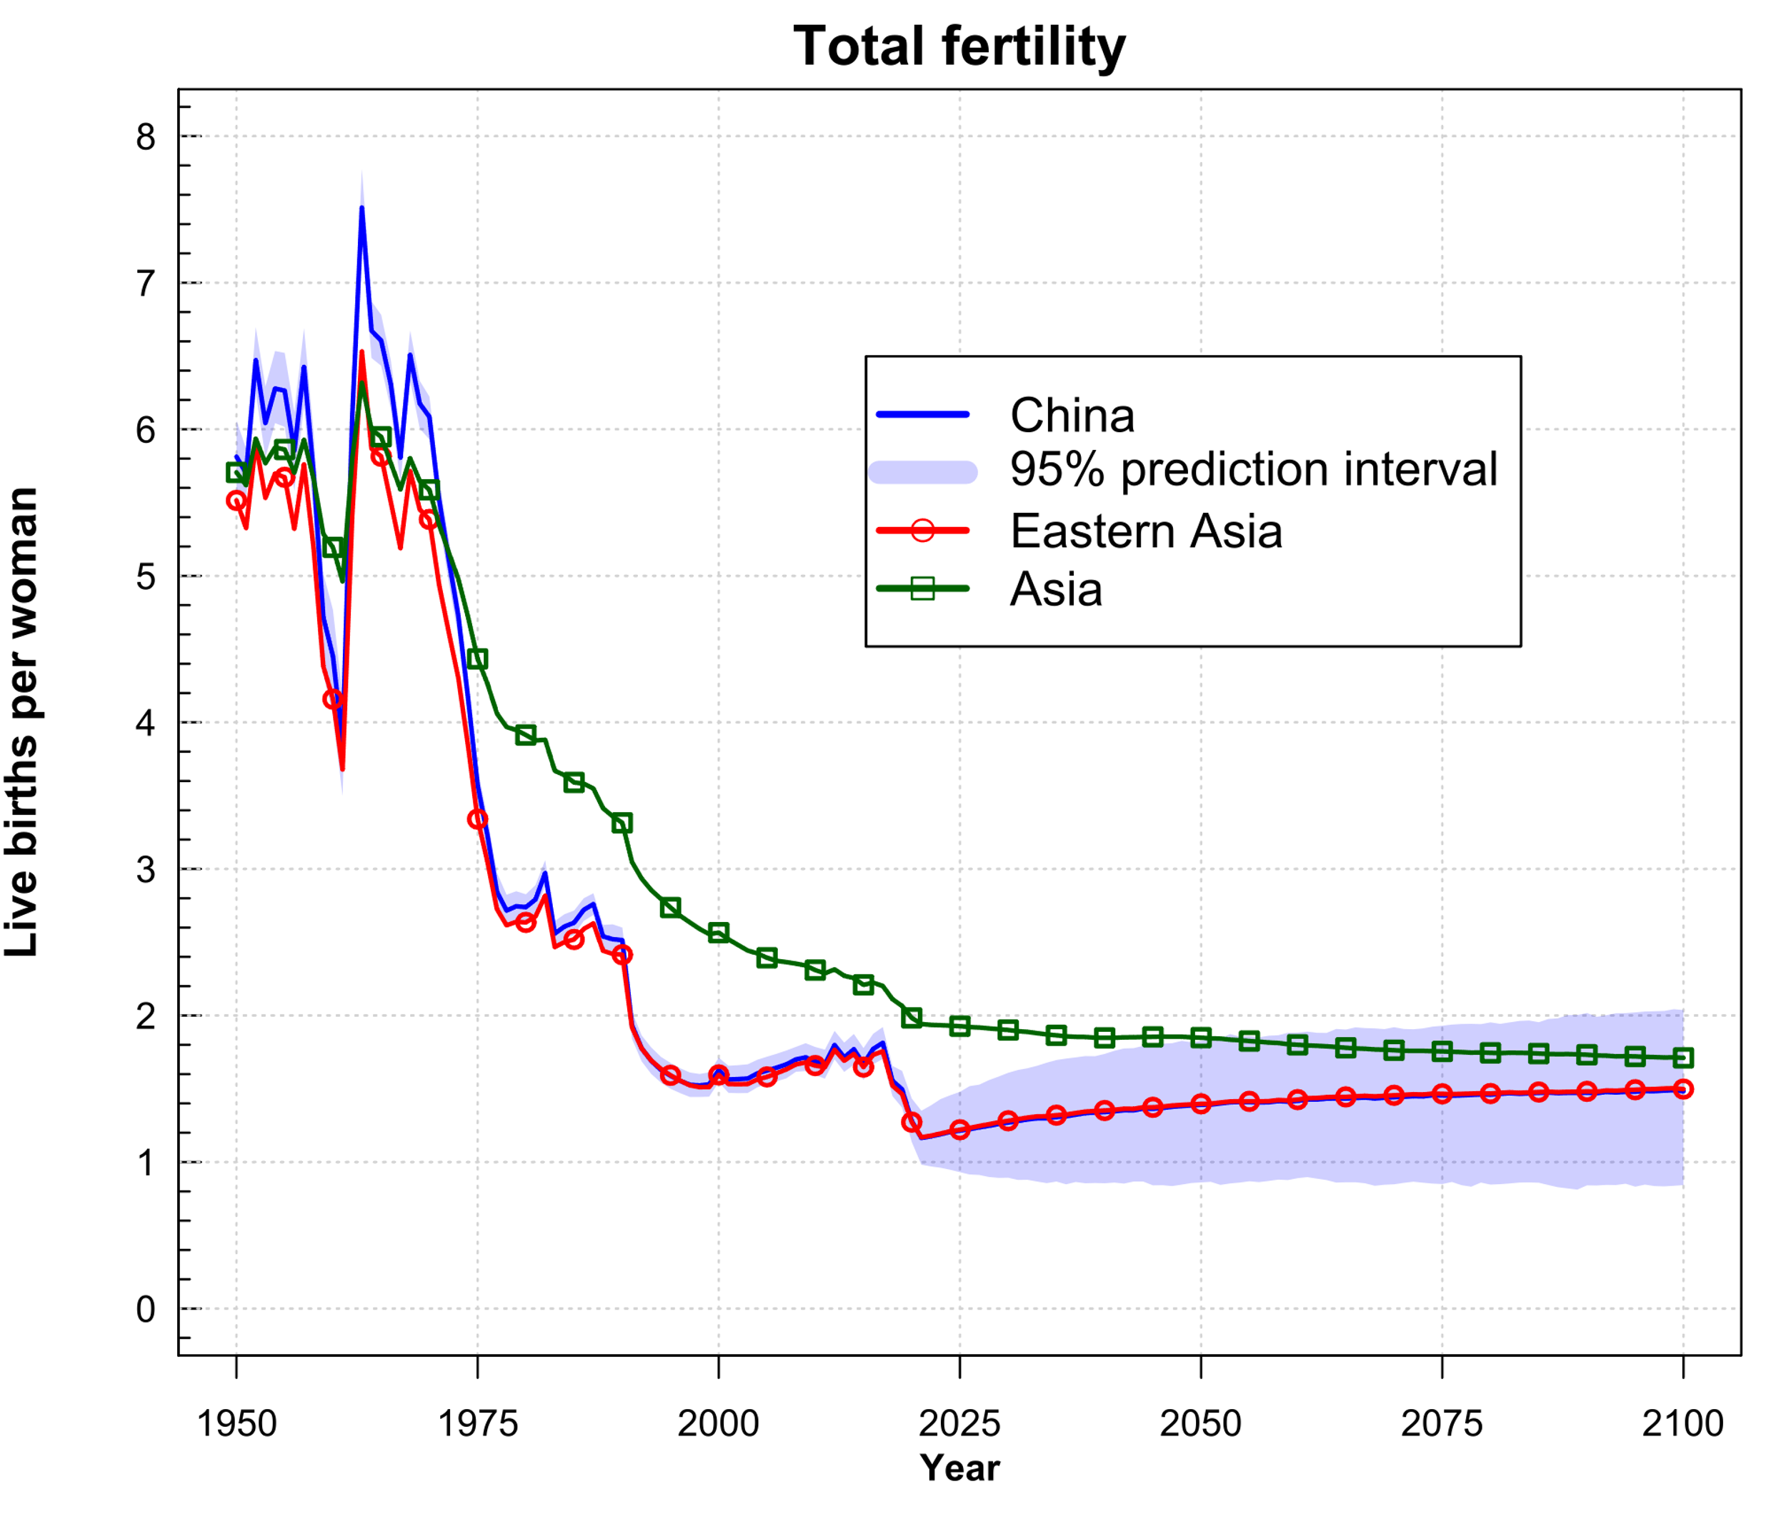
Impact of Compulsory Reduction in Fertility in China
Source: https://population.un.org/wpp/Graphs/DemographicProfiles/Line/913

Slide 57
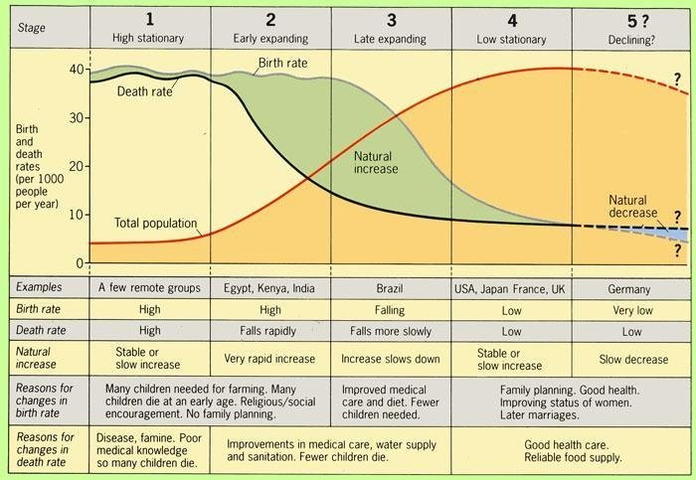
Source: “Special Volume 2015: A Global Public Health Curriculum”

Slide 58
Source: “Special Volume 2015: A Global Public Health Curriculum”

Slide 59
Source: “Special Volume 2015: A Global Public Health Curriculum”

Slide 60
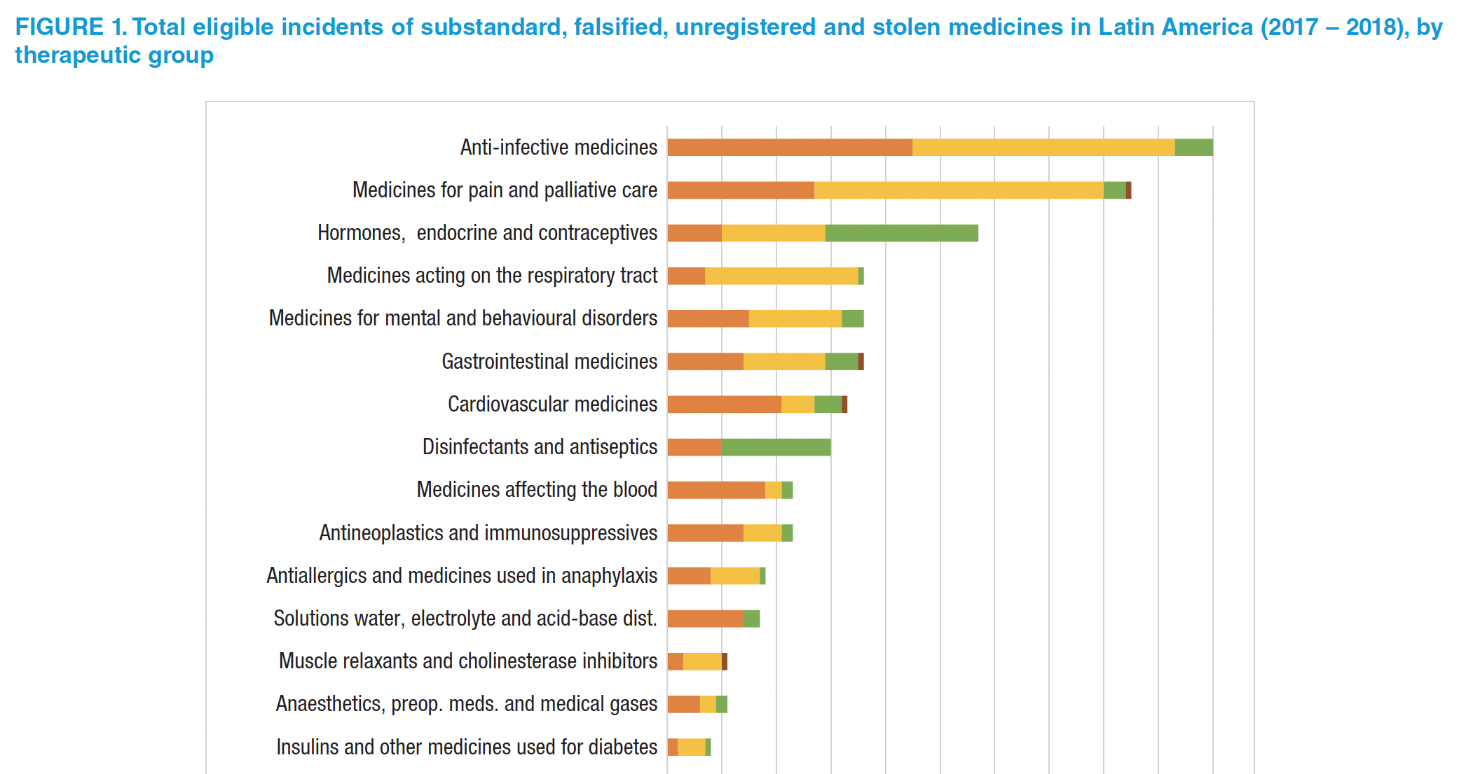

Source: Rojas-Cortés R. Substandard, falsified and unregistered medicines in Latin America, 2017-2018.
Rev Panam Salud Publica. 2020;44:e125 https://doi.org/10.26633/RPSP.2020.125

Slide 61
Potential Impacts on Democracy

Slide 62
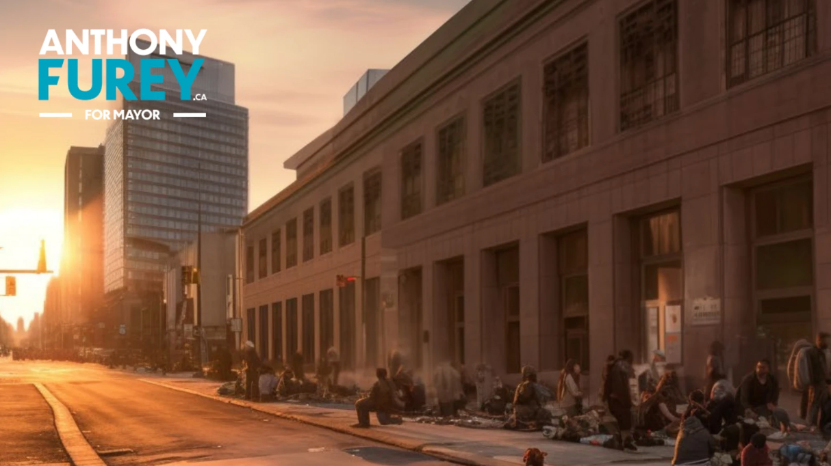

Slide 63
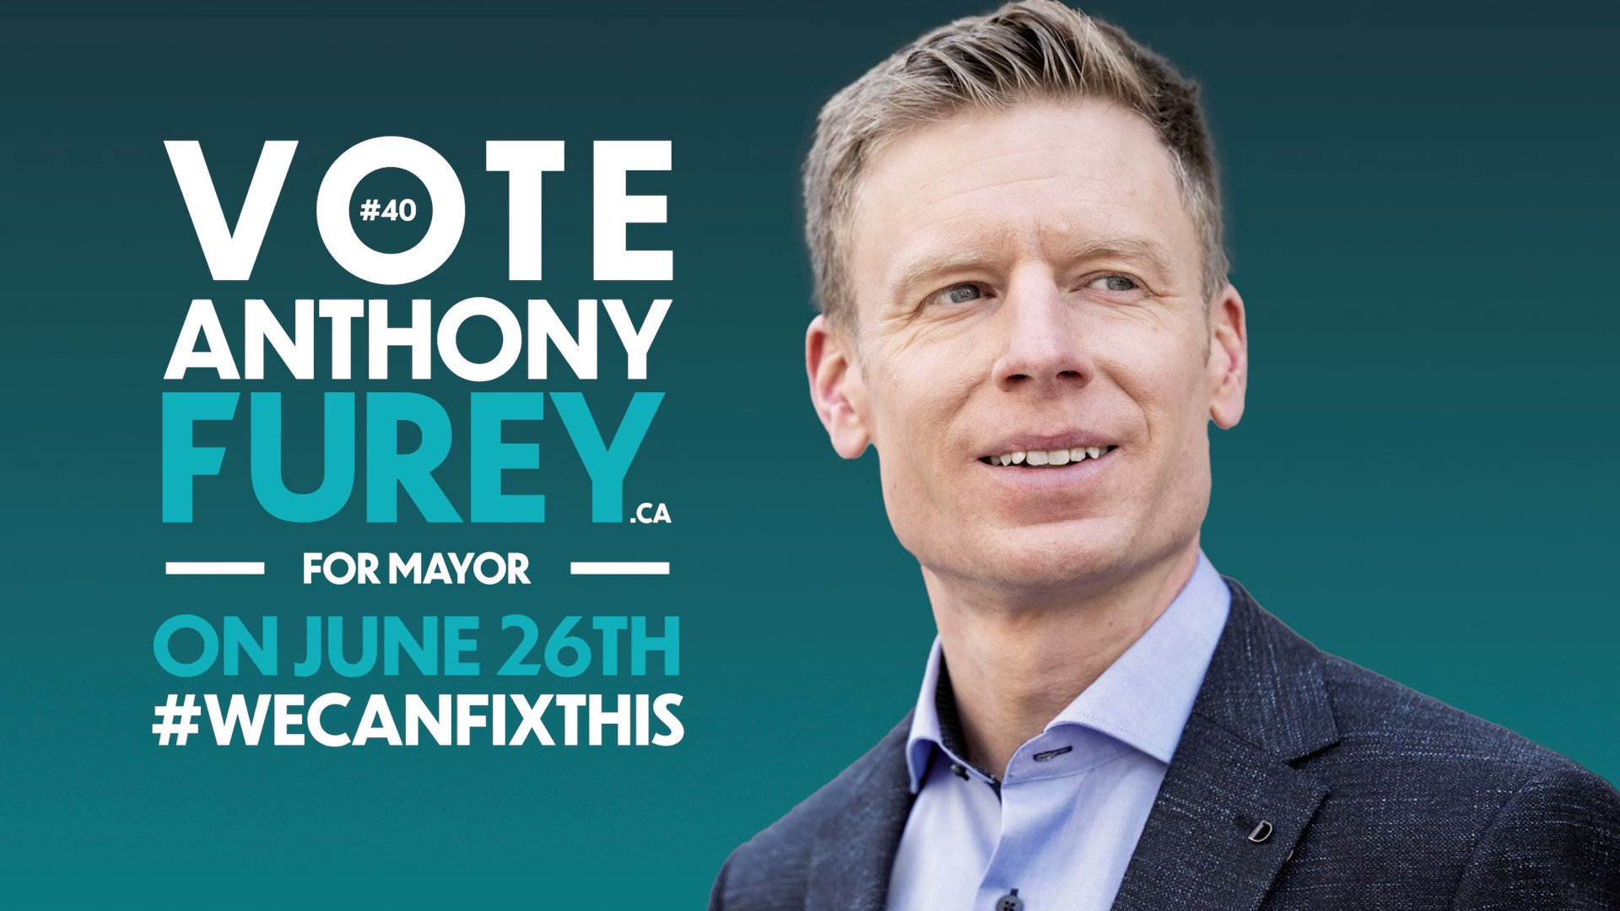

Slide 65


Slide 66

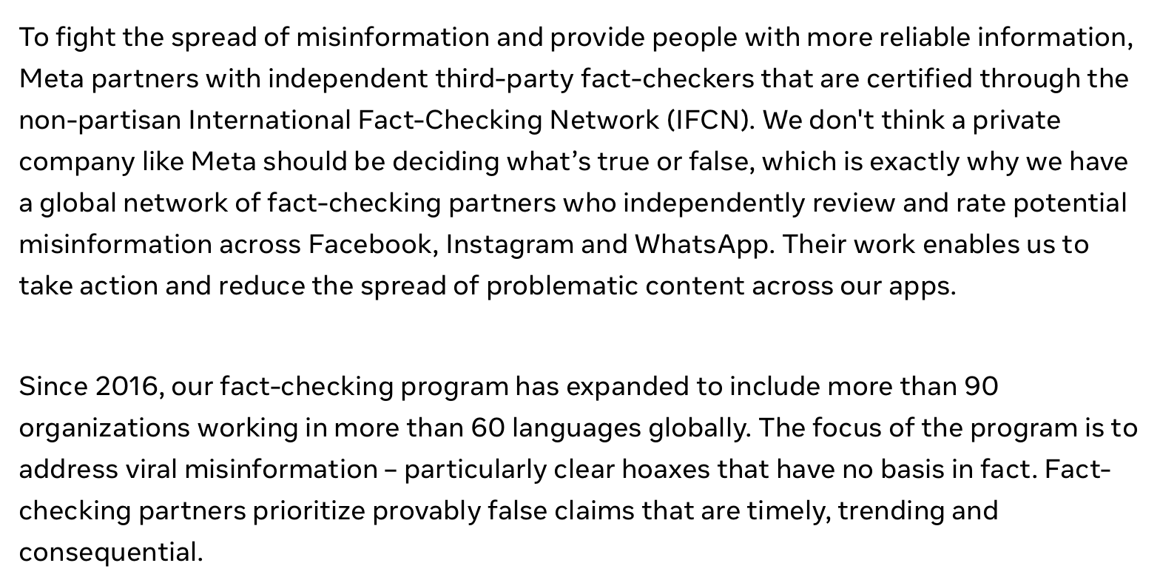

Slide 67
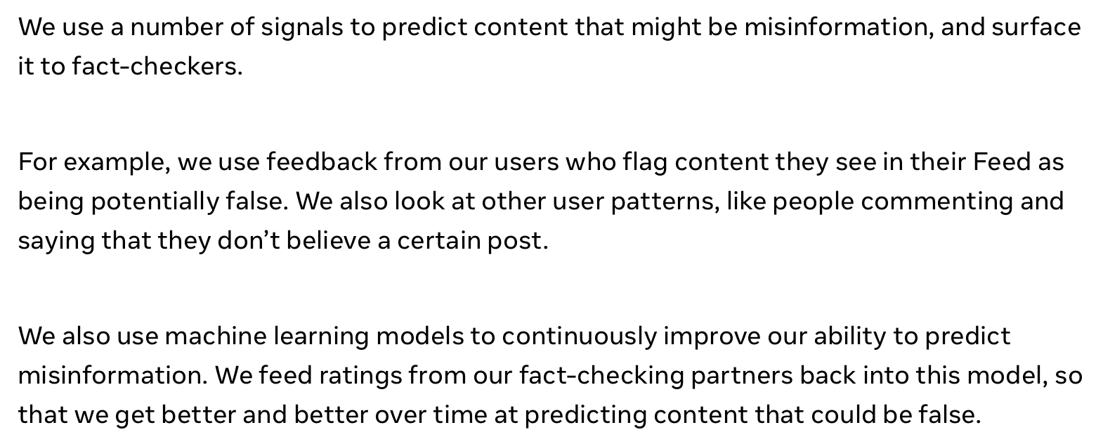

Slide 68
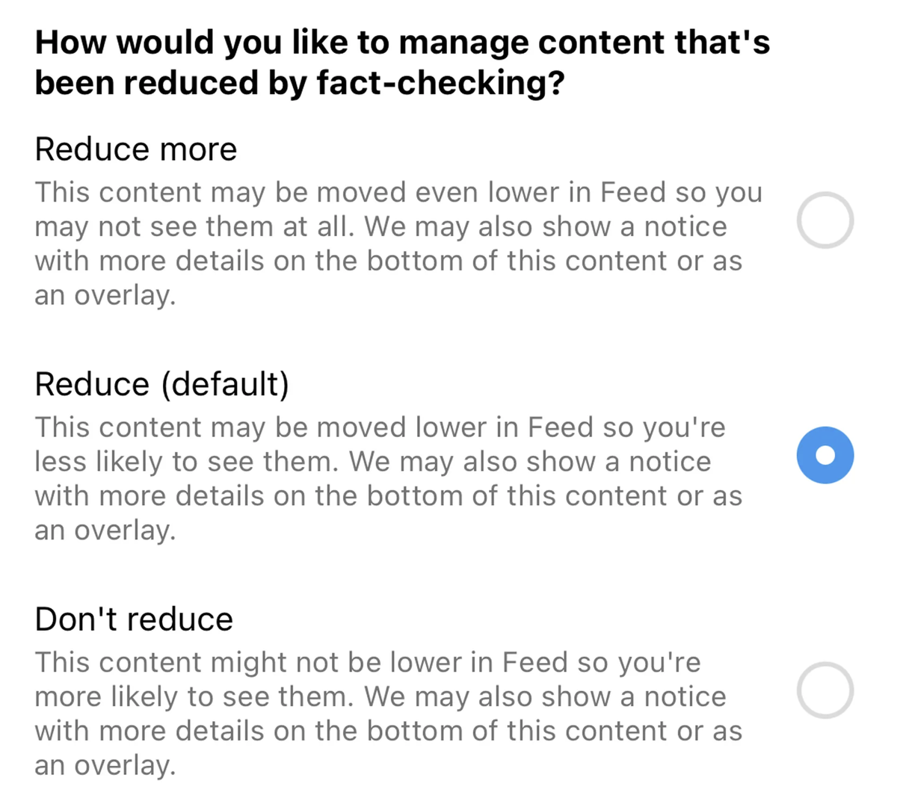

Slide 69
Potential Impacts on Meaningful Work and Self-Expression

Slide 70
Music:
Impact on creativity and self-expression of the increased availability of inexpensive, high-quality professional sound recordings?

Slide 71
2
Number of guitars sold in the United States from 2005 to 2021 (in 1,000s)
Note(s): United States; 2005 to 2021
Further information regarding this statistic can be found on page 8.
Source(s): The Music Trades; ID 440171

Slide 72
2
Number of acoustic pianos sold in the United States from 2005 to 2021
Note(s): United States; 2005 to 2021
Further information regarding this statistic can be found on page 8.
Source(s): The Music Trades; ID 452772

Slide 73
2
Retail sales value of the digital piano market in the United States from 2005 to 2021 (in million U.S. dollars)
Note(s): United States; 2005 to 2021; value of shipments to consumers
Further information regarding this statistic can be found on page 8.
Source(s): The Music Trades; ID 444518

Slide 74
4
Revenue of the musical instruments market worldwide by country in 2022 (in million U.S. dollars)
Note(s): Worldwide; Jan 1st to Dec 31st 2022
Further information regarding this statistic can be found on page 8.
Source(s): Statista Consumer Market Insights; ID 798815

Slide 75
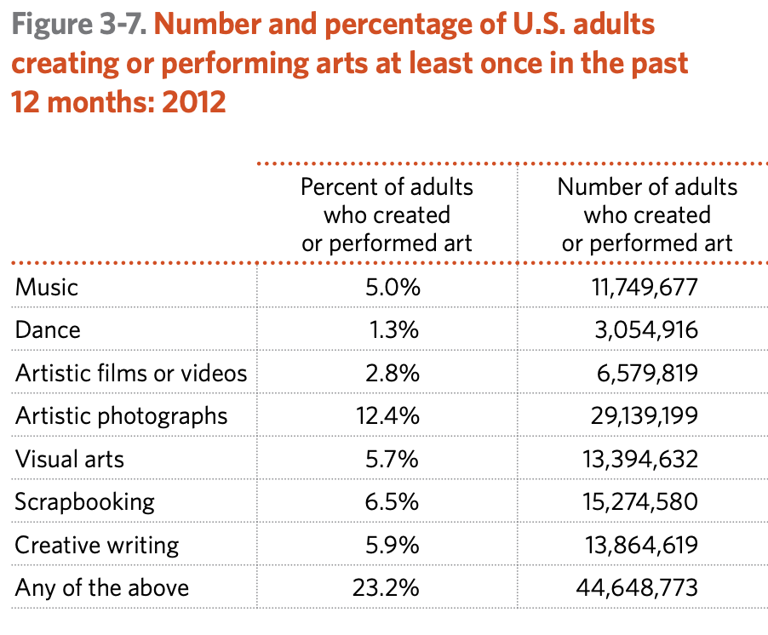
Source: National Endowment for the Arts, “A decade of arts engagement: findings from the survey of public participation in the arts, 2002–2012” (2015)

Slide 76
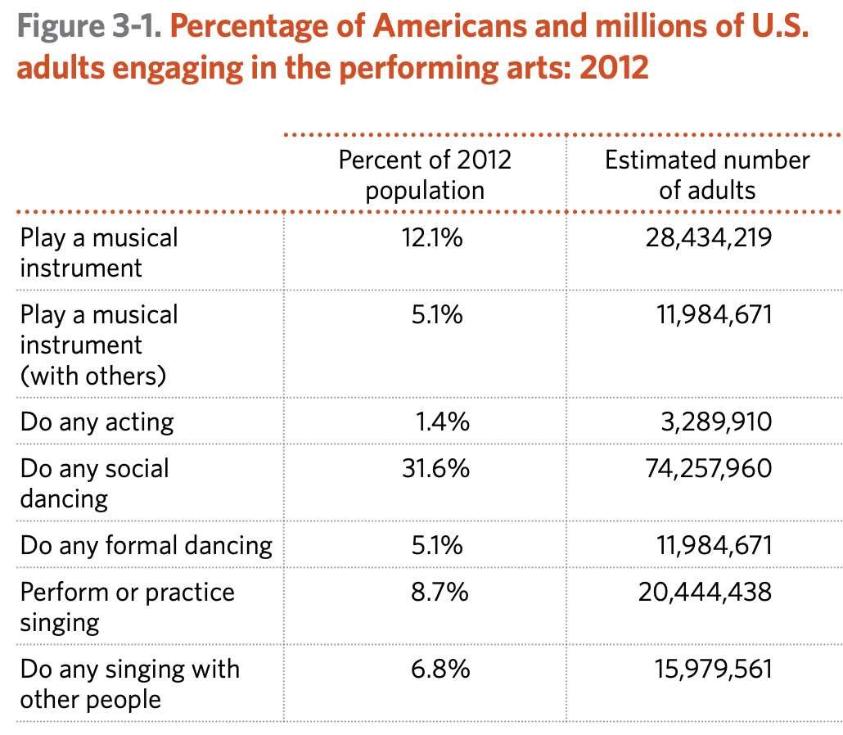
Source: National Endowment for the Arts, “A decade of arts engagement: findings from the survey of public participation in the arts, 2002–2012” (2015)

Slide 77
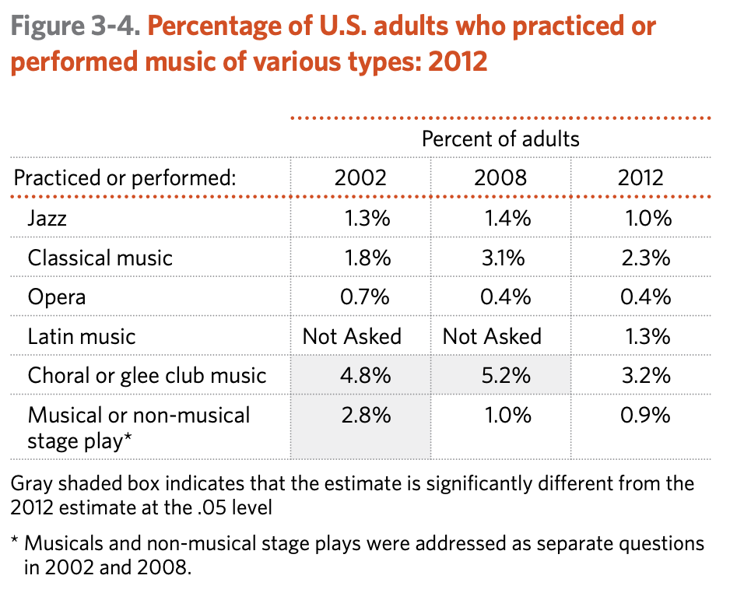
Source: National Endowment for the Arts, “A decade of arts engagement: findings from the survey of public participation in the arts, 2002–2012” (2015)

Slide 78
Potential Impacts on Equality

Slide 79
Inequality
Manifestations:
  The quality of the prose generated by ChatGPT in English is better than the quality of the prose it generates in any other language
  The quality of the information generated by ChatGPT when queried in English may be better than the quality it generates in any other language
  ChatGPT is increasingly aligned with the values of English speakers
Causes (tentative)
  The content of the databases on which ChatGPT has (thus far) been trained is biased toward the English language and English-speaking people
  The value-alignment process favors the values of the people who initially refined the model
  Bilingual and multilingual users tend to employ English, thus reinforcing the biases through usage and feedback

Slide 80
Inequality
Manifestations:
  The quality of the prose generated by ChatGPT in English is better than the quality of the prose it generates in any other language
  The quality of the information generated by ChatGPT when queried in English may be better than the quality it generates in any other language
  ChatGPT is increasingly aligned with the values of English speakers
Causes (tentative)
  The content of the databases on which ChatGPT has (thus far) been trained is biased toward the English language and English-speaking people
  The value-alignment process favors the values of the people who initially refined the model
  Bilingual and multilingual users tend to employ English, thus reinforcing the biases through usage and feedback

Slide 81
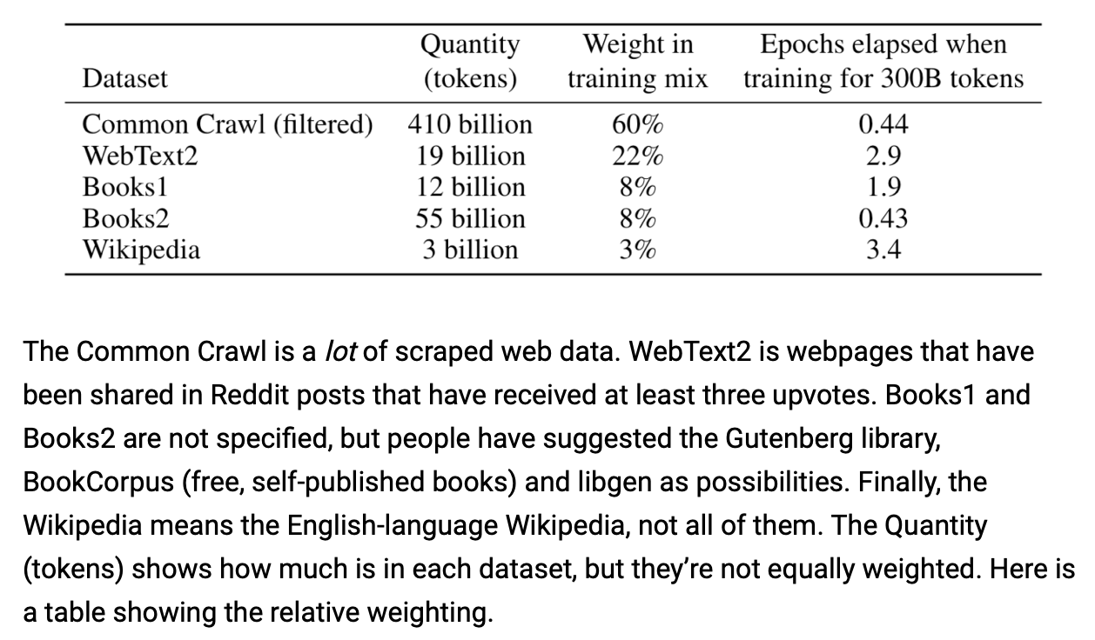
Jill Walker Rettberg, “ChatGPT is multilingual but monocultural, and it’s learning your values”
(December 6, 2022), https://jilltxt.net/right-now-chatgpt-is-multilingual-but-monocultural-but-its-learning-your-values/
Weight
0.73
5.5
4
0.72
3

Slide 82
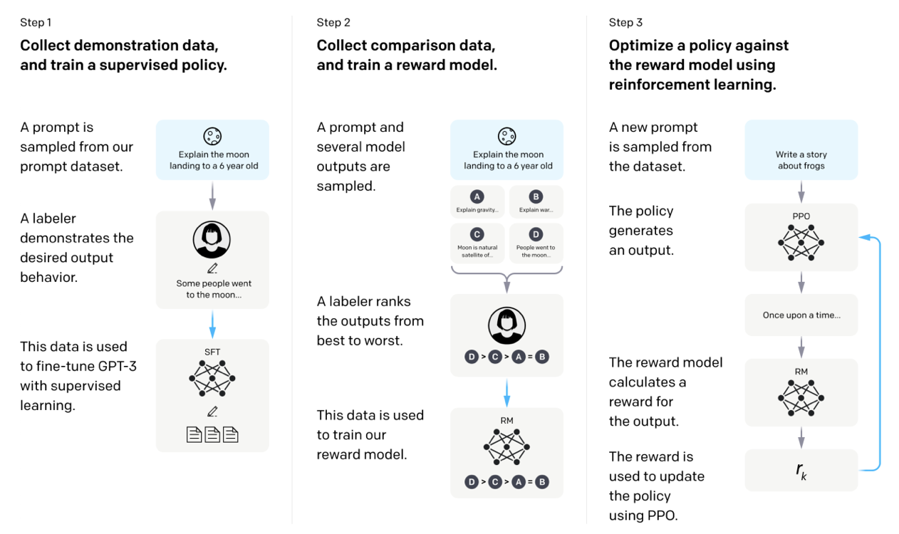
Jill Walker Rettberg, “ChatGPT is multilingual but monocultural, and it’s learning your values”
(December 6, 2022), https://jilltxt.net/right-now-chatgpt-is-multilingual-but-monocultural-but-its-learning-your-values/

Slide 83
Part III: How might legal reform help nudge AI in beneficial directions and away from hazardous paths?

Slide 84
Increased Alignment through legal reform
Mandatory attribution with respect to the fruits of AI [cf. DOO Negotiations for PCT]
IP Protection for Fruits
  Copyright protection for the fruits of generative AI
  Patent protection for drugs produced with aid of AI
No injunctive relief for IP on AI Methods
  E.g., use of copyrighted materials in training data
  E.g., infringement of AI-based drug discovery methods
Industry-specific compensation systems
Limits on usage & mandatory anonymization
Prizes for socially beneficial but unprofitable AI systems

Slide 85
Increased Alignment through legal reform
Mandatory attribution with respect to the fruits of AI [cf. DOO Negotiations for PCT]
IP Protection for Fruits
  Copyright protection for the fruits of generative AI
  Patent protection for drugs produced with aid of AI
No injunctive relief for IP on AI Methods
  E.g., use of copyrighted materials in training data
  E.g., infringement of AI-based drug discovery methods
Industry-specific compensation systems
Limits on usage & mandatory anonymization
Prizes for socially beneficial but unprofitable AI systems

Slide 86
Current Attribution Requirements
China Interim AI Guidelines (August 2023)
  Generative AI systems must disclose that their products were produced through the use of AI
EU AI Act (December 2023; effective in 2025)
  Generative AI systems must disclose that their products were produced through the use of AI
USA does not yet have a general attribution requirement
  “No Fakes Act” (pending) would forbid ”the production of a digital replica without the consent of the applicable individual or rights holder”

Slide 87
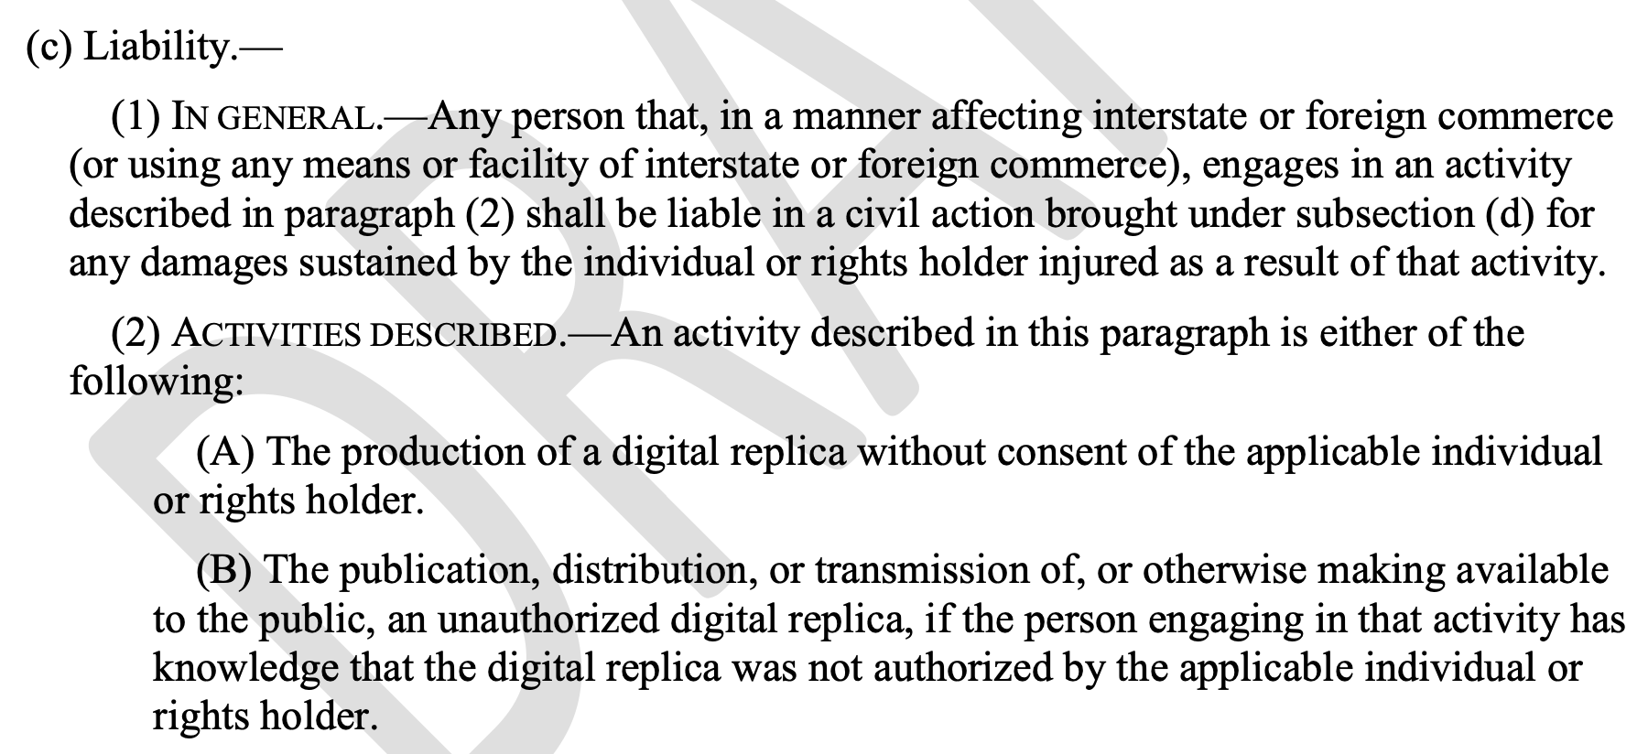
No Fakes Act (USA)

Slide 88
Increased Alignment through legal reform
Mandatory attribution with respect to the fruits of AI [cf. DOO Negotiations for PCT]
IP Protection for Fruits
  Copyright protection for the fruits of generative AI
  Patent protection for drugs produced with aid of AI
No injunctive relief for IP on AI Methods
  E.g., use of copyrighted materials in training data
  E.g., infringement of AI-based drug discovery methods
Industry-specific compensation systems
Limits on usage & mandatory anonymization
Prizes for socially beneficial but unprofitable AI systems

Slide 89
Increased Alignment through legal reform
Mandatory attribution with respect to the fruits of AI [cf. DOO Negotiations for PCT]
IP Protection for Fruits
  Copyright protection for the fruits of generative AI
  Patent protection for drugs produced with aid of AI
No injunctive relief for IP on AI Methods
  E.g., use of copyrighted materials in training data
  E.g., infringement of AI-based drug discovery methods
Industry-specific compensation systems
Limits on usage & mandatory anonymization
Prizes for socially beneficial but unprofitable AI systems

Slide 90
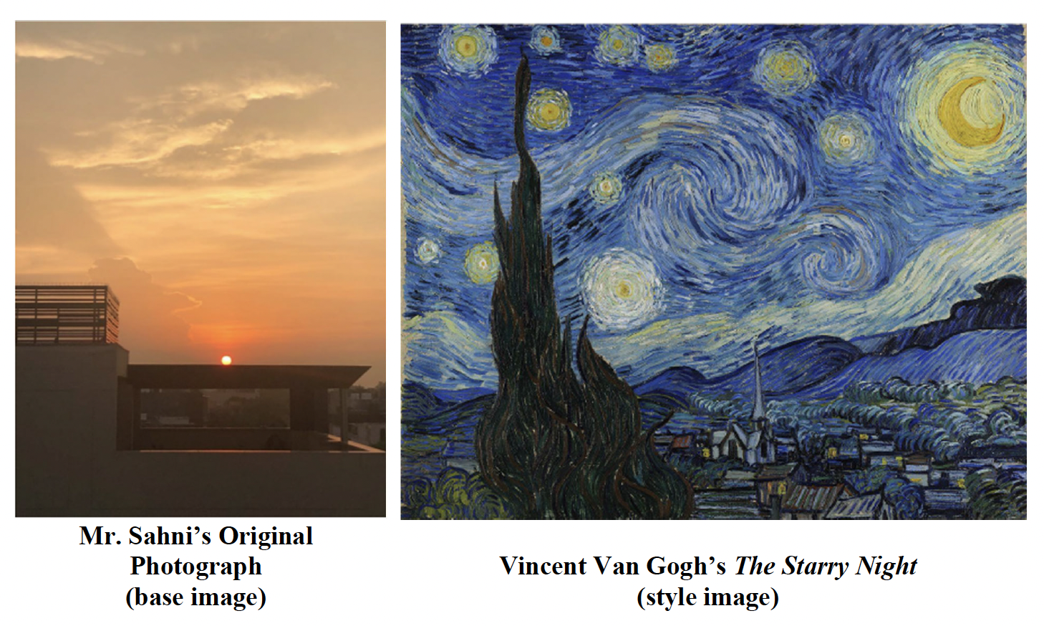
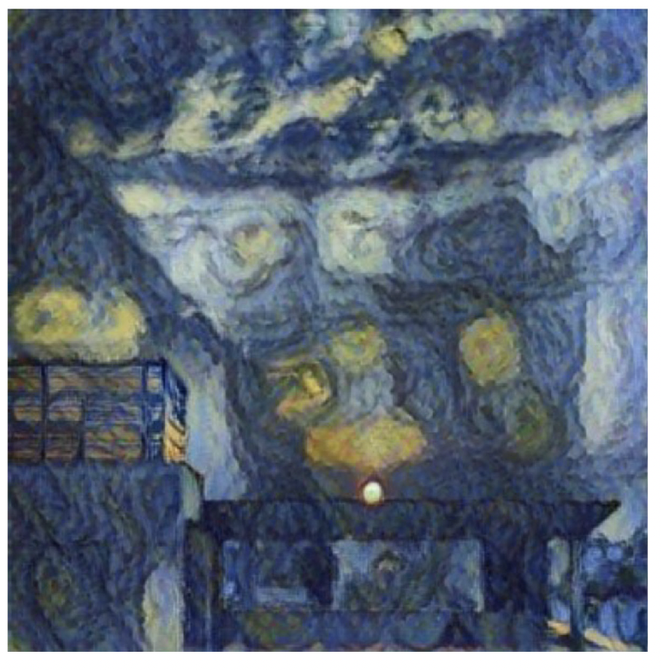
“Second Request for Reconsideration for Refusal to Register SURYAST” (Copyright Review Board, December 11, 2023)
SURYAST

Slide 91
“Second Request for Reconsideration for Refusal to Register SURYAST” (Copyright Review Board, December 11, 2023)
“If all of a work’s “traditional elements of authorship” are generated by AI, the work lacks human authorship, and the Office will not register it. If, however, a work containing AI-generated material also contains sufficient human authorship to support a claim to copyright, then the Office will register the human’s contributions….
“After considering the information provided by Mr. Sahni regarding his creation of the Work, including his description of RAGHAV, the Board concludes that the Work is not the product of human authorship. Specifically, the Board finds that the expressive elements of pictorial authorship were not provided by Mr. Sahni. As Mr. Sahni admits, he provided three inputs to RAGHAV: a base image, a style image, and a “variable value determining the amount of style transfer.” Because Mr. Sahni only provided these three inputs to RAHGAV, the RAGHAV app, not Mr. Sahni, was responsible for determining how to interpolate the base and style images in accordance with the style transfer value.”

Slide 92
Increased Alignment through legal reform
Mandatory attribution with respect to the fruits of AI [cf. DOO Negotiations for PCT]
IP Protection for Fruits
  Copyright protection for the fruits of generative AI
  Patent protection for drugs produced with aid of AI
No injunctive relief for IP on AI Methods
  E.g., use of copyrighted materials in training data
  E.g., infringement of AI-based drug discovery methods
Industry-specific compensation systems
Limits on usage & mandatory anonymization
Prizes for socially beneficial but unprofitable AI systems

Slide 93
Increased Alignment through legal reform
Mandatory attribution with respect to the fruits of AI [cf. DOO Negotiations for PCT]
IP Protection for Fruits
  Copyright protection for the fruits of generative AI
  Patent protection for drugs produced with aid of AI
No injunctive relief for IP on AI Methods
  E.g., use of copyrighted materials in training data
  E.g., infringement of AI-based drug discovery methods
Industry-specific compensation systems
Limits on usage & mandatory anonymization
Prizes for socially beneficial but unprofitable AI systems
Do not replace PHOSITA with MHOSITA (machine having ordinary skill in the art)

Slide 94
Increased Alignment through legal reform
Mandatory attribution with respect to the fruits of AI [cf. DOO Negotiations for PCT]
IP Protection for Fruits
  Copyright protection for the fruits of generative AI
  Patent protection for drugs produced with aid of AI
No injunctive relief for IP on AI Methods
  E.g., use of copyrighted materials in training data
  E.g., infringement of AI-based drug discovery methods
Industry-specific compensation systems
Limits on usage & mandatory anonymization
Prizes for socially beneficial but unprofitable AI systems

Slide 95
Increased Alignment through legal reform
Mandatory attribution with respect to the fruits of AI [cf. DOO Negotiations for PCT]
IP Protection for Fruits
  Copyright protection for the fruits of generative AI
  Patent protection for drugs produced with aid of AI
No injunctive relief for IP on AI Methods
  E.g., use of copyrighted materials in training data
  E.g., infringement of AI-based drug discovery methods
Industry-specific compensation systems
Limits on usage & mandatory anonymization
Prizes for socially beneficial but unprofitable AI systems

Slide 96
Increased Alignment through legal reform
Mandatory attribution with respect to the fruits of AI [cf. DOO Negotiations for PCT]
IP Protection for Fruits
  Copyright protection for the fruits of generative AI
  Patent protection for drugs produced with aid of AI
No injunctive relief for IP on AI Methods
  E.g., use of copyrighted materials in training data
  E.g., infringement of AI-based drug discovery methods
Industry-specific compensation systems
Limits on usage & mandatory anonymization
Prizes for socially beneficial but unprofitable AI systems

Slide 97
2
Estimated aggregate revenue of U.S. newspaper publishers from 2005 to 2021 (in billion U.S. dollars)
Note(s): United States; 2005 to 2021; includes all taxable employer firms
Further information regarding this statistic can be found on page 8.
Source(s): US Census Bureau; ID 184046

Slide 98
2
Newspaper publishing revenue in the United States from 2010 to 2021, by media type (in million U.S. dollars)
Note(s): United States; 2010 to 2021; includes all taxable employer firms
Further information regarding this statistic can be found on page 8.
Source(s): US Census Bureau; ID 184887

Slide 99
2
Number of local daily and non-daily newspapers in publication in the United States
Note(s): United States; 2004 and 2022; 2022 data covers papers still in publication as of May that year
Further information regarding this statistic can be found on page 8.
Source(s): Northwestern University; ID 944134

Slide 100
2
Number of employees in the newspaper industry in the United States by profession
Note(s): United States; 2006 and 2021
Further information regarding this statistic can be found on page 8.
Source(s): Bureau of Labor Statistics; Poynter Institute; ID 626459

Slide 101
2
Newspaper publishing revenue worldwide by source (in billion U.S. dollars)
Note(s): Worldwide; 2019
Further information regarding this statistic can be found on page 8.
Source(s): PwC; Press Gazette; ID 260201

Slide 102
Increased Alignment through legal reform
Mandatory attribution with respect to the fruits of AI [cf. DOO Negotiations for PCT]
IP Protection for Fruits
  Copyright protection for the fruits of generative AI
  Patent protection for drugs produced with aid of AI
No injunctive relief for IP on AI Methods
  E.g., use of copyrighted materials in training data
  E.g., infringement of AI-based drug discovery methods
Industry-specific compensation systems
Limits on usage & mandatory anonymization
Prizes for socially beneficial but unprofitable AI systems

Slide 103
Increased Alignment through legal reform
Mandatory attribution with respect to the fruits of AI [cf. DOO Negotiations for PCT]
IP Protection for Fruits
  Copyright protection for the fruits of generative AI
  Patent protection for drugs produced with aid of AI
No injunctive relief for IP on AI Methods
  E.g., use of copyrighted materials in training data
  E.g., infringement of AI-based drug discovery methods
Industry-specific compensation systems
Limits on usage & mandatory anonymization
Prizes for socially beneficial but unprofitable AI systems

Slide 104
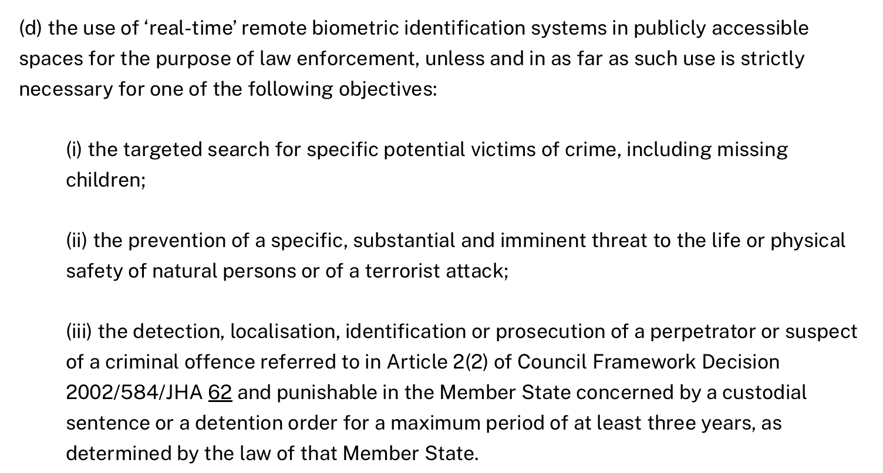
EU AI Act (draft 2023), Section 5.1 forbids:

Slide 105
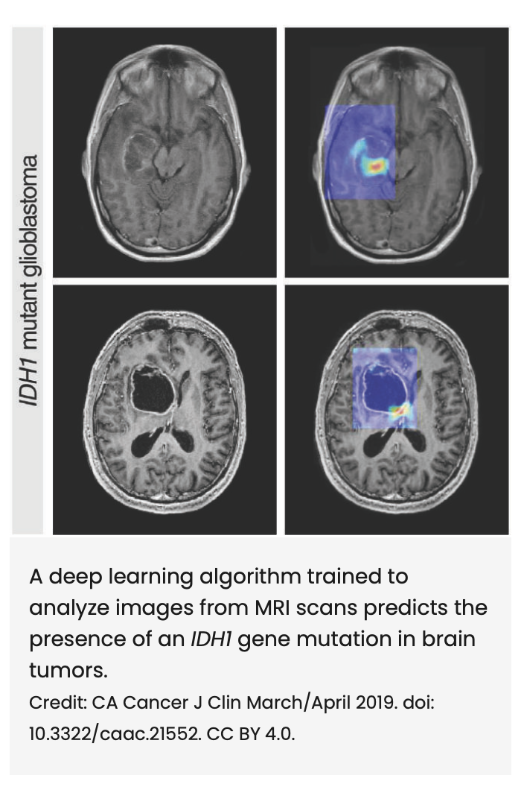
Source: Jaber et al., “Can Artificial Intelligence Help See Cancer in New, and Better, Ways?,” National Cancer Institute (2022)

Slide 106
“Artificial Intelligence and Cancer Care: the Future of Oncology?” Stanford Cancer Institute
“’Unlike the traditional approach, [the deep-learning model] does not rely on human input or expert knowledge. Instead, it learns informative patterns from the data that are relevant to the problem at hand,” Li explained. “It’s fully automatic. We supply the data, and it provides the output; the desired response.’”
“By incorporating this revolutionary approach to cancer imaging into the clinical workflow, Li anticipates that what once took hours of human labor can be done in the click of a button, so to speak. From there, he hopes to successfully “teach” the algorithm to take data from routine cancer care and use it to create a personalized treatment approach. …
“The drawback with this approach is the amount of data required to train the model what to identify. Because of the model’s size, it has millions of parameters in a typical network, requiring a very large data set to train a reliable model.
“A solution to this problem is “federated learning,” a decentralized approach to training machine learning models by leveraging datasets from multiple institutions of the same caliber, without compromising patient privacy. ”

Slide 107
“Artificial Intelligence and Cancer Care: the Future of Oncology?” Stanford Cancer Institute
“’Unlike the traditional approach, [the deep-learning model] does not rely on human input or expert knowledge. Instead, it learns informative patterns from the data that are relevant to the problem at hand,” Li explained. “It’s fully automatic. We supply the data, and it provides the output; the desired response.’”
“By incorporating this revolutionary approach to cancer imaging into the clinical workflow, Li anticipates that what once took hours of human labor can be done in the click of a button, so to speak. From there, he hopes to successfully “teach” the algorithm to take data from routine cancer care and use it to create a personalized treatment approach. …
“The drawback with this approach is the amount of data required to train the model what to identify. Because of the model’s size, it has millions of parameters in a typical network, requiring a very large data set to train a reliable model.
“A solution to this problem is “federated learning,” a decentralized approach to training machine learning models by leveraging datasets from multiple institutions of the same caliber, without compromising patient privacy. ”

Slide 108
Increased Alignment through legal reform
Mandatory attribution with respect to the fruits of AI [cf. DOO Negotiations for PCT]
IP Protection for Fruits
  Copyright protection for the fruits of generative AI
  Patent protection for drugs produced with aid of AI
No injunctive relief for IP on AI Methods
  E.g., use of copyrighted materials in training data
  E.g., infringement of AI-based drug discovery methods
Industry-specific compensation systems
Limits on usage & mandatory anonymization
Prizes for socially beneficial but unprofitable AI systems

Slide 109
Increased Alignment through legal reform
Mandatory attribution with respect to the fruits of AI [cf. DOO Negotiations for PCT]
IP Protection for Fruits
  Copyright protection for the fruits of generative AI
  Patent protection for drugs produced with aid of AI
No injunctive relief for IP on AI Methods
  E.g., use of copyrighted materials in training data
  E.g., infringement of AI-based drug discovery methods
Industry-specific compensation systems
Limits on usage & mandatory anonymization
Prizes for socially beneficial but unprofitable AI systems

Slide 110
Increased Alignment through legal reform
Mandatory attribution with respect to the fruits of AI [cf. DOO Negotiations for PCT]
IP Protection for Fruits
  Copyright protection for the fruits of generative AI
  Patent protection for drugs produced with aid of AI
No injunctive relief for IP on AI Methods
  E.g., use of copyrighted materials in training data
  E.g., infringement of AI-based drug discovery methods
Industry-specific compensation systems
Limits on usage & mandatory anonymization
Prizes for socially beneficial but unprofitable AI systems

Slide 111
Increased Alignment through legal reform
Implementation
Mandatory attribution with respect to the fruits of AI [cf. DOO Negotiations for PCT]
IP Protection for Fruits
  Copyright protection for the fruits of generative AI
  Patent protection for drugs produced with aid of AI
No injunctive relief for IP on AI Methods
  E.g., use of copyrighted materials in training data
  E.g., infringement of AI-based drug discovery methods
Industry-specific compensation systems
Limits on usage & mandatory anonymization
Prizes for socially beneficial but unprofitable AI systems
Treaties
Adjudication
Legislation

