Slide 1
Patent Law and COVID-19
Case Study 076
William Fisher
April 2024
Licensed under terms available at https://ipxcourses.org

Slide 2
I. Introduction

Slide 3
Timeline
31 December 2019: Wuhan Municipal Health Commission, China, reported a cluster of cases of pneumonia in Wuhan, Hubei Province. A novel coronavirus was eventually identified early January.
12 January 2020: China publicly shared the genetic sequence of COVID-19
30 January 2020: WHO stated outbreak constituted a Public Health Emergency of International Concern (PHEIC)
7 March 2020: Number of confirmed cases outside China surpasses 100,000
  Spreads fast– in twelve days reaches 200,000, 3 more days to reach 300,000 and 2 more days to reach 400,000 – see next slide on evolution of COVID-19
11 March 2020: the WHO declared Covid-19 to be a pandemic.

Slide 4
A. Cases

Slide 5
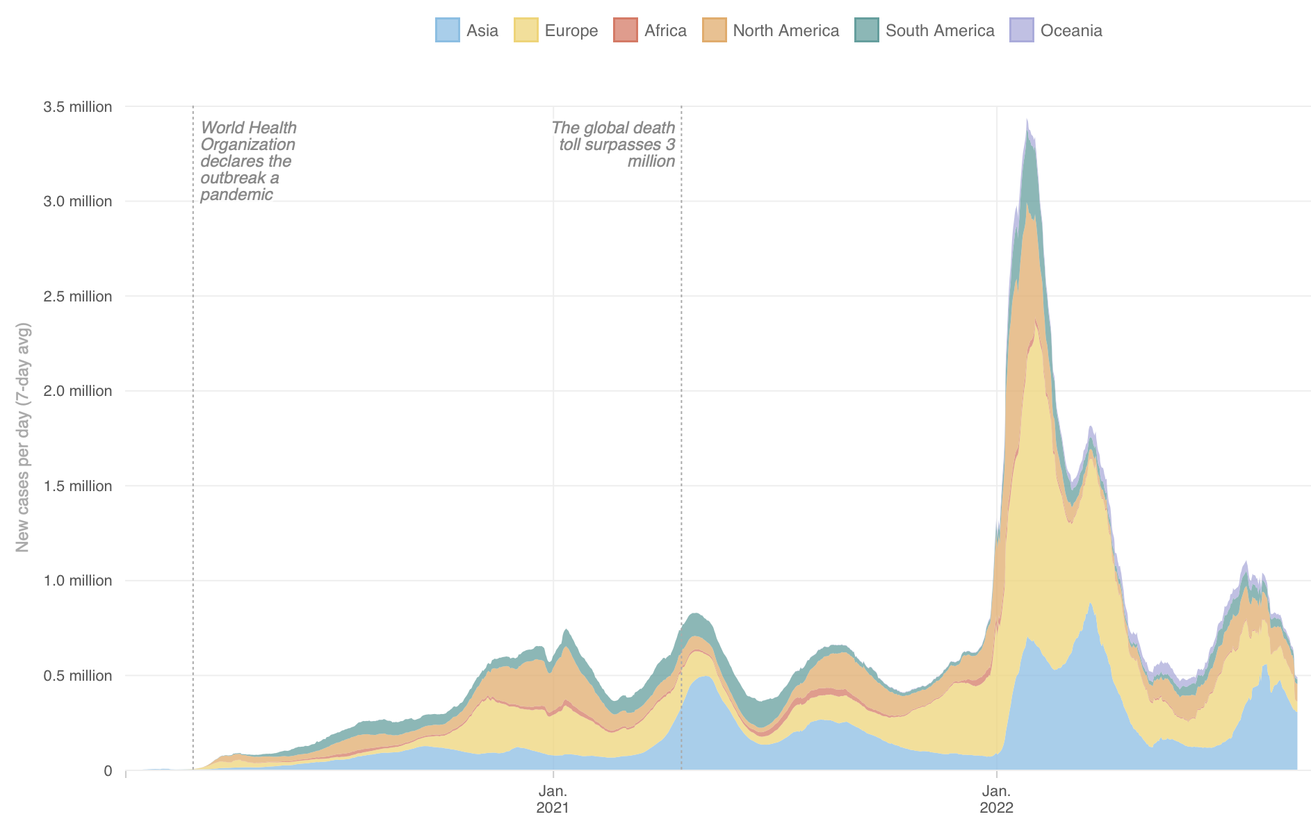
Covid-19:
New Daily Cases
Source: https://www.npr.org/sections/goatsandsoda/2020/03/30/822491838/coronavirus-world-map-tracking-the-spread-of-the-outbreak

Slide 6
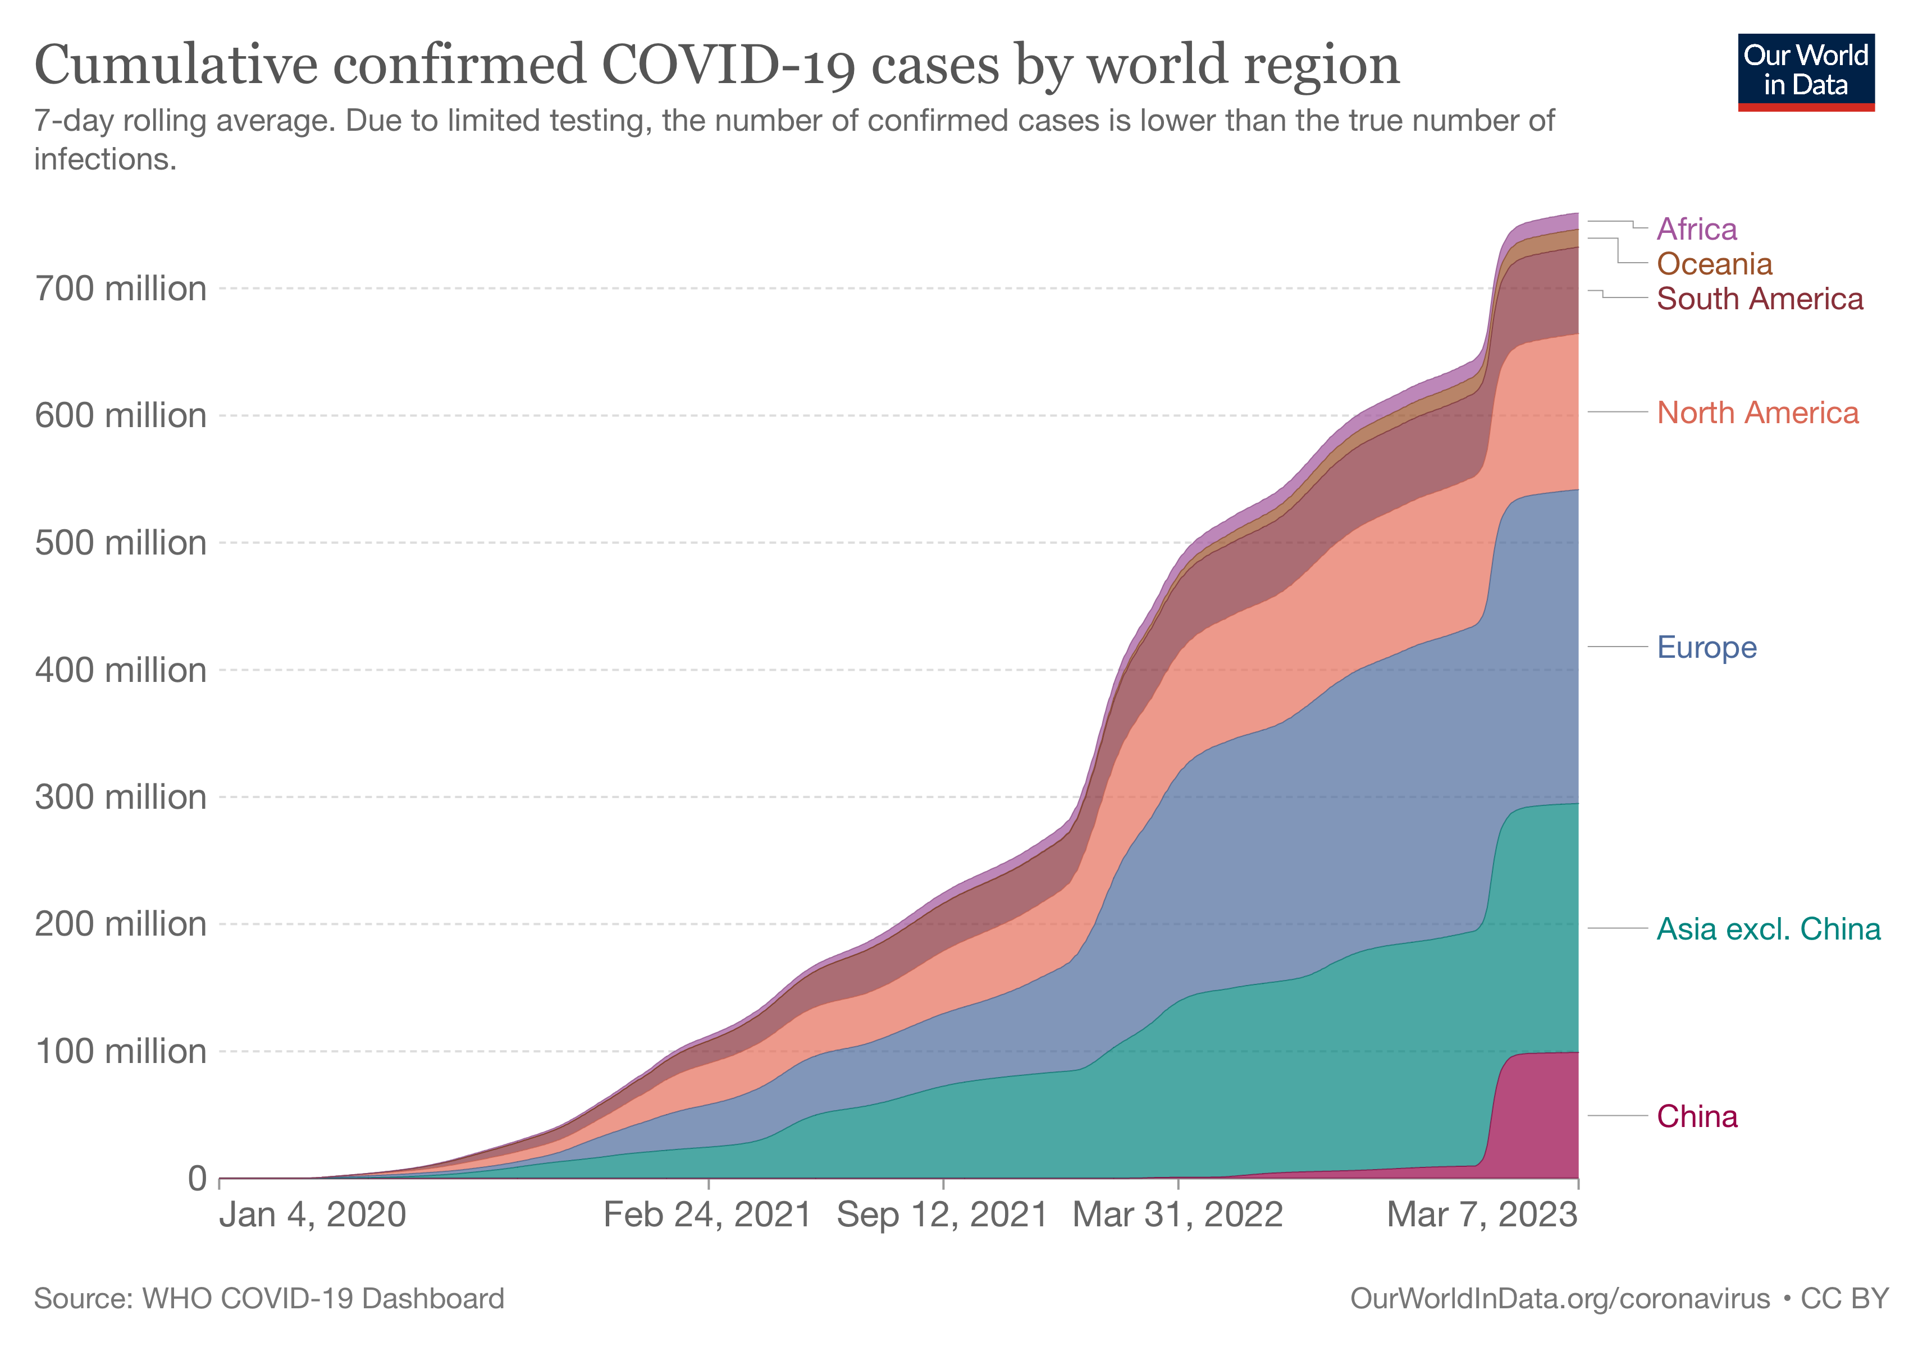

Slide 7

Number of coronavirus (COVID-19) cases worldwide as of May 2, 2023, by country or territory
Number of cases
5
Description: As of May 2, 2023, the outbreak of the coronavirus disease (COVID-19) had been confirmed in almost every country in the world. The virus had infected over 687 million people worldwide, and the number of deaths had reached almost 6.87 million. The most severely affected countries include the U.S., India, and Brazil. Read more
Note(s): Worldwide; as of May 2, 2023
Source(s): Worldometer

Slide 8
Countries with the Largest Number of Cumulative COVID cases
Over time: https://www.youtube.com/watch?v=lUvgBPa2QXk

Slide 9
B. Deaths

Slide 10
2
Coronavirus (COVID-19) cases, recoveries, and deaths worldwide as of May 2, 2023
Number of coronavirus (COVID-19) cases, recoveries, and deaths worldwide as of May 2, 2023
Note(s): Worldwide; May 2, 2023
Further information regarding this statistic can be found on page 8.
Source(s): Worldometer; ID 1087466

Slide 11
4
Mean number of excess deaths associated with the COVID-19 pandemic from all-causes worldwide in 2020 and 2021, by month
Note(s): Worldwide; 2020 and 2021
Further information regarding this statistic can be found on page 8.
Source(s): WHO; ID 1306932

Slide 12
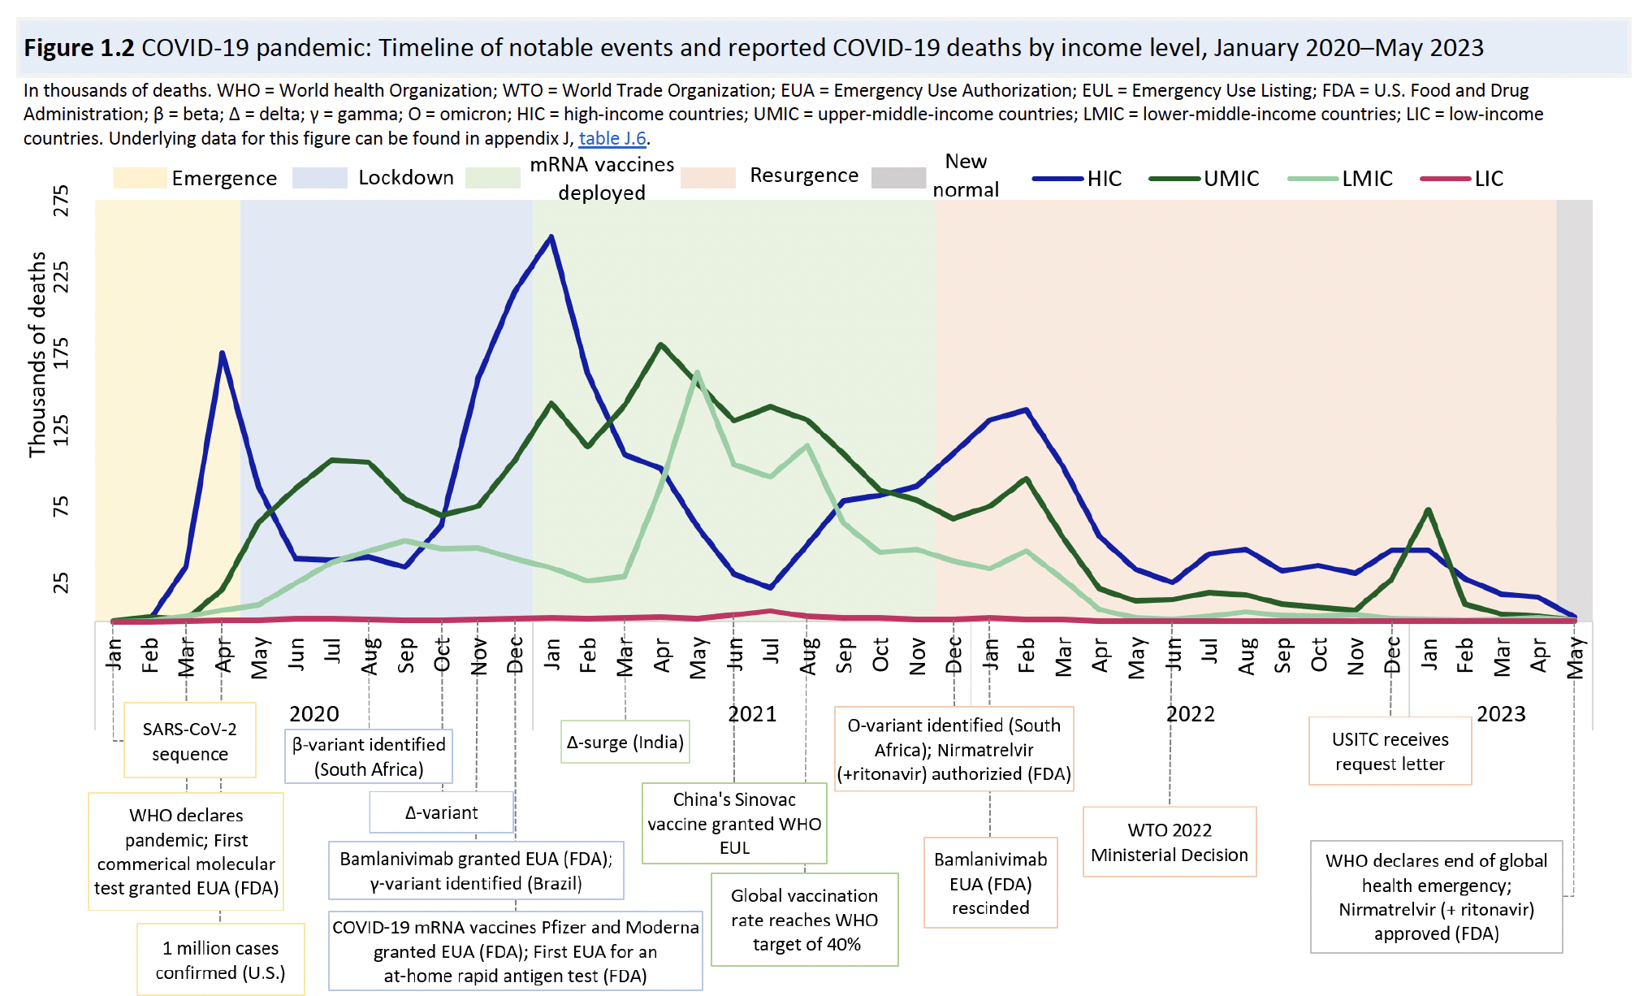
Source: United States International Trade Commission, “ COVID-19 Diagnostics and
Therapeutics: Supply, Demand, and TRIPS Agreement Flexibilities” (October 2023)

Slide 13


2
Rate of excess deaths due to COVID-19 pandemic in select countries worldwide 2020-21
Mean number of excess deaths associated with COVID-19 from all-causes in 2020 and 2021 in select countries worldwide (per 100,000 population)
Excess deaths per 100,000 population
Note(s): Worldwide; 2020 and 2021
Further information regarding this statistic can be found on page 8.
Source(s): WHO; ID 1083605

Slide 14
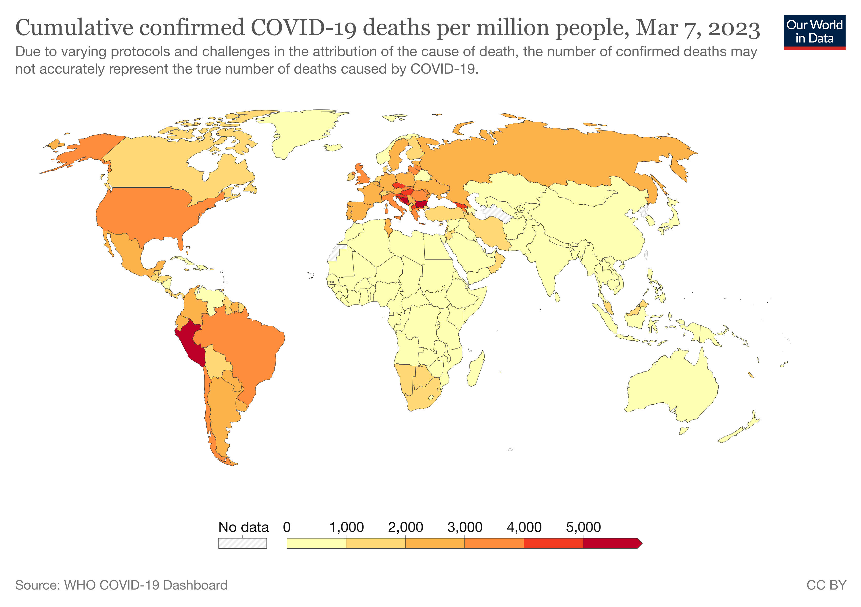

Slide 15
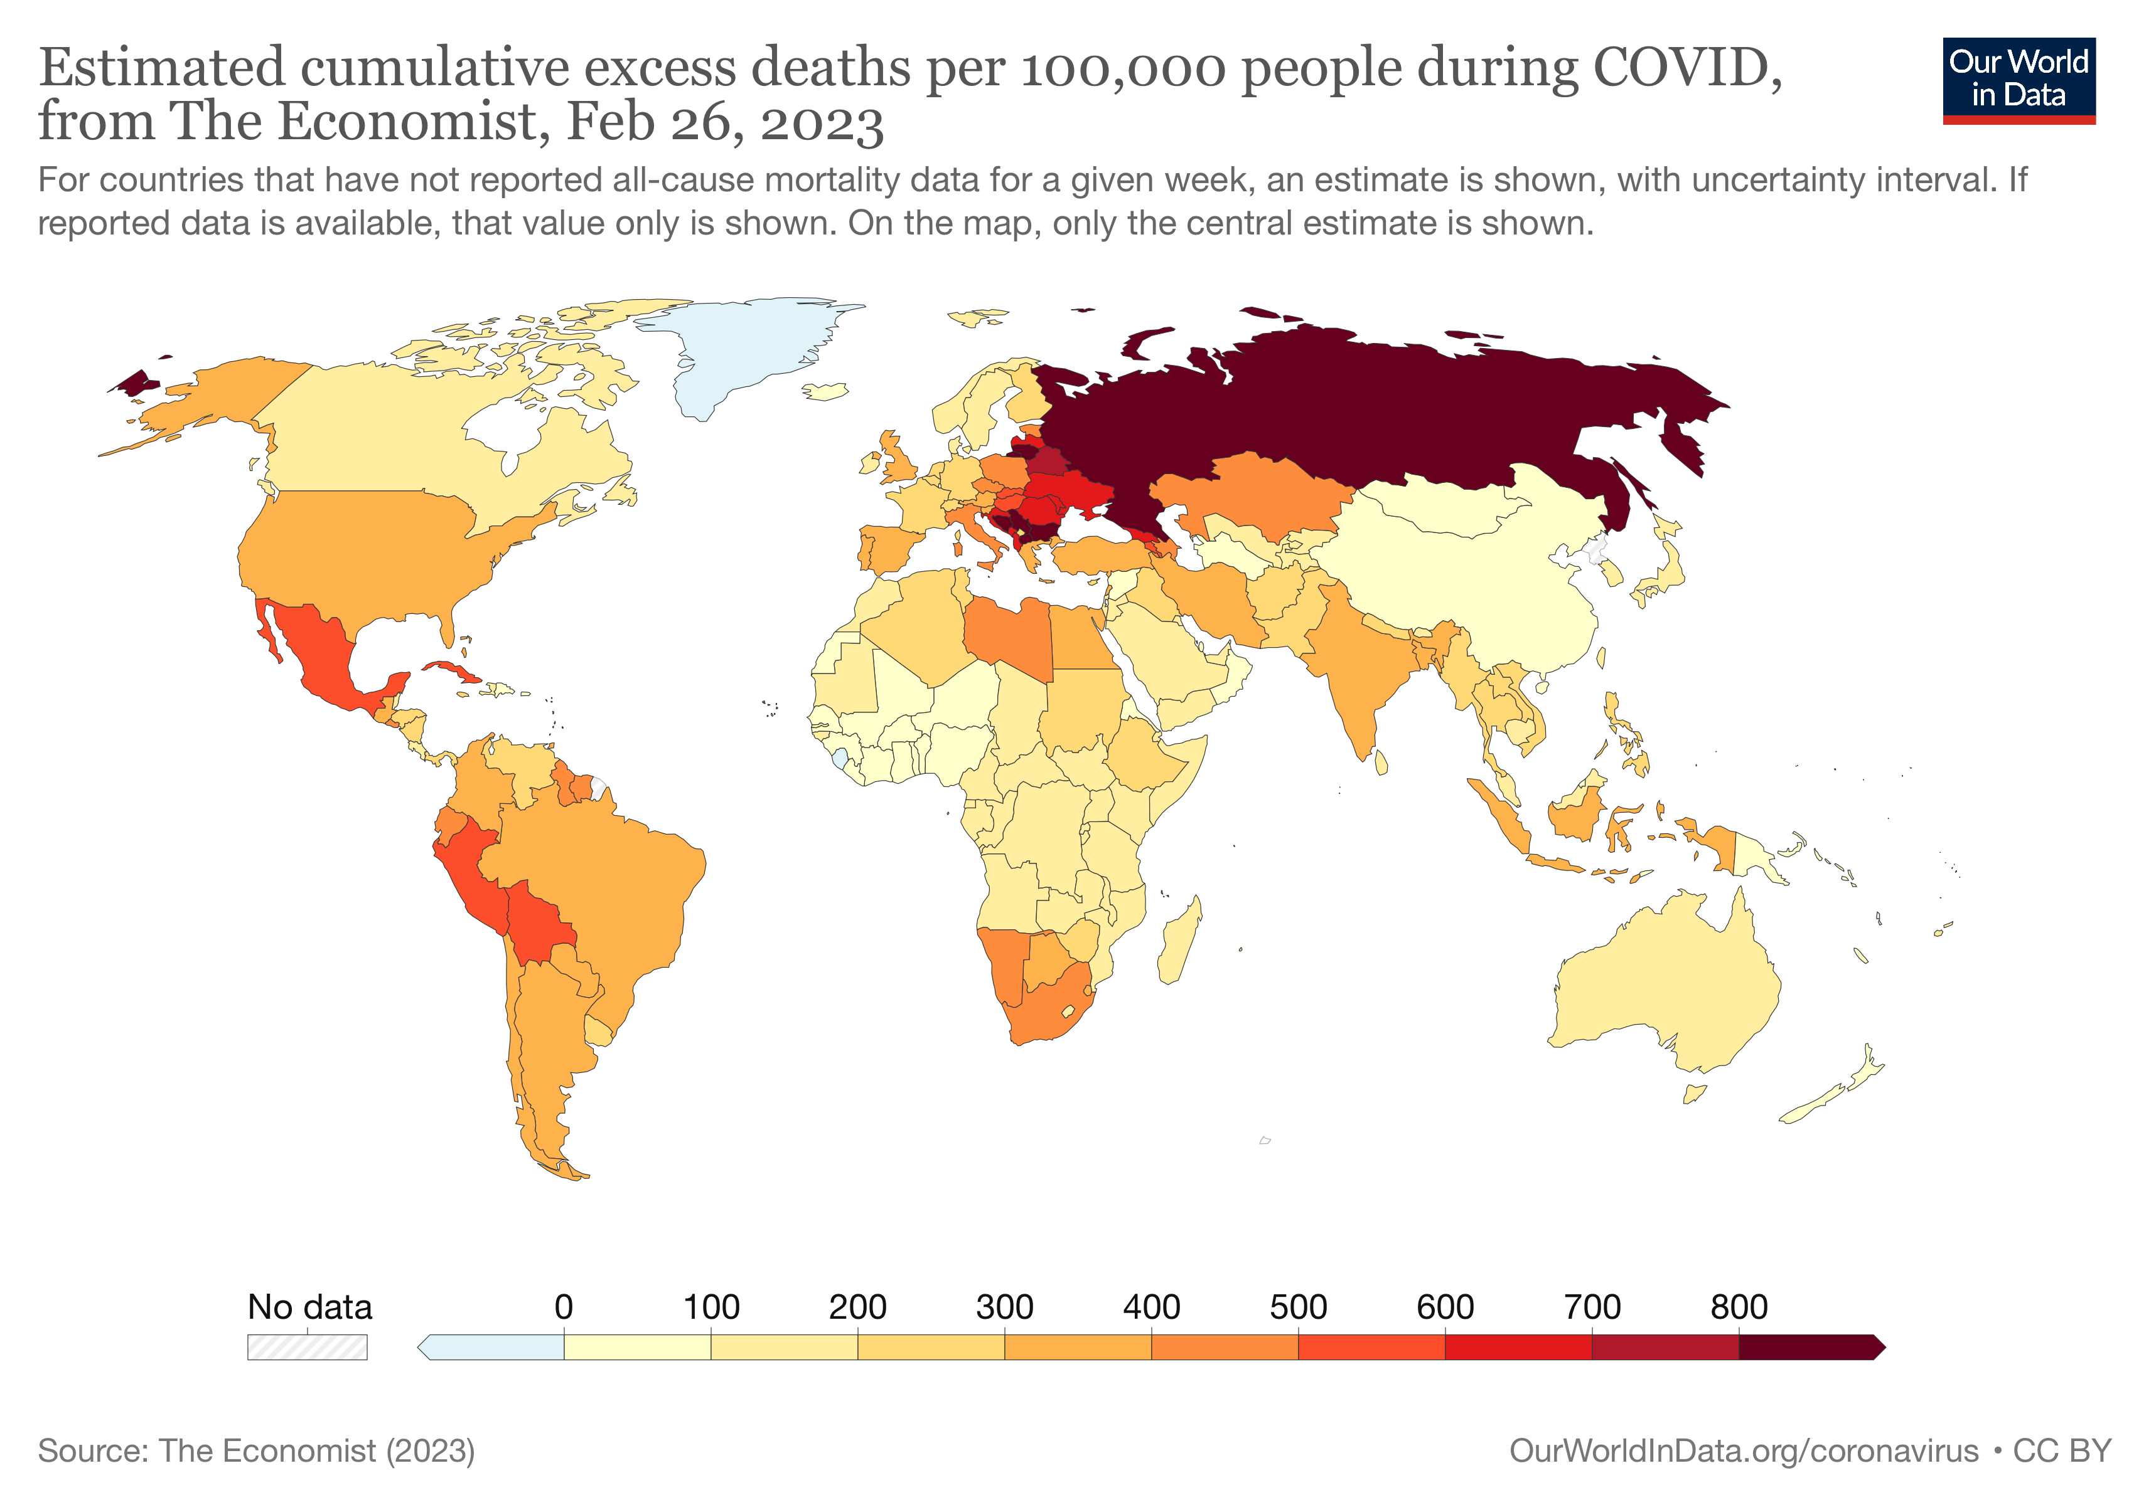

Slide 16
C. Vaccinations

Slide 17
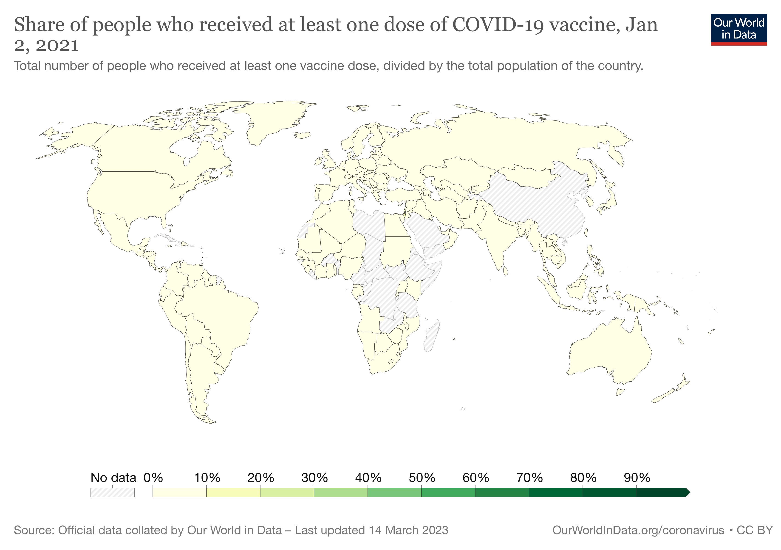

Slide 18
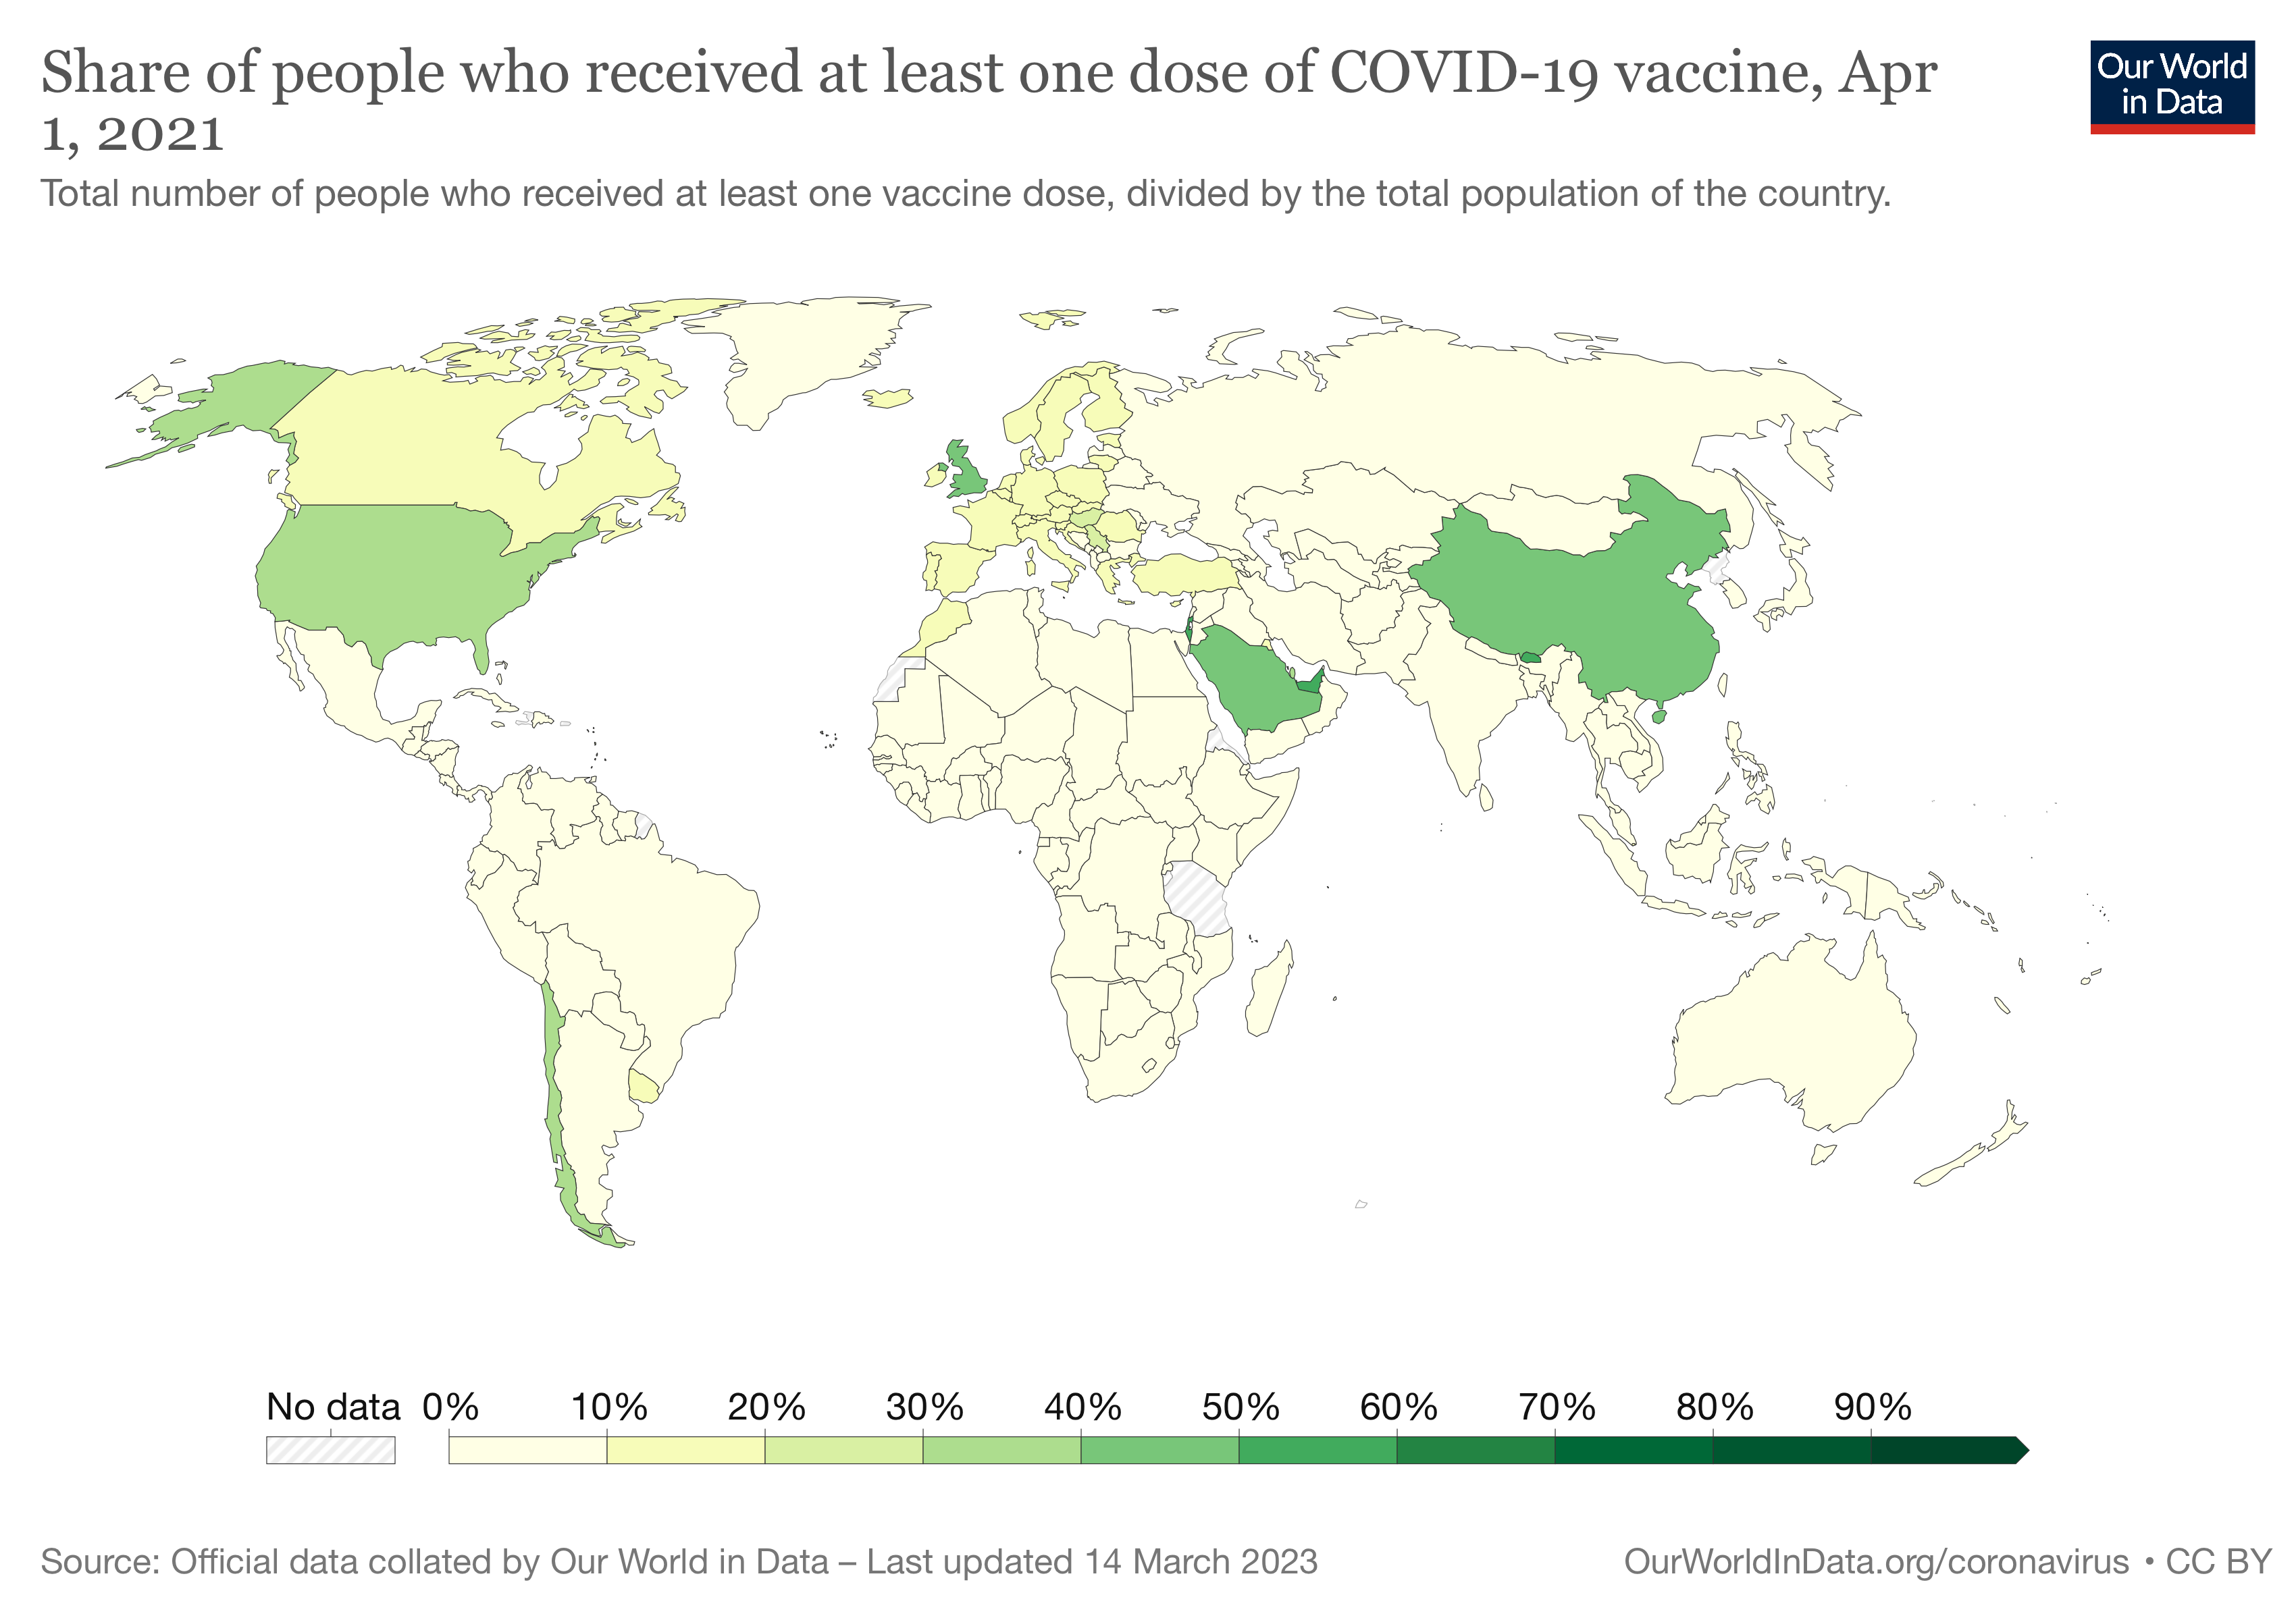

Slide 19
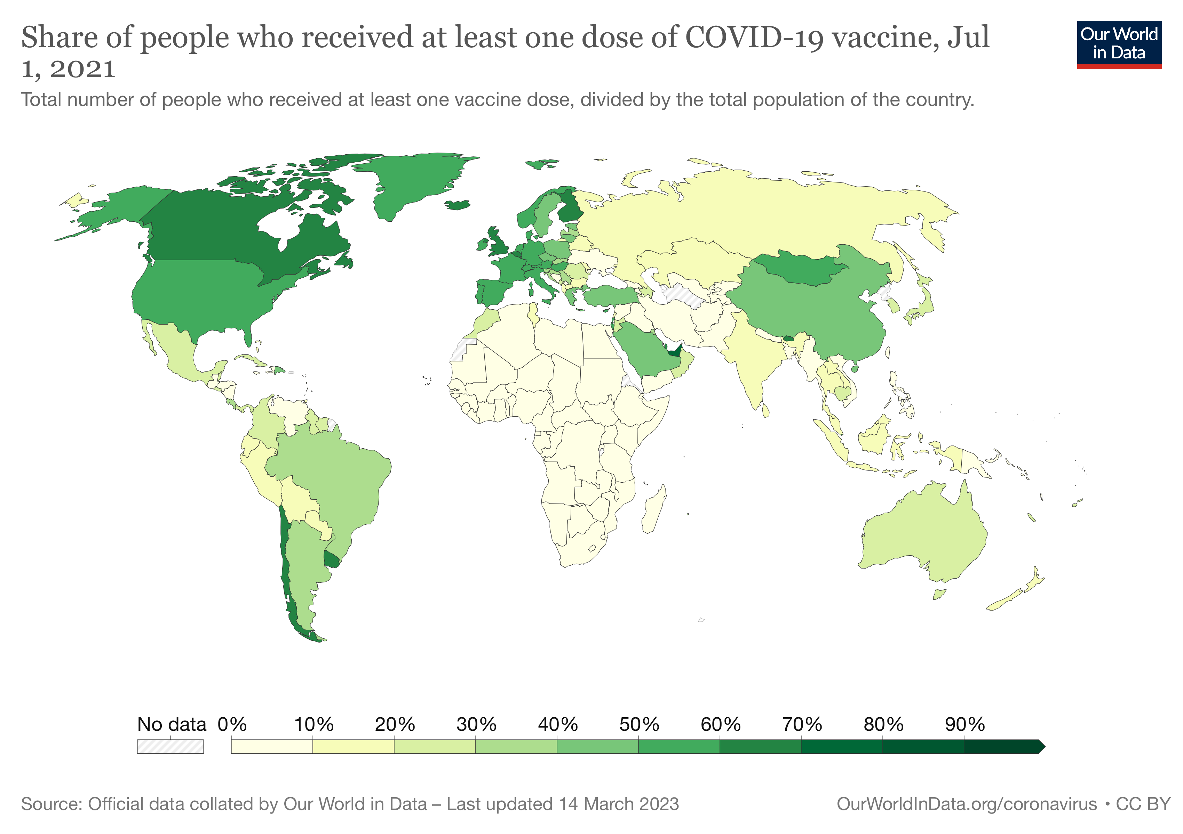

Slide 20
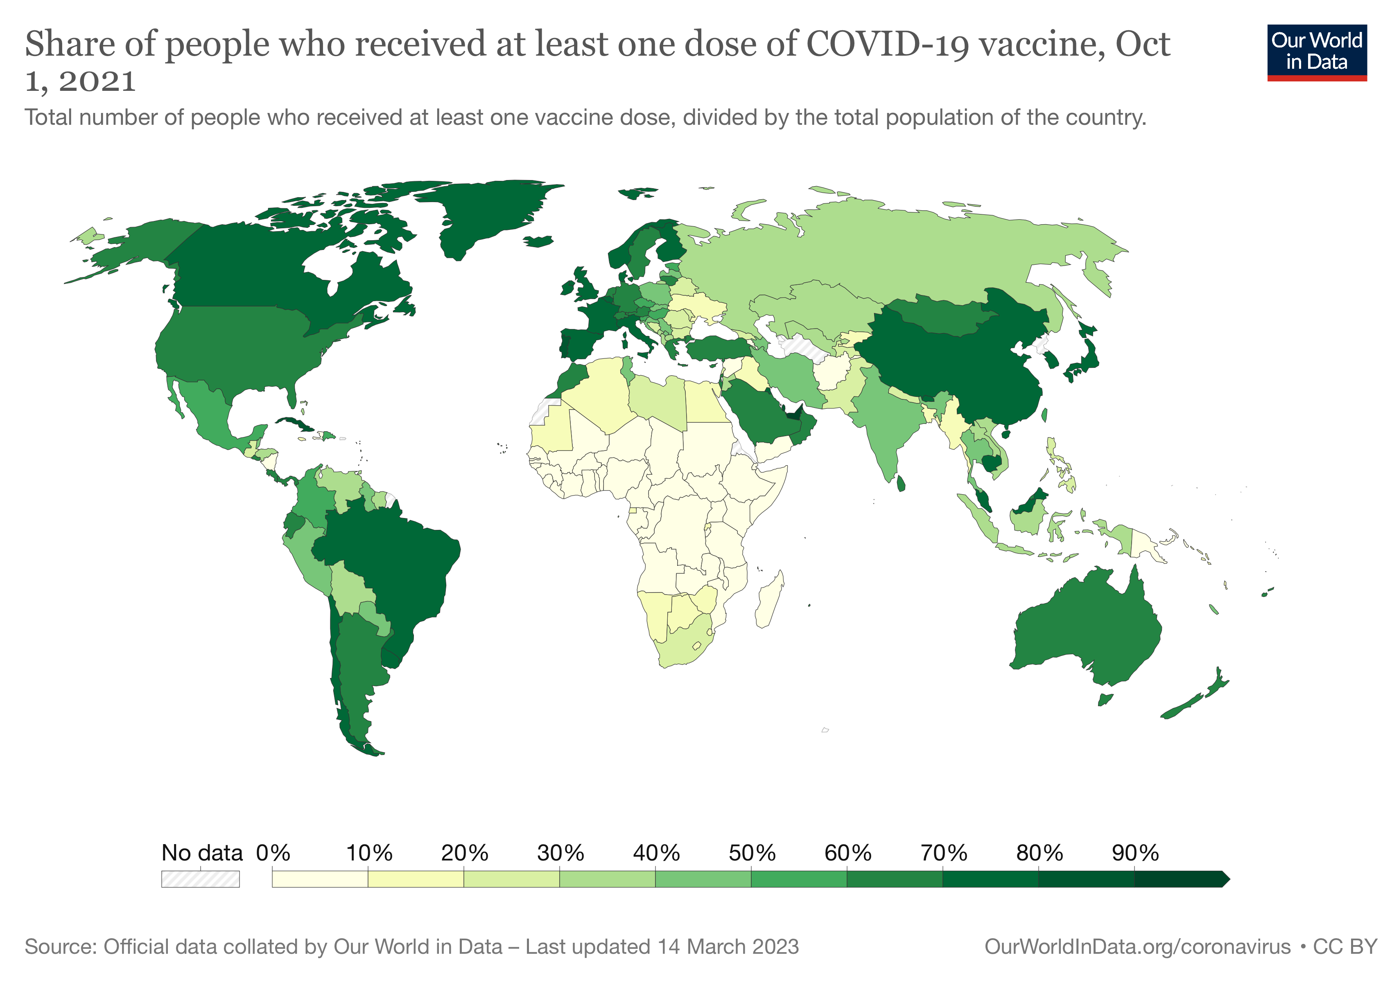

Slide 21
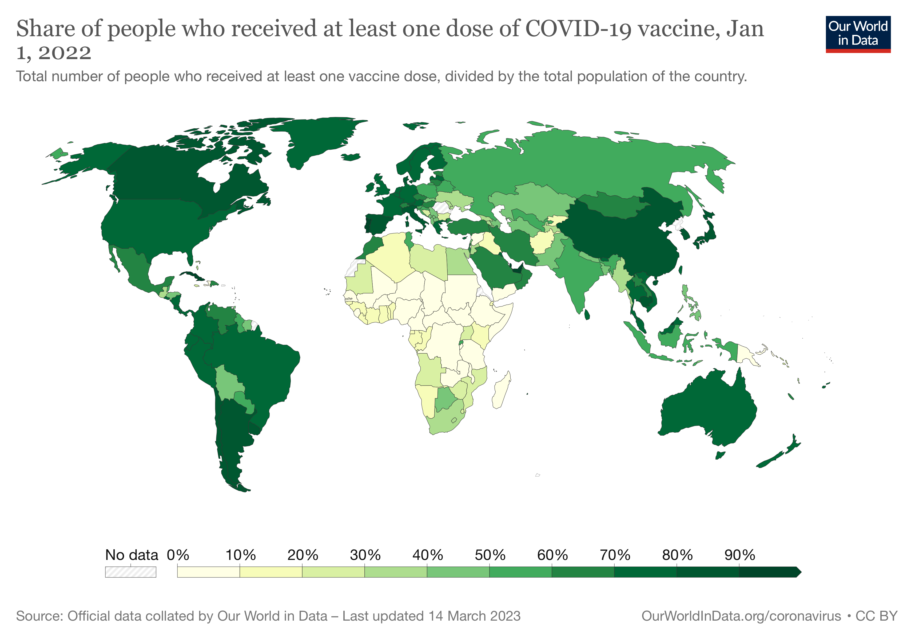

Slide 22


Slide 23
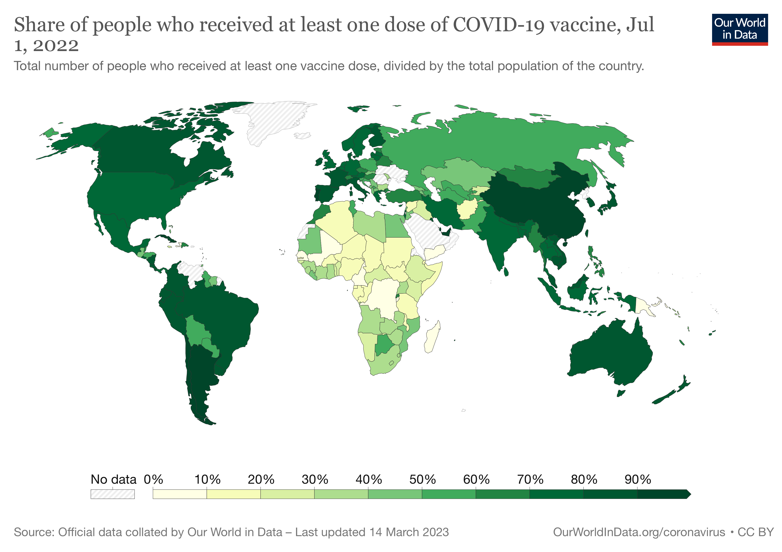

Slide 24
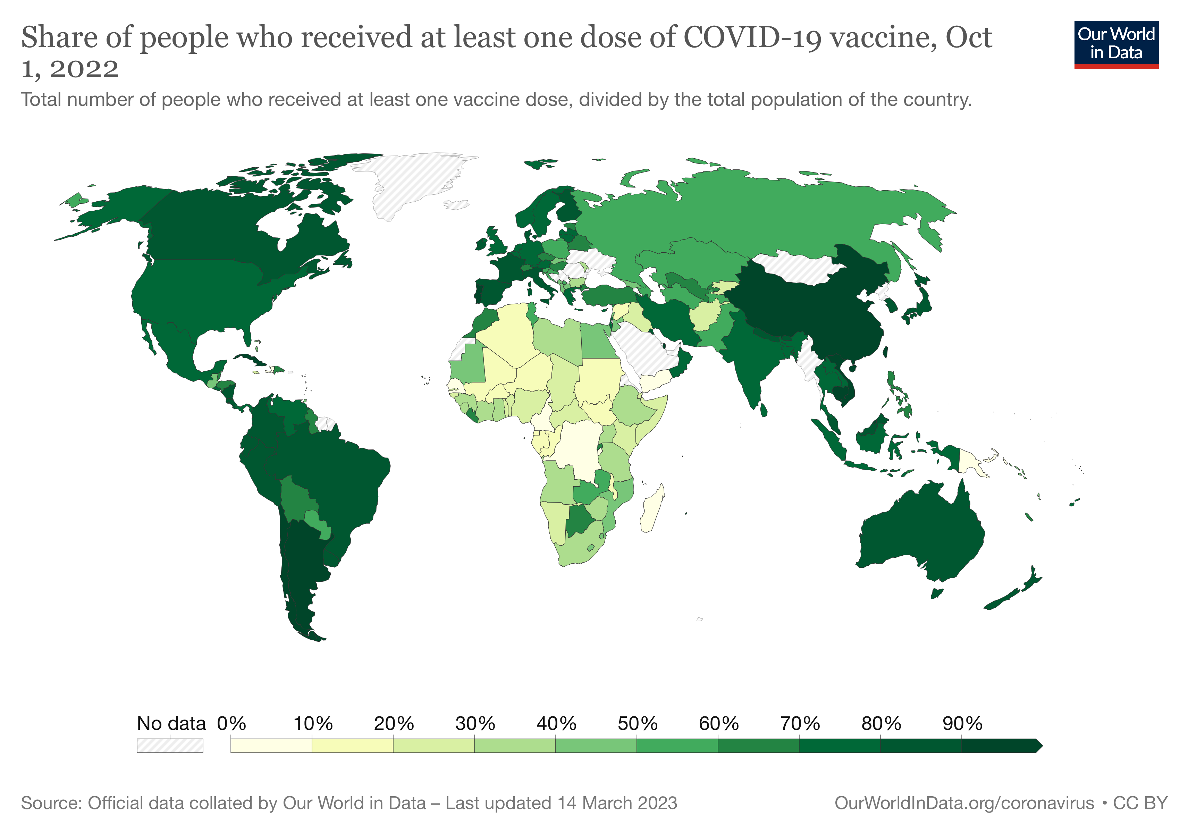

Slide 25
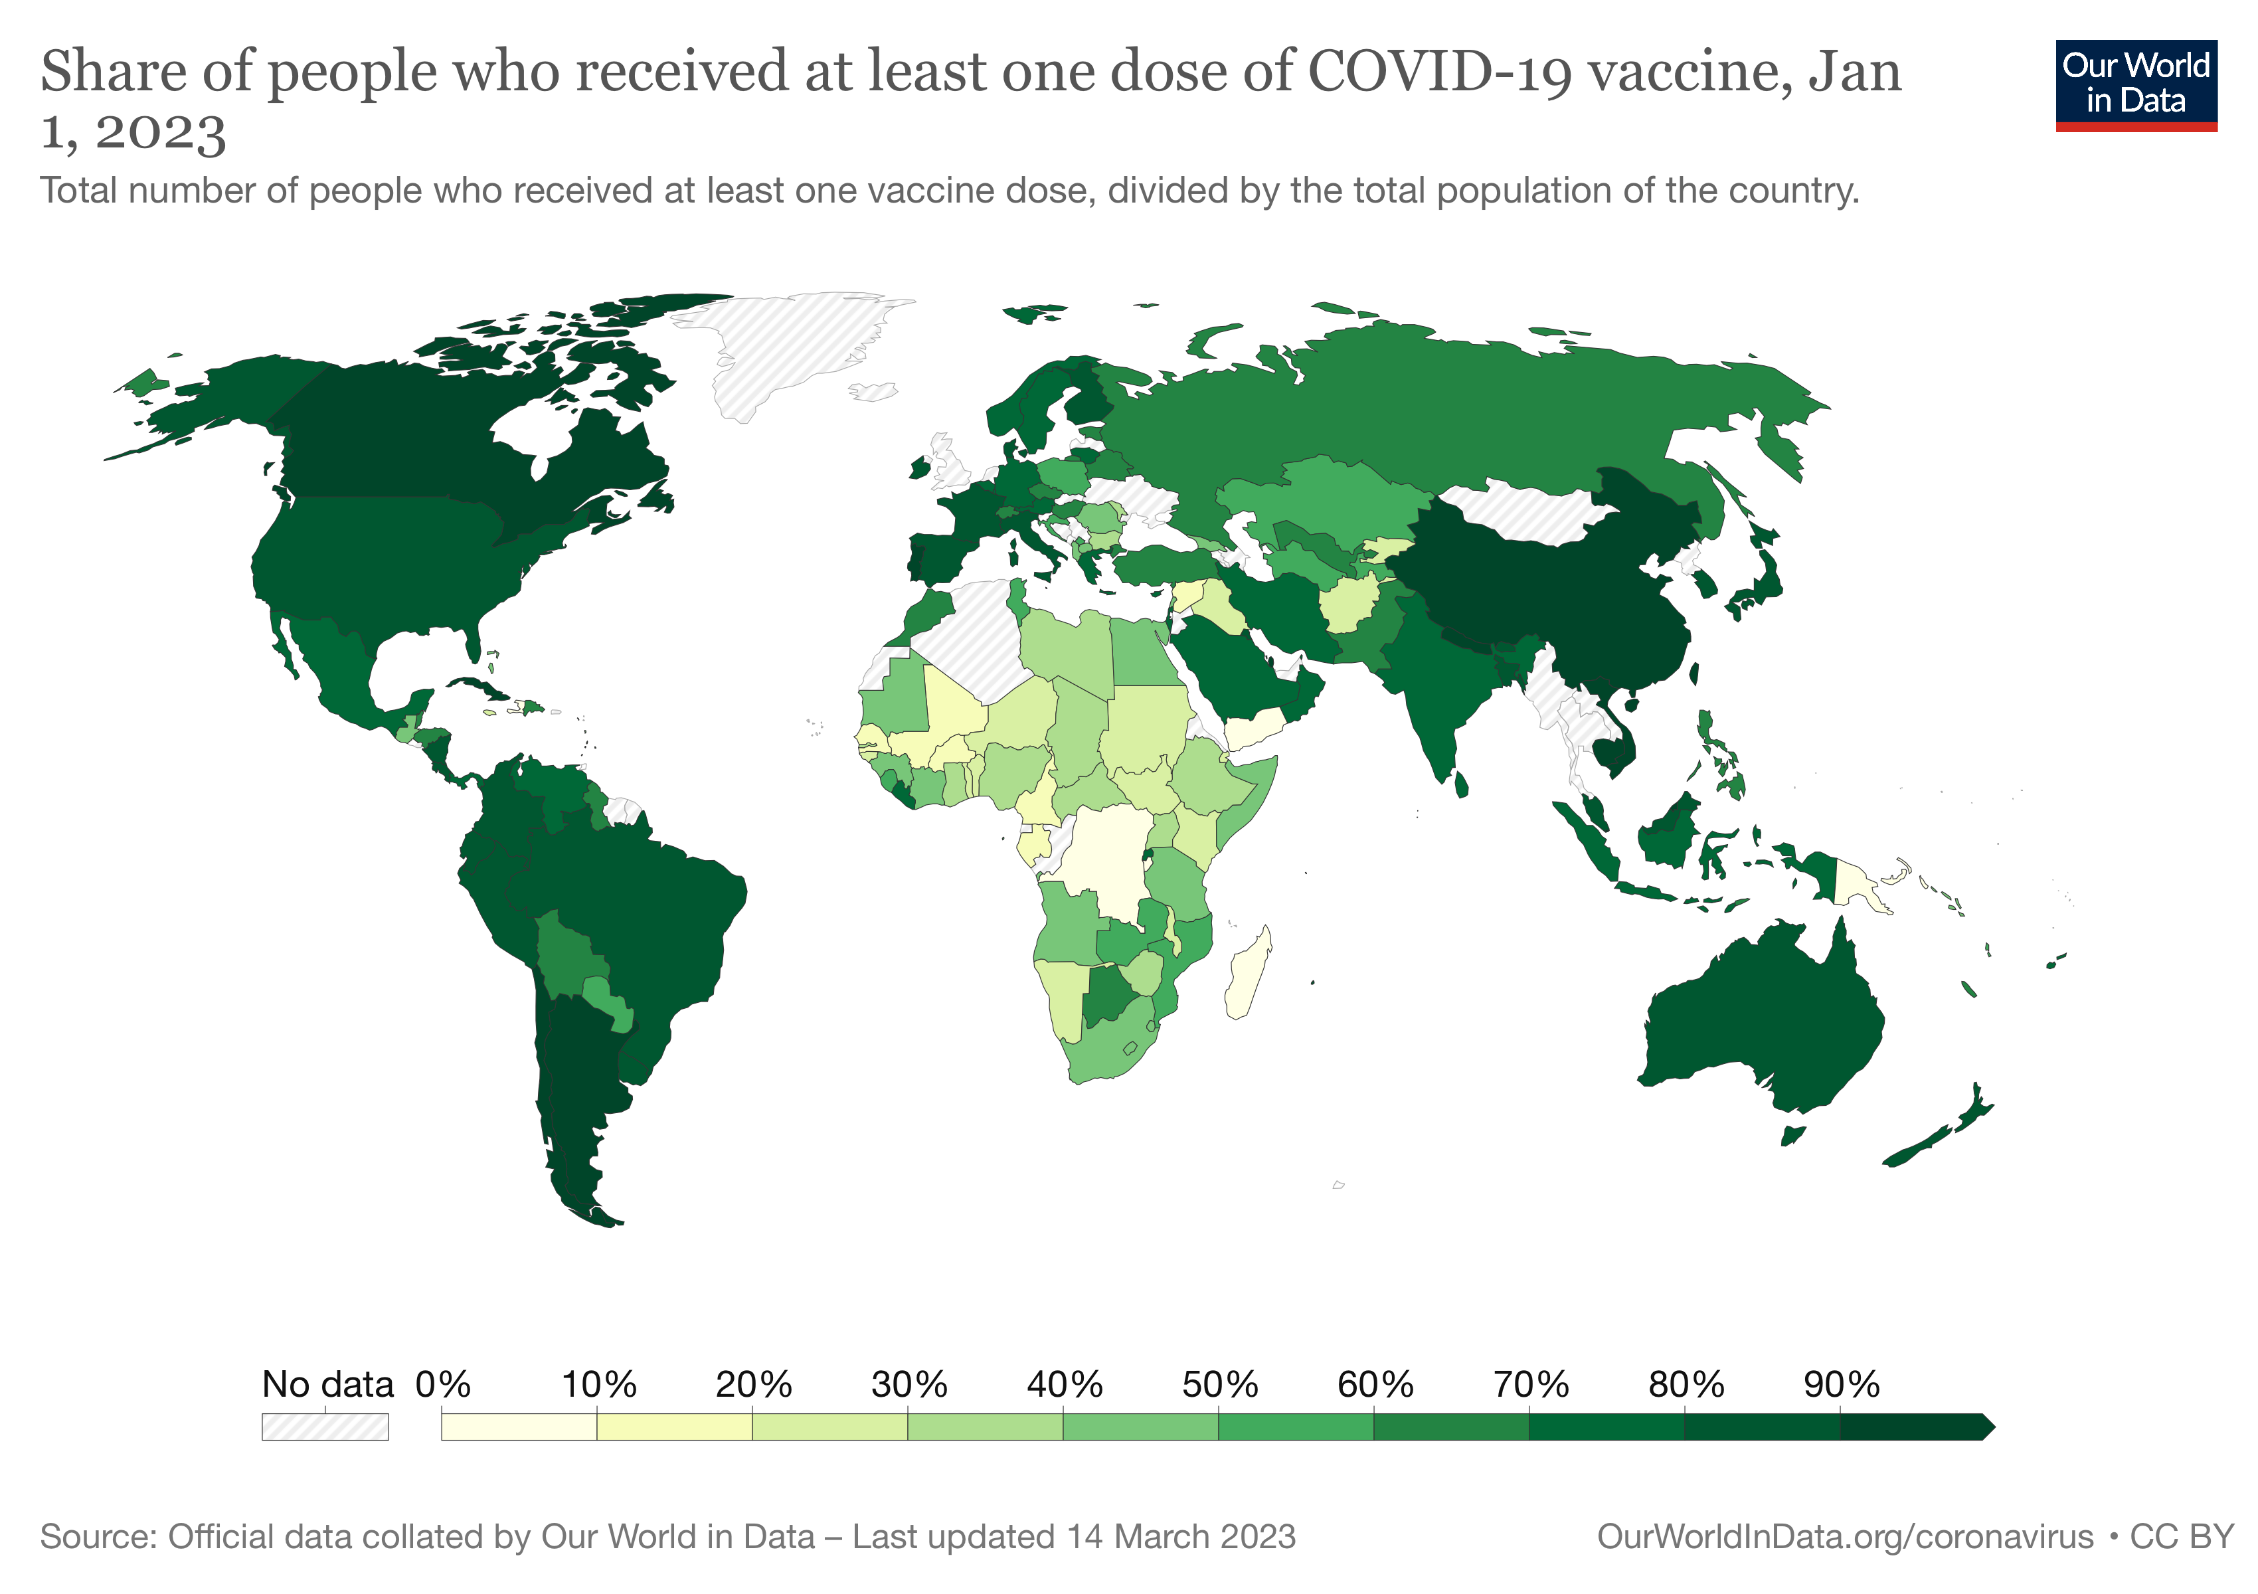

Slide 26


Slide 27
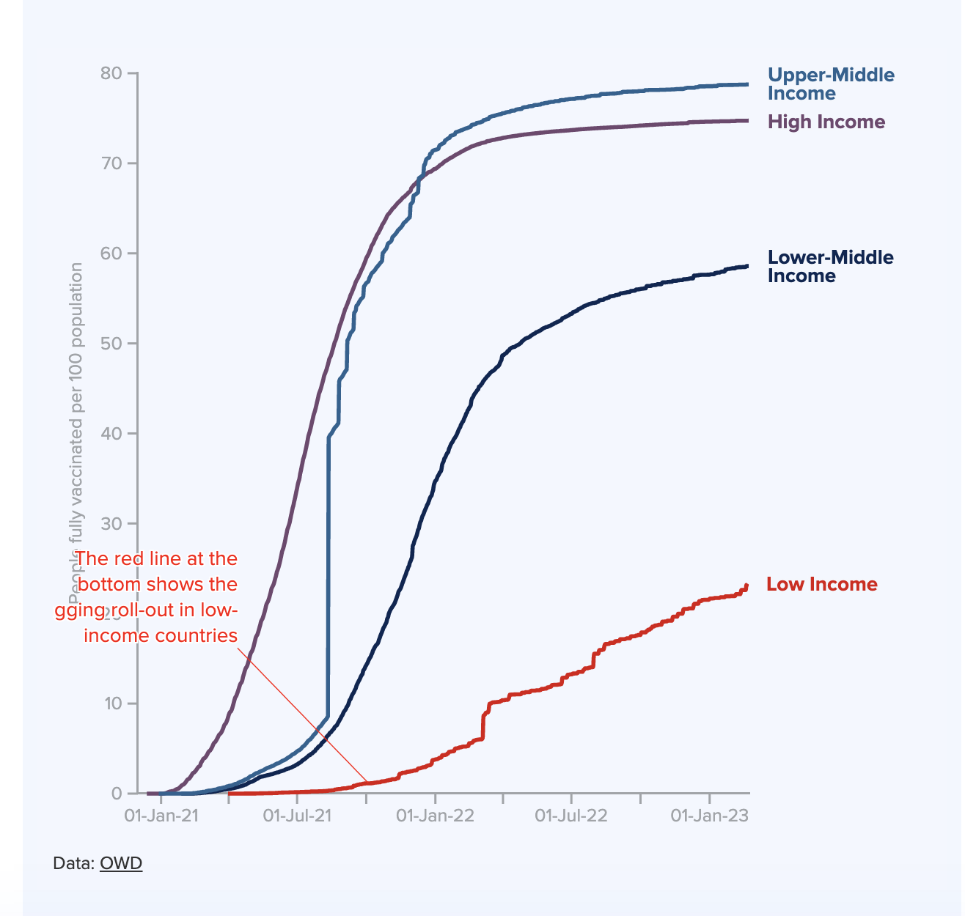
COVID-19 vaccines administered as of January 2023
Source: https://data.undp.org/vaccine-equity/

Slide 28
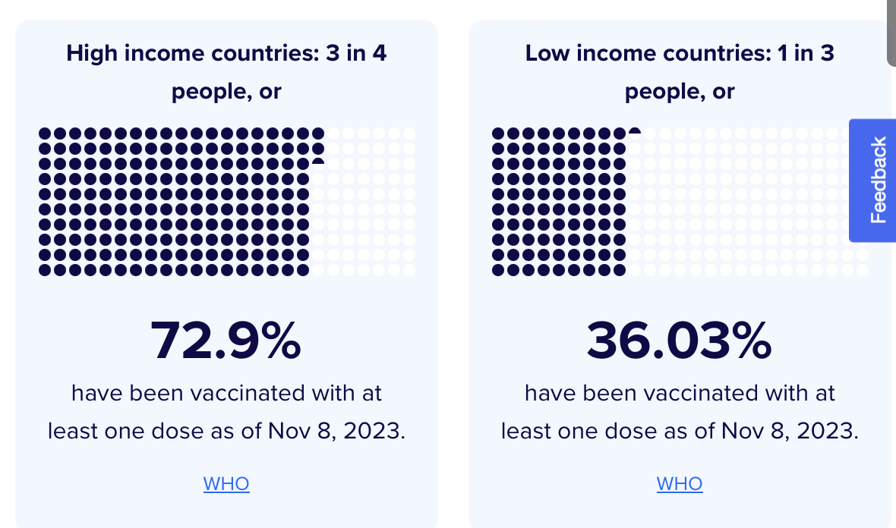
Source: https://data.undp.org/vaccine-equity/

Slide 29
D. Economic and Social Impact

Slide 30
2
Forecasted global real GDP growth 2019-2024
Global real Gross Domestic Product (GDP) growth after the coronavirus (COVID-19) from 2019 with a forecast until 2024
Note(s): Worldwide; June 2023
Further information regarding this statistic can be found on page 8.
Source(s): OECD; ID 1102889

Slide 31
Share of Gross Domestic Product (GDP) lost as a result of the coronavirus pandemic (COVID-19) in 2020, by economy
GDP loss due to COVID-19, by economy 2020
6
Description: In 2020, global gross domestic product declined by 6.7 percent as a result of the coronavirus (COVID-19) pandemic outbreak. In Latin America, overall GDP loss amounted to 8.5 percent. Read more
Note(s): Worldwide; 2020
Source(s): Centre for Economic Policy Research (UK) (VoxEU.org)

Slide 32
II. The (Apparent) Roles of Patent Law
National Level Controversies
  See, e.g., Case Study 016
Global Controversies
  Patent Law comes to be associated with vaccine nationalism and global inequity

Slide 33
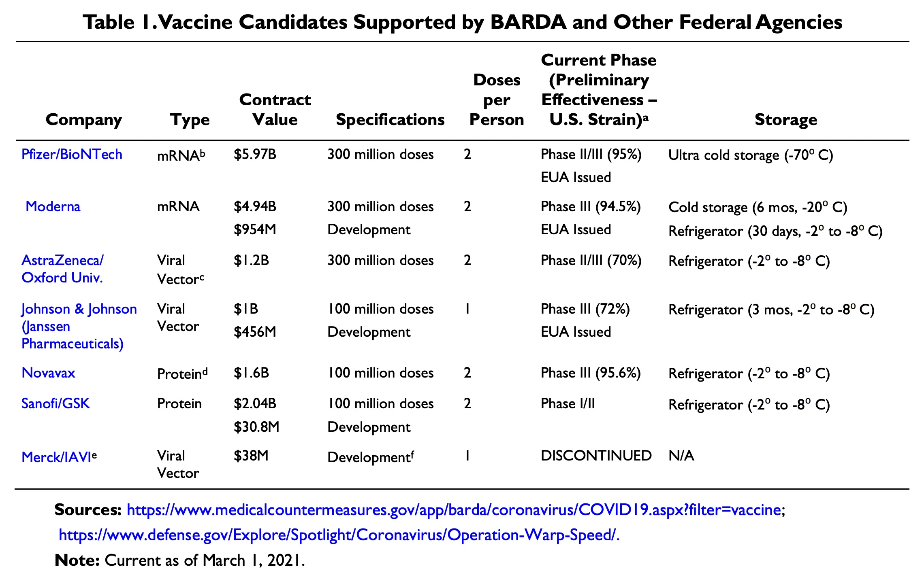
US GOVERNMENT (BARDA) FUNDING OF COVID-19 VACCINES AS OF MARCH 1 2021

Slide 34
COVID-19 vaccines administered as of January 2023
Source: https://data.undp.org/vaccine-equity/

Slide 35
III. Responses of the Global IP Institutions
WTO: COVID Waivers
WIPO
  WIPO/Harvard Course on Patent Law and Global Public Health
  WIPO Project on Conditional Grants

Slide 36
III. Responses of the Global IP Institutions
WTO: COVID Waivers
WIPO
  WIPO/Harvard Course on Patent Law and Global Public Health
  WIPO Project on Conditional Grants

Slide 37
Covid-19:
New Daily Cases
Source: https://www.npr.org/sections/goatsandsoda/2020/03/30/822491838/coronavirus-world-map-tracking-the-spread-of-the-outbreak

Slide 38
Covid-19:
New Daily Cases
India/South Africa
Proposal
Source: https://www.npr.org/sections/goatsandsoda/2020/03/30/822491838/coronavirus-world-map-tracking-the-spread-of-the-outbreak

Slide 39
South Africa, India proposal –IP/C/W/669 and IP/C/W/669/Rev.1
October 2020
Waiver from the implementation, application and enforcement of Sections 1 (minus Art 14), 4, 5, and 7 of the TRIPS Agreement in relation to prevention, containment or treatment of COVID-19.
Waiver should continue until widespread vaccination is in place globally, and the majority of the world's population has developed immunity.
This waiver shall be reviewed by the General Council not later than one year after it is granted, and thereafter annually until the waiver terminates.
Without prejudice to LDC extension; non-violation does not apply
May 2021
Waiver from the implementation, application and enforcement of Sections 1 (minus Article 14), 4, 5 and 7 of the TRIPS Agreement in relation to health products and technologies including diagnostics, therapeutics, vaccines, medical devices, personal protective equipment, their materials or components, and their methods and means of manufacture for the prevention, treatment or containment of COVID-19
This waiver shall be in force for at least 3 years from the date of this decision; the General Council shall determine the date of termination of the waiver after review.
This waiver shall be reviewed by the General Council not later than one year after it is granted, and thereafter annually until the waiver terminates.
Without prejudice to LDC extension; non-violation does not apply

Slide 40
Covid-19:
New Daily Cases
India/South Africa
Proposal
Source: https://www.npr.org/sections/goatsandsoda/2020/03/30/822491838/coronavirus-world-map-tracking-the-spread-of-the-outbreak

Slide 41
Covid-19:
New Daily Cases
India/South Africa
Revised Proposal
India/South Africa
Proposal
Source: https://www.npr.org/sections/goatsandsoda/2020/03/30/822491838/coronavirus-world-map-tracking-the-spread-of-the-outbreak

Slide 42
South Africa, India proposal –IP/C/W/669 and IP/C/W/669/Rev.1
October 2020
Waiver from the implementation, application and enforcement of Sections 1 (minus Art 14), 4, 5, and 7 of the TRIPS Agreement in relation to prevention, containment or treatment of COVID-19.
Waiver should continue until widespread vaccination is in place globally, and the majority of the world's population has developed immunity.
This waiver shall be reviewed by the General Council not later than one year after it is granted, and thereafter annually until the waiver terminates.
Without prejudice to LDC extension; non-violation does not apply
May 2021
Waiver from the implementation, application and enforcement of Sections 1 (minus Article 14), 4, 5 and 7 of the TRIPS Agreement in relation to health products and technologies including diagnostics, therapeutics, vaccines, medical devices, personal protective equipment, their materials or components, and their methods and means of manufacture for the prevention, treatment or containment of COVID-19
This waiver shall be in force for at least 3 years from the date of this decision; the General Council shall determine the date of termination of the waiver after review.
This waiver shall be reviewed by the General Council not later than one year after it is granted, and thereafter annually until the waiver terminates.
Without prejudice to LDC extension; non-violation does not apply

Slide 43
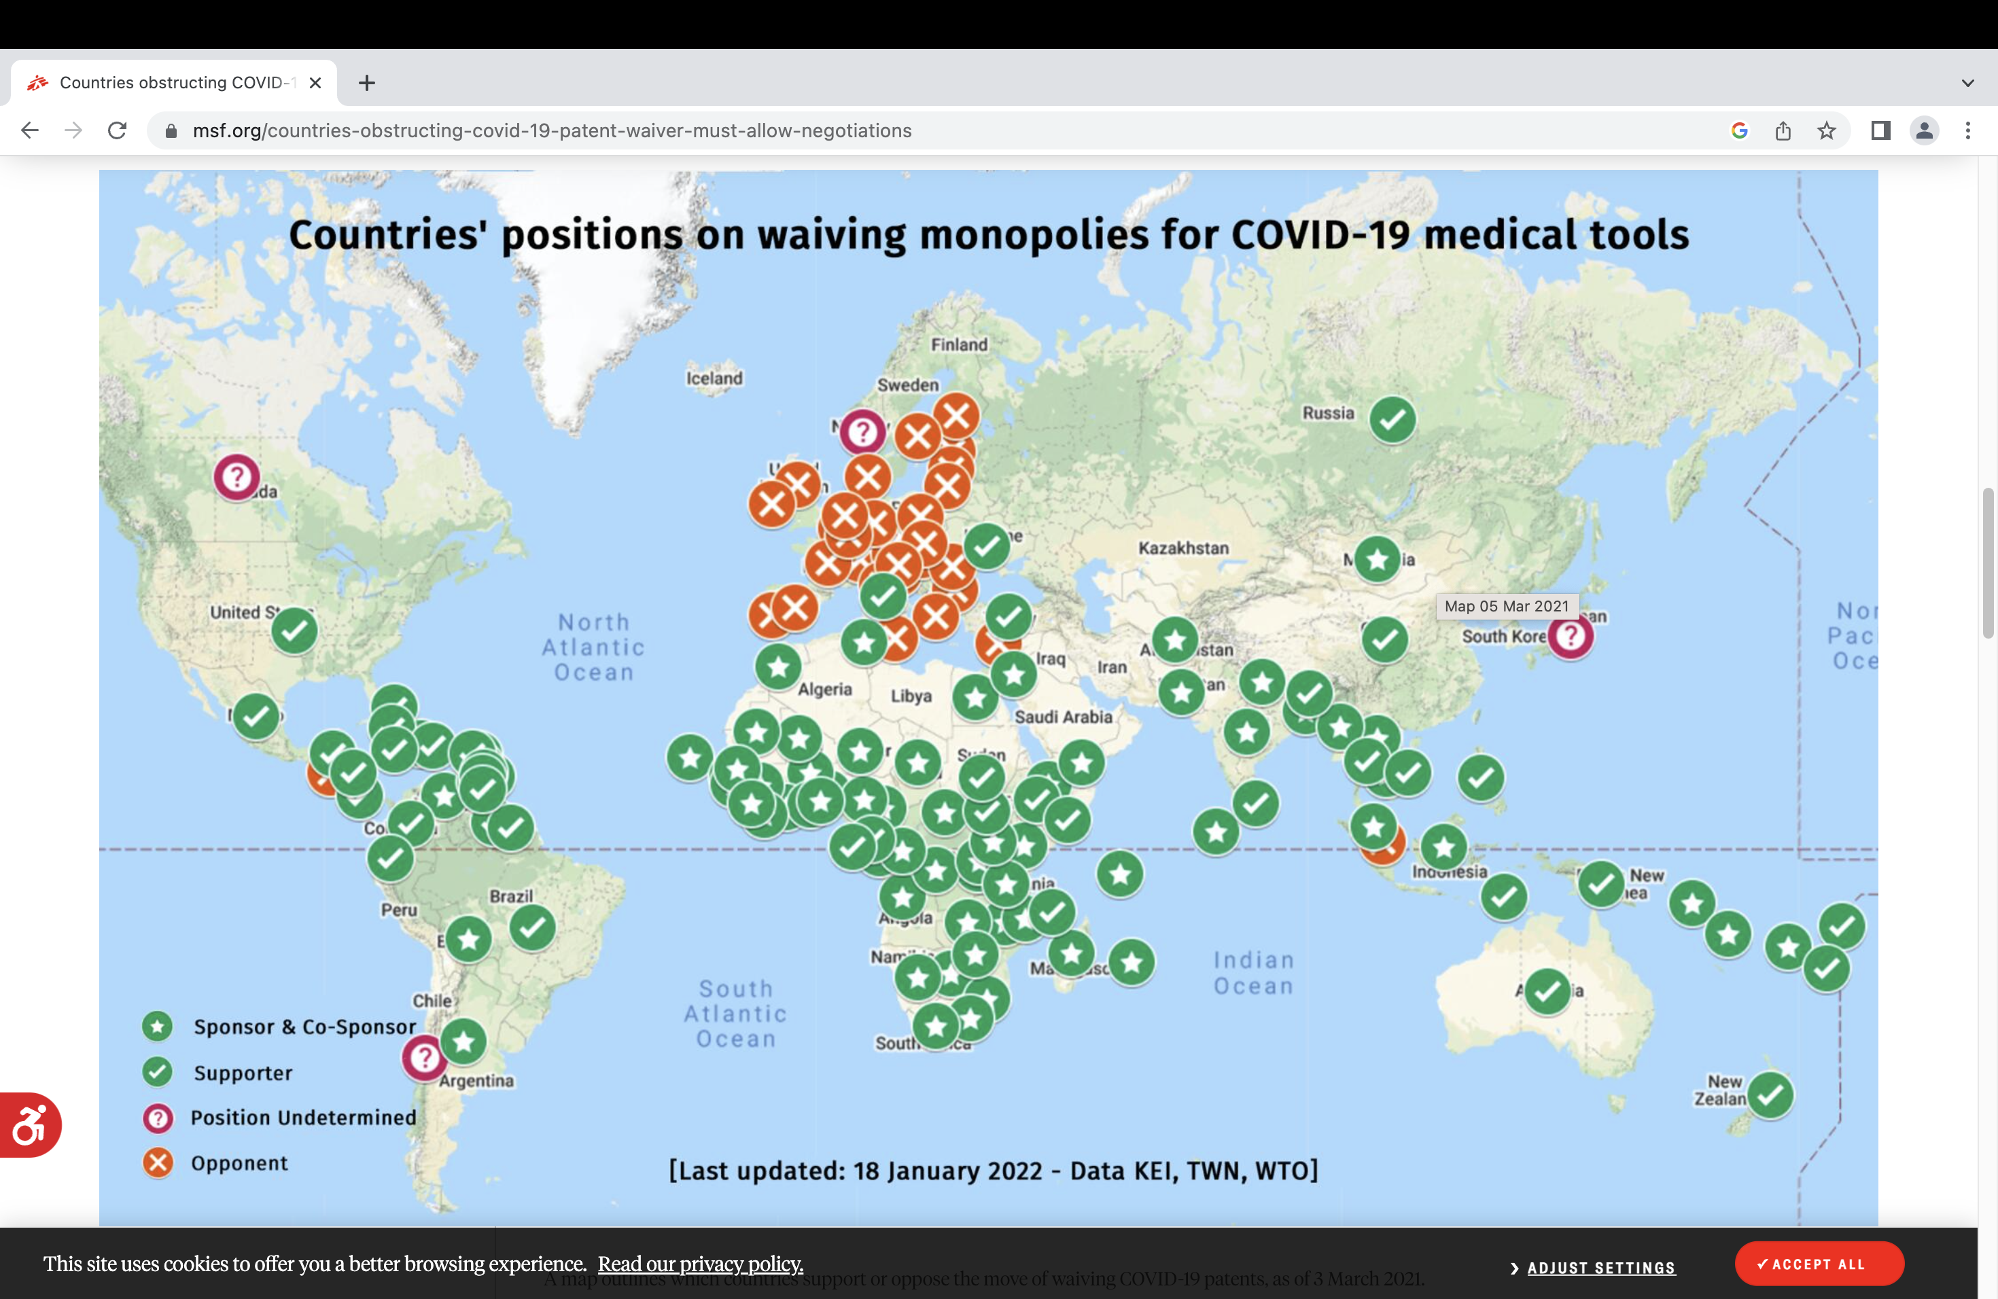

Slide 44
Covid-19:
New Daily Cases
India/South Africa
Revised Proposal
India/South Africa
Proposal
Source: https://www.npr.org/sections/goatsandsoda/2020/03/30/822491838/coronavirus-world-map-tracking-the-spread-of-the-outbreak

Slide 45
Covid-19:
New Daily Cases
EU Proposal
India/South Africa
Revised Proposal
India/South Africa
Proposal
Source: https://www.npr.org/sections/goatsandsoda/2020/03/30/822491838/coronavirus-world-map-tracking-the-spread-of-the-outbreak

Slide 46
DRAFT DECLARATION ON THE TRIPS AGREEMENT AND PUBLIC HEALTH IN THE CIRCUMSTANCES OF A PANDEMIC –EU PROPOSAL (IP/C/W/681 of 18 June 2021)
a. A pandemic is 'a national emergency or other circumstances of extreme urgency’ under Article 31(b).
  A Member may waive the requirement of making efforts to obtain authorization from the right holder.
b. Members may provide, that the remuneration for a CL reflects the price charged by the manufacturer (Article 31 (h))
c. The exporting Member may use a single notification to list of all countries to which vaccines and medicines are to be supplied (Article 31bis).

Slide 47
Covid-19:
New Daily Cases
EU Proposal
India/South Africa
Revised Proposal
India/South Africa
Proposal
Source: https://www.npr.org/sections/goatsandsoda/2020/03/30/822491838/coronavirus-world-map-tracking-the-spread-of-the-outbreak

Slide 48
Covid-19:
New Daily Cases
EU Proposal
MC12 Decision
India/South Africa
Revised Proposal
India/South Africa
Proposal
Source: https://www.npr.org/sections/goatsandsoda/2020/03/30/822491838/coronavirus-world-map-tracking-the-spread-of-the-outbreak

Slide 49
TRIPS MC12 Decision in brief - WT/MIN(22)/30
Authorises the use by eligible Members of the subject matter of a patent (including ingredients and processes) required for the production and supply of COVID-19 vaccines without the consent of the right holder to the extent necessary to address the COVID-19 pandemic, in accordance with the provisions of Article 31 of the Agreement, as clarified and waived in the Decision.
Eligible Members are developing country Members. In the WTO countries are categorized as developing/developed based on a self-declaration by the country concerned. Footnote 1 of the Decision encourages developing countries with existing capacity to make COVID-19 vaccines not to use the Decision, and takes China’s statement on record to be a binding commitment not to do so.
An eligible Member need not require the proposed user of the subject matter of a patent to make efforts to obtain an authorization from the right holder as set out in Article 31(b) [Please note this is not a waiver of the provision]
An eligible Member may waive the requirement of Article 31(f) that authorized use under Article 31 be predominantly to supply its domestic market and may allow any proportion of the products manufactured under the authorization in accordance with this Decision to be exported to eligible Members.
An eligible Member may apply the provisions of this Decision until 5 years from the date of this Decision.
This Decision is without prejudice to the flexibilities that Members have under the TRIPS Agreement

Slide 50
TRIPS MC12 DECISION COMPARED TO PRE-EXISTING OPTIONS
WT/MIN(22)/30 VS. Article 31(f) and Article 31bis
(Please read blog at: https://www.ejiltalk.org/analysis-of-the-12th-wto-ministerial-conference-decision-on-the-trips-agreement/ )
LIKELY FAVOURABLE/NEUTRAL PROVISIONS | LIKELY DISADVANTAGEOUS PROVISIONS
Alternative instruments to grant use without authorization | Use limited to developing country Members
No requirement of prior authorisation of right owner | Stricter obligation on re-exportation
No need for importing Members to notify eligibility not assessment of manufacturing capcity | No double remuneration exemption
No distinctive marking for exported COVID-19 vaccines | New confusing standard for remuneration
 | No special waiver for Regional Trade Agreements with majority LDC membership
 | Limited duration of decision

Slide 51
Extension to
Diagnostics and Therapeutics?

Slide 52
EXTENSION TO DIAGNOSTICS, THERAPEUTICS
8. No later than six months from the date of this Decision, Members will decide on its extension to cover the production and supply of COVID-19 diagnostics and therapeutics.
Is it a yes/no decision or a new decision with different terms and conditions?
    Most likely US and other developed countries didn’t want to cover D and T/ others did
    USTR has commissioned the U.S. International Trade Commission (USITC) in December 2022 to prepare a report; the USITC has launched a factfinding investigation, COVID-19 Diagnostics and Therapeutics: Supply, Demand, and TRIPS Agreement Flexibilities (Inv. No. 332-596)
    USITC report will be presented to the TRIPS Council early 2024 – unlikely that there will be any progress until then.

Slide 53
The Debate over the Extension

Slide 54
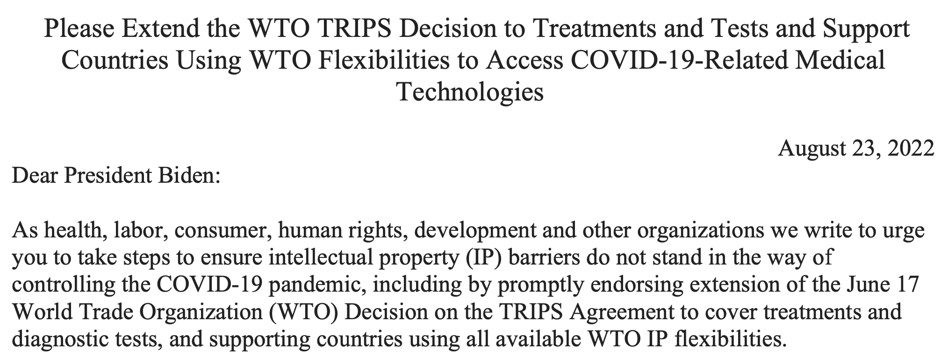
Perspective of US NGOs on Diagnostics and Therapeutics (August 2022)
Source: https://rethinktrade.org/wp-content/uploads/2022/08/TreatmentsLetter2.pdf

Slide 55
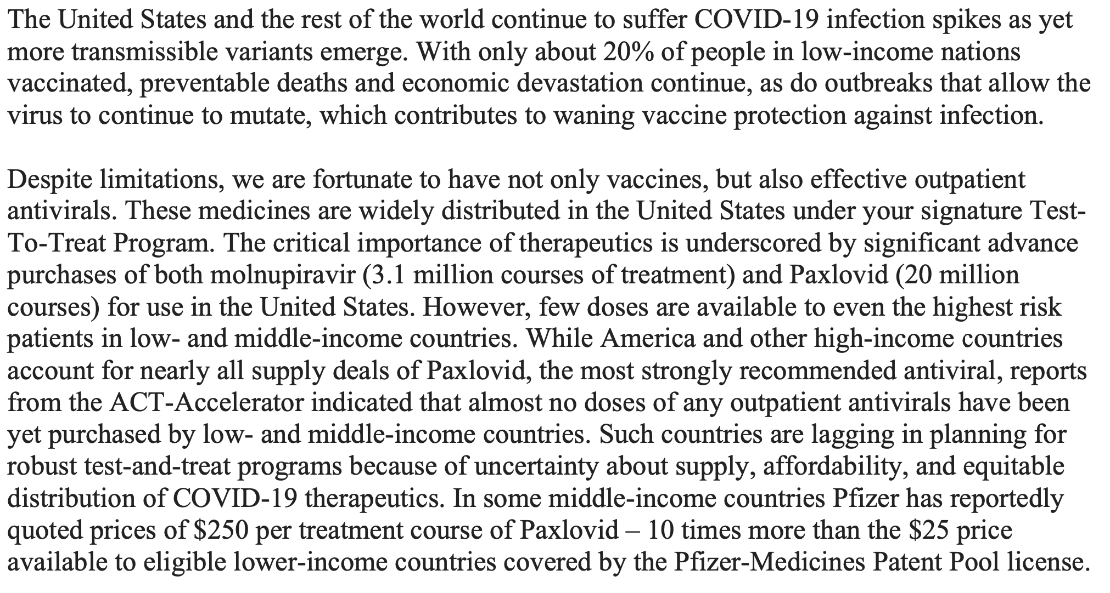
Perspective of US NGOs on Diagnostics and Therapeutics (August 2022)
Source: https://rethinktrade.org/wp-content/uploads/2022/08/TreatmentsLetter2.pdf

Slide 56
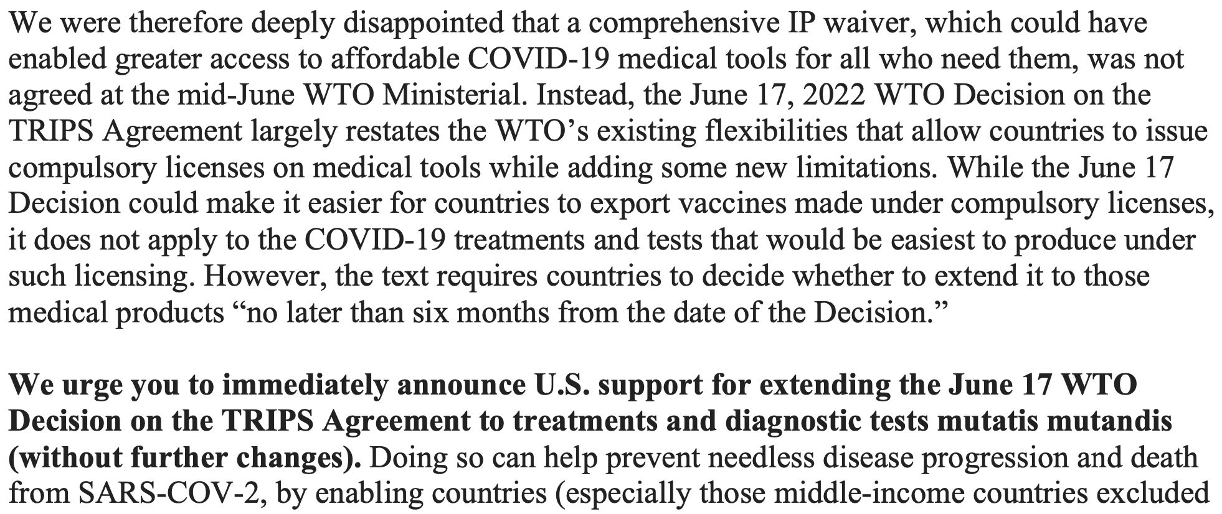
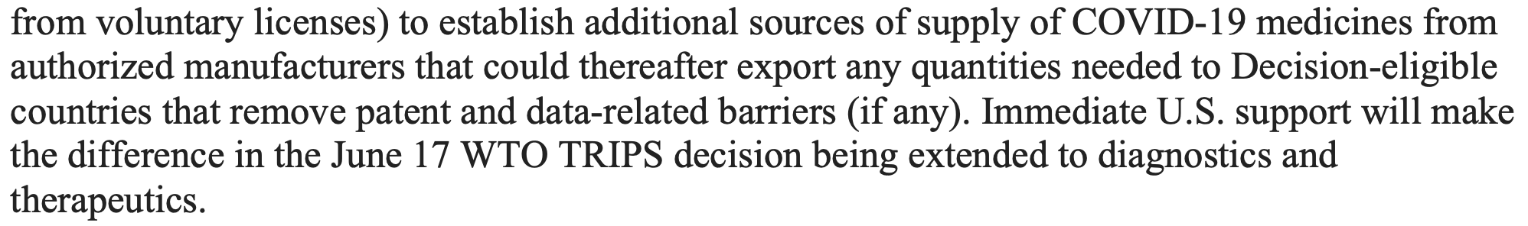
Perspective of US NGOs on Diagnostics and Therapeutics (August 2022)
Source: https://rethinktrade.org/wp-content/uploads/2022/08/TreatmentsLetter2.pdf

Slide 57
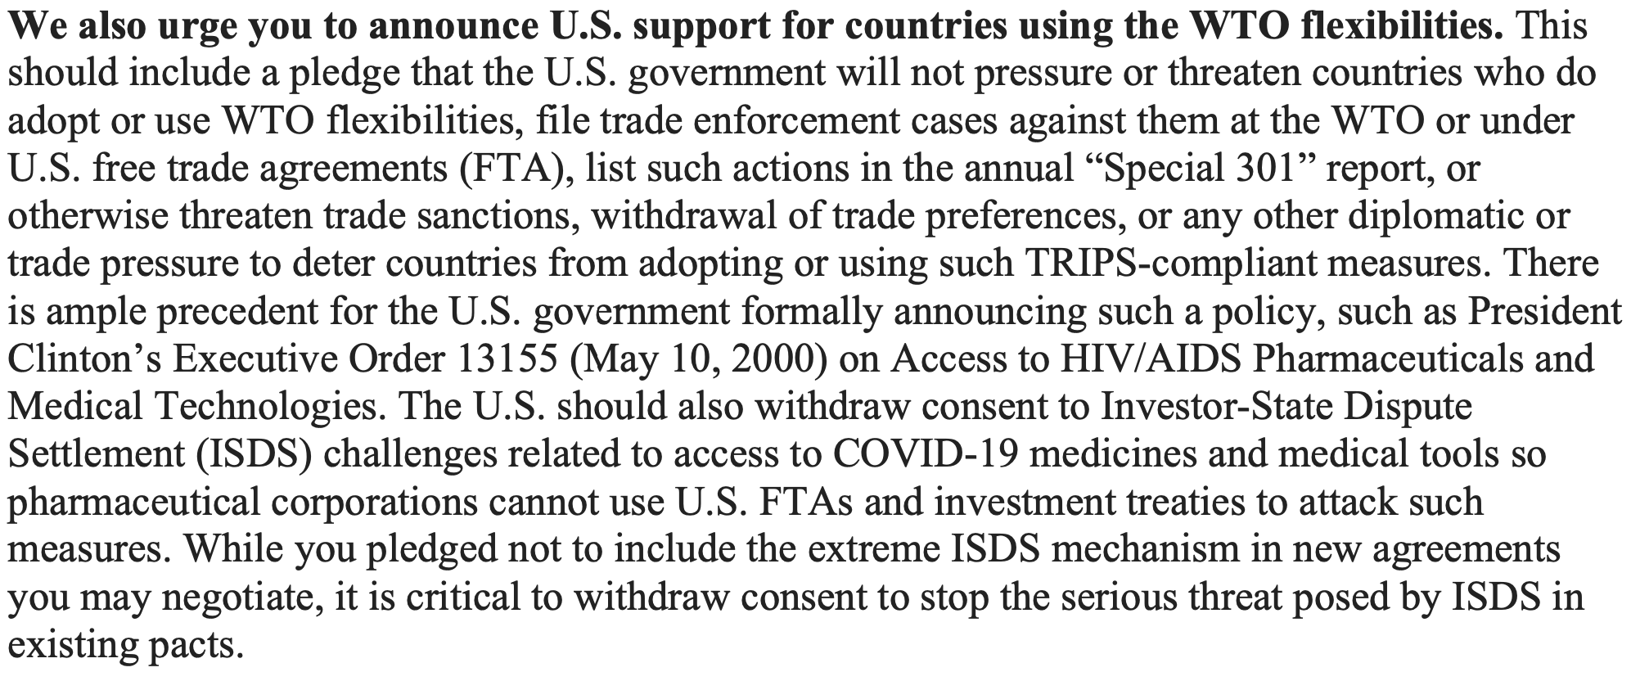
Perspective of US NGOs on Diagnostics and Therapeutics (August 2022)
Source: https://rethinktrade.org/wp-content/uploads/2022/08/TreatmentsLetter2.pdf

Slide 58
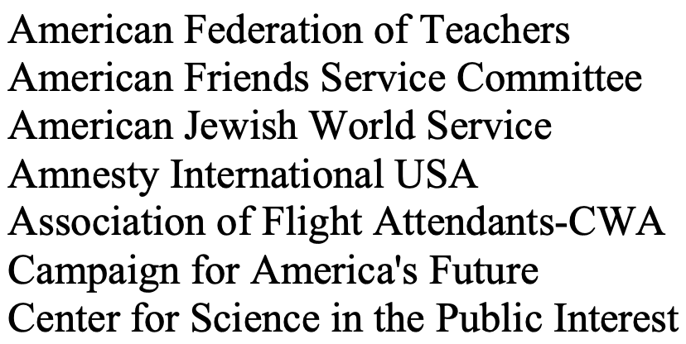
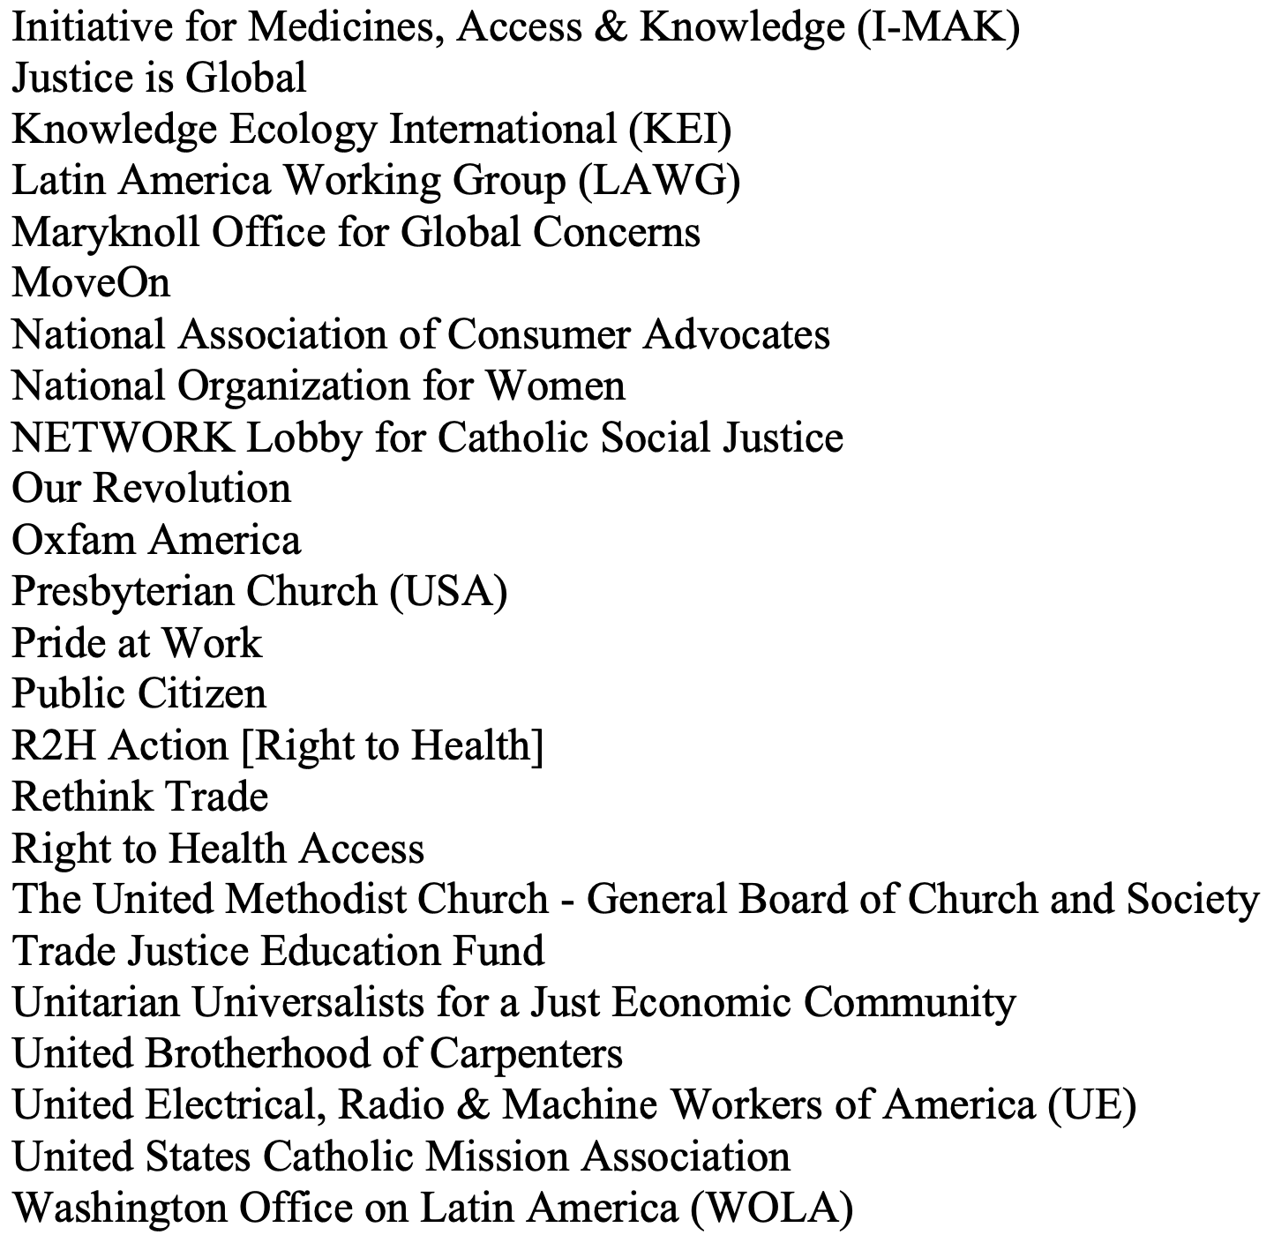
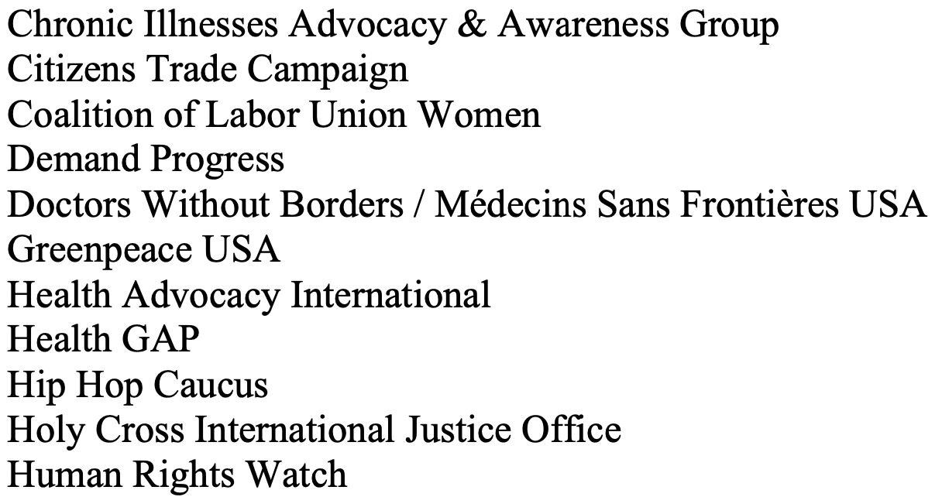
Source: https://rethinktrade.org/wp-content/uploads/2022/08/TreatmentsLetter2.pdf

Slide 59


Slide 60


Slide 61
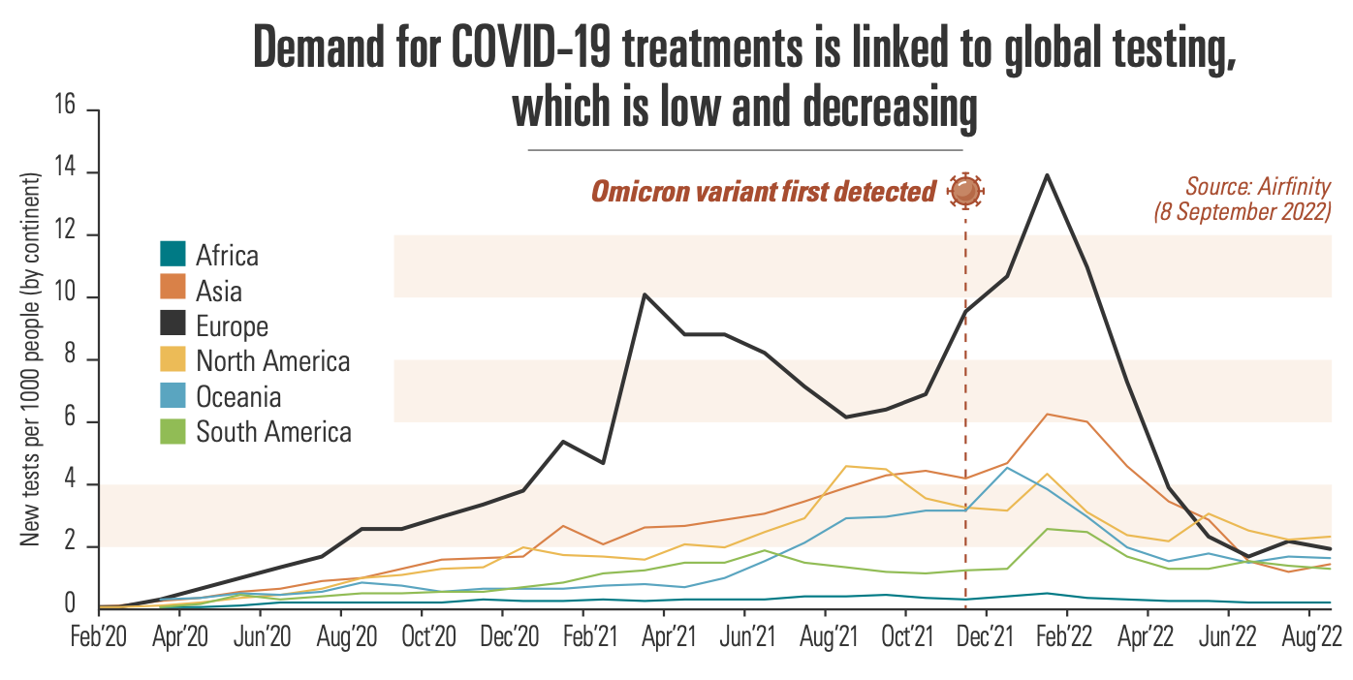
EFPIA Perspective on Diagnostics and Therapeutics (September 2022)
Source: https://www.efpia.eu/media/676724/factsheet-covid19-therapeutics.pdf

Slide 62
Outcome (March 2024)
TRIPS Council Abandons the Extension

Slide 63
III. Responses of the Global IP Institutions
WTO: COVID Waivers
WIPO
  WIPO/Harvard Course on Patent Law and Global Public Health
  WIPO Project on Conditional Grants

Slide 64
III. Responses of the Global IP Institutions
WTO: COVID Waivers
WIPO
  WIPO/Harvard Course on Patent Law and Global Public Health
  WIPO Project on Conditional Grants

Slide 65

Mr. Edward Kwakwa, Assistant Director General of the Global Challenges and Partnerships Sector, WIPO

Slide 66

Mr. Daren Tang, Director General, WIPO
Mr. Edward Kwakwa, Assistant Director General of the Global Challenges and Partnerships Sector, WIPO

Slide 67


Slide 68

https://www.wipo.int/academy/en
/news/2023/news_0060.html

Slide 69
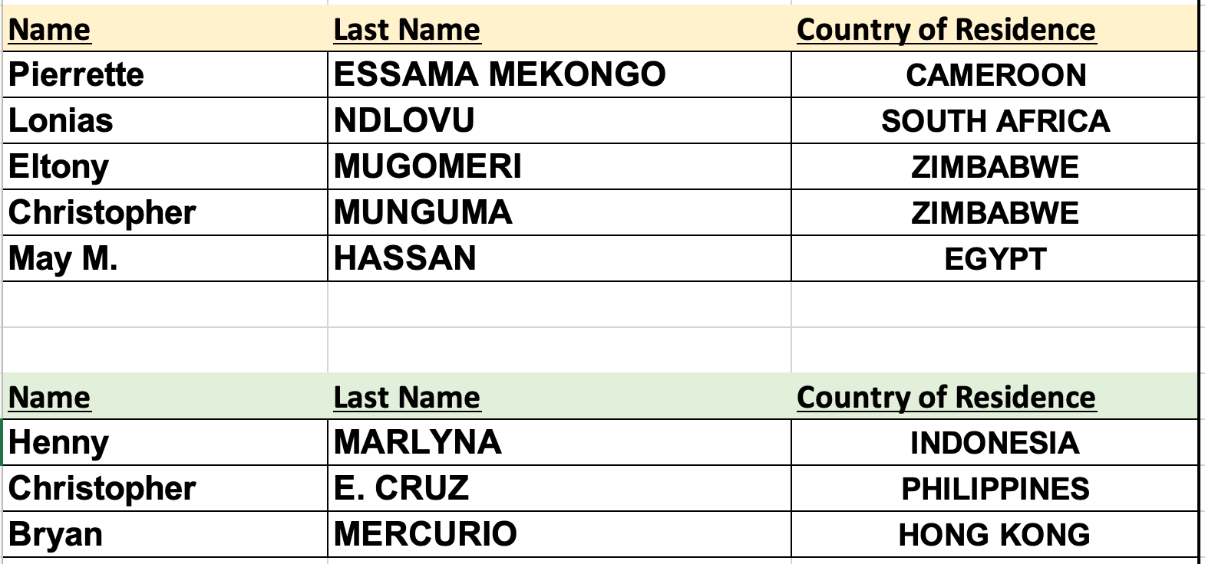
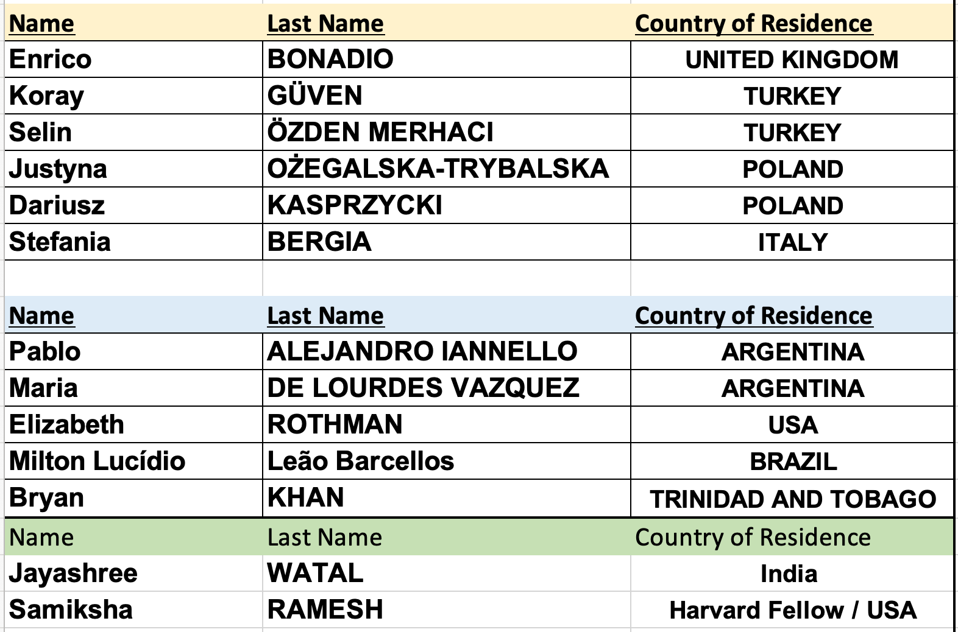
Harvard/WIPO Course, 3rd edition (2024)
Teachers

Slide 70
Harvard/WIPO Course, 3rd edition (2024)
Admitted Students by Countries of Residence (102 countries)
RWANDA: 1
SAUDI ARABIA: 5
SINGAPORE: 5
SLOVENIA: 1
SOMALIA: 1
SOUTH AFRICA: 7
SPAIN: 1
SRI LANKA: 4
SUDAN: 1
SWEDEN: 1
SWITZERLAND: 9
THAILAND: 3
NORTH MACEDONIA: 1
TOGO: 1
TUNISIA: 2
TÜRKIYE: 10
UGANDA: 9
UKRAINE: 6
UNITED ARAB EMIRATES: 3
UNITED KINGDOM: 3
TANZANIA: 1
UNITED STATES OF AMERICA: 8
URUGUAY: 1
UZBEKISTAN: 1
VIET NAM: 3
ZAMBIA: 2
ZIMBABWE: 18
AFGHANISTAN: 1
ALBANIA: 1
ALGERIA: 3
ARGENTINA: 6
ARMENIA: 1
AUSTRALIA: 3
AUSTRIA: 2
AZERBAIJAN: 4
BANGLADESH: 5
BARBADOS: 1
BELARUS: 1
BELGIUM: 5
BENIN: 1
BHUTAN: 1
BOTSWANA: 2
BRAZIL: 17
BULGARIA: 1
BURKINA FASO: 1
CAMBODIA: 1
CAMEROON: 11
CANADA: 1
CHILE: 3
CHINA: 16
COLOMBIA: 7
COSTA RICA: 3
CROATIA: 1
CYPRUS: 1
ECUADOR: 2
EGYPT: 10
ETHIOPIA: 5
FRANCE: 4
GAMBIA: 1
GEORGIA: 3
GERMANY: 6
GHANA: 8
GREECE: 1
GUINEA: 1
HONG KONG: 1
INDIA: 109
INDONESIA: 7
IRAN: 17
ITALY: 10
JAPAN: 1
JORDAN: 7
KAZAKHSTAN: 4
KENYA: 12
LEBANON: 1
LESOTHO: 3
LITHUANIA: 1
LUXEMBOURG: 1
MADAGASCAR: 1
MALAWI: 6 MALAYSIA: 2
MAURITIUS: 1
MEXICO: 10
MONGOLIA: 1
MOROCCO: 1
MYANMAR: 1
NAMIBIA: 5
NEPAL: 1
NETHERLANDS: 1
NEW ZEALAND: 2
NIGER: 2
NIGERIA: 29
NORWAY: 1
OMAN: 1
PAKISTAN: 12
PARAGUAY: 2
PERU: 3
PHILIPPINES: 4
POLAND: 4
PORTUGAL: 5
REPUBLIC OF KOREA: 3
ROMANIA: 2
RUSSIAN FEDERATION: 3

Slide 71
Possible Strategies for mitigating the global health crisis include:
Improve the procedures in low and middle-income countries [LMICs] for processing applications for marketing authorization;
Deploy better systems for detecting and eliminating substandard and falsified medical products [SFMPs];
Enable and encourage pharmaceutical firms to employ both international and intra-national differential pricing more often;
Facilitate increased use of voluntary licenses;
Employ apprenticeship, procurement policies, and limits on clinical trials to increase local production of vaccines and medicines in LMICs;
Impose compulsory licenses on the patents pertaining to crucial medical products;
Tighten the inventive-step and enablement requirements of patent law in LMICs;
Avoid or repeal extensions of the duration of patents on pharmaceutical products;
Advise judges in LMICs to minimize the use of injunctions in patent-infringement suits involving pharmaceutical products;
Extend the duration of patent protection and/or data-exclusivity protection in upper-income countries [UICs] for (a) vaccines; (b) neglected diseases; and (c) breakthrough drugs of all sorts;
Adjust the doctrines of claim construction, equivalents, and remedies in the patent laws of UICs to augment incentives to produce (a) vaccines; (b) neglected diseases; and (c) breakthrough drugs of all sorts;
Increase the use of governmental and philanthropic grants to support research and development for vaccines and medicines pertaining to neglected diseases;
Impose stricter conditions upon governmental and philanthropic grants of all sorts to increase the availability of their fruits in LMICs;
Increase the use of governmental and philanthropic prizes to support research and development for vaccines and medicines pertaining to neglected diseases;
Require pharmaceutical firms to achieve each year a social-responsibility index.

Slide 72
III. Responses of the Global IP Institutions
WTO: COVID Waivers
WIPO
  WIPO/Harvard Course on Patent Law and Global Public Health
  WIPO Project on Conditional Grants

Slide 73
III. Responses of the Global IP Institutions
WTO: COVID Waivers
WIPO
  WIPO/Harvard Course on Patent Law and Global Public Health
  WIPO Project on Conditional Grants

