Slide 1
Selected Slides Presented in Class on January 23, 2024
Copyright^{x}
William Fisher
Licensed under terms available at https://ipxcourses.org

Slide 2
Visiting a national park in North Sulawesi, Indonesia, award-winning photographer [David] Slater left his camera unattended for a while.
It soon attracted the attention of an inquisitive female from a local group of crested black macaque monkeys, known for their intelligence and dexterity….
“One of them must have accidentally knocked the camera and set it off because the sound caused a bit of a frenzy,” said Slater, 46.
“At first there was a lot of grimacing with their teeth showing because it was probably the first time they had ever seen a reflection. They were quite mischievous jumping all over my equipment, and it looked like they were already posing for the camera when one hit the button. The sound got his attention and he kept pressing it
“At first it scared the rest of them away but they soon came back - it was amazing to watch. He must have taken hundreds of pictures by the time I got my camera back, but not very many were in focus. He obviously hadn't worked that out yet….”
Revised account: “So I put my camera on a tripod with a very wide angle lens, settings configured such as predictive autofocus, motorwind, even a flashgun, to give me a chance of a facial close up if they were to approach again for a play. I duly moved away and bingo, they moved in, fingering the toy, pressing the buttons and fingering the lens. I was then to witness one of the funniest things ever as they grinned, grimaced and bared teeth at themselves in the reflection of the large glassy lens. Was this what they were afraid of earlier? Perhaps also the sight of the shutter planes moving within the lens also amused or scared them? They played with the camera until of course some images were inevitably taken!”

Slide 3
US Constitution, Article 1, Section 8, Clause 8
The Congress shall have Power … [t]o promote the Progress of Science and useful Arts, by securing for limited Times to Authors and Inventors the exclusive Right to their respective Writings and Discoveries;

Slide 4
US Copyright Office, Compendium of Copyright Practices (3d ed. December 2014)
306 The Human Authorship Requirement
The U.S. Copyright Office will register an original work of authorship, provided that the work was created by a human being. The copyright law only protects “the fruits of intellectual labor” that “are founded in the creative powers of the mind.” Trade-Mark Cases, 100 U.S. 82, 94 (1879). Because copyright law is limited to “original intellectual conceptions of the author,” the Office will refuse to register a claim if it determines that a human being did not create the work. Burrow-Giles Lithographic Co. v. Sarony, 111 U.S. 53, 58 (1884). For representative examples of works that do not satisfy this requirement, see Section 313.2 below.

Slide 5
US Copyright Office, Compendium of Copyright Practices (3d ed. December 2014)
313.2 Works That Lack Human Authorship
The Office will not register works produced by nature, animals, or plants. Likewise, the Office cannot register a work purportedly created by divine or supernatural beings, although the Office may register a work where the application or the deposit copy(ies) state that the work was inspired by a divine spirit.
Examples:
  A photograph taken by a monkey.
  A mural painted by an elephant.
  A claim based on the appearance of actual animal skin.
  A claim based on driftwood that has been shaped and smoothed by the ocean.
  A claim based on cut marks, defects, and other qualities found in natural stone.
  An application for a song naming the Holy Spirit as the author of the work.

Slide 6
Naruto v. Slater (San Francisco District Court 2016)
‘Naruto is not an “author” within the meaning of the Copyright Act. Next Friends argue that this result is “antithetical” to the “tremendous [public] interest in animal art.” Perhaps. But that is an argument that should be made to Congress and the President, not to me.’

Slide 7
Naruto v. Slater (9th Cir. 2018)
‘PETA does not claim to have a relationship with Naruto that is any more significant than its relationship with any other animal. Thus, PETA fails to meet the “significant relationship” requirement and cannot sue as Naruto’s next friend….
‘Because we believe the Supreme Court’s reasoning in Whitmore counsels against court-initiated expansion of “next friend” standing, we decline to recognize the right of next friends to bring suit on behalf of animals, absent express authorization from Congress….
‘[In Cetacean Community v. Bush (9th Cir. 2004),] the court crafted a simple rule of statutory interpretation: if an Act of Congress plainly states that animals have statutory standing, then animals have statutory standing. If the statute does not so plainly state, then animals do not have statutory standing. The Copyright Act does not expressly authorize animals to file copyright infringement suits under the statute. Therefore, based on this court’s precedent in Cetacean, Naruto lacks statutory standing to sue under the Copyright Act.’

Slide 8
Nichols “Pattern” Test
Idea
Expression

Slide 9
Zechariah Chafee (1945)
“No doubt the line does lie somewhere between the author's idea and the precise form in which he wrote it down. I like to say that the protection covers the "pattern" of the work ... the sequence of events, and the development of the interplay of characters.”

Slide 10
“At the birthday celebration ceremony of a royal king, a beautiful girl was presented to the king as a gift. This created a sense of crisis to the wife of the king, who had given birth to three girls but no boys. Shortly after the birthday celebration, the wife gave birth to a fourth girl. Out of fear of losing her status in the royal family, she accepted the suggestion of her servant and replaced the newly born girl with a baby boy from another family. Her baby girl was abandoned besides a creek, and a mark of plum blossom was imprinted on her shoulder so that the mother could identify her in future. (In Palace, it is a piece of red mark being imprinted on the abandoned girl’s shoulder).
“After the boy grew up as a prince, he met the abandoned princess accidentally, and even saved her from a miserable situation. They immediately fell in love. However, at the order of the emperor, the prince had to marry another girl from a royal family as his official (first) wife, through an arranged marriage, and could only keep the abandoned princess as his concubine. This created a complicated triangle love relationship among the fake prince, his arranged wife, and his concubine (the abandoned princess). Through the interactions between the emperor, the king, the prince, his official wife, and the abandoned princess, etc., the story was further driven by two factors: truth about births of the abandoned princess and the fake prince; jealousy from the official wife against the abandoned princess (concubine).”

Slide 11
Chiung Yao v. Yu Zheng
Beijing No. 3 Intermediate Court
Dec. 25, 2014
“A plot in a story might be either summarized as an abstract idea, or be presented as a specific expression. Thus, a plot still needs to be further analyzed to determine which part is an idea and what part is expression. To distinguish between an idea and an expression, one shall look at whether the plot in question is abstract and general, or if it is specific enough so that it provides a special aesthetic experience that is sufficient to identify the source of the work. If the plot is specific to such an extent, then it can be considered as an expression.”

Slide 12
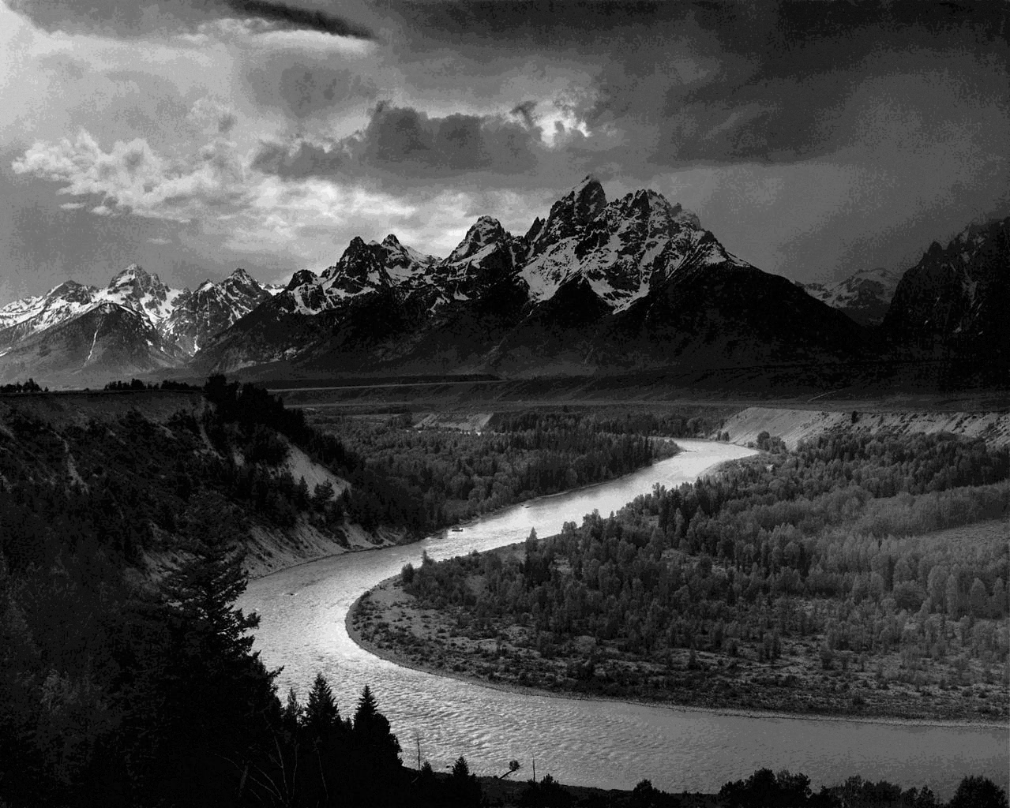
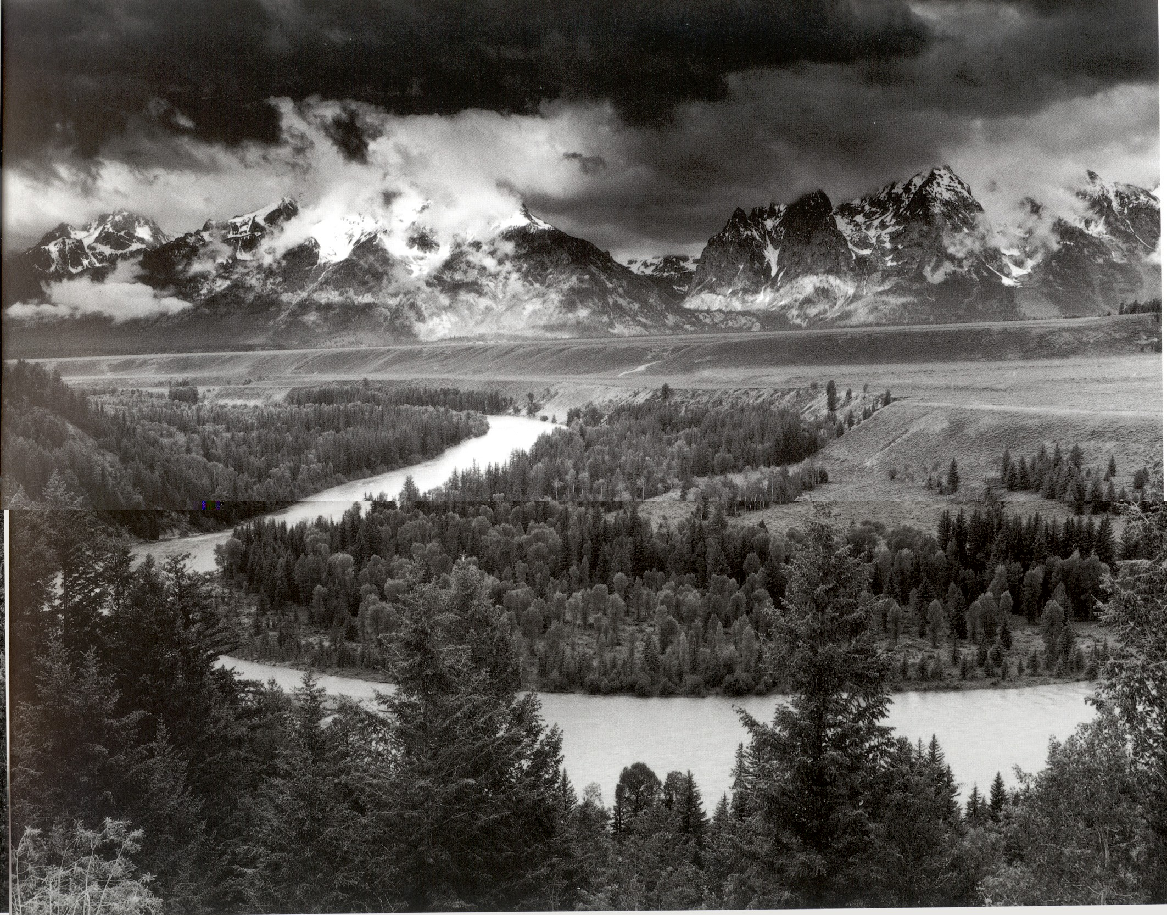
The Tetons and Snake River
Tetons Calendar Cover

Slide 13
Michelangelo, c. 1500
“Contrapposto” pose
Odisha, c. 1800
“Tribhanga” pose
Sources: https://emptyeasel.com/2007/12/18/what-is-contrapposto-in-art-heres-an-explanation-of-classical-contrapposto/;
https://upload.wikimedia.org/wikipedia/commons/7/74/Flöte_spielender_Gott_Krishna_Museum_Rietberg_RVI_530.jpg

