Slide 1
Google v. Oracle
CopyrightX Case Study 084B
William Fisher
March 2024
Notes:
Copyright notice for presentations authored by others:
© [Year], [Name 1]. This case study was originally written by [Name 2] and was subsequently revised by [Name 1]. The terms on which this case study may be used or modified are available at copyx.org/permission.
“This case study was originally written by [Name 2] and was subsequently revised by [Name 1],” should be omitted if the case study has never been revised.

Slide 2
Structure of Java
30,000 “methods”
  Each contains a small amount of “declaring code” and a large amount of “implementing code”
3000 “classes” of methods
166 “packages” of classes

Slide 3
Declaring code v. implementing code
Int Math.maxPair(x,y) {
if(x >= y) return x;
else return y;
}
vs.
Int Math.maxPair(x,y) {
if(y >= x) return y;
else return x;
}
Blue indicates declaring code; green indicates implementing code
Same declaring code, different implementations.
Source: Frank Xiao

Slide 4
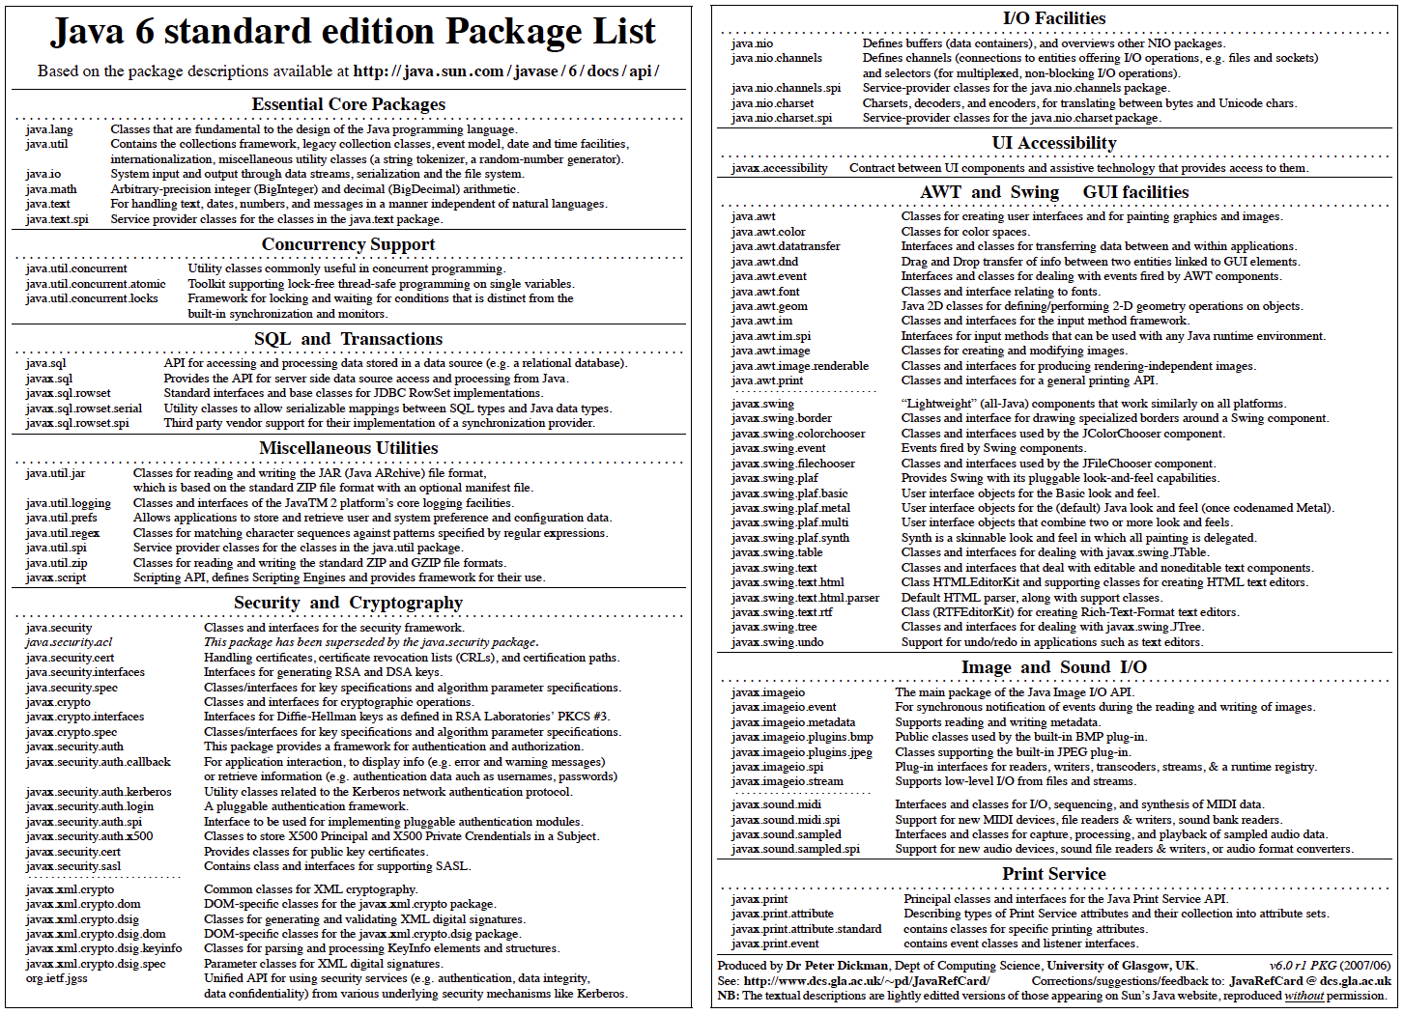

Slide 5
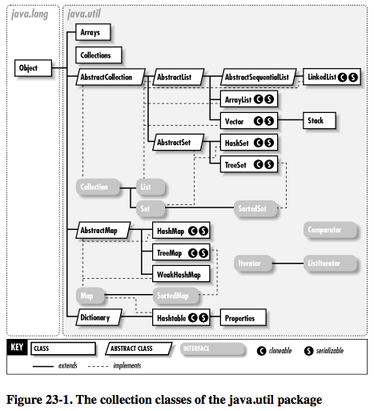
Source: http://docstore.mik.ua/orelly/java-ent/jnut/ch23_01.htm

Slide 6
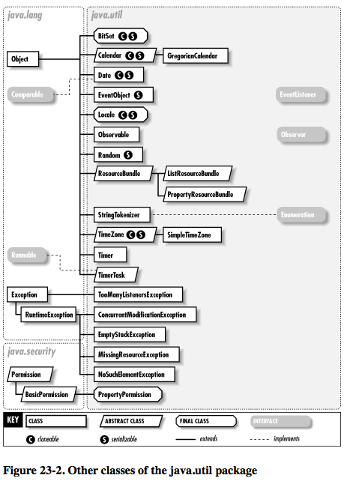
Source: http://docstore.mik.ua/orelly/java-ent/jnut/ch23_01.htm

Slide 7
History
Sun Microsystems develops Java, a software program that enables programmers efficiently to develop applications (“apps”) and then to allow those apps to run on a variety of hardware systems
  Sun’s business model:
  Charge hardware manufacturers for the right to install Java on their machines
  Grant royalty-free license to app developers
  Grant royalty-free licenses to developers of competing platforms to use and modify Java so long as they make public all modifications and permit competitors to use those modifications for free
  Charge the developers of competing platforms who wish to keep their modifications proprietary
    Condition: any modified version of Java must be compatible with Java, so that apps written in Java can run on it
    Licensees include Blackberry, Nokia, SavaJe, IBM, Oracle

Slide 8
Possible Bases of Liability
Google copied:
  Structure of 37 (out of 166) Java “Packages” and their components
  Declaring Code for components of 37 Java packages (7000 lines of source code)
  Implementing Code for 9 functions within those packages
Liability essentially conceded

Slide 9
History
Sun Microsystems develops Java, a software program that enables programmers efficiently to develop applications (“apps”) and then to allow those apps to run on a variety of hardware systems
2005: Google rejects license from Sun and develops Android
Oracle acquires Sun and brings a copyright (and patent) infringement suit against Google
Jury finds that Google copied copyrightable expression but fails to resolve fair use issue
District Court grants judgment notwithstanding the verdict, finding that declaring code and structure of Java are both not copyrightable
2014: CAFC reverses, remands for retrial on fair use
SCOTUS denies certiorari
2016: Jury finds fair use
2018: CAFC reverses, finding no fair use “as a matter of law”
2021: SCOTUS reverses, finding fair use “as a matter of law”

Slide 10
CAFC SCOTUS
1. Purpose and character of defendant’s use | π | (a) Google’s use of Oracle’s material is “overwhelmingly commercial” (relying on Napster definition); (b) G’s use is not transformative because (i) no new meaning and (ii) same purpose; (c) Although bad faith or unfair dealing counts against fair use, good faith does not count in favor of it | ∆ | Because the purpose and effect of copying the declaring code was to foster the creation of “new products” and to “expand the use and usefulness of Android-based smartphones, it is “consistent with that creative ‘progress’ that is the basic constitutional objective of copyright itself” and is thus “transformative”; Commercial character of the use is unimportant and lack of “good faith” may be irrelevant
2. Nature of copyrighted work | ∆ | “[R]easonable jurors could have concluded that functional considerations were both substantial and important.” | ∆ | Because the declaring code is “functional” and is intertwined with “uncopyrightable ideas (general task division and organization) and new creative expression,” it merits only weak copyright protection
3. Amount of copying | “at best neutral” | “Even assuming the jury accepted Google’s argument that it copied only a small portion of Java, no reasonable jury could conclude that what was copied was qualitatively insignificant, particularly when the material copied was important to the creation of the Android platform.” | ∆ | The percentage of Java as a whole that Google took was tiny, and “[t]he ‘substantiality’ factor will generally weigh in favor of fair use where, as here, the amount of copying was tethered to a valid, and transformative, purpose.”
4. Impact on potential market | π | Demonstrated harms to two existing markets: (a) Diminished sales of JAVA SE for smartphones; (b) Amazon pays less for JAVA on Kindle. In addition, “licensing JAVA SE for use on smartphones with increased processing capabilities” = a “traditional, reasonable, or likely to be developed” potential market | ∆ | Because Sun was poorly positioned to enter the smartphone market and because the licensing markets for Java and Android were distinct, the adverse economic impact on Sun/Oracle was modest. That impact must be weighed against the “public benefits” of the copying, including the “creative production of new expression”
Result:
π
No fair use “as a matter of law”
∆
Fair use “as a matter of law”

Slide 11
Ginsburg | Breyer
© is an affirmative good | © is a necessary evil
© is property | © is monopoly
Antitrust concerns are minor | Competition is beneficial
Price discrimination is good | Price discrimination is bad
Fairness is relevant | Strict utilitarianism
Europe is relevant | Europe is irrelevant
Uninterested in public-choice theory | Public-choice theory
Public domain = absence of © | Public domain has independent value
¶54
¶34-35

Slide 12
Ginsburg | Breyer
© is an affirmative good | © is a necessary evil
© is property | © is monopoly
Antitrust concerns are minor | Competition is beneficial
Price discrimination is good | Price discrimination is bad
Fairness is relevant | Strict utilitarianism
Europe is relevant | Europe is irrelevant
Uninterested in public-choice theory | Public-choice theory
Public domain = absence of © | Public domain has independent value
¶6, 8, 74, 89, 100
¶34-35

Slide 13
Videopipeline (2008)
Friedman (2011);
Cariou (2011)
Fairey (2011)
Socially
beneficial
Dr. Seuss (1997)
Connectix (2000)
Kelly (2003);
Perfect 10 (2007);
AV (2009); White (2013)
Gaylord (2010)
Google (2021)
Salinger (2010)
Graham (2006)
Nunez (2006)
Castle Rock
(1998)
Critical of π
Different
Purpose
Creative
Parody
Rogers (1992)
Campbell (1994);
Leibovitz (1998);
Suntrust (2001);
Mattel (2003)
Free Republic (2000)
Physical
modifications
Blanch (2006)
Lennon (2008)

Slide 14
CAFC SCOTUS
1. Purpose and character of defendant’s use | π | (a) Google’s use of Oracle’s material is “overwhelmingly commercial” (relying on Napster definition); (b) G’s use is not transformative because (i) no new meaning and (ii) same purpose; (c) Although bad faith or unfair dealing counts against fair use, good faith does not count in favor of it | ∆ | Because the purpose and effect of copying the declaring code was to foster the creation of “new products” and to “expand the use and usefulness of Android-based smartphones, it is “consistent with that creative ‘progress’ that is the basic constitutional objective of copyright itself” and is thus “transformative”; Commercial character of the use is unimportant and lack of “good faith” may be irrelevant
2. Nature of copyrighted work | ∆ | “[R]easonable jurors could have concluded that functional considerations were both substantial and important.” | ∆ | Because the declaring code is “functional” and is intertwined with “uncopyrightable ideas (general task division and organization) and new creative expression,” it merits only weak copyright protection
3. Amount of copying | “at best neutral” | “Even assuming the jury accepted Google’s argument that it copied only a small portion of Java, no reasonable jury could conclude that what was copied was qualitatively insignificant, particularly when the material copied was important to the creation of the Android platform.” | ∆ | The percentage of Java as a whole that Google took was tiny, and “[t]he ‘substantiality’ factor will generally weigh in favor of fair use where, as here, the amount of copying was tethered to a valid, and transformative, purpose.”
4. Impact on potential market | π | Demonstrated harms to two existing markets: (a) Diminished sales of JAVA SE for smartphones; (b) Amazon pays less for JAVA on Kindle. In addition, “licensing JAVA SE for use on smartphones with increased processing capabilities” = a “traditional, reasonable, or likely to be developed” potential market | ∆ | Because Sun was poorly positioned to enter the smartphone market and because the licensing markets for Java and Android were distinct, the adverse economic impact on Sun/Oracle was modest. That impact must be weighed against the “public benefits” of the copying, including the “creative production of new expression”
3
2
1
Result:
π
No fair use “as a matter of law”
∆
Fair use “as a matter of law”

