Slide 1
Fox v. Dish
Original author: Alan Ai
Revised by: William Fisher
Last Revised: March 2022

Slide 2
Background
Sony (SCOTUS 1984)
Cablevision (CA2 2008)
Aereo (SCOTUS 2014)

Slide 3
Sony v. Universal City Studios
(SCOTUS 1984)

Slide 4
Compensation System for Network Broadcasts of Films
Studio
Advertisers
licenses
advertising fees
license fees
TV Networks
free programming
(with embedded ads)
product
purchases
Viewers
SCOTUS (1984):
cost of VCRs
Manufacturer of a device that can be used to violate the copyright laws is liable for contributory copyright infringement if and only if the device is not capable of substantial noninfringing uses
Timeshifting copyrighted programs is a fair use
VCRs
Sony

Slide 5
Cablevision
(CA2 2008)

Slide 6

Warner Bros.
NBC
HBO
Cartoon Network
Unauthorized reproduction?
No; too ephemeral
(2) Unauthorized reproduction?
Not by Cablevision; perhaps by
User, but likely fair use
Cablevision
1.2 second buffer
BMR
0.1 second buffer
Primary buffer
Secondary buffer
hard drives
Home
DVR
Set-top box
Arroyo Server
(3) Public performance?
No, not “public”
--because it’s a transmission from a unique copy to a single recipient
TV
Subscriber

Slide 7
Aereo
(SCOTUS 2014)

Slide 8
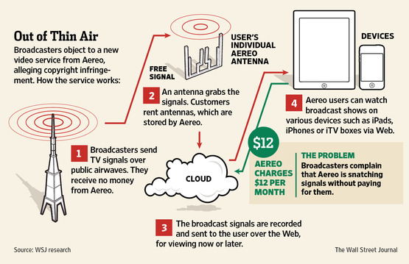
http://online.wsj.com/article/SB10001424052702304065704577424373775083522.html

Slide 9

Fox
One of the “big four” American broadcasting networks
Launched in 1986, joining ABC, CBS, and NBC
Provides free broadcasts over public airwaves; also enters into retransmission agreements with cable operators and satellite TV providers
Popular shows include The Simpsons, Family Guy, New Girl, Bones, and Glee – to which Fox owns the copyrights

Slide 10

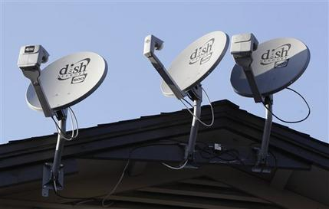

Dish
Direct-broadcast satellite (DBS) provider; main service is satellite television
~14 million subscribers at the end of 2014; 3rd largest pay television provider in the US
Competitors include DirecTV (another DBS provider) and cable television providers (Cablevision, Comcast, etc.)
Has retransmission agreements with each of the “big four” TV networks
AP Photo/Paul Sakuma

Slide 11
Business Model
Unlike Fox, DISH does not produce any programming. Instead, it buys programming from other organizations, bundles it into a signal, and transmits the signals to subscribers

Slide 12

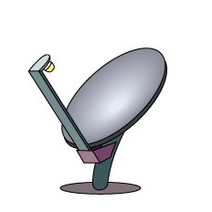
Studios
Fox
ABC
Cartoon Network
Home (Boston)
DVR
Set-top box
TV
Subscriber

Slide 13
Studios
Fox
ABC
Cartoon Network
Home (Boston)
Hopper
TV
Subscriber

Slide 14
Studios
Fox
ABC
Cartoon Network
$
2 revenue streams
Retransmission fees
  --renegotiated periodically
$
Home (Boston)
Hopper
TV
Subscriber

Slide 15
Studios
Fox
ABC
Cartoon Network
Ads
$
2 revenue streams
Retransmission fees
Advertising fees
$
Advertisers
$
Home (Boston)
$
Hopper
TV
Ads
Subscriber

Slide 16
Studios
Fox
ABC
Cartoon Network
Ads
$
Extra Features
“PrimeTime Anytime”
“Autohop”
$
Home (Boston)
Hopper
TV
Ads
Subscriber

Slide 17
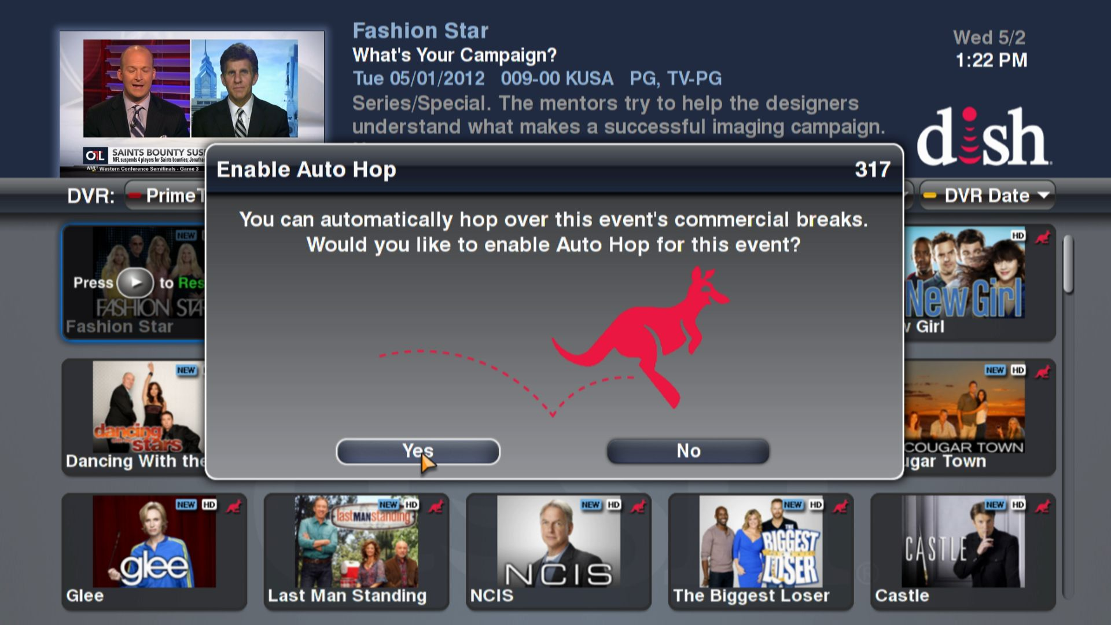
If a user selects this option, DISH transmit to the user’s Hopper a file, identifying the times in each program when an advertisement starts and stops. The Hopper then skips those segments when replaying the recording.

Slide 18
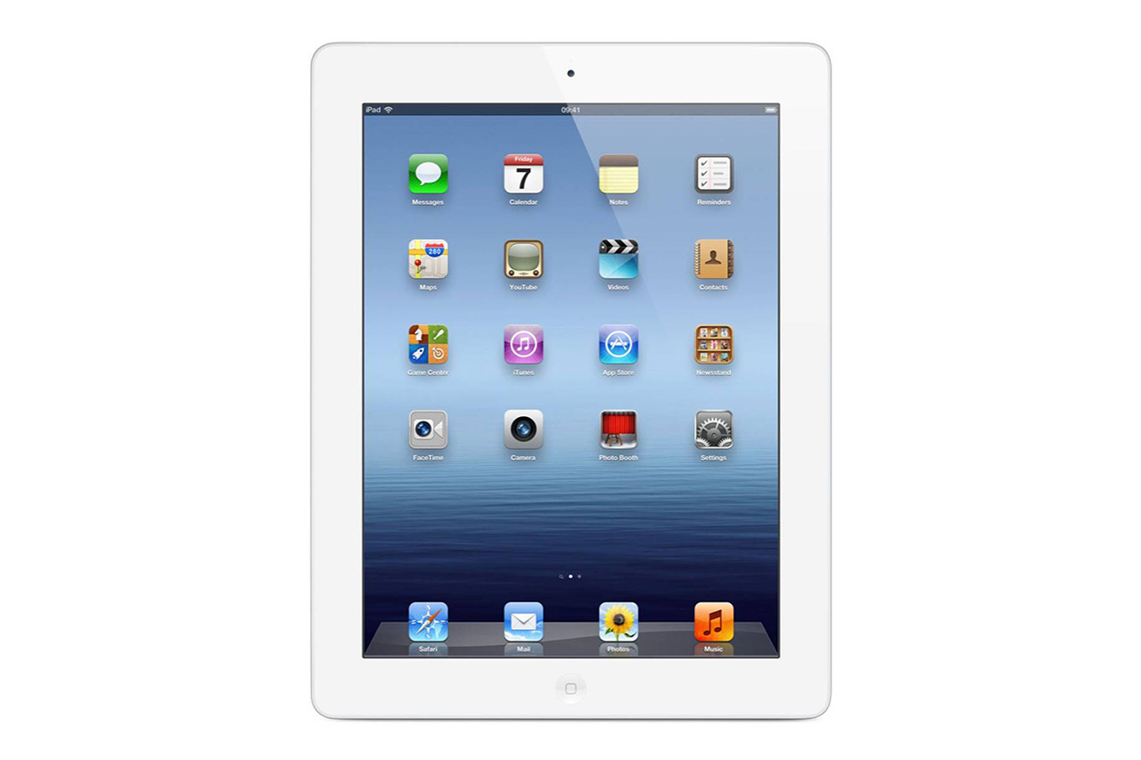
Studios
Fox
ABC
Cartoon Network
Ads
$
Extra Features
“PrimeTime Anytime”
“Autohop”
“Hopper Transfers”
$
Home (Boston)
Hopper
TV
Subscriber

Slide 19

Studios
Fox
ABC
Cartoon Network
Ads
$
Extra Features
“PrimeTime Anytime”
“Autohop”
“Hopper Transfers”
“Dish Anywhere” (“Sling”)
$
Home (Boston)
packets
transcoding
Hopper
Hotel (Seattle)
buffer
TV
Subscriber
Subscriber

Slide 20
Exercise
Groups A, B, C, D, E represent Fox
  With respect to each of the “extra features” deployed by Dish, what copyright claims might your client assert?
Groups J, K, L, M, N represent Dish
  With respect to each of the “extra features” deployed by Dish, what arguments might you make to repel Fox’s copyright claims?
Groups F, G, H, I
  Which of the two parties should prevail with respect to each of the “extra features”?

