Slide 1
Doctrinal Implications of the Theories
Case Study 254
Copyright^{x}
William Fisher
April 2024
Licensed under terms available at https://ipxcourses.org

Slide 2
Originality
Fairness
Personality
Welfare
Cultural
Protect all works that
(a) are not copied and
(b) originate in effort, including “sweat of the brow”
Protect all works that
(a) are not copied and
(b) reflect creators’ expressive choices
Protect only works that (a) are not copied and
(b) would not be created in the absence of the incentives associated with copyright
Protect a work if it
(a) is not copied and
(b) produces in a reasonable person an overall impression different from that produced by any other single work that had been publicly available prior to the creation of the work at issue

Slide 3
Illustrations of Cultural Theory Guideline for Originality
Not Original
Original
The floor plan of a suburban home at issue in Intervest Construction v. Canterbury Estate Homes;
The bass line of Marvin Gaye’s composition, “Give it Up.”
The floor plan of the Jewish Museum in Berlin;
The tune of Kookaburra

Slide 4
Idea/Fact/Expression
Fairness
Personality
Welfare
Cultural
Protect collections of facts gathered with effort (e.g., journalism; history)
Do not protect collections of fact
In borderline cases, define as ideas or facts things whose protection would generate more social harm than social benefit (e.g., newly created names of geographic features)
Texts, recordings, or other material essential to civic engagement should be deemed either facts or ideas (e.g., public speeches; blog posts by politicians)

Slide 5
Fair Use
Fairness
Personality
Welfare
Cultural
Emphasize factor #4 (ensure creators have appropriate rewards);
Narrow conception of “potential market” (no reaping where one has not sown);
Reorient factor #1 to focus on defendant’s labor (parasite vs. contributor);
Deemphasize factor #2 (journalism is as worthy labor as writing fiction)
Factor #1: “transformation” should weaken, rather than strengthen, argument for fair use;
Factor #2: hostility to disclosure of unpublished works;
Factor #4: Do not penalize artists for refusing to license uses of their works; “harms” should include tarnishing
Activities with high ratios of incentives to welfare loss = unfair; activities with low ratios = fair
treat as “fair” uses with high positive externalities (e.g., parody);
treat as “fair” socially beneficial activities that would be blocked by transaction costs;
track popular attitudes (avoid negative “psychic externalities”)
Substitute “adverse impact on a just and attractive society” for “welfare loss” in the incentive/loss ratio.
transformative uses should be given more latitude than consumptive uses of copyrighted materials;
uses that either constitute or facilitate creative engagement with intellectual products = fair;
generous treatment of commentary and criticism;
generous treatment of educational uses

Slide 6
Moral Rights
Fairness
Personality
Welfare
Cultural
Make all moral rights freely alienable
Extend rights of integrity and attribution to all types of artistic works; eliminate exception for WFHs; eliminate waivability
Protect moral rights if and only if their availability would augment incentives to create new works
Reduced protection for the right of integrity;
Enhanced protection for the right of attribution

Slide 7
Formalities
Fairness
Personality
Welfare
Cultural
Preserve no-formalities principle of Berne Convention
Preserve no-formalities principle of Berne Convention
Reinstate notice requirement;
Comprehensive mandatory registration system
Reinstate notice requirement;
Comprehensive mandatory registration system

Slide 8
Compulsory Licenses
Fairness
Personality
Welfare
Cultural
Avoid CLs, because they encroach upon creators’ natural property rights
Avoid CLs with respect to copyrighted works expressive of their creators’ personalities; eliminate section 115
Employ CLs only when the net social benefits of the uses in question exceed transaction costs associated with voluntary licenses
Generalize section 115 to cover other types of follow-on innovation;
More CLs for educational activities (percentage of profits)

Slide 9
Differential Pricing
Fairness
Personality
Welfare
Cultural
Kirtsaeng was rightly decided because of “one bite at the apple” principle
Kirtsaeng was wrongly decided because it’s inconsistent with artists’ continuing control over creations
Kirtsaeng was wrongly decided because it corrodes revenues and thus incentives
Kirtsaeng was wrongly decided because it undermines global distributive justice;
Protection for DRM that facilitates global geographic differential pricing

Slide 10
Secondary Liability
Fairness
Personality
Welfare
Cultural
Require parties who knowingly benefit from others’ violations of copyright law to disgorge those benefits (curb parasitism)
Impose liability upon all parties who intentionally encourage or aid others to violate copyright law
Liability should be imposed on third parties only if:
(1) otherwise, the incidence of copyright infringement would be unacceptably high;
(2) the third parties, left to their own devices, would not intervene to curb infringement;
(3) the third parties can effectively suppress infringement; and
(4) the social and economic costs of penalizing the third parties are not unacceptably high.
Same as the Welfare Theory, with an emphasis (in factor 4) on the cultural value of dual-use technologies

Slide 11
Artificial Intelligence
Fairness
Personality
Welfare
Cultural
Compulsory license for nonpermissive use of copyrighted materials in training sets
Injunctive relief for nonpermissive use of expressive materials in training sets if it poses a risk of producing distorted outputs
Nonpermissive use of copyrighted materials in training sets should be deemed fair use
Mandatory attribution with respect to the fruits of generative AI
Copyright protection for the fruits of generative AI
No injunctive relief for nonpermissive use of copyrighted materials in training data
Industry-specific compensation systems

Slide 12
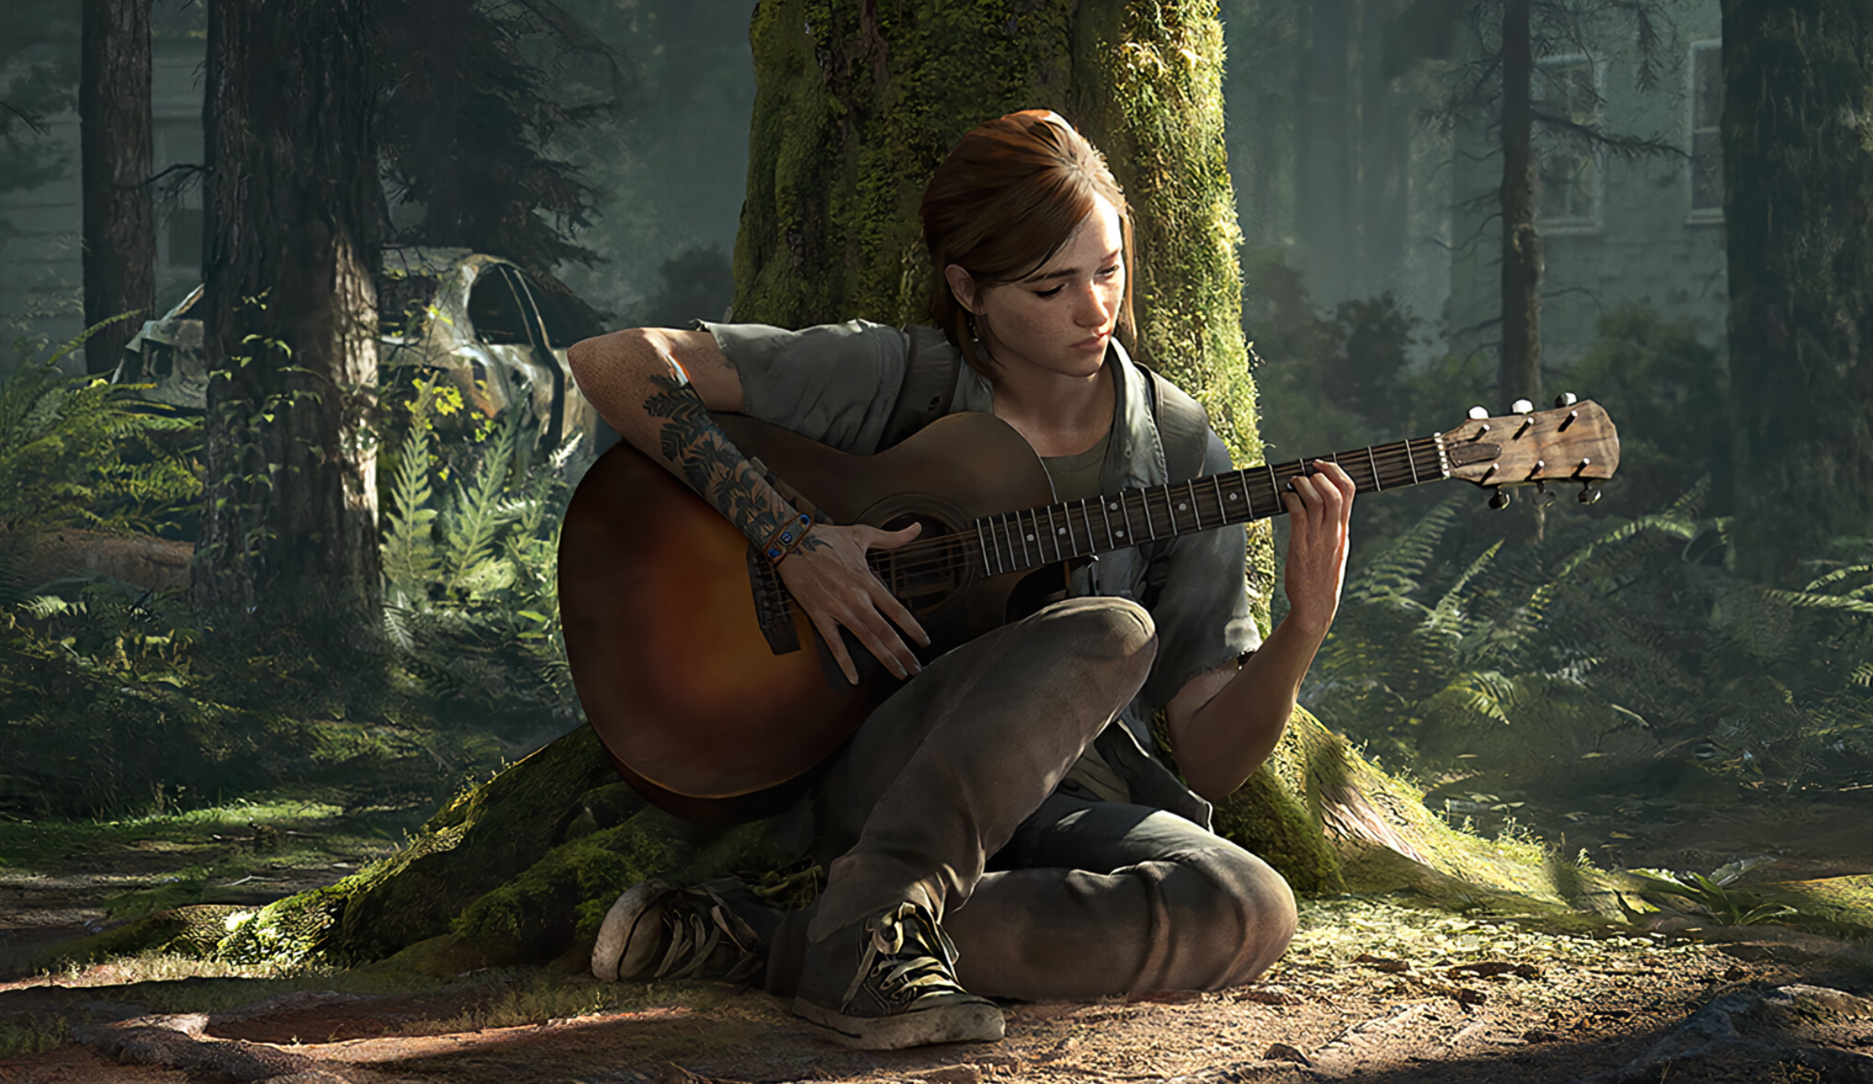
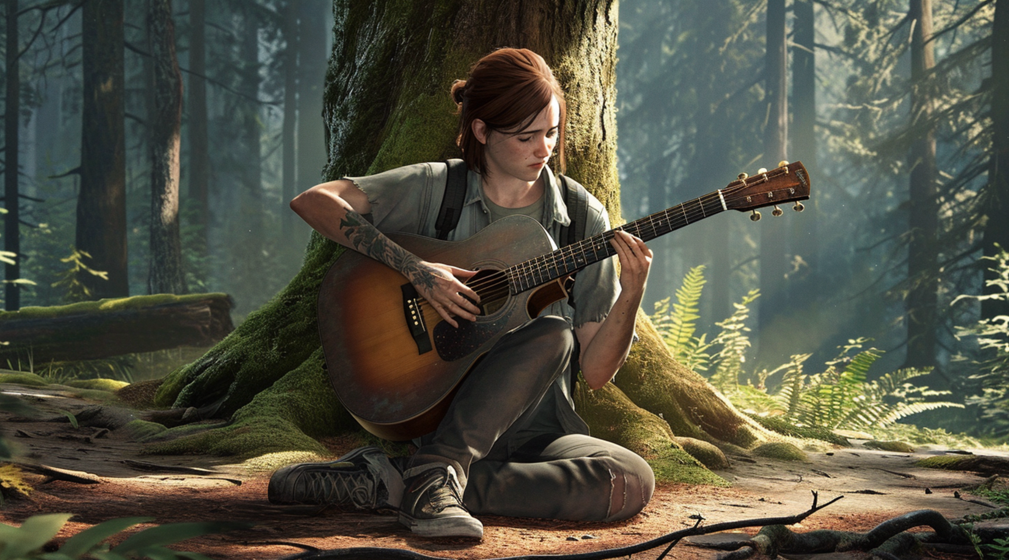
Image generated by MidJourney in response to prompt:
“the last of us 2 ellie with guitar in front of tree --v 6.0 --ar 16:9”
Copyrighted image from Naughty Dog, the video game developer

