Slide 1
Fearless Girl
Case Study 256
Copyright^{x}
Ben Hopper
Revised by William Fisher
April 2024
Licensed under terms available at https://ipxcourses.org

Slide 2
Charging Bull
Arturo Di Modica, an immigrant from Sicily, conceived “Charging Bull” in the days after the stock-market crash of 1987- intended as a symbol of New York’s drive, optimism and willingness to barrel ahead against the odds
1989: Di Modica spends $350,000 of his own money to cast “Charging Bull” in his Soho studio as a Christmas gift to the city
15 December 1989: Di Modica and team covertly place Charging Bull on Wall Street in the middle of the night
“It was love right away,” Di Modica, now 73, told MarketWatch. “They wanted to touch it, embrace it — it was beautiful. I stood there watching until about noon, when I took a break and went to lunch.”
Notes:
Source http://www.marketwatch.com/story/wall-streets-famed-cast-bronze-bull-turns-25-2014-12-15

Slide 3
Charging Bull
Notes:
Source: http://www.abc.net.au/news/2017-03-28/charging-bull-sometimes-called-the-wall-street/8393006

Slide 4
Charging Bull
Executives at the New York Stock Exchange, including Richard Grasso, then president and chief operating officer at the NYSE, were not amused
Police called in, and then private contractors removed Charging Bull to Queens
Notes:
Source http://www.marketwatch.com/story/wall-streets-famed-cast-bronze-bull-turns-25-2014-12-15

Slide 5
Charging Bull
Di Modica paid to bail Charging Bull out of Queens, and with the help of community activists, and the city’s Parks Department, found a new home for him just a few blocks away from the stock exchange in Bowling Green
Notes:
Source http://www.marketwatch.com/story/wall-streets-famed-cast-bronze-bull-turns-25-2014-12-15

Slide 6
Charging Bull
Di Modica likely recouped the expense of building the bull several times over, having cast sibling bulls for cities around the world, and having sold many smaller versions to collectors
Periodically, Di Modica pays a visit to his most famous creation, watching the tourists pose with it the way they first did 25 years before
Notes:
Source http://www.marketwatch.com/story/wall-streets-famed-cast-bronze-bull-turns-25-2014-12-15

Slide 7
Fearless Girl
Anticipating International Women’s Day on March 8, 2017, State Street Global Advisors (a large Boston-based investment firm) commissioned artist, Kristen Visbal, to make the “Fearless Girl” sculpture¹
  McCann, SSGA’s New York advertising firm, appears to have been involved in the conception of the sculpture²
SSGA secured a temporary permit from New York City to place the sculpture in the park opposite the bull
Notes:
See https://www.nytimes.com/2017/03/27/nyregion/fearless-girl-statue-de-blasio.html?_r=0; https://www.ssga.com/global/en/our-insights/viewpoints/enhancing-gender-diversity-on-boards-emea.html
See https://www.theguardian.com/us-news/2017/apr/12/charging-bull-new-york-fearless-girl-statue-copyright-claim

Slide 8
Fearless Girl
Notes:
Source: https://www.theguardian.com/us-news/2017/apr/12/charging-bull-new-york-fearless-girl-statue-copyright-claim

Slide 9
Fearless Girl
The sculpture was an instant sensation
Seen as a powerful symbol against oppression:
  "The bull represents men and power," says Cristina Pogorevici, 18, a student from Bucharest, Romania, who visited the statues this past week. "So she is a message of women's power and things that are changing in the world right now.”¹
An online petition requesting that the sculpture remain in place permanently had garnered more than 28,000 signatures by March 27, 2017²
Notes:
See https://www.usatoday.com/story/news/nation/2017/03/26/new-york-invite-fearless-girl-statue-stay-wall-street/99677644/
See https://www.nytimes.com/2017/03/27/nyregion/fearless-girl-statue-de-blasio.html?_r=0

Slide 10
Fearless Girl
March 27, 2017: Mayor Bill de Blasio of New York stood beside the statue during a news conference on Monday as he announced the decision to extend its stay until the next International Women’s Day, on March 8, 2018. He called the statue a symbol of “standing up to fear, standing up to power, being able to find in yourself the strength to do what’s right.”
“Men who don't like women taking up space are exactly why we need the Fearless Girl.”
Notes:
Source: https://www.nytimes.com/2017/03/27/nyregion/fearless-girl-statue-de-blasio.html?_r=0

Slide 11
Fearless Girl
Some feminists object
E.g., Gina Bellafante:
  "Corporate feminism", she wrote, "operates with the singular goal of aiding and abetting a universe of mothers who tuck their daughters in at night whispering, 'Someday, honey, you can lead the emerging markets and sovereign debt team at Citigroup, and then become a director at Yahoo.’” (New York Times, March 16, 2017)
Notes:
See https://www.theguardian.com/us-news/2017/apr/12/charging-bull-new-york-fearless-girl-statue-copyright-claim
See https://www.theguardian.com/us-news/2017/apr/12/charging-bull-new-york-fearless-girl-statue-copyright-claim
See http://www.marketwatch.com/story/wall-street-bull-artist-calls-bs-on-fearless-girl-statue-2017-03-20

Slide 12
Problem #1

Slide 13
Fearless Girl
March 20, 2017: “A tipster tells us that just after midnight this morning, she saw two men put a Make America Great Again hat on [Fearless Girl] and drape an American flag across it. They also gifted the statue with a few pro-Trump signs, including one reading, "VETS B4 ILLEGALS" and another with a drawing of Pepe the Frog. The reader tells us that though the men dressing the statue claimed nothing they did to it was offensive, Pepe the Frog has in fact been deemed a white nationalist hate symbol by the Anti-Defamation League.”
  Rebecca Fishbein, Gothamist, March 20, 2017
Notes:
See https://www.theguardian.com/us-news/2017/apr/12/charging-bull-new-york-fearless-girl-statue-copyright-claim
See https://www.theguardian.com/us-news/2017/apr/12/charging-bull-new-york-fearless-girl-statue-copyright-claim
See http://www.marketwatch.com/story/wall-street-bull-artist-calls-bs-on-fearless-girl-statue-2017-03-20

Slide 15
Problem #2

Slide 16
Fearless Girl
Arturo Di Modica’s reaction:
  New York City is violating his legal rights by allowing the “Fearless Girl” statue to be installed facing the bronze beast, without his permission¹
  The presence of the girl infringed on his own artistic copyright by changing the creative dynamic²
  “That is not a symbol! That’s an advertising trick,” the 76-year-old Sicilian immigrant said, clutching his heart³
At a press conference, he argued that "Fearless Girl" tarnished the positive message of the bull, which is "a better America and a better world."
On Di Modica’s view, the symbol of New York’s resilience is turned to symbol of oppression
Notes:
See https://www.theguardian.com/us-news/2017/apr/12/charging-bull-new-york-fearless-girl-statue-copyright-claim
See https://www.theguardian.com/us-news/2017/apr/12/charging-bull-new-york-fearless-girl-statue-copyright-claim
See http://www.marketwatch.com/story/wall-street-bull-artist-calls-bs-on-fearless-girl-statue-2017-03-20

Slide 17
Fearless Girl
November 2018: In response to di Modica’s complaints, Fearless Girl is relocated to a spot near the New York Stock Exchange
A plaque with footprints is placed at the original location
Notes:
See https://www.theguardian.com/us-news/2017/apr/12/charging-bull-new-york-fearless-girl-statue-copyright-claim
See https://www.theguardian.com/us-news/2017/apr/12/charging-bull-new-york-fearless-girl-statue-copyright-claim
See http://www.marketwatch.com/story/wall-street-bull-artist-calls-bs-on-fearless-girl-statue-2017-03-20

Slide 18
Problem #3

Slide 19
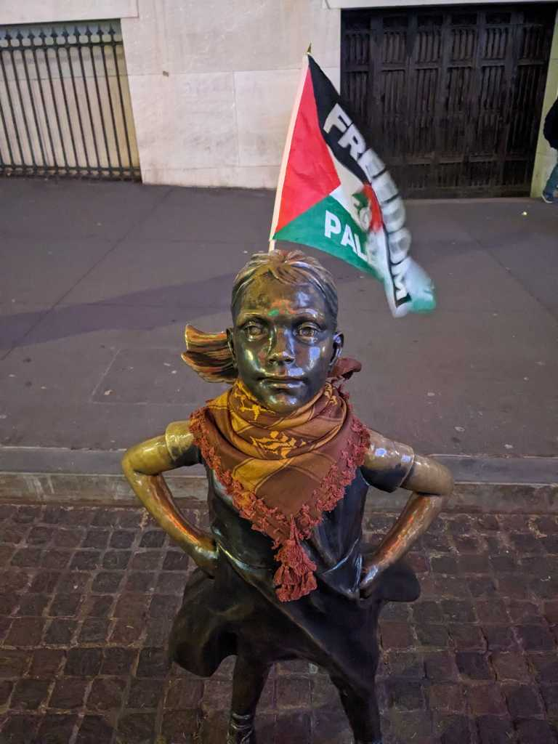
“The New York City-born activist, who identified herself only as Fatima, draped a brown keffiyeh around the neck of the bronze sculpture, to protest the Biden administration’s backing for Israel’s military actions in the Gaza Strip, she told The Post. She also attached a Palestinian flag bearing the words “Freedom for Palestine” to the statue” – New York Post, January 4, 2024

Slide 20
Fearless Girl – Questions
Did Visbal or SSGA have a claim against the two Trump supporters?
  Suppose that the city permitted the additions to remain in place. Would either have a claim against the city?
Did Di Modica have a copyright claim against Kristen Visbal, State Street Global Advisors, McCann (ad agency), or NYC?
Did Visbal or SSGA have a claim against Fatima?
  Suppose that the city permitted the additions to remain in place. Would either have a claim against the city?
What rules should govern such situations?
Notes:
Potential claims: 106(2), 106A, secondary liability of SSGA, McCann and NYC (VI/CI/II)? Potential defenses: 107
Visbal: WFH; hence, no moral rights claim
Policy discussion: where does the public interest lie? Is freedom of expression implicated?

