Slide 1
Gaylord Case Study 251
Copyright^{x}
William Fisher
March 2024
Licensed under terms available at https://ipxcourses.org

Slide 2
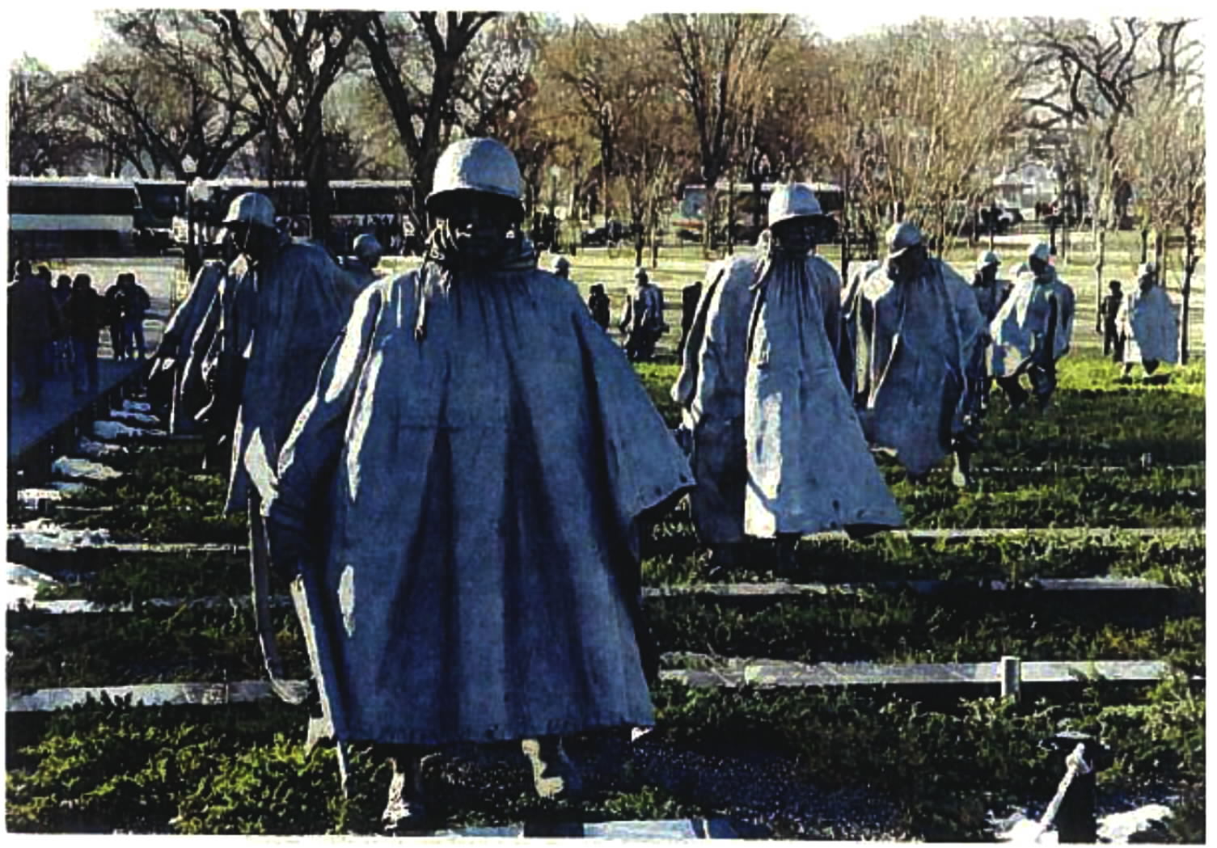

Slide 3
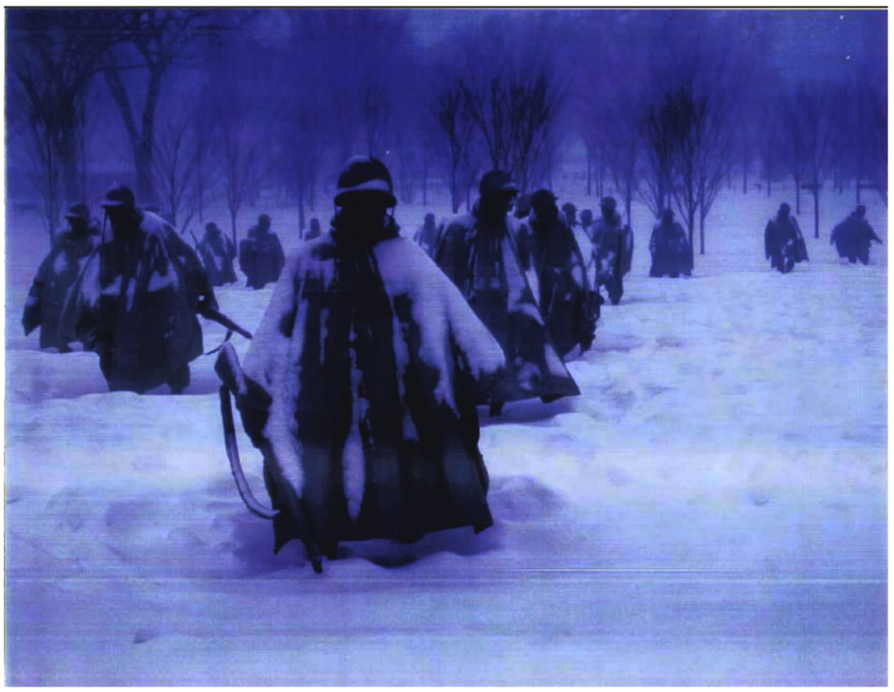

Slide 4
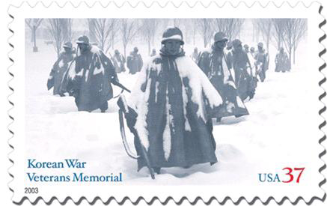

Slide 6
Gaylord
1. Purpose and character of defendant’s use | π | Same purpose: honor Korea veterans
2. Nature of copyrighted work | π | Sculpture is “expressive and creative”; publication is less important
3. Amount of copying | π | The stamp incorporated images of “many of the soldiers”
4. Impact on potential market | Δ | No adverse impact on primary or derivative markets
5?
Result:
π

