Slide 1
Ownership Composite Case Study 237
Copyright^{x}
William Fisher
February 2024
Licensed under terms available at https://ipxcourses.org

Slide 2
1. Suryast

Slide 3
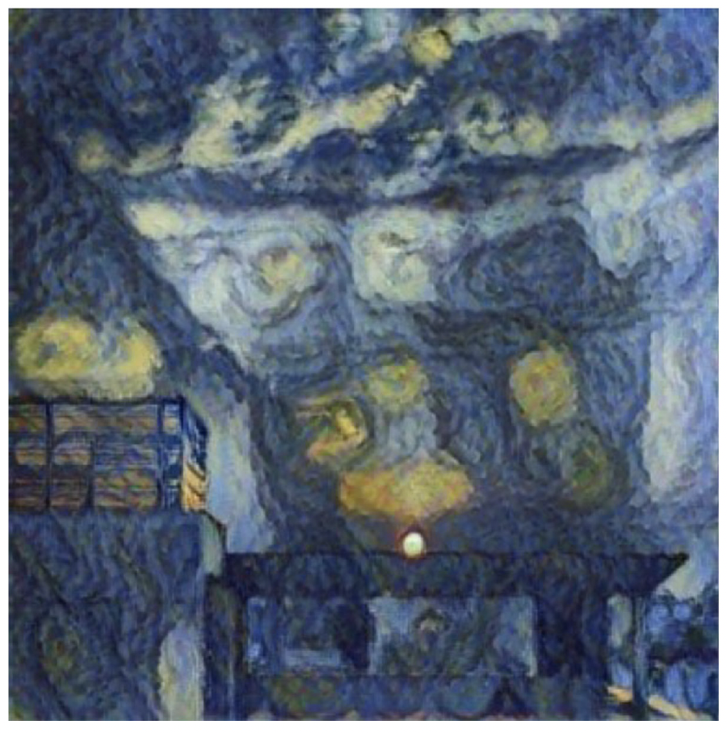
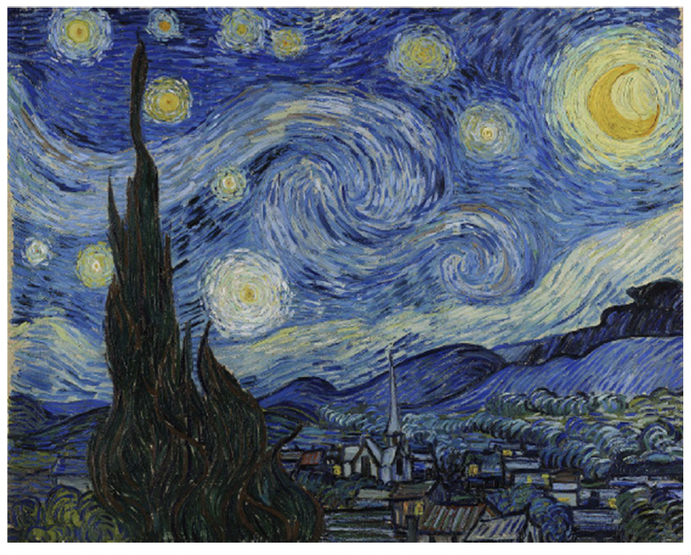
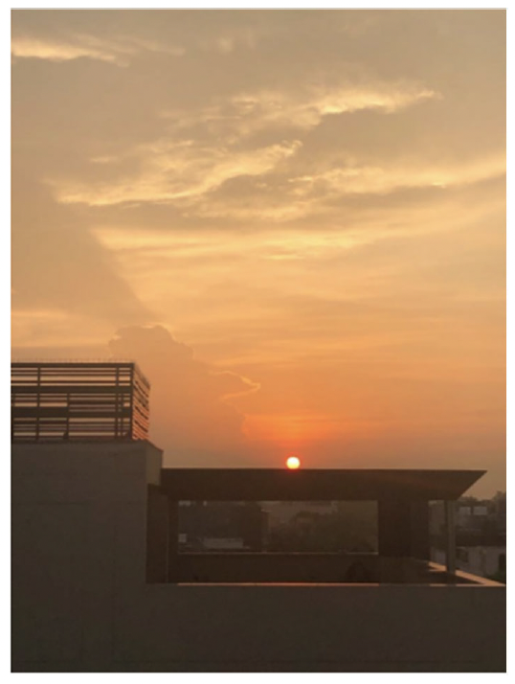
Generative Artificial Intelligence
Programmer(s)
Copyrighted Material
AI Firm
Creators
Assignees
ImageNet
RAGHAV
Suryast
Material in
the Public Domain
Sahni
Source
Material

Slide 4
2. Gigi Hadid (Kat Geddes)

Slide 5
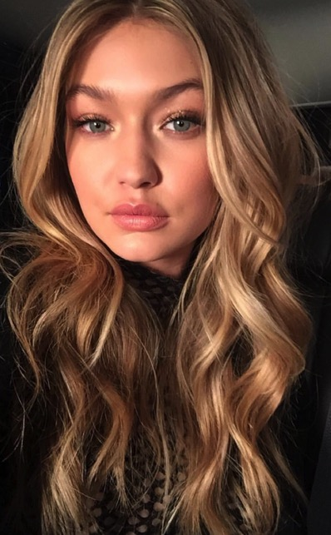
Gigi Hadid
American Fashion Model
43,000,000 Instagram followers

Slide 6
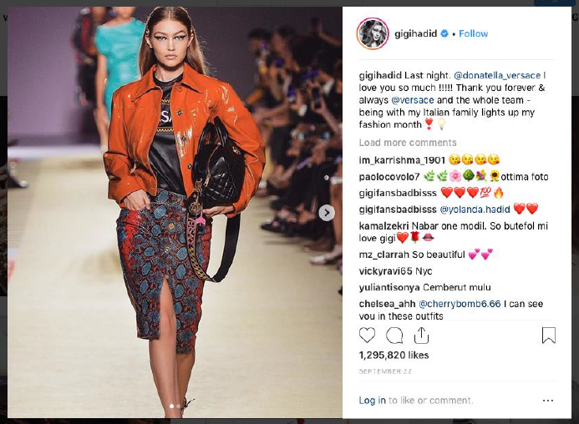

Slide 7
Top Influencers in 2018
 | Instagram followers | Fee per sponsored post
1. Kylie Jenner | 112,000,000 | $1,000,000
2. Selena Gomez | 139,000,000 | $800,000
3. Cristiano Ronaldo | 137,000,000 | $750,000
4. Kim Kardashian West | 114,000,000 | $720,000
5. Beyonce Knowles | 116,000,000 | $700,000
6. Dwayne Johnson | 111,000,000 | $650,000
7. Justin Bieber | 101,000,000 | $650,000
8. Neymar Da Silva Santos | 100,000,000 | $600,000
9. Lionel Messi | 100,000,000 | $500,000
10. Kendall Jenner | 100,000,000 | $500,000
Gigi Hadid | 43,000,000 | $300,000
Source: https://www.cnbc.com/2018/07/31/kylie-jenner-makes-1-million-per-paid-instagram-post-hopper-hq-says.html

Slide 8
Photos taken by paparazzi photographers on Oct. 11, 2018
All photos found on Twitter (@myqueengigiilg) with no attribution
Xclusive’s photo

Slide 9
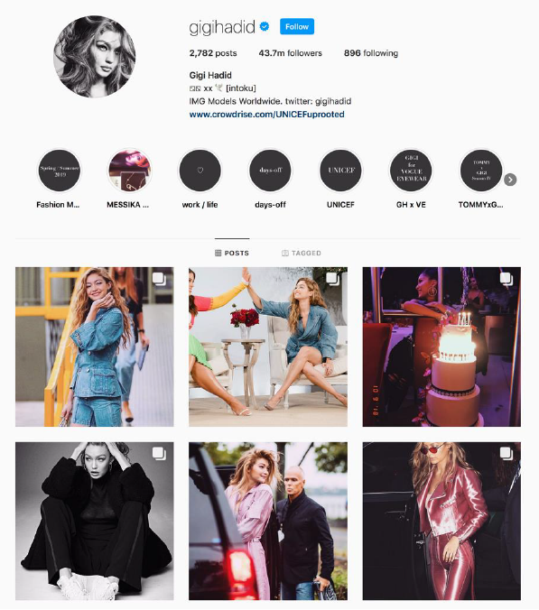

Slide 10
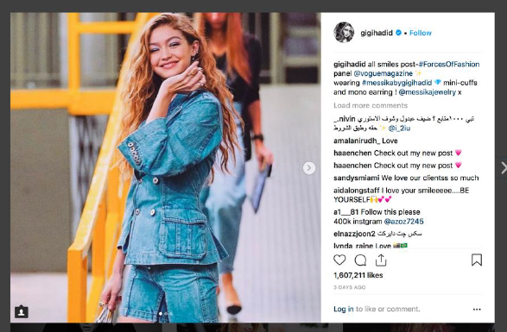

Slide 11
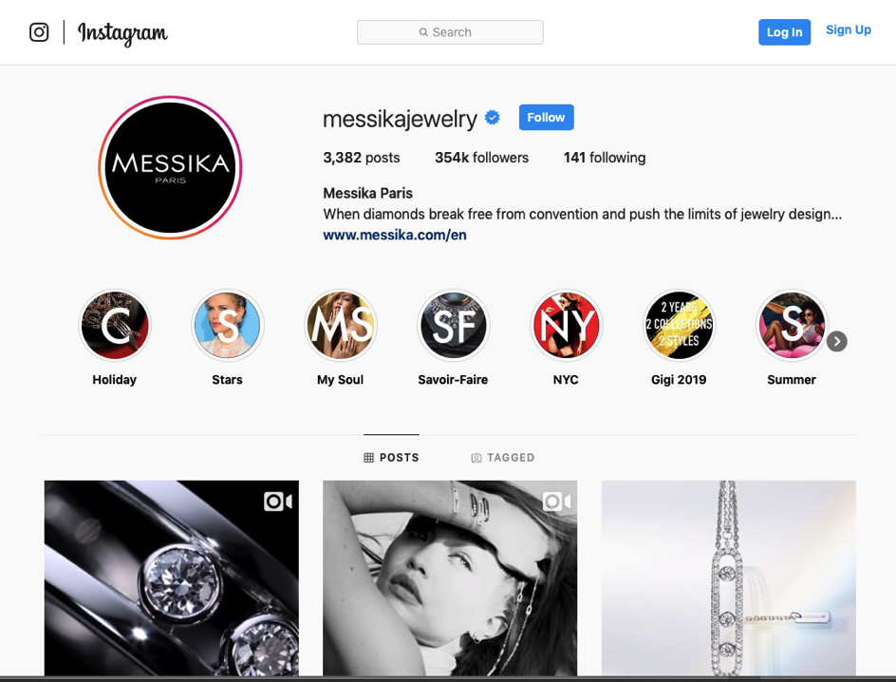

Slide 12
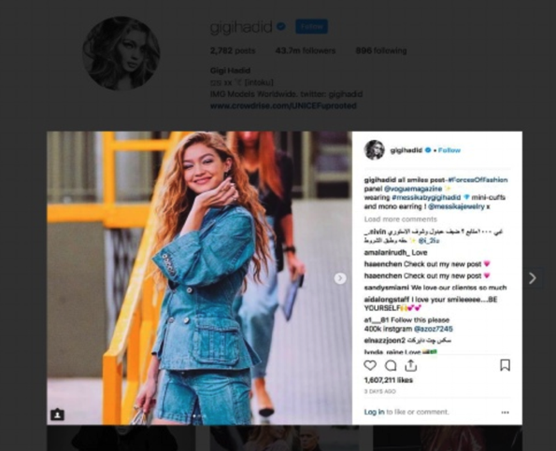
Xclusive’s photo (source: SCRIBD)
Gigi Hadid’s Instagram post (October 12) (source: Instagram)
Xclusive threatens litigation
Hadid removes the post

Slide 13
Outcome
July 2019: District Court dismisses the suit on the ground that Xclusive failed to register the copyright prior to filing suit; rejects request to amend the complaint
Suggests that, if Xclusive file a new complaint after Registration, it more clearly plead how it came to own the copyright

Slide 14
From PetaPixel
“Fortunately, the judge didn’t buy Hadid’s infamous argument that she could use the photograph because she had posed/smiled when it was taken, making her a co-author. Nor was the case dismissed on fair use grounds, because Hadid cropped the photo (another silly argument).”

Slide 15
3. Firefighter

Slide 16
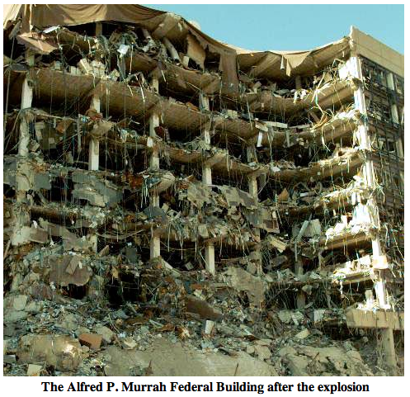
April 19, 1995

Slide 17
Porter
“On the morning of April 19, 1995, Charles (Chuck) Porter IV, banker and keen amateur photographer, left his desk on the 13th floor of the Liberty Bank building in Oklahoma City to go process a loan. No sooner had he arrived four floors below than he heard a tremendous boom and felt the building shaking. His first thought was of a controlled demolition but, looking out the window, he saw debris floating past. His curiosity was piqued.
“Porter had never forgotten advice given to him by John White, the Chicago photojournalist and Pulitzer Prize winner, to keep a loaded camera with him at all times. …. With camera in hand, he went in search of the source of the debris. Rounding the corner a couple of blocks away from the Liberty Bank, he came upon a stupefying site. …. The front of the edifice was gone and a large section off-centre had been gouged out from top to bottom. … He was on the scene before the first responders. There wasn’t a journalist in sight. He immediately began taking photographs.
“When I asked Porter to reflect on his emotions at the time, he recalled feeling shocked. But he also believes his camera became his buffer, separating him from the mayhem unfolding before his eyes. He spent around 45 minutes at the scene and shot two rolls of film. He did not know that a bomb planted by Timothy McVeigh had caused the damage and killed 168 people.”
Source: “The Accidental Photographer” (2016): https://www.theglobeandmail.com/news/national/the-accidental-photographer/article28511579/

Slide 18
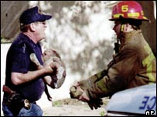

Slide 19
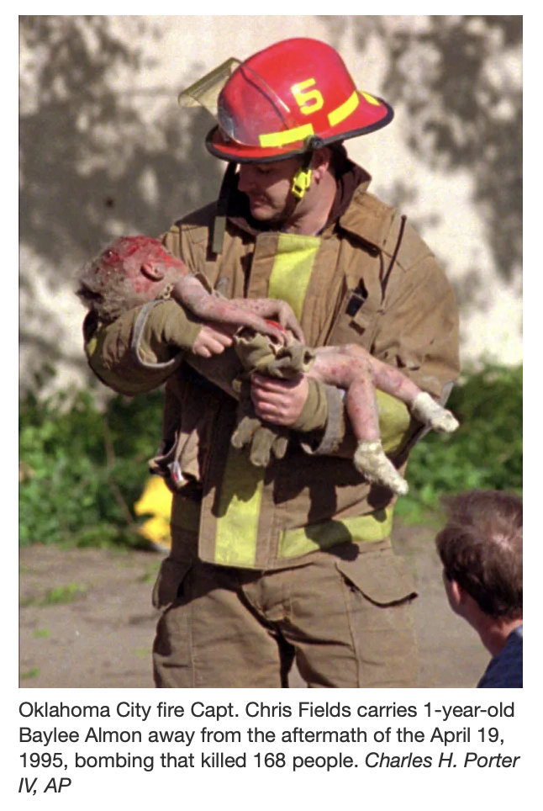
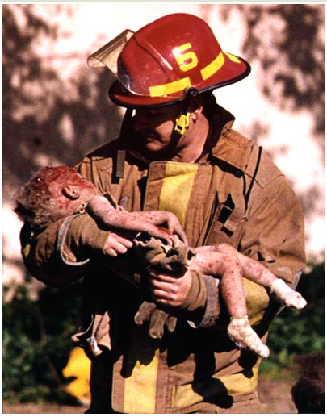
Porter photo

Slide 20
LaRue
“These cases all stem from the bombing that destroyed the Alfred P. Murrah Building in Oklahoma City, Oklahoma, on April 19, 1995.
“The Company is a natural gas utility that serves Oklahoma City. On April 19, 1995, Mr. LaRue was employed by the Company as the Safety Coordinator for its Oklahoma City district. As Safety Coordinator, it was part of Mr. LaRue's job to investigate explosions and take photographs of the scene.
“Mr. LaRue was in his office when the explosion destroyed the Murrah Building. Thinking the explosion may have been due to a natural gas leak, Mr. LaRue drove to the scene in a company vehicle to investigate. Once at the scene, he began taking photographs with a camera and film supplied by the Company. He took photographs of the overall scene, as well as of company crews shutting off gas lines. During this time, Mr. LaRue also assisted company crews by watching for dangerous overhead debris and by locating and shutting off gas lines. At least once, he reported in to the Company's command center at the scene.
“At one point, while preparing to photograph a company crew going into a basement area to rescue victims, Mr. LaRue noticed a firefighter cradling an injured infant. He took a photograph of the two, which became the well-known "firefighter and baby" photograph at the heart of this dispute.
Source: Oklahoma City Gas Co. v. LaRue (CA10 1998)

Slide 21
Commercialization
Both photographers license the photos for use on T-shirts, mugs, etc.
Mother of the baby, mothers of other babies killed in the attack, other firefighters, and the public at large are increasingly critical

Slide 22
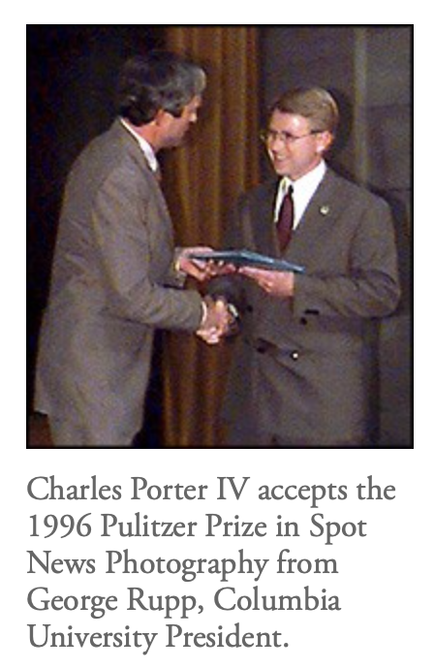
Porter
“Porter's photograph, distributed by The Associated Press, garnered numerous honors, including the British Picture Editor's Award and the National Headliners Award.”

Slide 23
Oklahoma Natural Gas Co. v. LaRue (CA10 1998)
“On October 5, 1995, the Company filed an action against Mr. LaRue in federal district court claiming copyright ownership of the photographs of the Oklahoma City bombing scene. The Company sought a determination of copyright ownership, damages for infringement, an accounting of the money already paid to Mr. LaRue for use of the photographs, and an injunction preventing Mr. LaRue from future use of the photographs. After full briefing, the district court granted the Company partial summary judgment, holding that it was the copyright owner. The district court then held a non-jury trial to resolve the remaining issues. Following the trial, the district court entered a Memorandum Opinion and Order in which it enjoined Mr. LaRue from future use of the copyrighted photographs in violation of the Company's copyright and assessed $ 34,623.50 in damages….

Slide 24
Oklahoma Natural Gas Co. v. LaRue (CA10 1998)
“Overwhelming evidence demonstrates Mr. LaRue was acting within the scope of his employment as he took the photographs in question, including: taking photographs was part of his job; it was during work hours; he used a company camera and film; the Company paid to develop the film; he reported in to the Company throughout the day; and he never told anyone he was taking personal time. The district court properly focused on application of the work made for hire doctrine, through which the Company was entitled to ownership of the copyrights. Mr. LaRue's certificate of registration does not establish any presumptions that would alter the work made for hire analysis, and as such, cannot create a genuine issue as to any material fact. “

Slide 25
4. Daughter in the Rubble (Zeynep Ülkü Kahveci)

Slide 26
Earthquake in Turkey
An earthquake with a magnitude 7.8 hit Kahramanmaraş, a city in Turkey at 04:17 am (local time) on 6 February 2023.
It caused major destruction in 10 cities in Turkey, as well as in neighboring cities in Syria.
A second earthquake with a magnitude 7.5 at hit 01:24 pm on 6 February 2023 (9 hours after the first one).
11,020 aftershocks have been recorded as of March 1, 2023.

Slide 27
Aftermath (in Turkey) – as of March 1, 2023
45,000 people were killed.
13.5 million people were directly affected.
2 million people have been displaced.

Slide 28
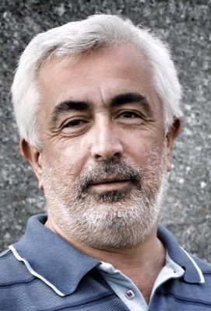
Press Coverage
Adem Altan : photographer based in Agence France Presse (AFP)'s Ankara bureau
Altan went to Kahramanmaraş on February 7 to document the earthquake site.

Slide 30
How did Altan take this photo? (AFP’s version)
“AFP photographer Adem Altan was taking pictures of a collapsed apartment building in Kahramanmaras the day after the earthquake hit the Turkish city when he noticed a man sitting alone in the middle of the rubble.
With rescue teams yet to arrive, people who lived in the block were trying to get to loved ones trapped under the piles of concrete and broken bricks.
But one man was not moving despite the rain and the freezing cold. It was then that Adem noticed that he was holding a hand. He trained his camera on him from about 60 metres (200 feet). It was a delicate moment, but the man in the orange jacket called him in.”
https://correspondent.afp.com/turkey-quake-fathers-pain

Slide 31
How did Altan take this photo? (AFP’s version)
““Take pictures of my child,” the man called in a low trembling voice. For a brief second Mesut Hancer let go of his daughter’s hand to show where she lay. Fifteen-year-old Irmak was crushed in her bed when the first pre-dawn tremor struck. The father wanted the world to see his loss. And it did.
As he took the photo “I had tears in my eyes,” said Adem, an image that would go around the world and become a symbol of the appalling suffering visited on the people of southern Turkey, but also of their quiet dignity.”

Slide 33
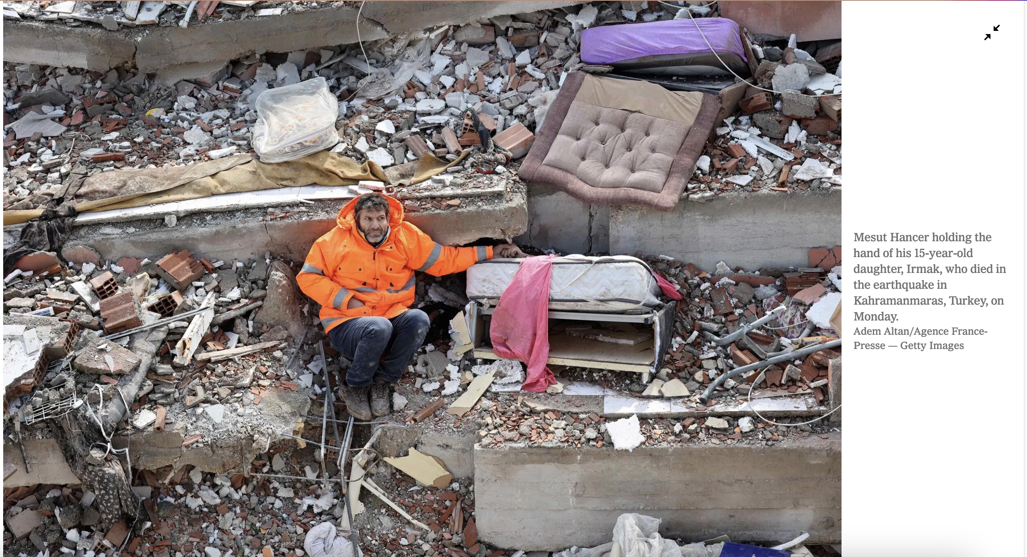

Slide 34
Copyright Law of Turkey, section 18(2)
The economic rights associated with a work created by an employee within the scope of employment are assigned automatically to the employer;
Employee remains the author of work and retains moral rights

Slide 35
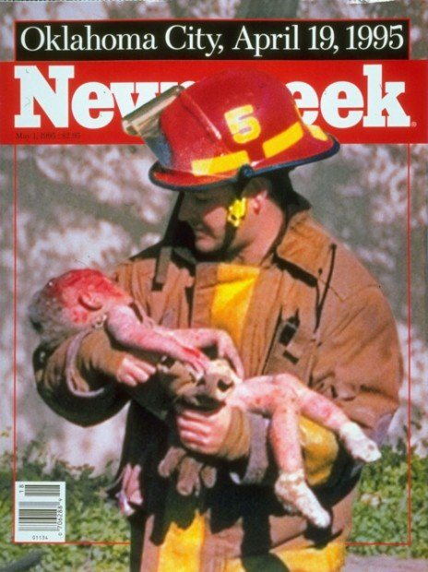
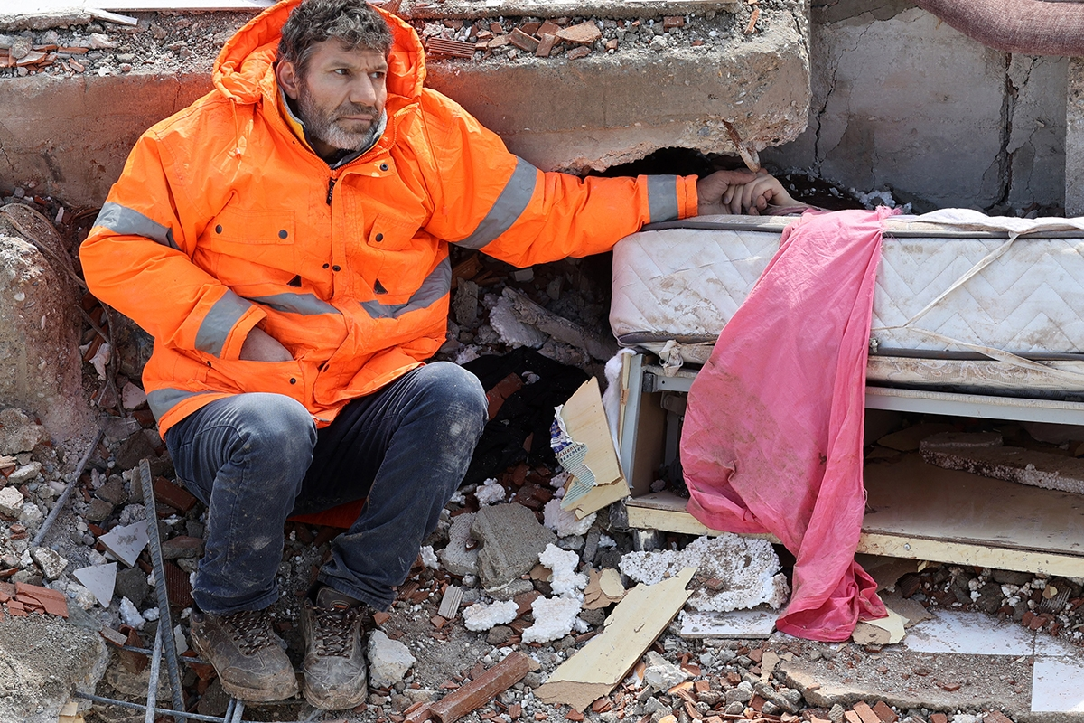
No one owns the copyright
Gas Company owns the copyright [work for hire]
Photographer owns the copyright [sole authorship]
Photographer owns the copyright; economic rights assigned automatically to AFP
Semble: Xclusive owns the copyright
[assignment from photographer]

