Slide 1
Choreography
CopyrightX Case Study 234
William Fisher
February 2020

Slide 2
The Growth of US
Copyright Law
Music
Prints
Photos
Sound
recordings
Paintings
Books, maps, charts
Software
Movies
Sculpture
Dramatic
works
Useful objects
Architecture
Lectures
Ads
Characters
Choreography

Slide 3
Choreography problems
 | Subject Matter coverage? | Originality? | Expression? | Copying? | Substantial similarity?
Les Twins
Fleaflicker
Bikram Yoga
Route du Rhum

Slide 4
Les Twins
World of Dance: http://www.youtube.com/watch?v=_XLGYxeL1iQ
Comparison: http://www.youtube.com/watch?v=3s1doSilyQc
Tokyo Hip Hop: https://youtu.be/nSZW-gRE0tw
Street Battle: https://youtu.be/VLcKX1f9tnM

Slide 5
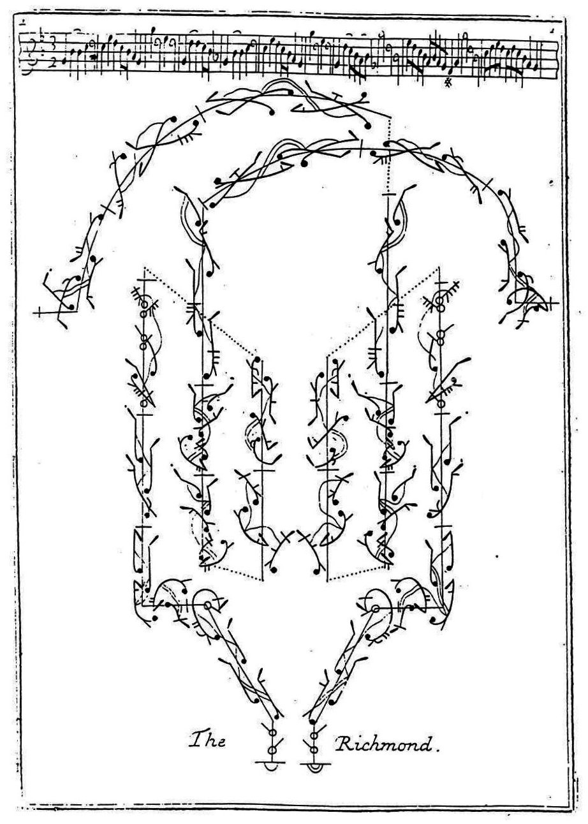
Examples of Dance Notation
Source: http://chrisbrady.itgo.com/dance/stepdance/hornpipe_conference.htm

Slide 6
By Jeffness at en.wikipedia [CC-BY-SA-2.5 (http://creativecommons.org/licenses/by-sa/2.5)], from Wikimedia Commons. http://commons.wikimedia.org/wiki/File:FleaFlicker.png
Notes:
Another way to illustrate a flea flicker is through the play diagrams that American football coaches share with their players:
Note the numbered steps.
Now a question for discussion: Could the flea flicker be copyrighted? If so, what is copyrightable?

Slide 7
Copyright Office Compendium 805.5(B)(3)
The Office cannot register claims to copyright in athletic activities or competitive events, because they do not constitute copyrightable subject matter under Section 102(a)(4) of the Copyright Act. See Registration of Claims to Copyright, 77 Fed. Reg. at 37,607.
Examples:
• Football plays.
• Slam dunking maneuvers.
• Gymnastic programs.
• Ice skating or ice dancing routines.
• Skateboarding or snowboarding.
• Synchronized swimming.
• Cheerleading routines.
• Marching band routines.

Slide 8
Litigation
Copyright Registrations
1979: Registration granted for “Bikram’s Beginning Yoga Class” (book containing the 26 asanas)
2002: Copyright Office clarifies registration; can be construed to recognize protection for a “compilation of floor exercises”
2003-2005: First wave of suits against unlicensed studios
Open Source Yoga Unity (NDCal. 2005): copyrightability is a question of fact; deny summary judgment – followed by settlement
Many unlicensed studios retreat
2011-2015: Second wave of suits
2012: Copyright Office repudiates registrability of yoga sequences
2012: Evolation Yoga (CDCal.): grant D’s motion for summary judgment
New version of Copyright Office Compendium
2015: Evolation Yoga (CA9) affirms grant of summary judgment

Slide 9
Copyright Office Ruling 77 C.F.R. 37607 (2012)
A sequence of yoga poses cannot be copyrighted
Bikram yoga in particular does not enjoy copyright protection
Any prior registrations of copyrights in yoga “were issued in error”

Slide 10
Copyright Office Compendium 805.5(B)(3)
Choreography and pantomime are the only types of works comprised exclusively of bodily movements that are eligible for copyright protection under Section 102(a)(4) of the Copyright Act. Because choreography is a subset of dance, a work of authorship cannot be registered as a choreographic work unless it is comprised of dance steps, dance movements, and/or dance patterns.

Slide 11
Copyright Office Compendium 805.5(B)(3)
“Functional physical movements” and “ordinary motor activities” — in and of themselves — do not represent the type of authorship that Congress intended to protect as choreography. Registration of Claims to Copyright, 77 Fed. Reg. at 37,607. The U.S. Copyright Office cannot register a claim to copyright in functional physical movements that merely implement an idea, procedure, process, system, method of operation, concept, principle, or discovery, regardless of the form in which the movements may be described, explained, or illustrated. 17 U.S.C. § 102(b). A work may be precluded from registration as a functional system or process if the particular movements and the order in which they are performed purportedly improve one’s health or physical or mental condition. See Bikram’s Yoga College of India, L.P. v. Evolation Yoga, LLC, 2012 U.S. Dist. LEXIS 177671, at *9-13 (C.D. Cal. Dec. 14, 2012) (quoting the Office’s policy statement concerning the registration of compilations from Registration of Claims to Copyright, 77 Fed. Reg. at 37,607). Examples of functional physical movements that cannot be registered with the Office include exercise routines, aerobic dances, yoga positions, and the like.

