Slide 1
MGM v. Honda
Case Study 193A
Copyright^{x}
Stefan Lehnardt & William Fisher
March 2024
Licensed under terms available at https://ipxcourses.org

Slide 2
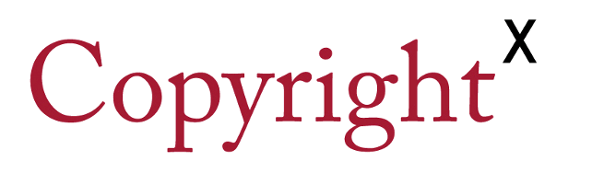
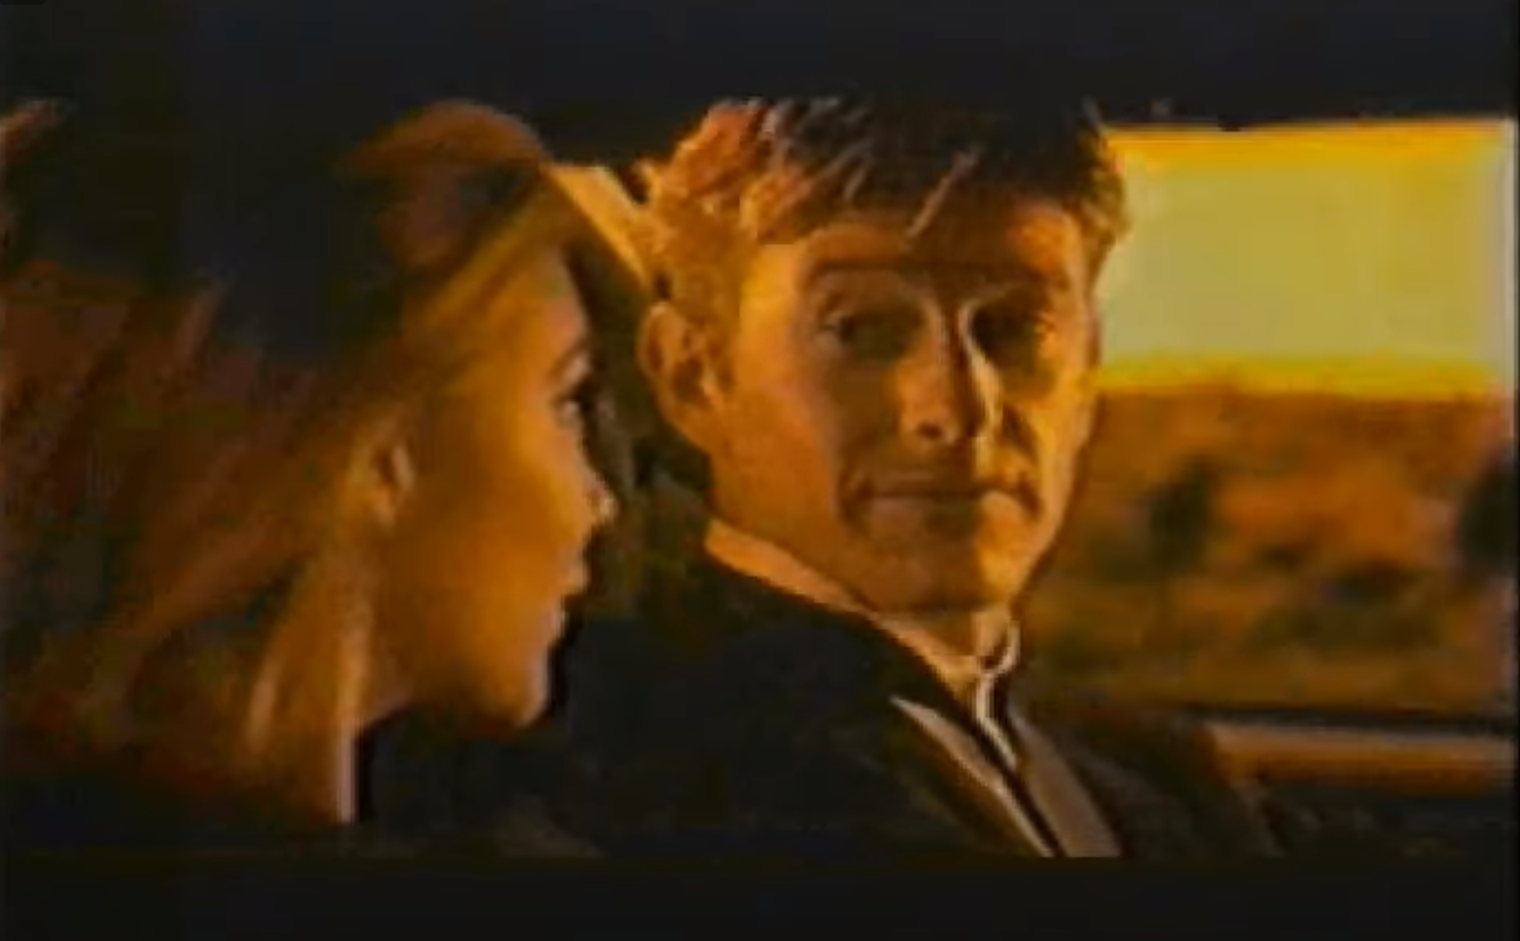
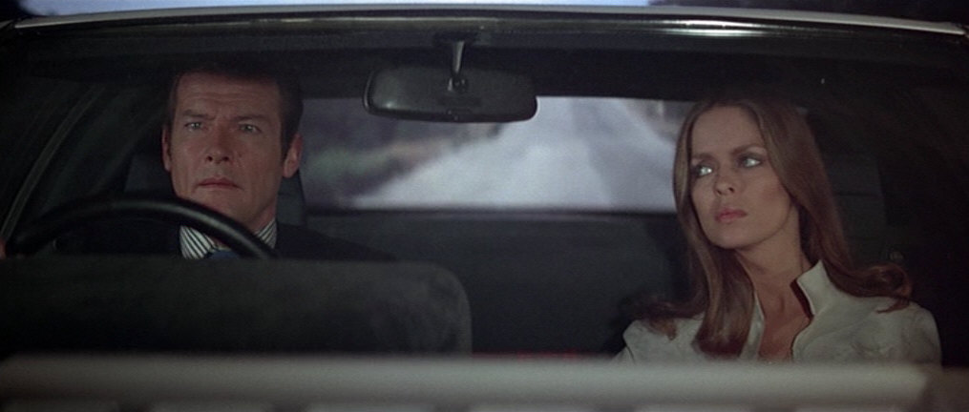
METRO-GOLDWYN-MAYER, INC. V. AMERICAN HONDA MOTOR
https://www.youtube.com/watch?v=gqa-b3assCA

Slide 3
Fair Use Factors
Factor | Who it favors | Court's Reasoning
Purpose and Character of new work | π | Parody in advertising given less indulgence than parody for its own sake
Nature of copyrighted work | π | Unique niche in action film genre
Amount used | π | Brevity does not excuse copying
Effect upon market for copyrighted work | π | James Bond makes lots of money lending upscale cachet to cars

