Slide 1
White v. West
Case Study 184
Copyright^{x}
William Fisher
March 2024
Licensed under terms available at https://ipxcourses.org

Slide 2
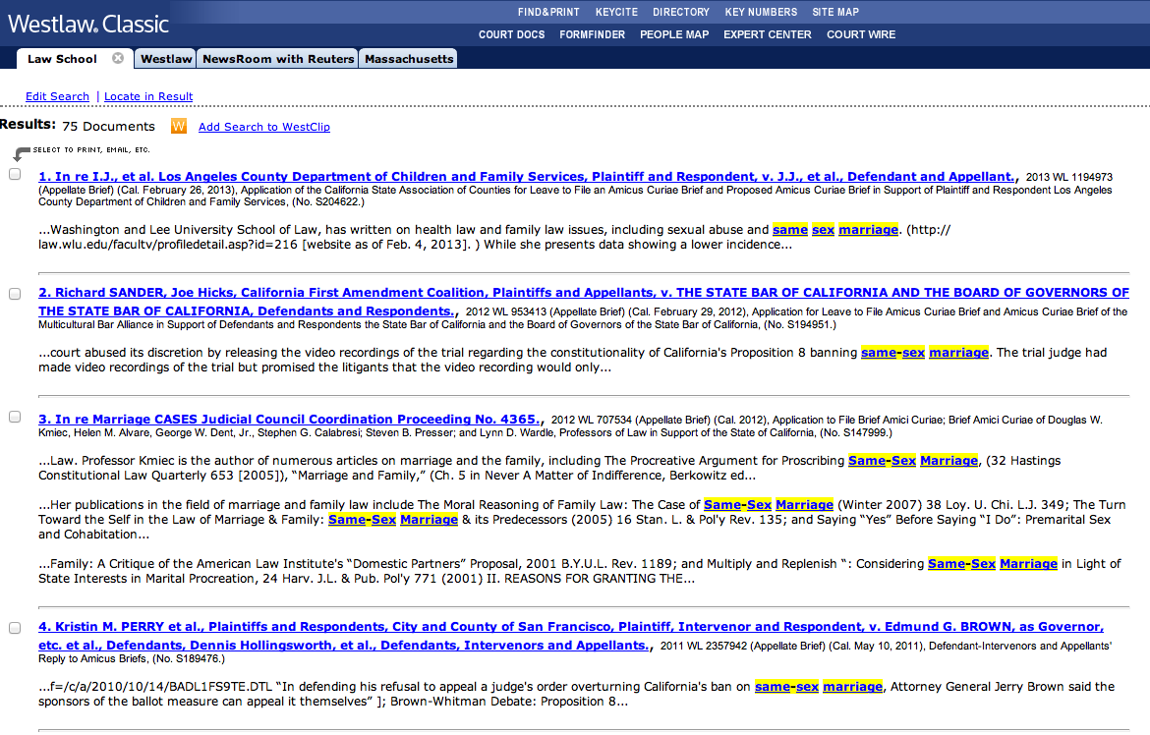

Slide 3
SDNY (Rakoff, J.)
1. Purpose and character of defendant’s use | D | Transformative because (a) different purpose (legal research tool) and (b) editing. Commercial purpose unimportant
2. Nature of copyrighted work | D | ”functional presentations of law and fact”; filing with court ~ publication
3. Amount of copying | D | Copying entirety is essential to function, thus neutral
4. Impact on potential market | D | No secondary market for briefs exists or is likely to exist
5?
Result:
D

