Slide 1
Star Athletica
CX 167
William Fisher
February 2022

Slide 2
Music
Prints
Photos
Sound
recordings
Paintings
Books, maps, charts
Software
Movies
Sculpture
Dramatic
works
Useful objects
Architecture
Lectures
Ads
Characters
Choreography

Slide 3
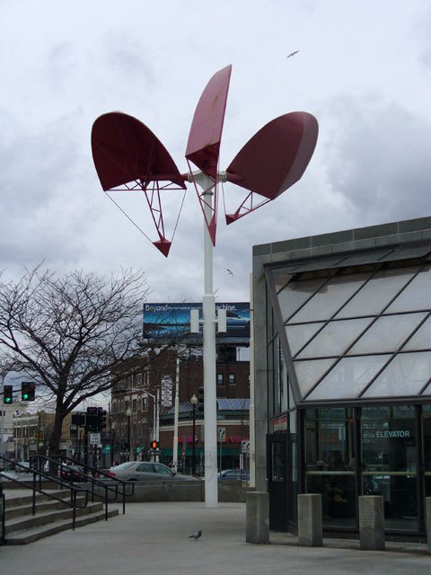
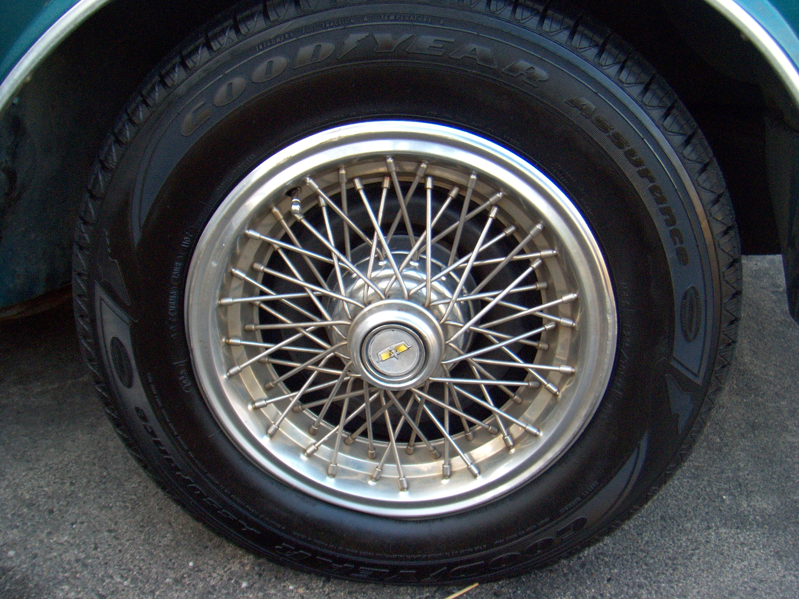
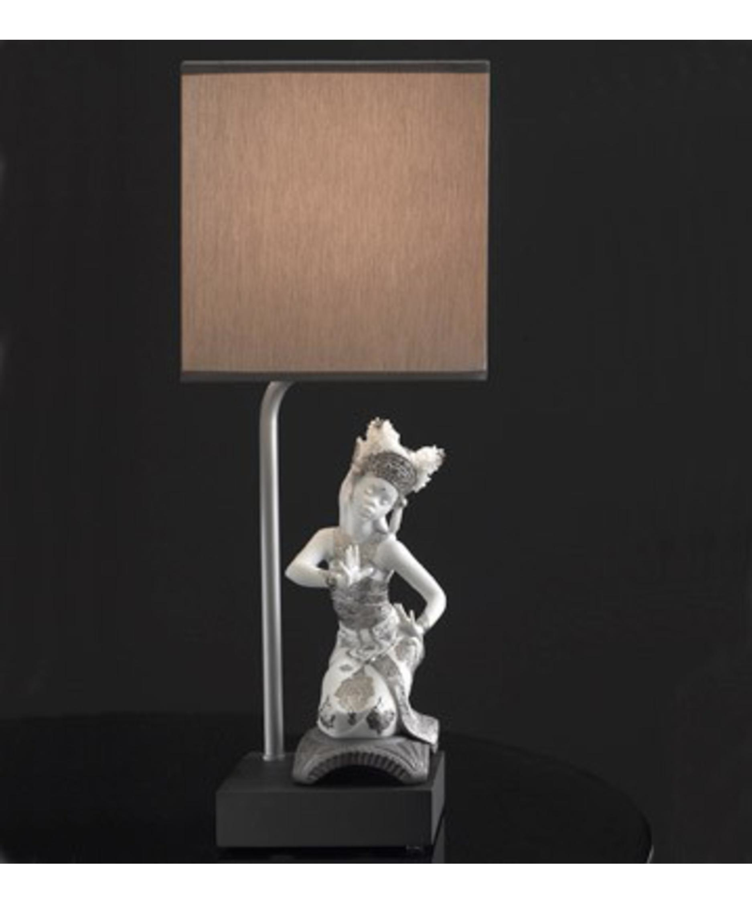
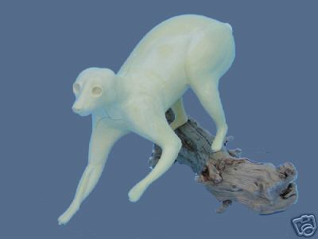
“Useful article”
Not “useful article”

Slide 4
“Useful article”
Not “useful article”

Slide 5
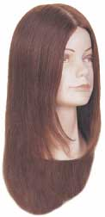
CA7 assumes for the sake of argument that it’s a useful article
“Useful article”
Not “useful article”

Slide 6
Music
Prints
Photos
Sound
recordings
Paintings
Books, maps, charts
Software
Movies
Sculpture
Dramatic
works
Useful objects
Architecture
Lectures
Ads
Characters
Choreography

Slide 7
Interpretations of Conceptual Separability

Slide 8
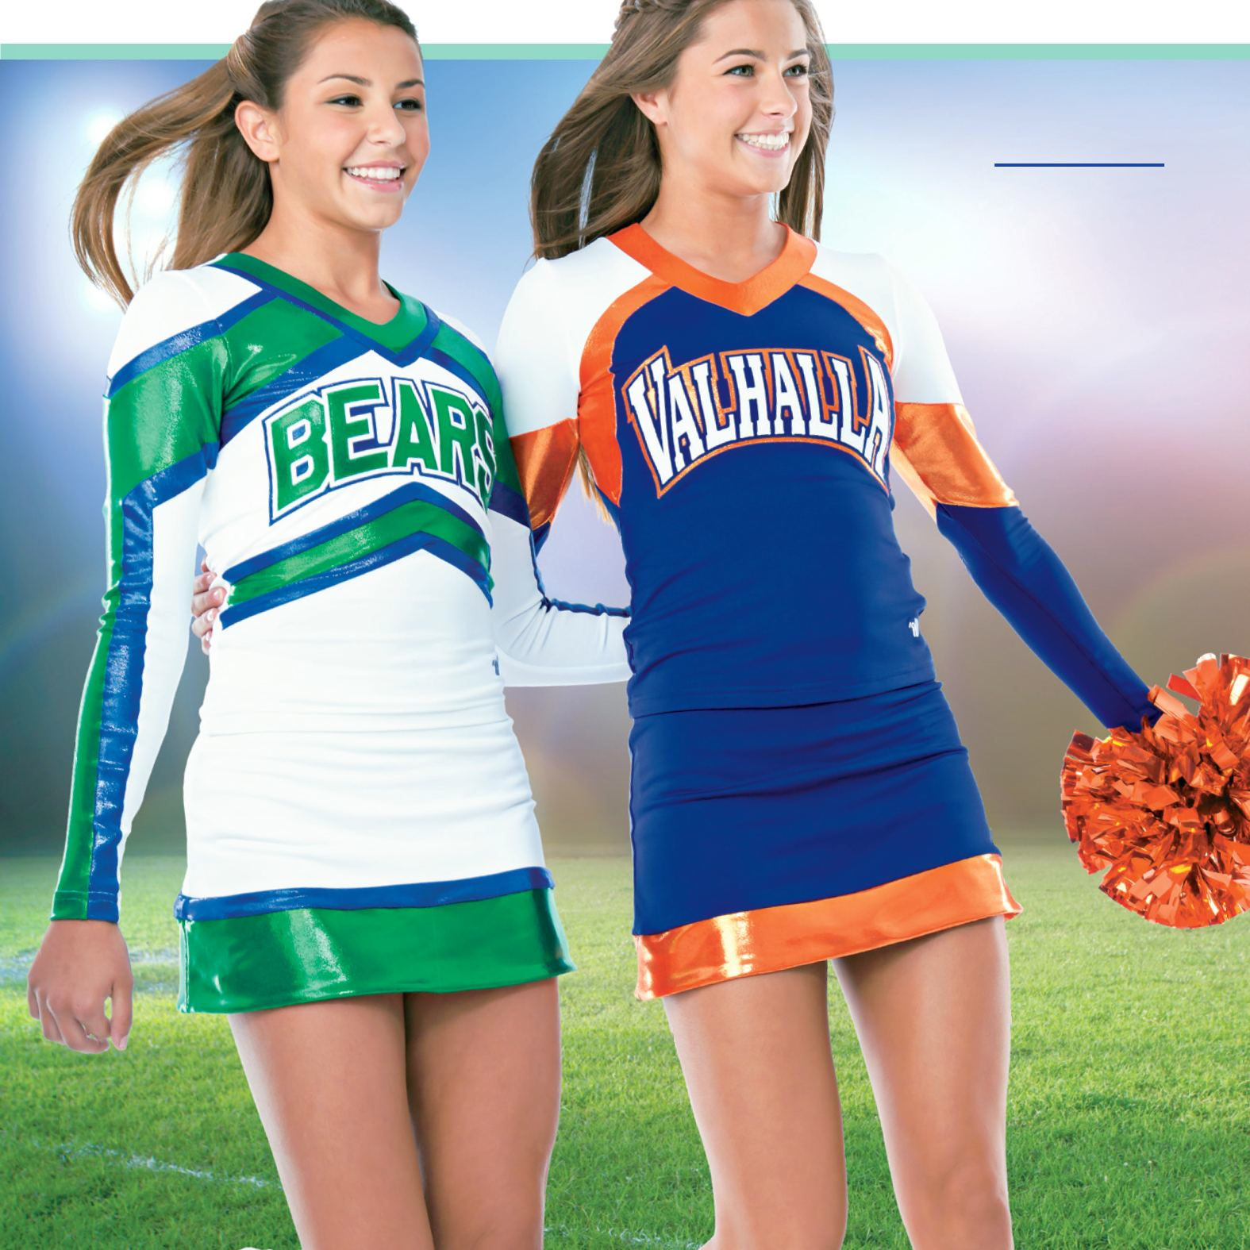
Star Athletica (March 2017)
“We hold that an artistic feature of the design of a useful article is eligible for copyright protection if the feature
can be perceived as a two- or three-dimensional work of art separate from the useful article and
would qualify as a protectable pictorial, graphic, or sculptural work either on its own or in some other medium if imagined separately from the useful article.”
“Applying this test to the surface decorations on the cheerleading uniforms is straightforward.
First, one can identify the decorations as features having pictorial, graphic, or sculptural qualities.
Second, if the arrangement of colors, shapes, stripes, and chevrons on the surface of the cheerleading uniforms were separated from the uniform and applied in another medium—for example, on a painter’s canvas—they would qualify as ‘two-dimensional . . . works of . . . art,’ §101. And imaginatively removing the surface decorations from the uniforms and applying them in another medium would not replicate the uniform itself.”

Slide 9
“Marita” (Mara Series)
– Pivot Point
http://pivotpointstore.com/
marita_20.html

Slide 10
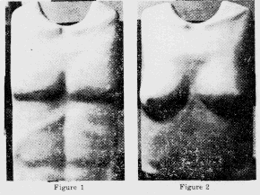

Slide 11
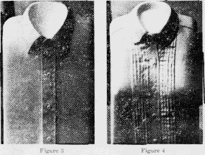

Slide 12
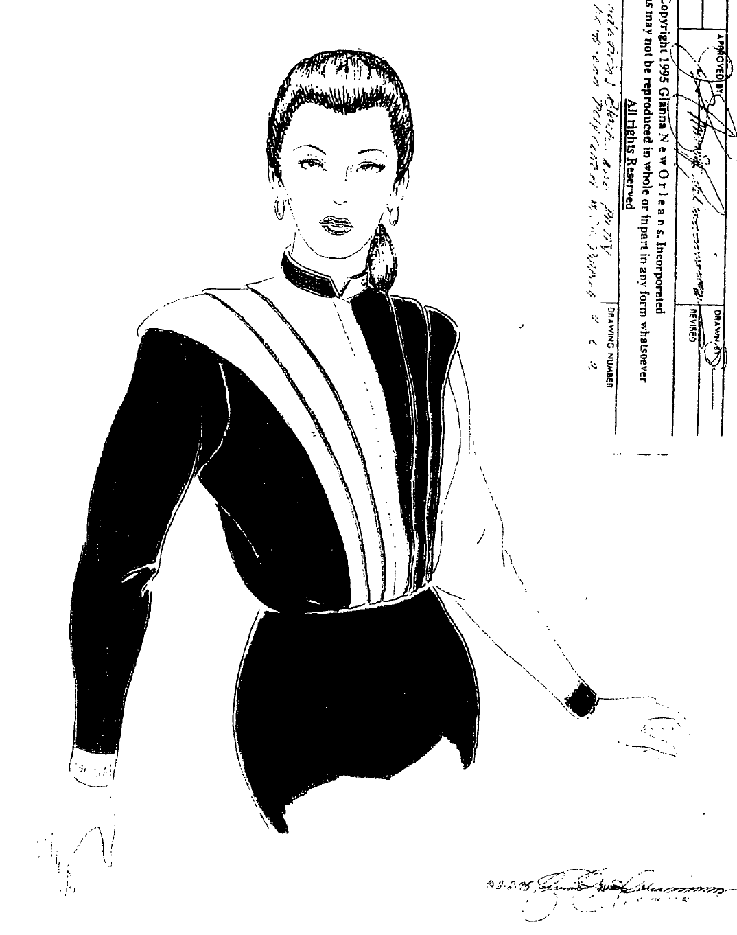
Galiano
Source: Plaintiffs’ Exhibit

Slide 13
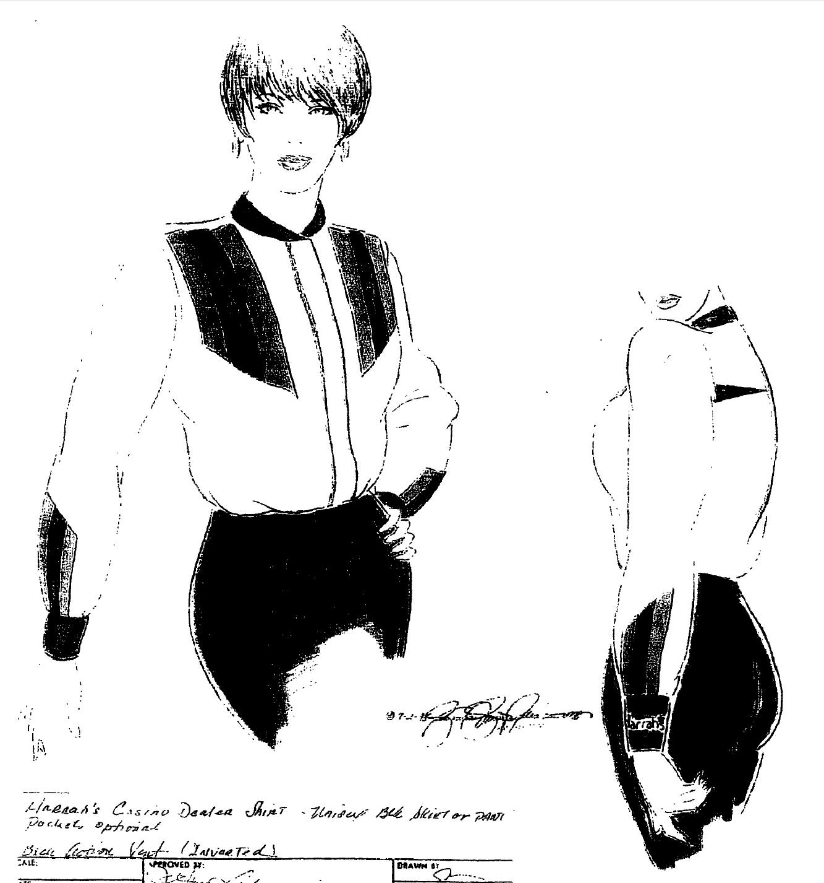
Galiano
Source: Plaintiffs’ Exhibit

Slide 14
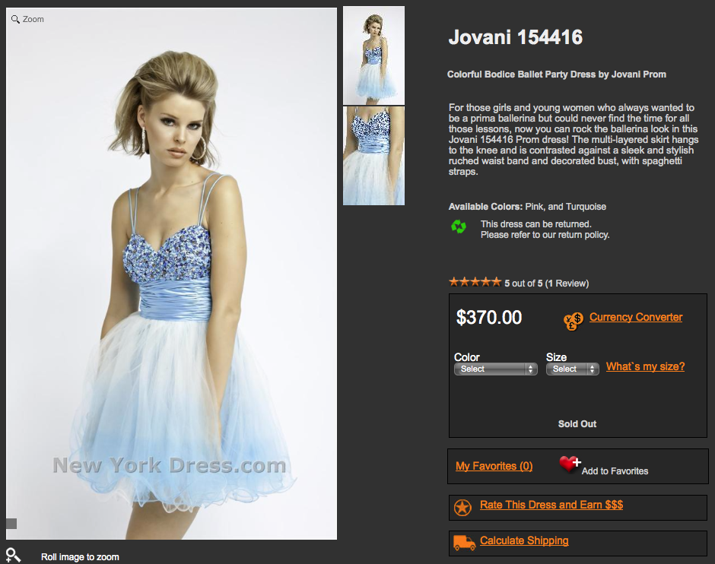
Source: http://www.newyorkdress.com/Jovani/154416.html

Slide 15
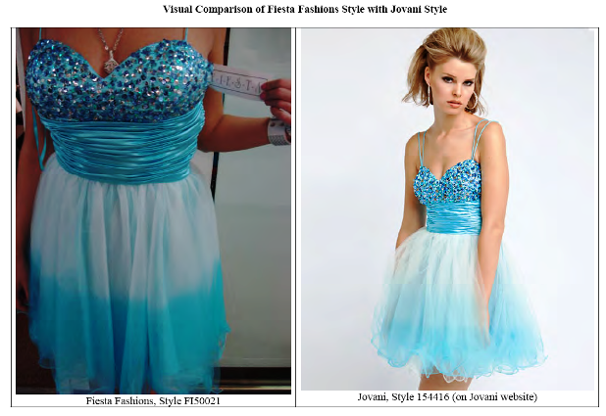

Slide 16
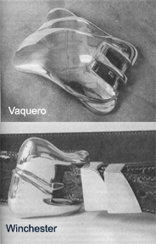
Kieselstein Buckles

Slide 17
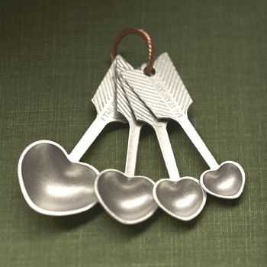

Slide 20
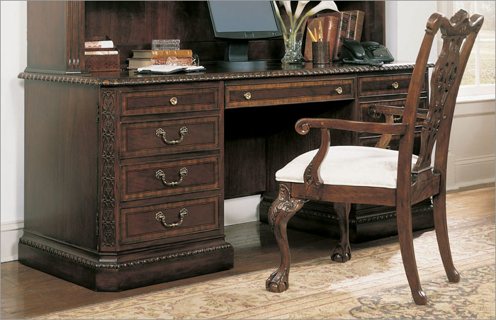

Slide 21
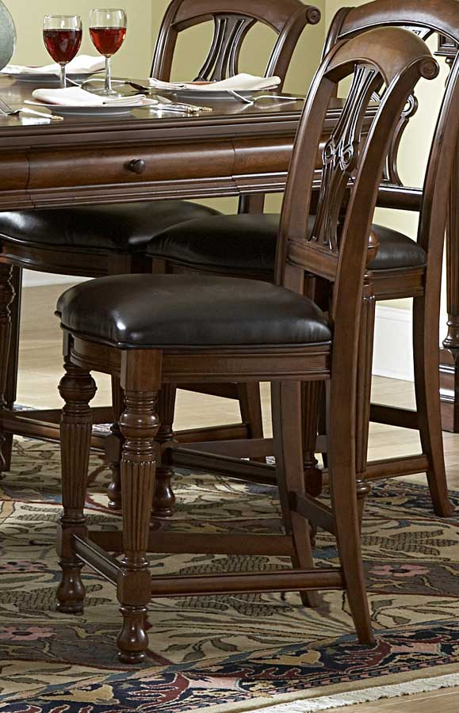

Slide 22
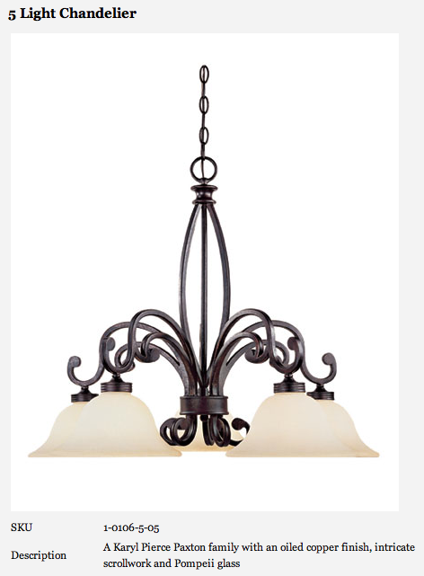
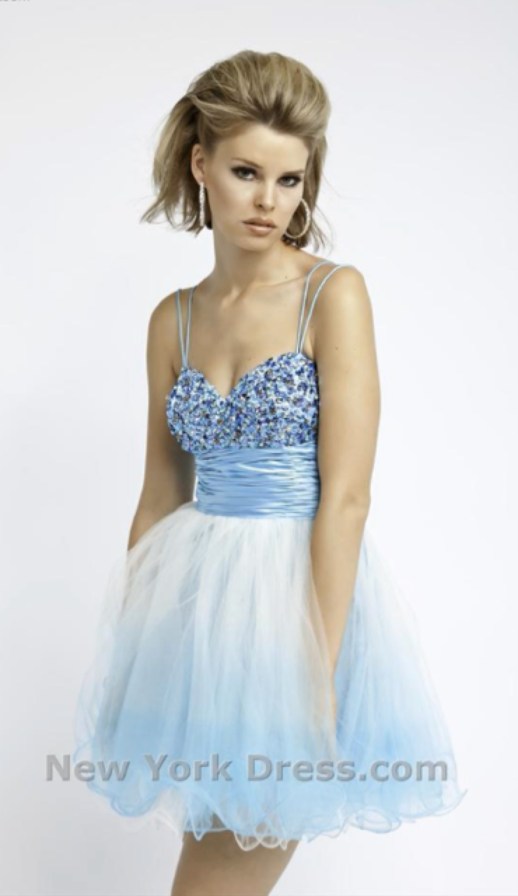
Progressive
Lighting
Pivot Point
Barnhart
Cases in which the article was deemed conceptually separable before Star Athletica
Galiano
Universal
Kieselstein
Brandir
Y
Jovani
Bonazoli
Star
Group: ________________
Indicate in each left box whether you think this object would be deemed conceptually separable by a court today.
Indicate in each right box whether, in your opinion, it should enjoy copyright protection.

Slide 23
Fleur de Lis

Slide 24
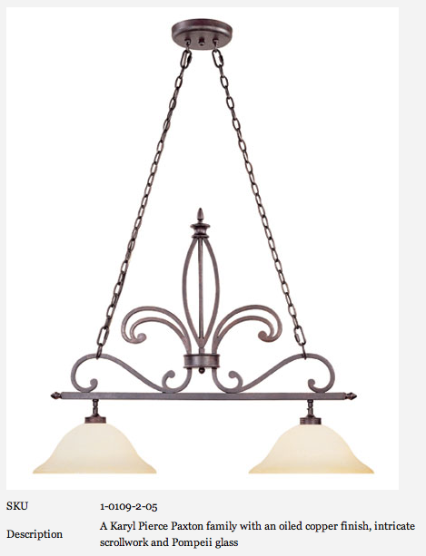

Slide 25
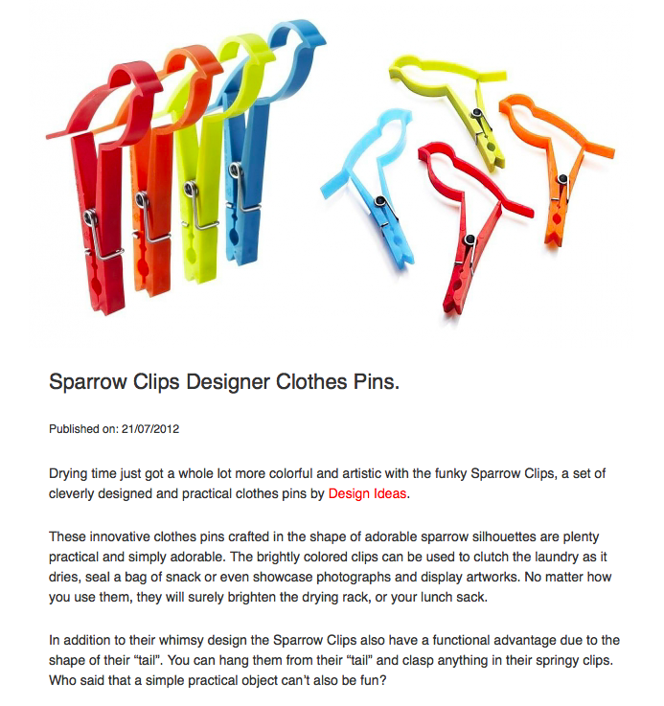
Source: DesignisThis Blog, https://www.designisthis.com/blog/en/post/sparrow-clips-designer-clothes-pins

Slide 26
