Slide 1
5Pointz
Medha Gargeya
Revised by William Fisher
April 2022

Slide 2
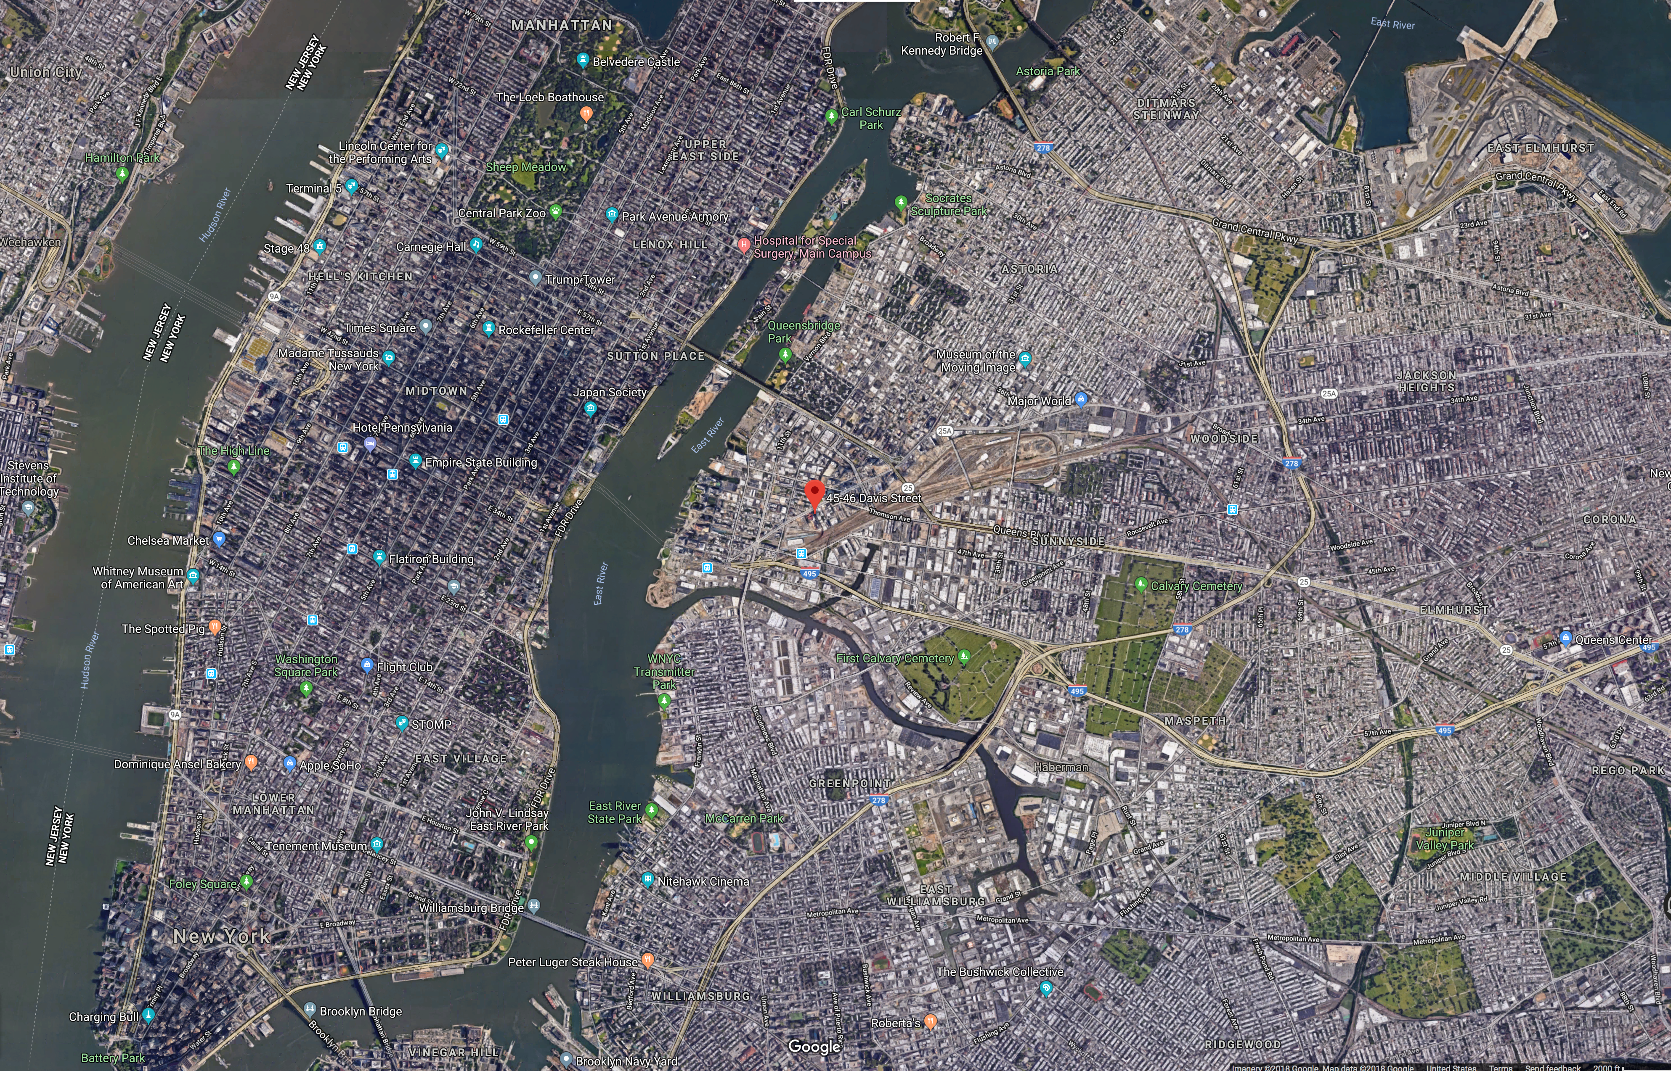

Slide 3
Front and Side of 5 Pointz

Slide 4
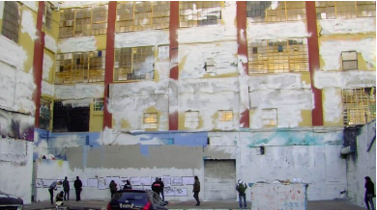
Whitewashed
Notes:
https://voicesofny.org/2013/11/5pointz-gone-but-not-the-culture-artists-say/
5Pointz, now covered with white paint. (Photo by Juliette Dekeyser/Voices of NY)

Slide 5
Statutory Damages
Factfinder may award between $750 and $30,000 per work, unless the infringement was committed willfully; if so, the award may be as high as $150,000 per work
  Wilfulness = defendant knew that “conduct represented infringement or… recklessly disregarded the possibility” Bryant v. Media Right Prods., 603 F.3d 135, 143 (2d Cir. 2010)
When determining the amount of statutory damages to award for copyright infringement, courts consider:
  the infringer’s state of mind;
  the expenses saved, and profits earned, by the infringer
  the revenue lost by the copyright holder
  the deterrent effect on the infringer and third parties
  the infringer’s cooperation in providing evidence concerning the value of the infringing material
  the conduct and attitude of the parties.
Notes:
Cohen v. G&M Realty L.P., No. 13-CV-05612(FB)(RLM), 2018 WL 851374, at *36, *45 (E.D.N.Y. Feb. 12, 2018).

Slide 6
Statutory Damages
Willful? | Actual or constructive knowledge of disregarding plaintiffs’ VARA claims. Could have given 90-day notice to salvage works.
Infringer’s State of Mind | Willful, whitewashing mutilated works → high award
Expenses saved, and profits earned, by the infringer | Indirect profit from value of site increasing from $40 million to $200 million when variance was obtained → high award
Revenue lost by the copyright holder | Artists couldn’t show clients work as readily → high award
Deterrent effect on the infringer and third parties | “Wolkoff has been singularly unrepentant.” No remorse, need to show VARA’s “teeth” → high award
Infringer’s cooperation in providing evidence concerning the value of the infringing material | Not mentioned
Conduct and attitude of the parties | “Plaintiffs have conducted themselves with dignity, maturity, respect, and at all times within the law” → high award
Notes:
Cohen v. G&M Realty L.P., No. 13-CV-05612(FB)(RLM), 2018 WL 851374, at *49 (E.D.N.Y. Feb. 12, 2018).

Slide 7
Damages
 | Plaintiff | Defendant | Judge
Actual Damages | $50k - $80k based on Banksy piece | No market value, because hard to remove | No market value
Statutory Damages |  |  | $150,000 for each of the 45 works, for a total statutory damages award of $6,750,000
Total Damages |  |  | $6.75 million
“If not for Wolkoff’s insolence, these damages would not have been assessed. If he did not destroy 5Pointz until he received his permits and demolished it 10 months later, the Court would not have found that he had acted willfully.”
Notes:
Cohen v. G&M Realty L.P., No. 13-CV-05612(FB)(RLM), 2018 WL 851374, at *40—49 (E.D.N.Y. Feb. 12, 2018).

Slide 8
Museum of Street Art
Opened October 2018 in stairwell of CitizenM Bowery Hotel
https://www.youtube.com/watch?v=4pzK0fKGlQY&feature=youtu.be

