Slide 1
William Fisher
February 2022

Slide 2
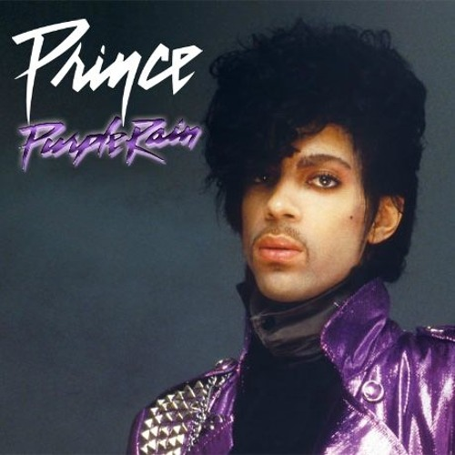
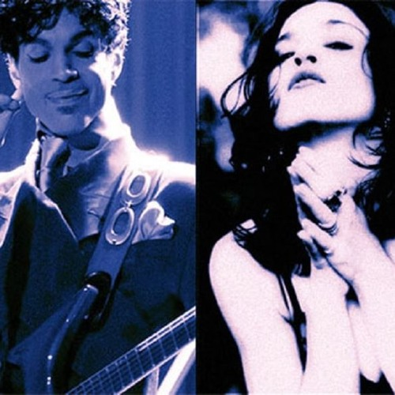
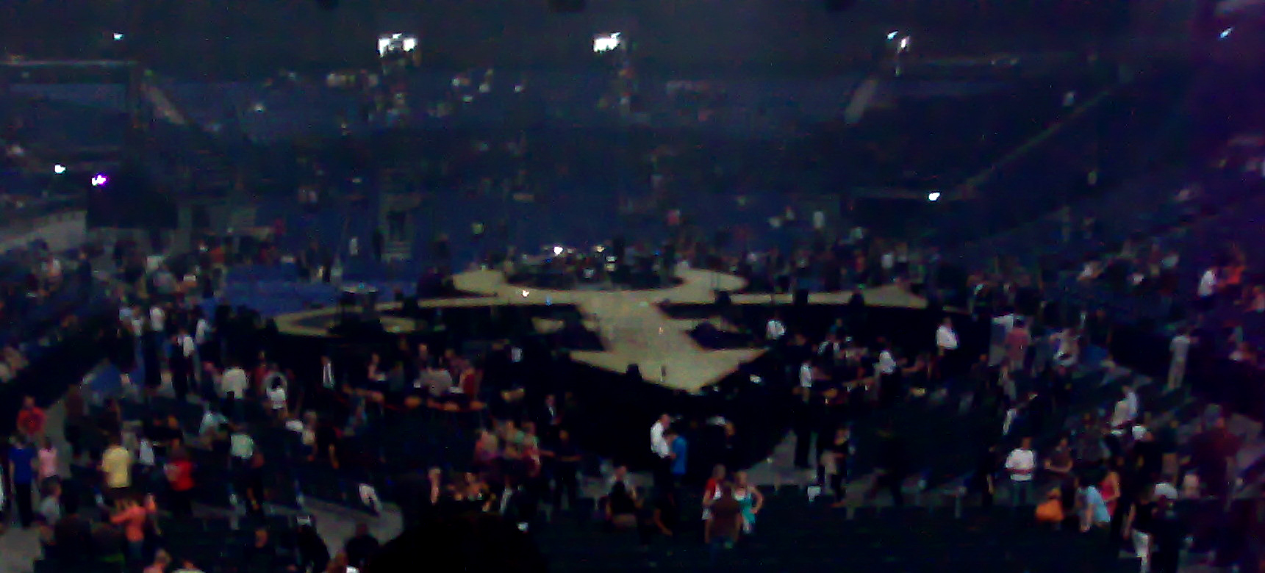
Responsibilities of Comerica:
Ascertain Prince’s assets
Maximize the value of those assets
Determine their (maximum) value
Pay taxes
Distribution to heirs at law
For You
4/7/1978
Purple Rain
6/24/1984
2007: Superbowl
halftime show
“Love Song”
1989
2014
Renegotiation of contract with Warner Bros.
1/20/2017 Comerica Bank replaces Bremer Trust as administrator
1977 Recording contract with Warner Bros.:
3 albums
Born
6/7/1958
1993 changes
name to
1996 releases final album, fulfilling contract with Warner
1998 Recording contract with Arista; he retains rights to the masters
Death 4/21/2016

Slide 3
Tyka Nelson (sister)
Half siblings: John Nelson, Norrine Nelson,
Sharon Nelson, Alfred Jackson, Omarr Baker
Source: http://www.usmagazine.com/celebrity-news/news/princes-sister-tyka-nelson-claims-he-left-no-will-w204255

Slide 4
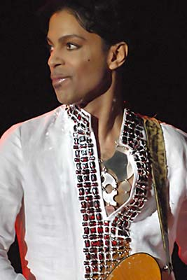
Prince estate
Musical creations:
39 albums
Composed at least 500 songs

Slide 5
Prince estate
(Intestate) Estate:
Real Estate (Paisley Park)
Cash and Investments
Copyrights
Contract rights
Vault containing
Several fully produced albums
Recordings of concerts
50 music videos
Potential infringement claims against bootleggers
Potential trademarks

Slide 6
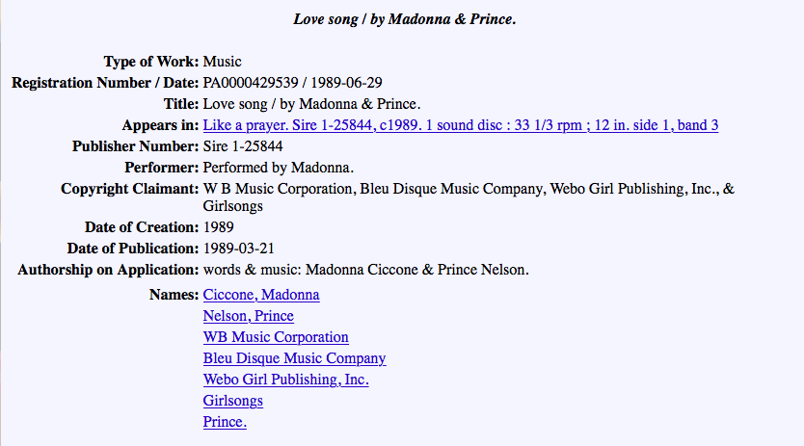

Slide 7
Life Annuity
The term life annuity refers to a financial product that features a predetermined periodic payout amount until the death of the annuity owner—called the annuitant. An annuitant typically pays into the annuity periodically when they are still working. Annuitants may also buy the annuity product in one large, lump-sum purchase—usually at retirement. Life annuities are commonly used to provide guaranteed and/or supplemental retirement income that cannot be outlived.

Slide 8
SF 3609: Personal Rights in Names Can Endure (PRINCE) Act
BE IT ENACTED BY THE LEGISLATURE OF THE STATE OF MINNESOTA:
Section 1. [604.25] CLAIM FOR COMMERCIAL APPROPRIATION.
(a) For purposes of this section, "governing instrument" means a will, trust, or other dispositive or nominative document recognized by law.
(b) A claim for commercial appropriation as it exists in common law is transferable and descendible, in whole or in part, by contract, by means of a governing instrument, or by intestacy under chapter 524. The claim survives the death of an individual and exclusively vests in the persons entitled to the claim under a contract, governing instrument, or intestacy.
(c) The claim survives for a period of 50 years after death of the individual, subject to the applicable statute of limitations.
(d) The rights and remedies provided for in this section are cumulative and are in addition to other rights and remedies under law.
EFFECTIVE DATE. This section is effective the day following final enactment and applies to causes of action that accrue on or after that date. This section applies to the rights of a deceased individual who was domiciled in Minnesota at the time of the individual's death.

Slide 9
Commentary
“Proponents of the legislation — including the law firm Stinson Leonard Street, which represents Bremer Trust, the special administrator of Prince’s estate — argue that immediate action is required to protect the late pop legend’s legacy and clarify 2016 tax issues for Prince’s heirs.
“But for opponents, the race to pass legislation is a gratuitous attempt to capitalize on the goodwill that Minnesotans feel toward Prince, who died at his home in Chanhassen on April 21. Experts in the field of media law, as well as attorneys who represent artists and other creative clients, are concerned that litigious rights holders will take advantage of the new law to chill media coverage and stifle artistic representation.”
Source: Keith Harris, “Why media law experts have some serious problems with the Legislature’s PRINCE bill,” MinnPost, 05/16/2016

Slide 10
Prince & Madonna
Assignment of musical-works copyright
WB Music
Reproduction
license
Performance
license
Sheet Music
Printer
Subpublishing
license
BMI;
ASCAP;
SESAC
Harry Fox
Agency
Foreign
Subpublisher
Prince
Synchronization
license
Mechanical
license
Blanket licenses
Assignment
of sound-recording
copyright
Movie
Studio
Radio
or TV
Station
Restaurant
Webcaster
Sound
Exchange
Warner
Bros.
“Indies”
payola

Slide 11
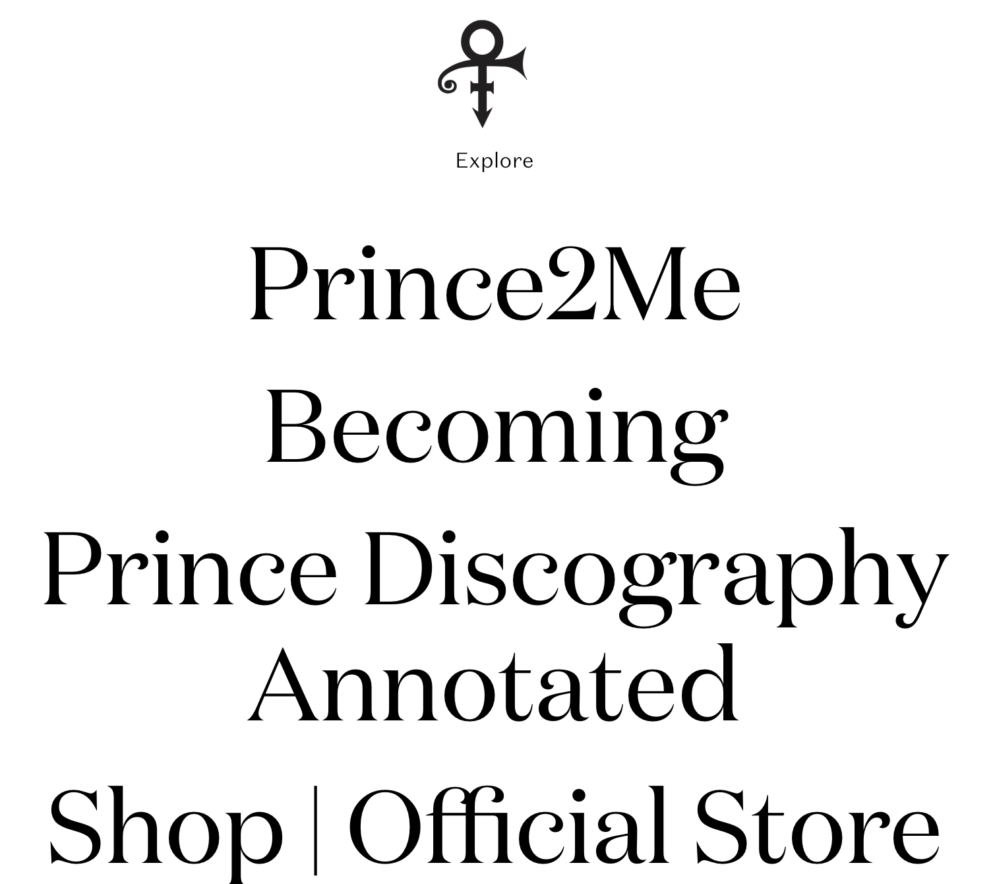

Slide 13
Works Created in 1978 or later
Who can terminate:
Author
Spouse/children/descendants (per stirpes)
Author’s executor
§203 Termination Rules
nonwaivable
2-10 yrs
Terminated rights pass to persons entitled to terminate on date of original notice
inter vivos transfer
by author
35 yrs
5 yrs
Creation
Federal Copyright Protection
Life + 70 yrs
Publication
Public Domain

Slide 14
* Not drawn to scale
For You
4/7/1978
Purple Rain
6/24/1984
2007: Superbowl
halftime show
“Love Song”
1989
Comerica values estate at $82M,
Pays estate tax;
2021: IRS values the estate at $163M;
Demands additional $32M in taxes and $6M penalty
2022: Settle for $156M
2014
Renegotiation of contract with Warner Bros.
1/20/2017 Comerica Bank replaces Bremer Trust as administrator
1977 Recording contract with Warner Bros.:
3 albums
Born
6/7/1958
1993 changes
name to
1996 releases final album, fulfilling contract with Warner
1998 Recording contract with Arista; he retains rights to the masters
Death 4/21/2016

Slide 15
Outcome:
3 of the siblings (or their heirs) sell their interests to “Primary Wave”;
The other 3 form an “estate management holding company”: Prince Legacy LLC
They plan to manage the assets on a 50/50 basis
This arrangement is already breaking down.
Tyka Nelson (sister)
Half siblings: John Nelson, Norrine Nelson,
Sharon Nelson, Alfred Jackson, Omarr Baker
Source: http://www.usmagazine.com/celebrity-news/news/princes-sister-tyka-nelson-claims-he-left-no-will-w204255

