Slide 1
Sand Castles Case Study 117
Copyright^{x}
William Fisher
March 2024
Licensed under terms available at https://ipxcourses.org

Slide 2
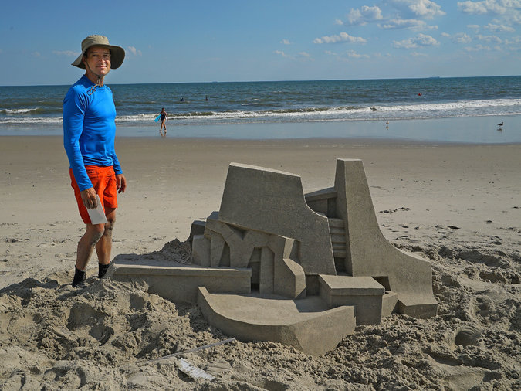
Calvin Seibert
Source: http://www.nytimes.com/2015/08/16/nyregion/king-of-the-sand-castle.html

Slide 3
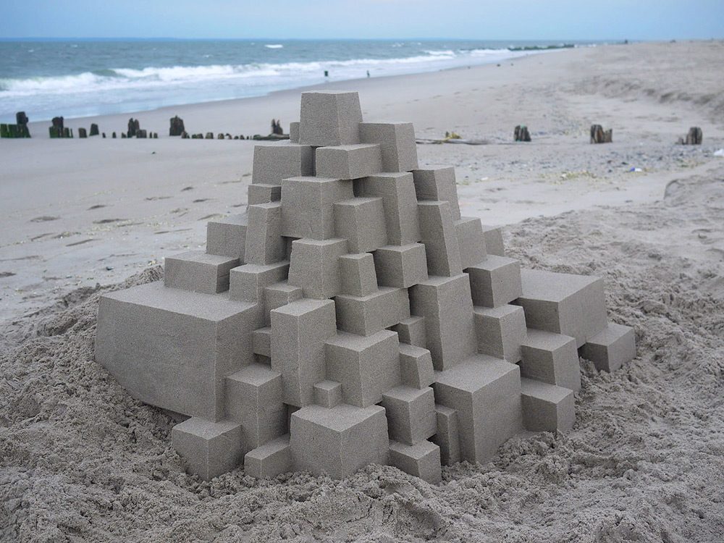
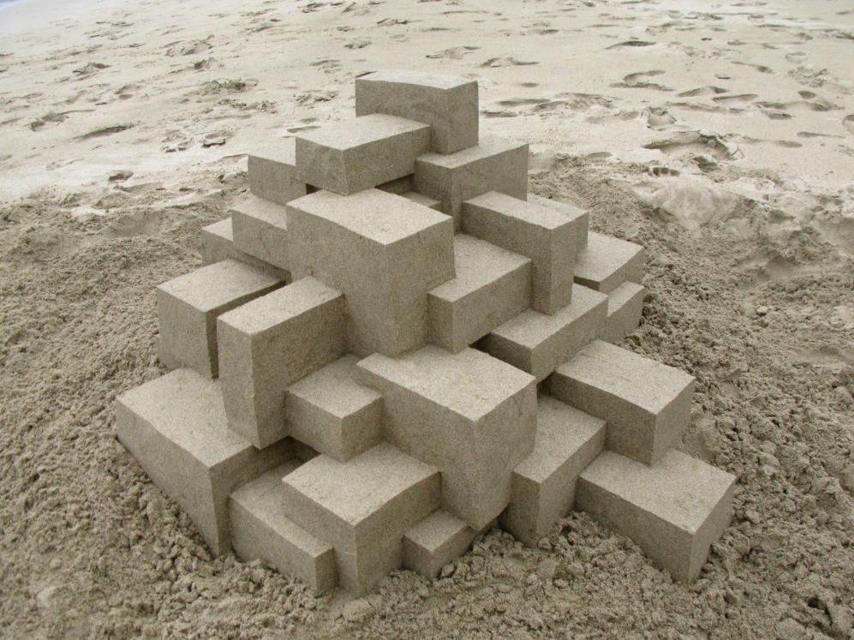
Seibert
Jones
Jones

Slide 4
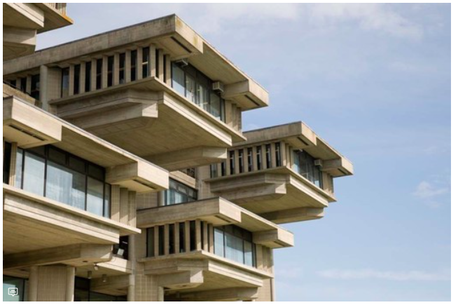
“Brutalism” in Architecture
Paul Randolph

