Slide 1
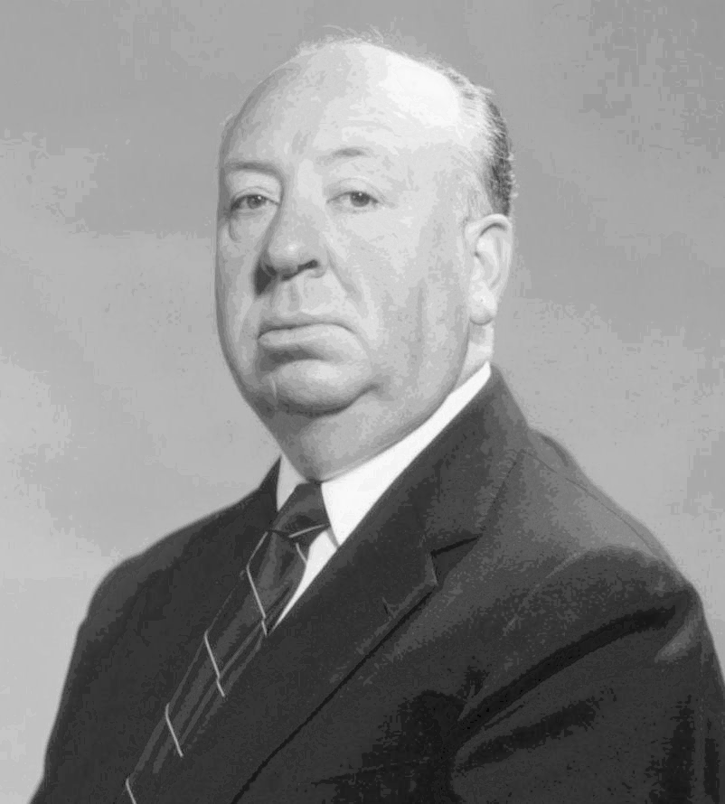
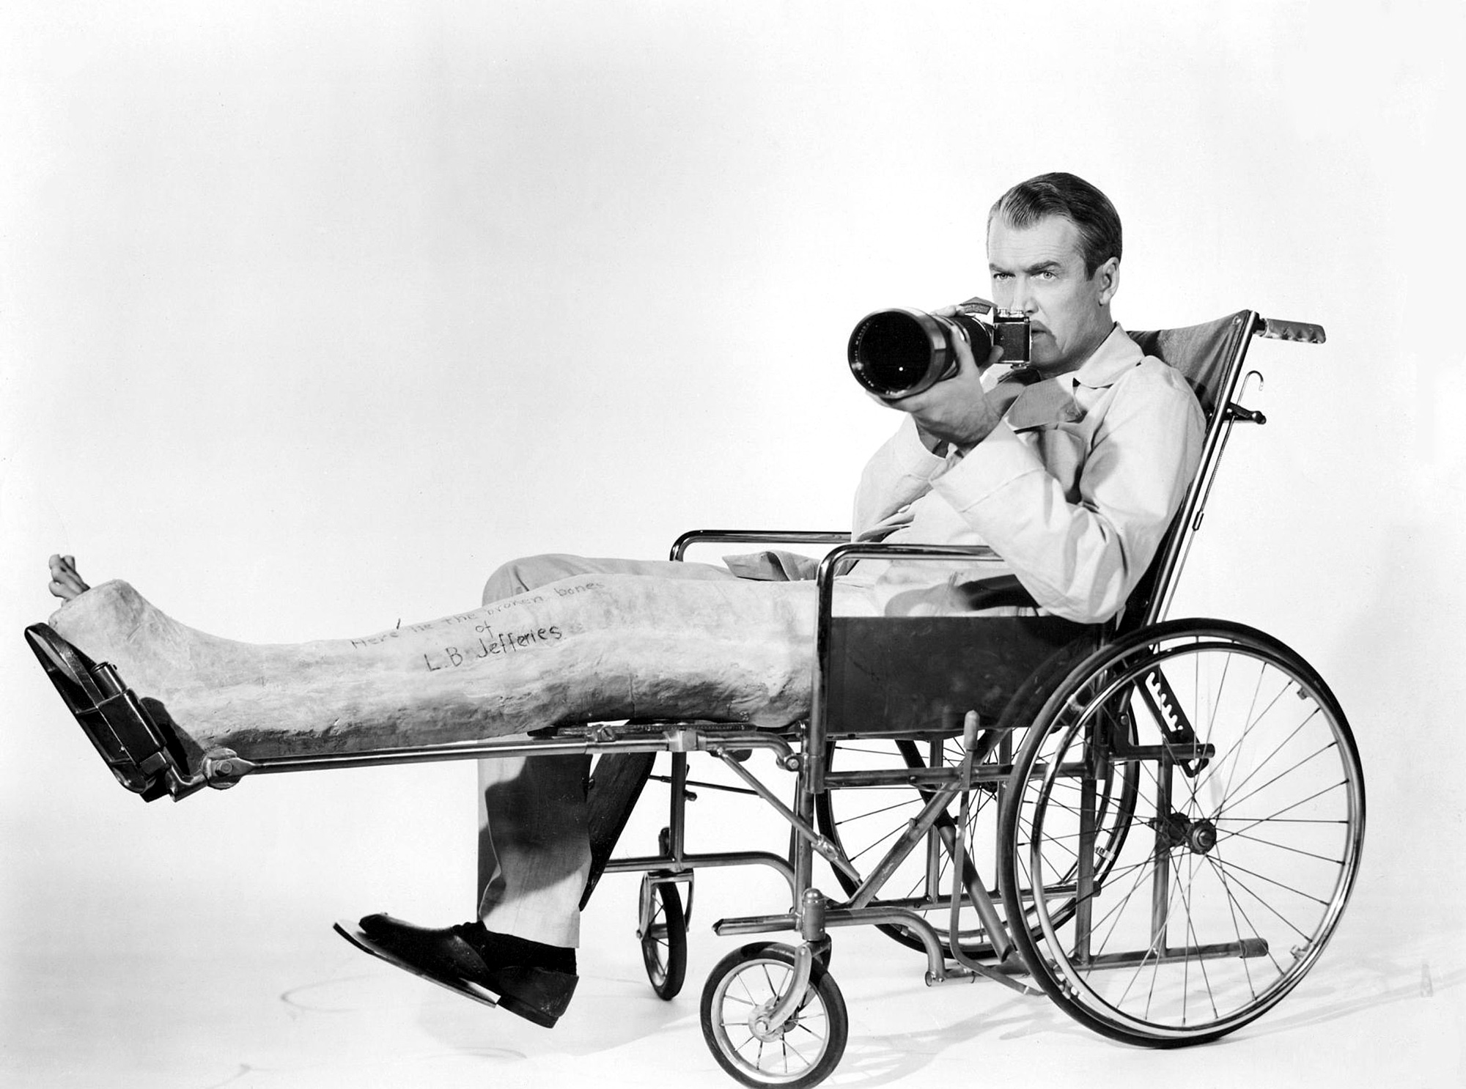
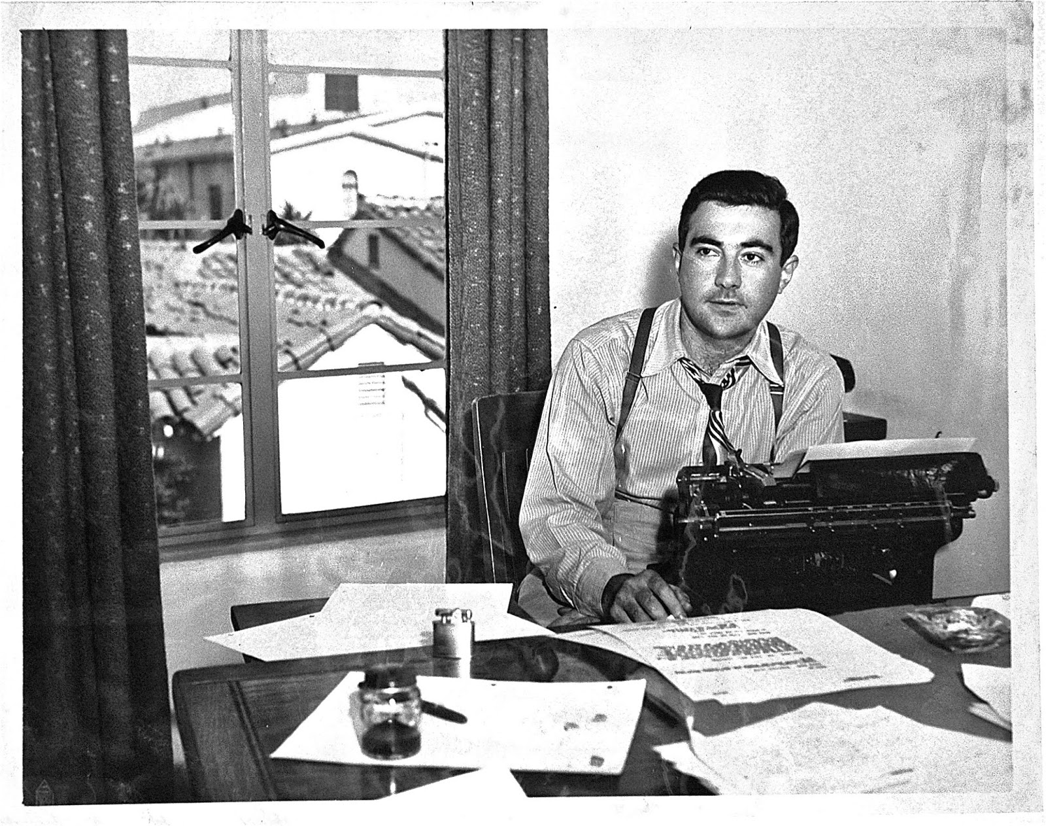
Facts of Stewart v. Abend
“Rear Window”
Compulsory License
Re-assignment of movie rights
1953
Patron (Stewart)
Patron (Stewart)
Assignment of movie rights
1945
Chase assigns to Abend
Abend
DeSylva
1970
2037
©
28-yr
term
1968
Woolrich dies
28-yr
renewal
term
47-yr
renewal
extended
67-yr
renewal extended
Woolrich
1942
Published
Public Domain
* Not drawn to scale

