Slide 1
The Snowman
Case Study 115
Michelle Elsner & William Fisher
April 2024
Notes:
Copyright notice for presentations authored by others:
© [Year], [Name 1]. This case study was originally written by [Name 2] and was subsequently revised by [Name 1]. The terms on which this case study may be used or modified are available at copyx.org/permission.
“This case study was originally written by [Name 2] and was subsequently revised by [Name 1],” should be omitted if the case study has never been revised.

Slide 2
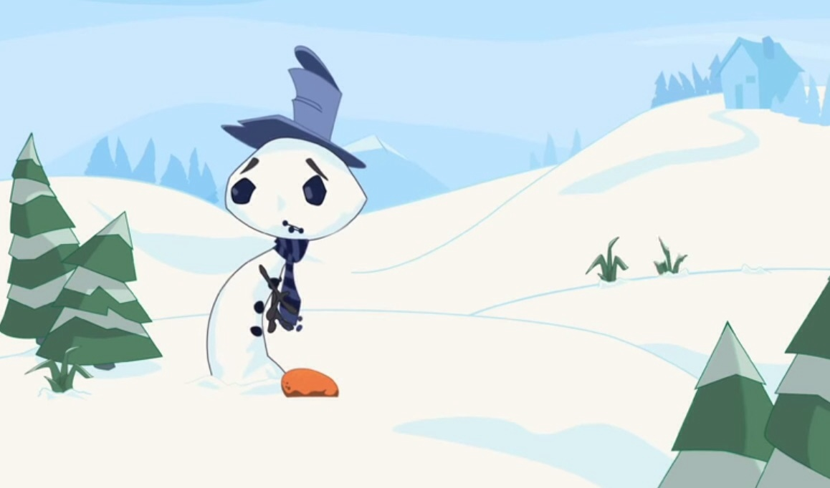
Kelly Wilson creates,
writes, designs, directs
and animates The Snowman
San Francisco
International Film Festival
4/2011
Wilson files complaint
As to the principal claim, District Court denies summary judgment to both parties and sets case for jury trial
The Snowman
available at kellywilsonfilms.com
8 Film Festivals
Snowman posted on YouTube
1/10/2013
skirmishing
2008
2009
2010
2011
2012
2013
2014
2015
Disney produces
the trailer
Frozen teaser trailer released
6/18/2013
Kelly Wilson submits 4 job applications to Disney, includes Snowman
Disney begins producing Frozen
Frozen
In-Theaters
11/2013

Slide 3
Film Festivals
The Snowman was an official selection of 6 of the festivals:
the San Francisco International Film Festival (04/21/2011-05/05/2011),
the Santa Barbara International Film Festival (01/26/2012-02/05/2012),
the Animation Block Party (Brooklyn, NY) (07/29/2011-07/31/2011),
the Palo Alto International Film Festival (09/29/2011-10/02/2011),
the Green Bay International Film Festival (02/25/2011-02/27/2011)
the Film Stream Festival (Prescott, AZ) (08/01/2012-08/08/2012).
These festivals had up to 90,000 attendees.
At the San Francisco International Film Festival, The Snowman won “Youth Work Honorable Mention” and competed against a short film Play by Play created by an employee of Pixar Animation Studios, a subsidiary of Disney.
Pixar employees were present for the four screenings of The Snowman and both Wilson and the Pixar employees were invited on stage together to discuss their respective films.

Slide 4
Comparisons
Snowman: https://www.youtube.com/watch?v=PJ6c7RLV8ew
Trailer: https://www.youtube.com/watch?v=-WdC4DaYIeQ

Slide 5
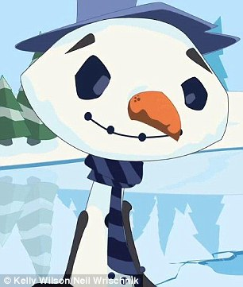
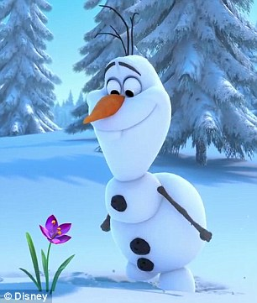

Slide 6
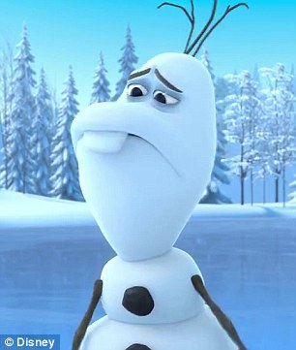

Slide 7
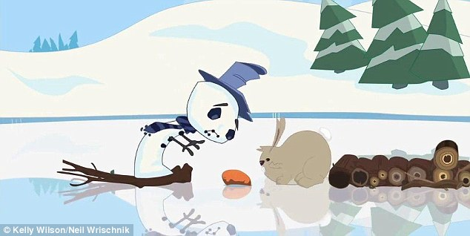
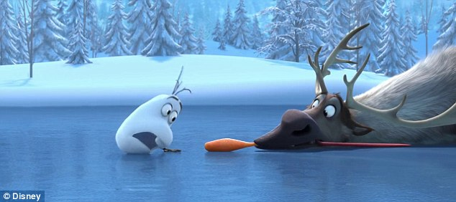

Slide 8
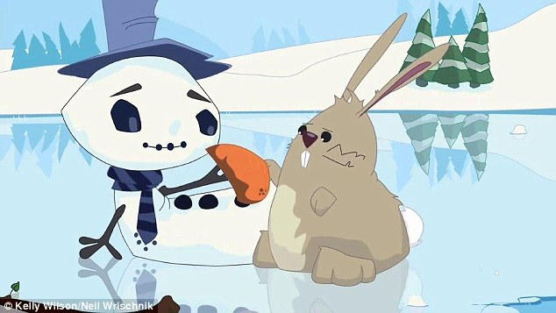
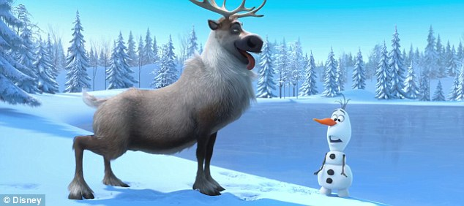

Slide 13
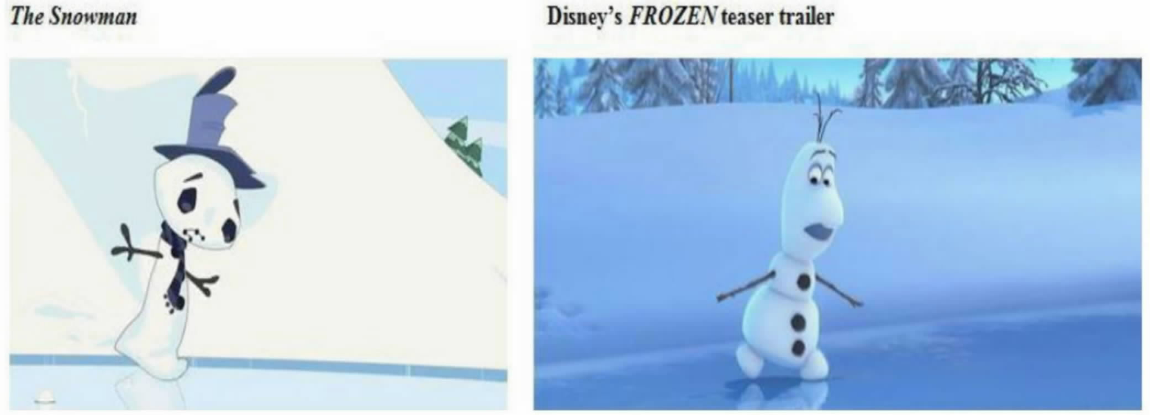

Slide 14
Similarities between The Snowman and Frozen’s Teaser Trailer According to Wilson
Both films open on a winter scene with a snowman
Both snowmen are awkward and clumsy characters
Both snowmen lose their carrot noses
Both snowmen have their carrot noses fall onto a frozen body of water
Both films have the snowman and another character pursuing the nose
Both films have the characters unable to cross the ice to retrieve the carrot nose because the ice is too slippery
In both films the adversary (bunny/reindeer) retrieves the nose, but then gives the nose to the snowman
In both films, once the carrot is returned, the snowman smiles

Slide 15
Plot Differences According to Disney
The teaser trailer begins with Olaf having an allergic reaction to a flower and sneezing his nose off. A snowman losing his nose is an abstract, unprotectable idea. The particular expression of that idea in the teaser trailer--an allergic reaction sparking a sneeze--has no equivalent in The Snowman.
The teaser trailer includes visually expressive scenes of Olaf repeatedly rearranging his body parts to move across the ice. There is no equivalent in The Snowman. (Neither the rabbits nor the snowman makes physical contact with the ice.)
In the teaser trailer, when Olaf and Sven reach the center of the ice the carrot flies off into a snowy embankment and Sven goes chasing after it. There is no equivalent in The Snowman, in which the remaining action takes place at the center of the pond.
At the end of the teaser trailer, Olaf sneezes again. There is no equivalent in The Snowman.

Slide 16
Disney’s Profits from Frozen
Revenues
$1.27 billion in box office revenues worldwide
$390 million in DVD and Blu-ray sales
Aprx. $1 billion in merchandizing licenses
Total: aprx. $2.7 billion
Cost to produce and market: $150 million
Net: aprx. $2.5 billion

Slide 17
Attorneys Fees
“As of 2011, the average cost of litigating a copyright infringement case through trial, for either plaintiff or defendant—and excluding judgment and awards—was estimated to range from $384,000 to … $2 million.” Balganesh, “Copyright Infringement Markets” (2013)

Slide 18
Snowman Exercise
Assume the following:
It is the summer of 2015
The District Court has granted partial summary judgment to Disney on the claim that The Snowman is infringed by Frozen (the movie)
The District Court has denied summary judgment to both parties on the claim that The Snowman is infringed by the trailer for Frozen – and has set the case for trial
The parties stipulate that the widespread distribution of the trailer has resulted in a 2% increase in the total revenues for Frozen (the movie) – and will continue to do so in the future.
Against this backdrop, counsel for the parties engage in settlement negotiation
Groups A-G represent Wilson
Groups H-N represent Disney
Each group should fill out a confidential “Settlement Preparation Form,” designed to help guide the negotiation
All forms must be submitted to tfisher@law.harvard.edu no later than 4:00pm on April 15

Slide 19
Probabilities
Wilson wins on the merits
Disney wins on the merits
10%
20%
30%
40%
50%
60%
70%
80%
90%
Disney must pay Wilson’s atty fees
Wilson must pay Disney’s atty fees

