Slide 1
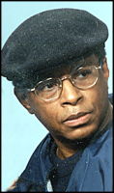
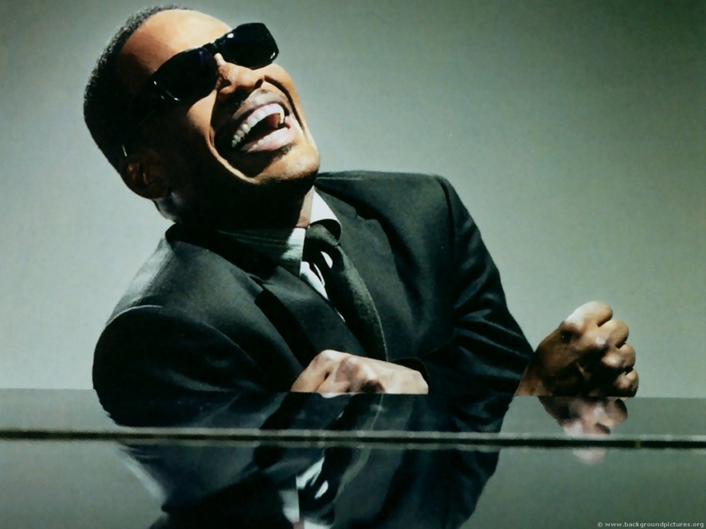
World’s
Fair
(press
release)
(not to scale)
Contact
Pepsi
Baltimore
Takeall registers © on “words and narration”
Contact KFC
franchisee
Contact
Pizza Hut
“You got the right one,
uh huh.”
videotape
radio
standup
Job Corps
1977
1984
1988
1989
1990
1991
1992
1993
Pepsi revising its image
Pepsi discusses
“The Right One”
Ad campaign
Ad agency
Discusses
“Uh, huh”
Ray Charles ads
are introduced
“You got the right one, baby, uh huh.”
Source: http://mikecrutcher.com/alto_instrumental_ray_charles/

