Slide 1
12 Monkeys
William Fisher
February 2020

Slide 2
Lebbeus Woods, “War and Architecture” (2002)
“Architecture and war are not incompatible. Architecture is war. War is architecture. I am at war with my time, with history, with all authority that resides in fixed and frightened forms. I am one of millions who do not fit in, who have no home, no family, no doctrine, no firm place to call my own, no known beginning or end, no "sacred and primordial site." I declare war on all icons and finalities, on all histories that would chain me with my own falseness, my own pitiful fears. I know only moments, and lifetimes that are as moments, and forms that appear with infinite strength, then "melt into air." I am an architect, a constructor of worlds, a sensualist who worships the flesh, the melody, a silhouette against the darkening sky. I cannot know your name. Nor you can know mine. Tomorrow, we begin together the construction of a city.”

Slide 3
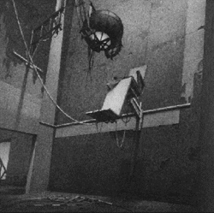
Neomechanical Tower (Upper) Chamber (1987)
Source: http://www.benedict.com/Visual/Monkeys/Monkeys.aspx

Slide 4
Excerpt from “12 Monkeys”
https://www.youtube.com/watch?v=TpGPSRGrL3s

Slide 5
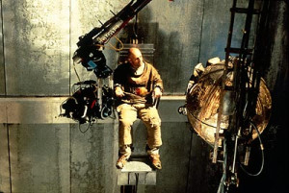
“12 Monkeys”
Source: http://zernerlaw.wordpress.com/2011/05/25/the-hangover-2-tyson-tattoo-
lawsuit-and-the-problems-of-not-clearing-copyright-issues-before-filming-starts/

