Slide 1
Lotus v. Borland
William Fisher
February 2022

Slide 2
By 1990,
only 3 remained
viable
Excel
Quattro
VP Planner
Lotus 123
Visicalc
1970
1980
1990
2000
2010

Slide 3
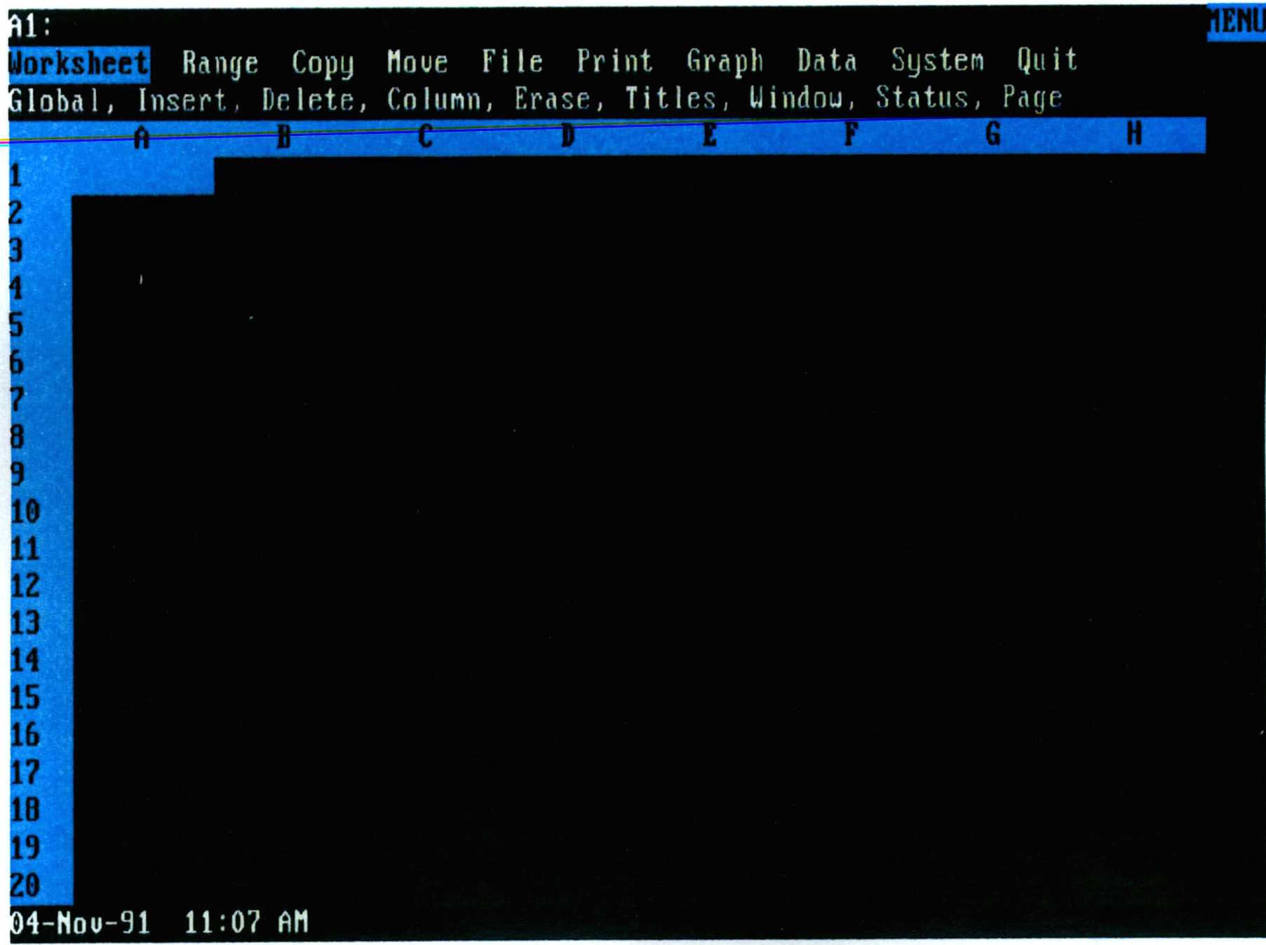
1-2-3
Notes:
Source: 1-2-3 2.01, Lotus Development Corp. v. Borland Intern., Inc., at 969 (Supreme Court Joint Appendix) (No. 90-11662-K)

Slide 4
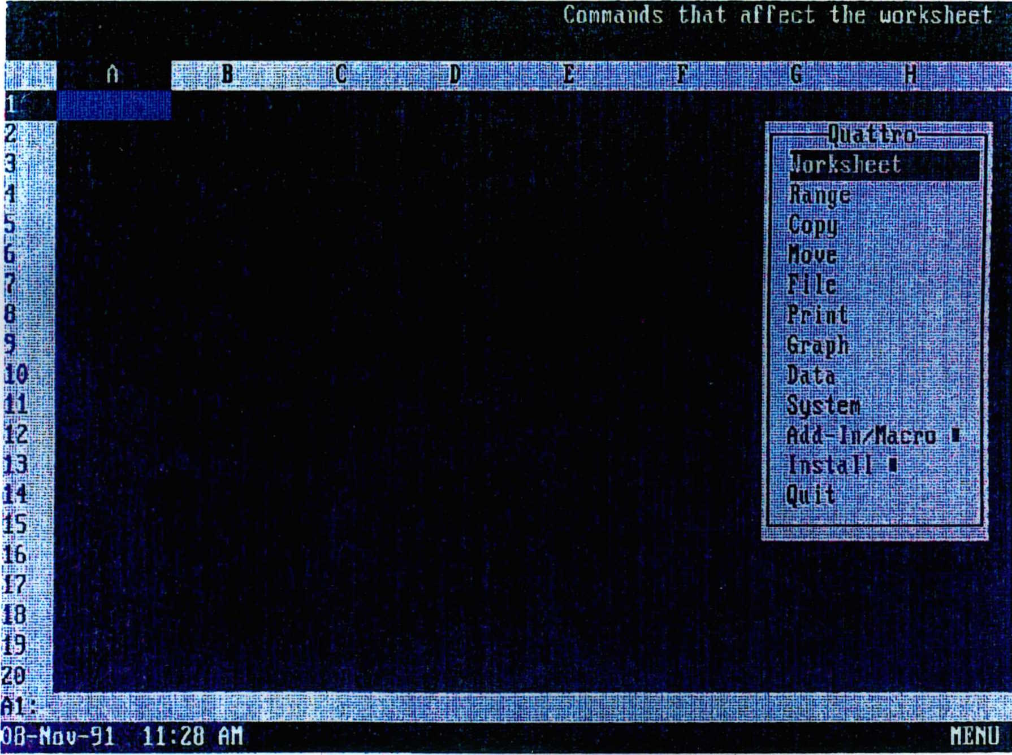
Quattro
Notes:
Source: Quattro, Lotus Development Corp. v. Borland Intern., Inc., at 971 (Supreme Court Joint Appendix) (No. 90-11662-K)

Slide 5
Lotus v. Borland (1993, 1995)
Excel
Lotus v. Paperback (1990)
Quattro
Litigation over
Menu Hierarchies
VP Planner
Lotus 123
Visicalc
1970
1980
1990
2000
2010

Slide 6
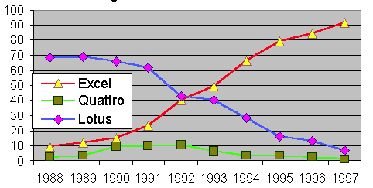
Source: Liebowitz & Margolis, “Network Effects”
Complaint filed
CA1 decision
District Court decision

Slide 7
Possible Arguments for Borland
Lack of Originality
Menu is not protected “expression”
Merger
Scene-a-faire
No protection for “words and short phrases”
Method of Operation – 102(b)
De minimis copying
Fair Use
Privilege for Interoperability
Copyright protection for software is bad policy

Slide 8
District Court
The ‘idea’ or ‘system’ of the Lotus 1-2-3 interface is “a system of menus, each menu consisting of less than a dozen commands, arranged hierarchically, forming a tree in which the main menu is the root/trunk of the tree and submenus branch off from higher menus, each submenu being linked to a higher menu by operation of a command, so that all the specific spreadsheet operations available in Lotus 1-2-3 are accessible through the paths of the menu command hierarchy.”
“Does the Lotus 1-2-3 user interface include identifiable elements of expression?...I conclude that it does. A very satisfactory spreadsheet menu tree can be constructed using different commands and a different command structure from those of Lotus 1-2-3. In fact, Borland has constructed just such an alternate tree for use in Quattro Pro’s native mode....it is possible to generate literally millions of satisfactory menu trees by varying the menu commands employed.”
“The question posed by this element of the copyrightability test is whether the creativity involved in establishing the menu commands, menu command hierarchy, macro language, and keystroke sequences was more than trivial. No reasonable jury could find otherwise.”

Slide 9
Possible Arguments for Borland
Lack of Originality
Menu is not protected “expression”
Merger
Scene-a-faire
No protection for “words and short phrases”
Method of Operation – 102(b)
De minimis copying
Fair Use
Privilege for Interoperability
Copyright protection for software is bad policy
District Court

Slide 10
First Circuit
Lotus 1-2-3’s menus are an uncopyrightable “method of operation” under §102(b)
“The "expressive" choices of what to name the command terms and how to arrange them do not magically change the uncopyrightable menu command hierarchy into copyrightable subject matter.”

Slide 11
Possible Arguments for Borland
Lack of Originality
Menu is not protected “expression”
Merger
Scene-a-faire
No protection for “words and short phrases”
Method of Operation – 102(b)
De minimis copying
Fair Use
Privilege for Interoperability
Copyright protection for software is bad policy
District Court
Stahl
Boudin

Slide 12
Borland
Lotus
SCOTUS
Solicitor General
(Drew Days, Solicitor General; Beth Brinkmann, Assistant to the Solicitor General)
SG’s Brief is due
Friday, December 8, 1995
Notes:
Source for CEA: Kathleen Wallman, Memorandum for Jack Quinn, 12/5/1995, “CEA supported the filing of a brief” (Kagan documents 1, page 88 of 90, http://clinton.presidentiallibraries.us/items/show/27282
Source for DoJ antitrust: David Ogden, Memo to Elena Kagan, Kagandocs-2, p 2 of 93 http://clinton.presidentiallibraries.us/items/show/27283

Slide 13
Borland
Lotus
SCOTUS
Solicitor General
(Drew Days, Solicitor General; Beth Brinkmann, Assistant to the Solicitor General)
Pro-Borland
(support SG amicus brief)
Pro-Lotus
(oppose SG amicus brief)
White House
(Jack Quinn, Counsel to the President; Elena Kagan, Associate Counsel to the President; Kathleen Wallman, Deputy Counsel to the President)
Commerce Dept. & PTO
(Lawrence Goffney, Acting Deputy Secretary of Commerce and Deputy Commissioner of Patents and Trademarks)
DoJ Antitrust
(Joel Klein, Deputy Assistant Attorney General; David Ogden, Associate Deputy Attorney General)
Council of Economic Advisors (CEA)
Copyright Office
(Marybeth Peters, Register)
Notes:
Source for CEA: Kathleen Wallman, Memorandum for Jack Quinn, 12/5/1995, “CEA supported the filing of a brief” (Kagan documents 1, page 88 of 90, http://clinton.presidentiallibraries.us/items/show/27282
Source for DoJ antitrust: David Ogden, Memo to Elena Kagan, Kagandocs-2, p 2 of 93 http://clinton.presidentiallibraries.us/items/show/27283

Slide 14
Borland
Lotus
SCOTUS
Solicitor General
(Drew Days, Solicitor General; Beth Brinkmann, Assistant to the Solicitor General)
Pro-Borland
(support SG amicus brief)
Pro-Lotus
(oppose SG amicus brief)
White House
(Jack Quinn, Counsel to the President; Elena Kagan, Associate Counsel to the President; Kathleen Wallman, Deputy Counsel to the President)
Commerce Dept. & PTO
(Lawrence Goffney, Acting Deputy Secretary of Commerce and Deputy Commissioner of Patents and Trademarks)
DoJ Antitrust
(Joel Klein, Deputy Assistant Attorney General; David Ogden, Associate Deputy Attorney General)
Council of Economic Advisors (CEA)
Copyright Office
(Marybeth Peters, Register)
Friday, December 1, 1995
Notes:
Source for CEA: Kathleen Wallman, Memorandum for Jack Quinn, 12/5/1995, “CEA supported the filing of a brief” (Kagan documents 1, page 88 of 90, http://clinton.presidentiallibraries.us/items/show/27282
Source for DoJ antitrust: David Ogden, Memo to Elena Kagan, Kagandocs-2, p 2 of 93 http://clinton.presidentiallibraries.us/items/show/27283

Slide 15
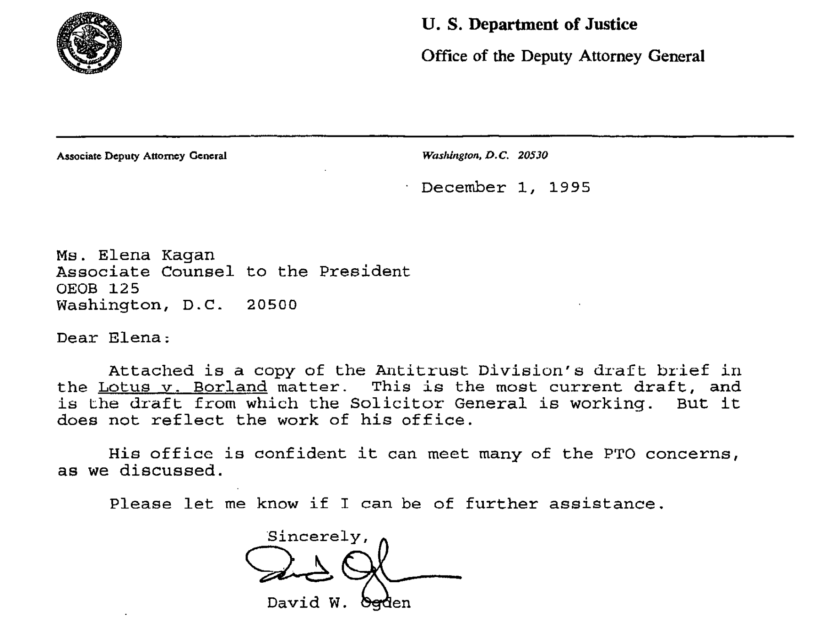

Slide 16
Borland
Lotus
SCOTUS
Solicitor General
(Drew Days, Solicitor General; Beth Brinkmann, Assistant to the Solicitor General)
Pro-Borland
(support SG amicus brief)
Pro-Lotus
(oppose SG amicus brief)
White House
(Jack Quinn, Counsel to the President; Elena Kagan, Associate Counsel to the President; Kathleen Wallman, Deputy Counsel to the President)
Meeting
Commerce Dept. & PTO
(Lawrence Goffney, Acting Deputy Secretary of Commerce and Deputy Commissioner of Patents and Trademarks)
DoJ Antitrust
(Joel Klein, Deputy Assistant Attorney General; David Ogden, Associate Deputy Attorney General)
Council of Economic Advisors (CEA)
Copyright Office
(Marybeth Peters, Register)
Monday, December 4, 1995
Notes:
Source for CEA: Kathleen Wallman, Memorandum for Jack Quinn, 12/5/1995, “CEA supported the filing of a brief” (Kagan documents 1, page 88 of 90, http://clinton.presidentiallibraries.us/items/show/27282
Source for DoJ antitrust: David Ogden, Memo to Elena Kagan, Kagandocs-2, p 2 of 93 http://clinton.presidentiallibraries.us/items/show/27283

Slide 17
Borland
Lotus
SCOTUS
Solicitor General
(Drew Days, Solicitor General; Beth Brinkmann, Assistant to the Solicitor General)
Pro-Borland
(support SG amicus brief)
Pro-Lotus
(oppose SG amicus brief)
White House
(Jack Quinn, Counsel to the President; Elena Kagan, Associate Counsel to the President; Kathleen Wallman, Deputy Counsel to the President)
Commerce Dept. & PTO
(Lawrence Goffney, Acting Deputy Secretary of Commerce and Deputy Commissioner of Patents and Trademarks)
DoJ Antitrust
(Joel Klein, Deputy Assistant Attorney General; David Ogden, Associate Deputy Attorney General)
Council of Economic Advisors (CEA)
Copyright Office
(Marybeth Peters, Register)
Monday, December 4, 1995
Notes:
Source for CEA: Kathleen Wallman, Memorandum for Jack Quinn, 12/5/1995, “CEA supported the filing of a brief” (Kagan documents 1, page 88 of 90, http://clinton.presidentiallibraries.us/items/show/27282
Source for DoJ antitrust: David Ogden, Memo to Elena Kagan, Kagandocs-2, p 2 of 93 http://clinton.presidentiallibraries.us/items/show/27283

Slide 18
Borland
Lotus
SCOTUS
Solicitor General
(Drew Days, Solicitor General; Beth Brinkmann, Assistant to the Solicitor General)
Pro-Borland
(support SG amicus brief)
Pro-Lotus
(oppose SG amicus brief)
White House
(Jack Quinn, Counsel to the President; Elena Kagan, Associate Counsel to the President; Kathleen Wallman, Deputy Counsel to the President)
Commerce Dept. & PTO
(Lawrence Goffney, Acting Deputy Secretary of Commerce and Deputy Commissioner of Patents and Trademarks)
DoJ Antitrust
(Joel Klein, Deputy Assistant Attorney General; David Ogden, Associate Deputy Attorney General)
Council of Economic Advisors (CEA)
Copyright Office
(Marybeth Peters, Register)
Monday, December 4, 1995
Notes:
Source for CEA: Kathleen Wallman, Memorandum for Jack Quinn, 12/5/1995, “CEA supported the filing of a brief” (Kagan documents 1, page 88 of 90, http://clinton.presidentiallibraries.us/items/show/27282
Source for DoJ antitrust: David Ogden, Memo to Elena Kagan, Kagandocs-2, p 2 of 93 http://clinton.presidentiallibraries.us/items/show/27283

Slide 20
Possible Arguments for Borland
Lack of Originality
Menu is not protected “expression”
Merger
Scene-a-faire
No protection for “words and short phrases”
Method of Operation – 102(b)
De minimis copying
Fair Use
Privilege for Interoperability
Copyright protection for software is bad policy
DOJ prefers this theory
DOJ
Stahl
Boudin

Slide 21
Borland
Lotus
SCOTUS
Solicitor General
(Drew Days, Solicitor General; Beth Brinkmann, Assistant to the Solicitor General)
Pro-Borland
(support SG amicus brief)
Pro-Lotus
(oppose SG amicus brief)
White House
(Jack Quinn, Counsel to the President; Elena Kagan, Associate Counsel to the President; Kathleen Wallman, Deputy Counsel to the President)
Commerce Dept. & PTO
(Lawrence Goffney, Acting Deputy Secretary of Commerce and Deputy Commissioner of Patents and Trademarks)
DoJ Antitrust
(Joel Klein, Deputy Assistant Attorney General; David Ogden, Associate Deputy Attorney General)
Council of Economic Advisors (CEA)
Copyright Office
(Marybeth Peters, Register)
Tuesday, December 5, 1995
Notes:
Source for CEA: Kathleen Wallman, Memorandum for Jack Quinn, 12/5/1995, “CEA supported the filing of a brief” (Kagan documents 1, page 88 of 90, http://clinton.presidentiallibraries.us/items/show/27282
Source for DoJ antitrust: David Ogden, Memo to Elena Kagan, Kagandocs-2, p 2 of 93 http://clinton.presidentiallibraries.us/items/show/27283

Slide 22
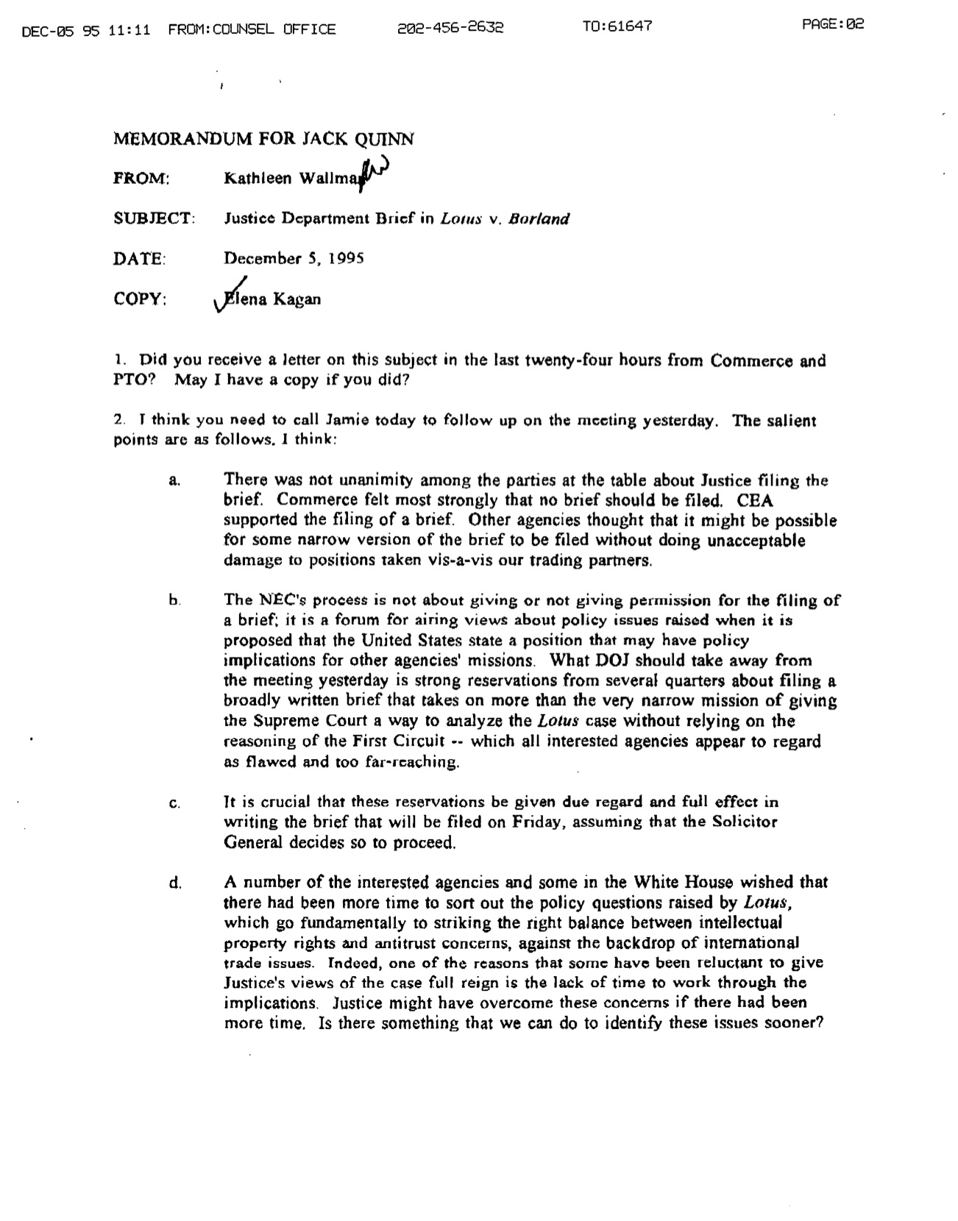
“A number of the interested agencies and some in the White House wished that there had been more time to sort out the policy questions…which go fundamentally to striking the right balance between intellectual property rights and antitrust concerns, against the backdrop of international trade issues…”

Slide 23
Borland
Lotus
SCOTUS
Solicitor General
(Drew Days, Solicitor General; Beth Brinkmann, Assistant to the Solicitor General)
Pro-Borland
(support SG amicus brief)
Pro-Lotus
(oppose SG amicus brief)
White House
(Jack Quinn, Counsel to the President; Elena Kagan, Associate Counsel to the President; Kathleen Wallman, Deputy Counsel to the President)
Commerce Dept. & PTO
(Lawrence Goffney, Acting Deputy Secretary of Commerce and Deputy Commissioner of Patents and Trademarks)
DoJ Antitrust
(Joel Klein, Deputy Assistant Attorney General; David Ogden, Associate Deputy Attorney General)
Council of Economic Advisors (CEA)
Copyright Office
(Marybeth Peters, Register)
Tuesday, December 5, 1995
Notes:
Source for CEA: Kathleen Wallman, Memorandum for Jack Quinn, 12/5/1995, “CEA supported the filing of a brief” (Kagan documents 1, page 88 of 90, http://clinton.presidentiallibraries.us/items/show/27282
Source for DoJ antitrust: David Ogden, Memo to Elena Kagan, Kagandocs-2, p 2 of 93 http://clinton.presidentiallibraries.us/items/show/27283

Slide 24
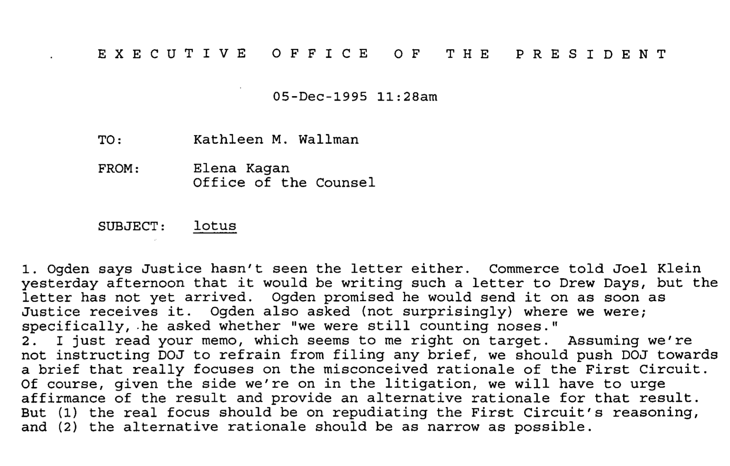

Slide 25
Borland
Lotus
SCOTUS
Solicitor General
(Drew Days, Solicitor General; Beth Brinkmann, Assistant to the Solicitor General)
Pro-Borland
(support SG amicus brief)
Pro-Lotus
(oppose SG amicus brief)
White House
(Jack Quinn, Counsel to the President; Elena Kagan, Associate Counsel to the President; Kathleen Wallman, Deputy Counsel to the President)
Commerce Dept. & PTO
(Lawrence Goffney, Acting Deputy Secretary of Commerce and Deputy Commissioner of Patents and Trademarks)
DoJ Antitrust
(Joel Klein, Deputy Assistant Attorney General; David Ogden, Associate Deputy Attorney General)
Council of Economic Advisors (CEA)
Copyright Office
(Marybeth Peters, Register)
Tuesday, December 5, 1995
Notes:
Source for CEA: Kathleen Wallman, Memorandum for Jack Quinn, 12/5/1995, “CEA supported the filing of a brief” (Kagan documents 1, page 88 of 90, http://clinton.presidentiallibraries.us/items/show/27282
Source for DoJ antitrust: David Ogden, Memo to Elena Kagan, Kagandocs-2, p 2 of 93 http://clinton.presidentiallibraries.us/items/show/27283

Slide 26
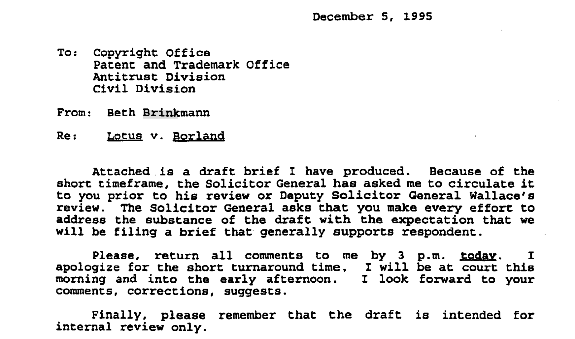

Slide 27
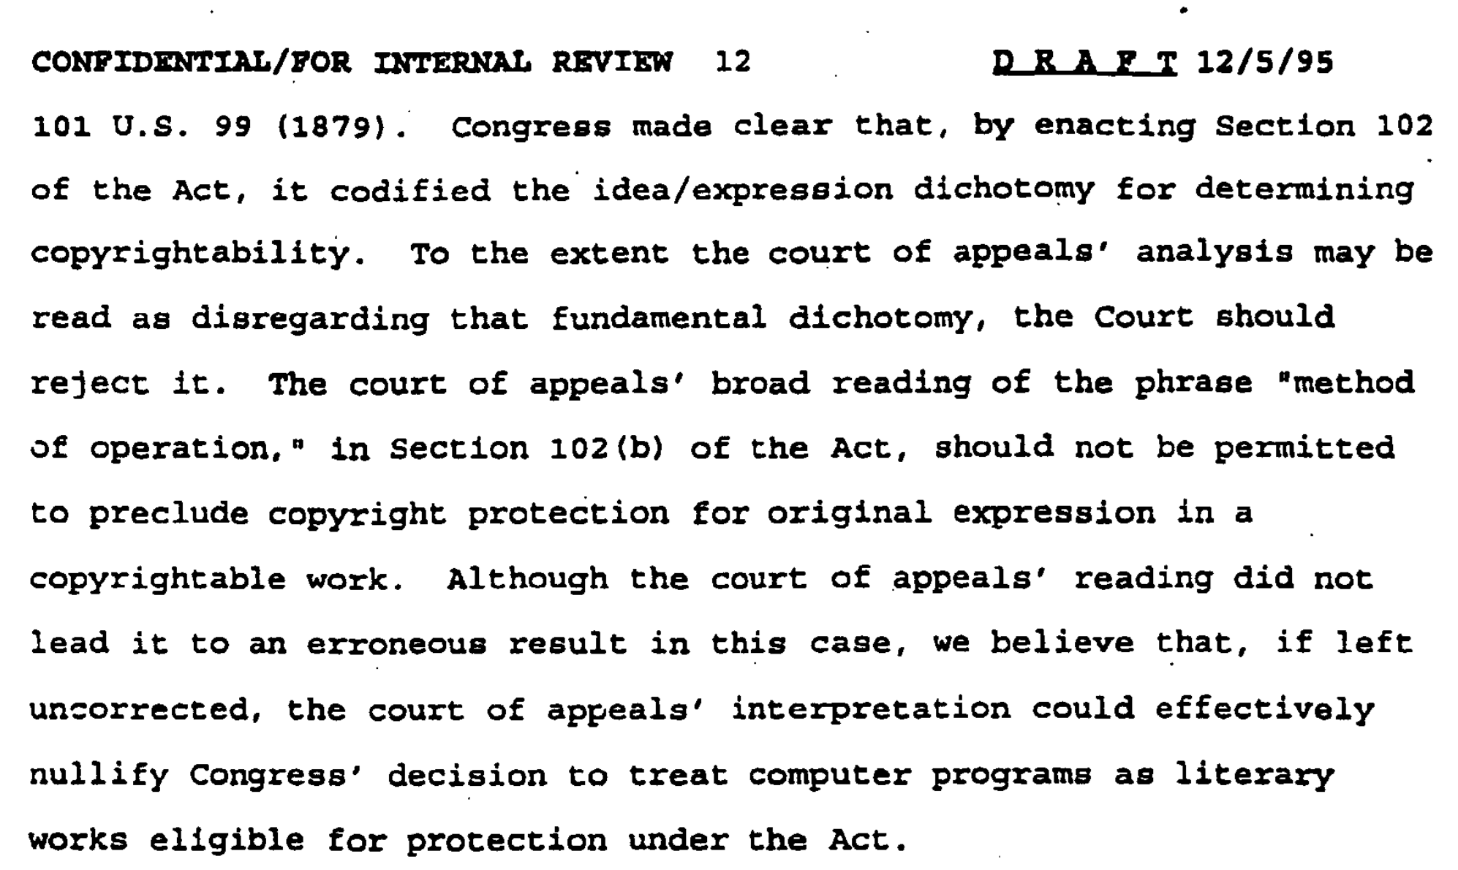

Slide 28
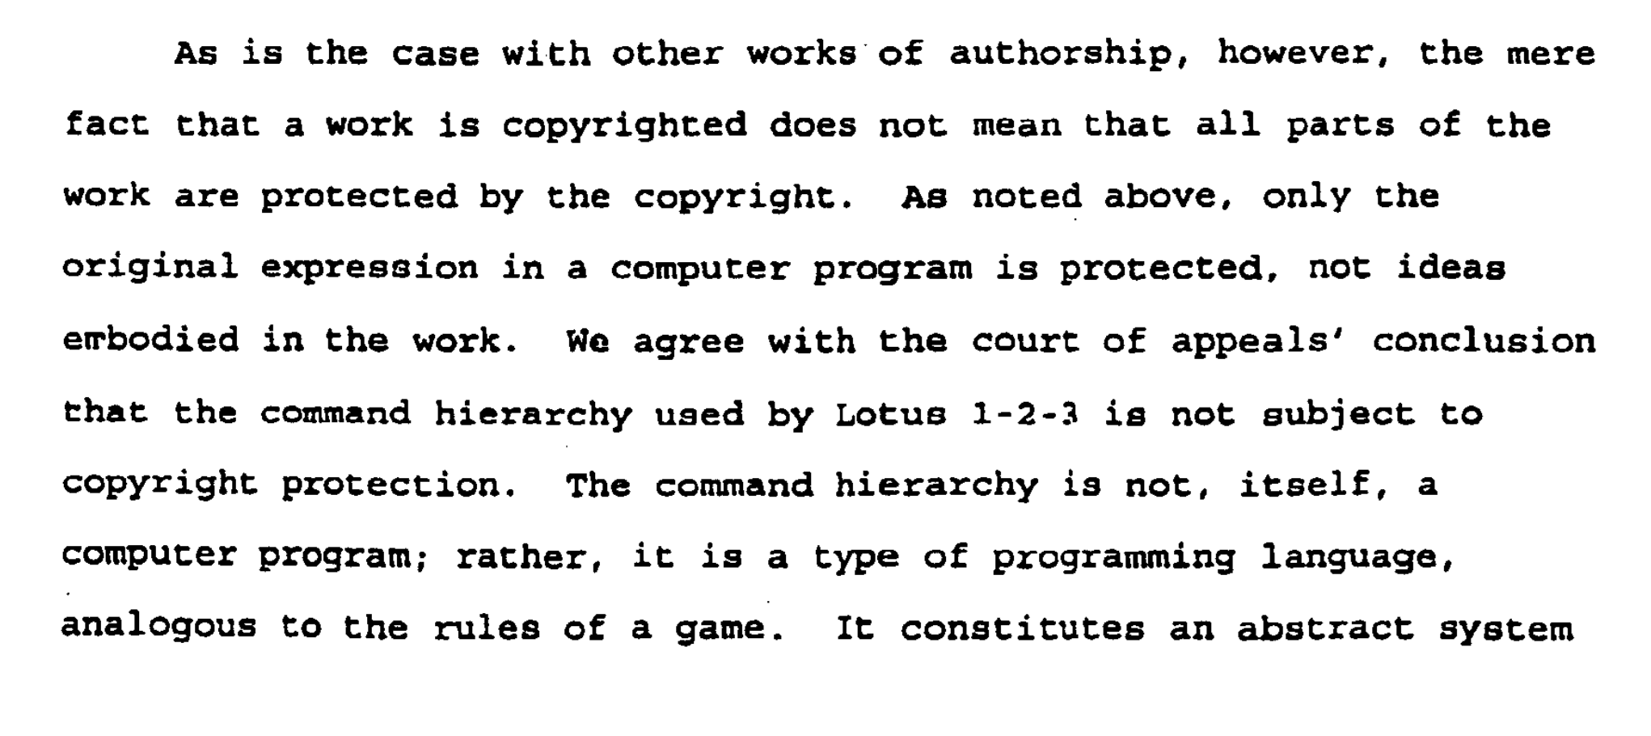

Slide 29
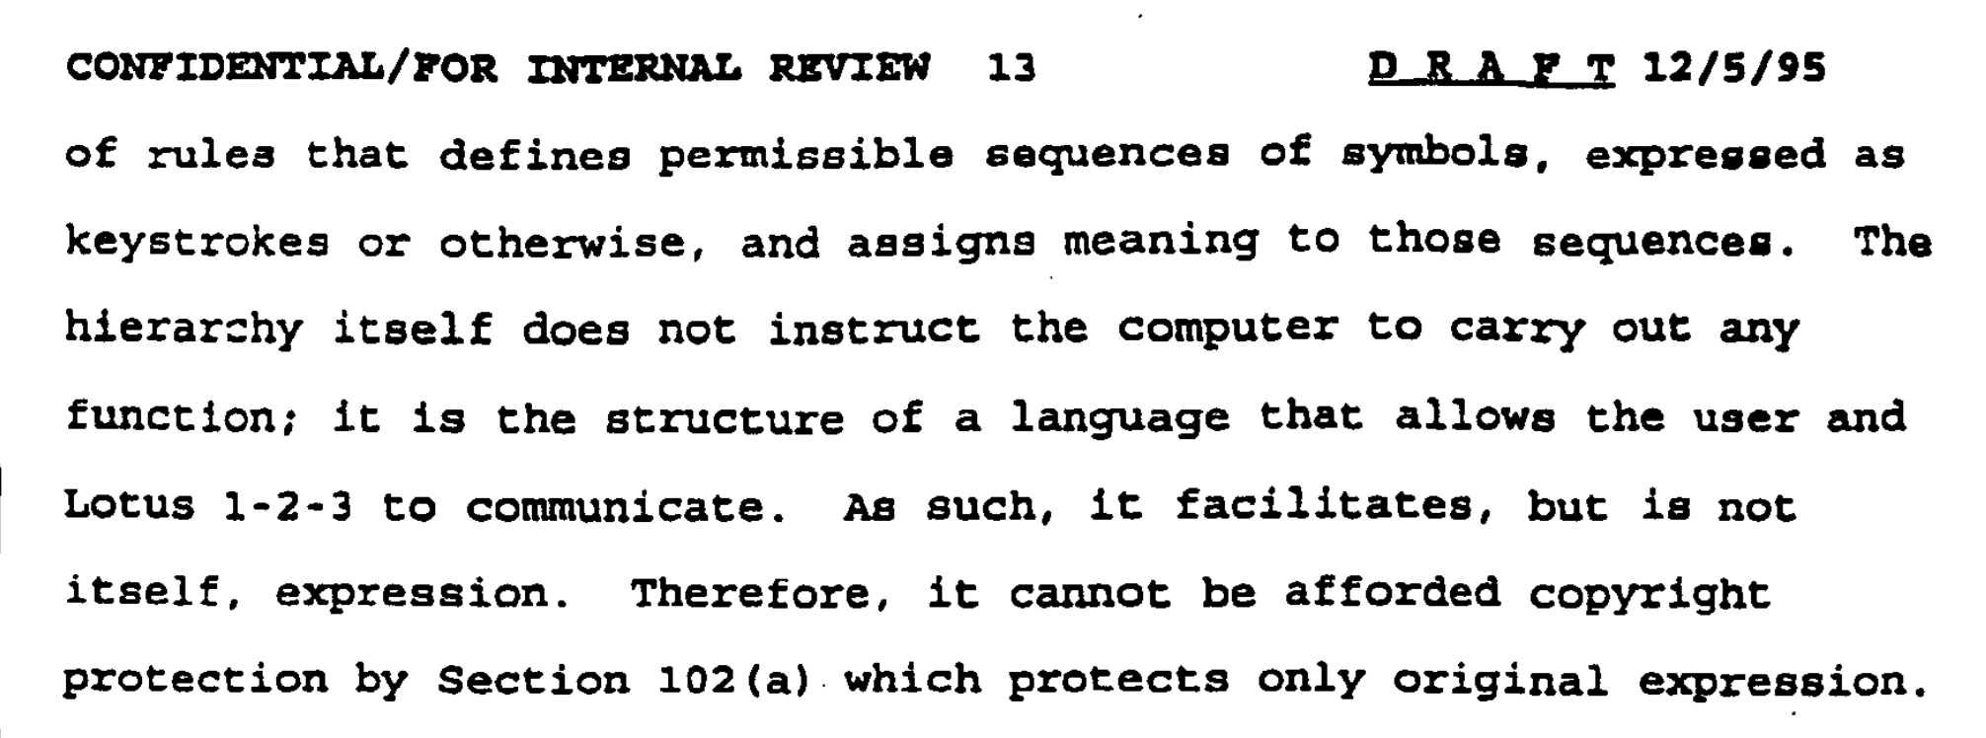

Slide 30
Possible Arguments for Borland
Lack of Originality
Menu is not protected “expression”
Merger
Scene-a-faire
No protection for “words and short phrases”
Method of Operation – 102(b)
De minimis copying
Fair Use
Privilege for Interoperability
Copyright protection for software is bad policy
DOJ prefers this theory
Solicitor General sides with DOJ (and White House)
DOJ
Stahl
Boudin

Slide 31
Borland
Lotus
SCOTUS
Solicitor General
(Drew Days, Solicitor General; Beth Brinkmann, Assistant to the Solicitor General)
Pro-Borland
(support SG amicus brief)
Pro-Lotus
(oppose SG amicus brief)
White House
(Jack Quinn, Counsel to the President; Elena Kagan, Associate Counsel to the President; Kathleen Wallman, Deputy Counsel to the President)
Commerce Dept. & PTO
(Lawrence Goffney, Acting Deputy Secretary of Commerce and Deputy Commissioner of Patents and Trademarks)
DoJ Antitrust
(Joel Klein, Deputy Assistant Attorney General; David Ogden, Associate Deputy Attorney General)
Council of Economic Advisors (CEA)
Copyright Office
(Marybeth Peters, Register)
Tuesday, December 5, 1995
Notes:
Source for CEA: Kathleen Wallman, Memorandum for Jack Quinn, 12/5/1995, “CEA supported the filing of a brief” (Kagan documents 1, page 88 of 90, http://clinton.presidentiallibraries.us/items/show/27282
Source for DoJ antitrust: David Ogden, Memo to Elena Kagan, Kagandocs-2, p 2 of 93 http://clinton.presidentiallibraries.us/items/show/27283

Slide 32
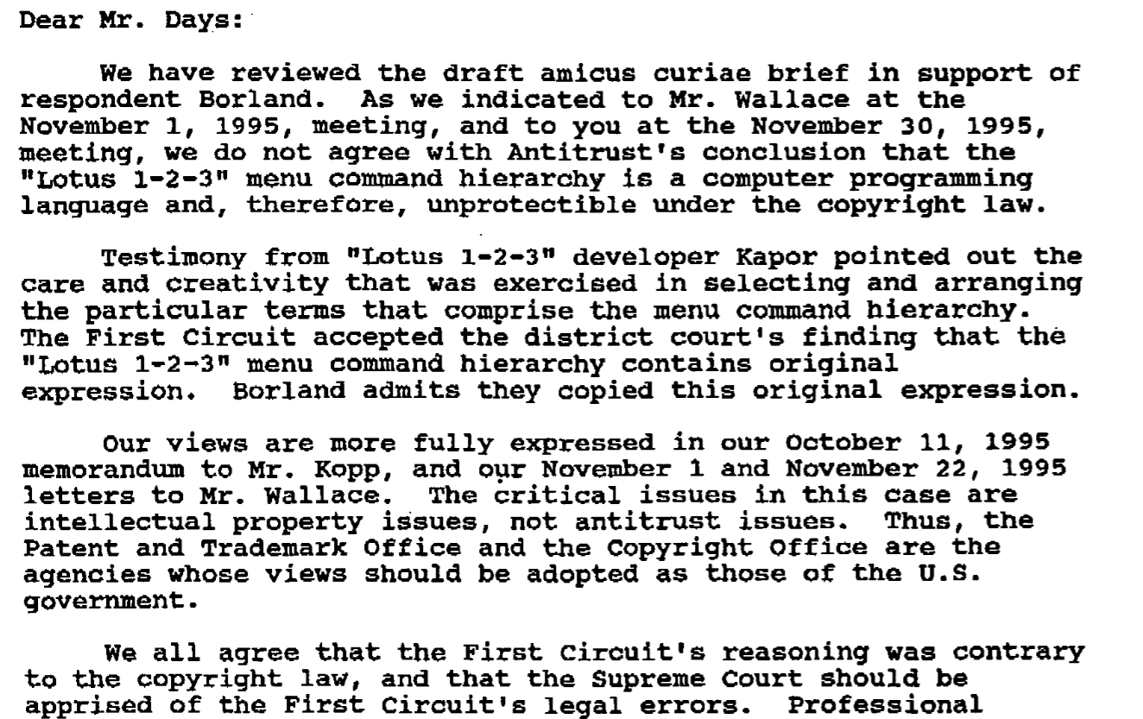

Slide 33
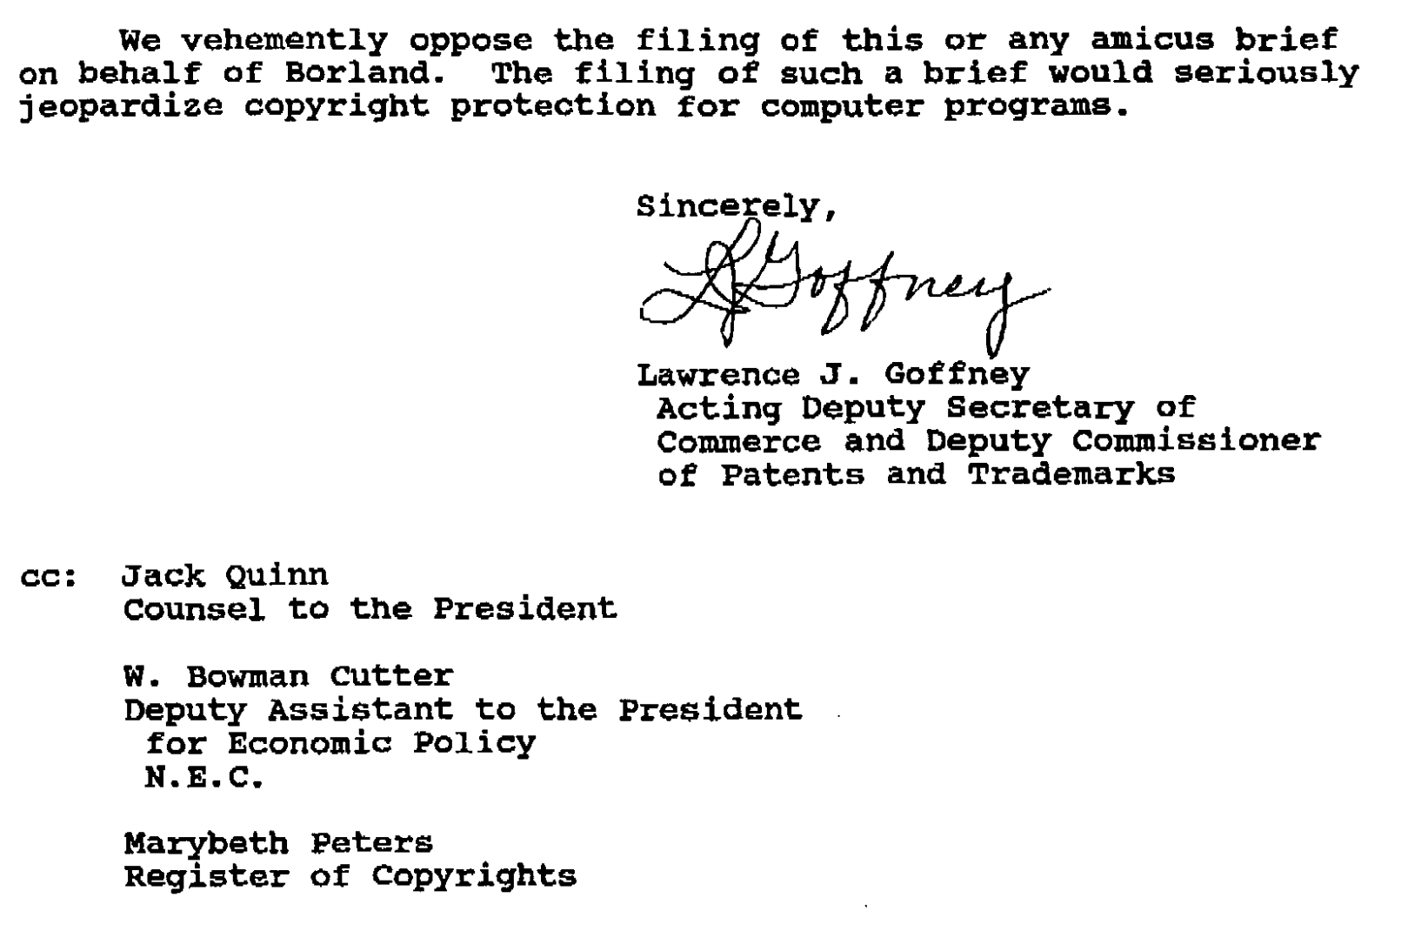

Slide 34
Borland
Lotus
SCOTUS
Lester Hyman
(atty for Lotus)
Solicitor General
(Drew Days, Solicitor General; Beth Brinkmann, Assistant to the Solicitor General)
Pro-Borland
(support SG amicus brief)
Pro-Lotus
(oppose SG amicus brief)
White House
(Jack Quinn, Counsel to the President; Elena Kagan, Associate Counsel to the President; Kathleen Wallman, Deputy Counsel to the President)
Commerce Dept. & PTO
(Lawrence Goffney, Acting Deputy Secretary of Commerce and Deputy Commissioner of Patents and Trademarks)
DoJ Antitrust
(Joel Klein, Deputy Assistant Attorney General; David Ogden, Associate Deputy Attorney General)
Council of Economic Advisors (CEA)
Copyright Office
(Marybeth Peters, Register)
Wednesday, December 6, 1995
Notes:
Source for CEA: Kathleen Wallman, Memorandum for Jack Quinn, 12/5/1995, “CEA supported the filing of a brief” (Kagan documents 1, page 88 of 90, http://clinton.presidentiallibraries.us/items/show/27282
Source for DoJ antitrust: David Ogden, Memo to Elena Kagan, Kagandocs-2, p 2 of 93 http://clinton.presidentiallibraries.us/items/show/27283

Slide 35
Borland
Lotus
SCOTUS
Solicitor General
(Drew Days, Solicitor General; Beth Brinkmann, Assistant to the Solicitor General)
Pro-Borland
(support SG amicus brief)
Pro-Lotus
(oppose SG amicus brief)
White House
(Jack Quinn, Counsel to the President; Elena Kagan, Associate Counsel to the President; Kathleen Wallman, Deputy Counsel to the President)
Commerce Dept. & PTO
(Lawrence Goffney, Acting Deputy Secretary of Commerce and Deputy Commissioner of Patents and Trademarks)
DoJ Antitrust
(Joel Klein, Deputy Assistant Attorney General; David Ogden, Associate Deputy Attorney General)
Council of Economic Advisors (CEA)
Copyright Office
(Marybeth Peters, Register)
Wednesday, December 6, 1995
Notes:
Source for CEA: Kathleen Wallman, Memorandum for Jack Quinn, 12/5/1995, “CEA supported the filing of a brief” (Kagan documents 1, page 88 of 90, http://clinton.presidentiallibraries.us/items/show/27282
Source for DoJ antitrust: David Ogden, Memo to Elena Kagan, Kagandocs-2, p 2 of 93 http://clinton.presidentiallibraries.us/items/show/27283

Slide 36
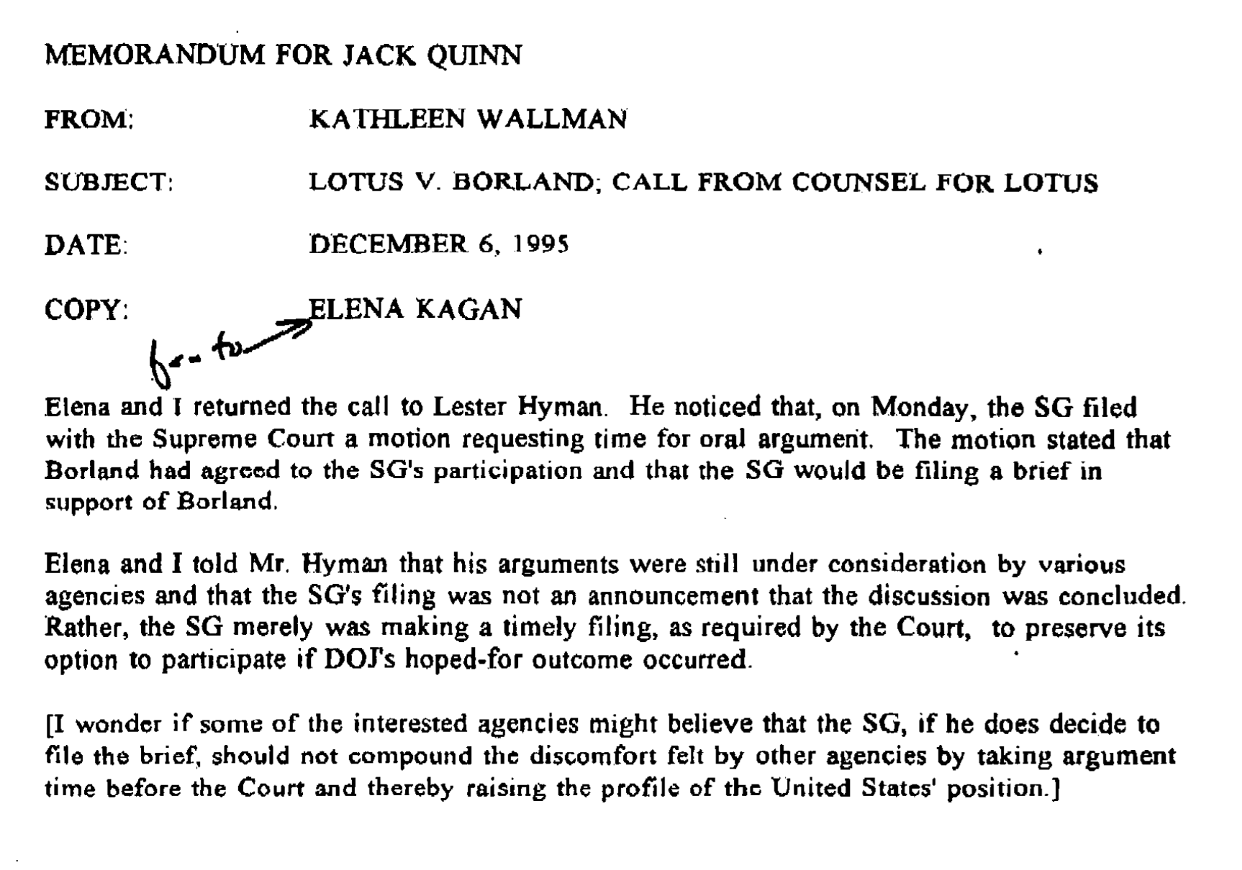
The Next Day…
Notes:
(the brief never ended up being filed)

Slide 37
Borland
Lotus
SCOTUS
Friday, December 8, 1995
Notes:
Source for CEA: Kathleen Wallman, Memorandum for Jack Quinn, 12/5/1995, “CEA supported the filing of a brief” (Kagan documents 1, page 88 of 90, http://clinton.presidentiallibraries.us/items/show/27282
Source for DoJ antitrust: David Ogden, Memo to Elena Kagan, Kagandocs-2, p 2 of 93 http://clinton.presidentiallibraries.us/items/show/27283

Slide 38
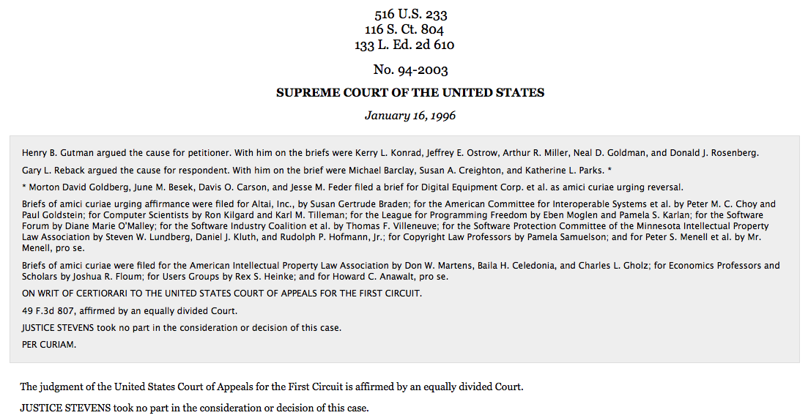
Outcome

Slide 39
Possible Arguments for Borland
Lack of Originality
Menu is not protected “expression”
Merger
Scene-a-faire
No protection for “words and short phrases”
Method of Operation – 102(b)
De minimis copying
Fair Use
Privilege for Interoperability
Copyright protection for software is bad policy
Stahl
Boudin

