Slide 1
Modifications
Case Study 017
Copyright^{x}
William Fisher
January 2024
Licensed under terms available at https://ipxcourses.org

Slide 2
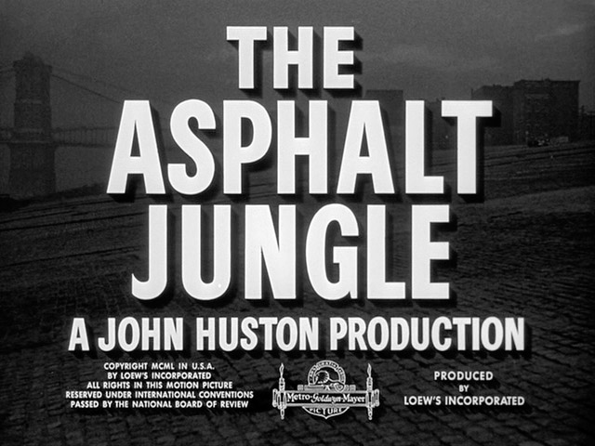
Source: http://annyas.com/screenshots/updates/the-asphalt-jungle-1950-john-huston-sterling-hayden-james-whitmore-marilyn-monroe/

Slide 3
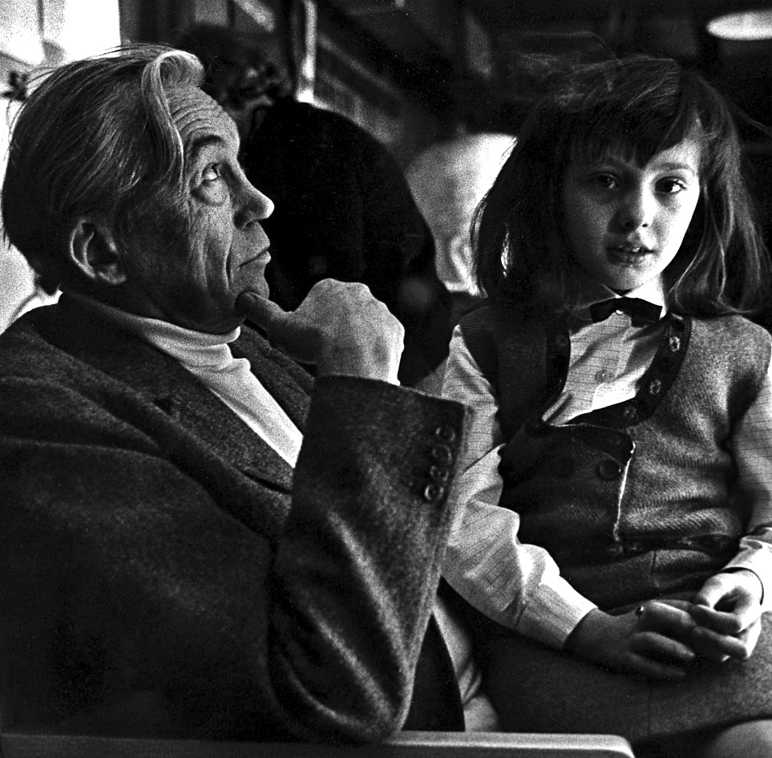
John Huston

Slide 4
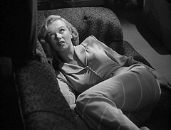
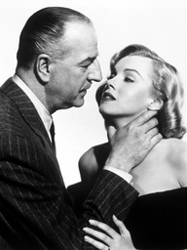

Slide 5
The Asphalt Jungle
Colorized scene: http://www.youtube.com/watch?v=B5fRvEvE9NA

Slide 6
CleanFlicks
“About Us CleanFlicks is a family-oriented company based in Pleasant Grove, Utah. We love movies, but prefer to watch them without the sex, nudity, profanity or extreme violence. Because we recognize others may have a similar desire, we provide this editing service to you. Our mission is to provide access to Hollywood entertainment free from objectionable elements, thus helping maintain high moral values.”

Slide 7
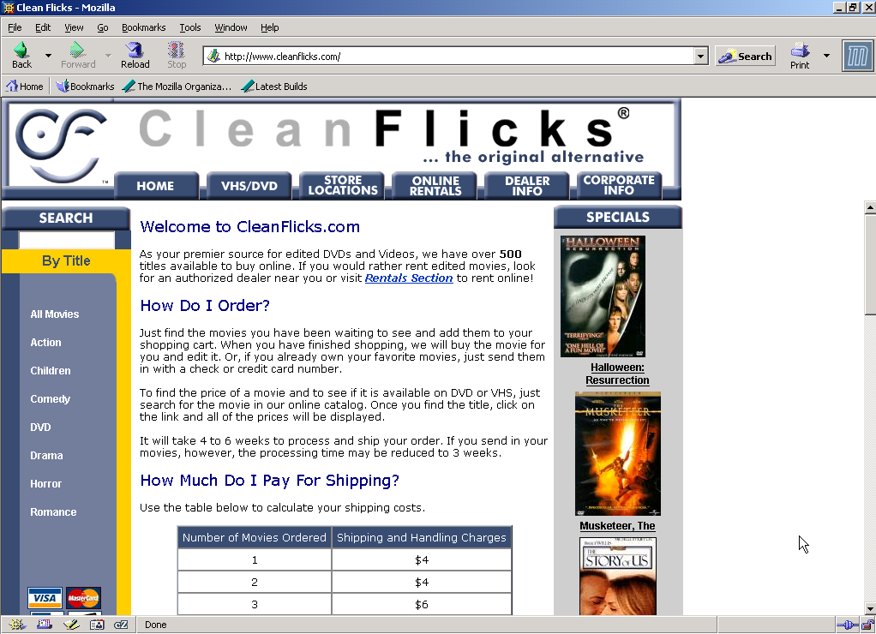

Slide 8
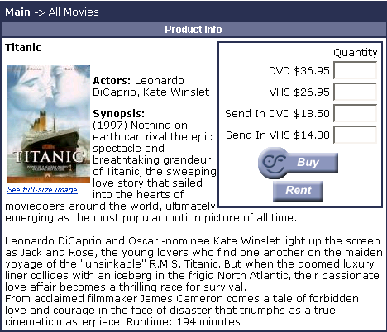

Slide 9
