Slide 1
Frozen Case Study 016
Copyright^{x}
William Fisher
January 2024
Licensed under terms available at https://ipxcourses.org

Slide 2
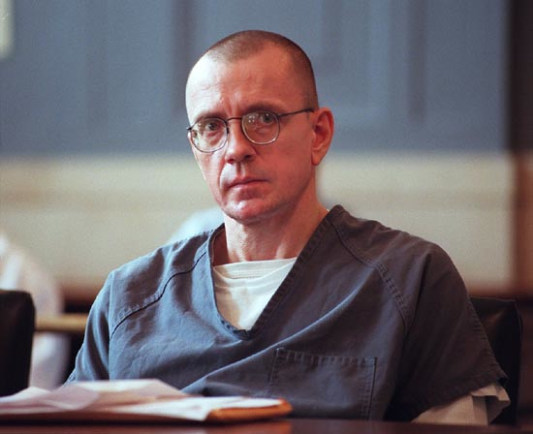
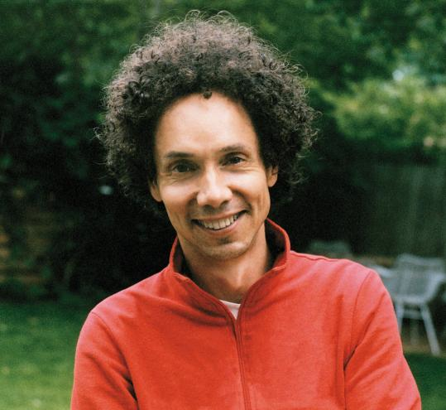
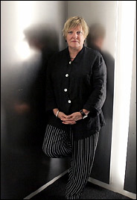
Franklin
Interview with
TV Station
“I can’t say that I do… The only thing I’m sorry about is that it’s not legal.”
“What’s not legal?”
“Killing Jews.”
“Damaged,”
New Yorker (1997)
“I can’t say that I do,” he said. He paused again, then added, “The only thing I’m sorry about is that it’s not legal.”
“What’s not legal?”
Franklin answered as if he’d been asked the time of day: “Killing Jews.”
Lewis
Guilty by Reason
of Insanity (1998)
Gladwell
“I can’t say that I do… The only thing I’m sorry about is that it’s not legal.”
“What’s not legal?”
“Killing Jews.”
Frozen (2003)
Lavery

Slide 3
Franklin
Interview with
TV Station
“Damaged,”
New Yorker (1997)
“The difference between a crime of evil and a crime of illness is the difference between a sin and a symptom.”
Lewis
Guilty by Reason
of Insanity (1998)
Gladwell
“The difference between a crime of evil and a crime of illness is the difference between a sin and a symptom.”
Frozen (2003)
Lavery

Slide 4
Franklin
Interview with
TV Station
“Damaged,”
New Yorker (1997)
“It is the function of the cortex—and, in particular, those parts of the cortex beneath the forehead, known as the frontal lobes—to modify the impulses that surge up from within the brain, to provide judgment, to organize behavior and decision-making, to learn and adhere to rules of everyday life.”
Lewis
Guilty by Reason
of Insanity (1998)
Gladwell
“It is the function of the cortex—and, in particular, those parts of the cortex beneath the forehead, known as the frontal lobes—to modify the impulses that surge up from within the brain, to provide judgment, to organize behavior and decision-making, to learn and adhere to rules of everyday life.”
Frozen (2003)
Lavery

Slide 5
Franklin
Interview with
TV Station
Facts:
New York academic
Neurologist collaborator
Study 15 killers
Sniff
Kiss
Backpack
Biting fantasy
Theory of serial killing
“Damaged,”
New Yorker (1997)
Lewis
Guilty by Reason
of Insanity (1998)
Gladwell
Fiction:
New York academic
Neurologist collaborator
Study 15 killers
Sniff
Kiss
Backpack
Biting fantasy
Theory of serial killing
Affair with collaborator
Frozen (2003)
Lavery

Slide 6
Differentiating Copyright and Plagiarism
Copyright
Plagiarism
No protection for ideas or facts
Attribution does not excuse a violation
“Work for hire” doctrine causes copyrights often to be held by employers
Legal sanctions
Protection for ideas and perhaps for facts
Proper attribution is an antidote
Proper attribution requires identification of the individual author, not his or her employer
Only extralegal sanctions

Slide 7
 | Immoral? | Plagiarism? | Copyright Infringement? (ignore fair use)
1. Lavery reproduces Franklin quotations (“Killing Jews”, etc.)
2. Lavery uses details from Lewis’ life (kiss, sniff, bite, etc.)
3. Lavery adds fictitious affair to “Frozen”
4. Lavery reproduces passages from Gladwell article (“crime of illness”; “function of the cortex”; etc.)

Slide 8
Functions of social norms concerning plagiarism
Ensure that authors and researchers get appropriate credit for their contributions to the body of knowledge
Enable fair allocation of material rewards for intellectual work
Facilitate selection and promotion of the people most likely to contribute to the body of knowledge in the future
Force students to think for themselves, thus fostering education
Reveal or cultivate socially valuable (and virtuous) traits – honesty, integrity, neatness, etc.
Roots:
Personality Theory
Fairness Theory
Welfare Theory

Slide 9
Functions of social norms concerning plagiarism
Ensure that authors and researchers get appropriate credit for their contributions to the body of knowledge
Enable fair allocation of material rewards for intellectual work
Facilitate selection and promotion of the people most likely to contribute to the body of knowledge in the future
Force students to think for themselves, thus fostering education
Reveal or cultivate socially valuable (and virtuous) traits – honesty, integrity, neatness, etc.
Relevance to the conduct of President Gay?
“D. Stephen Voss, an associate professor of political science at the University of Kentucky, knew Gay when they were both graduate students at Harvard. He was her teaching fellow, or T.A., and they worked in the same lab. Voss was a co-author of a 1996 paper that was included in a list of works that Gay allegedly copied from, which, according to the Washington Free Beacon, was compiled in an anonymous complaint to Harvard. One of the two paragraphs in question is pretty technical, describing the methodology of the paper; there are overlapping phrases, but they’re indirect. The other paragraph is a nearly verbatim copying of three or four sentences that Voss and his co-author wrote, with a few words changed..” Emma Green, New Yorker, Jan. 5, 2024

Slide 10
Functions of social norms concerning plagiarism
Ensure that authors and researchers get appropriate credit for their contributions to the body of knowledge
Enable fair allocation of material rewards for intellectual work
Facilitate selection and promotion of the people most likely to contribute to the body of knowledge in the future
Force students to think for themselves, thus fostering education
Reveal or cultivate socially valuable (and virtuous) traits – honesty, integrity, neatness, etc.
Relevance to the conduct of President Gay?
“’ The plagiarism in question here did not take an idea of any significance from my work. It didn’t steal my thunder. It didn’t stop me from publishing. And the bit she used from us was not in any way a major component of what made her research important or valuable.’..” Emma Green, New Yorker, Jan. 5, 2024

Slide 11
Functions of social norms concerning plagiarism
Ensure that authors and researchers get appropriate credit for their contributions to the body of knowledge
Enable fair allocation of material rewards for intellectual work
Facilitate selection and promotion of the people most likely to contribute to the body of knowledge in the future
Force students to think for themselves, thus fostering education
Reveal or cultivate socially valuable (and virtuous) traits – honesty, integrity, neatness, etc.
Relevance to the conduct of President Gay?
✖︎
✖︎
✖︎
✖︎
✓

Slide 12
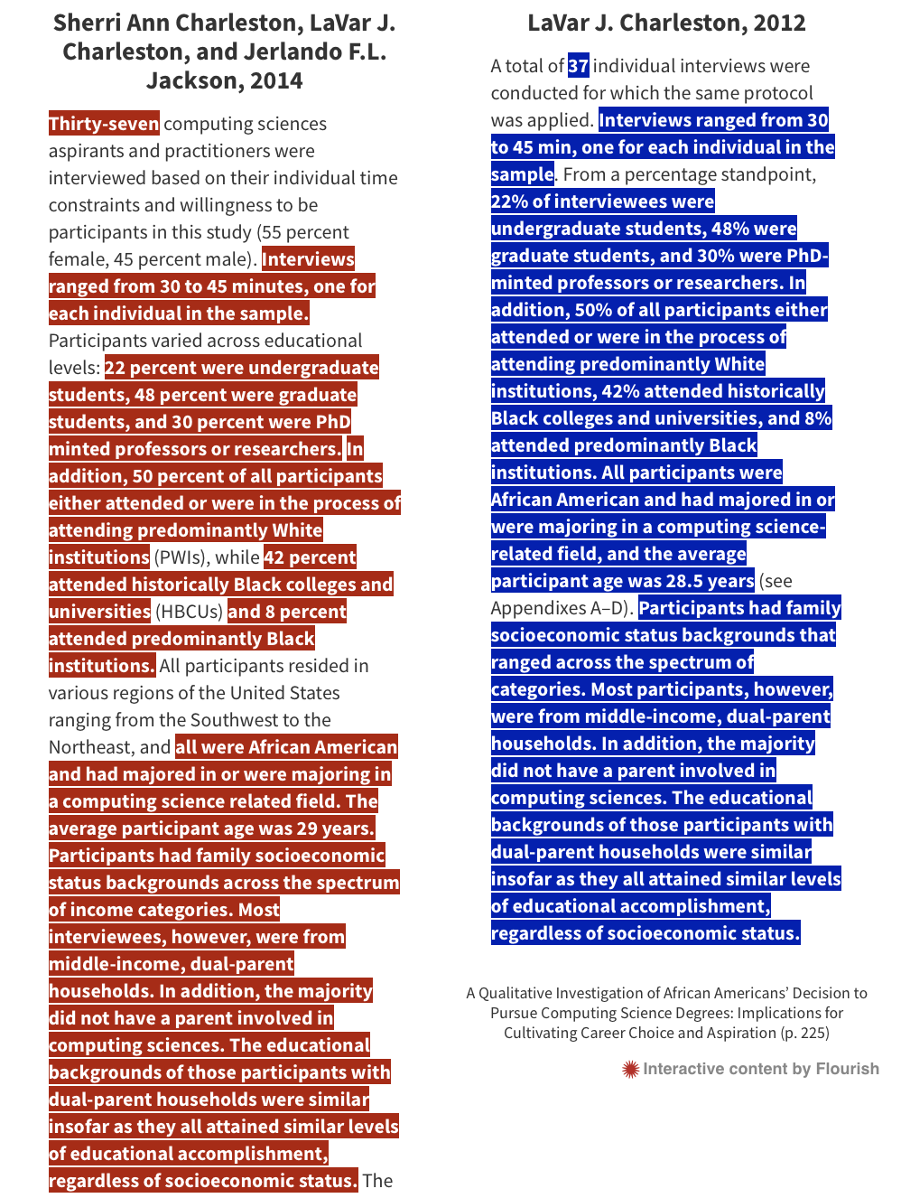

Slide 13
Functions of social norms concerning plagiarism
Ensure that authors and researchers get appropriate credit for their contributions to the body of knowledge
Enable fair allocation of material rewards for intellectual work
Facilitate selection and promotion of the people most likely to contribute to the body of knowledge in the future
Force students to think for themselves, thus fostering education
Reveal or cultivate socially valuable (and virtuous) traits – honesty, integrity, neatness, etc.
Relevance to the conduct of Sherri Ann Charleston?
✖︎
✖︎
✓
✖︎
✓

