Slide 1
Selena y los Dinos
Justin Ward
2022

Slide 2
The Concert
On February 7, 1993, Selena performed at Corpus Christi Memorial Stadium.
Local station KIII-TV filmed the show.
Abraham Quintanilla set up the stage and lights, and hired an audio production company to record the show.
He also advised KIII-TV on where to place the cameras and when to “zero in” during filming.
Notes:
If you haven’t talked about Wikipedia in section yet, I suggest showing one of the short videos from the TF materials before this slideshow.

Slide 3
The Notes
The KIII-TV director sent Abraham Quintanilla a note before the show:
  “Thank you for allowing us to videotape the concert tomorrow night. . . . As per our agreement, we will use the video on the Domingo Show and other news shows. In turn, we will provide you with a master copy on 3/4 [inch recording tape] to use for promotional purposes.”
And one afterward:
  “As we agreed, enclosed please find copies of the concert for your use. In exchange, we will use the footage on the Domingo Show.”
Notes:
If you haven’t talked about Wikipedia in section yet, I suggest showing one of the short videos from the TF materials before this slideshow.

Slide 4
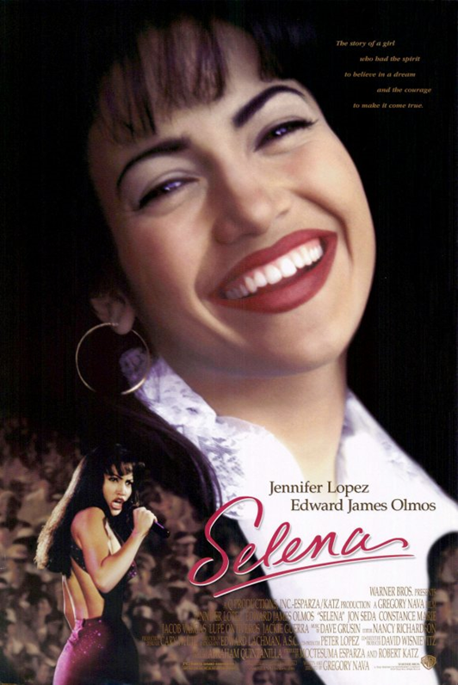
Tragedy
On March 31, 1995, Selena was murdered by the president of her fan club.
Selena’s murder made headlines and unleashed “Selenamania.”
Record sales boomed.
Warner Brothers capitalized by releasing a major motion picture starring J-Lo in 1997.
Notes:
If you haven’t talked about Wikipedia in section yet, I suggest showing one of the short videos from the TF materials before this slideshow.

Slide 5
The Litigation
On March 31, 1996, KIII-TV aired a “Selena Special” that included portions of the concert footage.
In 1997, Abraham Quintanilla sued KIII-TV, claiming it had infringed his copyright in the video.
In addition to Quintanilla, the named plaintiffs included Selena’s siblings and bandmates, who had written the songs played during the concert.
Notes:
If you haven’t talked about Wikipedia in section yet, I suggest showing one of the short videos from the TF materials before this slideshow.

Slide 6
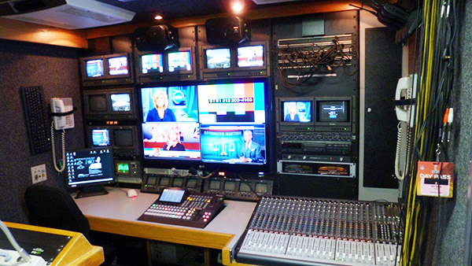
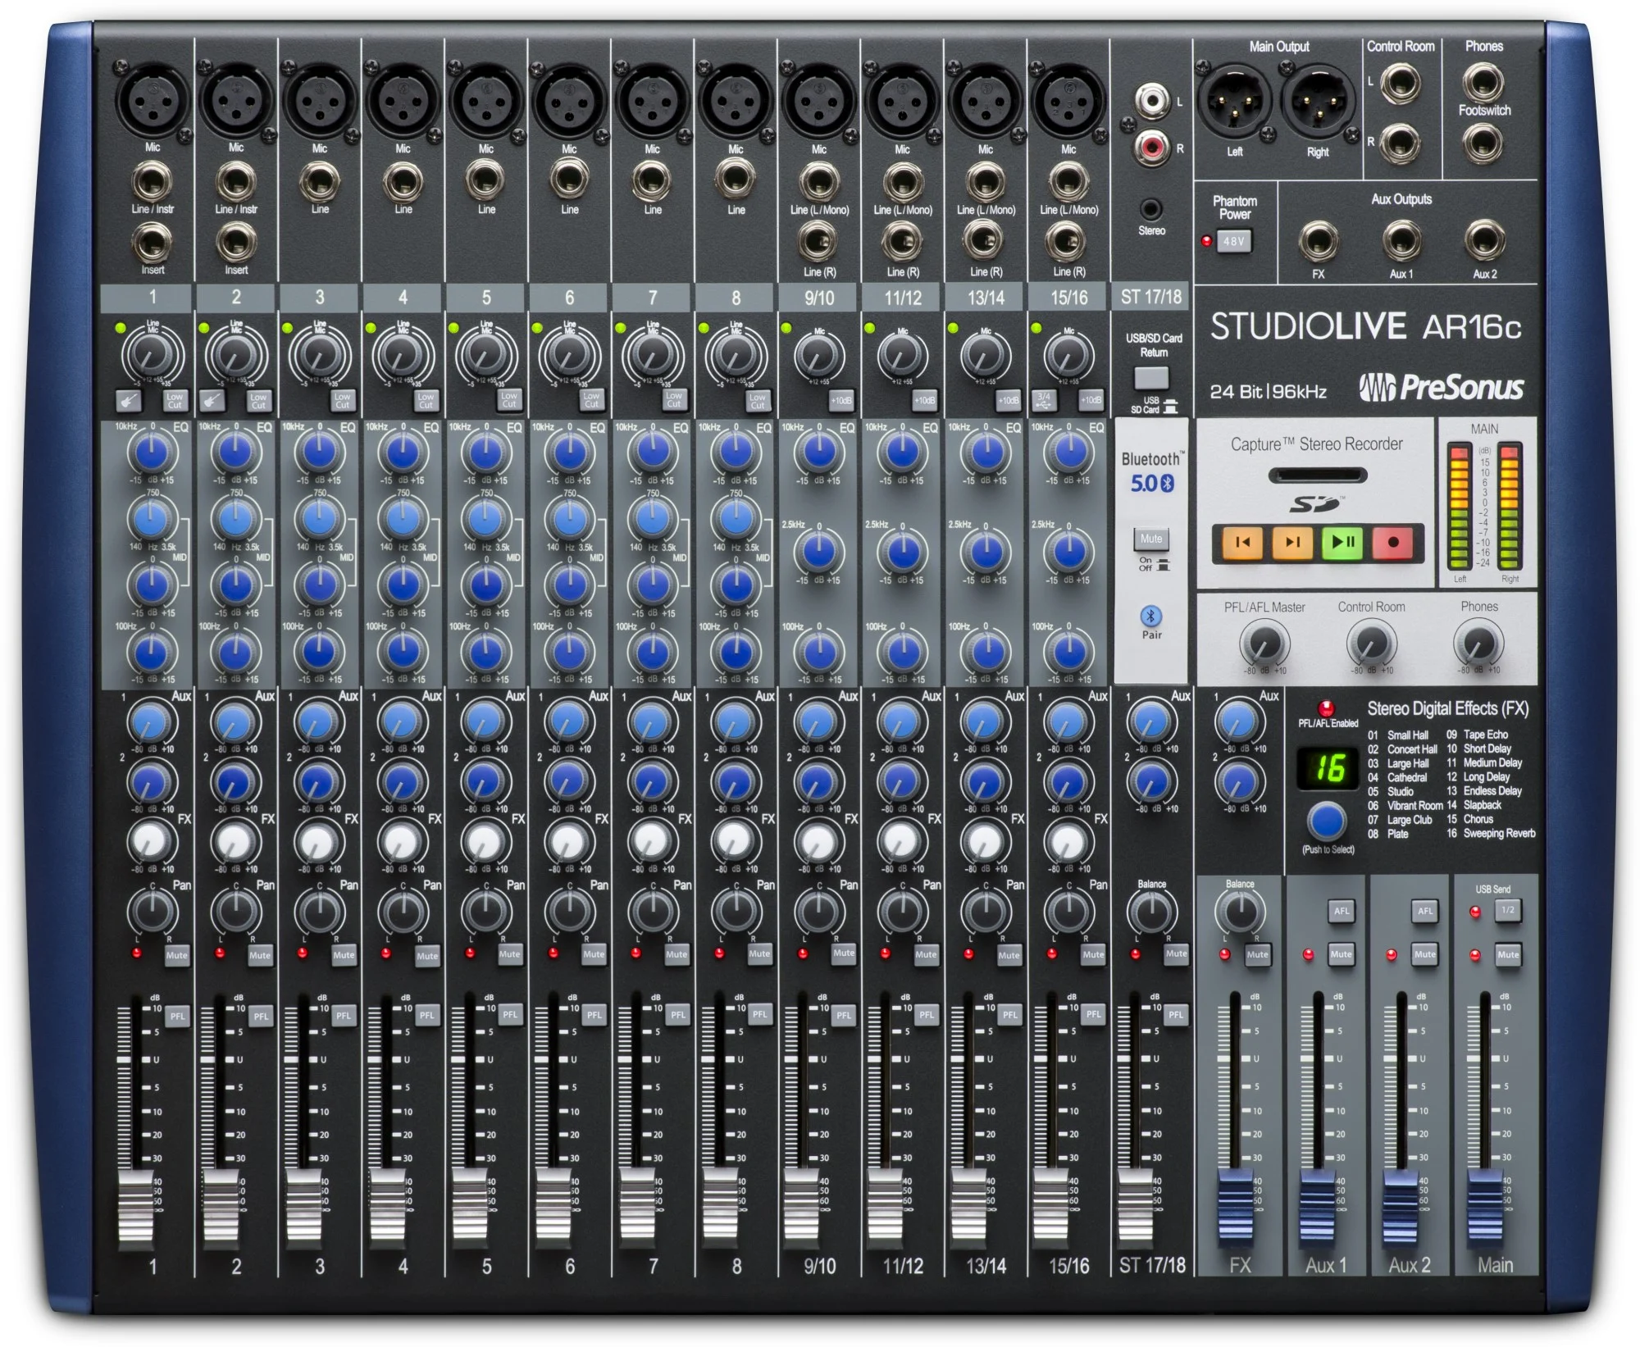
KIII - TV
Quintanilla
A.B.
Perez
Selena
Sanchez
Camera operator
Camera operator
Camera operator
Audio technicians
Black arrows represent contributions to the audiovisual work;
Red arrows represent legal and economic relationships
“Selena Live” Audio Recording
Audiovisual Work

Slide 7
Exercise (10 minutes)
Groups A, B, C, D, E: You represent the plaintiffs. What legal arguments could be made on behalf of your clients? What evidence would you need to support each argument?
Groups F, G, H, I, J: You represent the defendant. Anticipate the arguments that the plaintiffs might make and develop the best response to each of them.

