Slide 1
The Global Health Crisis: Alternative Incentive Systems
William Fisher WilmerHale Professor of Intellectual Property Law
Harvard Law School
April 2023

Slide 2
The following images appear in the background of the recorded lecture for Module 204 in the PatentX course. The recording itself is available at https://ipxcourses.org/lectures-2/. Removed from their original context, the images will not make much sense. The function of this collection of images is to enable persons who have already watched the lecture to review the material it contains.
The terms on which these images may be used or modified are available at http://ipxcourses.org.

Slide 3
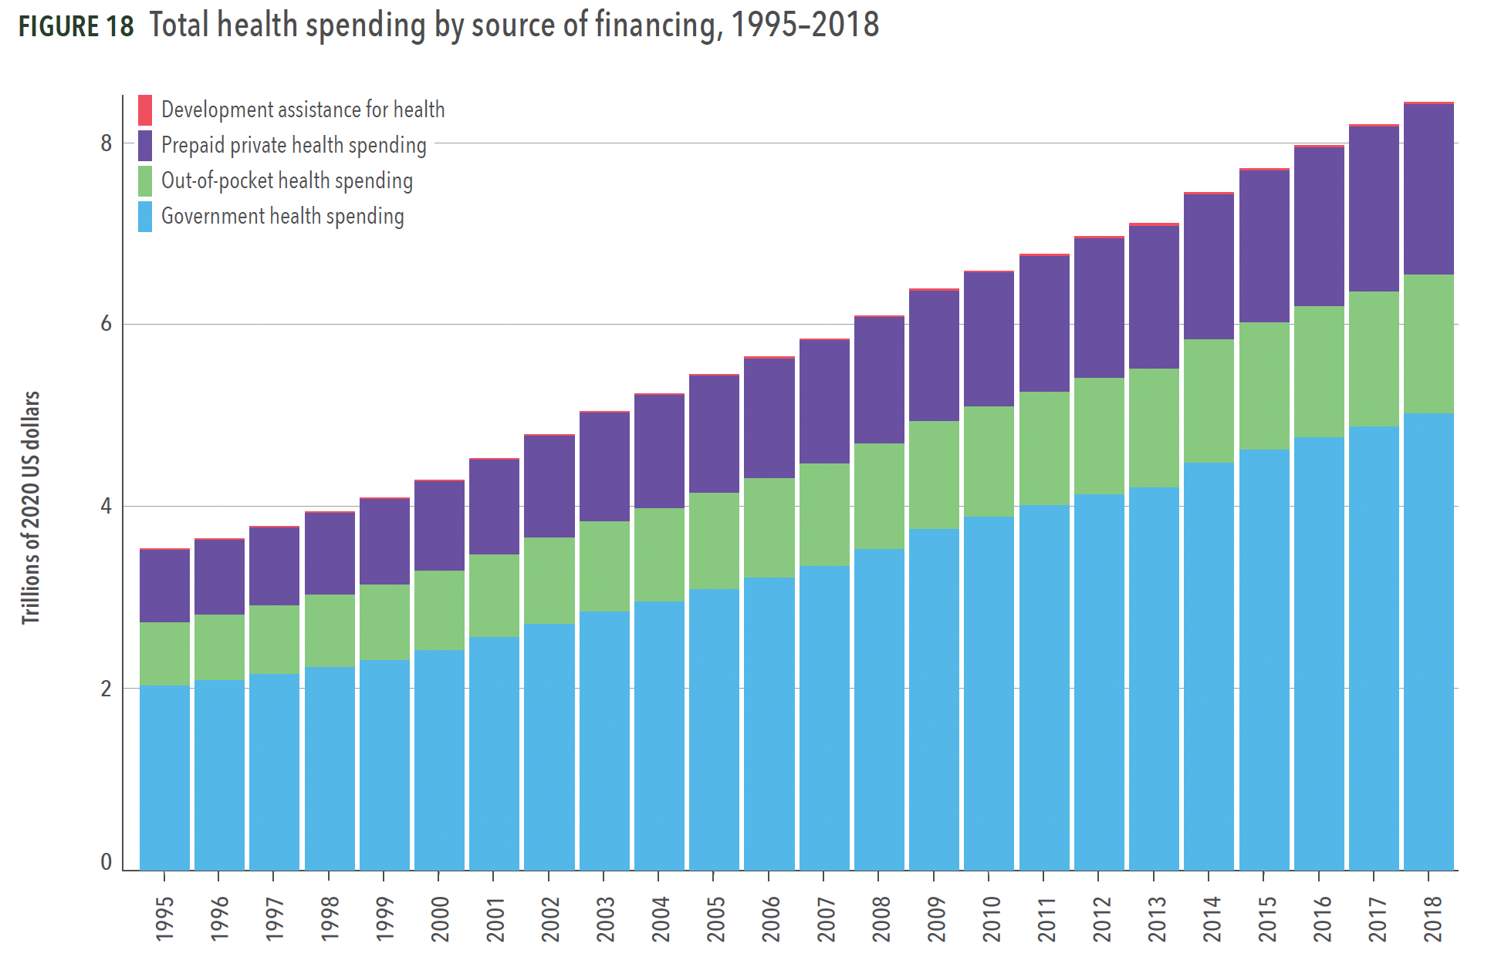
Source: Institute for Health Metrics and Evaluation, Financing Global Health 2020

Slide 4
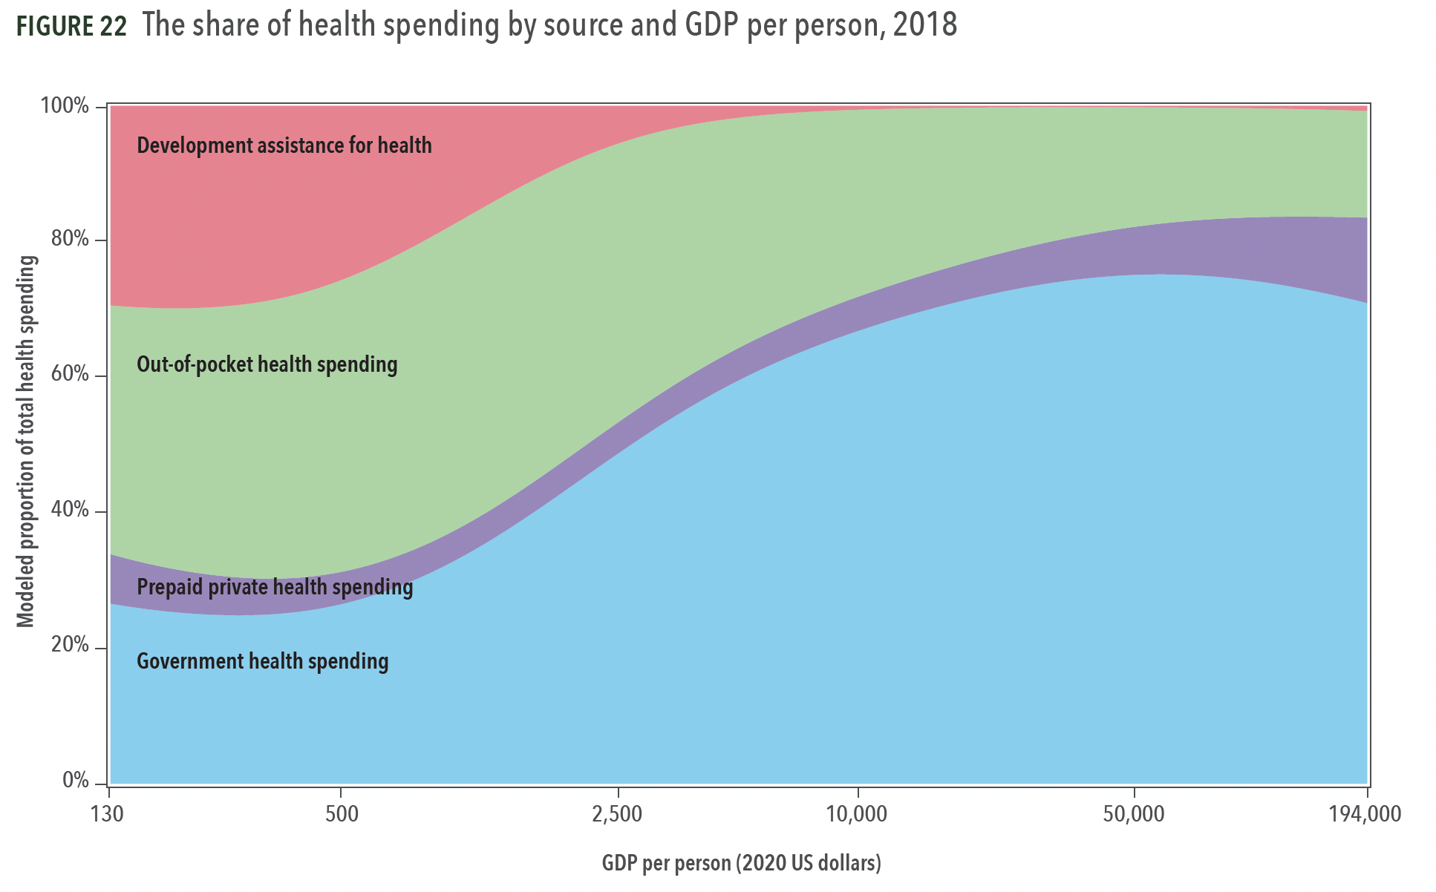
Source: Institute for Health Metrics and Evaluation, Financing Global Health 2020

Slide 5
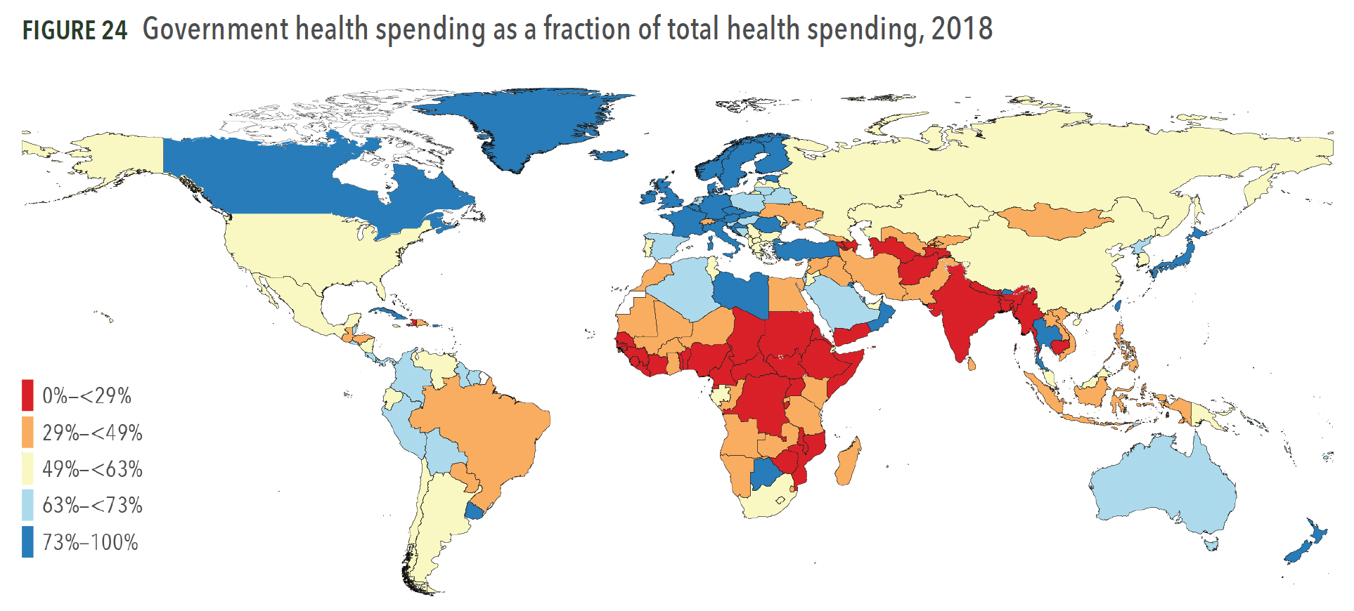
Source: Institute for Health Metrics and Evaluation, Financing Global Health 2020

Slide 6
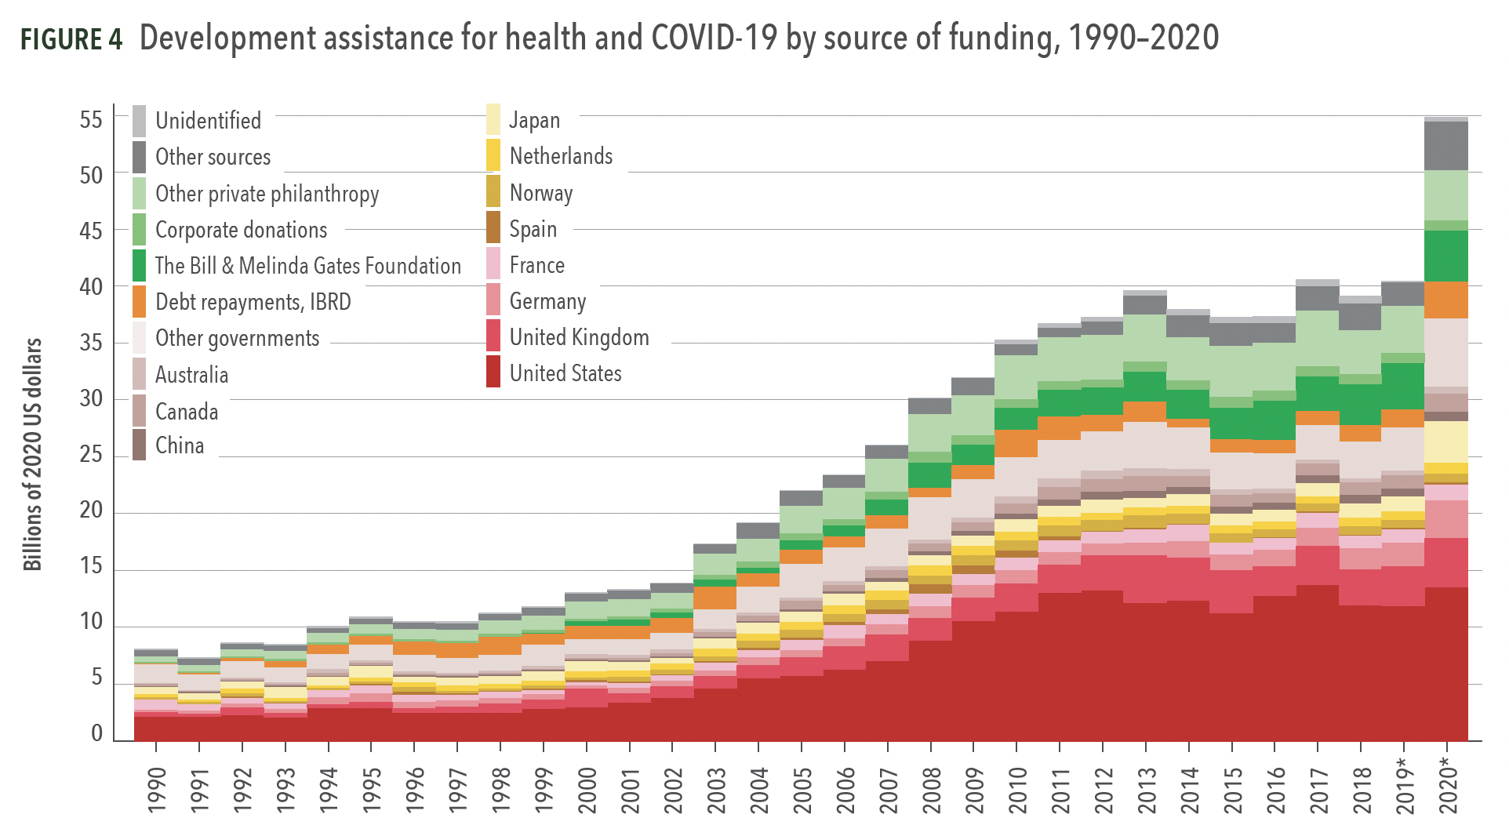
Source: Institute for Health Metrics and Evaluation, Financing Global Health 2020

Slide 7
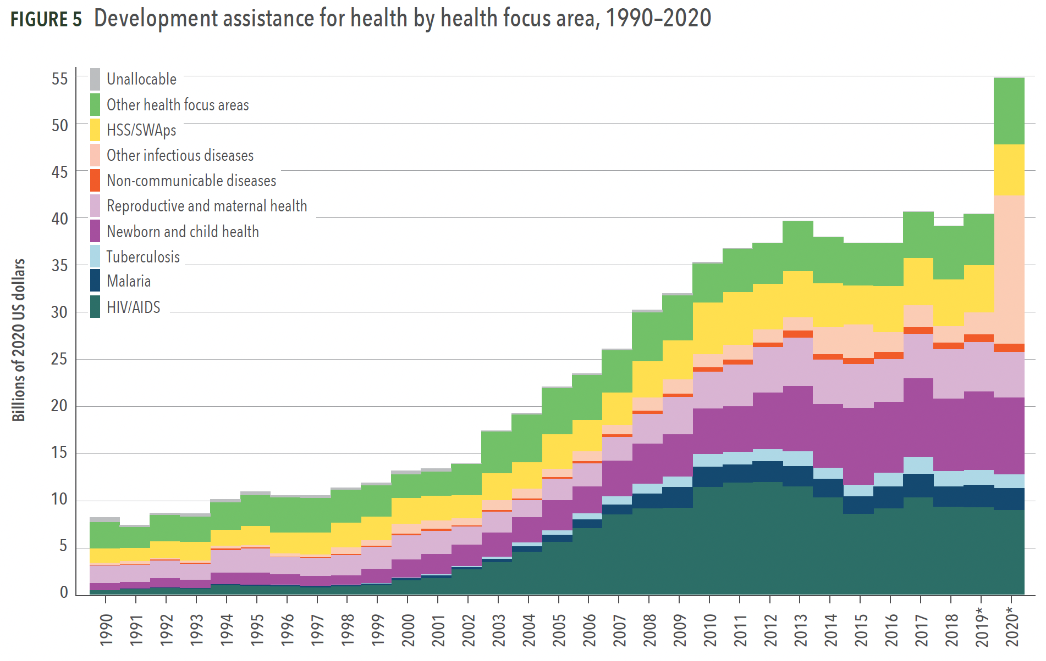
Source: Institute for Health Metrics and Evaluation, Financing Global Health 2020

Slide 8
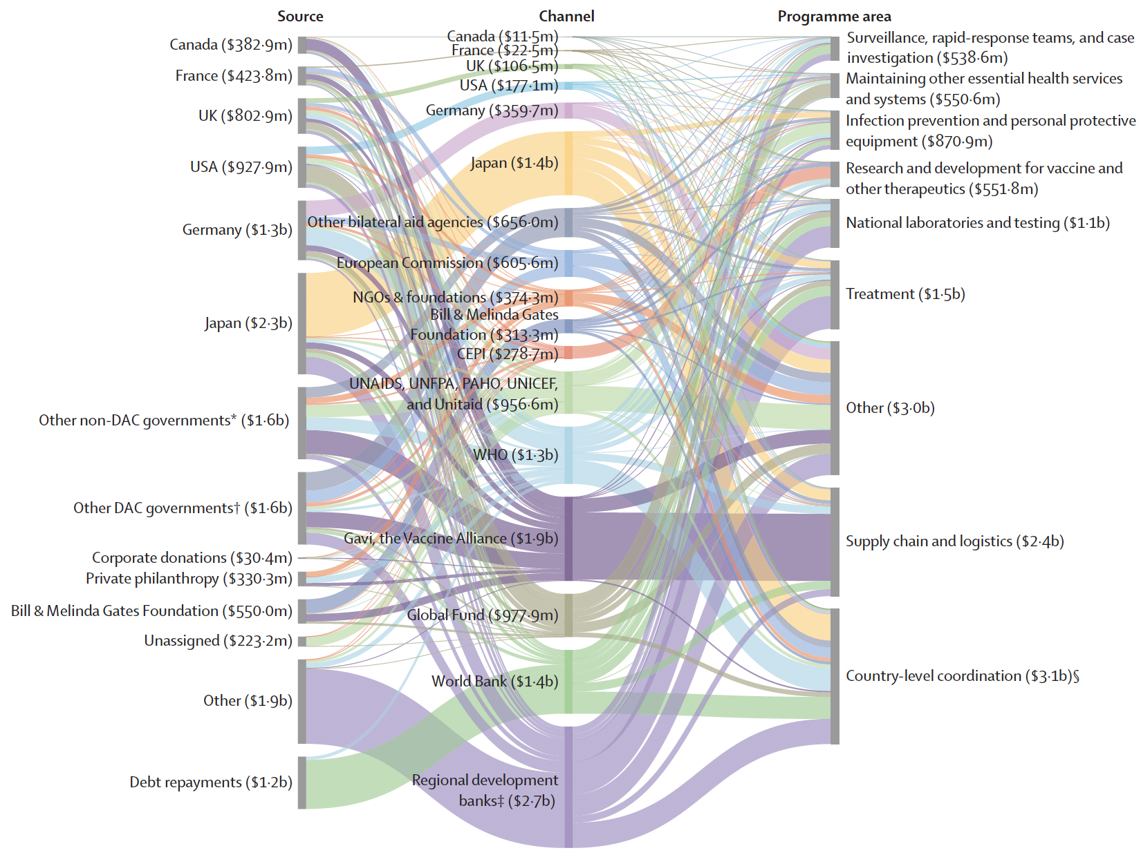
Source: ”Tracking development assistance for health and for COVID-19:
a review of development assistance, government, out-of-pocket, and
other private spending on health for 204 countries and territories, 1990–2050,” The Lancet (2021)
Flows of Assistance
For COVID-19
In 2020
(Total: $13 billion)

Slide 9
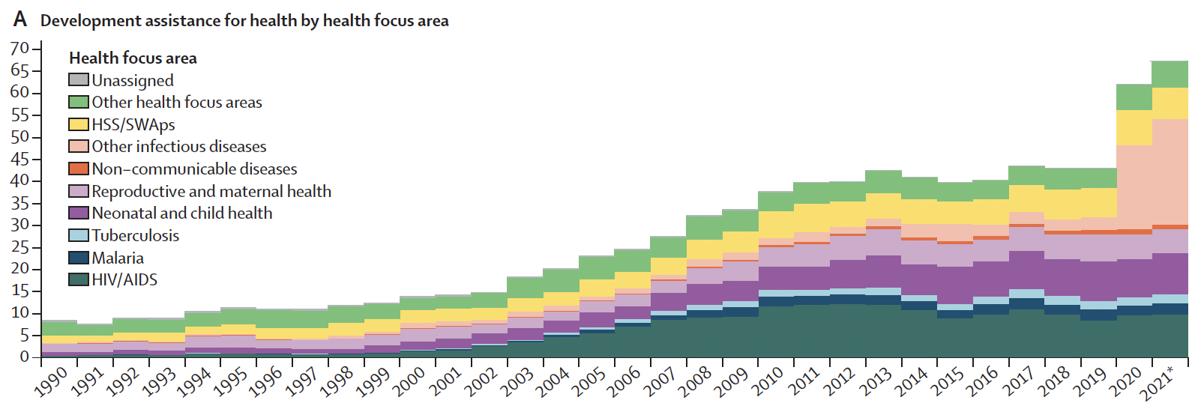
Source: Global investments in pandemic preparedness and COVID-19: development assistance and domestic spending on health between 1990 and 2026,” The Lancet 2023

Slide 10
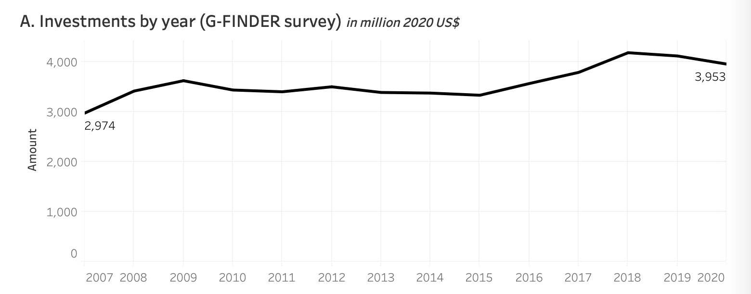
Investments by Governments and Philanthropies in R&D on Neglected Diseases
Source: https://www.who.int/observatories/global-observatory-on-health-research-and-development/monitoring/
distribution-of-r-d-funding-flows-for-neglected-diseases-by-country-funder-recipient-organization

Slide 11
To qualify as “neglected,” a disease must meet three requirements

Slide 12
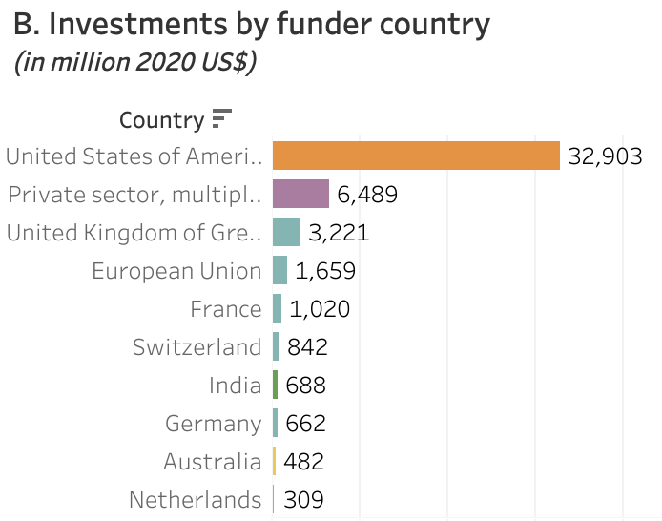
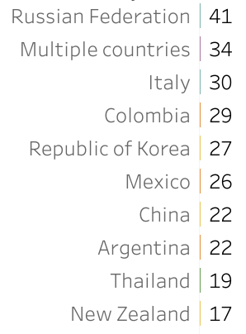
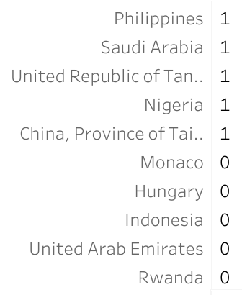
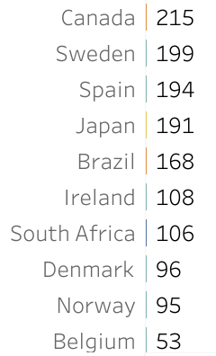
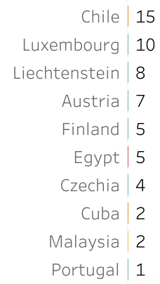
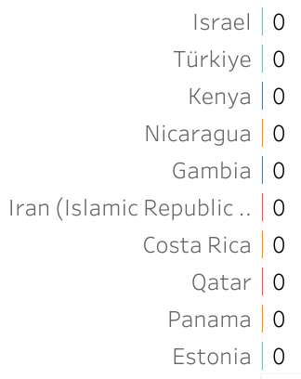
(Totals for 2007-2020)
Source: https://www.who.int/observatories/global-observatory-on-health-research-and-development/monitoring/
distribution-of-r-d-funding-flows-for-neglected-diseases-by-country-funder-recipient-organization

Slide 13
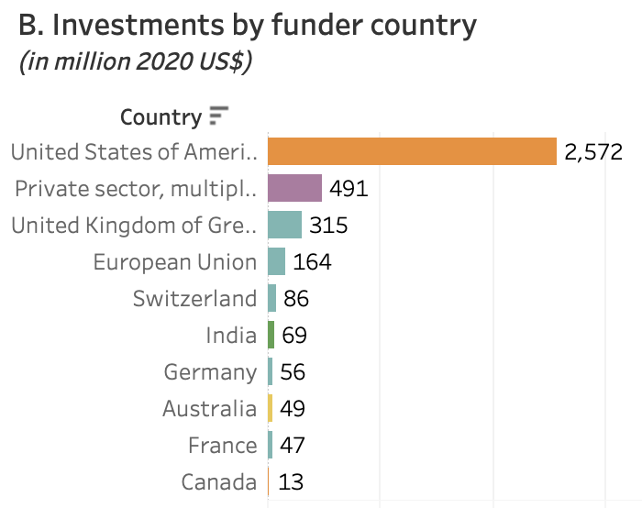
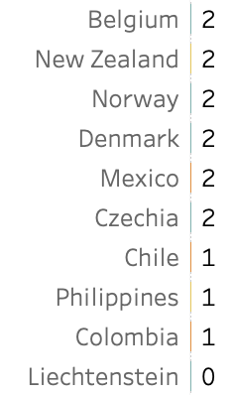
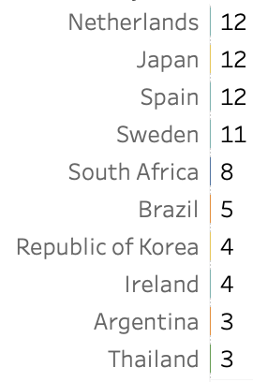
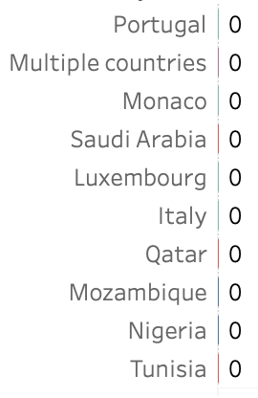
(in 2020)
Source: https://www.who.int/observatories/global-observatory-on-health-research-and-development/monitoring/
distribution-of-r-d-funding-flows-for-neglected-diseases-by-country-funder-recipient-organization

Slide 14
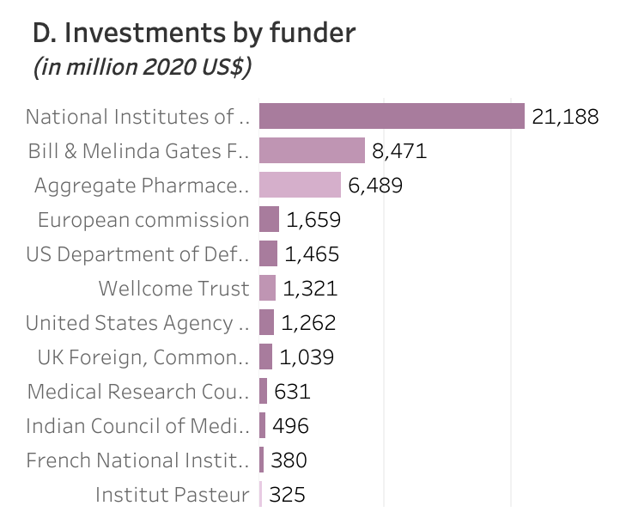
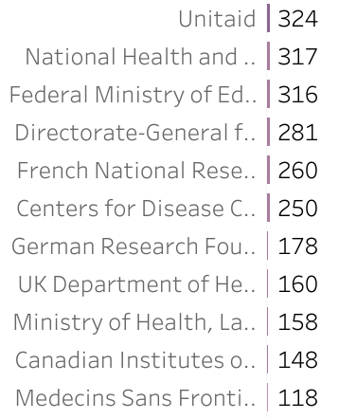
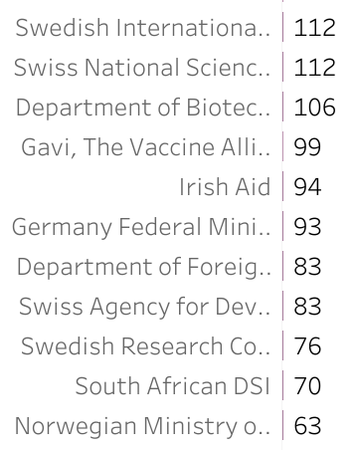
(Totals for 2007-2020)
Source: https://www.who.int/observatories/global-observatory-on-health-research-and-development/monitoring/
distribution-of-r-d-funding-flows-for-neglected-diseases-by-country-funder-recipient-organization

Slide 15
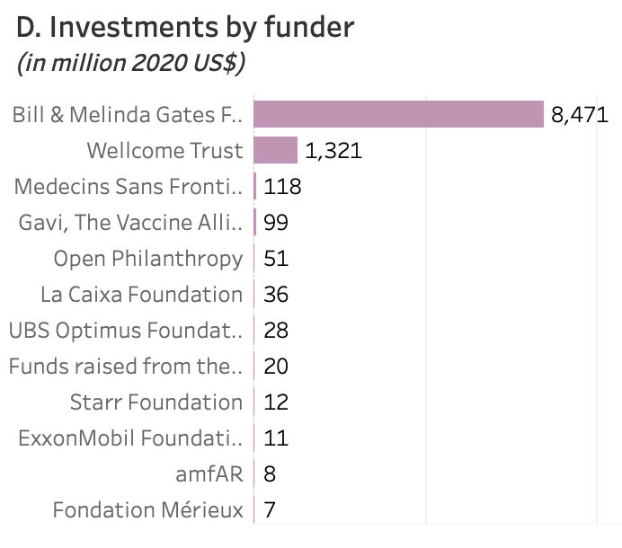
(Philanthropies alone)
Source: https://www.who.int/observatories/global-observatory-on-health-research-and-development/monitoring/
distribution-of-r-d-funding-flows-for-neglected-diseases-by-country-funder-recipient-organization
(Totals for 2007-2020)

Slide 16
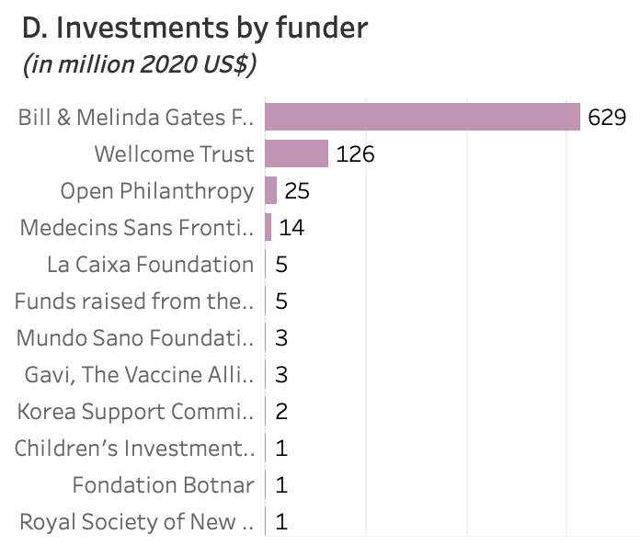
(Philanthropies alone)
Source: https://www.who.int/observatories/global-observatory-on-health-research-and-development/monitoring/
distribution-of-r-d-funding-flows-for-neglected-diseases-by-country-funder-recipient-organization
(in 2020)

Slide 17
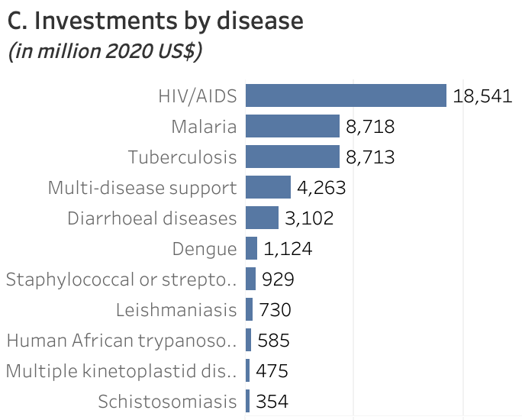
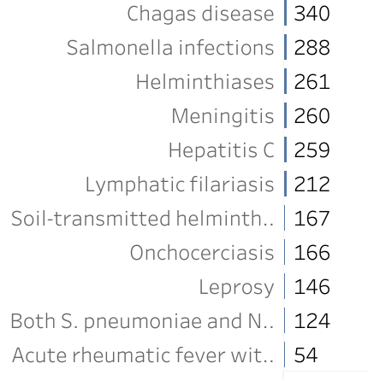
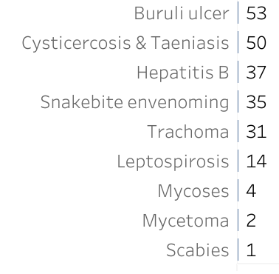
(Totals for 2007-2020)
Source: https://www.who.int/observatories/global-observatory-on-health-research-and-development/monitoring/
distribution-of-r-d-funding-flows-for-neglected-diseases-by-country-funder-recipient-organization

Slide 18
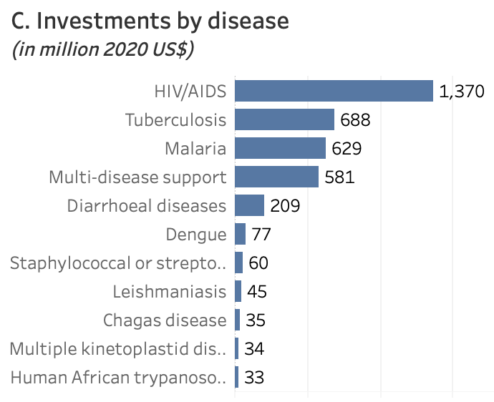
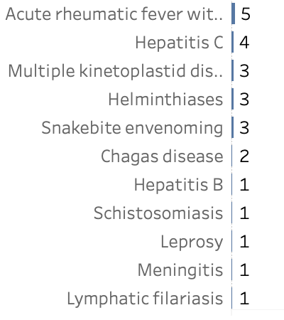
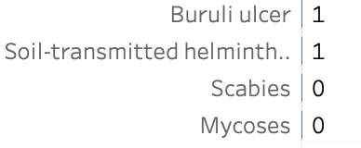
(in 2020)
Source: https://www.who.int/observatories/global-observatory-on-health-research-and-development/monitoring/
distribution-of-r-d-funding-flows-for-neglected-diseases-by-country-funder-recipient-organization

Slide 19
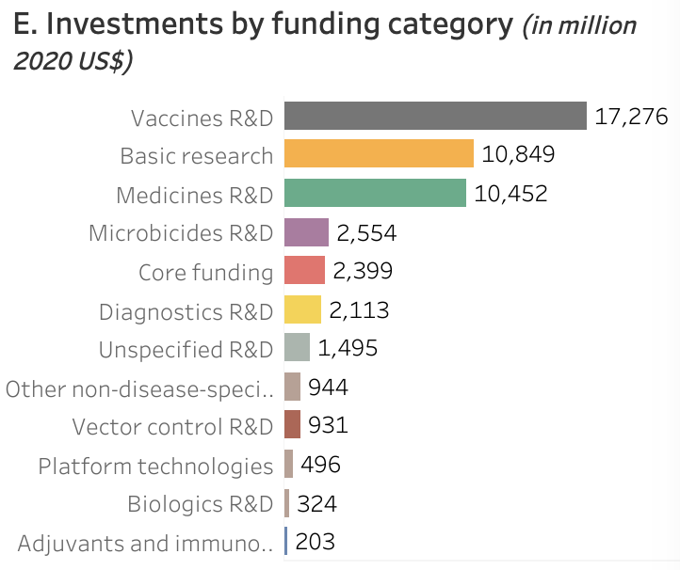
(Totals for 2007-2020)
Source: https://www.who.int/observatories/global-observatory-on-health-research-and-development/monitoring/
distribution-of-r-d-funding-flows-for-neglected-diseases-by-country-funder-recipient-organization

Slide 20
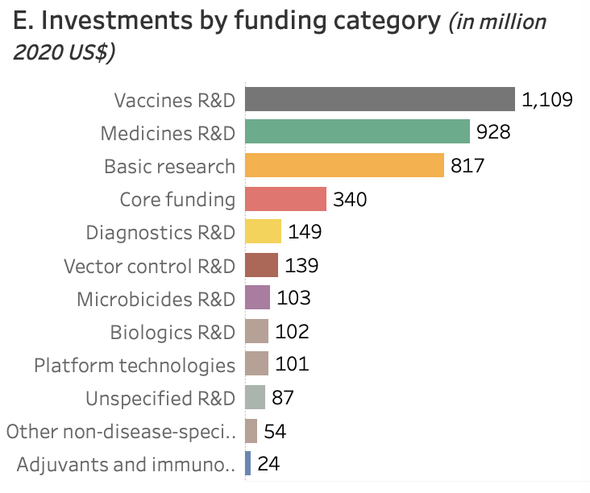
(in 2020)
Source: https://www.who.int/observatories/global-observatory-on-health-research-and-development/monitoring/
distribution-of-r-d-funding-flows-for-neglected-diseases-by-country-funder-recipient-organization

Slide 21
Examples of Forms of Funding for Pharmaceutical R&D
In-house
Research
Grants
Prizes
Money
Money
Disbursement
of Money
Priority Review Vouchers
Tax Relief
Honors

Slide 22
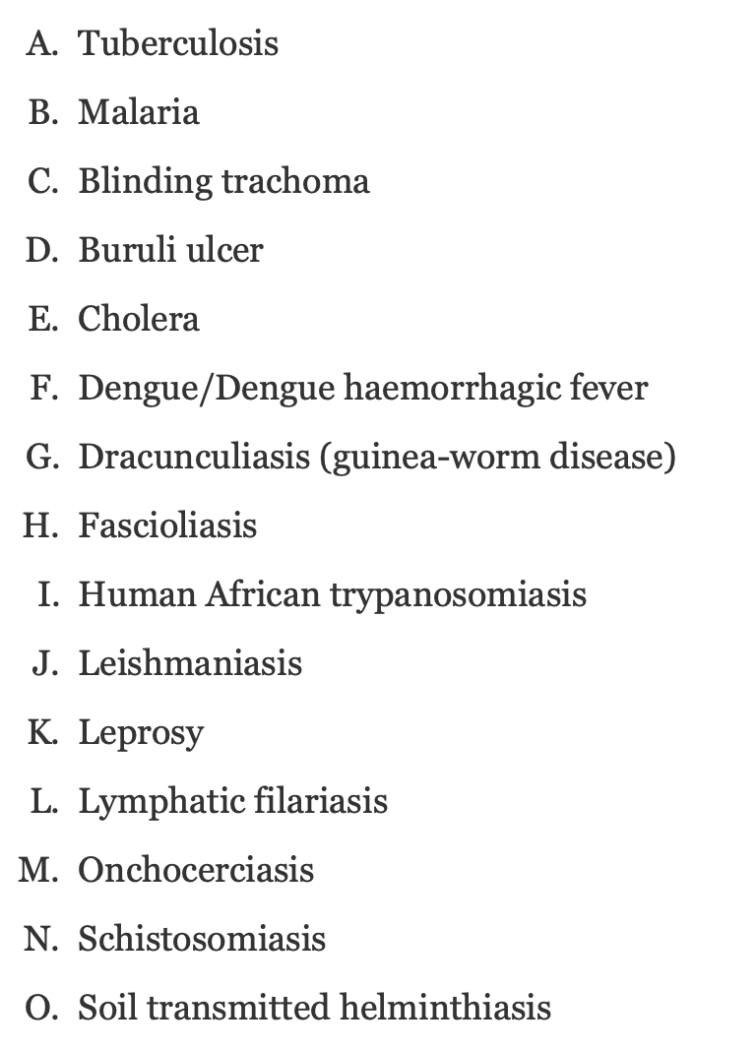
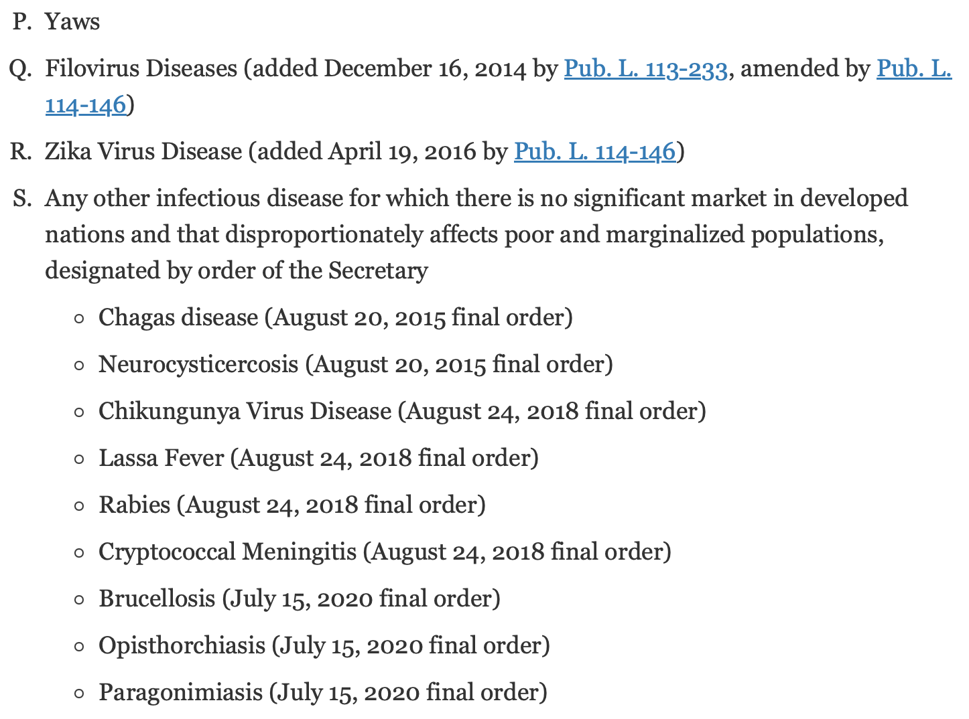
The current list of “Tropical Diseases”
Source: https://www.fda.gov/about-fda/center-drug-evaluation-and-research-cder/tropical-disease-priority-review-voucher-program

Slide 23
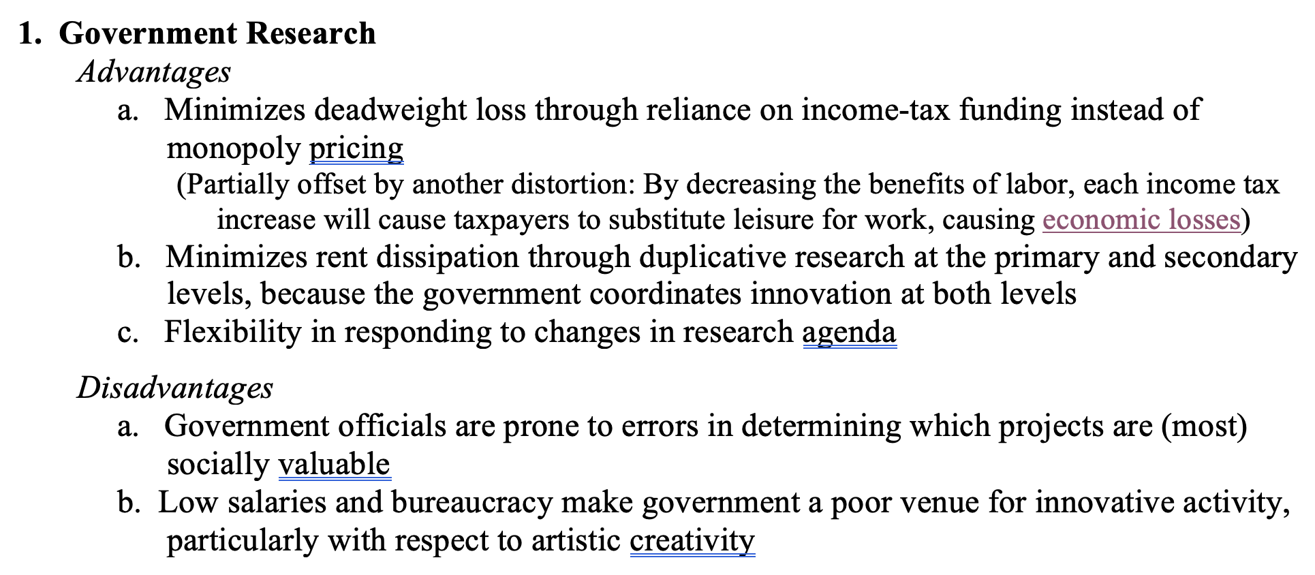
Comparing the Forms

Slide 24
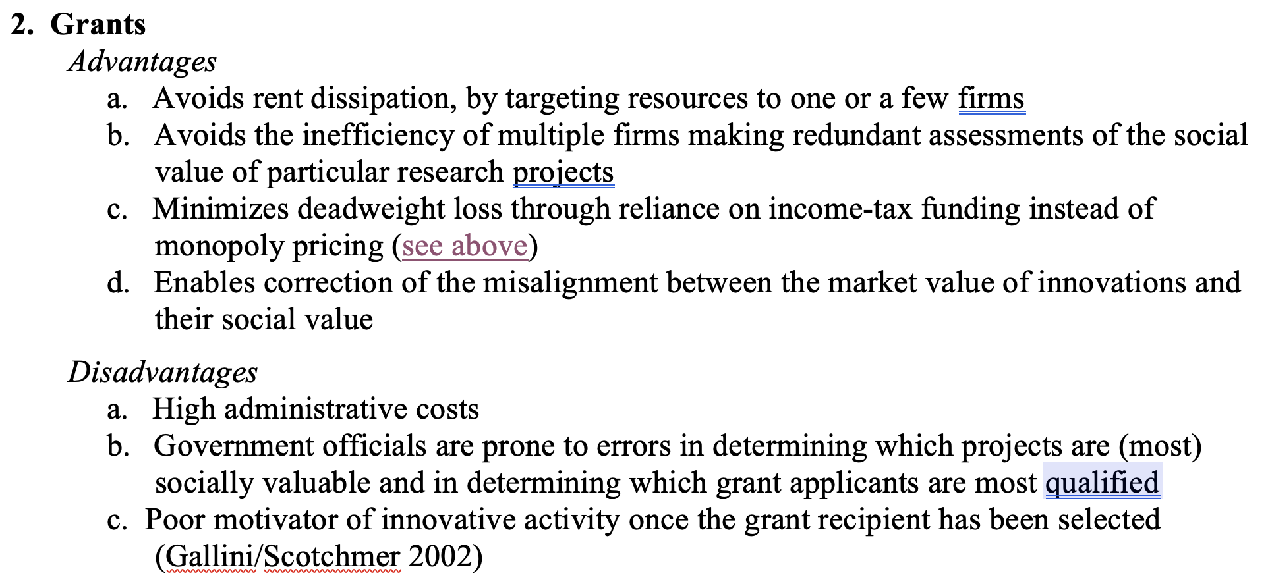
Comparing the Forms

Slide 25
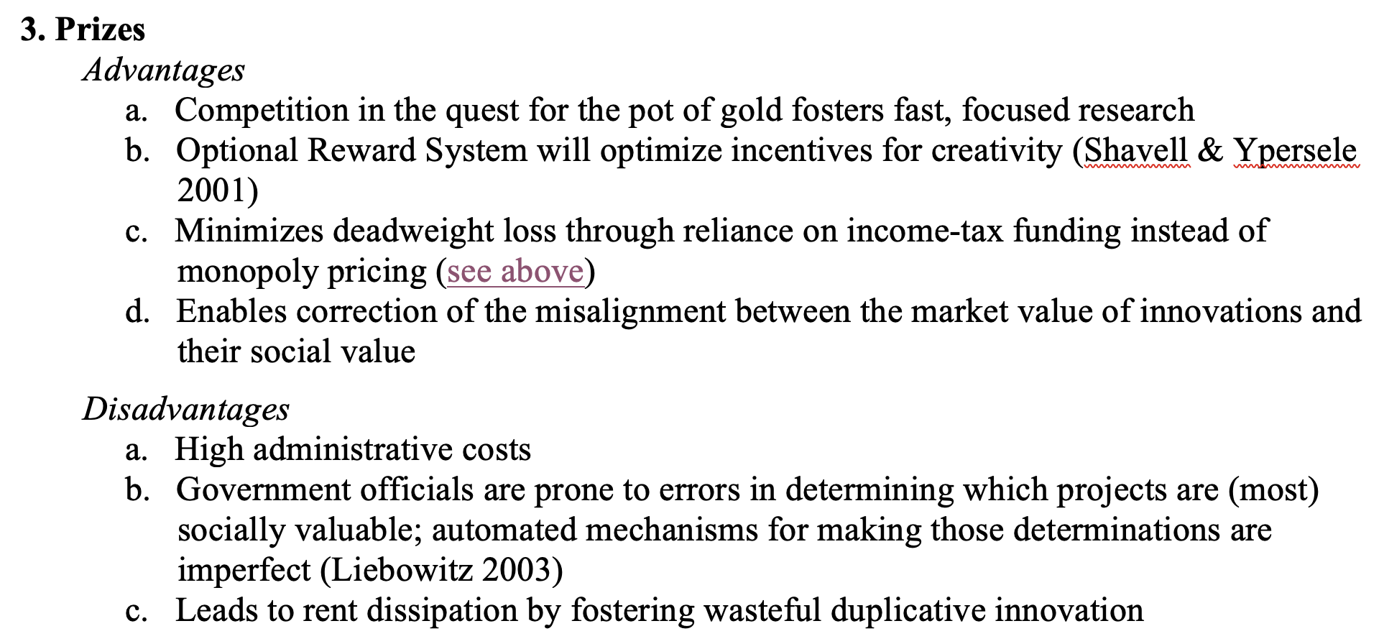
Comparing the Forms

Slide 26
Breakthrough Drugs
Drugs aimed at Neglected Infectious Diseases
Vaccines

Slide 27
(thousands) | Global Deaths | Global DALYs
HIV/AIDS | 675 | 40147
Tuberculosis* | 1208 | 66024
Malaria* | 411 | 33398
STDs (excluding HIV/AIDS)
Syphilis | 43 | 3814
Chlamydia | 1 | 324
Gonorrhoea | 2 | 231
Trichomoniasis | 0 | 282
Genital herpes | 0 | 250
Other STDs | 3 | 352
Diarrhoeal Diseases | 1519 | 79311
Childhood Diseases
Pertussis (“whooping cough”) | 111 | 9839
Diphtheria | 5 | 420
Measles | 165 | 14528
Tetanus | 47 | 3474
Meningitis | 233 | 16314
Encephalitis | 78 | 4174
Hepatitis
A | 40 | 2102
B | 36 | 1633
C | 22 | 655
E | 2 | 123
(thousands) | Global Deaths | Global DALYs
Parasitic and vector diseases (excluding Malaria)
Trypanosomiasis* | 2 | 102
Chagas* | 8 | 217
Schistosomiasis | 12 | 1628
Leishmaniasis* | 6 | 722
Lymphatic filariasis (elephantiasis) | 0 | 1616
Onchocerciasis (river blindness) | 0 | 1210
Cysticercosis | 7 | 988
Echinococcosis | 9 | 461
Dengue | 30 | 1952
Trachoma (infectious blindness) | 0 | 194
Yellow fever | 6 | 413
Rabies | 47 | 2634
Intestinal nematode infections
Ascariasis | 2 | 749
Trichuriasis | 0 | 232
Hookworm | 0 | 962
Food-bourne trematodes | 7 | 805
Leprosy | 13 | 36
Other infectious diseases | 370 | 19000
Totals | 5101 | 311318

Slide 28
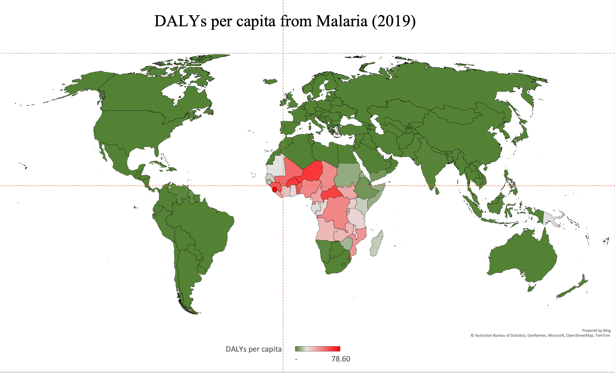

Slide 29
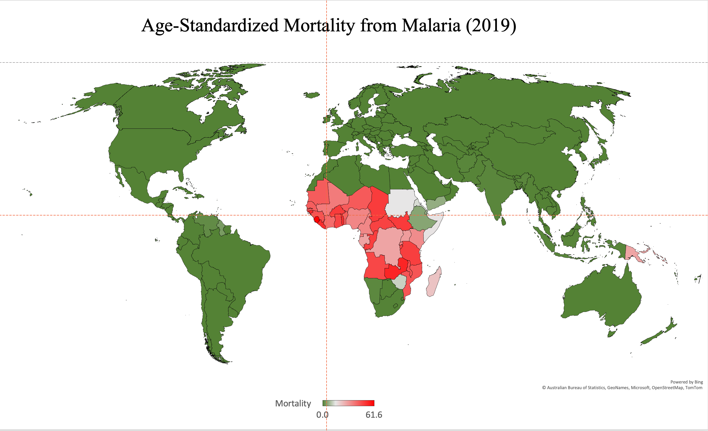

Slide 30
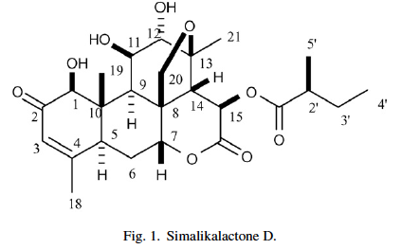
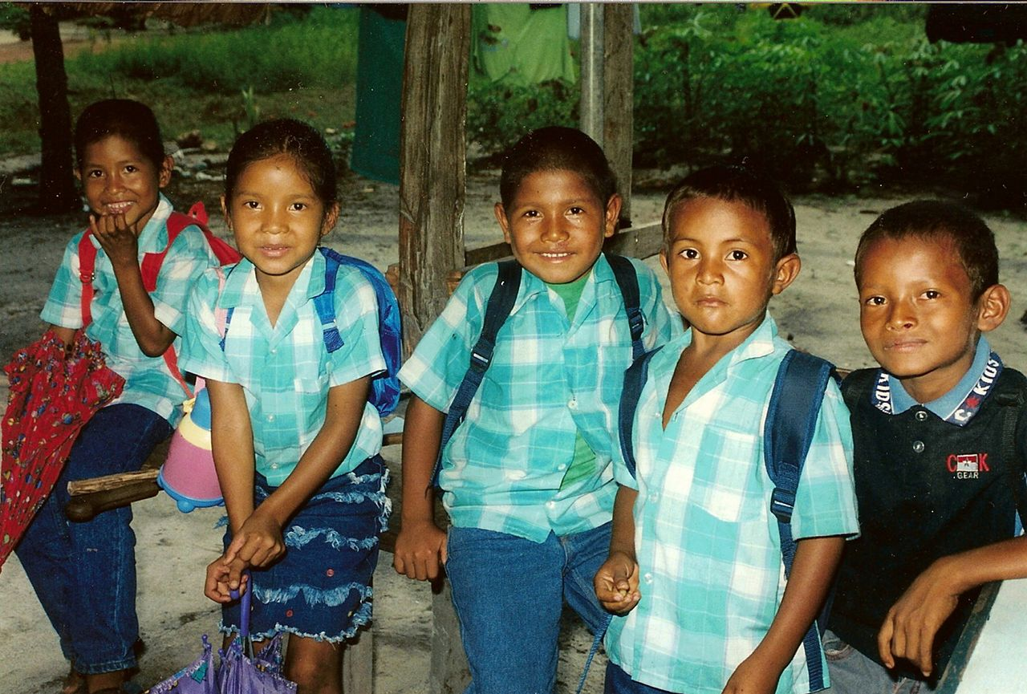
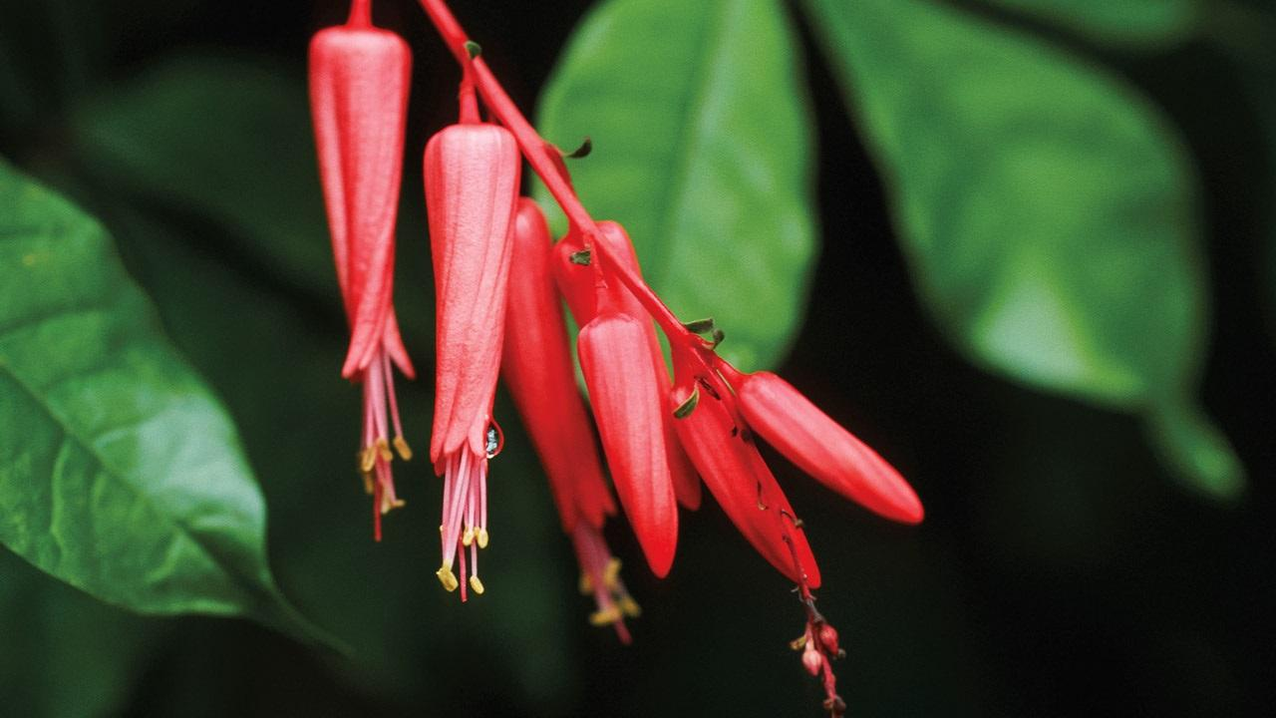
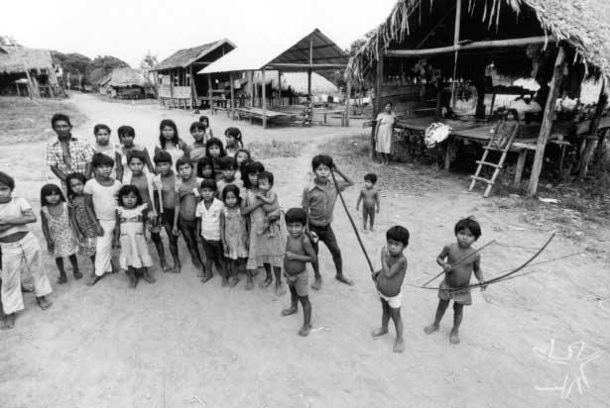
EPO Patent 2015
2014
Quassia Amara
Kalina
Palikur
Creole
Brazilians
Europeans

Slide 31
Arguments for Enhanced Protection for Traditional Knowledge
Labor
Utility
Incentives to commercialize
Incentives to preserve
Psychic externalities
Corrective Justice
Distributive Justice

Slide 32
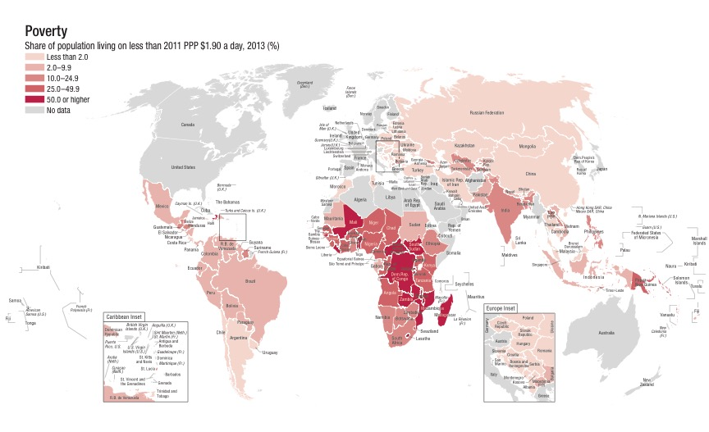
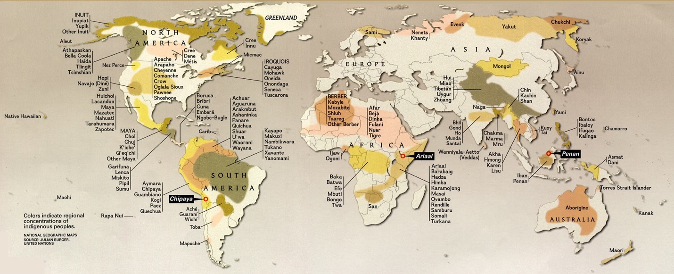
Geographic Distribution of Indigenous Groups
Geographic Distribution of Wealth

Slide 33
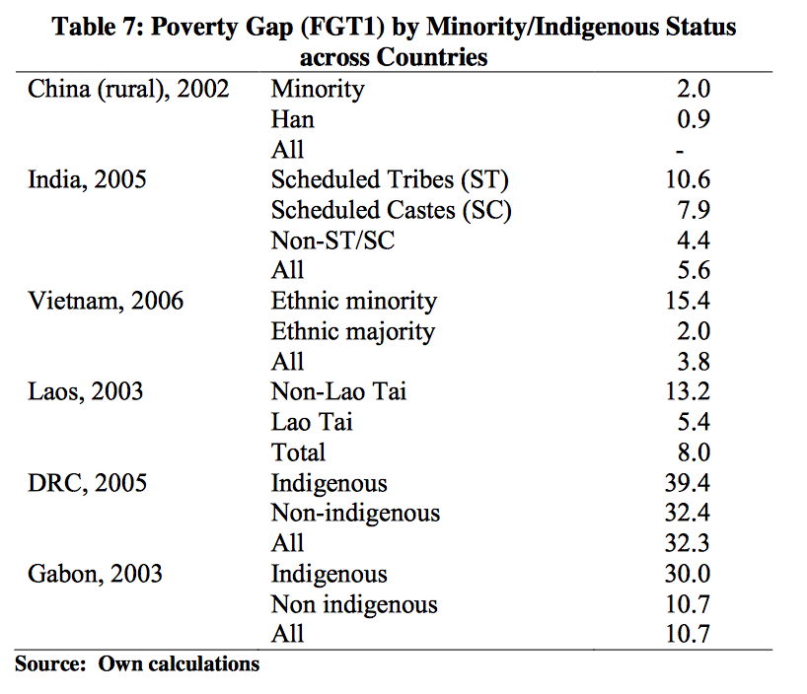
Source: http://siteresources.worldbank.org/EXTINDPEOPLE/Resources/407801-1271860301656/Chapter_9_Conclusion.pdf

Slide 34
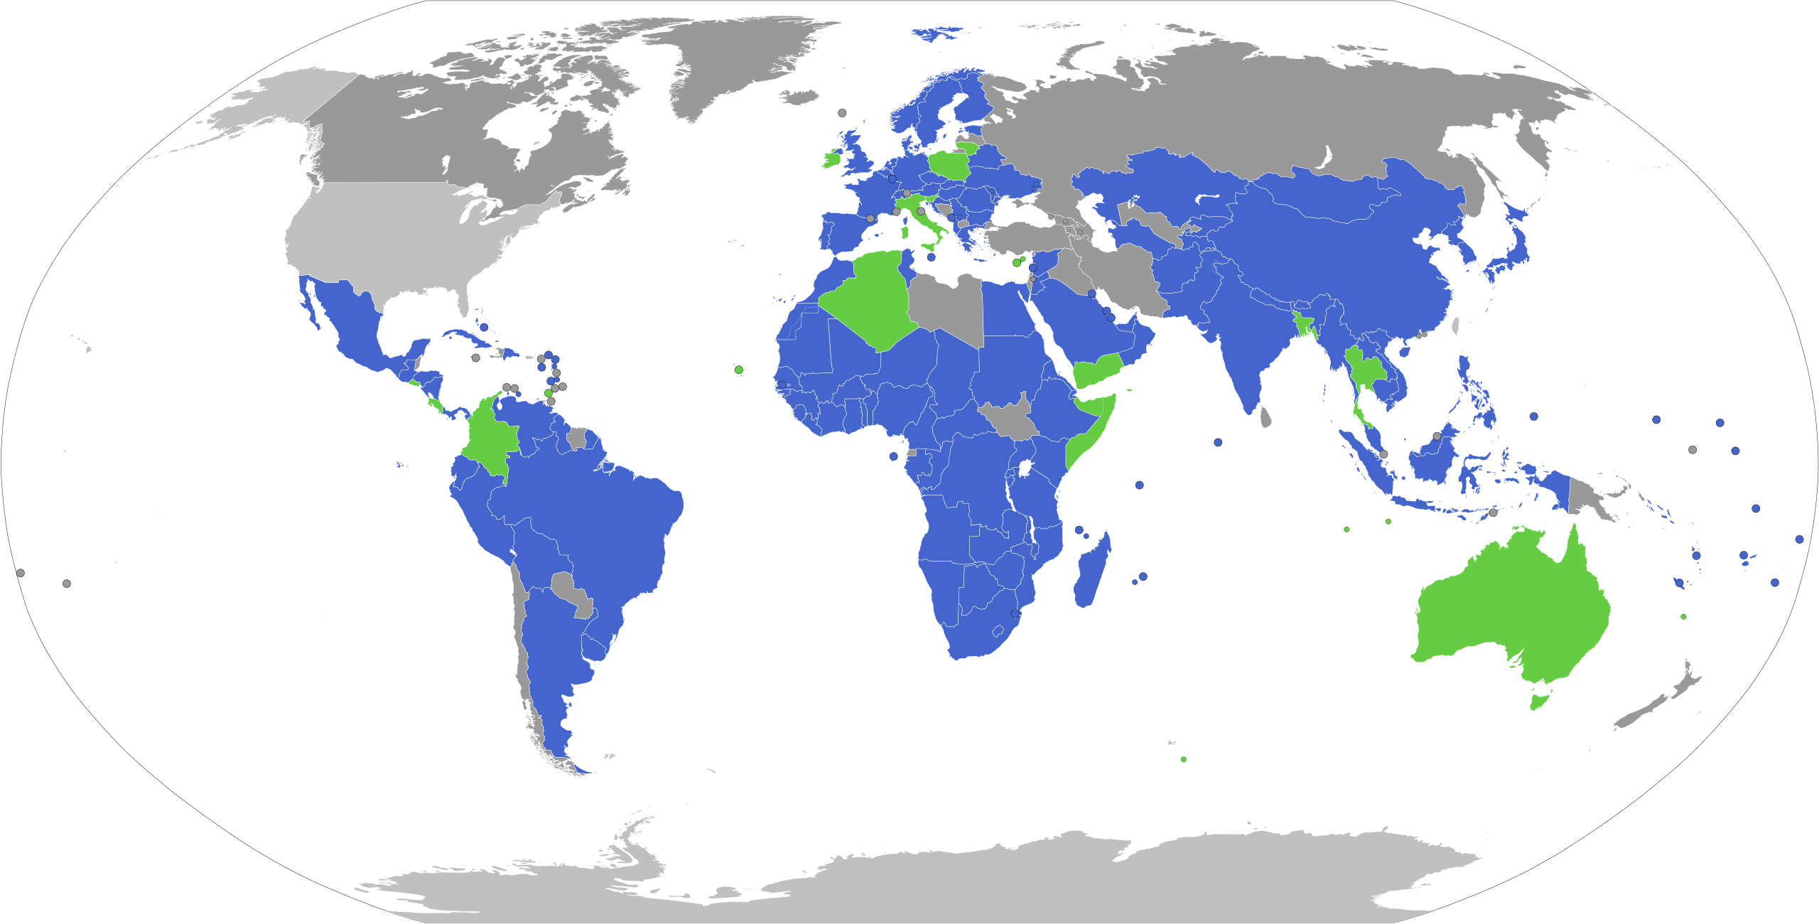
Membership in the Nagoya Protocol

Slide 35
Proposed “Social Responsibility Index”
Each pharmaceutical firm must achieve, each year, a ratio:
Numerator: the total number of Disability Adjusted Life Years saved as a result of the distribution and consumption of the firm’s products during the year.
Denominator: a measure of the firm’s size (presumptively its global gross revenues during the year)

Slide 36
Methods of Complying
Reduce the prices charged in developing countries for drugs already in its portfolio, thereby increasing the number of persons able to afford the drugs and earning more DALYs
Alter the formulations of drugs already in its portfolio so that they could be distributed more easily in developing countries
Increase its investment in research projects that promise to generate drugs with large health benefits
Alter its business-acquisition policies to acquire more “startup” biotechnology companies that have developed products that offer large health benefits.
Collaborate with governments or NGOs in developing countries to improve the distribution systems for its drugs
Buy DALYs from other firms better positioned to improve public health
Reduce the prices of some or all of its products, thereby lowering the denominator of its ratio.

