Slide 1
Module 202 Slides
William Fisher WilmerHale Professor of Intellectual Property Law
Harvard Law School
September 2022

Slide 2
The following images appear in the background of the lecture on “Improving Pharmaceutical Markets” in the PatentX lecture series. A recording of the lecture itself is available at https://ipxcourses.org/lectures-2/. Removed from their original context, the images will not make much sense. The function of this collection of images is to enable persons who have already watched the lecture to review the material it contains.
The terms on which these materials may be used or modified are available at http://ipxcourses.org.

Slide 3
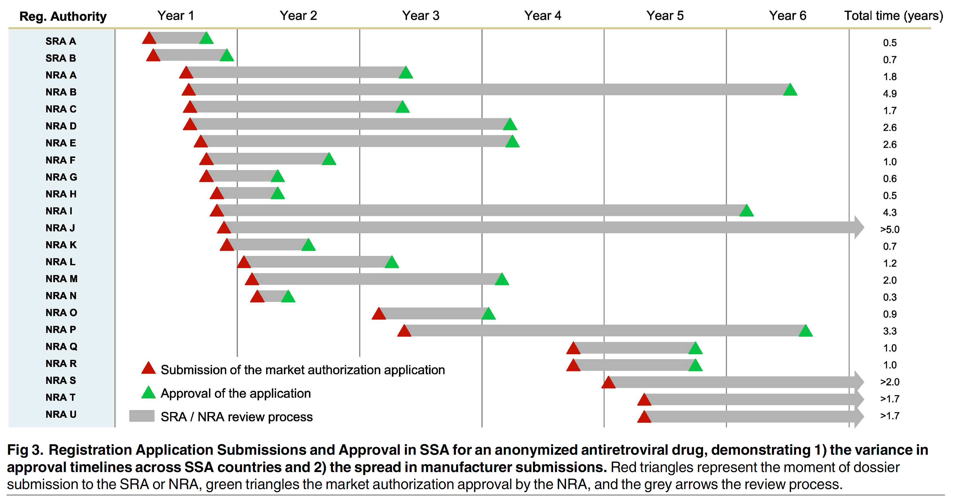
Source: Vincent Ahonkhai et al., "Speeding Access to Vaccines and Medicines in Low- and Middle-Income Countries: A Case for Change and a Framework for
Optimized Product Market Authorization," PLoS ONE 11, no. 11 (2016)

Slide 4
Collaborating Institutions
SAQAN
Global Access in Action (Harvard University)
Mission for Essential Drugs & Supplies (MEDS)
Ministries of Health in Participating Countries
Innospectra
London School of Hygiene and Tropical Medicine
Infectious Diseases Data Observatory
World Health Organization

Slide 5
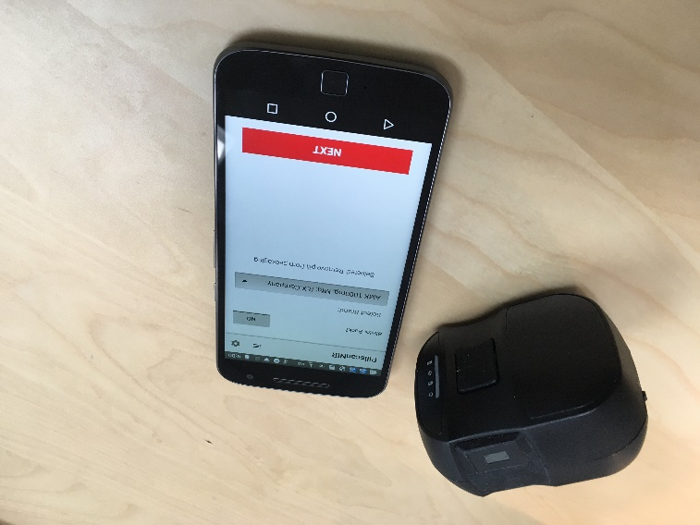
Components:
NIR Scanner
Motorola smartphone
Custom software (developed by Global Good)
Database (library of profiles of authentic medicines)

Slide 6
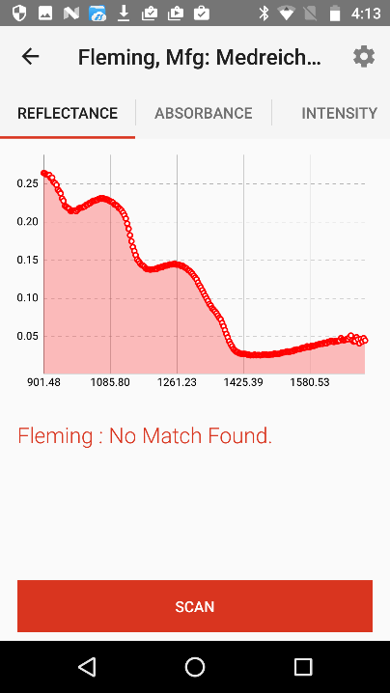
Procedure:
Turn on the devices
Select a pill to be scanned
Select the type of drug that the pill purports to be
Use camera to photograph the packaging (automatically dated and geo-tagged)
Place pill on scan head
Press “Scan”
Report of the scan appears on the smartphone

Slide 7
The records of the scans performed by each devices are regularly downloaded and aggregated.
The data will then be used to generate a map of current “hotspots,” which will guide further testing;
In addition, the data gathered in each participating country will be shared (in a secure environment) with Health Ministries in other participating countries

Slide 8
Advantages
Fast
Inexpensive
Training of Inspectors requires only a few hours
Enables quick, random tests of pharmacies and distributors
Each participating country benefits from data gathered in other participating countries
Data can be used both to purge the health-care system of falsified drugs and to inform selection of (and negotiations with) suppliers
Facilitates local production of medicines and vaccines

Slide 9
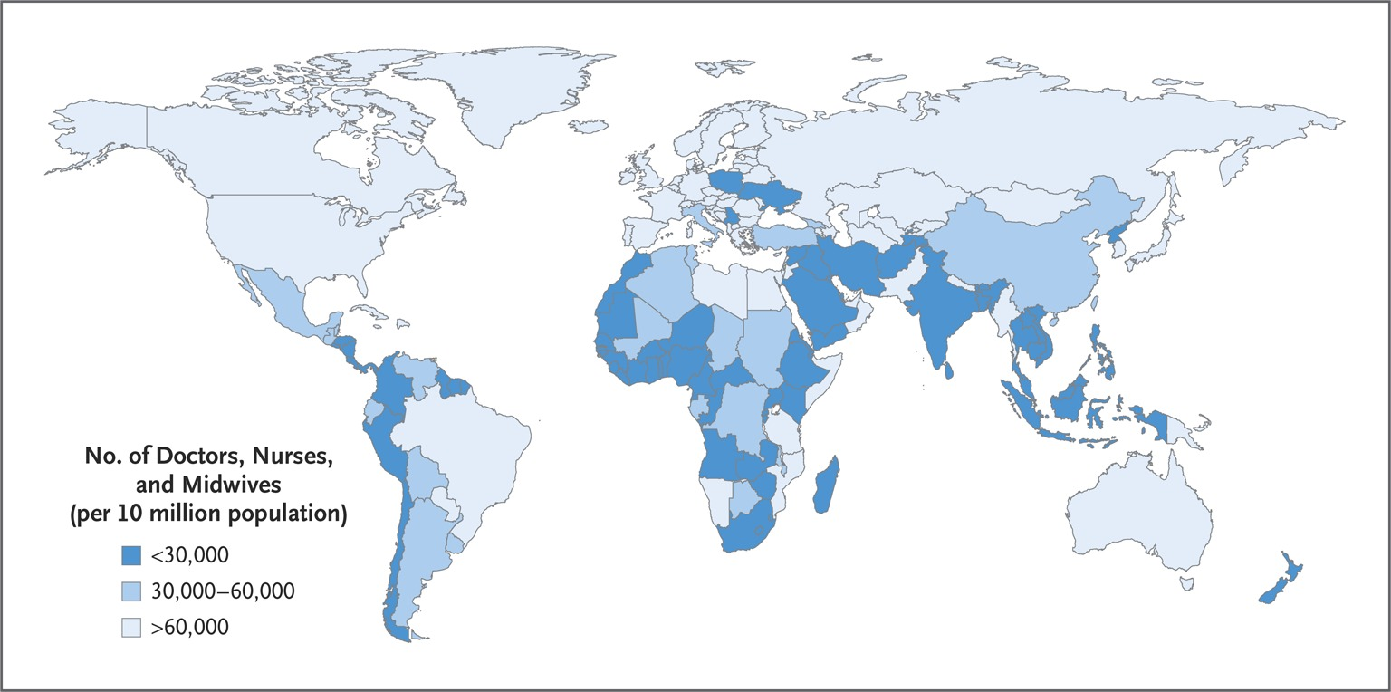
Source: https://www.nejm.org/doi/full/10.1056/nejmra1111610

Slide 10
Community Health Workers, defined
Lay health workers who:
Live in the area they serve
Are primarily based in the community (as opposed to a health facility)
Belong to the formal health system (i.e., are managed by the government or an implementing NGO)
Perform tasks related to health care delivery, and
Have received organized training but may not have received formal or paraprofessional certification or tertiary education degree
Source: https://www.globalhealthdelivery.org/files/ghd/files/ghd-c11_chw_concept_note.pdf

Slide 11
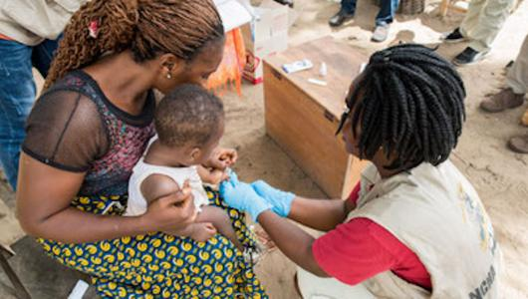
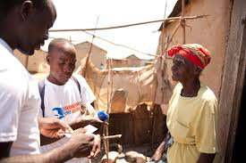
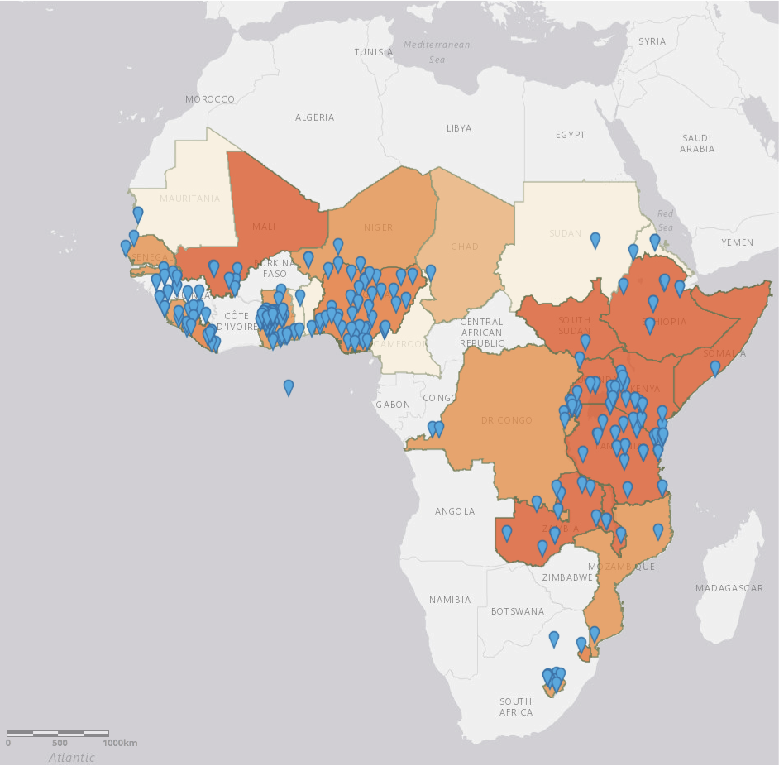
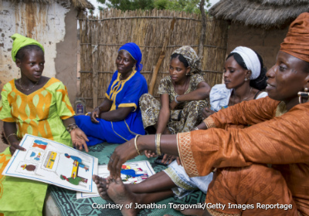
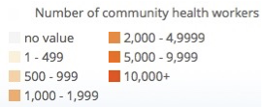
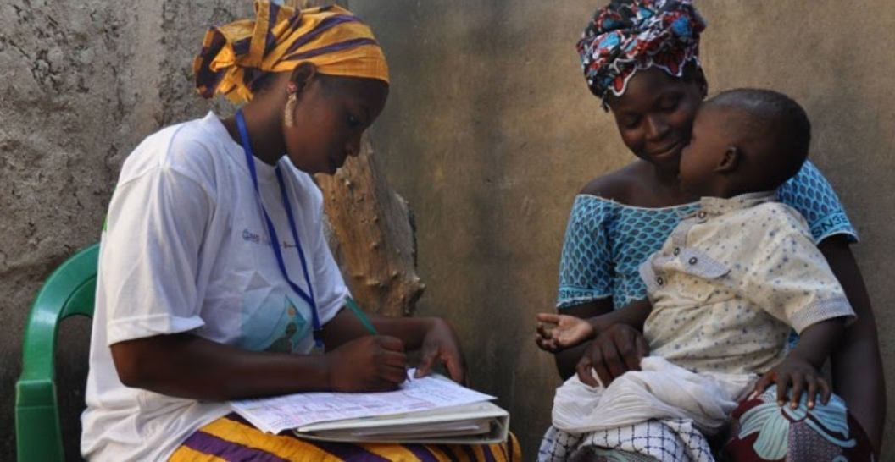
Source: https://www.globalhealthdelivery.org/files/ghd/files/ghd-c11_chw_concept_note.pdf

Slide 12
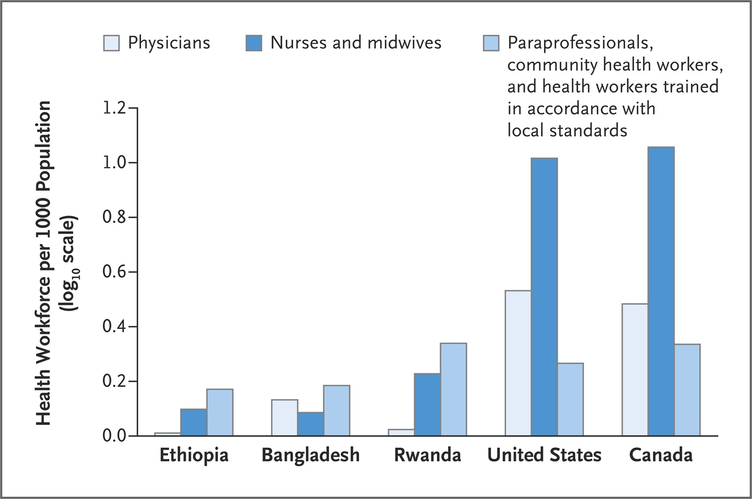

Slide 13
Effectiveness
“Systematic reviews have concluded that CHWs can safely and effectively deliver health services as diverse as birth control injections; perinatal and neonatal care; case management and prevention of malaria, diarrhea, and acute respiratory infections; and HIV care management.
“Meta-analysis of moderate-quality evidence indicates that CHWs can, in comparison to usual care, increase the number of children whose immunizations are up-to-date; promote the initiation of exclusive breastfeeding; increase care seeking for pregnancy-related complications; and improve pulmonary TB cure rates.
“Modeling of health system investments in CHWs found that the return was as high as 10:1 when accounting for increased productivity from a healthier population, the avoidance of the high costs of health crises, and the economic impact of increased employment.”
Source: https://www.globalhealthdelivery.org/files/ghd/files/ghd-c11_chw_concept_note.pdf

Slide 14
Funding
One of the principal limits on the scale of these systems is the shortage of funds from governments and foundations
This hampers recruitment and retention
Roughly half of the cost of most of the systems is devoted to purchasing the drugs they distribute to patients
Lowering the cost of the drugs would enable expansion of the systems and/or better recruitment and training

Slide 15
UC country
Distributors
Patients
Contract
Manufacturer
FDA; EMA; etc.
manufacturing
contract
Branded version
Licensor
LMIC country
Voluntary
License #1
Private
Purchaser
Generic #1
Generic
versions
of the
drug
Distributors
Patients
Voluntary
License #2
Generic #2
Government
Purchaser
Regulatory Agency
Funder

Slide 16
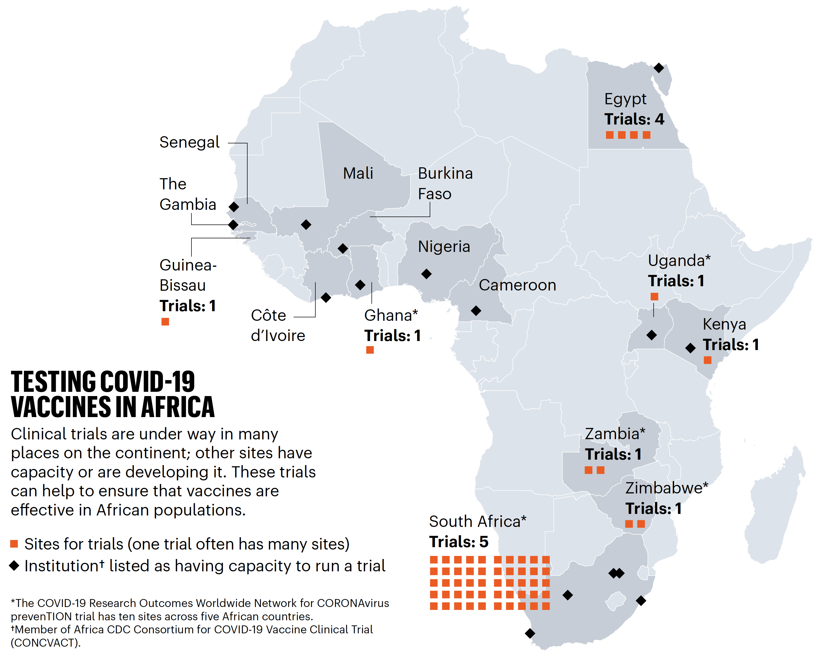
Source: John N. Nkengasong et al., "Covid-19 Vaccines: How to Ensure Africa Has Access," Nature (2020), https://www.nature.com/articles/d41586-020-02774-8.

