Slide 1
Spreadsheets
William Fisher
November 2023

Slide 2
1970
1980
1990
2000
2010

Slide 3
Visicalc
1970
1980
1990
2000
2010

Slide 4
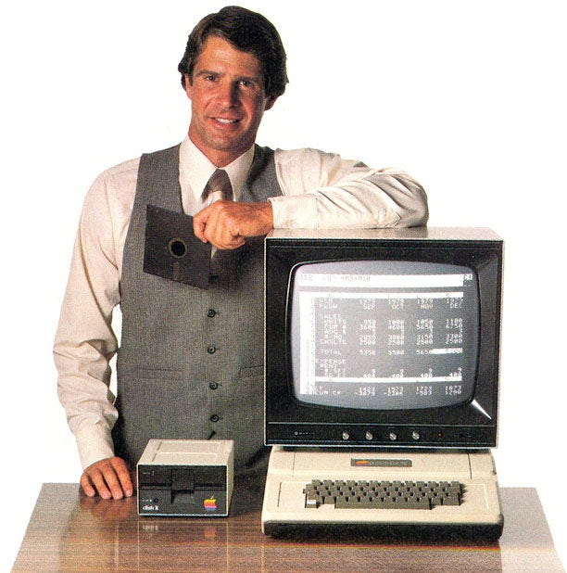

Slide 5
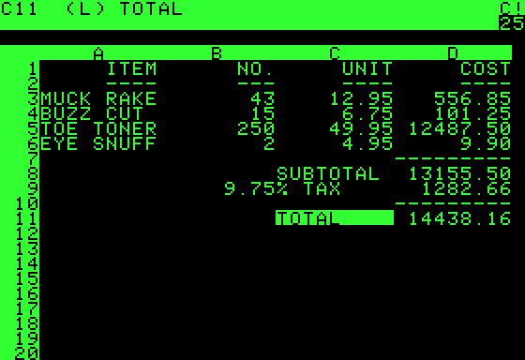
Visicalc

Slide 6
Life Cycle
“Eventually VisiCalc was losing to newcomer Lotus’ 1–2–3 spreadsheet, created by two former VisiCalc employees. Lotus was packed with more features that took advantage the PC increased memory, screen, and performance.
“Considered the first ‘life cycle’ software, VisiCalc was created in ‘78, released in ’79, peaked in ‘82 and was done by ’85. By 1985 Lotus acquired the insolvent, nearly dead VisiCalc.”
Source: Ryan Crosbie, “The Story of Visicalc” (2017) https://medium.com/@ryancrosbie/the-story-of-visicalc-9c9322350210

Slide 7
Lotus 123
Visicalc
1970
1980
1990
2000
2010

Slide 8
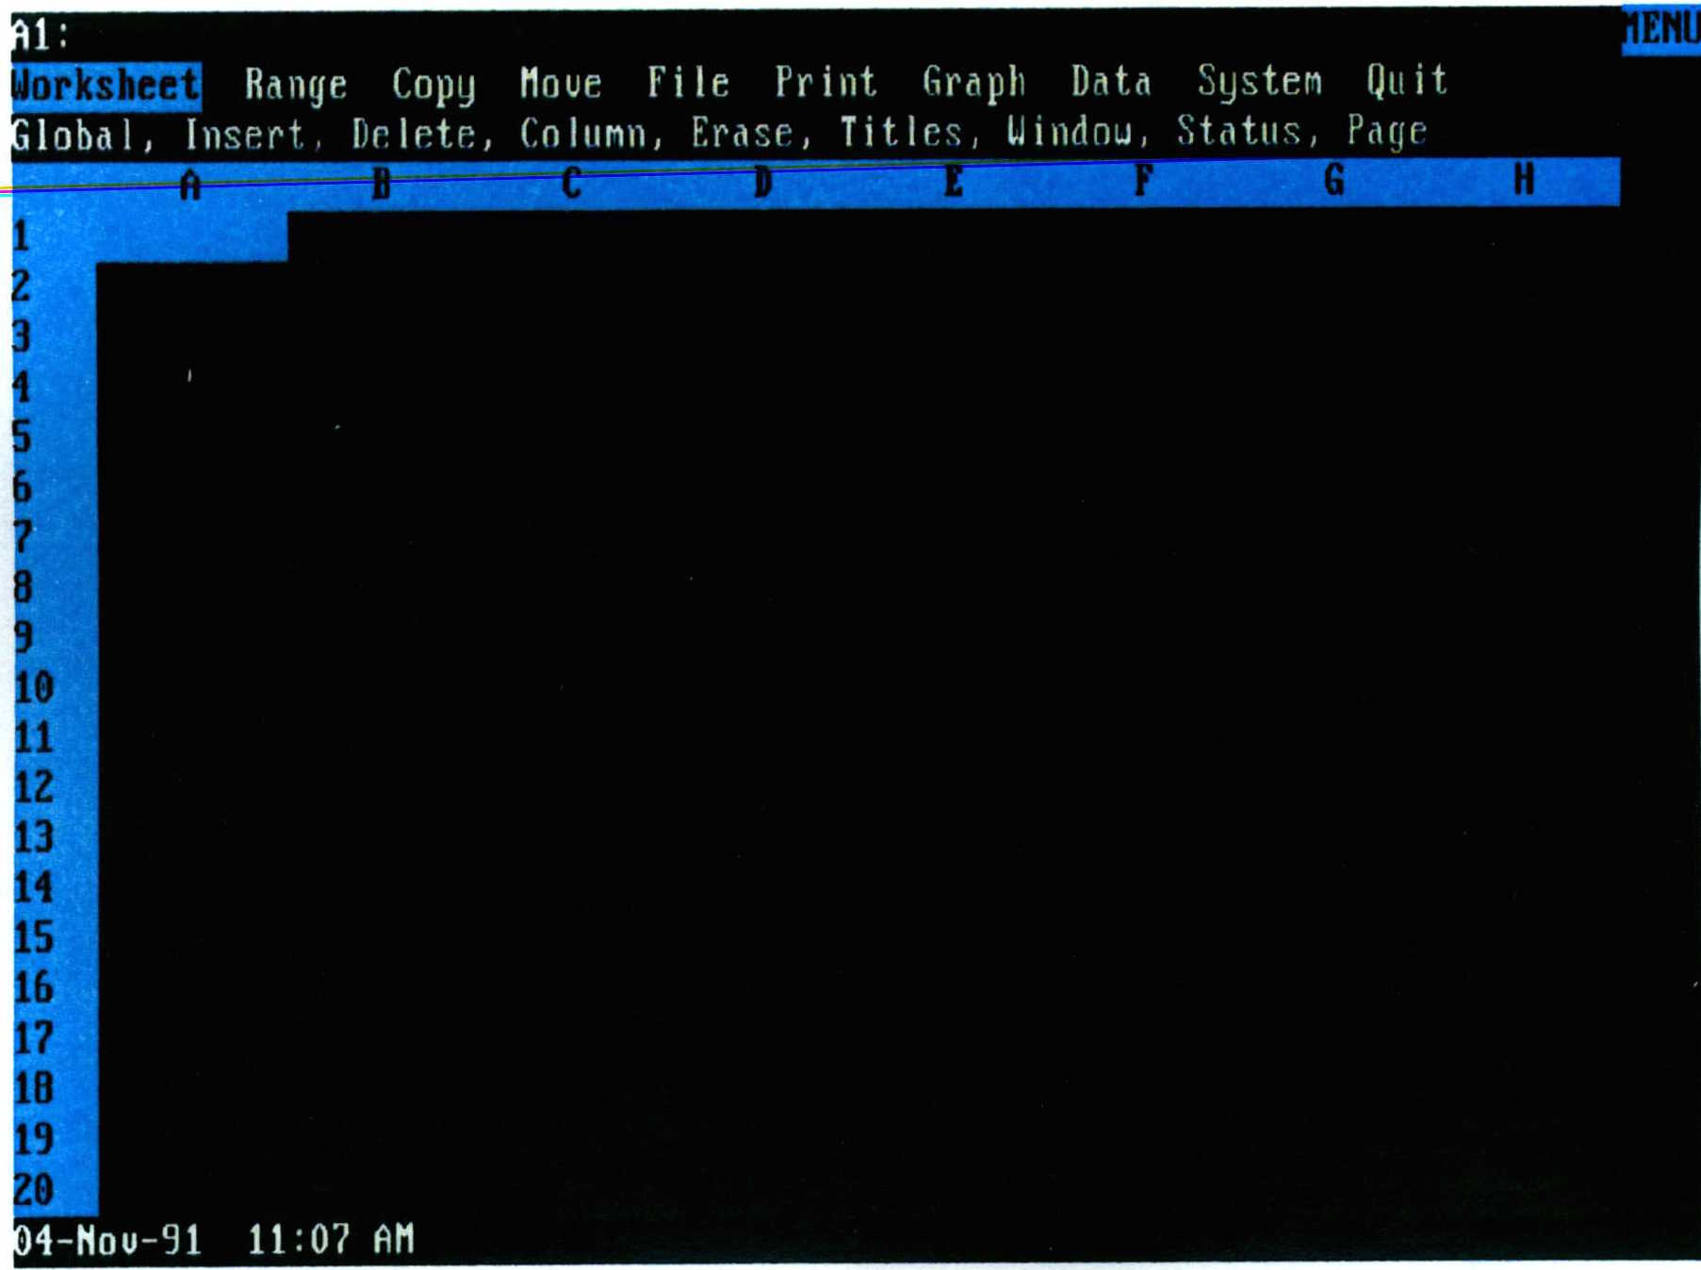
1-2-3
Notes:
Source: 1-2-3 2.01, Lotus Development Corp. v. Borland Intern., Inc., at 969 (Supreme Court Joint Appendix) (No. 90-11662-K)

Slide 9
Lotus 123
Visicalc
1970
1980
1990
2000
2010

Slide 10
VP Planner
Lotus 123
Visicalc
1970
1980
1990
2000
2010

Slide 11
Quattro
VP Planner
Lotus 123
Visicalc
1970
1980
1990
2000
2010

Slide 12
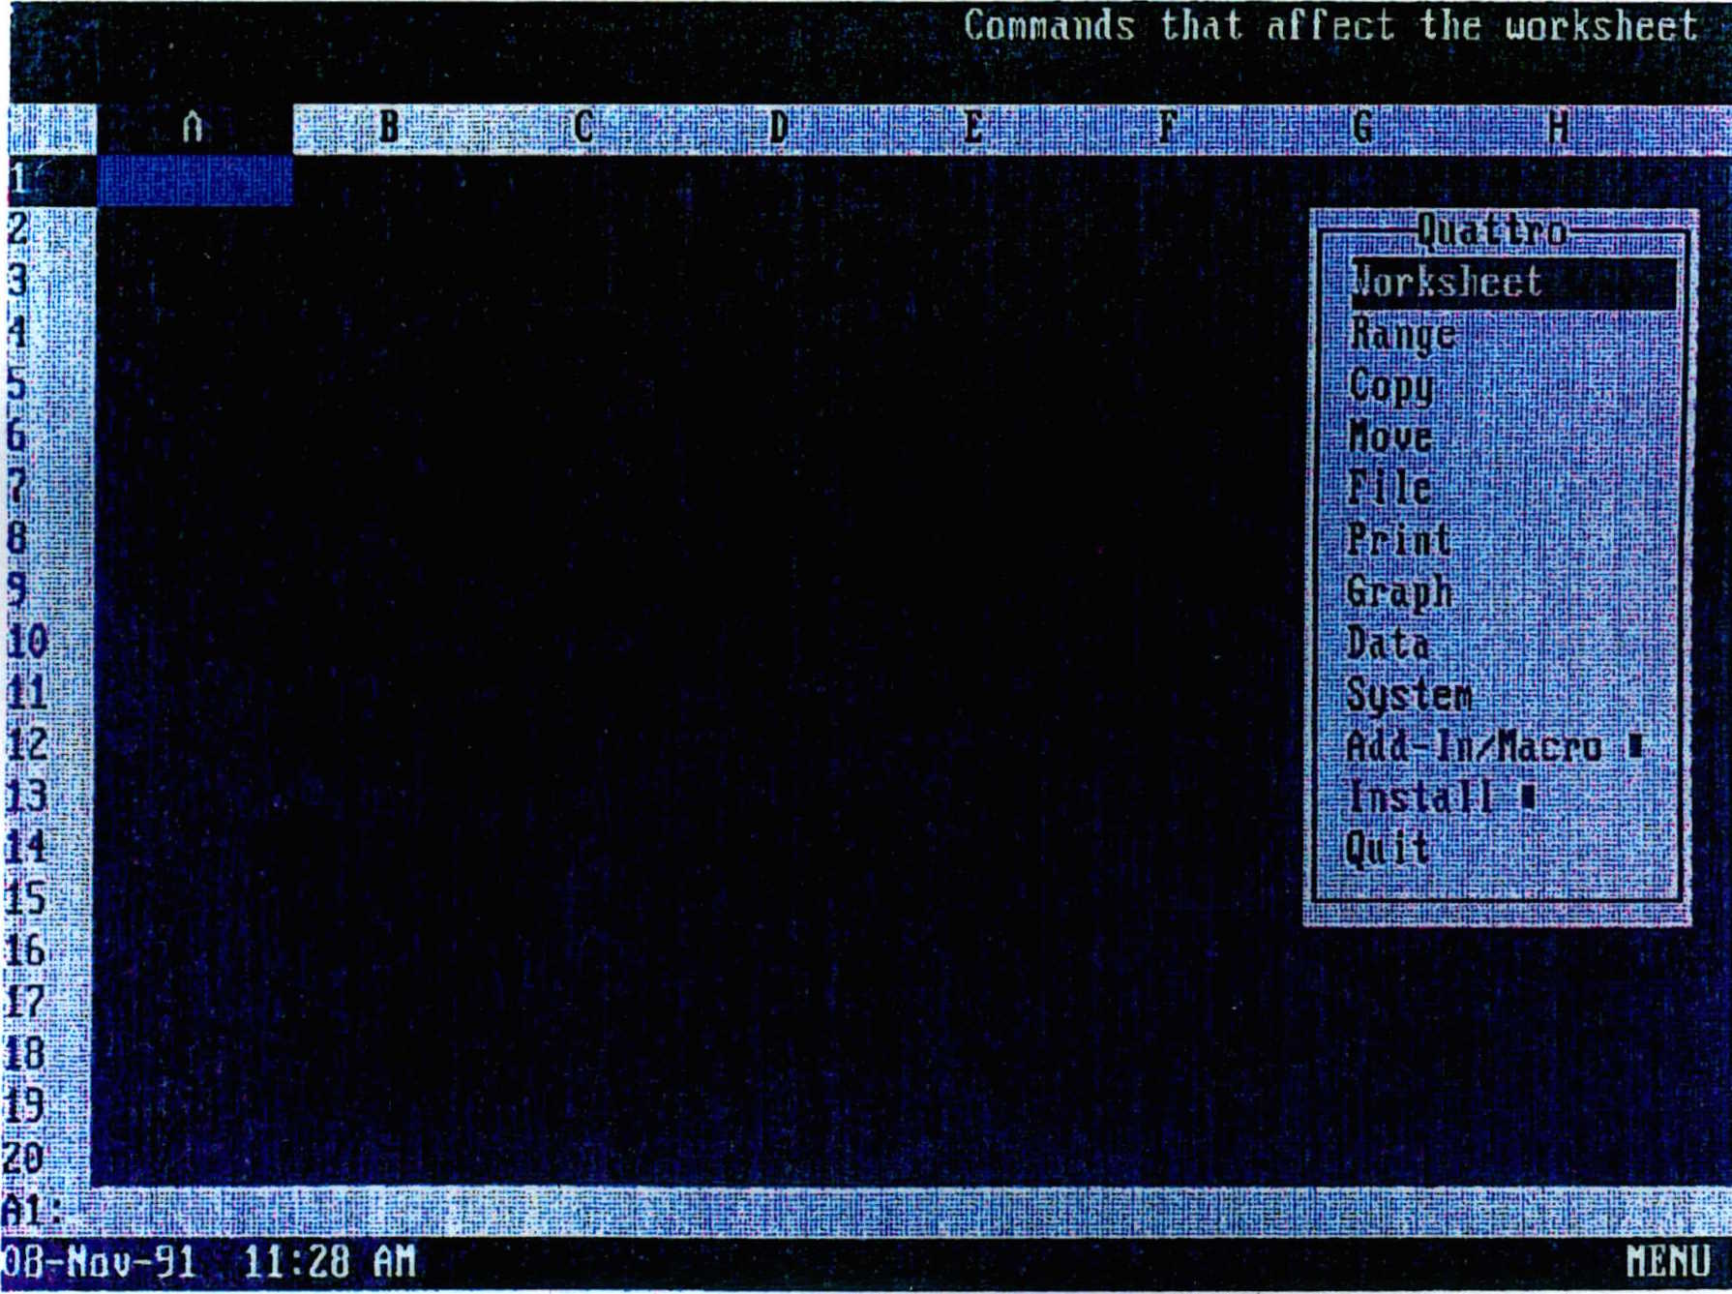
Quattro
Notes:
Source: Quattro, Lotus Development Corp. v. Borland Intern., Inc., at 971 (Supreme Court Joint Appendix) (No. 90-11662-K)

Slide 13
Quattro
VP Planner
Lotus 123
Visicalc
1970
1980
1990
2000
2010

Slide 14
Excel
Quattro
VP Planner
Lotus 123
Visicalc
1970
1980
1990
2000
2010

Slide 15
By 1990,
only 3 remained
viable
Excel
Quattro
VP Planner
Lotus 123
Visicalc
1970
1980
1990
2000
2010

Slide 16
Excel
Quattro
VP Planner
Lotus 123
Visicalc
1970
1980
1990
2000
2010

Slide 17
Excel
Lotus v. Paperback (1990)
Quattro
VP Planner
Lotus 123
Visicalc
1970
1980
1990
2000
2010

Slide 18
Lotus v. Borland (1993, 1995)
Excel
Lotus v. Paperback (1990)
Quattro
VP Planner
Lotus 123
Visicalc
1970
1980
1990
2000
2010

Slide 19
Lotus v. Borland (1993, 1995)
Excel
Lotus v. Paperback (1990)
Quattro
VP Planner
Lotus 123
Visicalc
1970
1980
1990
2000
2010

Slide 20
Possible Arguments for Borland
Lack of Originality
Menu is not protected “expression”
Merger
Scene-a-faire
No protection for “words and short phrases”
Method of Operation – 102(b)
De minimis copying
Fair Use
Privilege for Interoperability
Copyright protection for software is bad policy

Slide 21
District Court decision
The ‘idea’ or ‘system’ of the Lotus 1-2-3 interface is “a system of menus, each menu consisting of less than a dozen commands, arranged hierarchically, forming a tree in which the main menu is the root/trunk of the tree and submenus branch off from higher menus, each submenu being linked to a higher menu by operation of a command, so that all the specific spreadsheet operations available in Lotus 1-2-3 are accessible through the paths of the menu command hierarchy.”
“Does the Lotus 1-2-3 user interface include identifiable elements of expression?...I conclude that it does. A very satisfactory spreadsheet menu tree can be constructed using different commands and a different command structure from those of Lotus 1-2-3. In fact, Borland has constructed just such an alternate tree for use in Quattro Pro’s native mode....it is possible to generate literally millions of satisfactory menu trees by varying the menu commands employed.”
“The question posed by this element of the copyrightability test is whether the creativity involved in establishing the menu commands, menu command hierarchy, macro language, and keystroke sequences was more than trivial. No reasonable jury could find otherwise.”

Slide 22
Possible Arguments for Borland
Lack of Originality
Menu is not protected “expression”
Merger
Scene-a-faire
No protection for “words and short phrases”
Method of Operation – 102(b)
De minimis copying
Fair Use
Privilege for Interoperability
Copyright protection for software is bad policy

Slide 23
First Circuit
Lotus 1-2-3’s menus are an uncopyrightable “method of operation” under §102(b)
“The "expressive" choices of what to name the command terms and how to arrange them do not magically change the uncopyrightable menu command hierarchy into copyrightable subject matter.”

Slide 24
Possible Arguments for Borland
Lack of Originality
Menu is not protected “expression”
Merger
Scene-a-faire
No protection for “words and short phrases”
Method of Operation – 102(b)
De minimis copying
Fair Use
Privilege for Interoperability
Copyright protection for software is bad policy

Slide 25
Possible Arguments for Borland
Lack of Originality
Menu is not protected “expression”
Merger
Scene-a-faire
No protection for “words and short phrases”
Method of Operation – 102(b)
De minimis copying
Fair Use
Privilege for Interoperability
Copyright protection for software is bad policy
Stahl

Slide 26
Possible Arguments for Borland
Lack of Originality
Menu is not protected “expression”
Merger
Scene-a-faire
No protection for “words and short phrases”
Method of Operation – 102(b)
De minimis copying
Fair Use
Privilege for Interoperability
Copyright protection for software is bad policy
Stahl
Boudin

Slide 27
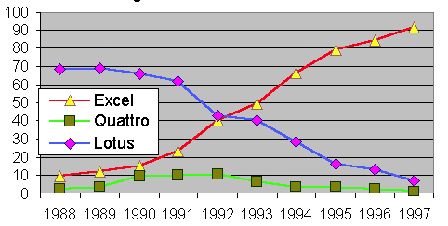
Source: Liebowitz & Margolis, “Network Effects”

Slide 28
Source: Liebowitz & Margolis, “Network Effects”
Complaint filed

Slide 29
Source: Liebowitz & Margolis, “Network Effects”
Complaint filed
District Court decision

Slide 30
Source: Liebowitz & Margolis, “Network Effects”
Complaint filed
CA1 decision
District Court decision

Slide 31
US Supreme Court affirms by equally divided vote
Source: Liebowitz & Margolis, “Network Effects”
Complaint filed
CA1 decision
District Court decision

