Slide 1
RegTech
November 2023

Slide 2
2
Total value and number of venture capital, private equity, and merger and acquisition (M&A) investment deals in regtech worldwide 2018 to H1 2022

Slide 3
“I have a dream. It is futuristic, but realistic. It involves a Star Trek chair and a bank of monitors. It would involve tracking the global flow of funds in close to real time …, in much the same way as happens with global
weather systems and global internet traffic. Its centerpiece would be a global map of financial flows, charting spill-overs and correlations.” Andy Haldane, Chief Economist, Bank of England (2014)
--source: Arner et al. (2016)

Slide 4
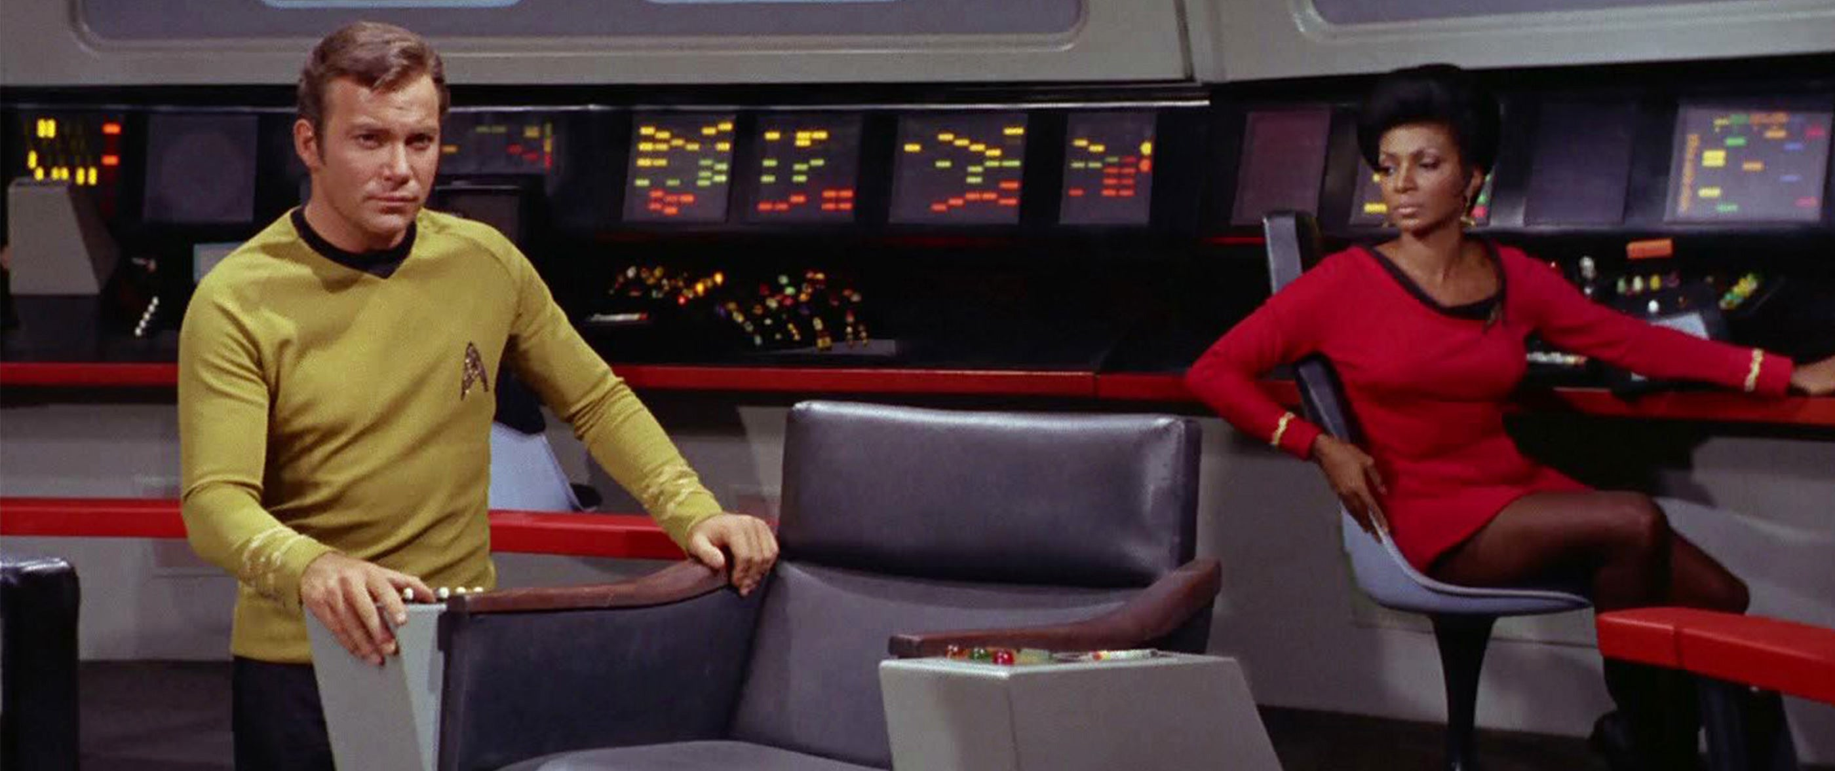
“I have a dream. It is futuristic, but realistic. It involves a Star Trek chair and a bank of monitors. It would involve tracking the global flow of funds in close to real time …, in much the same way as happens with global
weather systems and global internet traffic. Its centerpiece would be a global map of financial flows, charting spill-overs and correlations.” Andy Haldane, Chief Economist, Bank of England (2014)
--source: Arner et al. (2016)

Slide 5
Global Maritime Traffic
90% of goods transported globally move on ships
Each ship carries an AIS device, that continuously broadcasts its location, speed, and heading
Publicly available AIS data enables real-time monitoring of all traffic

Slide 6
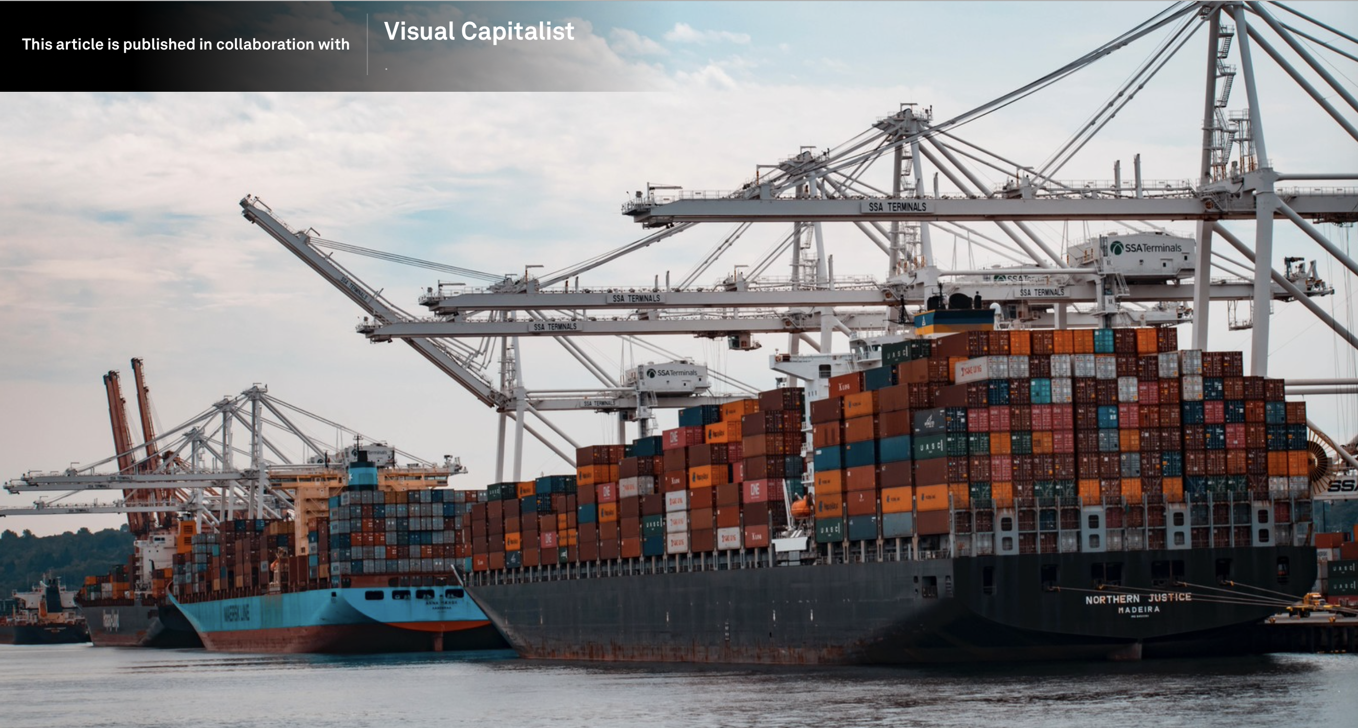
Source: https://www.weforum.org/agenda/2022/06/shipping-lanes-maritime-traffic-global-maps/

Slide 7
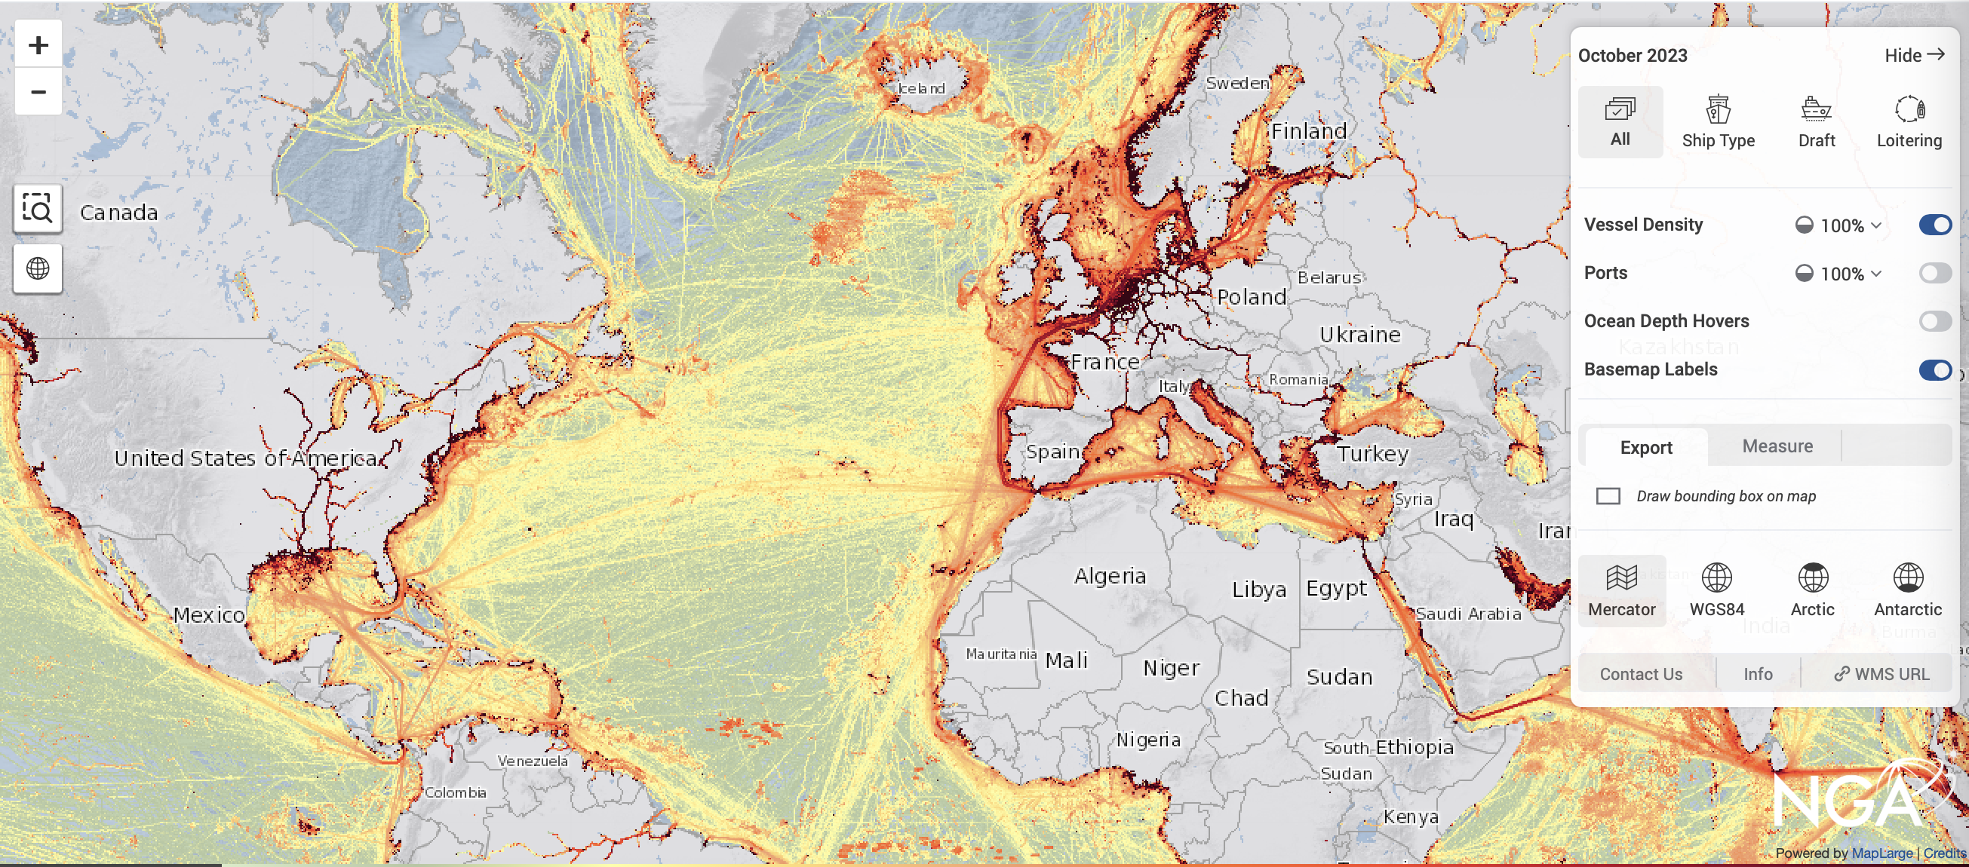

Slide 8
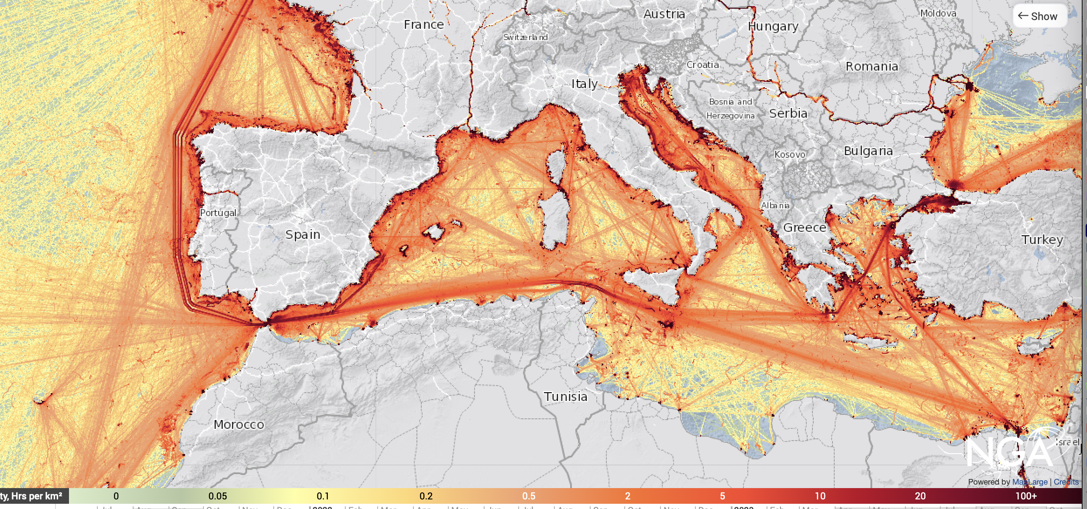

Slide 9
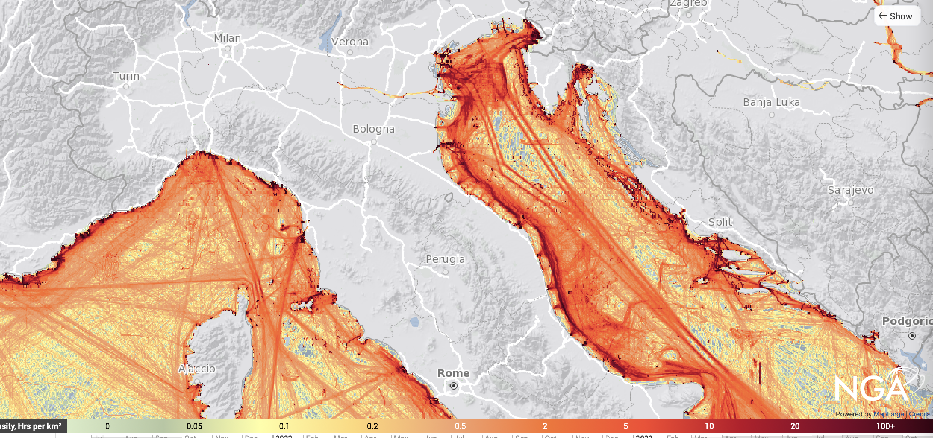

Slide 10
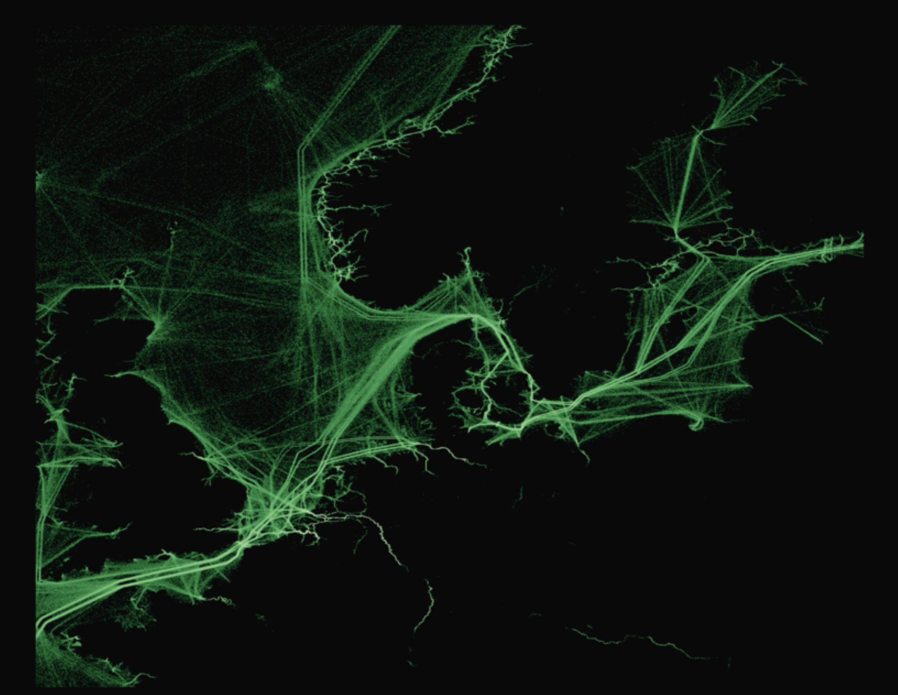
Danish Strait
Source: https://www.weforum.org/agenda/2022/06/shipping-lanes-maritime-traffic-global-maps/

Slide 11
Should regulators be able (required?) to monitor financial transactions in the same way?

