Slide 1
Initial Coin Offerings

Slide 2
ICOs
“Consider a group of entrepreneurs who want to create a soda company. Though they have an amazing recipe, they lack sufficient seed capital to quit their day jobs and market their soda to the world. To access the traditional capital markets, they might form a corporation and seek a business loan, or perhaps a few rounds of private venture capital funding. If successful, they might then choose to issue shares on the New York Stock Exchange (NYSE). In exchange for payment of a price (in dollars) set by investment bankers through careful underwriting, the team would part with shares of its company. The purchasers of those shares would then possess a bundle of rights to govern the corporation, along with residual claims on its assets in proportion to the number of shares they own. Once built, the corporation could charge its customers in dollars, pay its employees and suppliers in the same, and then distribute the leftovers to its shareholders.”
Source: Shaanan Cohney, David Hoffman, Jeremy Sklaroff & David Wishnick, “Coin Operated Capitalism,” Columbia Law Review (2019)

Slide 3
ICOs
“Consider a group of entrepreneurs who want to create a soda company. Though they have an amazing recipe, they lack sufficient seed capital to quit their day jobs and market their soda to the world. To access the traditional capital markets, they might form a corporation and seek a business loan, or perhaps a few rounds of private venture capital funding. If successful, they might then choose to issue shares on the New York Stock Exchange (NYSE). In exchange for payment of a price (in dollars) set by investment bankers through careful underwriting, the team would part with shares of its company. The purchasers of those shares would then possess a bundle of rights to govern the corporation, along with residual claims on its assets in proportion to the number of shares they own. Once built, the corporation could charge its customers in dollars, pay its employees and suppliers in the same, and then distribute the leftovers to its shareholders.”
“The new world of coin-based finance looks different from this traditional model. Instead of issuing contractual claims on the assets of a legal entity (in the form of debt or equity), the team might now issue a token—call it Colacoin—that it promises will be the only way to buy sodas from its (yet to be deployed) vending machines. The team could also pledge that possession of Colacoins would enable their holders to vote on proposed alterations to the vending machine’s prices. Further, they could even commit to paying suppliers—bottling companies, truckers, lawyers who work for them—in Colacoin. If, and as long as, the dehydrated people of the world want access to machine-vended cola, then Colacoin will hold value. And if Colacoin is easily exchangeable for dollars, then the nascent company’s truckers and lawyers will not mind receiving their initial payments in a strange currency. Replace Coca-Cola with a software-based venture (like a file-sharing service or a platform for streaming video), and Colacoin with a cryptoasset, and you have an ICO.”
Source: Shaanan Cohney, David Hoffman, Jeremy Sklaroff & David Wishnick, “Coin Operated Capitalism,” Columbia Law Review (2019)

Slide 4
ICOs
“Consider a group of entrepreneurs who want to create a soda company. Though they have an amazing recipe, they lack sufficient seed capital to quit their day jobs and market their soda to the world. To access the traditional capital markets, they might form a corporation and seek a business loan, or perhaps a few rounds of private venture capital funding. If successful, they might then choose to issue shares on the New York Stock Exchange (NYSE). In exchange for payment of a price (in dollars) set by investment bankers through careful underwriting, the team would part with shares of its company. The purchasers of those shares would then possess a bundle of rights to govern the corporation, along with residual claims on its assets in proportion to the number of shares they own. Once built, the corporation could charge its customers in dollars, pay its employees and suppliers in the same, and then distribute the leftovers to its shareholders.”
“The new world of coin-based finance looks different from this traditional model. Instead of issuing contractual claims on the assets of a legal entity (in the form of debt or equity), the team might now issue a token—call it Colacoin—that it promises will be the only way to buy sodas from its (yet to be deployed) vending machines. The team could also pledge that possession of Colacoins would enable their holders to vote on proposed alterations to the vending machine’s prices. Further, they could even commit to paying suppliers—bottling companies, truckers, lawyers who work for them—in Colacoin. If, and as long as, the dehydrated people of the world want access to machine-vended cola, then Colacoin will hold value. And if Colacoin is easily exchangeable for dollars, then the nascent company’s truckers and lawyers will not mind receiving their initial payments in a strange currency. Replace Coca-Cola with a software-based venture (like a file-sharing service or a platform for streaming video), and Colacoin with a cryptoasset, and you have an ICO.”
Source: Shaanan Cohney, David Hoffman, Jeremy Sklaroff & David Wishnick, “Coin Operated Capitalism,” Columbia Law Review (2019)

Slide 5
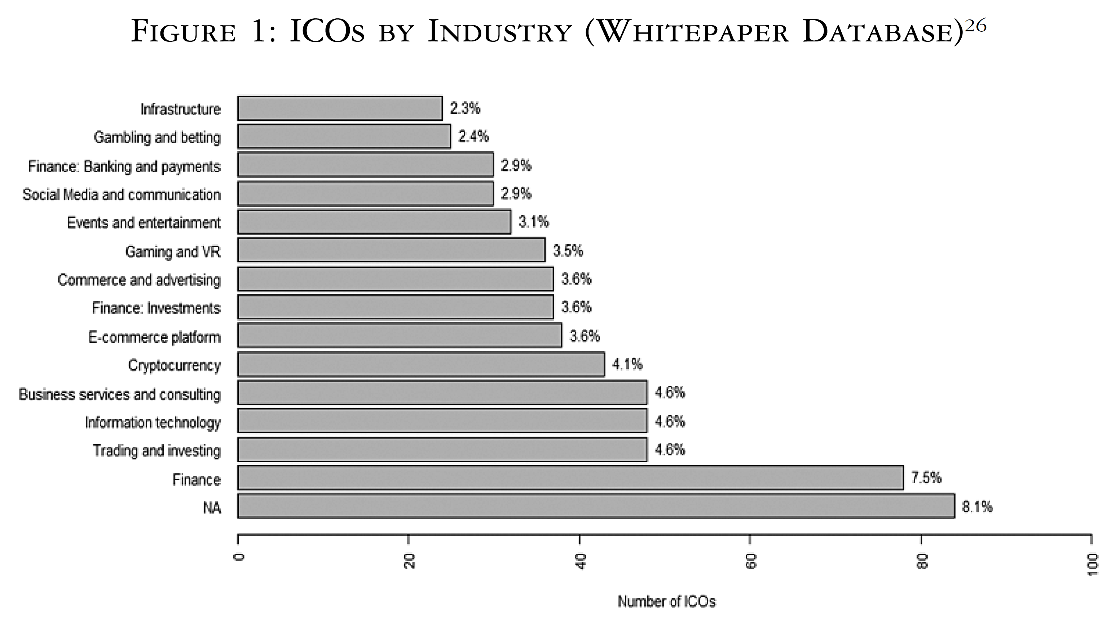
Source: Zetzsche et al.,
The ICO Gold Rush (2019)

Slide 6
Varieties of ICOs
“The tokens often called “coins,” typically exhibit the characteristics of a digital voucher and grant the participants a right of some kind, which can take a range of forms and functions. The particular right represented by a token varies. A token may represent a license to use a software program (usage token), a membership in a community (community token) or an entitlement to a financial asset.
“There are two broad categories of financial tokens: currency tokens and equity tokens.
Currency tokens are characterized by a token reflecting a right in another currency, whether crypto or otherwise.
Equity tokens represent the right to a share in a cash flow generated by some underlying asset. Among the equity tokens, some ICOs confer participation of token holders in an asset pool in a non-segregated manner, while in other cases the token allows participation in one single asset, separable from other assets.”
Zetzsche et al., “The ICO Gold Rush” (2019)

Slide 7
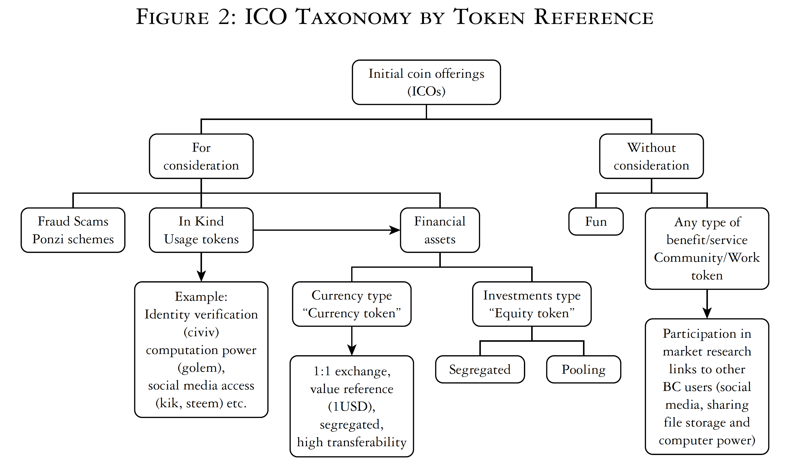
Source: Zetzsche et al.,
The ICO Gold Rush (2019)

