Slide 1
Fintech Geography
William Fisher
November 2023

Slide 2
Regions

Slide 3
2
Value of investment in fintech worldwide in 2019-2023, by region
Value of investment in fintech companies worldwide from 2019 to H1 2023, by region (in billion U.S. dollars)
Note(s): Worldwide; 2019 to H1 2023
Further information regarding this statistic can be found on page 8.
Source(s): PitchBook; KPMG; ID 412622

Slide 4
Number of fintech startups worldwide from 2018 to 2023, by region
Number of fintech startups worldwide 2018-2023, by region
3
Description: As of May 2023, there were 11,651 fintech (financial technology) startups in the Americas, making it the region with the most fintech startups globally. In comparison, there were 9,681 fintech startups in the EMEA region (Europe, the Middle East, and Africa) and 5,061 in the Asia Pacific region. In 2023, the United States ranked first in terms of the number of fintech unicorns globally, having roughly five times more of these companies than the United Kingdom, that ranked second. Read more
Note(s): 2018 to November 2021
Source(s): BCG; CrunchBase; Statista

Slide 5
2
Share of investment deals in fintech sector 2018-2022, by region
Share of investment deals in the fintech sector from 2018 to 2022, by region
Note(s): Worldwide; 2018 to 2022
Further information regarding this statistic can be found on page 8.
Source(s): CB Insights; ID 1331438

Slide 6
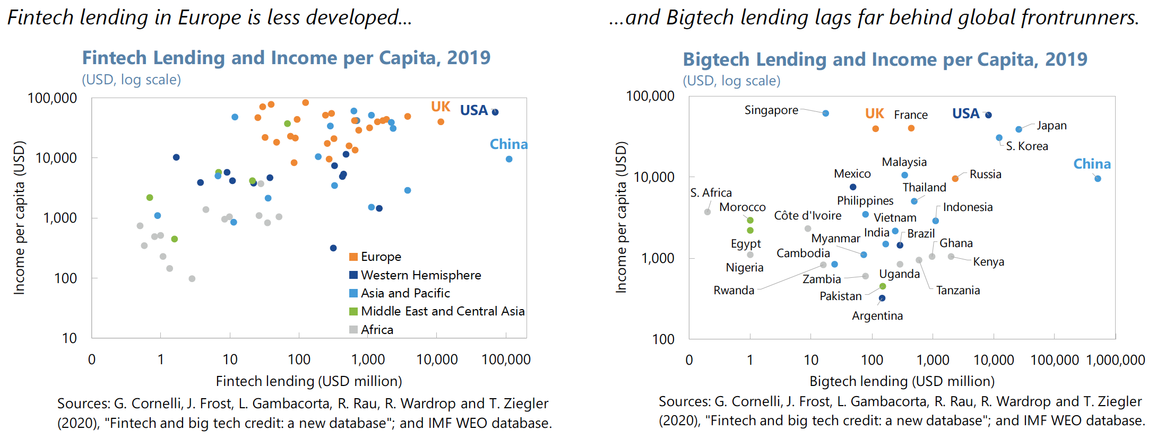
Source: Baba et al., “Fintech in Europe: Promises and Threats,” IMF Working Paper (2020)

Slide 7
Reasons for Lag in Europe
High level of financial development
Dominance of banks in both personal finance and capital markets
Heterogeneous regulatory environment impedes EU-wide initiatives
In some countries (e.g., Germany), cultural preference for cash as a shield for privacy
Source: Baba et al., “Fintech in Europe: Promises and Threats,” IMF Working Paper (2020)

Slide 8
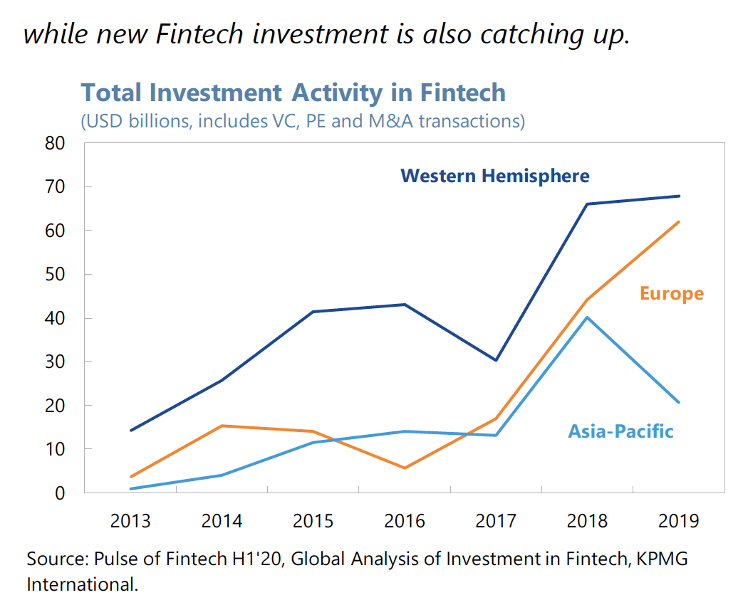
Source: Baba et al., “Fintech in Europe: Promises and Threats,” IMF Working Paper (2020)

Slide 9
Arner et al. (2016)
“FinTech 3.5 in the developing world is supported by a strong underlying rationale, including, but not limited to, the following characteristics:
(1) young digitally savvy populations equipped with mobile devices;
(2) a fast-growing middle class with 60% of the world's middle class to be located in Asia by 2030;
(3) inefficient financial and capital markets creating opportunities for informal alternatives;
(4) shortage of physical banking infrastructure;
(5) behavioral pre-disposition in favour of convenience over trust;
(6) untapped market opportunities (1.2 billion people without bank accounts); and
(7) less stringent data protection and competition.
(8) In addition, particularly in India and China, there are very large numbers of engineering and technology graduates.”

Slide 10
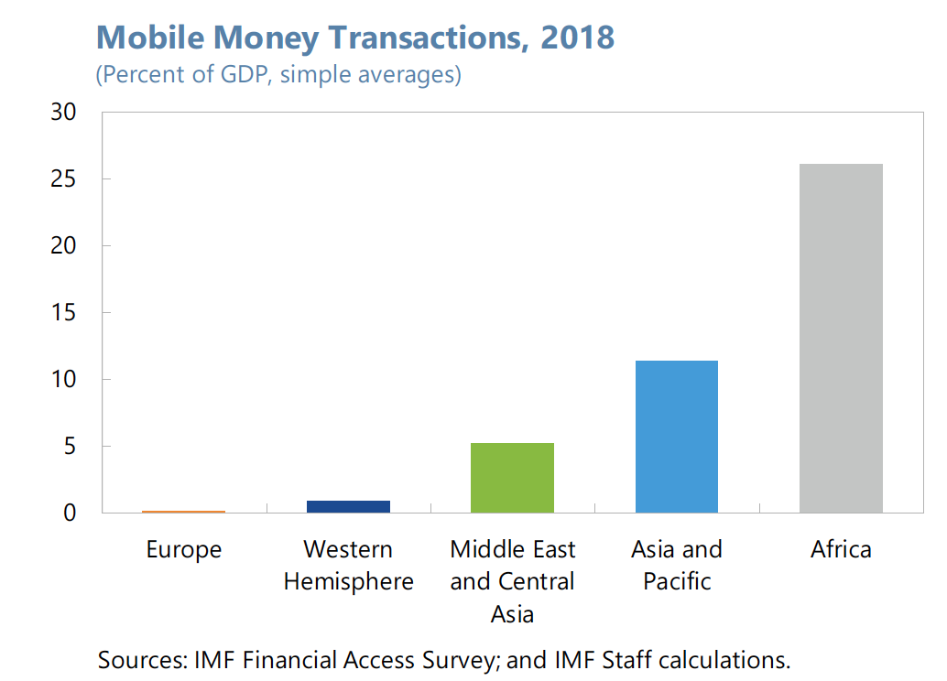
Source: Baba et al., “Fintech in Europe: Promises and Threats,” IMF Working Paper (2020)

Slide 11
Individual Countries

Slide 12
Leading countries for fintech adoption 2019, by category
Leading countries for fintech adoption 2019, by category
 | Banking and payments | Financial management | Financing | Insurance
China | 92% | 91% | 89% | 62%
U.S. | 52% | 49% | 41% | 31%
Mexico | 49% | 36% | 31% | 23%
South Africa | 47% | 43% | 34% | 26%
U.K. | 41% | 37% | 34% | 24%
Total | 56% | 51% | 46% | 33%
29
Description: This statistic presents the adoption rates of fintech services worldwide in 2019, by category. China was the leader in banking and payments, with 92 percent of fintech adoption by small and medium enterprises in this category. Read more
Note(s): Worldwide; January 15-30, 2019; 1,000*; 18 years and older; Senior decison-makers of SME organizations; *The source interviewed 200 organizations per market. The source adds the following information: "The figures show the average [...] Read more
Source(s): BI Intelligence; EY

Slide 13
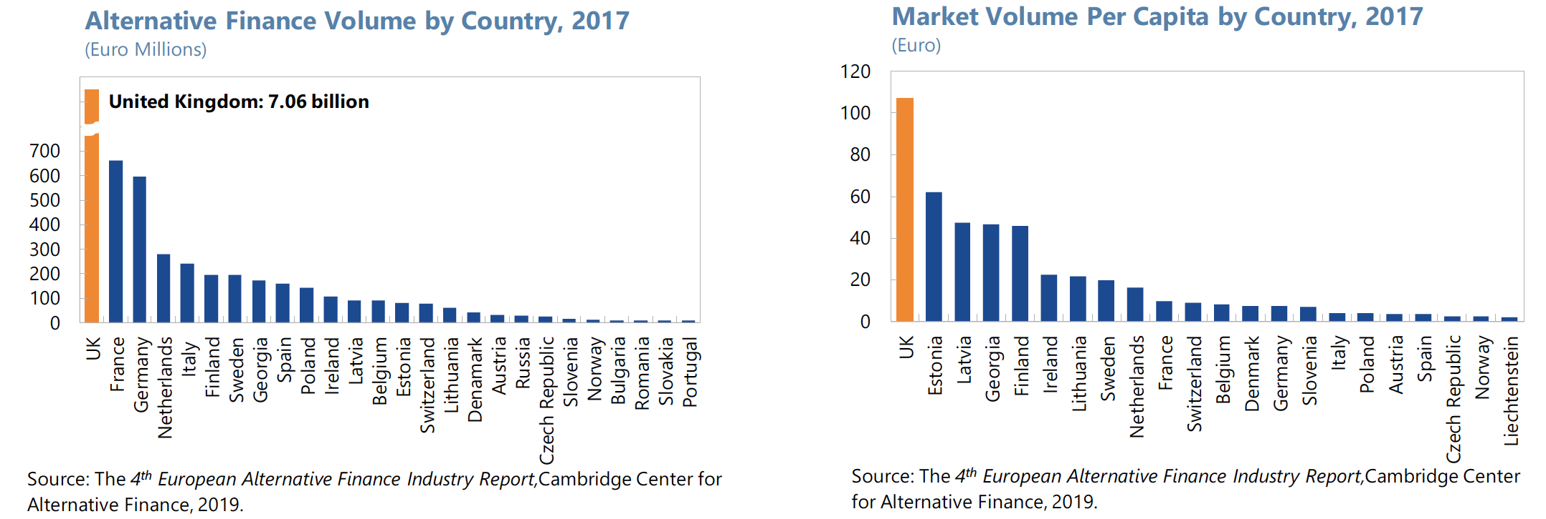
Source: Baba et al., “Fintech in Europe: Promises and Threats,” IMF Working Paper (2020)

Slide 14
Source: Baba et al., “Fintech in Europe: Promises and Threats,” IMF Working Paper (2020)

Slide 15
Countries in Europe with the highest amount of venture capital (VC) investments in fintech companies from 2016 to 2021 (in billion euros)
Biggest countries in Europe for VC funding in fintech 2021
15
Description: The United Kingdom (UK) is the European country recording the highest venture capital (VC) funding in the fintech sector. As of June 2021, fintech companies in the UK raised approximately 4.3 billion euros, more than twice as German fintech, second in the list, which raised 2.1 billion euros. Swedish fintech companies, led by Klarna, raised 1.6 billion euros in VC funding during the first half of 2021. Read more
Note(s): France, Germany, Sweden, United Kingdom; 2016 to 2021
Source(s): Dealroom.co; Sifted

Slide 16
4
Largest fintech companies worldwide 2022, by market cap
Market capitalization of largest fintech companies worldwide in 2022 (in billion U.S. dollars)
Note(s): Worldwide; 2022; The source used various sources to get to this ranking, with numbers sometimes stemming from different dates. The source admits a ranking like this "has its limitations".
Further information regarding this statistic can be found on page 8.
Source(s): Google (Google Finance); Various sources (Company reports); ID 1262288

