Slide 1
Financial Crisis
November 2022

Slide 2
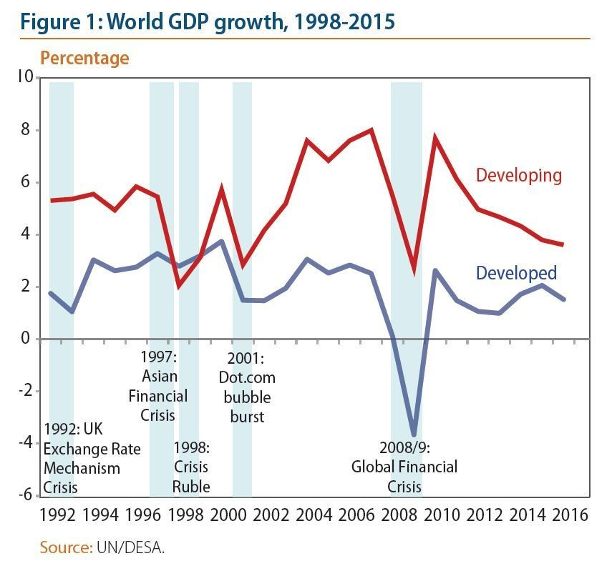
Source: https://www.weforum.org/agenda/2018/11/
the-next-economic-crisis-could-cause-a-global-conflict-heres-why/

