Slide 1
CopyrightX Lecture 9: Fair Use Selected Illustrations
William Fisher
March 2013

Slide 2
The following images appear in the background of the 9th lecture in the CopyrightX lecture series. A recording of the lecture itself is available at http://ipxcourses.org/lectures/. Removed from their original context, the images will not make much sense. The function of this collection of images is to enable persons who have already watched the lecture to review the material it contains.
The terms on which these materials may be used or modified are available at http://ipxcourses.org.

Slide 3
Fair Use Factors
Green = favors fairness; Red = disfavors fairness
 | Sony | Harper & Row | Campbell
1. Purpose and character of defendant’s use | ◆ | ◆ | ◆
2. Nature of copyrighted work |  | ◆ | ◆
3. Amount of copying |  | ◆
4. Impact on potential market | ◆ | ◆ | ◆
neutral
neutral
Fair Unfair Fair

Slide 4
Director
Composer
Movies
Actors
“Location”
owners
Screenwriters
Record
Company
Novelist
releases
“Work for Hire” agreements
Master use license
Music
Publisher
Derivative-work license
Synchronization and
performance licenses
Producer
Distribution agreement
Studio
derivative-work
licenses
Rentals plus
performance licenses
Advertiser
Theatres
mechanical license
Merchandise
manufacturer
HBO, Airlines
Compulsory license
Sales
TV Networks
Record
company
Video Stores
Cable
company

Slide 5
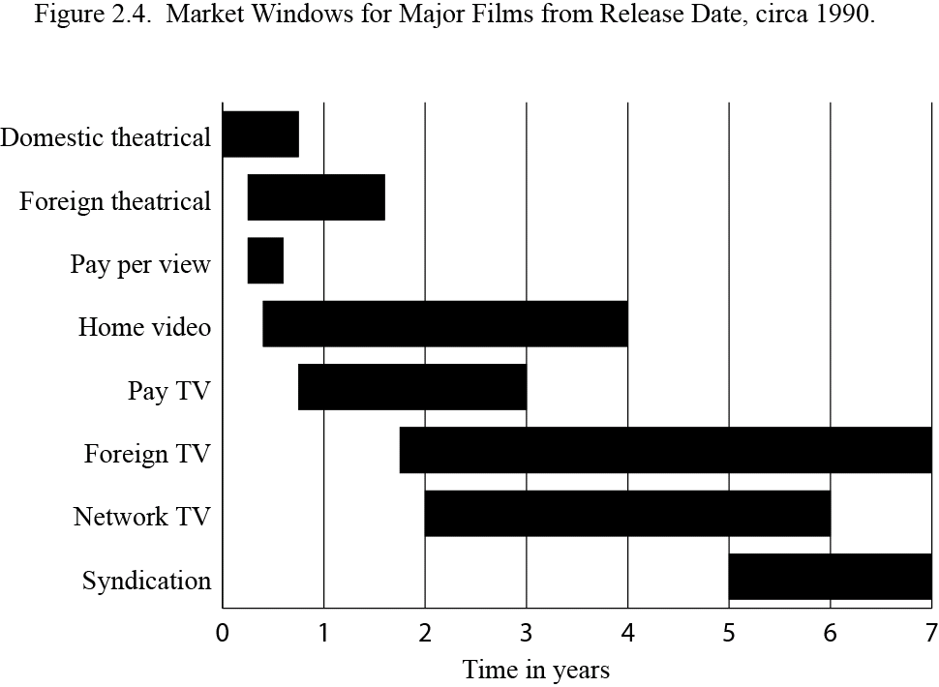

Slide 6
Compensation System for Network Broadcasts of Films
Studio
Advertisers
licenses
advertising fees
license fees
TV Networks
free programming
(with embedded ads)
product
purchases
Viewers
cost of VCRs
VCRs
Sony

Slide 7
Holdings of Sony
Manufacturer of a device that can be used to violate the copyright laws is liable for contributory copyright infringement if and only if the device is not capable of substantial noninfringing uses
Timeshifting copyrighted programs is a fair use

Slide 8
Justice Blackmun, dissenting
“The situations in which fair use is most commonly recognized are listed in section 107 itself; fair use may be found when a work is used ‘for purposes such as criticism, comment, news reporting, teaching, . . . scholarship, or research.’ … Each of these uses … reflects a common theme: each is a productive use, resulting in some added benefit to the public beyond that produced by the first author’s work. The fair use doctrine, in other words, permits works to be used for ‘socially laudable purposes.’ I am aware of no case in which the reproduction of a copyrighted work for the sole benefit of the user has been held to be fair use.”

Slide 9
Justice Blackmun, dissenting
“The requirement that a putatively infringing use of a copyrighted work, to be ‘fair,’ must not impair a ‘potential’ market for the work has two implications. First, an infringer cannot prevail merely by demonstrating that the copyright holder suffered no net harm from the infringer's action. Indeed, even a showing that the infringement has resulted in a net benefit to the copyright holder will not suffice. Rather, the infringer must demonstrate that he had not impaired the copyright holder's ability to demand compensation from (or to deny access to) any group who would otherwise be willing to pay to see or hear the copyrighted work. Second, the fact that a given market for a copyrighted work would not be available to the copyright holder were it not for the infringer's activities does not permit the infringer to exploit that market without compensating the copyright holder.”

Slide 10
CONSUMER HOME VIDEO AND THEATER SPENDING
Home video spending
Theater spending
Compound annual growth rates
1980-2003
1999-2003
+27%
+14%
Home video
+6%
+7%
$millions
Theater

Slide 11
Harper & Row
Ford & ghost writer
payment
copyright
Harper & Row
“purloined” copy
Infringement
suit
The Nation
Cancel contract
Article with
300-400
copied
words
part payment
$
license
Time Magazine
Public

Slide 12
Campbell
“The first factor in a fair use enquiry is ‘the purpose and character of the use.’… The central purpose of this investigation is to see, in Justice Story's words, whether the new work merely ‘supersede[s] the objects’ of the original creation, or instead adds something new, with a further purpose or different character, altering the first with new expression, meaning, or message; it asks, in other words, whether and to what extent the new work is ‘transformative.’ Although such transformative use is not absolutely necessary for a finding of fair use, Sony, [464 U.S.] at 455, n. 40, the goal of copyright, to promote science and the arts, is generally furthered by the creation of transformative works. Such works thus lie at the heart of the fair use doctrine's guarantee of breathing space within the confines of copyright, see, e. g., Sony, supra, at 478-480 (Blackmun, J., dissenting), and the more transformative the new work, the less will be the significance of other factors, like commercialism, that may weigh against a finding of fair use.”

Slide 13
Campbell
“Modern dictionaries accordingly describe a parody as a ‘literary or artistic work that imitates the characteristic style of an author or a work for comic effect or ridicule,’ or as a ‘composition in prose or verse in which the characteristic turns of thought and phrase in an author or class of authors are imitated in such a way as to make them appear ridiculous.’ For the purposes of copyright law, the nub of the definitions, and the heart of any parodist’s claim to quote from existing material, is the use of some elements of a prior author's composition to create a new one that, at least in part, comments on that author's works.”

Slide 14
Sega (CA9 1992)
Licensed
Games
Sega Games
Accolade
Games
License fees
TMSS
Sega Genesis III

Slide 15
Videopipeline (2008)
Friedman (2011);
Cariou (2011)
Fairey (2011)
Socially
beneficial
Dr. Seuss (1997)
Connectix (2000)
Kelly (2003);
Perfect 10 (2007);
AV (2009); White (2013)
Gaylord (2010)
Salinger (2010)
Graham (2006)
Nunez (2006)
Castle Rock
(1998)
Critical of π
Different
Purpose
Creative
Parody
Rogers (1992)
Campbell (1994);
Leibovitz (1998);
Suntrust (2001);
Mattel (2003)
Free Republic (2000)
Physical
modifications
Blanch (2006)
Lennon (2008)

Slide 16
Strength of Copyright Protection
Factual
Creative
Unpublished Published

Slide 17
Factor 4: Markets
Anyone willing to pay
P willing to license
P likely to license
Reasonable
Traditional
Likely to develop
Existing

